Slide 1
Lecture 7: Implementing a Prototype: Overview of Using PowerPoint, Balsamiq, InVision, html, etc.
Brad Myers
05-863 / 45-888: Introduction to Human Computer Interaction for Technology Executives
Fall, 2017, Mini 2

Slide 2

Happy Thanksgiving!
No class Wednesday
Homework 2 grades are on Canvas
Homework 3 due today
Homework 4 due next Monday – no extensions!

Slide 3
Implementing your Prototype
How “complete” an implementation for HW4?
Screen transitions must work
All buttons should do something, even if go to a “not implemented yet” page – facilitates user testing
Search, other computation does not have to work
“Click-through” level of behaviors
Must show any external reactions
E.g., taking a picture, starting microwave, making a copy…
Pop-up a dialog box saying what’s happening…
Level of complexity required:
(Same as listed on homework0 page)
At least 30 “controls” (widgets: buttons, text fields)
About 10 different screens/pages/windows/modes
Must be done in one (1) week – no extensions!
Will be given to your classmates for HW 5

Slide 4
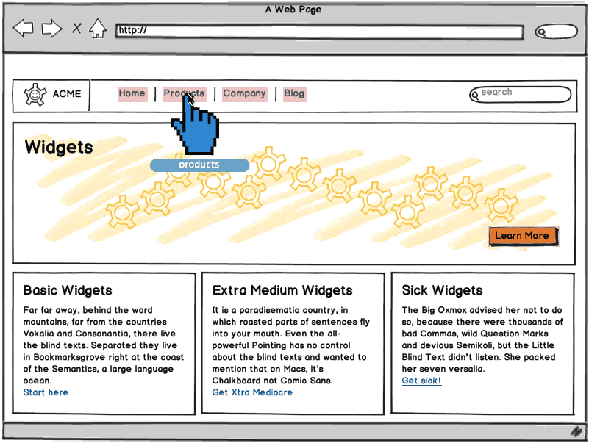
“Wireframe” Level Prototype
Outlines of the buttons and controls
No need for final graphics
Our requirement: sufficient functionality to support your tasks
Labels should be the real ones
So can test that users understand what they do
Source: http://support.balsamiq.com/customer/portal/articles/107999-specifying-interaction-with-mockups

Slide 5
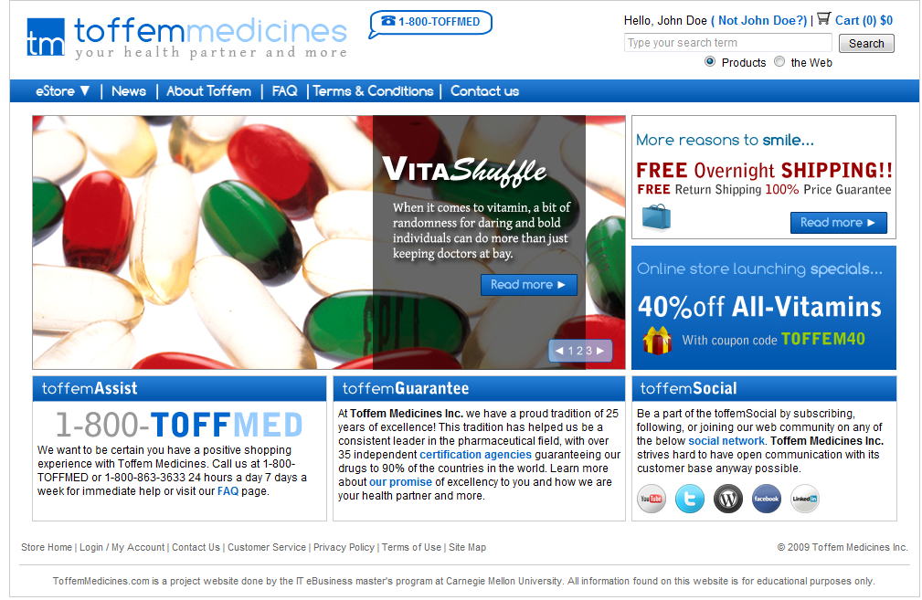
Or, Produce Final-Looking Graphics
Alternatively, could use Photoshop, Illustrator, etc. and produce final-looking graphics
Designers want to show what real UI will look like
Details of the “look”
Web pages often use final graphics
E.g., Toffem Medicines
Add “click-through” behaviors
Usually limited mostly to screen transitions
Notes:
Search for “vitamins” on Toffem page
Note that all the buttons go to somewhere – most to the NIY page

Slide 6
All Buttons must be labeled and should “work”
User should be able to be equally confused by your prototype as by the real interface.
For each screen on the prototype that you create, that screen should have every control that would be on the real screen.
Each control should do something
Most will go to a “not implemented yet” page
Should not take excessive amount of time to implement
Talk to TA for ideas if getting too long

Slide 7
Using resources on the web
It is Ok to use small pictures from the web
E.g., Pictures of products
It is not allowed to copy a whole page or a whole website
It is Ok to use a template from the web
You must fill it in
You must be able to turn in a zip file of the implementation
No on-line-only tools

Slide 8
Implementation Options for HW4
Pretty much any way you want
Must “work” – not just paintings
“Click-through prototypes”
We recommend you do not use Java, C++, Objective C (iPhone), or other “professional” language
Even JavaScript, Swift, etc. would probably be too much work!
Note: you must be able to create software that is easy for others to run
Must work on both PC and Mac
Output a set of web pages, or a pdf file
If you use OmniGraffle or Sketch (Mac only) or Visio or Visual Studio (PC only), you must output as clickable pdf or html or something.
Do NOT use ActiveX controls that are PC only

Slide 9
Recommended Options
PowerPoint
Easiest to use
Balsamiq
Html + CSS
Using editor like Dreamweaver
Dreamweaver has a free 30-day trial
(maybe a little JavaScript more programming)
InVision – demo
Free student accounts

Slide 10
Lots of other choices…
Axure is a popular commercial tool
www.axure.com
Advantage – only one with components that can be used on multiple pages
https://moqups.com/
JustInMind - http://www.justinmind.com/
Flinto - https://www.flinto.com/ - prototype Smartphone apps
Old tools:
Adobe Flash
Visual Basic
HyperCard (1998) & similar
Flash Catalyst (2010)

Slide 11
Lots of Lists of Tools
Search for “Prototyping tools” or “Wireframing Tools”
http://www.cooper.com/prototyping-tools (kept up to date)
http://uxdesignweekly.com/ux-resources/prototyping-tools/
http://www.creativebloq.com/web-design/top-10-prototyping-tools-2016-21619216 (updated March 06, 2017)
https://blog.lemonstand.com/9-best-prototyping-tools-2017/
One of our MHCI Alum compares prototyping tools in 2013:
http://www.cooper.com/journal/2013/07/designers-toolkit-proto-testing-for-prototypes

Slide 12
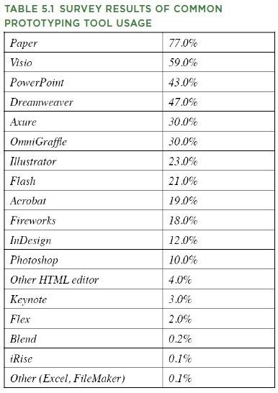
What Are People Using?
http://www.uie.com/articles/prototyping_tools/?link=tips100318_6
Mar 18, 2010
My survey results are similar (2007)

Slide 13
Previous Year’s tool choices
PowerPoint | 24
Balsamiq | 21
html (+ CSS and/or JS) | 5
inVision | 5
Just In Mind | 4
Axure | 3
Marvelapp | 3
Proto.io | 3
Flinto | 1
Fluid UI.com | 1
Lucid Charts | 1
Mockingbot | 1
Moqups | 1
Sketch | 1

Slide 14
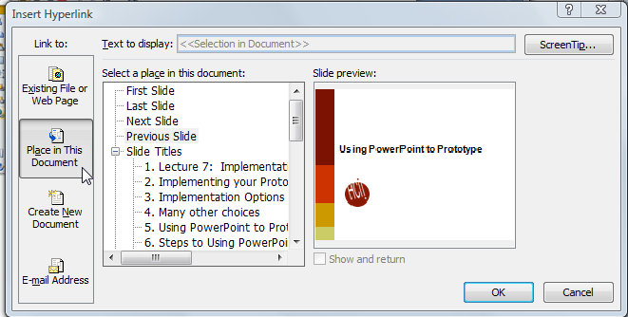
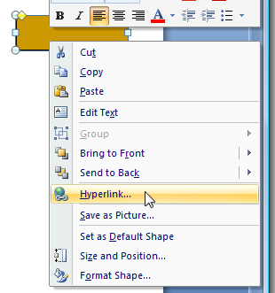
Using PowerPoint to Prototype
Go back
Add a shape, with a label
Right click menu - Add a “Hyperlink”:
Select “Place in this document”
button

Slide 15
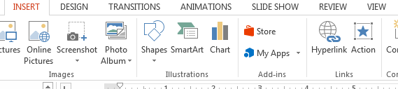
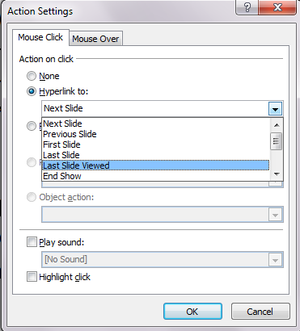
Using PowerPoint to Prototype
On “Insert” tab, add “Action”
More options, including “last slide viewed”
Useful for “under construction” page
Use Insert / Action also to edit it
Create a slide for each mode of the application
Can add mouse-over action
But only highlight, sound or change screen unless write code
Can add nice animations

Slide 16

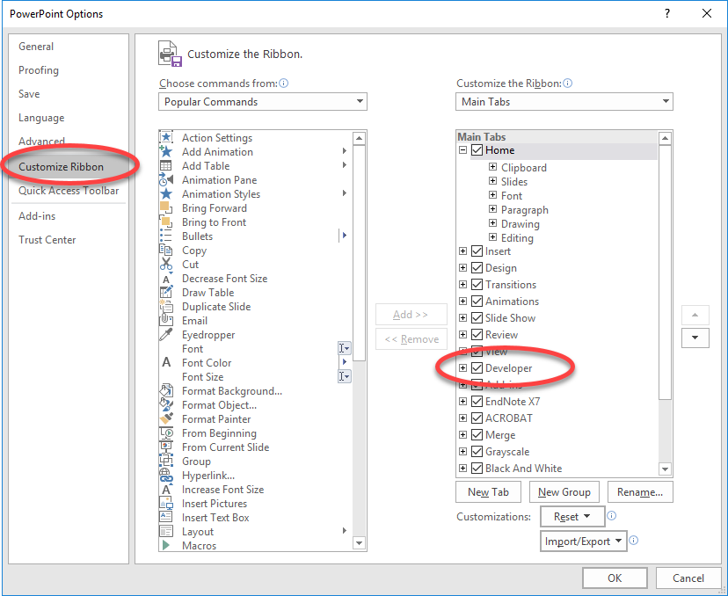
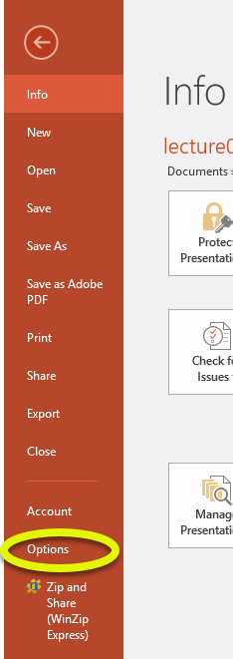
Adding Controls in PowerPoint
NOTE: PC only – so NOT for HW#4
Turn on “Developer Toolbar”
Can add buttons, text entry, etc.
(Office 2016)

Slide 17

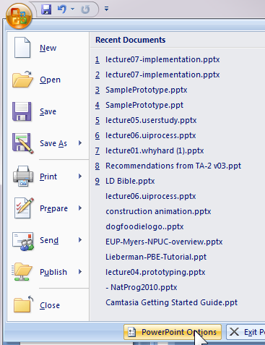
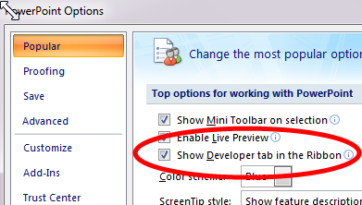

Old office
Office 2007

Slide 18
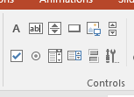
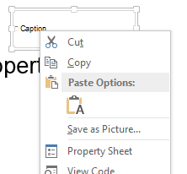
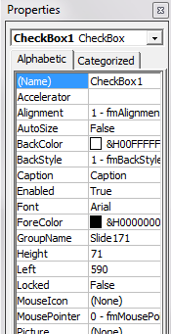
Some controls
Select control, drag out for position and size
Change Caption with property sheet from right-click menu
Can only have behaviors by writing Visual Basic code
Can add text boxes that users can enter text into
No validation (OK!)

Slide 19
Simulating Widgets (Controls)
Just pretend that user does input
Can have 2 screens
Click to transition
Search:
Search:
Aspirin|

Slide 20
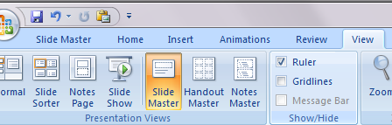
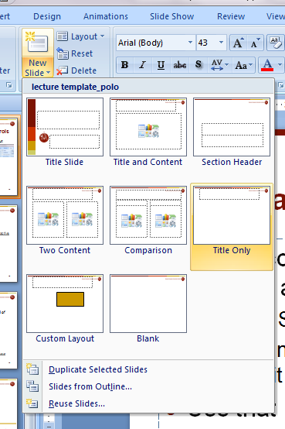
Use “Master” for Shared Items
If want controls on multiple pages, can put them on a “Master”
“View / Slide Master”
Create new master slide and edit as with any other slide
Use that master for new slides
Drop down from “New Slide”
Controls like check boxes, text boxes in Master use same value across all slides

Slide 21
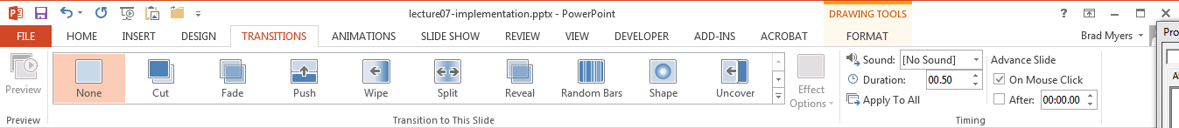
PowerPoint – turn off auto-advance
Very Useful!!!
Make sure that clicking does not advance slide
Office 2010 & 2013 – on “Transitions” ribbon
Office 2007 – on “Animations” ribbon
http://blogmines.com/blog/how-to-disable-advance-slide-on-mouse-click-in-powerpoint-2010/

Slide 22
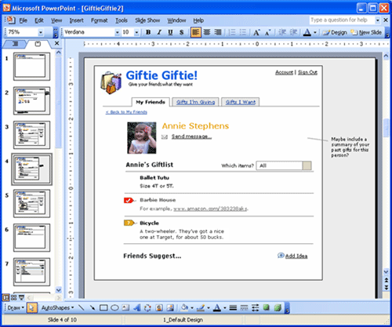
PowerPoint examples
Great training in using PowerPoint:
http://boxesandarrows.com/interactive-prototypes-with-powerpoint/
by Maureen Kelly on 2007/08/06
Local copy

Slide 23
TA-Run Demos
Slides in a different file: http://www.cs.cmu.edu/~bam/uicourse/05863fall17/slides/lecture07-implementation-TA%20part.pdf
Adobe Photoshop
Adobe XD
Axure
HTML/CSS
Balsamiq
InVision

