Slide 1
Lecture 6:
How to Design a
Good Usability Evaluation
Brad Myers
05-863 / 45-888: Introduction to
Human Computer Interaction for
Technology Executives
Fall, 2017, Mini 2

Slide 2
Homeworks
HW #1 graded on Canvas
  Can download annotated pdf files
  Can redo if more than 10 points off
HW #2 due today
  Generous late policy for #1, #2 and #3 (but not #4-6)
Start on HW #3 – note that due on Monday
  Shorter time to do it
  Warning: cannot be easily done quickly – two phases
  Not diagrams this time – instead use table in the template document

Slide 3
Why Evaluate with
“Usability Evaluations”?
Following guidelines never sufficient for good UIs
Need both good design and user studies
(Similar to users with CI)
Note: users, subjects → participants
Good
designers
Average
designers
Quality, before and
after user studies

Slide 4
“Don’ts” of Usability Evaluations
Don’t evaluate whether it works (quality assurance)
Don’t have experimenters evaluate it – get users
Don’t (just) ask user questions. Not an “opinion survey.” Instead, watch their behavior.
Don’t evaluate with groups: see how well system works for each person individually (not a “focus group”)
Don’t train users: want to see if they can figure it out themselves.
Don’t test user → evaluate the system
  Not a “user test” → call it Usability Evaluation instead
Don’t put your ego as a designer on the line

Slide 5
Issue: Reliability
Do the results generalize to other people?
  Individual differences
  Up to a factor of 10 in performance
If comparing two systems
  Statistics for confidence intervals, p<.01
  But rarely are doing A vs. B studies
Also, small number of users cannot evaluate an entire site
  Just a sample

Slide 6
Issue: Validity
Did the evaluation measure what we wanted?
  Wrong users
  “Confounding” factors, etc,
    Issues which were not controlled but not relevant to the evaluation
    Other usability problems, setting, etc.
    Ordering effects
    Learning effects
    Too much help given to some users

Slide 7
Plan your Evaluation
Goals:
  Formative – help decide features and design ← CIs
  Summative – evaluate system ← Now
Pilot evaluations
  Preliminary evaluations to check materials, look for bugs, etc.
  Evaluate the instructions, timing
  Users do not have to be representative

Slide 8
Evaluation Design
“Between subjects” vs. “within subjects”
  For comparing different conditions
  Within:
    Each user does all conditions
    Removes individual differences
    Add ordering effects
  Between
    Each user does one condition
    Quicker for each user
    But need more users due to huge variation in people
Randomized assignment of conditions
  To people, or order

Slide 9
Some Measurements
Learnability: Time to learn how to do specific tasks (at a specific proficiency)
Efficiency: (Expert) Time to execute benchmark (typical) tasks. Throughput.
Errors: Error rate per task. Time spent on errors. Error severity.
Lots of measures from web analytics:
  Abandonment rates, Completion rates, Clickthroughs,
  % completions, etc.
Subjective satisfaction: Questionnaire.

Slide 10
Performance Measurements
Time, number of tasks completed, number of errors, severity of errors, number of times help needed, quality of results, emotions, etc.
  Decide in advance what is relevant
  Can get quantifiable, objective numbers
  “Usability Engineering”
Can instrument software to take measurements
  Or try to log results “live” or from videotape
  Some available from web analytics
Emotions and preferences from questionnaires and apparent frustration, happiness with system

Slide 11
Goal Levels
Pick Levels for your system:
  Minimum acceptable level
  Desired (planned) level
  Theoretical best level
  Current level or competitor's level
Minimum
Acceptable
Current
Best
Desired
0
1
2
5
Errors

Slide 12
Questionnaire Design
Collect general demographic information that may be relevant
  Age, sex, computer experience, etc.
Evaluate feelings towards your product and other products
Important to design questionnaire carefully
  Users may find questions confusing
    May not answer the question you think you are asking
  May not measure what you are interested in

Slide 13
Questionnaire, 2
“Likert scale”
  Propose something and let people agree or disagree:
  agree disagree
  The system was easy to use: 1 .. 2 .. 3 .. 4 .. 5
“Semantic differential scale”
  Two opposite feelings:
  difficult easy
  Finding the right information was: -2 .. -1 .. 0 .. 1 .. 2
If multiple choices, rank order them:
  Rank the choices in order of preference (with 1 being most preferred and 4 being least):
  Interface #1 Interface #2 Interface #3 Interface #4
  (in a real survey, describe the interfaces)

Slide 14
Question Design
Very hard to design questions that are hard to misunderstand or misread
  Clear writing, simple sentences
If users make mistakes, then questionnaire is invalid
For example, all positive answers in a column
  Do not alternate (ref: http://www.measuringu.com/positive-negative.php)
    This website was easy to use.
    It was difficult to find what I needed on this website.
User confusion overrides trying to make people pay attention (doesn’t work)

Slide 15
Questionnaire, examples
Examples of problems:
  “How big is the codebase for this project?”
    300
    50k SLOC
    342658
    2000 files
    Big
  Revised: have ranges instead of a textbox:
    Up to 1000 LOC
    1000 – 10,000
    10,000 – 100,000
    100,000 – 1,000,000
    Bigger than 1,000,000

Slide 16
Standard (Validated) Questionnaires
“Questionnaire for User Interface Satisfaction” (QUIS)
  Chin, J.P., Diehl, V.A., Norman, K.L. (1988) Development of an Instrument Measuring User Satisfaction of the Human-Computer Interface. ACM CHI'88 Proceedings, 213-218.
  http://lap.umd.edu/quis/
  Short version: http://hcibib.org/perlman/question.cgi?form=QUIS
  License costs money, but can be downloaded for free.
  Long version has 16 pages of questions
“System usability scale” – short questionnaire (10-12 items)
  Brooke, J. (1996). "SUS: a "quick and dirty" usability scale". In P. W. Jordan, B. Thomas, B. A. Weerdmeester, & A. L. McClelland. Usability Evaluation in Industry. London: Taylor and Francis.
  http://www.usabilitest.com/uxxc4jP

Slide 17
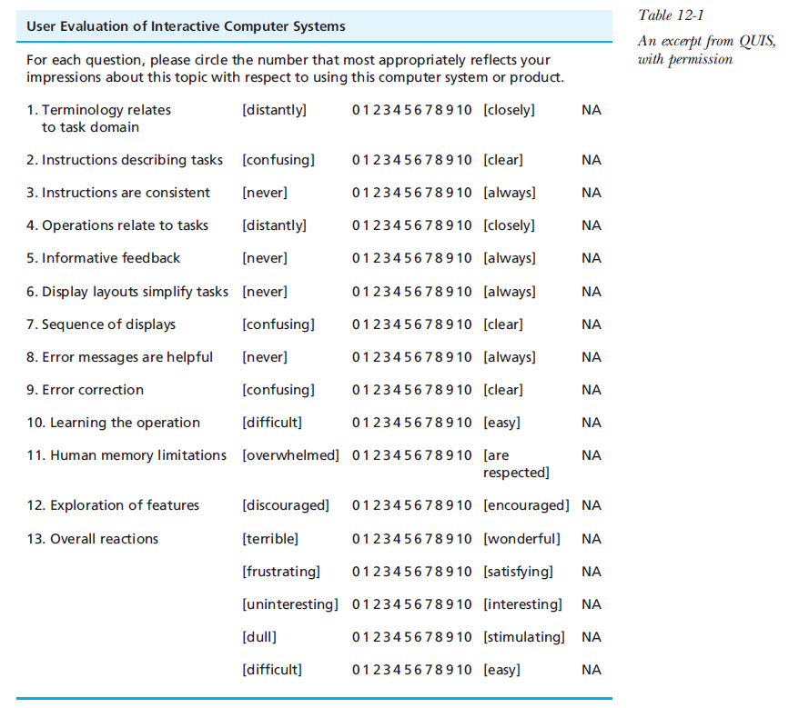
Survey example
Hartson & Pyla, p. 446

Slide 18
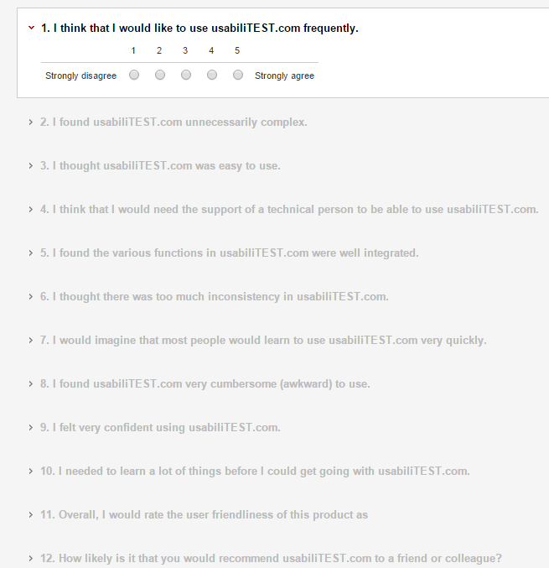
http://www.usabilitest.com/uxxc4jP

Slide 19
Videotaping
Often useful for measuring after the evaluation
  But very slow to analyze and transcribe
Useful for demonstrating problems to developers, management
  Compelling to see someone struggling
Facilitate Impact analysis
  Which problems will be most important to fix?
  How many users and how much time wasted on each problem
But careful notetaking will often suffice when usability problems are noticed

Slide 20
“Think Aloud” Protocols
“Single most valuable usability engineering method” – Nielsen
Get user to continuously verbalize their thoughts
Find out why user does things
  What thought would happen, why stuck, frustrated, etc.
Encourage users to expand on whatever interesting
But interferes with timings
May need to “coach” user to keep talking
  Unnatural to describe what thinking
  Ask general questions: “What did you expect”, “What are you thinking now”
    Not: “What do you think that button is for”, “Why didn’t you click here”
    Will “give away” the answer or bias the user
Alternative: have two users and encourage discussion

Slide 21
Getting Users
Should be representative
If multiple groups of users
  Representatives of each group, if possible
Issues:
  Managers will pick most able people as participants
  Getting users who are specialists
    E.g., doctors, dental assistants
    Maybe can get students, retirees
  Paying users
Novices vs. experts
  Very different behaviors, performance, etc.

Slide 22
Ideas for getting users
If you want people who are not like you
  Laundromats
  Coffee shops
Paying people
  Good for general people
  Not for companies
  Not for “highly compensated” people (Doctors)
    But everyone likes a gift, like a Starbucks card

Slide 23
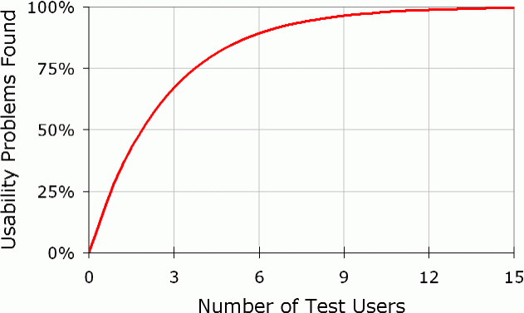
Number of participants
About 20 for statistical studies
As few as 5 for usability evaluation
  Can update after each user to correct problems
    But can be misled by “spurious behavior” of a single person
      Accidents or just not representative
  cite: https://www.nngroup.com/articles/how-many-test-users/
  Five users cannot
  evaluate all of a system
    Different tests for different
    parts
    Can’t just do longer tests

Slide 24
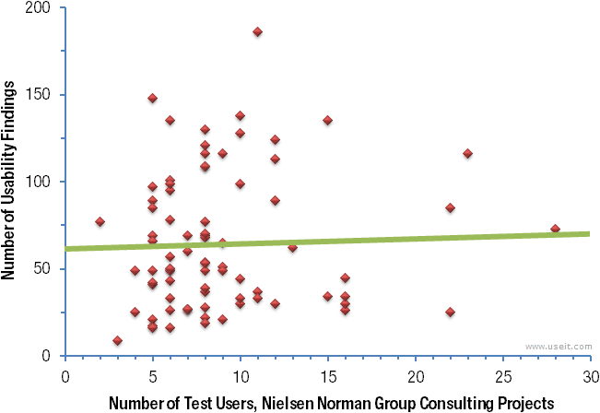
Another chart for number
Testing more users didn't result in appreciably more insights
  cite: https://www.nngroup.com/articles/how-many-test-users/

Slide 25
Ethical Considerations
No harm to the users
Emotional distress
  Highly trained people especially concerned about looking foolish
Emphasize system being evaluated, not user
Results of evaluation and users’ identities kept secret
Stop evaluation if user is too upset
At end, ask for comments, explain any deceptions, thank the participants
At universities, have “Institutional Review Board” (IRB)

Slide 26
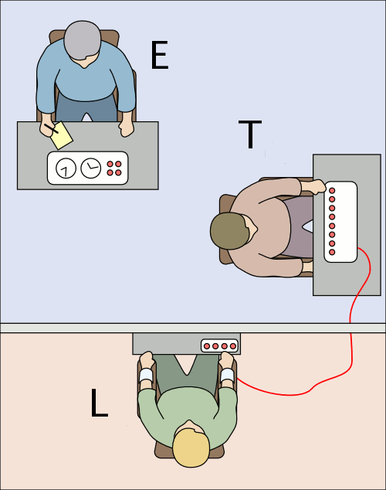
Milgram Psychology Experiments
Stanley Milgram 1961-1962
  Subject (“teacher” T) told by experimenter (E) to shock another person ("Learner" L, an actor) if L gets answers wrong
  > 65% of subjects were willing to give apparently harmful electric shocks – up to 450 volts – to a pitifully protesting victim
Study created emotional distress
  Some subjects needed significant counseling afterward
http://www.stanleymilgram.com/
Image from Wikipedia

Slide 27
Authoring the Evaluation
Set up realistic situation
Write up task scenarios
Write detailed script of what you will say
PRACTICE
Recruit users

Slide 28
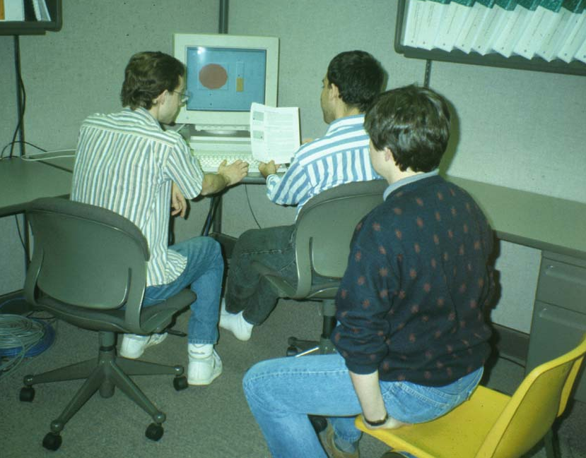
Who runs the experiment?
Trained usability engineers know how to run a valid usability evaluation
  Called “facilitators”
  Good methodology is important
    2-3 vs. 5-6 of 8 usability problems found
But useful for developers & designers to watch
  Available if system crashes or user gets
  completely stuck
  But have to keep them from interfering
    Randy Pausch’s strategy
  Having at least one observer
  (notetaker) is useful
Common error: don’t help too early!

Slide 29
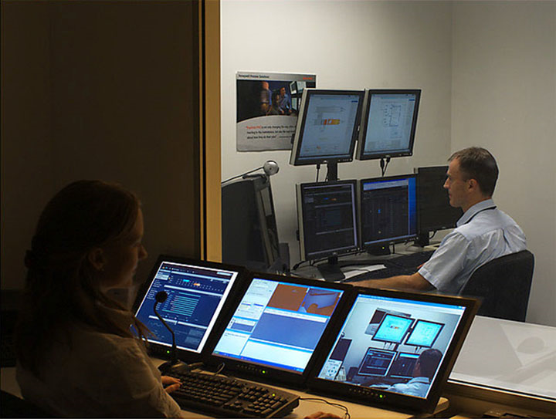
Where Evaluate?
Usability Labs
  Cameras, 2-way mirrors,
  specialists
  Separate observation
  and control room
    Should disclose who is watching
  Having one may increase usability evaluations in an organization
Can usually perform an evaluation anywhere
  Can use portable video recorder, screen recorder, etc.

Slide 30
Stages of an Evaluation
Preparation
Introduction
Running the evaluation
Cleanup after the evaluation

Slide 31
Preparation and Introduction
Make sure evaluation is ready to go before user arrives
Introduce the observation phase
  Say purpose is to evaluate software
  Consent form
  Pre-test questionnaire
  Give instructions
  Instruct them on how to do a think aloud
  Write down script to make sure consistent for all users
Final instructions (“Rules”):
  Say that you won’t be able to answer questions during, but if questions cross their mind, say them aloud
  If you forget to think aloud, I’ll say “Please keep talking”
Notes:
Introduce the observation phase
Begin observation
<play DateTime3.scm>
Conclude observation
<play conclusion.scm>

Slide 32
Running the Evaluation
Run the think-aloud
At end:
  Post-test questionnaire
  Explain purpose & any deceptions
  Thanks

Slide 33
Cleaning up after an evaluation
For desktop applications
  Remove old files, recent file lists, etc.
Harder for evaluations of web sites:
  In evaluations of web sites, need to remove history to avoid hints to next user
  Browser history, “cookies”, etc.

Slide 34
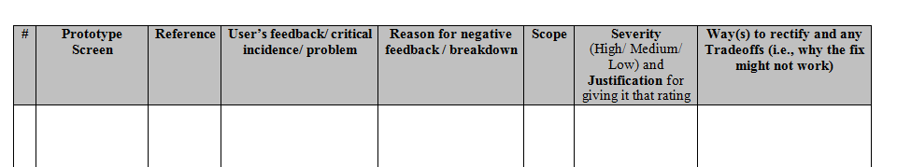
Analyzing the data
Numeric data
  Example: times, number of errors, etc.
  Tables and plots using a spreadsheet
  Look for trends and outliers
Organize problems by scope and severity
  Scope: How widespread is the problem?
  Severity: How critical is the problem?
  http://www.cs.cmu.edu/~bam/uicourse/UsabilityEvalReport_template2016.docx

Slide 35
Scope and Severity Separately
 |  | Proportion of users experiencing the problem
 |  | Few | Many
Impact of the problem on the users who experience it | Small | Low Severity | Medium Severity
 | Large | Medium Severity | High Severity

Slide 36
Write a Summarizing Report
“Executive” summary
Conceptual re-designs are most important
If just “tuning”, then a “top ten” list
  Levels of severity help rank the problems
“Highlights” video is often a helpful communications device

Slide 37
What to do with Results
Modify system to fix most important problems
Can modify after each user, if don’t need statistical results
  No need for other users to “suffer”
But remember: user is not a designer
  Don’t necessarily adopt the user’s proposed fixes

