Slide 1
Lecture 5:
Design in HCI
Brad Myers*
* Some content from Profs. John Zimmerman and Karen Kornblum Berntsen
05-863 / 45-888: Introduction to
Human Computer Interaction for
Technology Executives
Fall, 2017, Mini 2

Slide 2
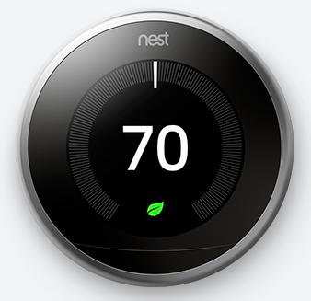
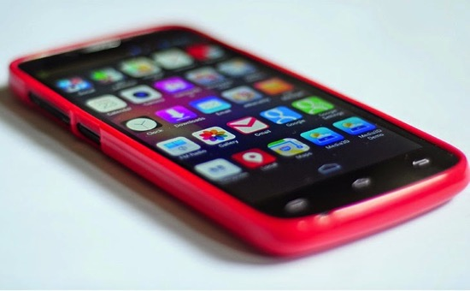
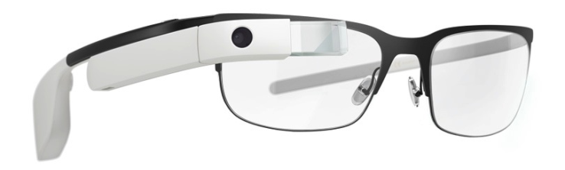
Design in HCI

Slide 3
Administrative
Device choice
  Not Games or Conversational Uis
HW 1 redo – 10 points off before Wednesday at 1:30

Slide 4
“Design”
Everyone “designs”
  Engineering Design, Software Design
We have a “Design” department in CFA
Here, focus on “graphic design” or “communication design”
Aesthetics

Slide 5
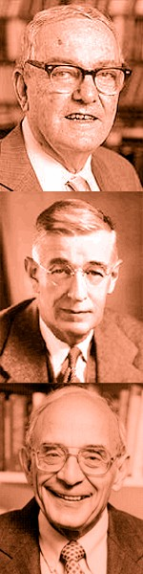
Design
Simon: design as focus on achieving a preferred state
Rittel: design inquiry as a means to address wicked problems (problems that cannot be broken down) through reframing
Schön: design inquiry as reframing through reflection in and on action

Slide 6
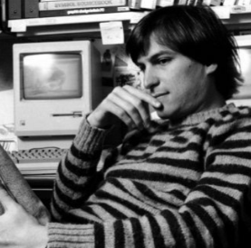
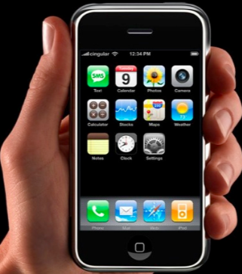
What is design?
“Design is not just what it looks like and feels like.
Design is how it works.”
Steve Jobs

Slide 7
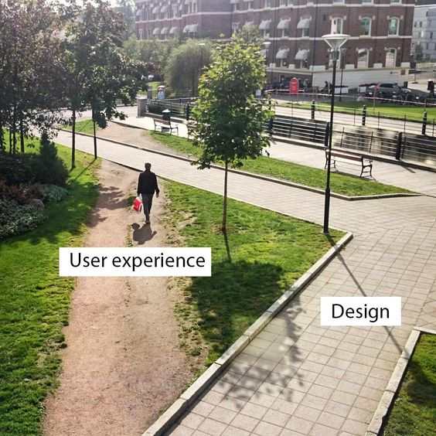
What is Bad Design

Slide 8
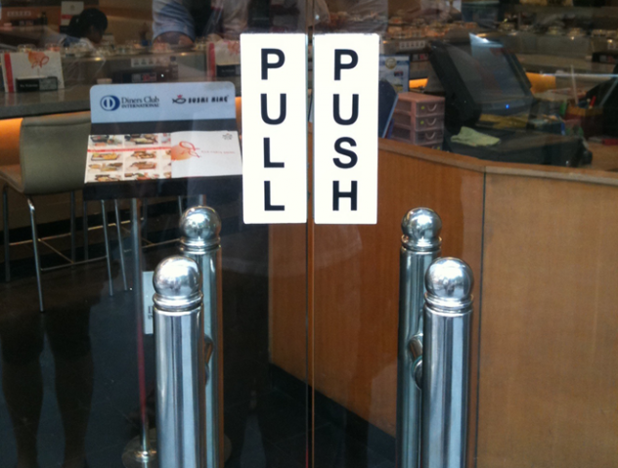

Slide 9
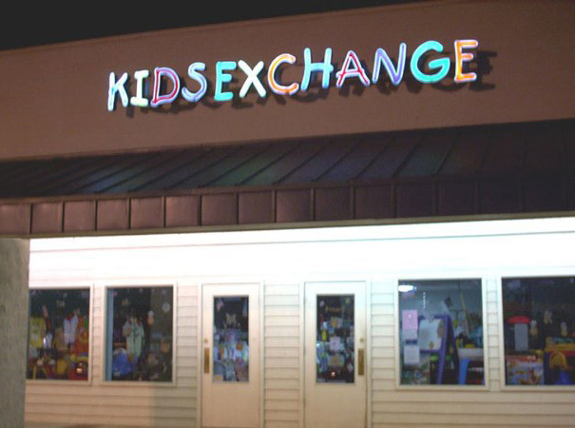

Slide 10
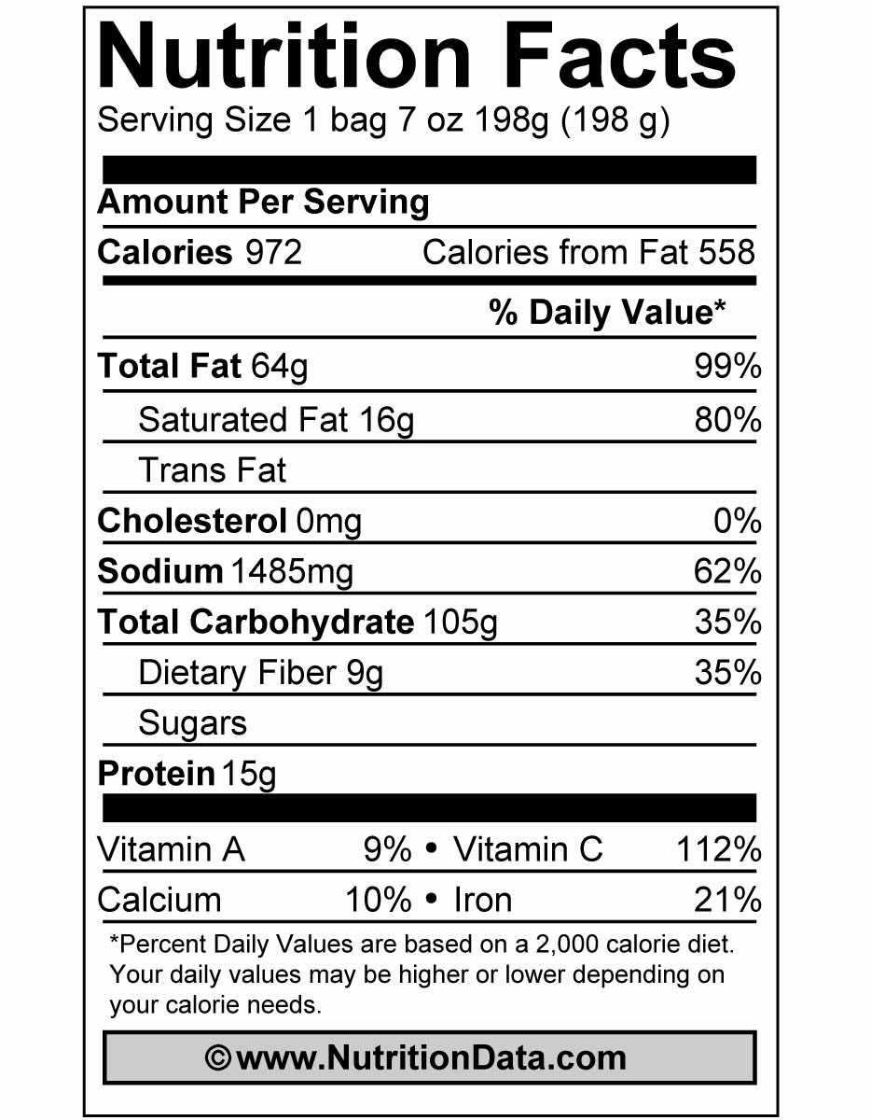
What is Communication Design?
Act of creating a communicative artifact: print piece, web site, way finding system, data visualization, illustration, etc.
Requires an awareness of the social and cultural systems within the context of use
Intention of information transfer … both of text and subtext
  Not just content, also feeling
Intention of specific user action or other outcome

Slide 11











designers struggle to:
combine words, pictures, and other graphic elements to form a unified whole — communicative gestalt

Slide 12




Three Linked Representations
system architecture
information architecture
user interface presentation

Slide 13
System Architecture
The way the application is implemented
May have unintended implications for UI
  Database design, data structures, architecture
  http://www.cs.cmu.edu/~bej/usa/

Slide 14
Information Architecture
“Structural design of shared information environments” – Wikipedia
How each piece of information is presented
  List, Tree, Diagram, paragraph of text…
Sitemap of a website or app
  How pieces of information and action are distributed throughout the app
  Navigation around the information
Independent of the implementation or look

Slide 15

Information Architecture
Richard Saul Wurman’s five ways of organizing information:
  LOCATION
  ALPHABETICALLY
  TIME
  CATEGORY
  HIERARCHY

Slide 16


UI Presentation

Slide 17
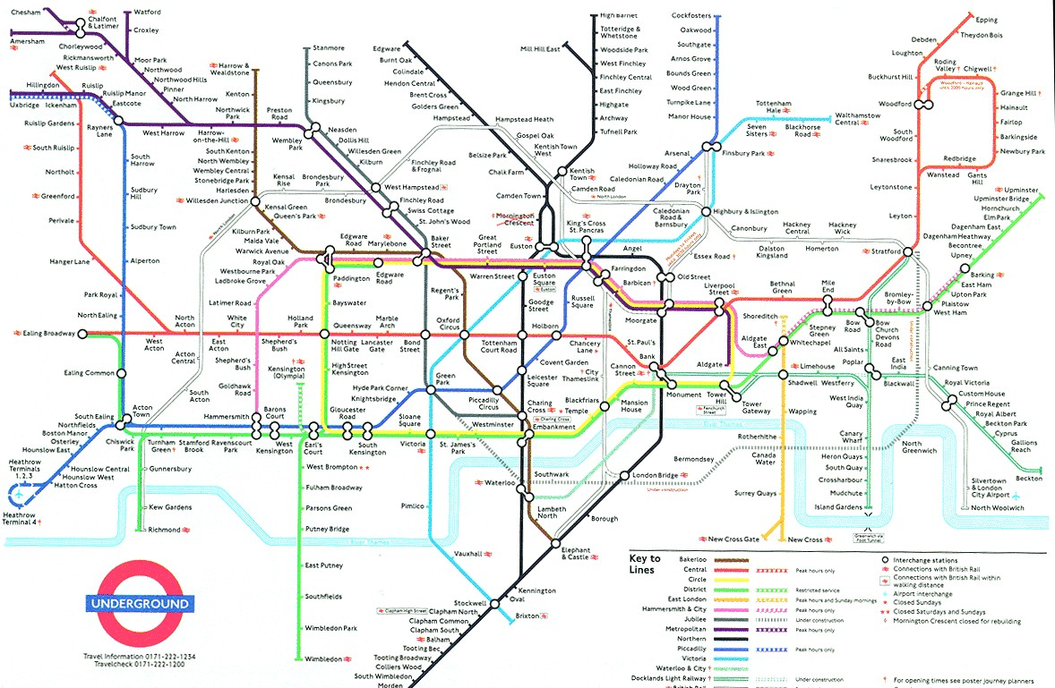

Slide 18


Slide 19


Slide 20
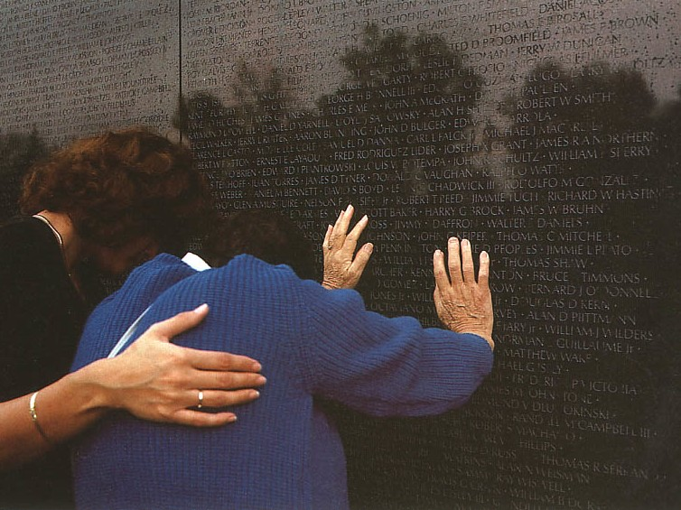

Slide 21
Topics in Communication Design
Typography
Color
Design Systems

Slide 22

Typography
civilization relies on alphabet and numerals … in English, we mix Roman letters and Arabic numbers
typography taught as the visual art of communication
designer investigates by working with elements and spatial relationships
goal is to provide a voice (intention and tone of write)
early systems:
ALL•CAPs•WITH•BULLETS•BETWEEN•WORDS•AND•NO•PUNCTUATION SOMETIMES•EVEN•RUNNING•LEFT•TO•RIGHT•AND•THEN•BACK•TO LEFT

Slide 23
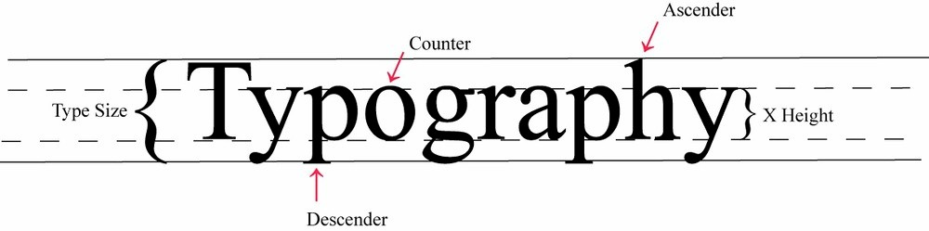
Anatomy of a Typeface
a typeface is a set of type families of a unifying and distinctive design (for instance, Times Roman)
a font is one instance of that family (Times Roman light italic)
standard measuring unit is the point, measured from top of ascender to bottom of descender

Slide 24
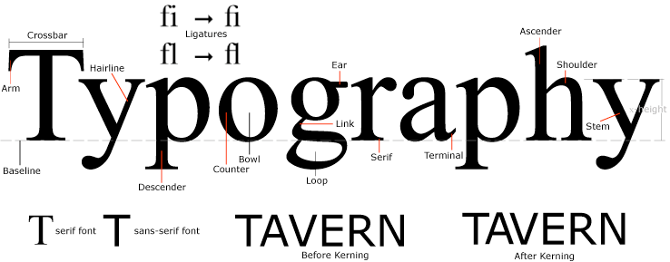
More on Type
two kinds of type, serif and sans serif

Slide 25
More on Type
the relationships between type and space around it makes paragraphs look diﬀerent:
  size of x-height
  type size
  leading
  line length

Slide 26
type x-height
Tiramisu displays real-time arrival information when a commuter is actively sharing GPS (figure 2C). When this is not available, the system shows historic arrival information, assuming the system has previous trace data for this bus at this time. When neither real-time nor historic arrival information are available, the interface shows the scheduled arrival time. In addition, the interface shows bus fullness information, something currently not available as an estimate in the schedule provided by the transit service. (11 pt Bernhard Modern)
Tiramisu displays real-time arrival information when a commuter is actively sharing GPS (figure 2C). When this is not available, the system shows historic arrival information, assuming the system has previous trace data for this bus at this time. When neither real-time nor historic arrival information are available, the interface shows the scheduled arrival time. In addition, the interface shows bus fullness information, something currently not available as an estimate in the schedule provided by the transit service. (11 pt Garamond)
Tiramisu displays real-time arrival information when a commuter is actively sharing GPS (figure 2C). When this is not available, the system shows historic arrival information, assuming the system has previous trace data for this bus at this time. When neither real-time nor historic arrival information are available, the interface shows the scheduled arrival time. In addition, the interface shows bus fullness information, something currently not available as an estimate in the schedule provided by the transit service. (11 pt Taz)
Tiramisu displays real-time arrival information when a commuter is actively sharing GPS (figure 2C). When this is not available, the system shows historic arrival information, assuming the system has previous trace data for this bus at this time. When neither real-time nor historic arrival information are available, the interface shows the scheduled arrival time. In addition, the interface shows bus fullness information, something currently not available as an estimate in the schedule provided by the transit service. (11 pt Gill Sans)

Slide 27
leading and line length
Tiramisu displays real-time arrival information when a commuter is actively sharing GPS (figure 2C). When this is not available, the system shows historic arrival information, assuming the system has previous trace data for this bus at this time.
When neither real-time nor historic arrival information are available, the interface shows the scheduled arrival time. In addition, the interface shows bus fullness information, something currently not available as an estimate in the schedule provided by the transit service.
To share GPS traces, commuters decide on the bus they wish to take, they select that bus from the list of arrival times, transitioning the interface to the “Destination” screen (Figure 2D). Here they select from a list of upcoming stops. Making a selection transitions the interface to the “Record” screen (Figure 2E).
Once they board the bus, commuters
indicate fullness and press the “Start Recording” button to share the fullness rating and the GPS trace.
While tracing, Tiramisu displays the next stop (Figure 2F). At the end of the trip, commuters press a stop recording button (Figure 2F) as they exit.
Tiramisu displays real-time arrival information when a commuter is actively sharing GPS (figure 2C). When this is not available, the system shows historic arrival information, assuming the system has previous trace data for this bus at this time. When neither real-time nor historic arrival information are available, the interface shows the scheduled arrival time. In addition, the interface shows bus fullness information, something currently not available as an estimate in the schedule provided by the transit service.
To share GPS traces, commuters decide on the bus they wish to take, they select that bus from the list of arrival times, transitioning the interface to the “Destination” screen (Figure 2D). Here they select from a list of upcoming stops. Making a selection transitions the interface to the “Record” screen (Figure 2E). Once they board the bus, commuters indicate fullness and press the “Start Recording” button to share the fullness rating and the GPS trace. While tracing, Tiramisu displays the next stop (Figure 2F). At the end of the trip, commuters press a stop recording button (Figure 2F) as they exit.
Tiramisu displays real-time arrival information when a commuter is actively sharing GPS (figure 2C). When this is not available, the system shows historic arrival information, assuming the system has previous trace data for this bus at this time. When neither real-time nor historic arrival information are available, the interface shows the scheduled arrival time. In addition, the interface shows bus fullness information, something currently not available as an estimate in the schedule provided by the transit service.
To share GPS traces, commuters decide on the bus they wish to take, they select that bus from the list of arrival times, transitioning the interface to the “Destination” screen (Figure 2D). Here they select from a list of upcoming stops. Making a selection transitions the interface to the “Record” screen (Figure 2E). Once they board the bus, commuters indicate fullness and press the “Start Recording” button to share the fullness rating and the GPS trace. While tracing, Tiramisu displays the next stop (Figure 2F). At the end of the trip, commuters press a stop recording button (Figure 2F) as they exit.

Slide 28
alignments: flush left, flush right, centered, and justified
Tiramisu displays real-time arrival information when a commuter is actively sharing GPS (figure 2C). When this is not available, the system shows historic arrival information, assuming the system has previous trace data for this bus at this time. When neither real-time nor historic arrival information are available, the interface shows the scheduled arrival time. In addition, the interface shows bus fullness information, something currently not available as an estimate in the schedule provided by the transit service.
To share GPS traces, commuters decide on the bus they wish to take, they select that bus from the list of arrival times, transitioning the interface to the “Destination” screen (Figure 2D). Here they select from a list of upcoming stops. Making a selection transitions the interface to the “Record” screen (Figure 2E). Once they board the bus, commuters indicate fullness and press the “Start Recording” button to share the fullness rating and the GPS trace. While tracing, Tiramisu
Tiramisu displays real-time arrival information when a commuter is actively sharing GPS (figure 2C). When this is not available, the system shows historic arrival information, assuming the system has previous trace data for this bus at this time. When neither real-time nor historic arrival information are available, the interface shows the scheduled arrival time. In addition, the interface shows bus fullness information, something currently not available as an estimate in the schedule provided by the transit service.
To share GPS traces, commuters decide on the bus they wish to take, they select that bus from the list of arrival times, transitioning the interface to the “Destination” screen (Figure 2D). Here they select from a list of upcoming stops. Making a selection transitions the interface to the “Record” screen (Figure 2E). Once they board the bus, commuters indicate fullness and press the “Start Recording” button to share the fullness rating and the GPS trace. While tracing, Tiramisu
Tiramisu displays real-time arrival information when a commuter is actively sharing GPS (figure 2C). When this is not available, the system shows historic arrival information, assuming the system has previous trace data for this bus at this time.
When neither real-time nor historic arrival information are available, the interface shows the scheduled arrival time. In addition, the interface shows bus fullness information, something currently not available as an estimate in the schedule provided by the transit service.
To share GPS traces, commuters decide on the bus they wish to take, they select that bus from the list of arrival times, transitioning the interface to the “Destination” screen (Figure 2D). Here they select from a list of upcoming stops. Making a selection transitions the interface to the “Record” screen (Figure 2E).
Once they board the bus, commuters
indicate fullness and press the “Start Recording” button to share the fullness rating and the GPS trace.
While tracing, Tiramisu
Tiramisu displays real-time arrival information when a commuter is actively sharing GPS (figure 2C). When this is not available, the system shows historic arrival information, assuming the system has previous trace data for this bus at this time. When neither real-time nor historic arrival information are available, the interface shows the scheduled arrival time. In addition, the interface shows bus fullness information, something currently not available as an estimate in the schedule provided by the transit
service.
To share GPS traces, commuters decide on the bus they wish to take, they select that bus from the list of arrival times, transitioning the interface to the “Destination” screen (Figure 2D). Here they select from a list of upcoming stops. Making a selection transitions the interface to the “Record” screen (Figure 2E). Once they board the bus, commuters indicate fullness and press the “Start Recording” button to share the fullness rating and the GPS trace. While tracing, Tiramisu

Slide 29
type “etiquette”
larger x-heights are often easier to read at small sizes, but look dense when leading is tight
tight leading makes long bodies of text hard to read, especially if the line length is long
long lines of type (>70 characters) are hard to read
very short lines break up text into non-syntactic groups of 2-3 words
justified text often creates river
just don’t center!!!!

Slide 30
choosing type for your design
take an inventory of text elements you need (ex: head, subhead, footnotes).
choose a type family or two to work with — no font salads
make sure faces look good together and support intended voice
find suitable sizes for each of the elements create guidelines and maintain them
test line length and leading if applicable
look at short and long pieces of text

Slide 31
working with type
use of ALL CAPS or all italic slows reading
readers pay attention to contrast among typographic elements
changes in weight (bold, etc.) may be noticed more than changes in typeface
reversed type (white letters on a black or colored background) is a strong visual element and should be used sparingly
white space helps to create visual tension and clusters of related elements

Slide 32
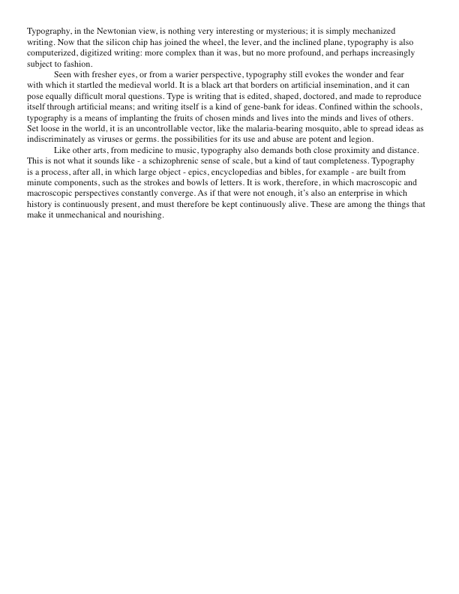

Slide 33
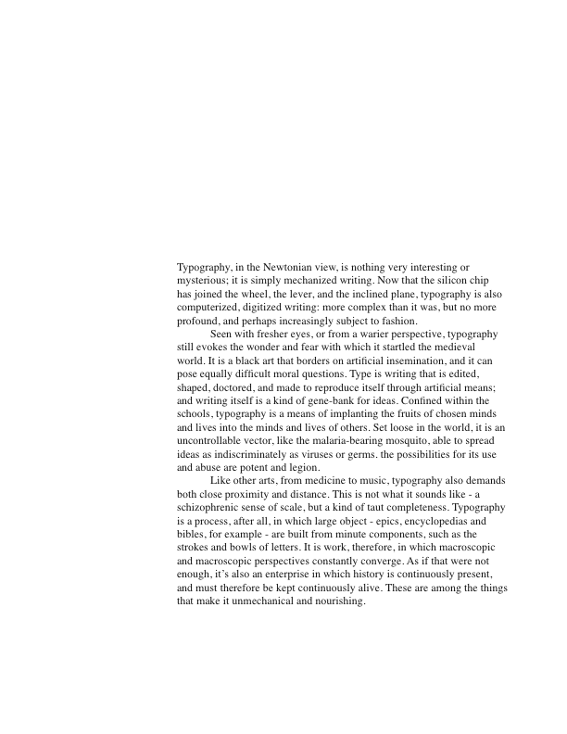

Slide 35
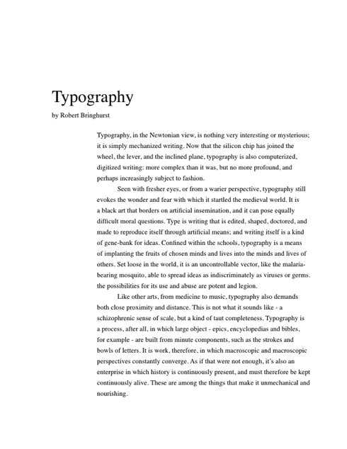

Slide 36
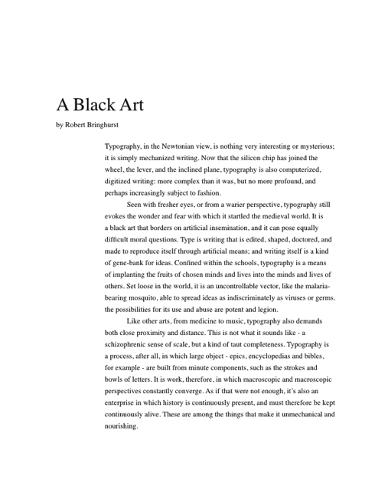

Slide 37
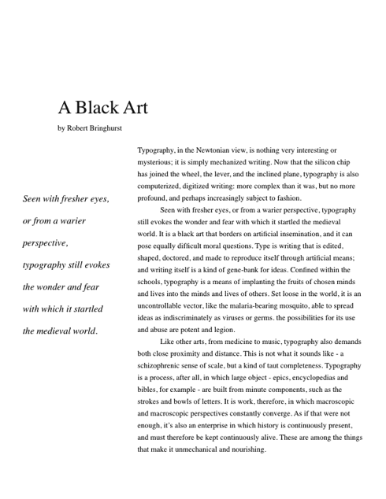

Slide 38
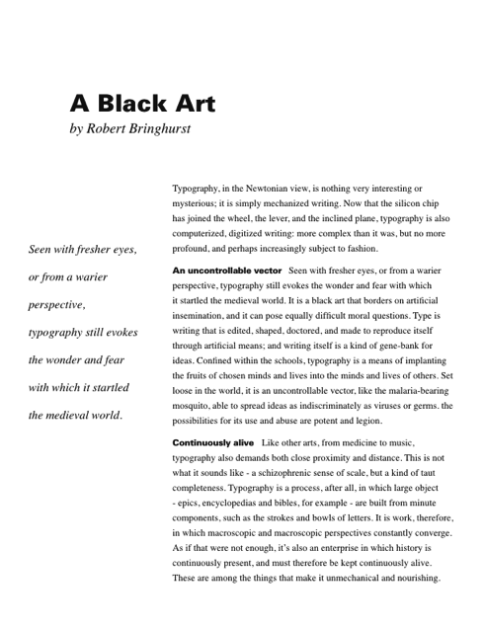

Slide 39


Color
Color carries emotion
and meaning

Slide 40



Color is Communication

Slide 41
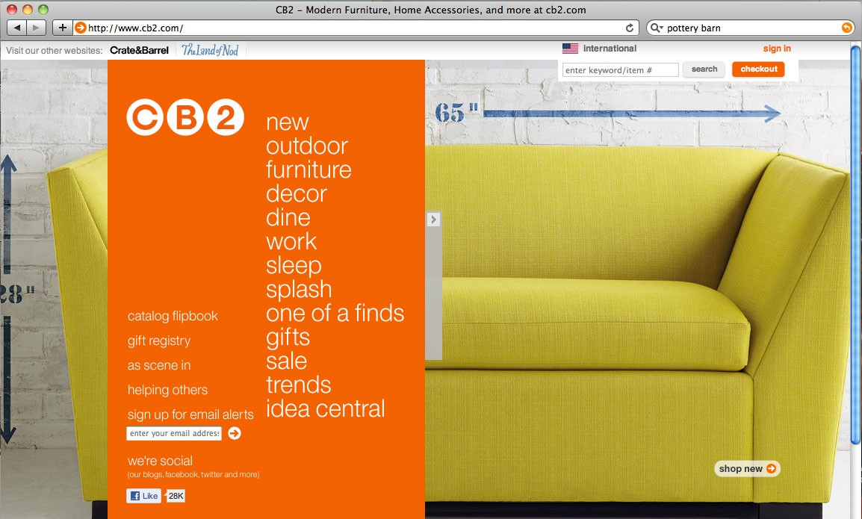
Color Matters

Slide 42

Color Matters

Slide 43
Color Basics
colors we seen in nature are reflections of the visible light around us.
calls attention to or relate elements
creates an emotional response
carries semantic meaning

Slide 44
Color is Difficult
cultural diﬀerences – Kodak yellow, Coke red
highly subjective
relative – aﬀected by light, context, environment, screen settings
simultaneous contrast – color is aﬀected by what color is next to it

Slide 45
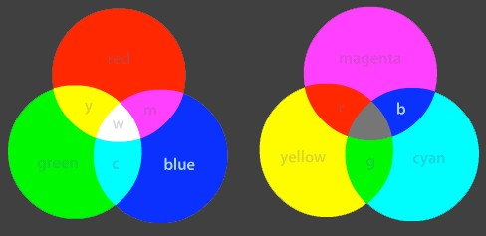
Color Models
Print and screens use diﬀerent color models.
The additive model used by screen displays mixes colors with light (white).
The subtractive model used by print media and pigment mixes colors with ink (black).

Slide 46
digital (screen) color
print uses CMYK or Pantone representations of color, and occasionally RGB
CMYK can give rich browns you cannot get in RGB
digital color is usually represented as RGB values
RGB can give intense blues that are hard in CMYK
hard to match between print and screen
print allows matte and gloss
black gloss print on matte black paper (can’t do this on the screen)

Slide 47
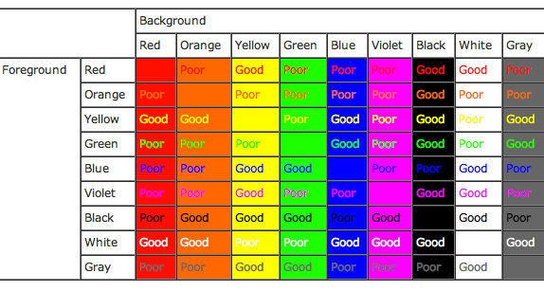
Color Contrasts

Slide 48

choosing color for your design
What do you want to evoke?
Color systems available at various websites
Ensure readability with sufficient contrast

Slide 49
Design Systems
Layout and organization of display
create ordered and systematic designs using grids and visual hierarchy
functional and aesthetic benefits include:
  approachable – use immediately
  recognizable – easy to assimilate and remember
  immediate – have a greater impact on the viewer
  usable – prominent, easy to engage with

Slide 50

Design Systems

Slide 51
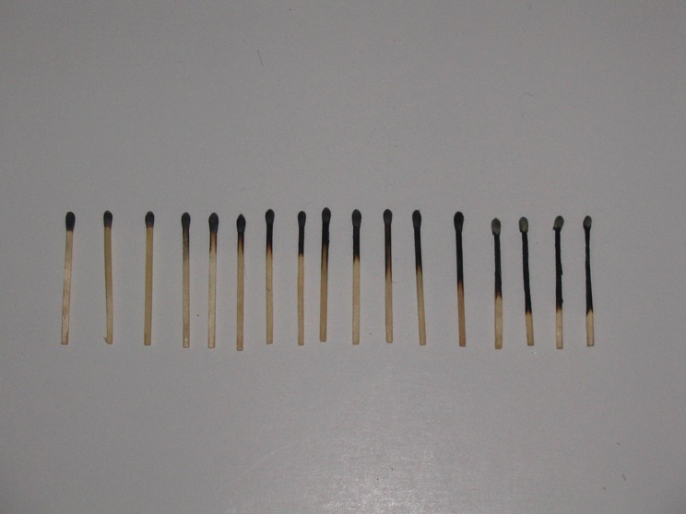

Slide 52
Design Systems
symmetry and asymmetry
scale, contrast and proportion
alignment
proximity and correspondence

Slide 53

symmetry and asymmetry
symmetry is similarity of form or arrangement on either side of a dividing line or plane
a symmetric organization symbolizes a restive state, while asymmetry suggests energy
content drives designers’ choices about symmetry.

Slide 54
Symmetry and asymmetry

Slide 55

scale, contrast, and proportion
the scale of elements determines where the viewer looks first, and what is most important
large, powerful visual elements must be used sparingly
saturated color and
high contrast areas
are very visually
attractive

Slide 56
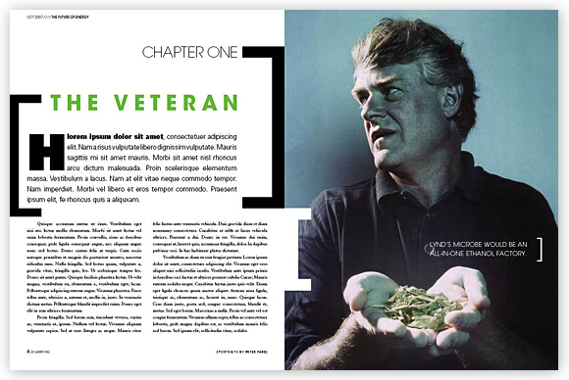
scale, contrast, and proportion

Slide 57
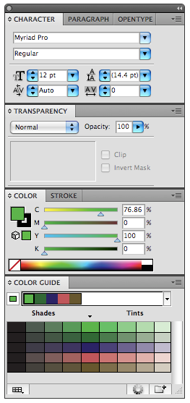
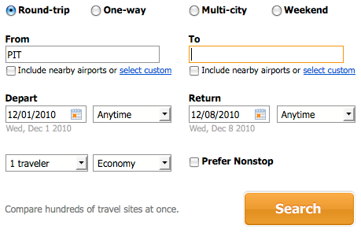
alignment
when forms, their edges, or their central axes align with one another, relationships and connections between them are established

Slide 58
Proximity and correspondence
When forms are near to each other, the eye makes visual groupings of the information.
Similar size, shape, color or texture can also cause groupings.
13
1 3
21 37
21 37

Slide 59
Design Systems
A design system is a comprehensive organization, utilizing repeated sizes, proportions, and design elements to maintain consistent functional and aesthetic qualities over a series of pages, screens, or artifacts.
Elements such as type sizes, styles, placement of elements, and colors are used consistently to unify a series of designs.

Slide 60
Design systems are based on grids
Grid systems allow the layout to be codified across a series of pages, displays, etc.
Grid systems are based on columns and rows.
More columns and rows gives more flexible design

Slide 61
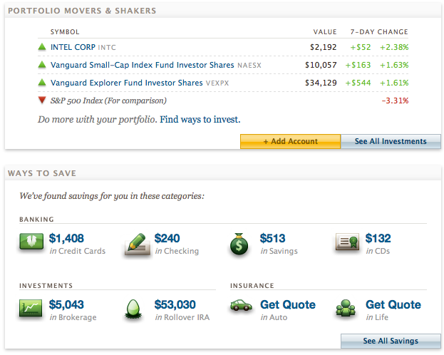
Design systems
When a grid system is put to good use, it will create a regular and rhythmic design.
Consistent use of
a grid, paired with
visual elements,
will create a
consistent “look
and feel”

Slide 62
Design System
Why is it good to have a design system?
  Structured: the foundation on which the design is built
  Predictable: simplifies the task of communicating information to the user
  Efficient: the basic design work is complete, and the design can be repeated easily

