Slide 1
Lecture 3: Contextual Analysis
Brad Myers
05-863 / 46-863: Introduction to Human Computer Interaction for Technology Executives
Fall, 2017, Mini 2

Slide 2
Why Context?
Design complete work process
Fits into “fabric” of entire operations
Not just “point solutions” to specific problems
Integration!
Consistency, effectiveness, efficiency, coherent
Design from data
Not just opinions, negotiation
Not just a list of features

Slide 3
Key distinctions about CIs
Interviews, Surveys, Focus Groups
Summary data & abstractions
What customers say
Subjective
Limited by reliability of human memory
What customers think they want
Contextual Inquiry
Ongoing experience & concrete data
What users do
Objective
Spontaneous, as it happens
What users actually need

Slide 4
Who?
Users
Between 6 – 20
Representative of different roles
Note: may not be people who will be doing the purchasing of the system
E.g., if for an enterprise; public kiosk
For HW#1 should be novice
Interviewers: “Cross-functional” team
Designers
UI specialists
Product managers
Marketing
Technical people
Generally, at least 2 interviewers

Slide 5
Some Alternative Contextual Inquiry Interview Methods
For tasks that are:
Intermittent
Uninterruptible
Extremely long
Multi-person tasks
Alternatives to “regular” Contextual Inquiry:
In-context cued recall
Activity logs
Post-observation inquiry
Artifact walkthrough
Retrospective interview

Slide 6
Contextual Inquiry
Issues to observe
Interview of work in progress, in “context”
Actual session of doing a task
Not an interview asking about possible tasks, etc.
Note that focusing on expert behavior & breakdowns
Questions to clarify about routine, motivations
Why do certain actions: need intent for actions
Notice problems (“breakdowns”)
Notice what happens that causes users to do something (“triggers”)
E.g. appearance of error messages, other feedback, external events (phone ringing), etc.

Slide 7
Example of CI
Brand new video of sample session with an eCommerce site
Re-creation of actual activities my wife had with a current website
http://www.cs.cmu.edu/~bam/uicourse/CI-Example.mp4

Slide 8
Parts of Homework 1
Part A:
Describe one or more representative tasks
Script of exactly what you will say
Part B:
Description of the user
Transcript of what the user did and said, and what you did and said
Part C: Contextual Analysis diagrams
Artifact model
Flow model
Social model
Optional: physical model

Slide 9
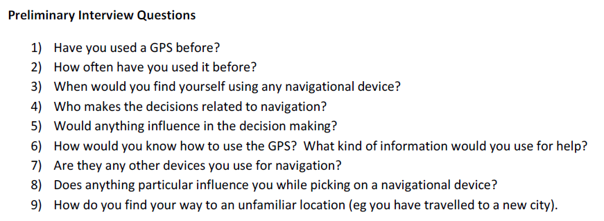
Script example from a previous year – Initial Questions
Garmin Nuvi 200 portable automobile GPS by Puja Subramanyam

Slide 10
Example, cont.: Tasks & User

Slide 11
Transcript
Need to create a transcript of what is said
Can be exact or a summary
Must have time codes or line numbers

Slide 12
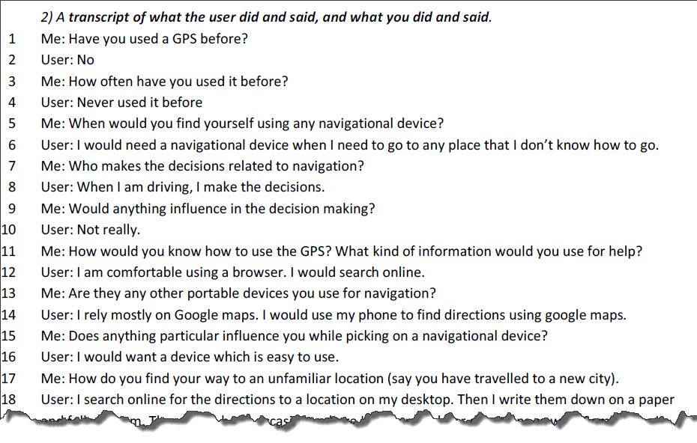
Start of Transcript
No need to follow your script exactly if it doesn’t make sense.

Slide 13
What to do with all the data?
How organize and use data from contextual inquiry?
Recommended technique: Use Graphical Models (diagrams)
Integrate
Summarize
Point back to the data
Help inspire and guide design
Provide shared focus
Provide an intermediate deliverable outside design team
“Opinions are cheap but insights are priceless.”

Slide 14
Why Graphical?
Displays whole picture at once
Reveals patterns
Forces summarization and conciseness
Multiple models provides different perspectives

Slide 15
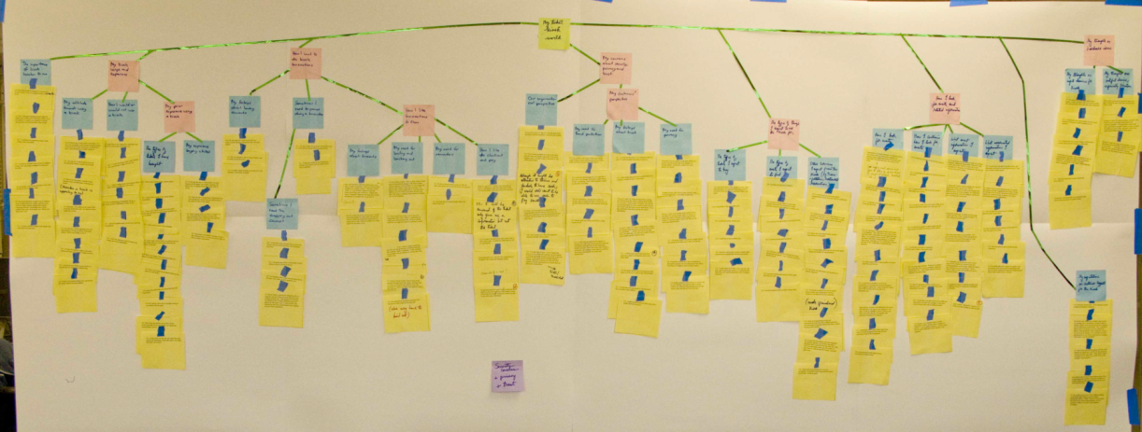
Analysis
Beyer & Holtzblatt call this process “Contextual Design”
But Hartson & Pyla call it “Analysis”
Better name!
Hartson & Pyla recommend doing a Work Activity Affinity Diagram (WAAD) first, but we go right from data → models
Affinity diagrams are more important for teams and when there are lots of ideas
You will make the models directly from your transcripts

Slide 16
Models:
Flow Model
Communication and coordination necessary to perform task
Social / Cultural Model
Constraints on work due to policy, culture, or values
Artifact Model
Physical things used and created
Physical Model
Layout of work environment as it affects the work.

Slide 17
More Models
Other models are in Hartson & Pyla but not covered further here (not in homeworks or on exam)
Task decompositions
Usage Scenarios (narratives about tasks)
Essential Use Cases (user and system steps)
Information Object Models (information needed and generated)
Sequence / Step-by-Step Model
Detailed work steps
Sequence in Beyer & Holtzblatt expanded in multiple models
“Step by Step Task Interaction Model”
Providing both “current” and “envisioned” versions of the models
We are only doing the current version

Slide 18
In ALL Models
ALWAYS label everything you put on the model with the line-number in the transcript (or time on the video/audio, if no transcript).
This allows you to get back to the raw data to see if a different interpretation is possible.
If there is no pointer back, then it is an unsupported Assumption and subject to additional scrutiny.
Don’t make things up – show only what is available in the data
Any assumptions must be marked with (A)

Slide 19
“Breakdowns” / “Barriers”
Problems that interfere with normal operation
Represented in most models
Key opportunities and issues for design
Often shown in red with a “lightning bolt”
Can’t see the screen

Slide 20
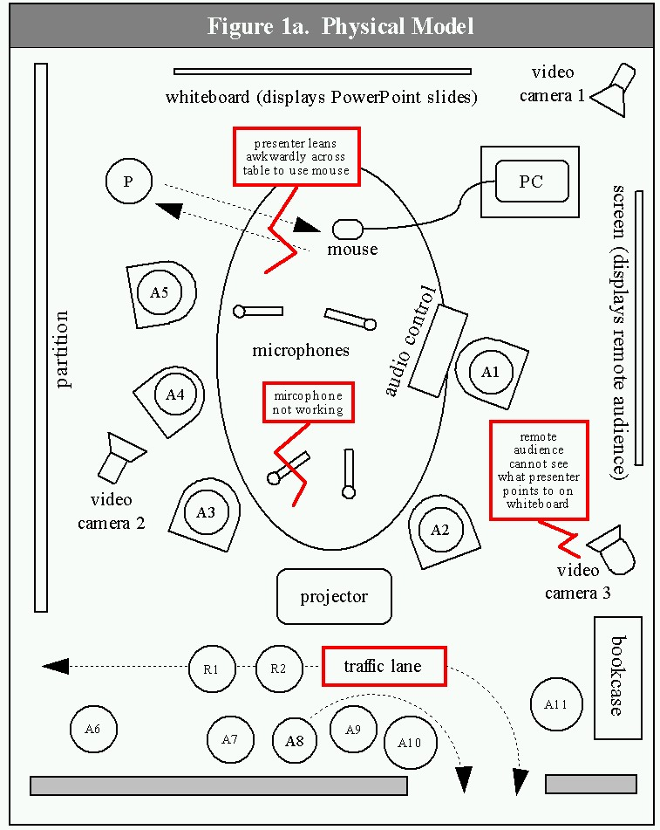
Additional Example
New example: Giving a presentation
From our paper:
Karen Cross, Adrienne Warmack, and Brad Myers. "Lessons Learned: Using Contextual Inquiry Analysis to Improve PDA Control of Presentations“
Results influenced design of SlideShow Commander remote control product for mobile phones
Used in the Hartson-Pyla textbook

Slide 21
Flow Model
Communication and coordination necessary to perform tasks
Work flow
Who talks to whom? Who gives what to whom?
Key roles of individuals or groups
Key responsibilities of that person with respect to the tasks
Flow of communication and artifacts, shown as arrows
Artifacts passed around
Actions along the way
Places that things or people go
Breakdowns

Slide 22
Flow Model structure
Circles and/or icons = people or groups by role
Boxes = things (artifacts), places, files, etc.
Arrows = flow
Red lightening bolts = breakdowns
Times refer to time codes in video
Could also refer to lines of a transcript
For homework, approximate times or line numbers are OK
“(A)” = Assumption = interpretation
Note: not for team-member's opinions about the UI
Instead (A) is for assumptions about what user did
Note: you (interviewer) are never in any model

Slide 23
Flow Model components
General
How do job responsibilities get assigned to people?
How do they get help?
How do new tasks get assigned, and how are they carried out?
Coordination: where did each artifact come from and where does it go?
Problems with coordination: forgetting, timing, steps
Creates the “bird’s eye view” of organizational structure
Web
NOT flow chart of pages visited
How information and command flow among the site(s)

Slide 24
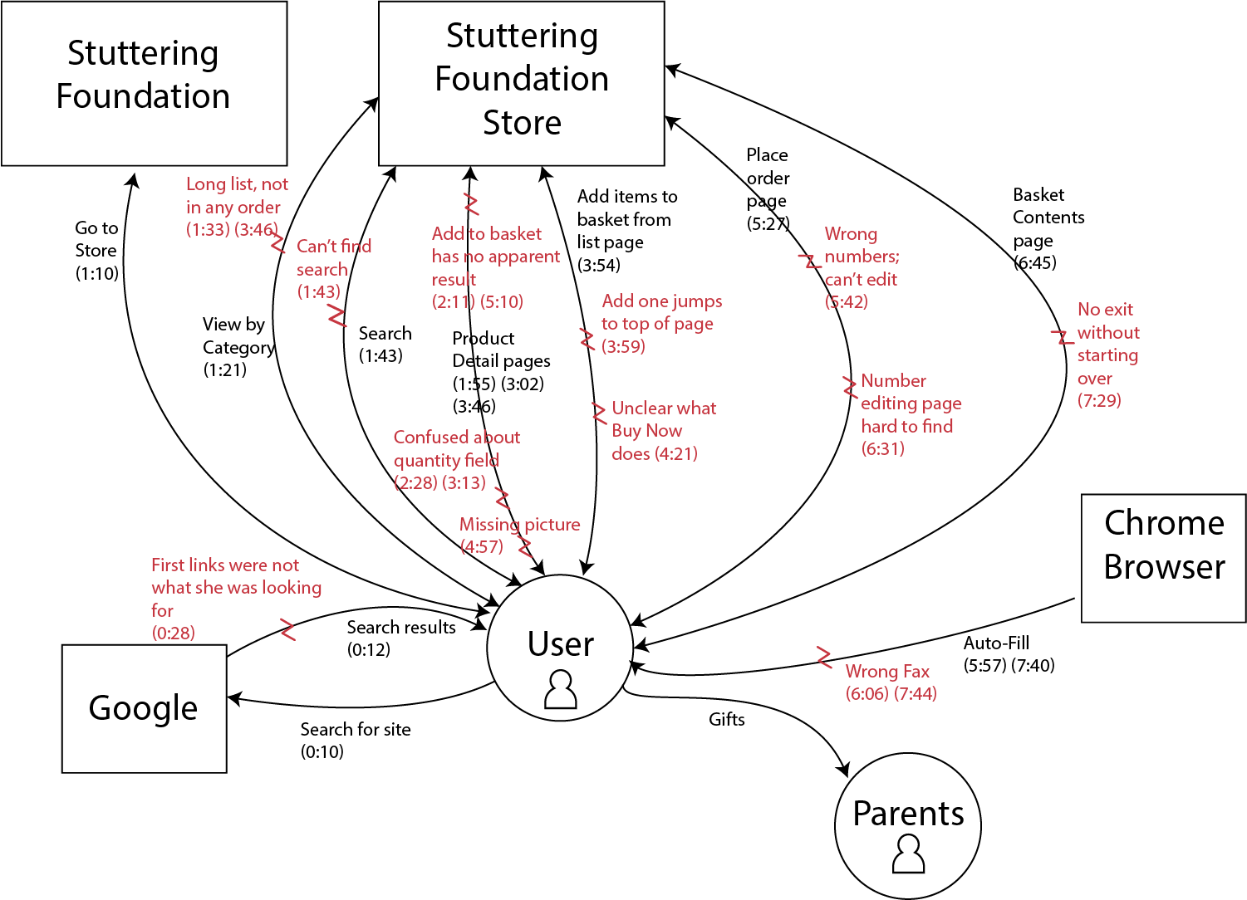
Flow Model Example

Slide 25
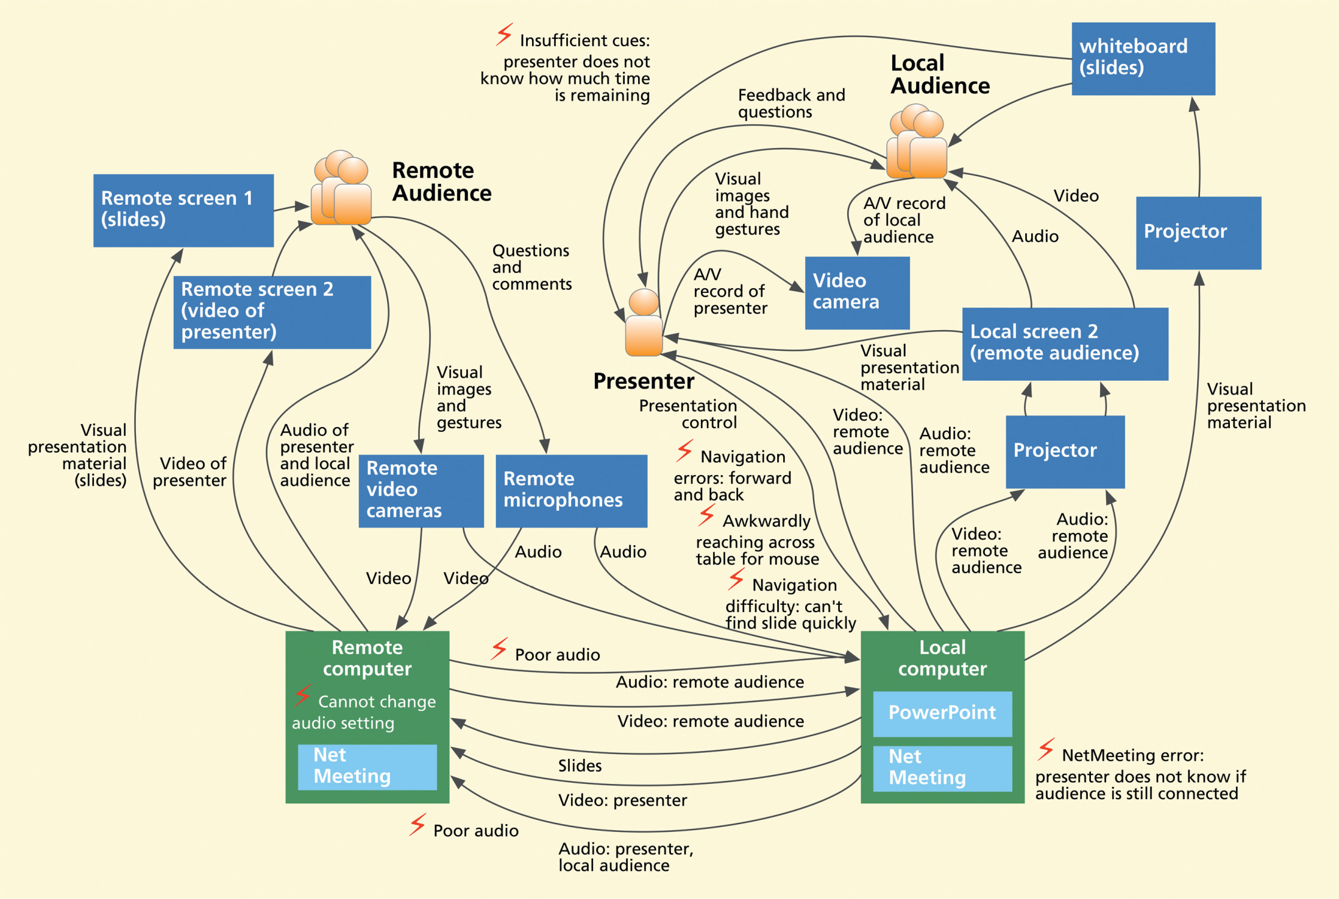
Flow Model Example (SSC)
Fig 6-8 in text

Slide 26
Social Model
Beyer & Holtzblatt call this “Cultural Model”
Culture of organization, family, community defines expectations, desires, policies, values and approach
“Culture is as invisible as water to a fish”
Pervasive, inescapable; yet invisible and intangible
Types of influences:
Formal and informal policies
Power of individuals and groups over each other
Values of company or team
Work domain constraints
Group’s sense of identity
People’s emotions about what they do
The style, values and preferences of individuals or teams
More examples of what goes on social model:
When acceptable to use a recording device
What friends might think

Slide 27
Social Model Structure
Ovals for “Influencers”: individuals or groups, internal or external
Thought bubbles for feelings/concerns that they actually expressed
Note: often from the preliminary questions or opinions during the CI
Arrows for direction of influence
Labels for samples of dialog showing type of influence and attitudes
Worded as commands
Also show “pushback” – influence in other direction
Breakdowns
In relationships among people
No need to repeat previously shown problems
NOTE: Not allowed to make stuff up!
Just what you actually have data to support!

Slide 28
Social Model Contents
What to put into social model for appliances:
Context of use: when used, other people around, whether OK to record other people, what it looks like
Feelings: proud to own it, embarrassed
Influences: why buy one vs. another, qualities desired
But need data to support all claims
From initial interview questions or other evidence
Can’t just make stuff up!

Slide 29
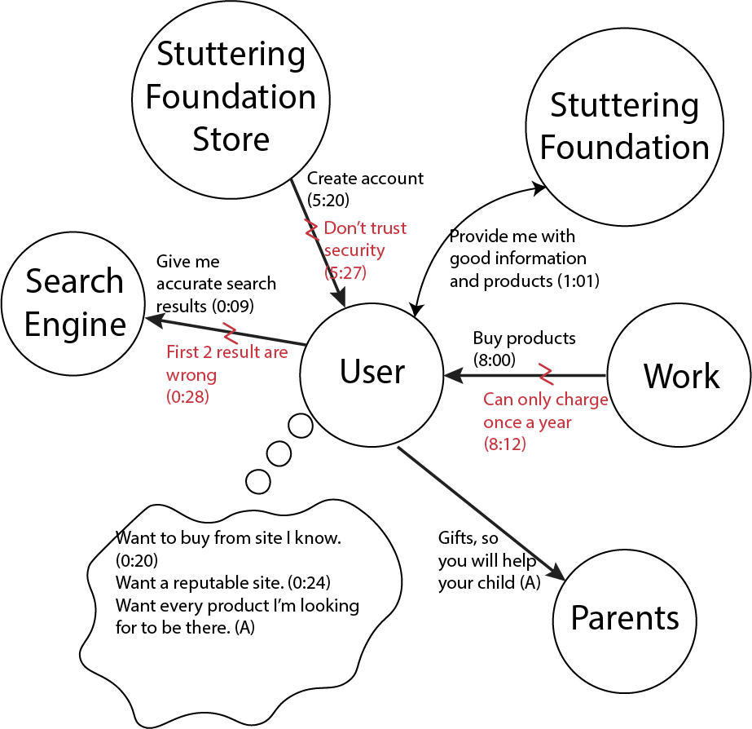
Social Model Example

Slide 30
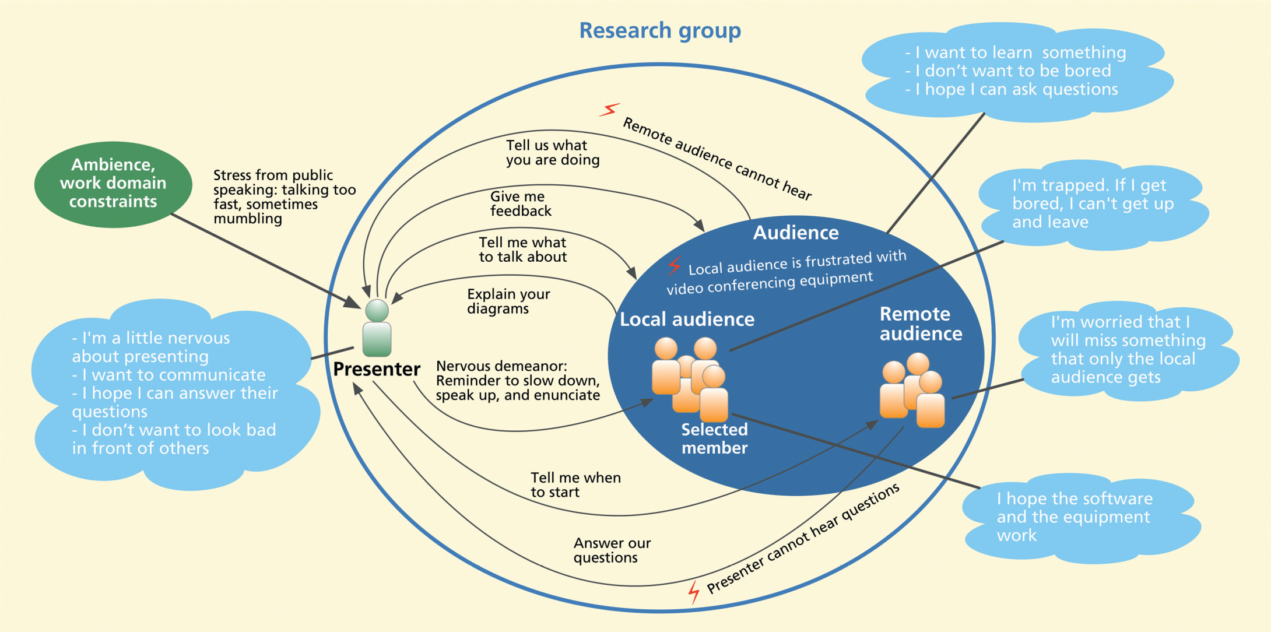
Social Model Example (SSC)
Fig 6-6 from text
Typo in book! This arrow goes the wrong way!

Slide 31
Artifact Model
Artifacts: What people create, modify and use as part of tasks
Reveal traces of people’s work practices
Examples:
Handwritten notes and signatures on hardcopy project plans -> information flow and approval
Fancy formatting on spreadsheet -> looks are important
Screen shots showing problematic features
Model = drawing, photograph or copy of real artifact
Annotate with observations

Slide 32
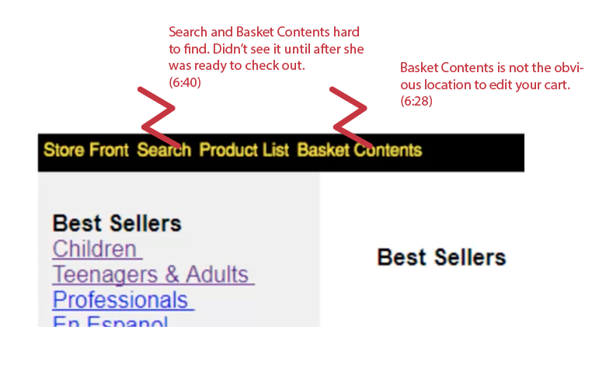
Artifact Model Examples

Slide 33
Artifact Models, cont.

Slide 34
Physical Model
Way the physical environment affects tasks
E.g, placement of items on a desk
Proximity of printers
Can’t hold a device with a keyboard while standing up
In presentation example, where people are and layout of environment
Note: Physical model not always relevant or needed
Seems less important for web, unless mobile
Not required for homework 1, but please do one if environment affects your system

Slide 35
Components of Physical Model
Places in which work occurs
Physical structures which limit or define the space
Usage and movement within the space
Hardware and other artifacts used
Layout of tools and artifacts
Positions of people within environment
Breakdowns due to physical environment

Slide 36
Physical Model, example

Slide 37
Beyer&Holtzblatt’s Sequence Model
Similar to Hartson&Pyla’s “Step-by-Step Task Interaction Model”
Steps taken to complete a task
Triggers that cause the step to happen
E.g., at a particular time; when something else happens
Intent is key to understanding the steps
Also called the goal
Why each step is performed, and why in that order
Arrows to show order of the steps
Can have loops
Breakdowns in communication or coordination
(Note: this model not in homeworks or exam)

Slide 38
Sequence Model Components
Can choose level of detail depending on focus (what investigating)
E.g., for writing a letter:
High-level (functional level): Find most recent letter written to same person, open it, delete date, replace with new date, delete contents, type new contents, …
Low level (user interface level): Switch windows explorer to details view, Sort files by date, double-click on top item, check “To:” to see if correct person, click and drag across date field, …
Notice hesitations and errors
Interrupt and ask why or what expected

Slide 39
Hartson&Pyla’s Task Structure Models
Their replacement for Sequence Model
Tasks that need to be supported by the system
You need to decide the important tasks in order to:
Optimize interface & design – what is important?
Design user study tasks – what will participants do?
Understanding tasks can help with better designs because organize UI by task, not by function
What to do, not how
Information needs – what need to know to do task
Unlike sequence models, task models try to capture all requirements, not just the ones in the data

Slide 40
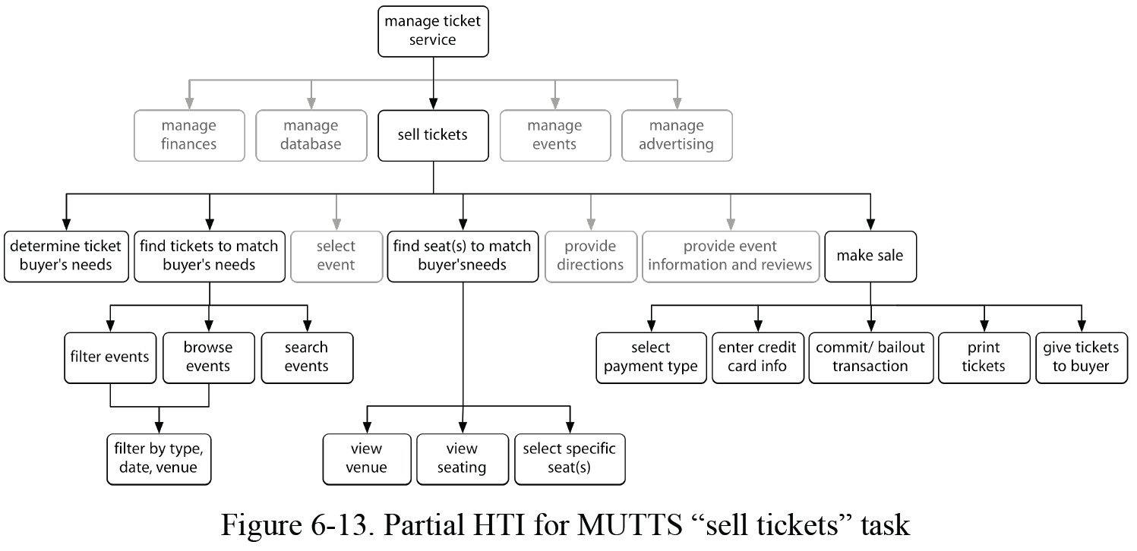
Hartson&Pyla’s Hierarchical Task Inventory
Hierarchical Task Inventory (HTI) shows tasks and subtasks
Doing a subtask is part of doing the parent task

Slide 41
Creating Models
Create models generalizing over all interviewees
“Consolidated” models
Barrier summaries
Key Idea: Induce generalizations from concrete data
Don’t rely on intuition alone
Don’t deduce from logical abstractions
Example:
Logic says system manager will diagnose the reason behind a system failure. Actual practice: System manager tries standard fixes first (like reboot) & diagnoses only if necessary
Main goal: Deduce the intent

Slide 42
What To Do With Models
User data drives innovation
Solve problems (breakdowns) identified in models
Grounded brainstorming
Flow model
Eliminate flows, roles, redundant data entry
Social / Cultural model
Increase communication, reinforce positive values
Artifact model:
Guide requirements, metaphors, remove screen problems
Physical model:
Depend only on what is available, reduce motion, improve flow of artifacts
Sequence model:
Eliminate, automate steps

