Slide 1
05-863 / 45-888:
Introduction to
Human Computer Interaction for Technology Executives
Mondays + Wednesdays at 1:30 – 2:50 pm ET
Brad Myers
Human Computer Interaction Institute
Fall, 2017, Mini 2

Slide 2
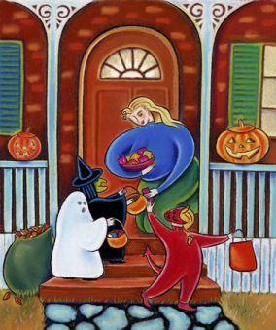
Happy Halloween!
Take 2 candies!

Slide 3
Course:
05-863 / 45-888 Introduction to
Human Computer Interaction for Technology Executives
  Both numbers are for the identical course
  Last year, also was 08-763
Mondays & Wednesdays, 1:30pm – 2:50pm
Room: NSH 1305
Simulcast to Silicon Valley Campus (10:30-11:50am)
  No particular room – watch from home or your own office
  Using “Panopto”
All lectures videotaped & available from schedule page anytime after the lecture is over

Slide 4
Registration Counts
NSH 1305 seats only 62 people
94 students are registered
  Some taking it at a distance (by video)
21 more still on the wait list (= 115!)
  They are all not likely to get in
Usually have had about 35% of the students dropping the class

Slide 5

Instructor
Brad Myers
  Human Computer Interaction Institute
  Office: Newell-Simon Hall (NSH) 3517
  Phone: x8-5150
  E-mail: bam@cs.cmu.edu
  http://www.cs.cmu.edu/~bam
  Office hours: By appointment.
Secretary: Ebony Dickey
  NSH 3526
  412-268-8204

Slide 6
Administrators
For course add/drop problems
Silicon Valley: Gladys Mercier
gladys.mercier@sv.cmu.edu
HCII – 05-863 | Tepper – 46-863
Indra Danti indras@cs.cmu.edu | Vickie Motz vmotz@andrew.cmu.edu

Slide 7
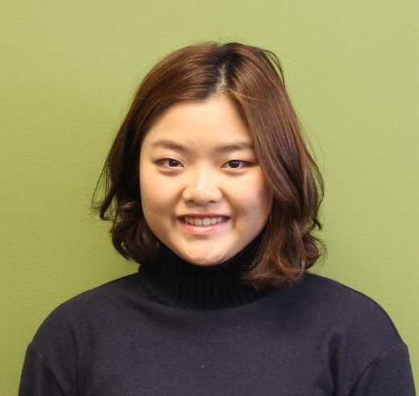
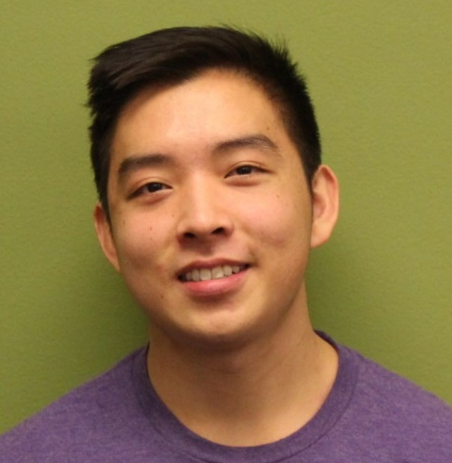

Teaching Assistants
Jenna Choo
  schoo@andrew.cmu.edu
Alex Wang
  awang1@andrew.cmu.edu
  www.alexwang.io
Christina Wagner
  amliu@andrew.cmu.edu
  http://amliu-portfolio.blogspot.com/

Slide 8
Course Web page:
Course Web page:
http://www.cs.cmu.edu/~bam/uicourse/05863fall17/
  Course schedule is tentative
  Note required readings – almost all from textbook
  Note homework and final exam schedule
  Note last lecture is after normal end of classes
  Some readings are CMU-only, use CMU network or VPN

Slide 9


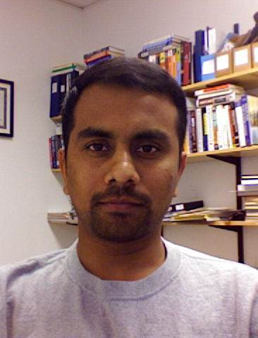
Textbook
H. Rex Hartson and Pardha S. Pyla, The UX Book: Ensuring a Quality User Experience, to be published by Morgan Kaufmann / Elsevier in 2011 or 2012. http://www.theuxbook.net/
Developed with 2 years of feedback from our course!
Very long, but you don’t need to read it all!
Will be revised – your feedback is requested!

Slide 10
Other useful books
Beyer, H. and Holtzblatt, K., “Contextual Design: Defining Custom-Centered Systems”. 1998, San Francisco, CA: Morgan Kaufmann Publishers, Inc. ISBN: 1-55860-411-1 (paperback)
Jakob Nielsen. "Usability Engineering". Boston: Academic Press, Inc. 1993.
Donald A. Norman, "The Design of Everyday Things". New edition: Basic Books, 2002, ISDN 0-465-06710-7. Or original edition (paperback): New York: Doubleday, 1988. ISBN 0-385-26774-6
Readings from these are “optional”
All readings listed on schedule

Slide 11
What is this class about?
Brief overview of Human Computer Interaction techniques
  Understanding of what usability is and means
  Awareness of Good and Bad design
  HCI ≅ “Human Factors”, “Ergonomics”, Man-Machine Interfaces (MMI), etc.
  Teach the 4 most important, proven methods for achieving better usability, and why they are important
    Contextual Inquiry
    Rapid Prototyping
    User studies
    Heuristic Analysis
  These methods won’t get obsolete – they work for any device
You will be learning new skills (not just about the skills)
You will be able to create better user interfaces, web sites, consumer products, etc.
You will be better able to lead design teams

Slide 12
Requirements for this Course
No requirement to be able to program
  One homework (#4) will have you create a medium-size prototype, but it can be in any language, including html or even PowerPoint
  You are expected to chose an implementation you can do mostly on your own
  Make this course more accessible to a wider range of students

Slide 13
Homeworks & Grading
6 individual homeworks
  Overview of homework grading & policies
    Note schedule of when due (switches from Wed → Mon)
  Due before class
  Turn-in electronically in pdf on Canvas
  Note: 6 unit mini = 12 hours of work/week
This course is a lot of work, but you can do it!
Final Exam
  Two exam dates, including distance students
Pass/fail OK with me
  Check with your program
  Must decide right away
Audit – not OK – sorry, no space
  Just watch the videos on-line

Slide 14
Homework & Exam
Deadlines
http://www.cs.cmu.edu/~bam/uicourse/05863fall17/homework.html
Homework due dates
Exam (tentative): Friday, December 15, 2017, NSH 3305, 8:30-11:30 or Monday December 18, 2017, 2:00pm - 5:00pm in Tepper room 151
Office hours to match homework due dates
  http://www.cs.cmu.edu/~bam/uicourse/05863fall17/staff.html
You should take advantage of office hours!

Slide 15
Assignment 0
Picking an appliance
http://www.cs.cmu.edu/~bam/uicourse/05863fall17/homework.html#0
Everyone must have a different appliance
Should be a problematic (bad) user interface!
  So you can redesign it better!
Due by Tuesday at 8:00pm (20:00) Eastern Time
Will fix any issues in class on Wednesday
  Should attend or else will get last choice
Enter your choices on the GoogleDoc
  See Canvas for the link (so private)

Slide 16
Lecture 1:
Introduction and
Why are UIs Important and Difficult to Design and Implement
Brad Myers

Slide 17
Who are “Users”?
People who will use a product or web site.
As opposed to the “Designers”
  People who create the system or web site
Designers ≠ Users
You are the designer
Have to make an effort to Know The User

Slide 18
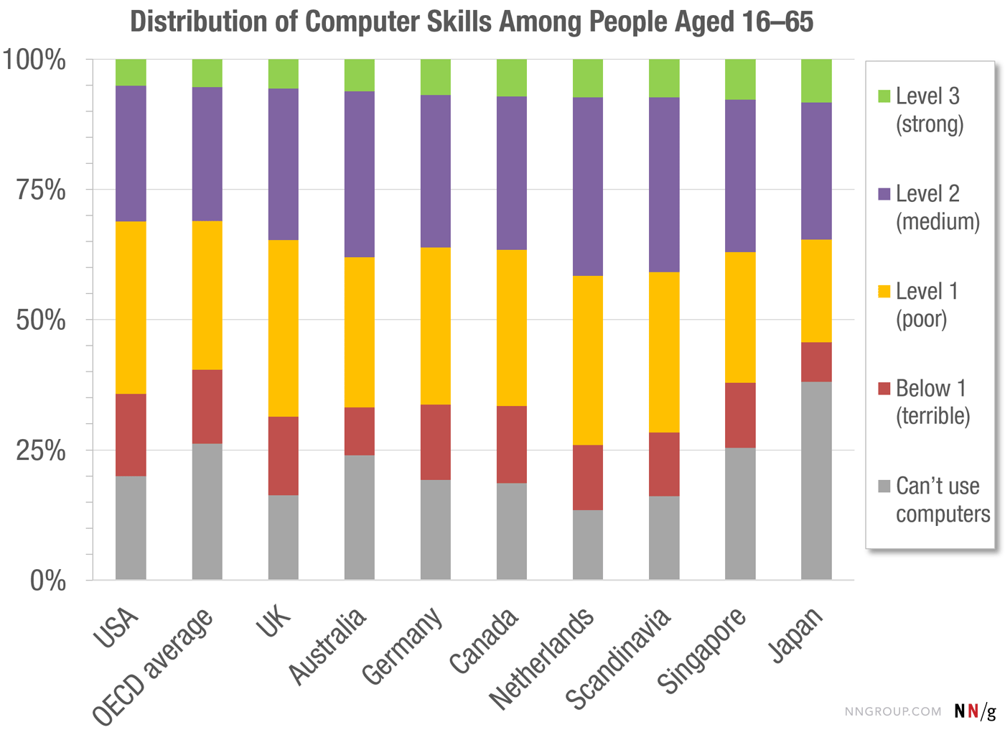
Users are not like you!
11/13/2016: Source: https://www.nngroup.com/articles/computer-skill-levels/

Slide 19
What is the “User Interface”?
Everything the user encounters
  Functionality & Usefulness
  Content
  Labels
  Presentation
  Layout
  Navigation
  Speed of response
  Emotional Impact
  Documentation & Help
Book calls it “User Experience”

Slide 20
What is Your Definition of “Quality” for a System?

Slide 21
What is “Usability”?
= Quality!
Learnability
Efficiency
  Productivity
Memorability
  Little “re-learning” required
Errors
Satisfaction
  Pleasurable

Slide 22
User “Experience” (UX)
Even more than “usability”
  Usability focuses on performance
User Experience
  Emotion, Heritage
  Fun, Style, Art
  Branding, Reputation
  Political, social personal connections
  Beyond just the device itself – “Service Design”
Blends: usability engineering, software engineering, ergonomics, hardware engineering, marketing, graphic design

Slide 23
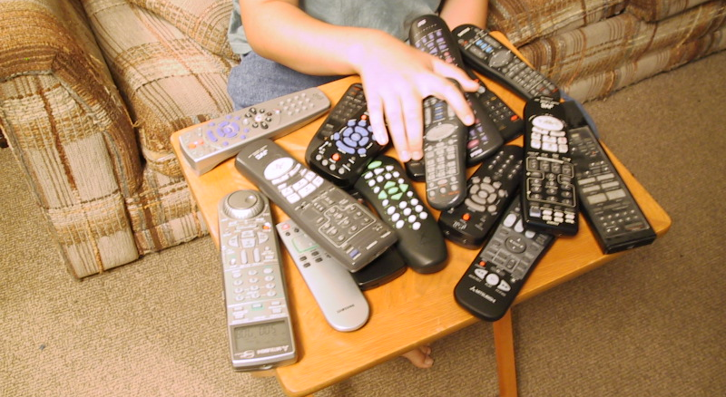
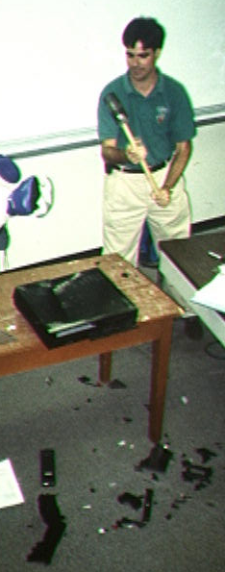
Problem
Appliances are too complex

Slide 24
Why are Interfaces Important?
Customer benefits:
  Novices will be more effective quicker
  Make experts more efficient
    Efficiency is important to customers, especially with shrinking workforces & outsourcing
  Reduce errors
  Increased pride of ownership
  Productivity and satisfaction

Slide 25
Why Important? cont.
Company Benefits
  Increase sales
    Removing a step during eCommerce purchase increased sales by 45% = $300,000,000 / year [cite]
  Usability engineering saves money (ROI)
    $39,000, $613,000, $8,200,000
    Up to 5000 times the cost
  Reduce calls to the support center & support costs in general
    Can cost $30 - $100 per call
  Reduced complaints from customers
  Can help identify what is really needed
    What will be useful and what is not needed

Slide 26
Company Benefits, cont.
Reduce redesign costs
  “lack of attention to user inputs is one of the most important reasons why many software projects were unsuccessful. This translated to costing corporations $80 billion dollars a year.” – [Hartson-Pyla, ch. 1, p. 33]
Easier to demonstrate and sell
Greater usage of features = realized value
Competitive Differentiation
→ Revenue and Profit

Slide 27
Why are Interfaces Important?
There are well-defined methods and techniques
  Not just opinions, luck, domain-experience
  HCI-trained people build better interfaces
  Exposure to different kinds of interfaces, problems
  User model, not system model
  Guidelines

Slide 28
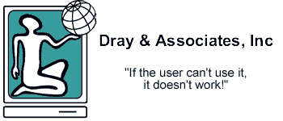
Why Important? cont.
Significant time and code devoted to HCI now!
    -- www.dray.com
    Corollary: If the user can’t find or use a feature, it doesn’t exist!

Slide 29
Especially for the Web
“Usability rules the web”
  If the customer cannot find your product, then it won’t be bought
  Your competitors are only one click away
  All web sites are compared to the best
  “Nearly 9 of 10 of Americans Have Negative Feelings About Brands with Poorly Performing Websites” – ref
Normal Products
Web Products

Slide 30
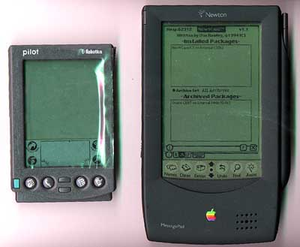
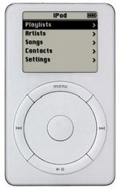
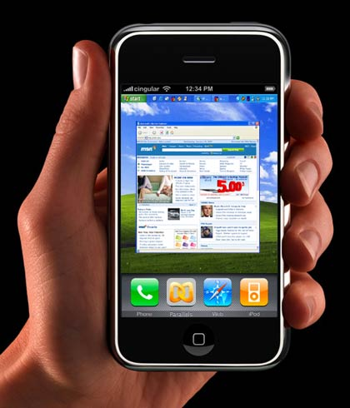
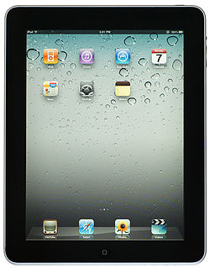
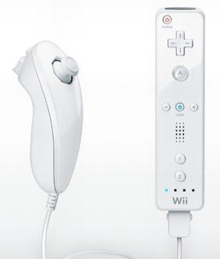
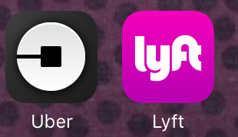
Good UIs on Successful Products
Palm succeeded where other handhelds had failed due to a focus on usability:
  Fit into pocket
  Reliable gestural text input
  Commands immediately available
Apple iPod lauded for
design and user interface
  iTunes → entire service design
Apple iPhone – unique UI
Apple iPad – desirable
Wii controller, vs. XBox, PS3
graphics & power
Uber/Lyft UI

Slide 31
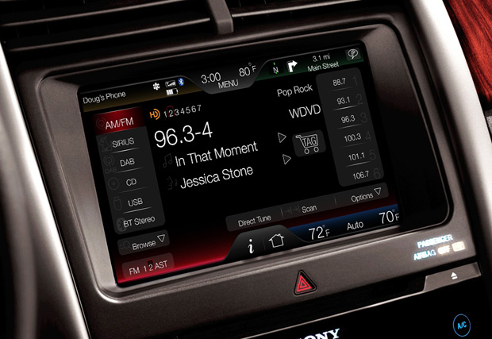
Bad UIs can Sink
Products & Companies
Damage reputations
“Negativity bias” – People remember bad things better
https://www.nngroup.com/articles/negativity-bias-ux/
Ford dropped in ratings in 2011 due to touch screen interface
  “Despite Ford’s improvements in manufacturing quality, their overall ratings fell precipitously this
  year due solely to the poor
  software interaction on
  their dashboards.”
  – NYT, Cooper Report
  “’Annoying’ behavior of their
  driver-facing interactive
  systems that caused their
  ratings to plummet.”

Slide 32
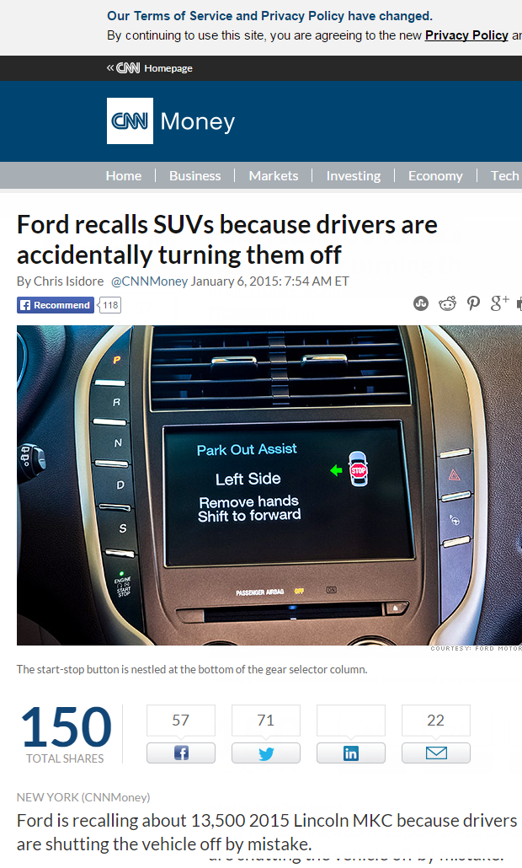
Another example:
Reference:
http://money.cnn.com/2015/01/06/autos/ford-push-button-ignition-recall/index.html
  “Ford is recalling about 13,500 2015 Lincoln MKC because drivers are shutting the vehicle off by mistake.”

Slide 33
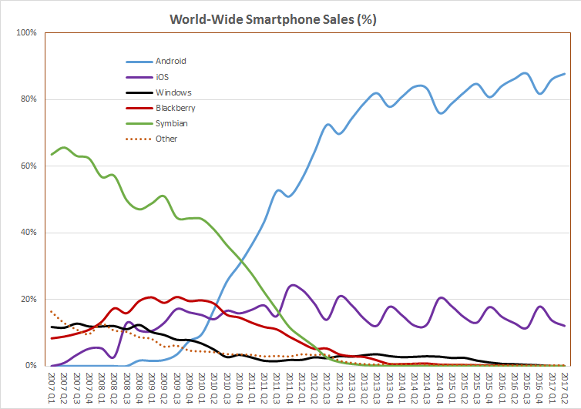
Nokia & RIM
http://en.wikipedia.org/wiki/File:World_Wide_Smartphone_Sales_Share.png

Slide 34
Bad UIs Can Cause Disasters
Aegis
  July 4, 1988; Iranian Airbus shootdown by the Vincennes
  http://www.washingtonpost.com/wp-srv/inatl/longterm/flight801/stories/july88crash.htm http://en.wikipedia.org/wiki/USS_Vincennes_%28CG-49%29
Deaths in kids: http://pediatrics.aappublications.org/cgi/content/abstract/116/6/1506
  “Unexpected Increased Mortality After Implementation of a Commercially Sold Computerized Physician Order Entry (CPOE) System”
    Because it took so much longer, did not reduce errors overall
Florida ballots (2000)
  http://www.asktog.com/columns/042ButterflyBallot.html

Slide 35
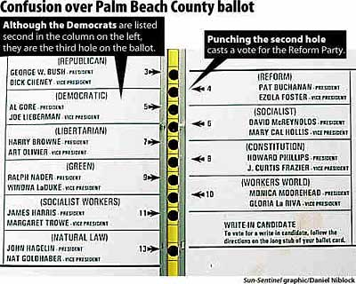
Florida Ballots in 2000

Slide 36
On-Going List
Send me your favorite examples of Good, Bad, and Catastrophic UIs:
https://docs.google.com/document/d/1AMn49vUgPzy-EIn6pZPlqZTYsQzgnF9VJNcdxCwqc1w/edit#

Slide 37
Why are User Interfaces Difficult to Design?

Slide 38
Why Hard to Design UIs?
“It is easy to make things hard. It is hard to make things easy.”
No silver bullet
Seems easy, common sense, but seldom done right
  Once done right, however, seems “obvious”
User Interface design is a creative process
Designers have difficulty thinking like users
  Often need to understand task domain
  Can’t “unlearn” something

Slide 39
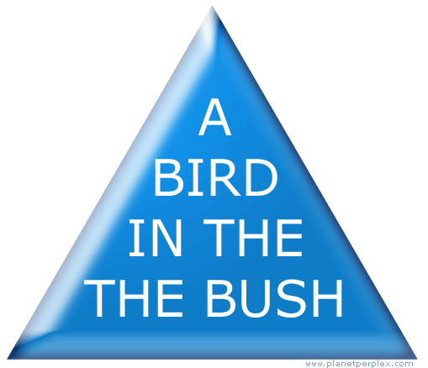
Can’t Unlearn Something

Slide 40
Why Difficult, 2
Specifications are always wrong:
  "Only slightly more than 30% of the code developed in application software development ever gets used as intended by end-users. The reason for this statistic may be a result of developers not understanding what their users need."
    -- Hugh Beyer and Karen Holtzblatt, "Contextual Design: A Customer-Centric Approach to Systems Design,“
    ACM Interactions, Sep+Oct, 1997, iv.5, p. 62.
  Need for prototyping and iteration

Slide 41
Why Difficult, 3
Tasks and domains are complex
  Word 1 (100 commands) vs. Word 2013 (>2000)
  MacDraw 1 vs. Illustrator
  BMW iDrive adjusts over 700 functions
Adding graphics can make worse
  Pretty ≠ Easy to use
Can’t necessarily just copy other designs
  Legal issues
All design/development involves tradeoffs
  Add Features
  Test/Fix Bugs
  Test/Fix usability
  Time-to-market

Slide 42
Why are User Interfaces Difficult to Implement?

Slide 43
Why Are User Interfaces Hard to Implement?
They are hard to design, requiring iterative implementation
  Not the waterfall model: specify, design, implement, test, deliver
They are reactive and are programmed from the "inside-out"
  Event based programming
  More difficult to modularize

Slide 44
Why Hard to Implement? cont.
They generally require multi-processing
  To deal with user typing; aborts
  Window refresh
  Window system as a different process
  Multiple input devices
There are real-time requirements for handling input events
  Output 60 times a second
  Keep up with mouse tracking
  Video, sound, multi-media

Slide 45
Why Hard to Implement? cont.
Need for robustness
  No crashing, on any input
  Helpful error messages and recover gracefully
  Aborts
  Undo
Lower testability
  Few tools for regression testing

Slide 46
Why Hard to Implement? cont.
Little language support
  Primitives in computer languages make bad user interfaces
  Enormous, complex libraries
  Features like object-oriented, constraints, multi-processing
Complexity of the tools
  Full bookshelf for documentation of user interface frameworks
  MFC, Java Swing, VB .Net, etc.
Difficulty of Modularization

Slide 47
Examples
Difference between displaying “hello” and displaying a blue rectangle
Difficulty to read a file name
  Reading a text string
  Configuring and handling built-in file dialog
  Creating a new file dialog

