Slide 1
Lecture 18: Games and Consumer Electronics
Brad Myers
05-640 : Interaction Techniques
Spring, 2019
Based on content created by: Jeffrey M. Rzeszotarski
05-899A/05-499A
Spring, 2014

Slide 2
Administrative
Finalize groups for final projects today

Slide 3
Consumer Electronics
Everyday use
Affordable, off the shelf
Entertainment, productivity, communication

Slide 4
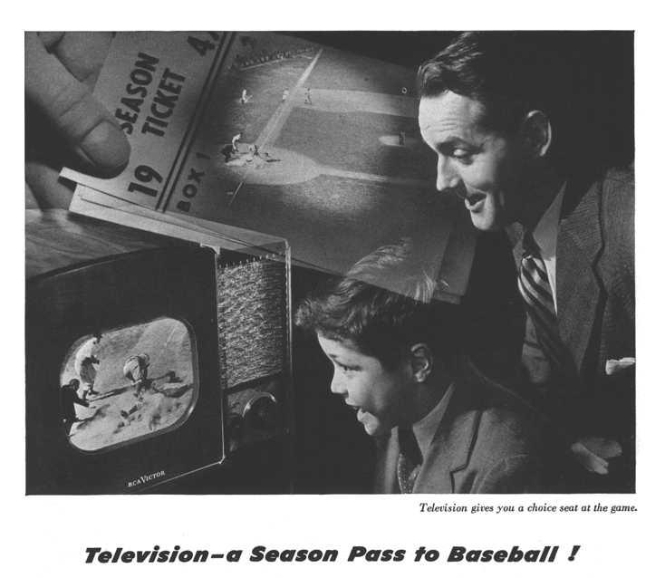
Notes:
RCA Victor television set
Post WW2 popularity
About the price of a good used car

Slide 5
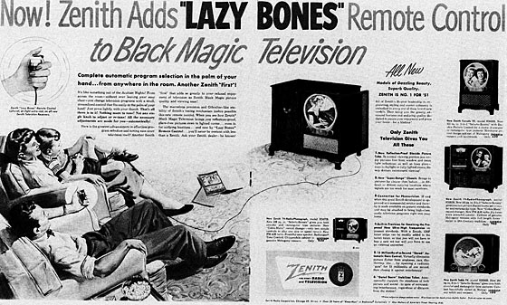
1950! Cite: https://www.reddit.com/r/vintageads/comments/6zsqff/1950_zenith_lazy_bones_tv_remote_control/
Notes:
Early 50s
Note the wire

Slide 6
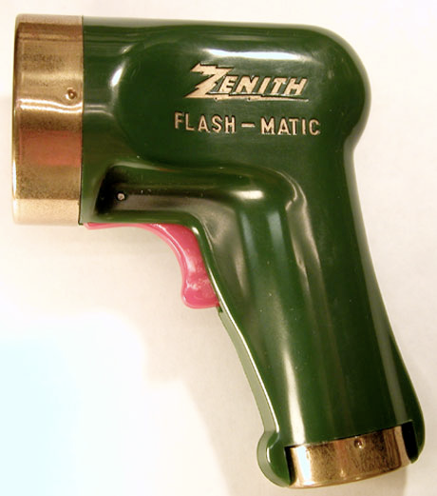
1955 – cite: https://www.theguardian.com/technology/2012/may/23/eugene-polley
Notes:
Mid 50s
Aim at the corners of the screen for different actions. Actuated a motor to turn the tuner

Slide 7
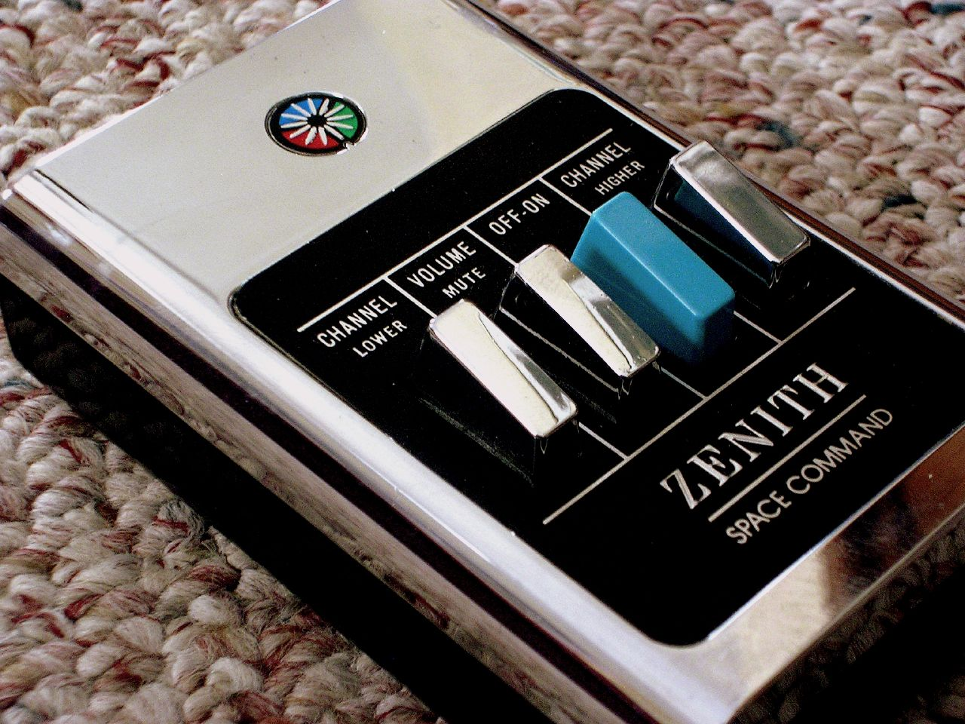
1956 – cite: https://en.wikipedia.org/wiki/Zenith_Electronics
Notes:
1956
Ultrasonic. Also triggered by xylophones
“clicker” term because of mechanics

Slide 8
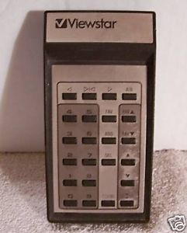
Notes:
1980 Viewstar cable box – new buttons!

Slide 9
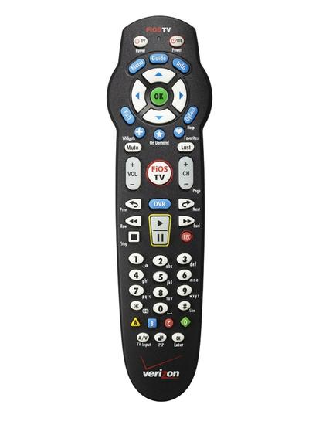
Notes:
Now remotes are rather complicated, especially for embedded boxes

Slide 10
Television Remotes
Modal options
Instantaneous operations (usually)
Better wireless affordances
Increasing complexity
Converging functionality

Slide 12
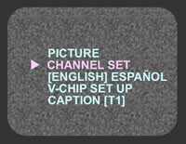

Slide 13
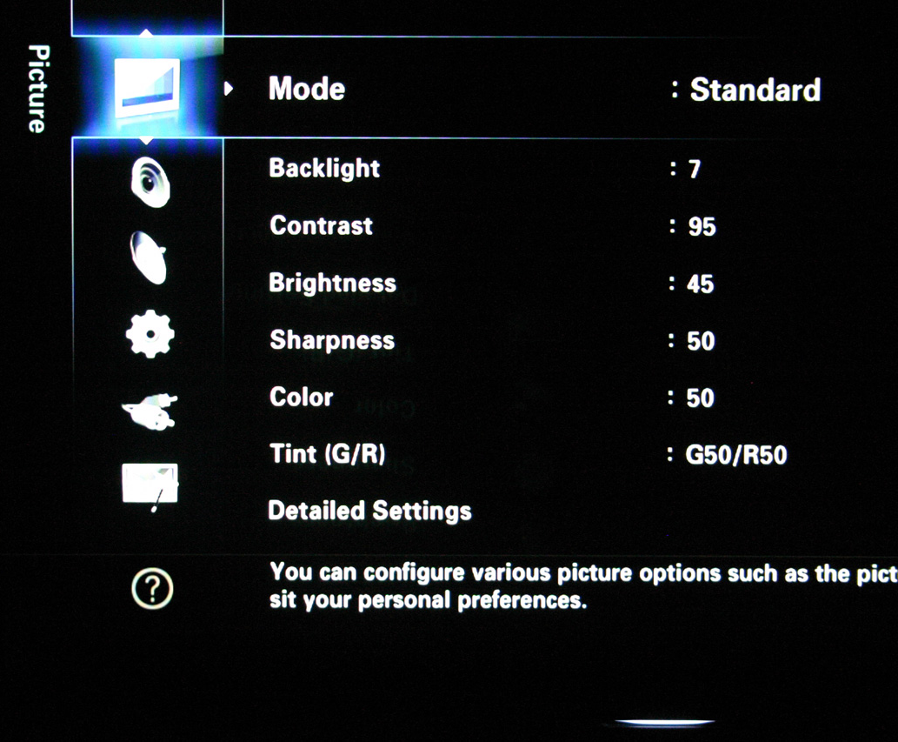

Slide 14
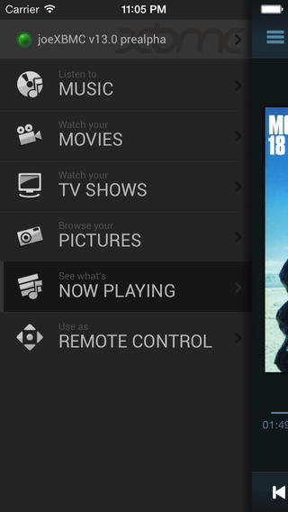

Slide 15
Television OSD
On-Screen Displays
Simple, text based overlays and menus
As televisions grew complex, so did menus
Adopting conventions of contemporary computer technology

Slide 16
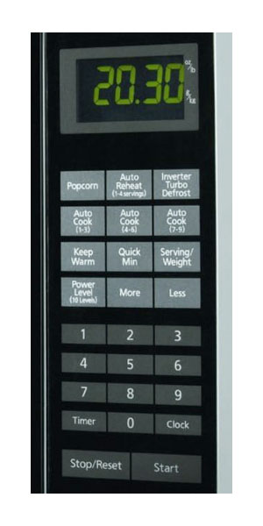
Lots of other interaction techniques to think about (and improve)
Notes:
Microwaves are a big contender. Consider the mix of prefix and postfix options on some microwaves

Slide 17
Video Games
“an electronic game that involves human interaction with a user interface to generate visual feedback on a video device”
(as per Wikipedia)

Slide 18
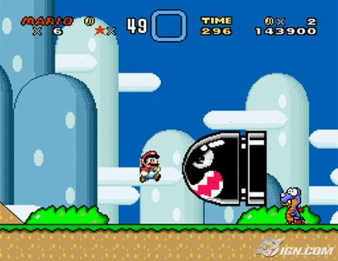
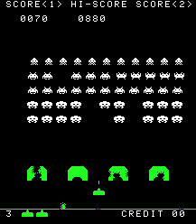
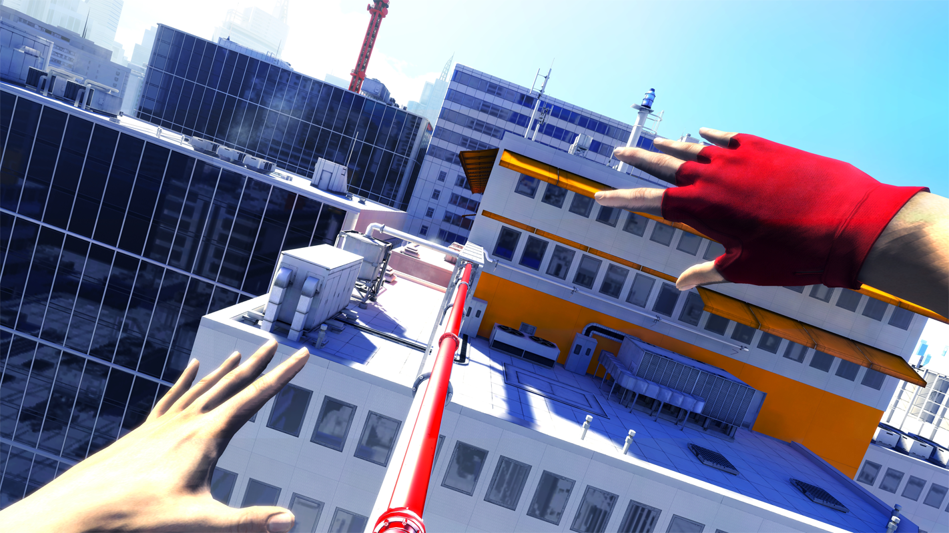
Middle
Early
Late

Slide 19
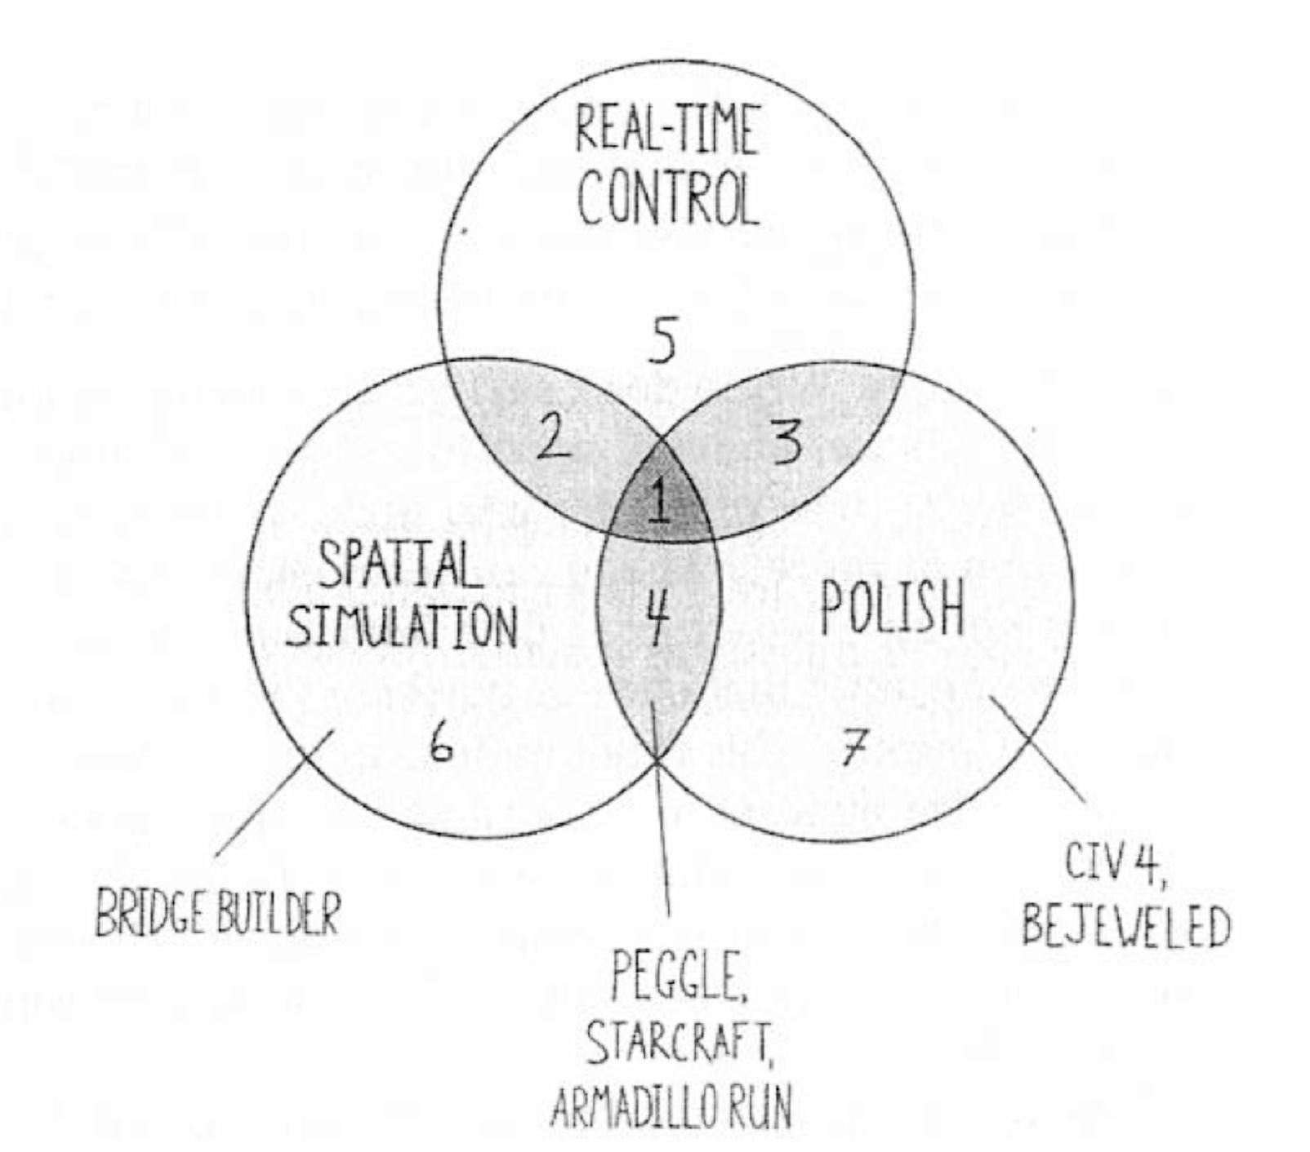
Notes:
Steve Swink’s breakdown of “game feel”

Slide 20
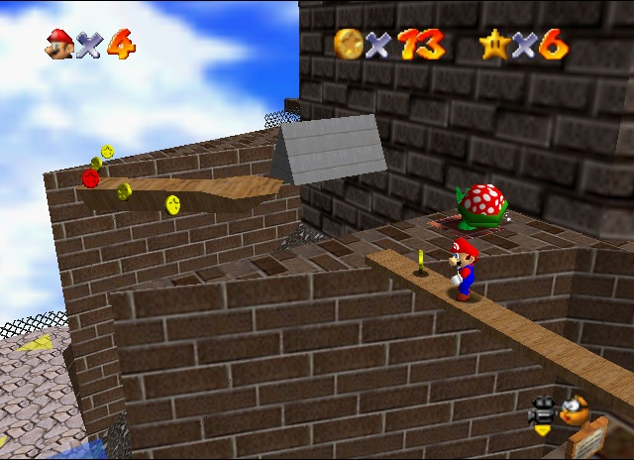

Slide 21
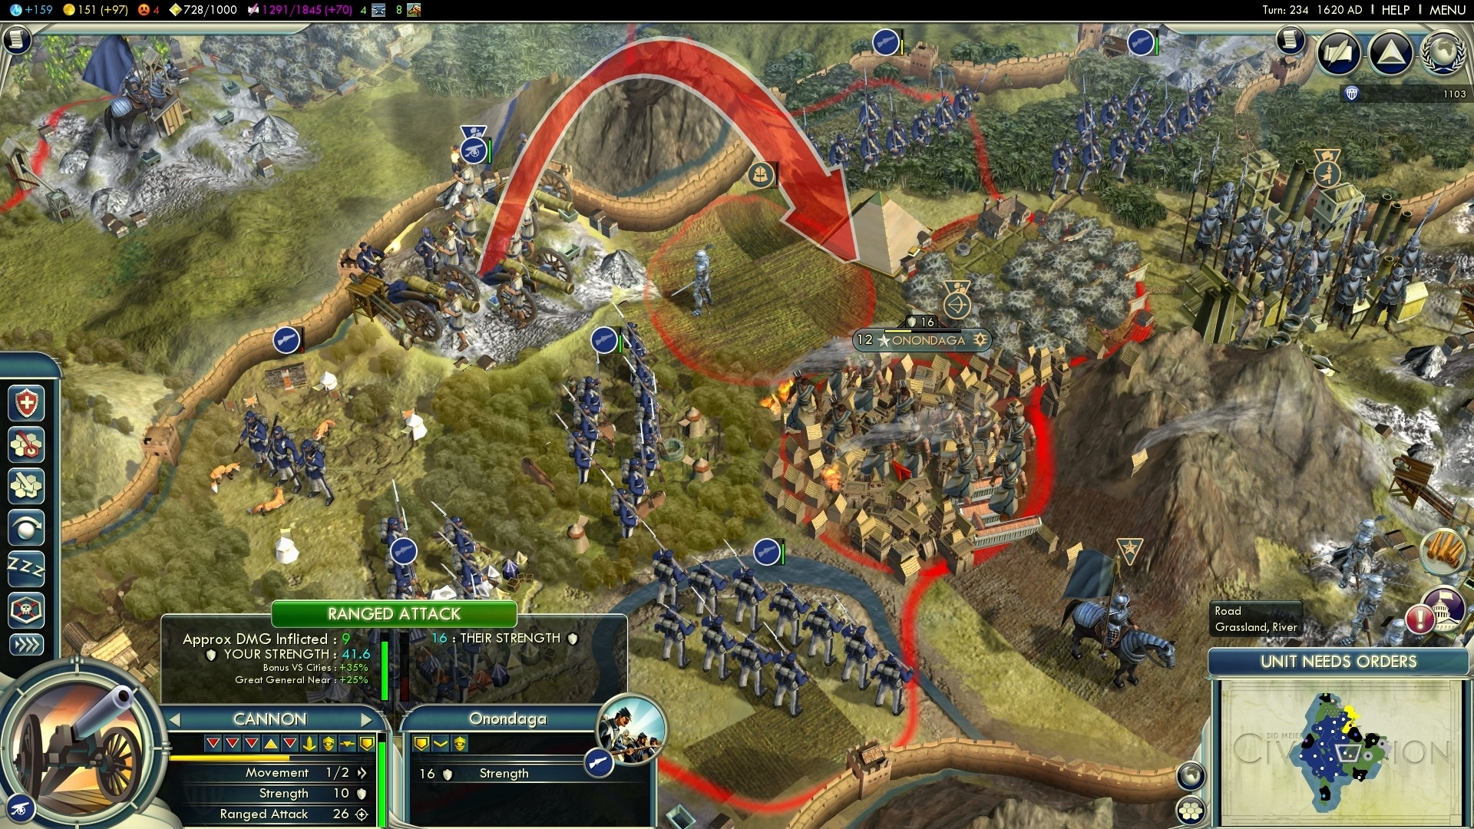

Slide 22
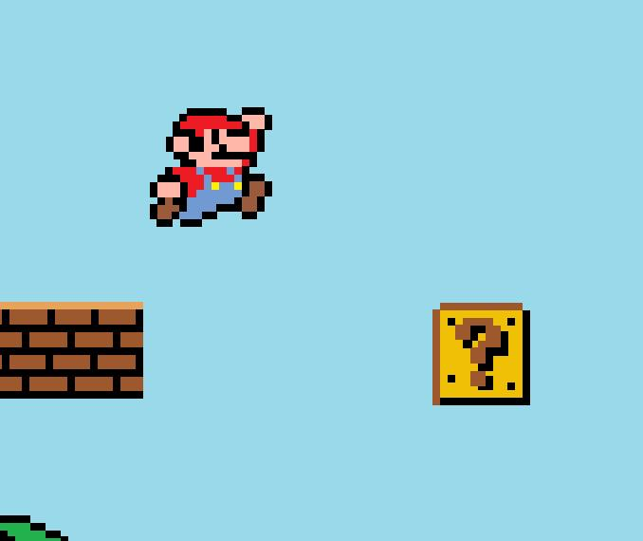
Taking Action
Moving
Status/Configuration

Slide 23
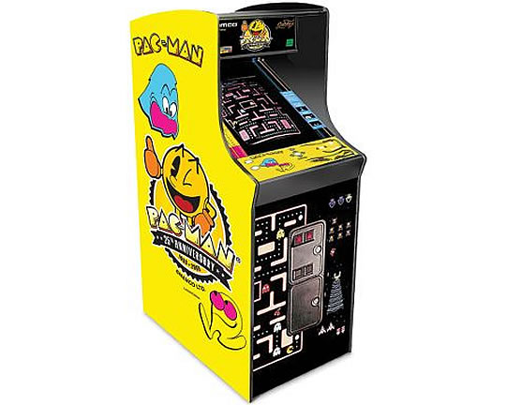
Early Era

Slide 24
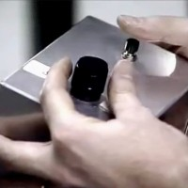
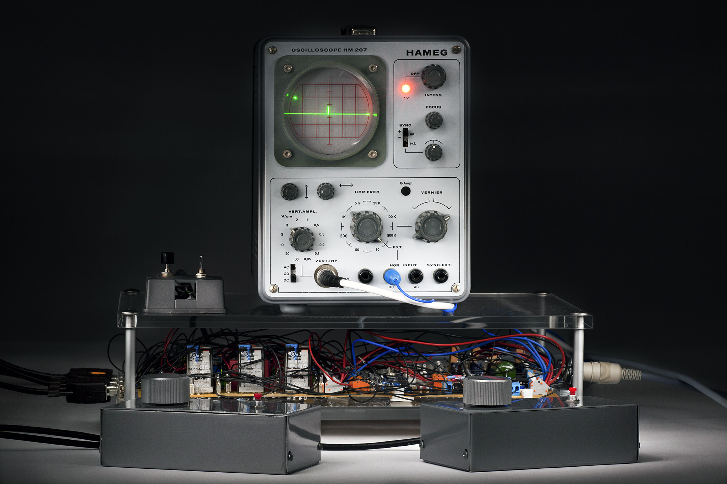
Tennis for Two - 1958

Slide 25
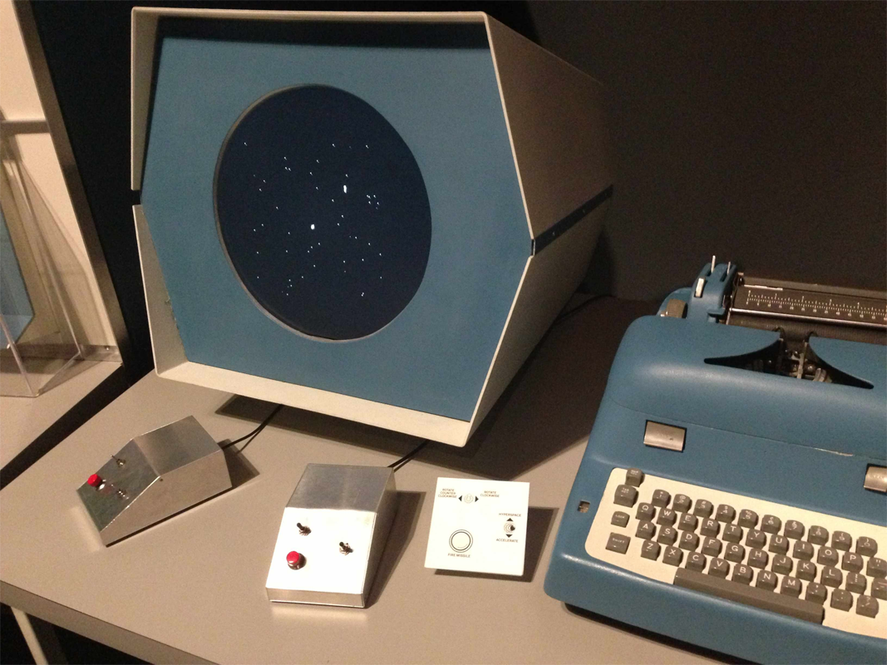
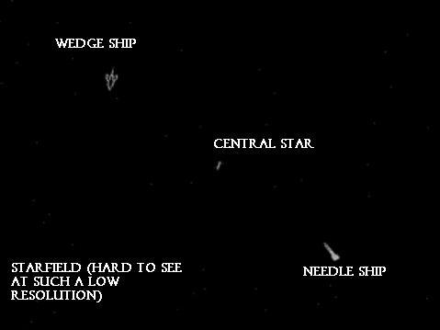
Spacewar!
1961
Notes:
Vector display had many limitations
Spread throughout colleges that had PDP1s
Terrible controls initially – wore out PDP switches

Slide 26
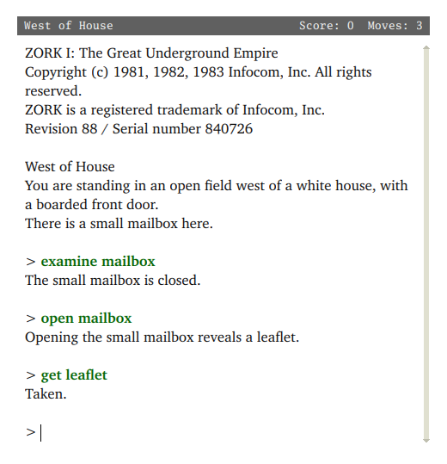
Zork
1977
Notes:
Zork – text adventure games – sole interaction was through text prompt – but problem is what to type – often get the wrong verbs, etc

Slide 27
Early Games
Appropriate existing physical games
‘Hacked’ together controllers
Very simple interactions
Arcades

Slide 28
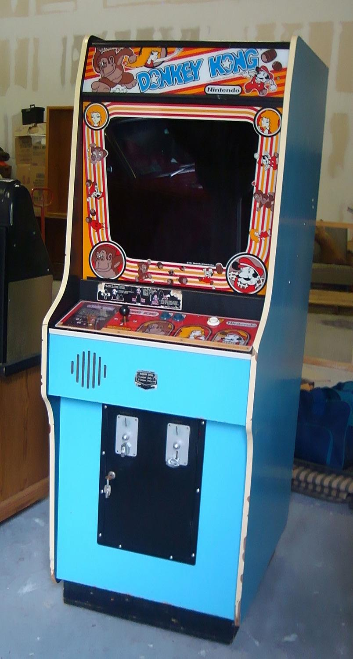
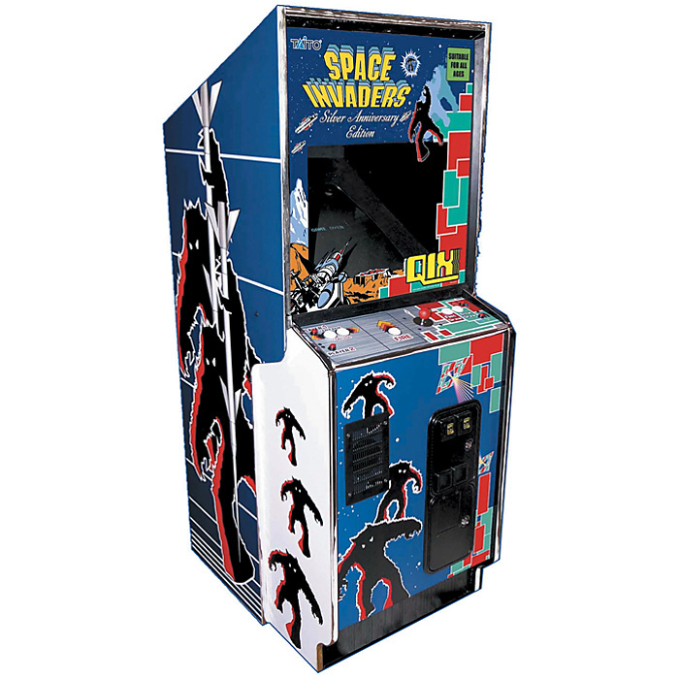
Arcade Games
Notes:
So-called golden age of the arcade – 1st half of 1980s

Slide 29
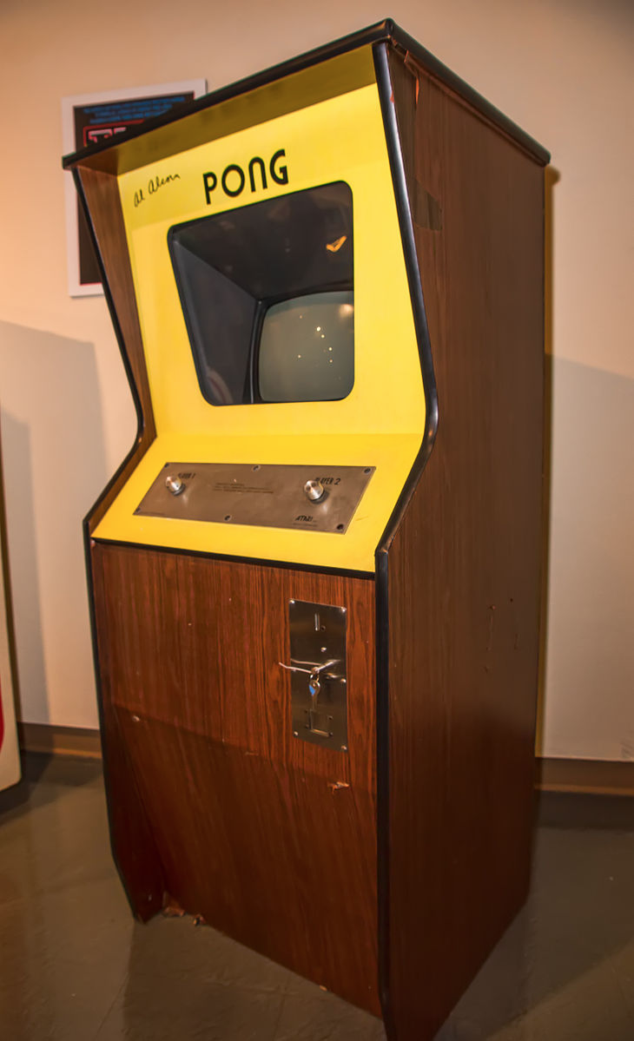
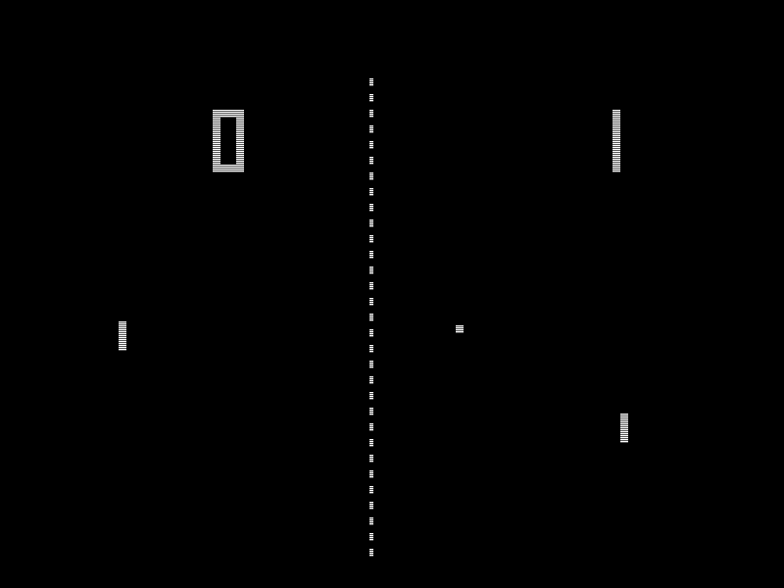
Pong
1972
Notes:
“Feeling the basic game was too boring, Alcorn added features to give the game more appeal. He divided the paddle into eight segments to change the ball's angle of return. For example, the center segments return the ball a 90° angle in relation to the paddle, while the outer segments return the ball at smaller angles. He also made the ball accelerate the more it was returned back and forth between paddles; missing the ball reset the speed.[3] Another feature was that the in-game paddles were unable to reach the top of screen. This was caused by a simple circuit that had an inherent defect. Instead of dedicating time to fixing the defect”

Slide 30
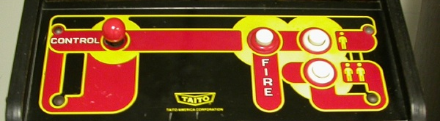
Space Invaders
1978
Notes:
No momentum or anything
Cellophane on the screen simulated color
Enemy craft speed up, but mainly because hardware could go faster the less enemies there were on the screen
Note modal buttons for player
How you teach the player – big graphic art on the bottom

Slide 31
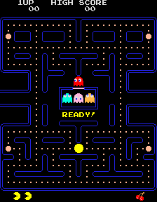
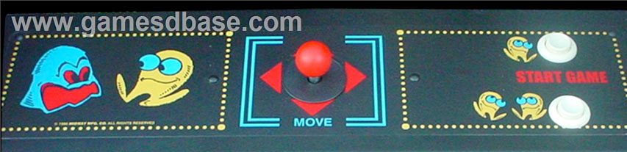
Pacman - 1980

Slide 32
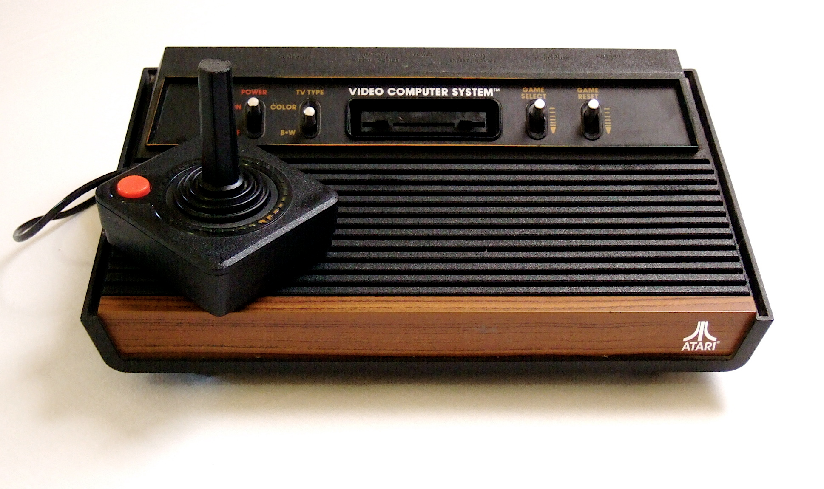
Consumer Game Consoles
Notes:
Starting mid 70s to 80s
Atari 2600 – digital stick controller, one button
Programmers started using switches on console as modal configurations because of lack of buttons. Also button combinations

Slide 33
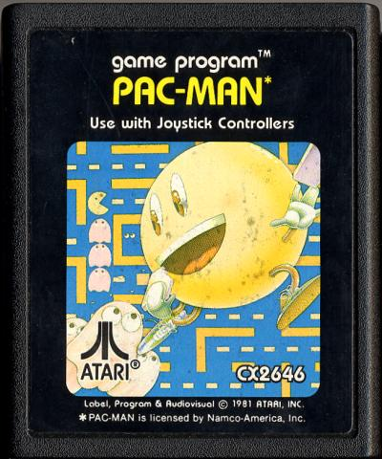
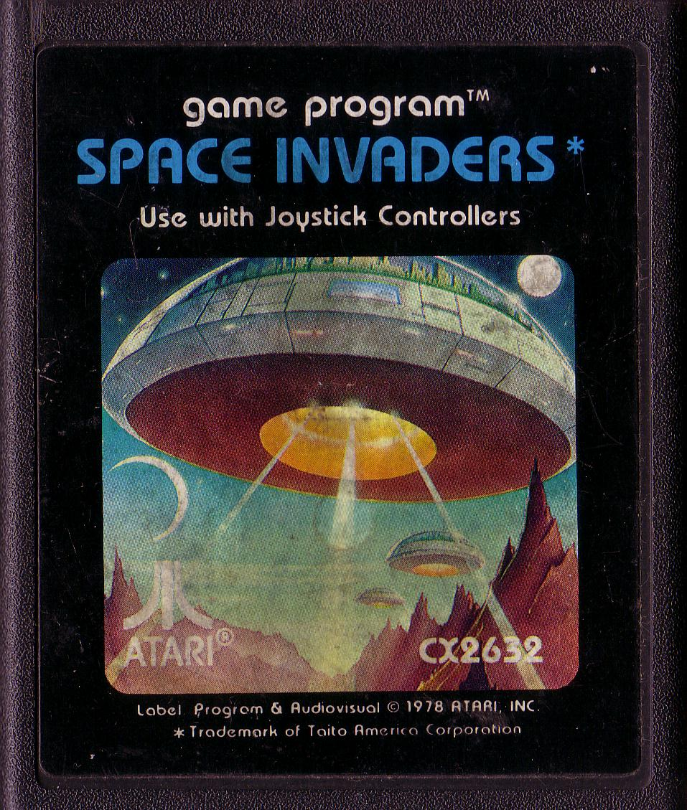
Atari 2600
Sears Video Arcade
1978 - $199
Space Invaders – 1980
Fancy, graphic manuals
Similar controls to arcade
Home gaming revolution
Notes:
Terrible sales at first
Licensing made it take off
Huge breakages reported throughout lifetime. Because stick was so tall, people gripped with fists and tore them out during gaming
Eventually crashed and burned – people thought home video games were over
Manuals to teach about game – explain what the little square is

Slide 34
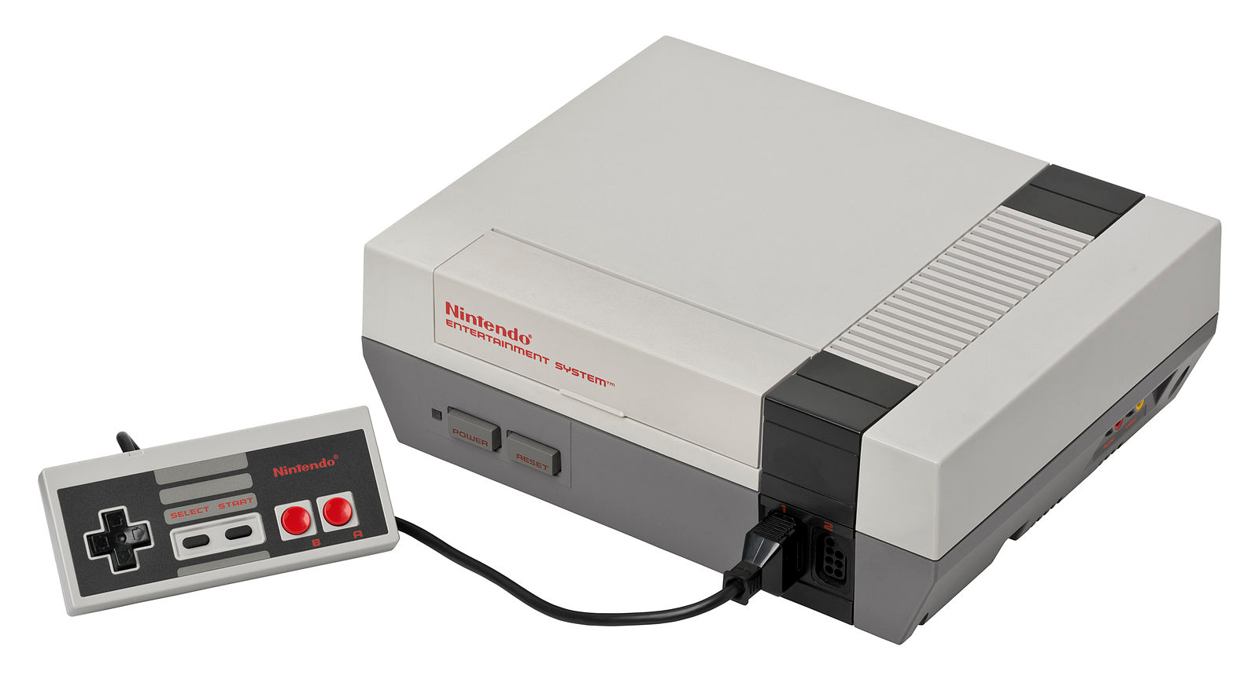
Nintendo Entertainment System
1983 / 1985
Notes:
North American one here - $199
Note that A is on the right, B is on the left – you use A more than B
Got rid of digital joystick, now just use a directional pad
Added concrete control buttons – Start and Select

Slide 35
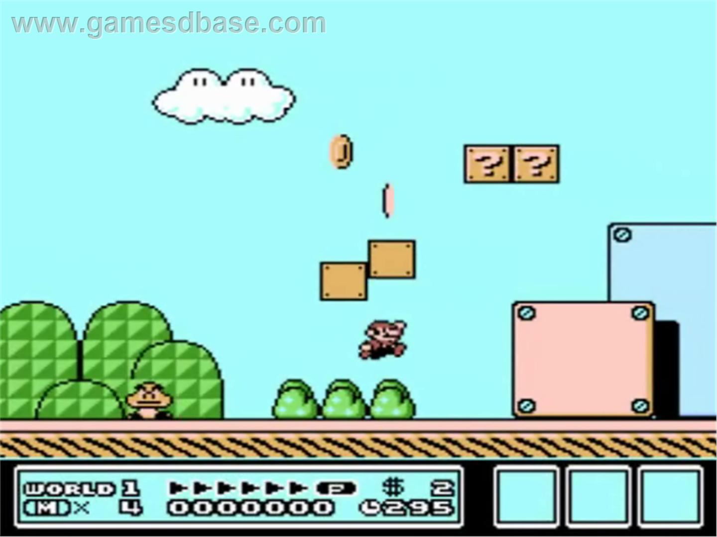
Notes:
Super Mario Brothers 3 – notice the heads up display taking up part of the screen

Slide 36
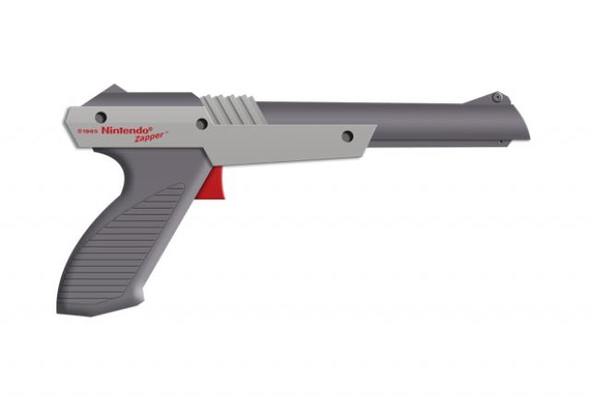
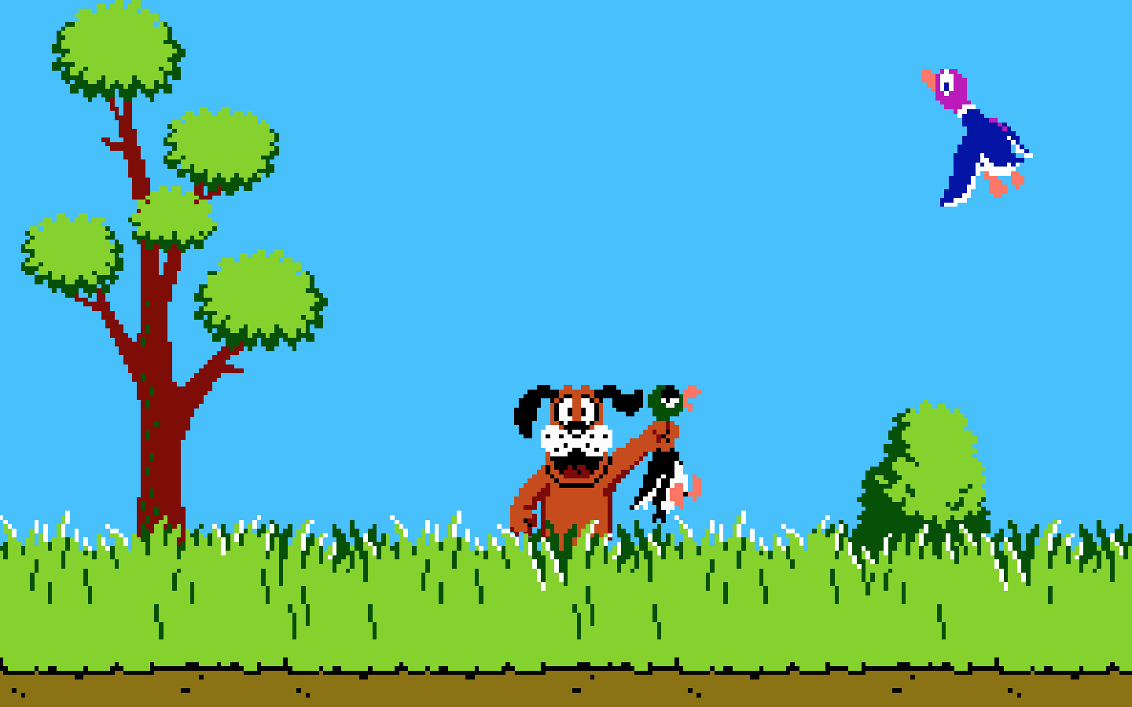
Notes:
A light gun
Oddly enough, duck hunt required a CONTROLLER too to navigate the menus – couldn’t aim and shoot

Slide 37
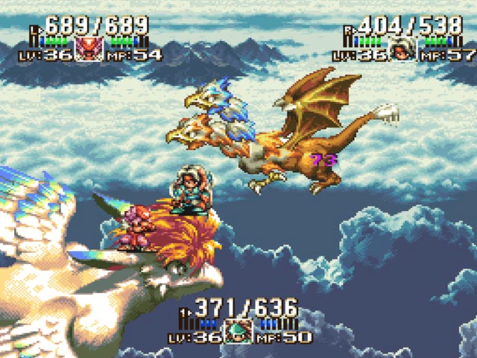
Middle Era
Notes:
Starting in around the 90s, we see fewer arcade game ports, more new franchises and ways of doing things
Arcades died in mid 80s, rise of inexpensive portable machines

Slide 38
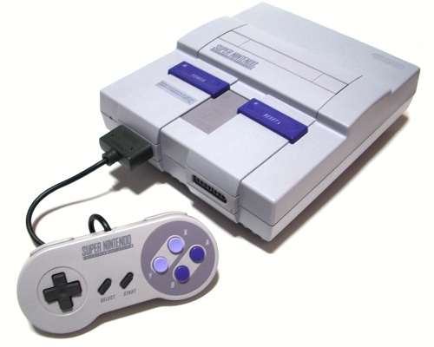
Super Nintendo
1990 / 1991
Notes:
$199

Slide 39
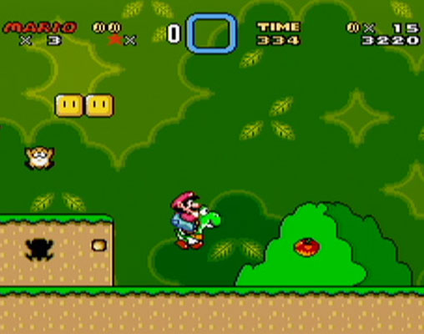
Notes:
Super Mario World – we have four new buttons so Mario can now use them!
Motion parallax, but still not real menus
See some tutorial screens to explain buttons, or levels that require you to use them

Slide 40
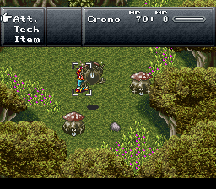
Notes:
Rise of console RPGs – hugely popular on NES with Dragon Quest, but real money-makers now
Chrono Trigger - player doesn’t always directly interact – use menu choices to perform actions, but move directly in the world environment
Emphasizing numbers and quantities for gameplay, character development
Spectrum of action RPG to traditional RPG

Slide 41
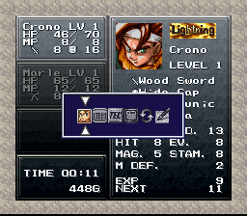
Notes:
Minimal menu hierarchy with icons to indicate different menu functions

Slide 42
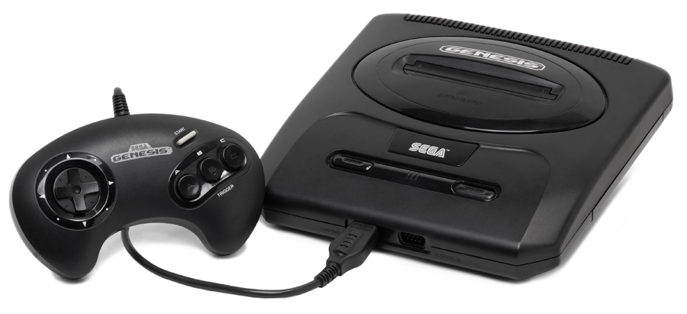
Sega Genesis
1988 / 1989
Notes:
Sega finally got popular with the genesis – clever $189 price
Their answer to Mario: Sonic (though he could do fewer things)

Slide 43
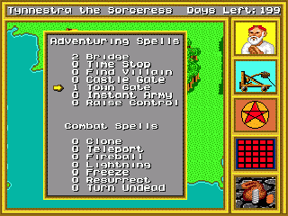
Notes:
King’s Bounty – a strategy game
Genesis relegated to many oddball titles, here is a strategy game that used all three buttons
Complex menu system with 2-3 levels, accept/cancel buttons, pauses game

Slide 44
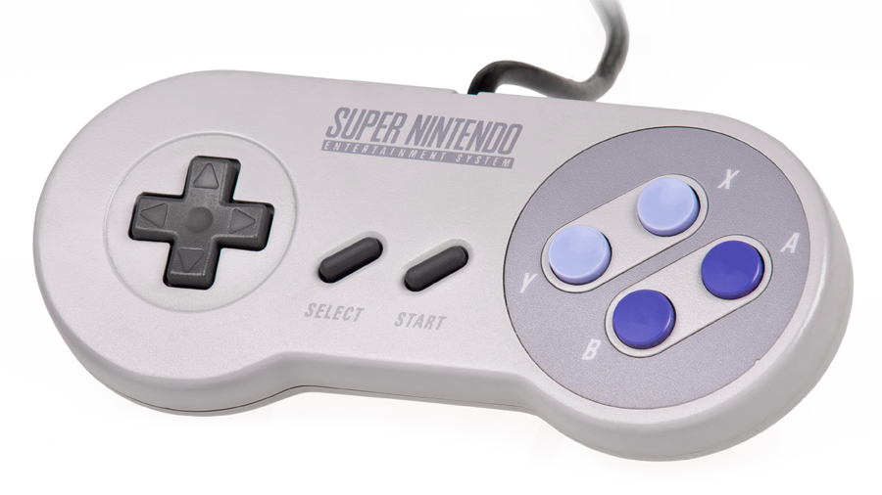
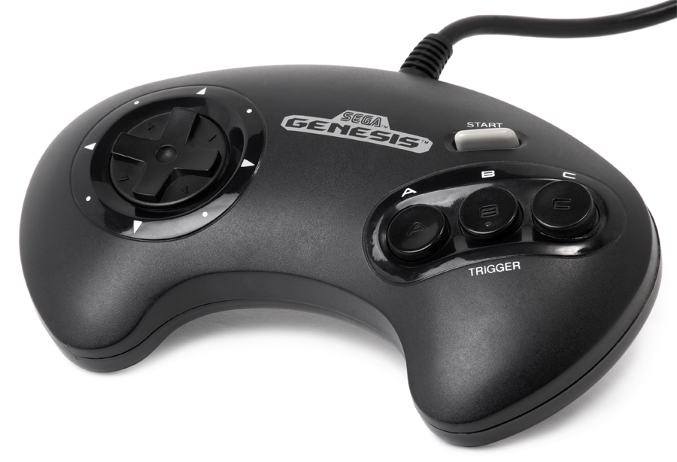
VS
Notes:
Design differences? What would help/hinder gameplay? Anything not likely to be used or hard to use?

Slide 45
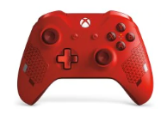
Game Behaviors
How to control everything using buttons and joysticks?
Advanced behaviors using combinations
Press one while holding another
What are some interesting interactions on consoles?

Slide 46
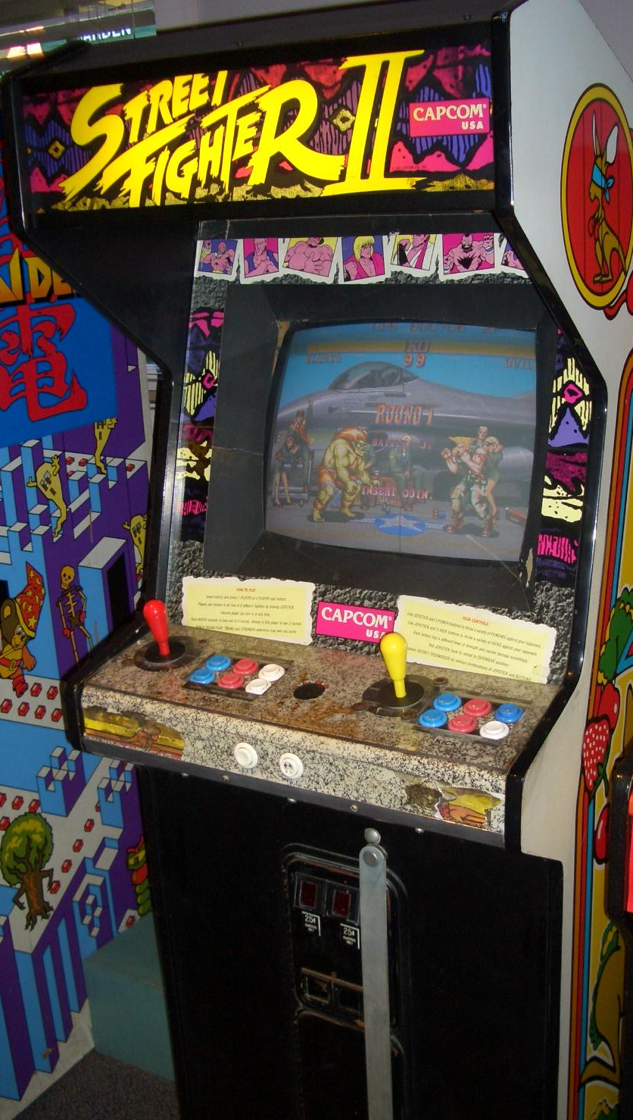
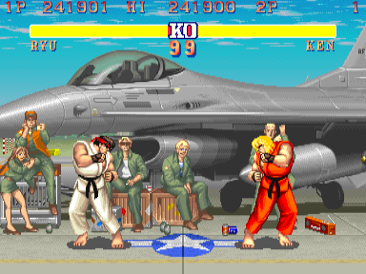
Notes:
What about arcades?
Street Fighter 2 – revolutionized the arcade industry and brought it back
COMPLEX control scheme but very, very low latency
Notice improvements in joystick design, but it’s still digital

Slide 47
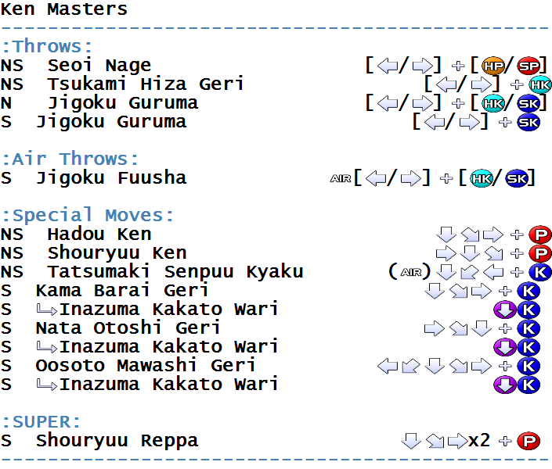
Notes:
Fighting games start to use complex series of key inputs to do powerful actions
Originally pioneered to deal with single button in Atari 2600 – now used to let players become skilled
Low latency helps here

Slide 48
Notes:
Namco Ridge Racer – mid 90s racing game, super big
and Time Crisis – a little bit later, this one has recoil and a cover pedal on the bottom

Slide 49
What about the PC?

Slide 50
Notes:
Kingdom of Kroz 1987 – used only characters to show the level, enemies, etc.
Dungeon navigating game – use arrow keys on computer
No mouse, so uses meta-keys to get to different options and special controls

Slide 51
Notes:
Sam and Max – so-called “Point and Click Adventures” where had to click on things to investigate/talk, drag-and-drop inventory of stored items
Inheritor of the text adventure – now challenge becomes what to press and why

Slide 52
Notes:
Sim City – borrowing even more Windows primitives – now we’ve got a palette menu, drop-downs with keyboard accelerators

Slide 54
YouTube Link
Notes:
DOOM 1993 – uses keyboard controls in first person view with heads-up display
Common traditions of so-called First Person Shooter genre all codified here

Slide 55
Nintendo 64
1996
Notes:
Retail $199
Cartridge games

Slide 56
Sony Playstation
1995
Notes:
Retail $299
Much more powerful hardware compared to N64
Cheaper games

Slide 58
Notes:
What is the extra handle in the middle for?

Slide 61
Notes:
From Swink – note how Mario does not jump at all like he would in the real world

Slide 63
Notes:
Why do you think these appeared on game consoles now? Any interface changes?
It’s the rate-controlled joysticks – they made pointing at least somewhat feasible for aiming a gun in the game and moving around

Slide 64
Meanwhile…

Slide 65
YouTube Link
Notes:
Quake 3 1999 – seminal first person shooter game – now uses the mouse for pointing

Slide 66
Notes:
See the emergence of WSAD as a control scheme standard for all shooters

Slide 67
Notes:
Starcraft 1998 – rise of strategy games. This is an experienced player using many keyboard accelerators. Less experienced players could use prefix/infix tools in the menu bars

Slide 69
Notes:
Playstation 2 2000 - $299

Slide 70
Notes:
Playstation 2 controller – more of the same

Slide 71
Notes:
Gamecube 2001 - $199
Nintendo Gamecube controller – note the drastic changes in response to the N64 controller. Analog triggers

Slide 72
Notes:
Microsoft XBOX 2001 - $299
Basically a 450mhz PC

Slide 73
Notes:
Look at the crazy number of buttons! Ran out of letters, so they use White and Black. Analog triggers

Slide 74
Notes:
Halo Combat Evolved – hugely successful first person shooter on XBOX
Potentially because of the drastically improved rate-limited joystick and graphics

Slide 75
Notes:
Other stuff also came up around this time in controllers
Steel Battalion controller – people pilot giant robots
Lots of other per-game controllers like this

Slide 76
Notes:
Another mild arcade revolution – Dance Dance Revolution dancing game. Arrows fall on the screen, and sole interaction is to step on arrow at the right time
Notice problem of navigating game menu – little hard buttons by railings
Home versions also showed up

Slide 77
Late Era

Slide 78
Notes:
PS3 – November 17, 2006
almost no changes, but now wireless! Has an accelerometer almost no-one uses because it’s awkward
Added a web brower – use joystick for pointing

Slide 79
Notes:
PS4 – November 15 2013
adds a touchpad in the center few things use as a pointing device, but otherwise the same

Slide 81
Notes:
Xbox 360 November 22, 2005
just refines controller. Actually gets rid of white and black in exchange for two more triggers like PS controllers

Slide 82
Notes:
Xbox one November 22, 2013
almost no different

Slide 83
Notes:
Big change is with Nintendo Wii - November 19, 2006
Infrared based, motion tracking. Later added accelerometers. Motion-based control, but rate-limited joystick for some purposes
Trigger underneath the remote to make clicking while pointing easier
TRAINING IS CRUCIAL – tutorial levels

Slide 85
Notes:
Wiimote proved unreliable as a pointing device – see laser pointer paper
As a result the menu is designed around large pointing targets to compensate
Unstability of pointing device

Slide 86
Notes:
Legend of Zelda – Skyward Sword – uses accelerometer to swing sword differently

Slide 87
Notes:
Included steering wheel with Mario Kart Wii racing game
Many older console players preferred to use rate-controlled joystick

Slide 88
Notes:
Nintendo keeps innovating – the Wii U has a massive screen on the controller - November 18, 2012
Here is another Zelda game – now you can select items while you play, or do something else while another person plays

Slide 89
Notes:
Microsoft Kinect also mixes things up a bit – released November 4, 2010

Slide 90
Notes:
Along side with the reduction in button counts, there is a trend towards reducing the amount of buttons needed to play a game
Comic about old game required complex combinations, while a newer game just needs 2 or 3 held down in combination

Slide 91
YouTube Link
Notes:
The player here is just holding down a couple buttons, and the game figures out the rest, making it cinematic.
The main interaction technique is just pointing the character in the proper direction
Tech demo of Assassin Creed 3

Slide 92
Notes:
Also tensions between console games and computer games – the menus in Skyrim
Made easy for consoles, but impossible to navigate on a computer when other means would be much easier

Slide 93
Notes:
But games also innovate and explore
Titanfall plays with different ways to display information to the user in an easy to interpret fashion

Slide 94
Notes:
And of course games also innovate and play with “dead” interaction techniques like pie menus

Slide 95
Phone Games
Controls:
Tilt, swipe, tap
Notes:
Tilt – to move ball around, Doodle Jump, Temple Run, Pappy Jump
Swipe – Temple Run- jump to slide, toilet paper unrolling, fruit ninja (slice fruit), Angry Birds
Tap on menu items – Words with Friends, Sodoco, Candy Crush
“soft joysticks” – center based on initial location –
Pokemon – virtual buttons
Emulators with soft console controls – partially transparent overlap
Whistle –
Constellations – using camera on back
Moves with you by using camera on the front
Tower Defense – shake phone
Nintendo DS – blow on microphone to remove powder – “Ace Attorney”, Guitar Hero
GBA game – photo cell – indoors vs. outdoors

