Slide 1
Lecture 16:
Past to Future: Interactions in 3D, Very Large Displays, and Virtual Reality
Brad Myers
05-440/05-640 :
Interaction Techniques
Spring, 2016

Slide 2
MidTerm Test
Grades
  Average: 85.8

Slide 3
Midterm Test – answers
Question 8 – which scrolling was best in HW3
  Sorted by average time
  Number after label is the number of entries

Slide 4
Midterm Test – answers
Q12 – state transition diagram
Move back up so no longer past threshold : change message back to “pull down to refresh”
Release : remove message
Start
Pulling down
past threshold
Pull down at top of list : display “pull down to refresh
Continue Pulling
Down past threshold : change message to be “release to refresh”
Release : start refreshing, display “refreshing” image
Refreshing
Refresh finished : move list back up
Manipulate list

Slide 5
Final Projects
Start today!
See description on line
Need to figure out groups and project ideas by this Wednesday!
Enter information into Piazza under “project”
I am available to discuss after class or by appointment today and tomorrow.

Slide 6
Lecture 16:
Past to Future: Interactions in 3D, Very Large Displays, and Virtual Reality

Slide 7
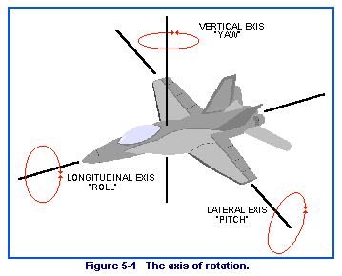
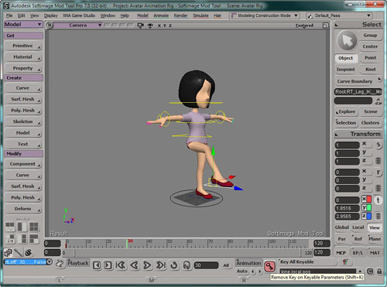
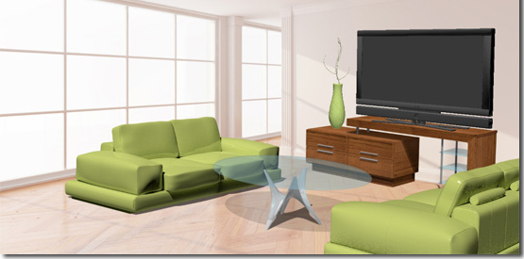
Why is 3D Harder?
Objects have six degrees of freedom (DoF)
  X, Y, Z
  Roll, pitch, yaw
Also camera position
  Occlusion and resolution issues
  Difficulty of orienting oneself
People are not very good at 3D manipulation or reasoning
  Mouse is basically 2D
Generally, dealing with complex, hierarchical objects

Slide 8
Why Hard, cont.
Rick Carey, Tony Fields, Andries van Dam, Dan Venolia. 1994. Why is 3-D interaction so hard and what can we really do about it? (panel). In Proceedings SIGGRAPH '94. ACM, pp. 492-493. http://doi.acm.org/10.1145/192161.192299
3D picking is hard – which object is selected?
  Occlusion, hierarchy, accuracy of pointing device
Designing widgets for 3D manipulation is hard
  Interfere with graphics
  Should they have shadows?
Harder to get interactive speeds for direct manipulation

Slide 9
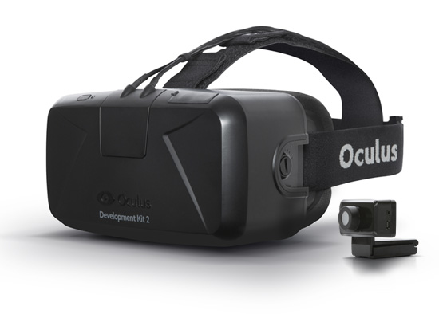

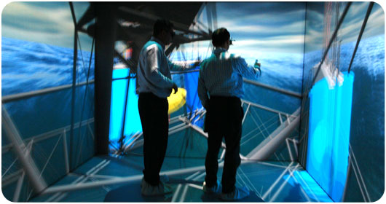
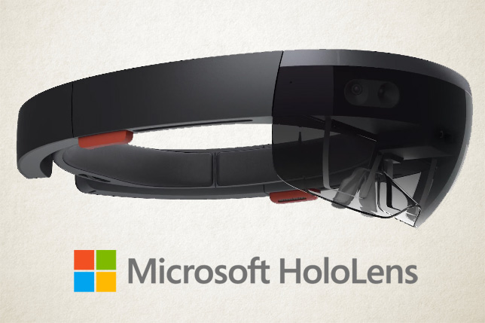
Where 3D displayed?
Desktops – just on a screen in the usual way
3D “Cave” or other large displays (ACM ref)
  Display on one or up to all walls and ceiling
Virtual Reality (VR) or Augmented Reality (AR) headsets
  AR – can see through the display, so
  pictures are superimposed on the view
Examples:
  Google Glass
  Oculus Rift
  Microsoft HoloLens

Slide 10
3D Control
Regular Mouse or touch – 2D
  Possibly with extra knobs or buttons
“Mouse in the air” tracked in 3D = “bat”; 6 DoF
  “bat” translates to fledermaus in German
  (mouse that flies through the air)
Fixed camera tracking object in 3D space
Moving the end of an articulated motorized arm
3D physical objects incorporating the above

Slide 11
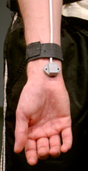
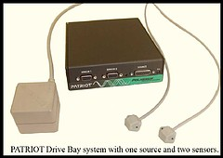
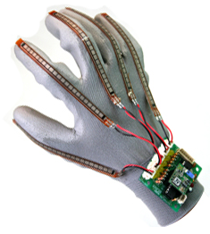
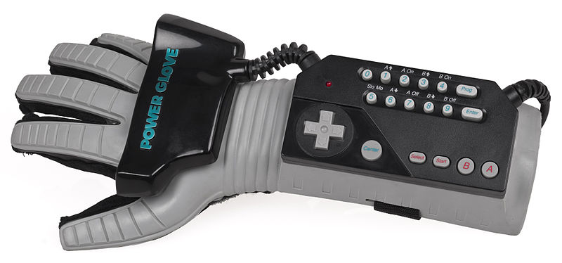
Types of 3D sensors
Earliest: Boxes with sets of knobs
for each dimension
Polhemus trackers (“bat”)
  Starting in 1969
  Magnetic cube on part to be tracked
  and nearby receiver
  6 DOF
  Limited sensing area
  Company still selling similar products
  Often attached to gloves, head-trackers, etc.
DataGlove
  Starting about 1982
  Measured finger bending =
  pose of hand
  Incorporated Polhemus tracker
  on the wrist
Nintendo “PowerGlove” – 1989
  Unsuccessful – only 2 games

Slide 12
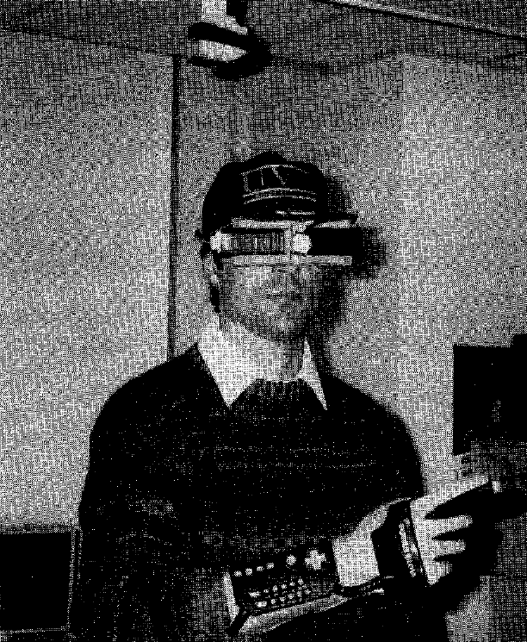
Virtual reality on five dollars a day
Randy Pausch. 1991. Virtual reality on five dollars a day. In Proceedings of the SIGCHI Conference on Human Factors in Computing Systems (CHI '91), ACM, pp. 265-270. http://dl.acm.org/citation.cfm?doid=108844.108913
Combined with inexpensive virtual reality headset

Slide 13
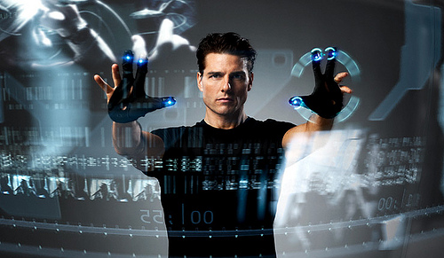
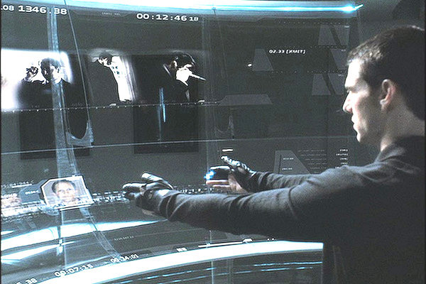
Minority Report, 2002
Using data gloves to interact with large 2-D displays in the air (or on a surface)
MIT Media Lab advised on science (John Underkoffler)

Slide 14
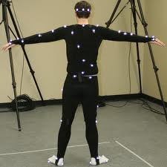
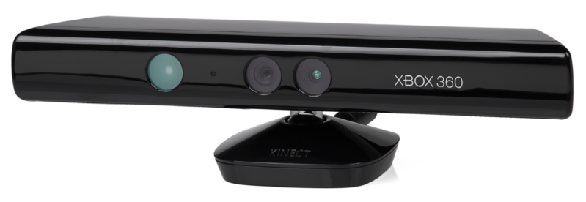
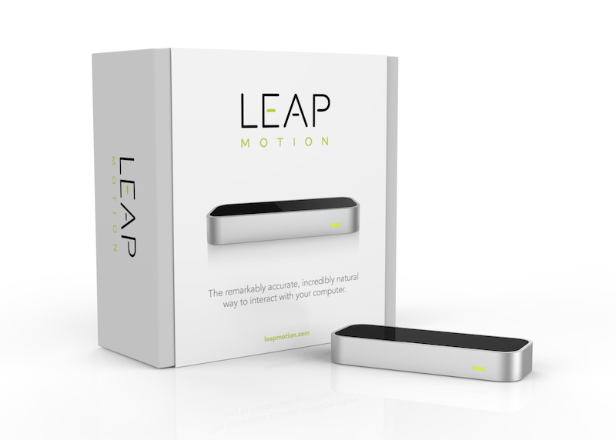
History of 3D sensors, cont.
Lots of motion capture research
and systems
  Motion capture rooms with cameras
  Used for movies, etc.
  (But no interaction techniques)
Kinect
  Introduced 2010
  Two cameras
  Next lecture (w/ game controllers)
Leap Motion
  2013
  Camera based – designed to look
  upwards

Slide 15
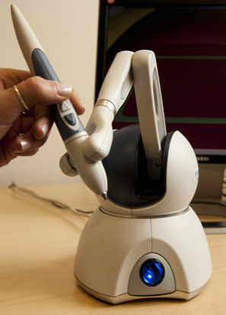
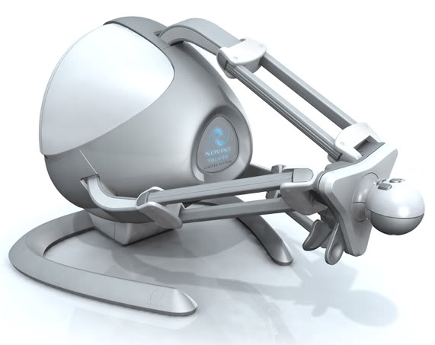
3D “arm” Controllers
Motors to measure 3D movements and provide force feedback
Phantom OMNI from Sensable Technologies
  Medical Applications, etc.
  3D editing and drawing (video)
Falcon from Novint
  Marketed for gaming

Slide 16
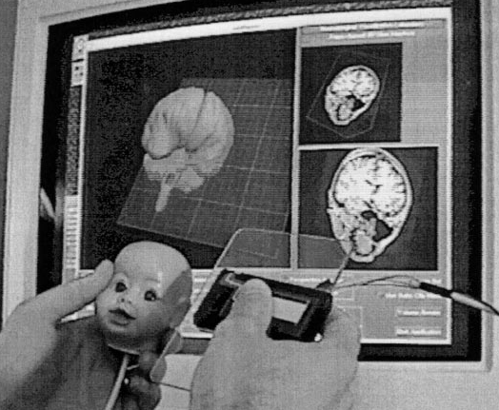
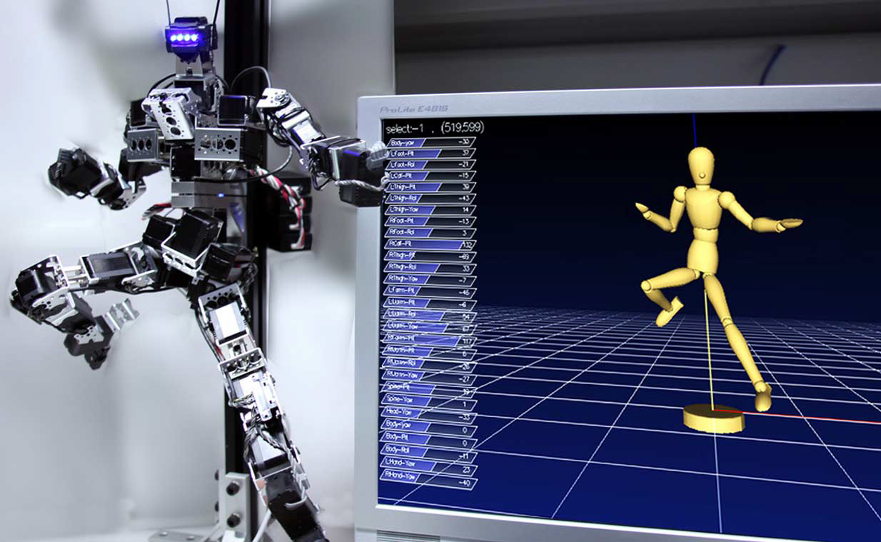
Special-purpose input devices for Manipulation
Head and cutting plane
  Ken Hinckley, Randy Pausch, Dennis Proffitt, and Neal F. Kassell. 1998. Two-handed virtual manipulation. ACM Trans. Comput.-Hum. Interact. 5, 3 (September 1998), 260-302. http://dl.acm.org/citation.cfm?doid=292834.292849
Articulated “marionette”
  Wataru Yoshizaki, et. al. 2011. An actuated physical puppet as an input device for controlling a digital manikin. In Proceedings CHI '11. ACM, pp. 637-646. http://dl.acm.org/citation.cfm?doid=1978942.1979034

Slide 17
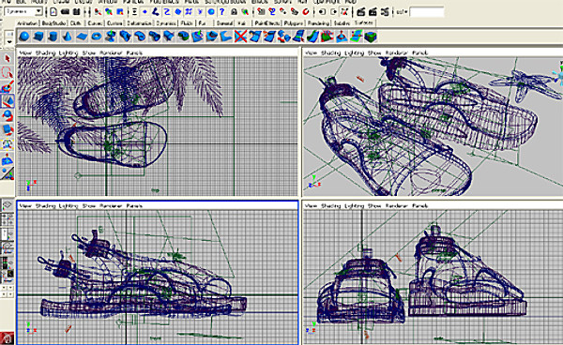
Mouse-Based 3D manipulation
Common 4-panel display
  Mouse works in conventional way in each panel
  Still tricky to manipulate
AutoDesk Maya

Slide 18
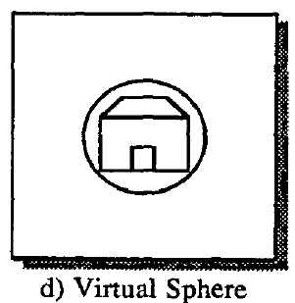
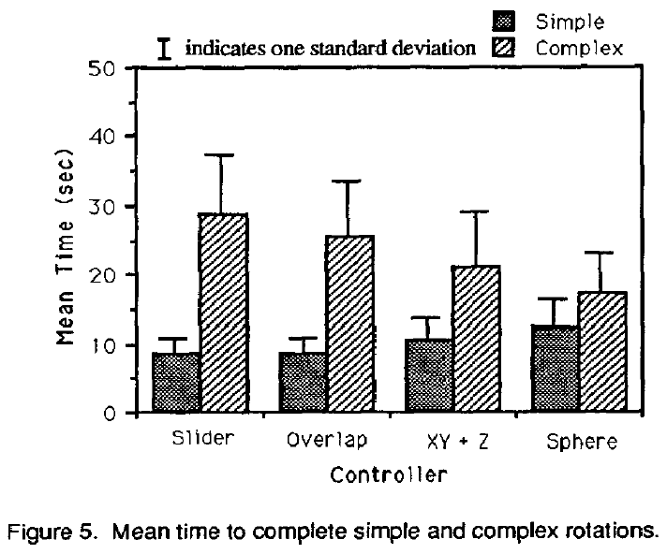
One screen mouse approaches
Michael Chen, S. Joy Mountford, and Abigail Sellen. 1988. A study in interactive 3-D rotation using 2-D control devices. In Proceedings SIGGRAPH '88. ACM pp. 121-129. http://doi.acm.org/10.1145/54852.378497
6D control with 2D mouse
  Sliders for each dimension
  2D areas (2D “sliders”) for each pair of
  dimensions
  Menus – pick axes to
  manipulate first
  Button modifiers – so can
  quickly change
“Virtual Sphere Controller”
for 3D rotation
  Pretend object is in a sphere so
  can rotate around outside

Slide 19

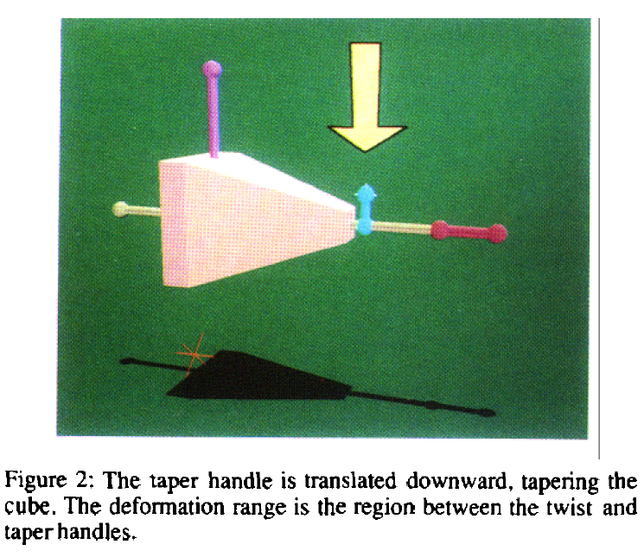
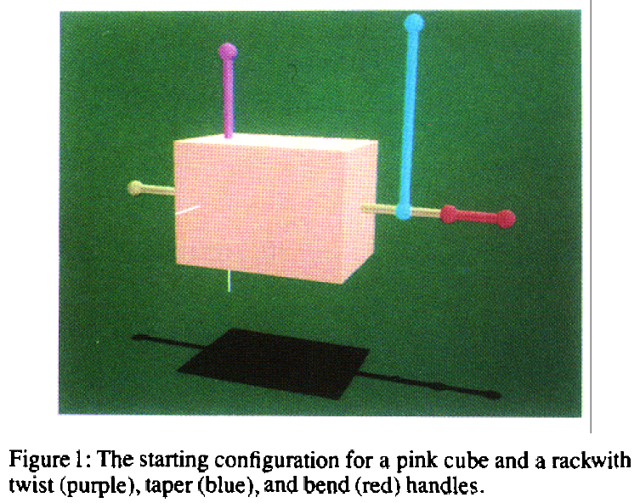
3D Handles
Extend idea of handles on 2D objects to 3D
Need handles for move, stretch, rotate, etc. in each dimension
  Many approaches for doing this. E.g.,
  Scott S. Snibbe, Kenneth P. Herndon, Daniel C. Robbins, D. Brookshire Conner, and Andries van Dam. 1992. Using deformations to explore 3D widget design. In Proceedings SIGGRAPH '92, ACM, pp. 351-352. http://doi.acm.org/10.1145/133994.134091

Slide 20
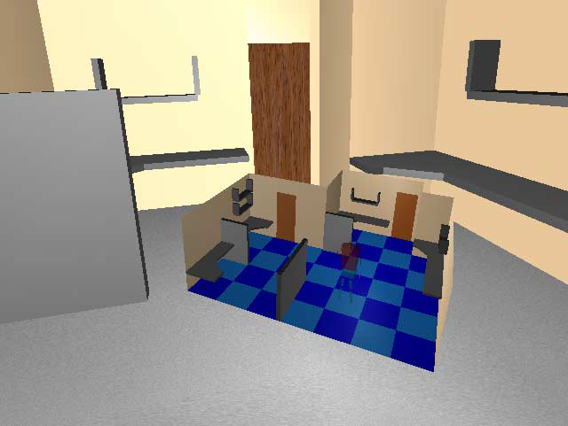
Research: 3D miniatures
Randy Pausch, Tommy Burnette, Dan Brockway, and Michael E. Weiblen. 1995. Navigation and locomotion in virtual worlds via flight into hand-held miniatures. In Proceedings of the 22nd annual conference on Computer graphics and interactive techniques (SIGGRAPH '95), ACM, pp. 399-400. http://dl.acm.org/citation.cfm?doid=218380.218495
Miniature version of the world held in your hand
Can move objects in
miniature version
to edit
Move avatar to
change camera view

Slide 21
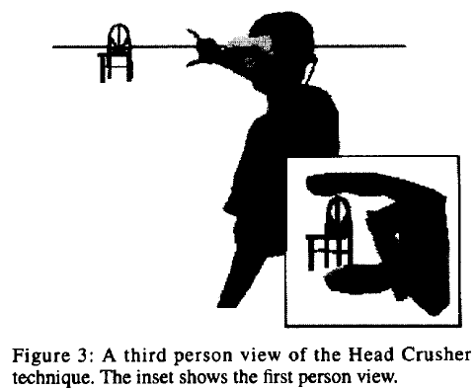
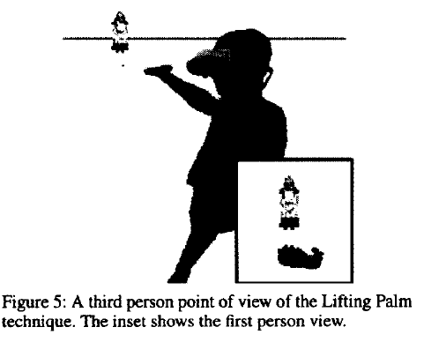
Research: Manipulating Objects
Jeffrey S. Pierce, Andrew S. Forsberg, Matthew J. Conway, Seung Hong, Robert C. Zeleznik, and Mark R. Mine. 1997. Image plane interaction techniques in 3D immersive environments. In Proceedings of the 1997 symposium on Interactive 3D graphics (I3D '97). ACM, 39-ff. http://dl.acm.org/citation.cfm?doid=253284.253303
Head-crusher, lifting palm
Renders hand in the scene, detects pose of hand, detects objects in relation to the pose

Slide 22
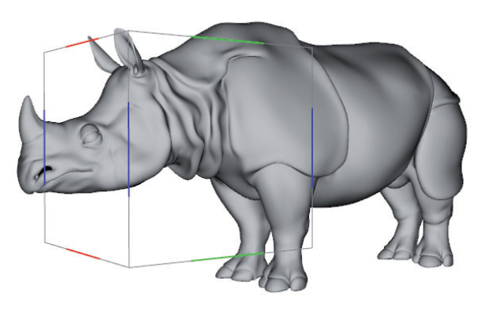
Research: 3D on Touch Screens
Aurélie Cohé, Fabrice Dècle, and Martin Hachet. 2011. tBox: a 3d transformation widget designed for touch-screens. In Proceedings of the SIGCHI Conference on Human Factors in Computing Systems (CHI '11). ACM, pp. 3005-3008. http://dl.acm.org/citation.cfm?doid=1978942.1979387
Surround 3D object with a cube
1 or 2 fingers moving on cube have special meanings
Translate, stretch,
move camera, etc.
Video (4:26) on ACM site

Slide 23
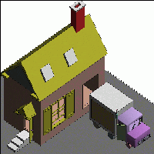
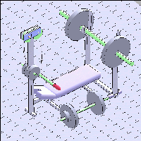
Research: 3D drawing by “Sketching”
Robert C. Zeleznik, Kenneth P. Herndon, and John F. Hughes. 1996. SKETCH: an interface for sketching 3D scenes. In Proceedings of SIGGRAPH '96. ACM, pp.163-170. http://graphics.cs.brown.edu/research/pub/papers/sig96-sketch/sig.html
Only use 1 button to draw (another to move camera)
Constructive Solid Geometry (CSG) = adding and removing pieces of geometric elements
  Cubes, spheres, etc.
Uses heuristics to guess what various drawings mean

Slide 24
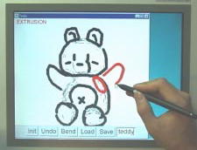
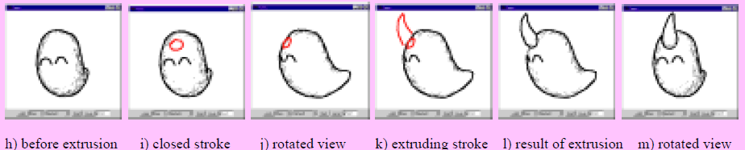
Research: Sketching Soft Objects
Takeo Igarashi, Satoshi Matsuoka, and Hidehiko Tanaka. 1999. Teddy: a sketching interface for 3D freeform design. In Proceedings of SIGGRAPH '99. ACM, pp. 409-416. http://dx.doi.org/10.1145/311535.311602
Smooth sketches turn into
smooth objects
Frequent rotations so can draw
on the image plane
Extrudes or cuts the shape
(YouTube) 5:01min

Slide 25
New Research
Still an active research area. E.g.
  UIST'13:
    Mime: Compact, Low Power 3D Gesture Sensing for Interaction with Head Mounted Displays (ACM DL)
    uTrack: 3D Input Using Two Magnetic Sensors (ACM DL)
    BodyAvatar: Creating Freeform 3D Avatars using First-Person Body Gestures (ACM DL)
  UIST’14
    Interactive Web program with 30 second videos
      Whole session on “Interacting with 3D Data” (Tubes, Planar, Paper3D)
  UIST’15
    SHOCam: A 3D Orbiting Algorithm (ACM DL)
    Joint 5D Pen Input for Light Field Displays (ACM DL) video (5:04)

