Slide 1
Computational Complexity in Economics
Constantinos Daskalakis
EECS, MIT

Slide 2
Computational Complexity in Economics
+ Design of Revenue-Optimal Auctions (part 1)
- Complexity of Nash Equilibrium (part 2)

Slide 3
Computational Complexity in Economics
+ Design of Revenue-Optimal Auctions (part 1)
- Complexity of Nash Equilibrium (part 2)
References: “The Complexity of Computing a Nash Equilibrium.” Communications of the ACM 52(2):89-97, 2009.
http://people.csail.mit.edu/costis/simplified.pdf

Slide 4
Games and Equilibria
1/2
1/2
Kick Dive | Left | Right
Left | 1 , -1 | -1 , 1
Right | -1 , 1 | 1, -1
Equilibrium:
A pair of randomized strategies so that no player has incentive to deviate if the other stays put.
1/2
1/2
Penalty Shot Game
von Neumann ’28: It always exists in two-player zero-sum games.

Slide 5
Games and Equilibria
2/5
3/5
Kick Dive | Left | Right
Left | 2 , -1 | -1 , 1
Right | -1 , 1 | 1, -1
Equilibrium:
A pair of randomized strategies so that no player has incentive to deviate if the other stays put.
1/2
1/2
Nash ’50: An equilibrium exists in every game.

Slide 6
A closer look at 2-Player Zero-Sum Games

Slide 7
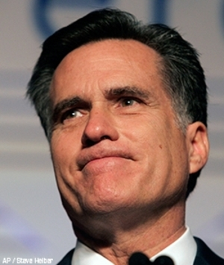
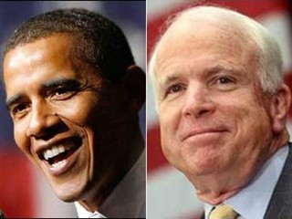
Presidential Elections
 | Morality | Tax Cuts
Economy | +3, -3 | -1, +1
Society | -2, +2 | 1, -1
Suppose Obama announces strategy (1/2,1/2).
What would Romney do?
A: focus on Tax Cuts with probability 1.
indeed against (1/2, 1/2) strategy “Morality” gives expected expected payoff -1/2 while “Tax Cuts” gives 0

Slide 8
Presidential Elections
 | Morality | Tax Cuts
Economy | +3, -3 | -1, +1
Society | -2, +2 | 1, -1
More generally, suppose Obama commits to strategy (x₁, x₂).
N.B.: Committing to a strategy in advance is not a smart thing for Obama to do since Romney may, in principle, exploit it.
How?
E[“Morality”]= - 3x₁+2 x₂
E[“Tax Cuts”]= x₁- x₂
So Romney’s payoff after best responding to (x₁, x₂) would be
max(- 3x₁+2 x₂, x₁- x₂),
resulting in the following payoff for Obama
-max(- 3x₁+2 x₂, x₁- x₂) = min(3x₁-2 x₂, -x₁+ x₂).
So the best strategy for Obama to commit to is:
(x₁, x₂) ∈ argmax min(3x₁-2 x₂, -x₁+x₂)

Slide 9
Presidential Elections
 | Morality | Tax Cuts
Economy | +3, -3 | -1, +1
Society | -2, +2 | 1, -1
So the best strategy for Obama to commit to is:
(x₁, x₂) ∈ argmax min(3x₁-2 x₂, -x₁+x₂)
To compute it Obama writes the following Linear Program:
solution:
z = 1/7,
(x₁, x₂)=(3/7,4/7)
No matter what Romney does Obama can guarantee 1/7 to himself by playing (3/7,4/7)

Slide 10
Presidential Elections
 | Morality | Tax Cuts
Economy | +3, -3 | -1, +1
Society | -2, +2 | 1, -1
Conversely if Romney were forced to commit to a strategy (y₁,y₂) he would solve:
solution:
w = -1/7,
(y₁, y₂)=(2/7,5/7)
No matter what Obama does Romney can guarantee -1/7 to himself by playing (2/7,5/7)

Slide 11
Presidential Elections “Miracle”
No matter what Romney does Obama can guarantee 1/7 to himself by playing (3/7,4/7).
No matter what Obama does Romney can guarantee -1/7 to himself by playing (2/7,5/7).
If Obama plays (3/7,4/7) and Romney plays (2/7,5/7) then none of them can improve their payoff by changing their strategy (because their sum of irrevocable payoffs is 0 and the game is zero-sum).
I.e. (3/7,4/7) is best response to (2/7,5/7) and vice versa.
Hence they jointly comprise a Nash equilibrium!
Why is it a “Miracle”?
Because (3/7,4/7) was computed as a pessimistic strategy for Obama and (2/7,5/7) was computed as a pessimistic strategy for Romney.
Nevertheless these strategies magically comprise a Nash equilibrium!

Slide 12
De-mystifying the “Miracle”
Obama’s LP
Romney’s LP
Why is it that the value of the left LP is equal to minus the value of the right LP?

Slide 13
De-mystifying the “Miracle”
Obama’s LP
Romney’s LP
Why is it that the value of the left LP is equal to minus the value of the right LP?

Slide 14
De-mystifying the “Miracle”
Obama’s LP
Romney’s LP
Why is it that the value of the left LP is equal to the value of the right LP?

Slide 15
De-mystifying the “Miracle”
Obama’s LP
Romney’s LP
Why is it that the value of the left LP is equal to the value of the right LP?
Linear Programming Duality
➔ Left LP is DUAL to Right LP, hence they have equal values!

Slide 16
Moral of the Story
 | Morality | Tax Cuts
Economy | +3, -3 | -1, +1
Society | -2, +2 | 1, -1
Existence of a Nash equilibrium in the Presidential Election game follows from Strong Linear Programming duality.
This proof technique generalizes to any 2-player zero-sum game.
Allows us to efficiently (i.e. in polynomial-time) compute Nash equilibria in these games.

Slide 17
Historical Note
von Neumann’s original proof (1928) used Brouwer’s fixed point theorem.
Together with Danzig in 1947 they realized the above connection to strong LP duality.
von Neumann’s theorem (1928) left open the existence of equilibria in general games.
This was established by Nash in 1950 using Kakutani’s fixed point theorem for correspondences.
In 1951 Nash published a proof using Brouwer’s fixed point theorem.
No proof using Linear Programming, or some simpler (constructive) theorem is known to date. Hence there is also no known efficient algorithm for computing equilibria in general games.

Slide 18
Brouwer’ s Fixed Point Theorem

Slide 19

Brouwer’s Fixed Point Theorem
Theorem: Let f : D D be a continuous function from a convex and compact subset D of the Euclidean space to itself.
Then there exists an x s.t. x = f (x) .
closed and bounded
Below we show a few examples, when D is the 2-dimensional disk.
f
D
D
N.B. All conditions in the statement of the theorem are necessary.

Slide 20
Brouwer’s Fixed Point Theorem
fixed point

Slide 21
Brouwer’s Fixed Point Theorem
fixed point

Slide 22
Brouwer’s Fixed Point Theorem
fixed point

Slide 23
Nash’s Proof

Slide 24
Visualizing Nash’s Proof
Kick Dive | Left | Right
Left | 1 , -1 | -1 , 1
Right | -1 , 1 | 1, -1
ƒ: [0,1]² →[0,1]², continuous
such that
fixed points ≡ Nash eq.
Penalty Shot Game

Slide 25
Visualizing Nash’s Proof
0
Pr[Right]
1
0
Kick Dive | Left | Right
Left | 1 , -1 | -1 , 1
Right | -1 , 1 | 1, -1
Pr[Right]
Penalty Shot Game
1

Slide 26
Visualizing Nash’s Proof
0
Pr[Right]
1
0
Kick Dive | Left | Right
Left | 1 , -1 | -1 , 1
Right | -1 , 1 | 1, -1
Pr[Right]
Penalty Shot Game
1

Slide 27
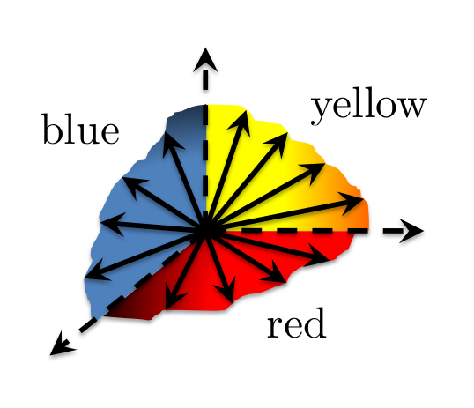
Visualizing Nash’s Proof
0
Pr[Right]
1
0
Kick Dive | Left | Right
Left | 1 , -1 | -1 , 1
Right | -1 , 1 | 1, -1
Pr[Right]
Penalty Shot Game
1

Slide 28
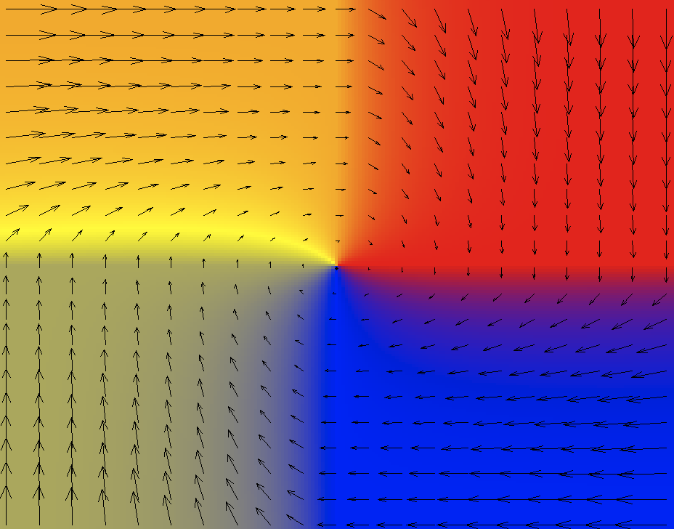
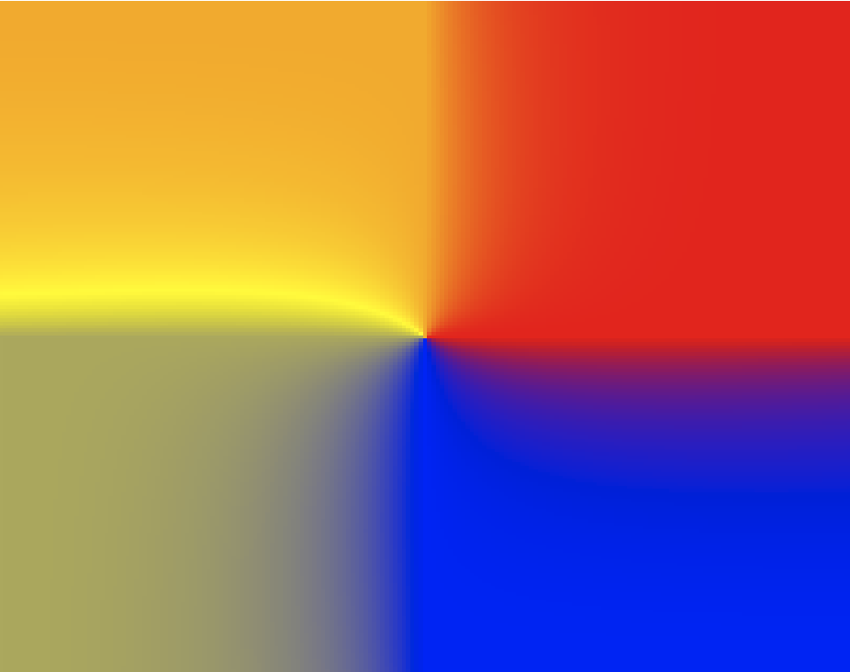
Visualizing Nash’s Proof
0
Pr[Right]
1
½
½
0
Kick Dive | Left | Right
Left | 1 , -1 | -1 , 1
Right | -1 , 1 | 1, -1
ƒ: [0,1]² →[0,1]², cont.
such that
fixed point ≡ Nash eq.
Pr[Right]
½
½
Penalty Shot Game
1
fixed point

Slide 29
Historical Note (cont.)
Intense effort for equilibrium algorithms following Nash’s work:
e.g. Kuhn ’61, Mangasarian ’64, Lemke-Howson ’64, Rosenmüller ’71, Wilson ’71, Scarf ’67, Eaves ’72, Laan-Talman ’79, and others…
Lemke-Howson: simplex-like, works with LCP formulation.
No efficient algorithm is known after 60+ years of research.

Slide 30
“Is it NP-complete to find a Nash equilibrium?”
the Pavlovian reaction

Slide 31
Why should we care about the complexity of equilibria?
First, if we believe our equilibrium theory, efficient algorithms would enable us to make predictions:
In the words of Herbert Scarf…
‘‘[Due to the non-existence of efficient algorithms for computing equilibria], general equilibrium analysis has remained at a level of abstraction and mathematical theoretizing far removed from its ultimate purpose as a method for the evaluation of economic policy.’’
The Computation of Economic Equilibria, 1973
More importantly: If equilibria are supposed to model behavior, computa-tional tractability is an important modeling prerequisite.
“If your laptop can’t find the equilibrium, then how can the market?”
Kamal Jain, eBay
N.B. computational intractability implies the non-existence of efficient dynamics converging to equilibria; how can equilibria be universal, if such dynamics don’t exist?

Slide 32
“Is it NP-complete to find a Nash equilibrium?”
the Pavlovian reaction
two answers
1. probably not, since a solution is guaranteed to exist…
2. it is NP-complete to find a “tiny” bit more info than “just” a Nash equilibrium; e.g., the following are NP-complete:
- find two Nash equilibria, if more than one exist
- find a Nash equilibrium whose third bit is one, if any
[Gilboa, Zemel ’89; Conitzer, Sandholm ’03]

Slide 33
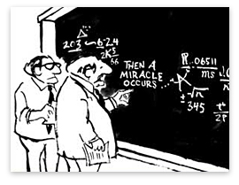
- the theory of NP-completeness does not seem appropriate;
complexity of finding a single equilibrium?
NP-complete
- in fact, NASH seems to lie well within NP;
i.e. is not NP-complete
NP
- making Nash’s theorem constructive…
P
what is the combinatorial nature of the existence argument buried in Nash’s proof?

Slide 34
Today’s menu
Min-Max theorem from Linear Programming
Brouwer ➔ Nash
Nash’s Proof: Reducing it to the bare minimum

Slide 35
The Non-Constructive Step
an easy parity lemma:
  a directed graph with an unbalanced node (a node with indegree ≠ outdegree) must have another.
Notes:
You may ask two questions:
a. what does this have to do with fixed-points and Nash equilibria?
b. how does it shed light to the complexity of computing a Nash equilibrium?

Slide 36
Sperner’s Lemma

Slide 37
Sperner’s Lemma

Slide 38
Sperner’s Lemma
Lemma: No matter how the internal nodes are colored there exists a tri-chromatic triangle. In fact, an odd number of them.

Slide 39
Sperner’s Lemma
Lemma: No matter how the internal nodes are colored there exists a tri-chromatic triangle. In fact, an odd number of them.

Slide 40
Sperner’s Lemma
!
Lemma: No matter how the internal nodes are colored there exists a tri-chromatic triangle. In fact, an odd number of them.

Slide 41
Sperner’s Lemma
Lemma: No matter how the internal nodes are colored there exists a tri-chromatic triangle. In fact, an odd number of them.

Slide 42
Sperner’s Lemma
Lemma: No matter how the internal nodes are colored there exists a tri-chromatic triangle. In fact, an odd number of them.

Slide 43
Sperner’s Lemma
Space of Triangles
Transition Rule:
If ∃ red - yellow door cross it with yellow on your left hand
?
₂
₁
Lemma: No matter how the internal nodes are colored there exists a tri-chromatic triangle.

Slide 44
Sperner’s Lemma
Space of Triangles
Bottom left Triangle
...
Notes:
The mere definition of the transition rule, gave rise to a graph of in-, out- degree at most 1, whose unbalanced nodes (except from the bottom-left triangle) are the sought after solutions!

Slide 45
The PPAD Class [Papadimitriou’94]
The class of all problems with guaranteed solution by dint of the following graph-theoretic lemma
  A directed graph with an unbalanced node (node with indegree ≠ outdegree) must have another.
Such problems are defined by a directed graph G, and an unbalanced node u of G; they require finding another unbalanced node.
e.g. finding a Sperner triangle is in PPAD
But wait a second…given an unbalanced node in a directed graph, why is it not trivial to find another?

Slide 46
The SPERNER problem (precisely)
Consider square of side 2^{n}:
2^{n}
2^{n}
and colors of internal vertices are given by a program:
input: the coordinates of a point
(n bits each)
x
C
y

Slide 47
Solving SPERNER
2^{n}
However, the walk may wonder in the box for a long time, before locating the tri-chromatic triangle. Worst-case: 2^{2n}.
Notes:
Taking n=50, this is larger than the nanoseconds since the birth of the universe!

Slide 48
The PPAD Class
The class of all problems with guaranteed solution by dint of the following graph-theoretic lemma
  A directed graph with an unbalanced node (node with indegree ≠ outdegree) must have another.
Such problems are defined by a directed graph G (huge but implicitly defined), and an unbalanced node u of G; they require finding another unbalanced node.
e.g. SPERNER ∈ PPAD
Where is PPAD located w.r.t. NP?

Slide 49
Today’s menu
Min-Max theorem from Linear Programming
Brouwer ➔ Nash
Nash’s Proof: Reducing it to the bare minimum
Sperner’s Lemma
PPAD
The Complexity of the Nash Equilibrium
Future Directions

Slide 50
(Believed) Location of PPAD
NP-complete
NP
PPAD
P

Slide 51

Problems in PPAD
SPERNER PPAD
[Previous Slides]
BROUWER PPAD
[By Reduction to SPERNER-Scarf ’67]
find an (approximate) fixed point of a continuous function from the unit cube to itself
SPERNER is PPAD-Complete [Papadimitriou ’94]
[for 2D: Chen-Deng ’05]
BROUWER is PPAD-Complete [Papadimitriou ’94]

Slide 52
(Believed) Location of PPAD
NP-complete
NP
PPAD
SPERNER, BROUWER are both PPAD-complete (i.e. as hard as any problem in PPAD)
NASH
P

Slide 53
The Complexity of the Nash Equilibrium
Theorem [Daskalakis, Goldberg, Papadimitriou ’06]:
Finding a Nash equilibrium is PPAD-complete.
Theorem [Chen, Deng ’06]:
… even in 2-player games.
i.e. finding an equilibrium is computationally intractable, exactly as intractable as the class PPAD
in particular, at least as hard as SPERNER, BROUWER
Corollary[CSVY ’06]:
Finding an Arrow-Debreu equilibrium in a market is also PPAD-complete.

Slide 54
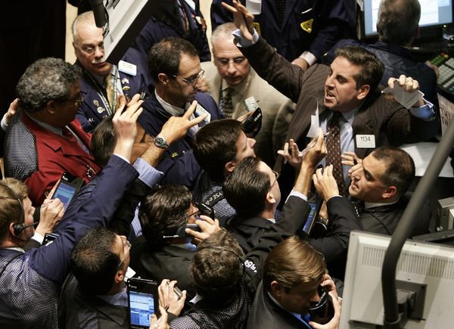
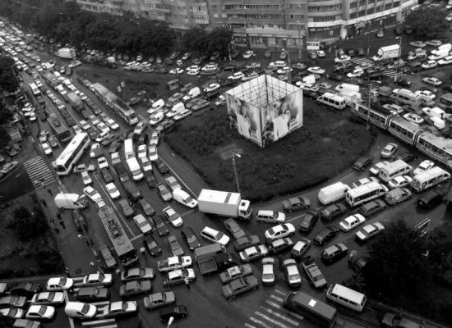
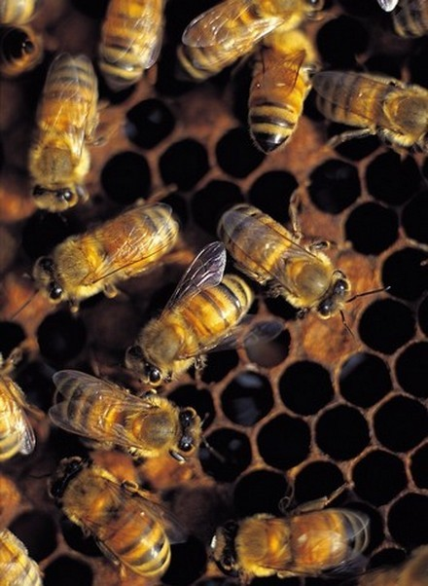
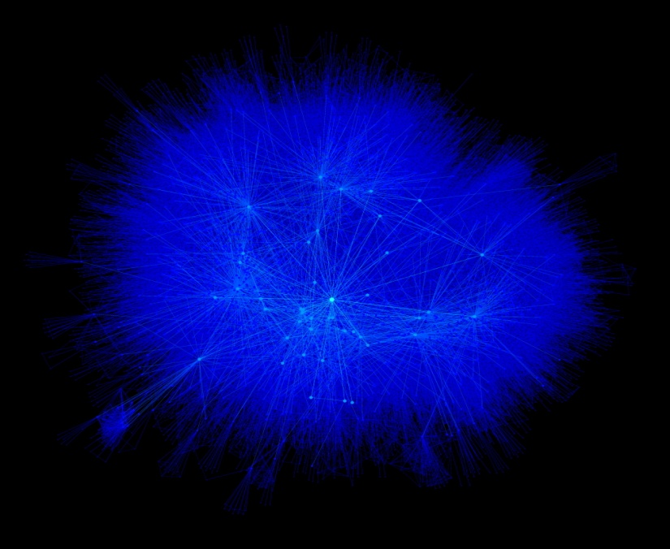
Markets
Traffic
Evolution
Social networks
Notes:
in other words, it is not plausible that large economic systems always converge to a Nash/market equilibrium.

Slide 55
Robert Aumann, 1987:
‘‘Two-player zero-sum games are one of the few areas in game theory, and indeed in the social sciences, where a fairly sharp, unique prediction is made.’’
Indeed equilibria of zero-sum games are efficiently computable, comprise a convex set, can be reached via dynamics efficiently
While outside of zero-sum games equilibria are PPAD-complete, disconnected, and not reachable via dynamics

Slide 56


?
absolutely NOT !

Slide 57
Game Over?
Alternative Solution Concepts with better algorithmic properties
  e.g. correlated equilibrium, axiomatize behavior via dynamics and not equilibria
Complexity of Approximate Nash Equilibria
  if tractable, the computational complexity barrier identified earlier is not relevant;
  unfortunately, approximate equilibria is not an avenue that looks fruitful (see Daskalakis, “The Complexity of Approximating a Nash equilibrium”)
Identify families of games with tractable equilibria (e.g. zero-sum)
  if your game is a good one, then equilibrium predictions are reliable
Mechanism Design:
  Design systems with an extra objective in mind: tractability of equilibria

Slide 58
A tractable class of games

Slide 59








Network Games
…
- Players are nodes of arbitrary given network G.
- Every edge is 2-player game between its endpoints.
- Every node choses a strategy and sums her derived utility from all edges adjacent to her.
…
e.g. Nodes are firms, making strategic decisions about their products; then they compete in various duopolies.
N.B. Finding a Nash equilibrium is an intractable problem.
but what if the total sum of players’ payoffs is always 0?

Slide 60
Zero-sum Network Games
Theorem [Daskalakis-Papadimitriou ’09, Cai-Daskalakis’11]
In a zero-sum network game:
- a Nash equilibrium can be found efficiently with linear-programming;
- the Nash equilibria comprise a convex set;
- if every node uses a no-regret learning algorithm to respond to stimuli, the players’ behavior converges to Nash equilibrium.
i.e. payoffs approach equilibrium payoffs, and empirical strategies approach Nash equilibrium
“no-regret learning”: very common dynamics, well-studied in online optimization (i.e. optimization of a function that is revealed piece-by-piece); e.g. multiplicative-weights updates method/hedging
Resolves model of Bergman-Fokin from the 1970’s.
Notes:
above theorem gives strong indication that Nash eq. makes sense in this setting.
essentially this is the broadest class of zero-sum games we could hope to solve (beyond pairwise separable utilities it is easy to construct PPAD-hard instances)

Slide 61
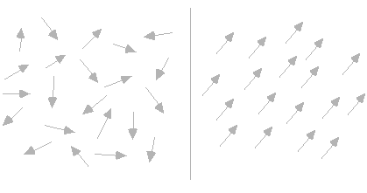
Some Future directions
More Classes of Games with tractable equilibria.
Games with large populations and symmetries
e.g. anonymous games: players are oblivious to identities of others
can solve these games by developing new kinds of CLTs (proper CLTs)
[with Papadimitriou ’07, ’08, ’09]
Long-Range Correlation of Behavior : how does players’ behavior across large distances in a network correlate?
Statistical physics
High temperature
Low temperature

Slide 62
Thanks for your attention
Questions?

Slide 63
Supplementary Material

Slide 64
Nash’s Function

Slide 65
Nash’s Function f
set of mixed strategy profiles, i.e. the Cartesian product of the simplices from which players choose mixed strategies
probability with which player p plays pure strategy s_{p}
where:
f is continuous, so by Brouwer’s theorem it has a fixed point. It can be shown that the fixed point is a Nash equilibrium.

Slide 66
Proof of Brouwer’s Fixed Point Theorem
We show that Sperner’s Lemma implies Brouwer’s Fixed Point Theorem in 2 dimensions. The construction generalizes to any dimension.

Slide 67
2D-Brouwer on the Square
Suppose ƒ: [0,1]² →[0,1]², continuous
must be uniformly continuous (by the Heine-Cantor theorem)
1
0
0
1

Slide 68
2D-Brouwer on the Square
Suppose ƒ: [0,1]² →[0,1]², continuous
must be uniformly continuous (by the Heine-Cantor theorem)
1
choose some and
triangulate so that the diameter of cells is
0
0
1

Slide 69
2D-Brouwer on the Square
Suppose ƒ: [0,1]² →[0,1]², continuous
must be uniformly continuous (by the Heine-Cantor theorem)
color the nodes of the triangulation according to the direction of
1
choose some and
triangulate so that the diameter of cells is
0
0
1

Slide 70
2D-Brouwer on the Square
Suppose ƒ: [0,1]² →[0,1]², continuous
must be uniformly continuous (by the Heine-Cantor theorem)
color the nodes of the triangulation according to the direction of
1
choose some and
triangulate so that the diameter of cells is
tie-break at the boundary angles, so that the resulting coloring respects the boundary conditions required by Sperner’s lemma
find a trichromatic triangle, guaranteed by Sperner
0
0
1

Slide 71
2D-Brouwer on the Square
Suppose ƒ: [0,1]² →[0,1]², continuous
must be uniformly continuous (by the Heine-Cantor theorem)
1
Claim: If z^{Y} is the yellow corner of a trichromatic triangle, then
0
0
1

Slide 72
Proof of Claim
Claim: If z^{Y} is the yellow corner of a trichromatic triangle, then
Proof: Let z^{Y}, z^{R} , z^{B} be the yellow/red/blue corners of a trichromatic triangle.
By the definition of the coloring, observe that the product of
Hence:
1
Similarly, we can show:
0
0
1

Slide 73
2D-Brouwer on the Square
Suppose ƒ: [0,1]² →[0,1]², continuous
must be uniformly continuous (by the Heine-Cantor theorem)
1
Claim: If z^{Y} is the yellow corner of a trichromatic triangle, then
Choosing
0
0
1

Slide 74
2D-Brouwer on the Square
Finishing the proof of Brouwer’s Theorem:
- pick a sequence of epsilons:
- define a sequence of triangulations of diameter:
- pick a trichromatic triangle in each triangulation, and call its yellow corner
- by compactness, this sequence has a converging subsequence
with limit point
Claim:
Proof:
Define the function . Clearly, is continuous since is continuous and so is . It follows from continuity that
But . Hence, . It follows that .
Therefore,

Slide 75
Showing that NASH is PPAD-hard

Slide 76
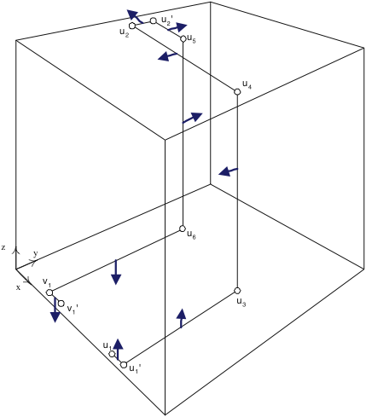
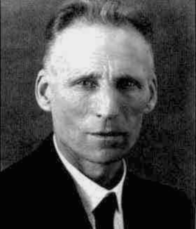
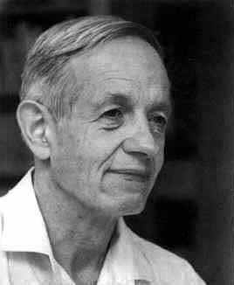
PPAD-hardness of NASH
[DGP ’05] = Daskalakis-Goldberg-Papadimitriou
[Pap ’94]
[DGP ’05]
0^{n}
Embedded PPAD
...
Generic PPAD
[DGP ’05]
4-player
NASH
[DGP ’05]
[DP ’05]
3-player
NASH
[DGP ’05]
[DGP ’05]
[CD’05]
[CD’05]
2-player
NASH
p.w. linear
BROUWER
multi-player
NASH
SPERNER
Notes:
[DGP ’05] = Daskalakis-Goldberg-Papadimitriou
[DGP ’05] = Daskalakis-Goldberg-Papadimitriou
[DGP ’05] = Daskalakis-Papadimitriou
[CD’05] = Chen-Deng

