Slide 1
Computational Complexity in Economics
Constantinos Daskalakis
EECS, MIT

Slide 2

Computational Complexity in Economics
+ Design of Revenue-Optimal Auctions (part 1)
- Complexity of Nash Equilibrium (part 2)

Slide 3
Computational Complexity in Economics
+ Design of Revenue-Optimal Auctions (part 1)
- Complexity of Nash Equilibrium (part 2)
References: http://arxiv.org/abs/1207.5518

Slide 4
Today’s menu
General Auction Setting
Background: welfare vs revenue optimization
Algorithmic Mechanism Design Challenges
-Focus: Revenue Optimization in Multi-item Settings
The algorithmics of reduced forms
Revenue maximization via reduced forms

Slide 5
Today’s menu
General Auction Setting
Background: welfare vs revenue optimization
Algorithmic Mechanism Design Challenges
-Focus: Revenue Optimization in Multi-item Settings
The algorithmics of reduced forms
Revenue maximization via reduced forms

Slide 6






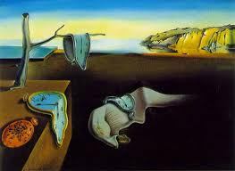

A General Auction Setting
revenue/social welfare/other objective
1
1
…
…
j
i
natural description complexity
…
…
m
n
Bidders have values on items and bundles of items.
Bidder’s valuation (aka type) encodes that information.
Bidders’ types (t₁,…,t_{m}) come from some known product distribution .
Bidder’s utility is quasi-linear in payment with a public budget:
    u_{i}(S) = v_{i}(S) – p_{i}(S), if p_{i}(S) ≤ B_{i} ; -∞ otherwise
Auctioneer needs to decide some allocation A ⊆ [m] x [n], and charge prices.
There are (possibly combinatorial) constraints on what allocations are allowed.
Some set system contains the feasible allocations.
  Could be a matching, some more general downwards-closed set-system, or not.

Slide 7
Example 1: selling paintings
1
1
…
…
j
i
…
…
m
n
Items are paintings.
No painting should be given to more than one bidder

Slide 8
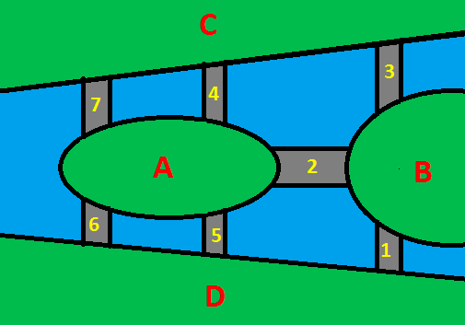
Example 2: where to build a bridge
1
…
i
…
m
Items are possible locations for building a bridge L = {l₁, l₂, …,l_{n}}.
If a location is given to one bidder, it is given to all bidders (as every bidder will use a bridge if it is built).
i.e.

Slide 9
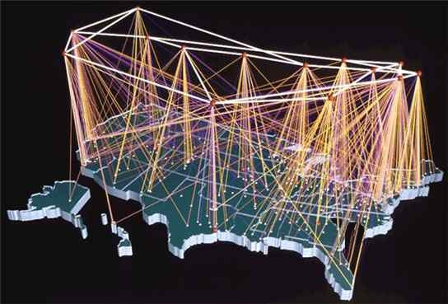
Example 3: selling paths on a network
1
…
i
…
m
Items are edges of a graph G = (V, E).
Each bidder i has some source-destination pair (s_{i}, t_{i}), and needs a path from s_{i} to t_{i}, or nothing.
No edge can be allocated to more than one bidder.
F = “No edge is given to more than one bidder” + “A bidder gets a path or nothing”

Slide 10



Auction in Action
1
1
expected welfare:
…
…
Auctioneer:
outcome in chosen
by mechanism
j
Commits to an auction design, specifying possible bidder behaviors, the allocation and the price rule;
Asks bidders to “play auction”;
Implements the allocation and price rule specified by the auction;
Goal: Optimize revenue/welfare.
i
…
…
over bidders’ types t₁, …, t_{m}, the randomness in the mechanism, and the bidders’ strategic behavior
m
n
expected revenue:
Each Bidder:
Uses as input: the auction specification, her own type, and her beliefs about the types of the other bidders;
Plays auction;
Goal: optimize her own utility.
payment made by bidder i to the auctioneer
over bidders’ types t₁, …, t_{m}, the randomness in the mechanism, and the bidders’ strategic behavior

Slide 11

Simplifications (1/2)
Focus on Direct Revelation Mechanisms (wlog)
  huge universe of possible auctions: what bidders can do, and how to allocate items and charge bidders when they do it
  The direct revelation principle: “Any auction has an equivalent one where the bidders are only asked to report their type to the auctioneer, and it is best for them to truthfully report it. Such mechanisms are called direct-revelation.”
  equivalent ?
    point-wise w.r.t. : the two auctions result in the same allocation, the same payments, and the same bidder utilities
  upshot:
    mechanism design reduces to computing two functions:
    subject to extra constraints: truthfulness
    exercise: Write down huge LP that finds revenue- or welfare- optimal auction.
    hint: keep variables for A, P ; obj. function, truthfulness constraints are linear
downside: laundry-list auction

Slide 12

Simplifications (2/2)
Focus on Additive Combinatorial Bidders
  agent’s type needs to specify how he values every subset of items
  n items  2^{n} values  intractable communication complexity
  a tractable model: an additive combinatorial bidder is defined by
    a (private) vector of values for the items:
    a (public) set of constraints .
    bidder’s valuation:
  such bidders can communicate their type to the auctioneer tractably
  N.B. all unit-demand bidders are additive
  exercise: All settings can be reduced to unit-demand additive (albeit not necessarily computationally efficiently). hint: introduce meta-items
  henceforth incorporates constraints of auctioneer and bidders

Slide 13



Truthfulness (additive bidders)
mechanism specified via ex-post allocation probabilities:
Bayesian Incentive Compatibility (BIC)
  for all i , and types :
Incentive Compatibility (IC)
  ditto, but point-wise w.r.t.
  (i.e. without expectation over ; just the randomness in the mechanism)
: probability (over randomness in mechanism) that item j is allocated to bidder i when the reported types by bidders are
: expected price that bidder i pays when reports are
Notes:
\mathbb{E}_{\vec{v}_{-i}}\left[ \sum_j \phi_{ij}(\vec{v}) \cdot v_{ij} - p_i(\vec{v}) \right] \ge \mathbb{E}_{\vec{v}_{-i}}\left[ \sum_j \phi_{ij}(\vec{v}_i'~;~\vec{v}_{-i}) \cdot v_{ij} - p_i(\vec{v}_i'~;~\vec{v}_{-i}) \right]

Slide 14
Today’s menu
General Auction Setting
Background: welfare vs revenue optimization
Algorithmic Mechanism Design Challenges
-Focus: Revenue Optimization in Multi-item Settings
The algorithmics of reduced forms
Revenue maximization via reduced forms

Slide 15

Welfare-Optimization
[Vickrey-Clarke-Groves]: Mechanism design for welfare-optimization is no harder than algorithm design for welfare-optimization.
The VCG auction as a computationally tractable reduction from mechanism to algorithm design:
  bidders are asked to report their types: t₁, t₂,…, t_{m} ;
  the mechanism chooses the allocation ;
    this is a call to a welfare optimization algorithm
  bidders are charged so that they report their true types.
    truthfulness-inducing payments can be computed via calls to a welfare optimization algorithm (e.g. Clarke pivot payments)
Corollary: The only bottleneck to tractable welfare-optimizing mechanisms is whether there is a computationally efficient algorithm for the underlying welfare optimization problem.
N.B. The VCG auction does not require a prior over types
  welfare optimization is achieved point-wise, and it is DST

Slide 16
Welfare and Approximation
Corollary: The only bottleneck to tractable welfare-optimizing mechanisms is whether there is a computationally efficient algorithm for the underlying welfare optimization problem.
Suppose that the underlying welfare-optimization problem is intractable, but it can be tractably approximated to within a factor of a .
Question: Does there exists a tractable, a-approximately optimal auction?
Two answers have been provided:
  Long line of research, e.g.,
  [Lavi-Swamy’05, Papadimitriou-Schapira-Singer’08, Dobzinski-Dughmi’09, BDFKMPSSU’10, Dughmi-Roughgarden’10, Dobzinski ’11, Dughmi-Roughgarden-Yan’11, Dughmi’11, Dughmi-Vondrak’11, Dobzinski-Vondrak’12]
  concludes with a negative answer to the question, if there is no prior over bidders’ types (so we’re shooting for IC mechanisms).
  [Hartline-Lucier’10, Hartline-Kleinberg-Malekian’11,Bei-Huang’11]:
  “In Bayesian settings, an a-approximation algorithm for welfare can be converted to an a-approximately optimal, BIC mechanism for welfare.”

Slide 17


Revenue-Optimization
[Myerson ’81]: In all single-item (and single multi-unit item) settings, mechanism design for revenue optimization reduces to algorithm design for welfare optimization.
Myerson’s auction as a reduction:
  bidders are asked to report their types ;
  reported types are transformed to virtual-types ;
  the virtual-welfare maximizing allocation is chosen;
    this is a call to a welfare optimization algorithm
  and prices are charged to make sure bidders report truthfully.
    truthfulness-inducing payments can be computed via calls to a welfare optimization algorithm
Corollary: If the underlying welfare-maximization problem is tractable, then so is the revenue-optimal auction.
Unanswered:
  Beyond single-item settings? Robustness to approximation?

Slide 18
Beyond Myerson
Large body of work in Economics, see [Vincent-Manelli ’07].
  Progress sporadic.
Recently (2007-present), algorithmic tools enabled progress.
  constant-factor approximations;
  exact solutions;
  still very limited settings; ad-hoc techniques.

Slide 19
Constant-Factor
all single-dimensional settings
[Myerson ’81]
one unit-demand bidder, ind. items
[Chawla-Hartline-Kleinberg ’07]
Exact
36 years
many unit-demand bidders, ind items,
matroid constraint on who is served
[Chawla-Hartline-Malec-Sivan’10]
[Kleinberg-Weinberg ’12]
In all these results:
bidders are capacitated additive
feasibility constraints are matroids or matroid-intersections
additive bidders w/ capacities and
budgets [Bhattacharya et al’10]
one unit-demand bidder, ind items [Cai-D ’11]
many-to-one reduction [Alaei’11]
constant number of additive bidders w/ capacities and budgets, symmetric item-distributions [D-Weinberg ’12]
constant number of additive bidders, ind MHR items [Cai-Huang ’12]
additive bidders, correlated items [Cai-D-Weinberg ’12]
“service constrained environment” i.e. k-units of same item w/ customization, unit-demand bidders, matroid constraints on who is served [Alaei et al ’12]
time

Slide 20
Main Challenges
Revenue optimization in general multi-item settings.
  ideally: unified solution for all settings, instead of ad-hoc techniques for individual settings
Optimization of other objectives in multi- or even single-item settings.
  e.g. minimizing makespan in scheduling auctions
Robustness of solutions to approximation, complexity.

Slide 21
Today’s menu
General Auction Setting
Background: welfare vs revenue optimization
Algorithmic Mechanism Design Challenges
-Focus: Revenue Optimization in Multi-item Settings
The algorithmics of reduced forms
Revenue maximization via reduced forms

Slide 22
Today’s menu
General Auction Setting
Background: welfare vs revenue optimization
Algorithmic Mechanism Design Challenges
-Focus: Revenue Optimization in Multi-item Settings
The algorithmics of reduced forms
Revenue maximization via reduced forms

Slide 23




The Reduced Form of a Mechanism
a.k.a. the interim allocation probabilities :
description size: ;
c.f. description complexity of ex-post allocation probabilities
feasibility hard to check:
  Can the per-bidder marginal probabilities be reconciled?
  …in a way that also respects the feasibility constraints given by ?
  i.e. when can interim probabilities be converted to a feasible mechanism?
: probability that item j is allocated to bidder i if his type is t_{i} in expectation over the other bidders’ types, and the randomness in the mechanism
Notes:
N.B. given feasible interim allocation probabilities, an additive bidder can compute her expected value

Slide 24
Feasibility of Reduced Forms (example)
easy setting: single item, two bidders with types uniformly distributed in T₁={A, B} and T₂={C, D} respectively
feasibility constraints = item cannot be given to more than one bidder
Question: Are the following interim allocation probabilities feasible?
½
A
C
½
bidder 1
so infeasible !
bidder 2
½
B
D
½
whenever types are A, C: A needs to get item
type A satiated
whenever types are A, D: A needs to get item
whenever types are B, C: C needs to get item
type C satiated
whenever types are B, D:
B needs to get item with prob. 0.4 and D needs to get item with prob. 0.8

Slide 25

Feasibility of Single-Item Reduced Forms
a necessary condition for single-item auctions:
: probability that bidder i’s type is t_{i} , and i gets item
( fix arbitrary )
: probability that bidder i’s type is in set S_{i} , and i gets item
: probability that the item goes to a bidder i whose type
is in S_{i}
: probability that some bidder i’s type is in S_{i}

Slide 26



Feasibility of Single-Item Reduced Forms
a necessary condition for single-item auctions:
Exercise: Argue that Border’s follows from the max-flow min-cut theorem.
Hint: Consider flow network with source node s, sink node t, and a bipartite graph with node set on one side and on the other in between s and t. Design edge capacities carefully.
Issue: Need to check linear constraints
  can be improved to (by arguing that some constraints can be dropped)
  still algorithmically non-useful
  why?
(*)
[Border ’91, Border ’07, Che-Kim-Mierendorff ’11]:
(*) is also a sufficient condition for feasibility.

Slide 27






Trivial Feasibility-LP
Input: - the given single-item reduced form
LP
Variables: - the ex-post allocation probabilities
Feasibility Constraints:
    the expected number of bidders receiving an item is at most 1
    the given reduced form corresponds to the ex-post allocation probabilites
- variables and constraints

Slide 28





Feasibility of Single-Item Reduced Forms
Question:
Answer to 1: Recall Border’s conditions-
1. can the Border conditions be reduced to a tractable number?
2. given a feasible single-item reduced form, is there a succinct description of a mechanism with that reduced form?
[Cai-Daskalakis-Weinberg’12]: - Assume T₁,…,T_{m} disjoint (wlog).
- Define normalized interim probability of a type as:
Order the types in in decreasing order of .
Then is feasible iff Border’s inequalities hold for all S₁,…,S_{m} such that is a prefix of the ordering.

Slide 29






Back to Easy Example
Question: Recall that the following reduced form is infeasible
Theorem implies that at least one of the following {A}, {A,C}, {A,C,D}, {A,C,D,B} should witness infeasibility
Indeed:
½
A
C
½
bidder 1
bidder 2
½
B
D
½

Slide 30

Feasibility of Single-Item Reduced form
Question:
Answer to 1:
  [Cai-Daskalakis-Weinberg’12]: - Border conditions suffice.
Answer to 2:
  [Cai-Daskalakis-Weinberg’12, Alaei et al ’12]: Checking feasibility of as well as implementing a single-item reduced form can be done in time polynomial in .
    quadratic in [Alaei et al ’12]
1. can the Border conditions be reduced to a tractable number?
2. given a feasible single-item reduced form, is there a succinct description of a mechanism with that reduced form?

Slide 31


Feasibility of Multi-Item Reduced Forms
- How about checking and implementing general multi-item reduced forms?
- [Cai-Daskalakis-Weinberg ’12 ]: Given black-box access to
max-welfare algorithm for can do this efficiently.*
some proof ideas
geometric view:
Notes:
Precise statement is given later.

Slide 32
Feasibility of Multi-Item Reduced Forms
set of feasible reduced forms
Claim 1:
Proof: Easy.
  A feasible reduced form is implemented by a feasible allocation rule M.
  M is a distribution over deterministic feasible allocation rules, of which there is a finite number. So: , where is deterministic.
  Easy to see:
  So
convex hull of reduced forms of feasible deterministic mechanisms

Slide 33
Feasibility of Multi-Item Reduced Forms
set of feasible reduced forms
Claim 1:
Claim 2: The vertices of the polytope are reduced forms of allocation rules that maximize virtual welfare.

Slide 34
Vertices of the Polytope

Slide 35
Vertices of the Polytope
virtual welfare maximizing reduced form when virtual
value functions are the f_{i}’s
expected virtual welfare achieved by allocation rule with reduced form
interpretation: virtual value derived by bidder i when given item j, if his type is A

Slide 36
Vertices of the Polytope
virtual welfare maximizing reduced form when virtual
value functions are the f_{i}’s
Q: Can you name an allocation rule doing this?
A: Yes, the VCG allocation rule
( w/ virtual value functions f_{i}, i=1,..,m )
=:virtual-VCG({f_{i}})
interpretation: virtual value derived by bidder i when given item j when his type is A

Slide 37



Characterization Theorem
A virtual VCG allocation rule is defined by virtual functions , where , for all i.
It takes as input a type-vector t₁, t₂, …, t_{m}
transforms it into the virtual type-vector
- then optimizes welfare using virtual types instead of true ones
is a polytope whose corners are implementable by virtual VCG allocation rules
[CDW ’12]: The reduced form of any mechanism can be implemented as a distribution over virtual VCG allocation rules.

Slide 38
An Example
1 item, 2 bidders, each with uniform type in {A,B}
consider following allocation rule M:
  If types are equal, give item to bidder 1
  Otherwise, give item to bidder 2
Can M be implemented as a distribution over virtual-VCG allocation rules?
A: No
  Proof: Suppose that M was a distribution over virtual VCG rules.
  If types are (t₁=A, t₂=A), or (t₁=B, t₂=B) then bidder 1 gets the item with probability 1.
  So all virtual VCG rules in the support of the distn’ need to satisfy:
    f₁(A)>f₂(A) and f₁(B)>f₂(B). (**)
  Likewise, all virtual VCG rules in the support need:
    f₂(A)>f₁(B) and f₂(B)>f₁(A). (*)
  (*) and (**) can’t happen simultaneously.

Slide 39
An Example
1 item, 2 bidders, each with uniform type in {A,B}
consider following allocation rule M:
  If types are equal, give item to bidder 1
  Otherwise, give item to bidder 2
Can M be implemented as a distribution over virtual-VCG allocation rules?
A: No
OK, what’s the reduced form of M?
A:
Can this be implemented as a distribution over virtual-VCG allocation rules?
A: yes, use:
  f₁(A)=f₁(B)=1, f₂(A)=f₂(B)=0, w/ prob. ½
  f₁(A)=f₁(B)=0, f₂(A)=f₂(B)=1, w/ prob. ½

Slide 40

Feasibility of Multi-Item Reduced Forms
set of feasible reduced forms
Claim 1:
Claim 2: The vertices of the polytope are reduced forms of allocation rules that maximize virtual welfare.
Claim 3: Given max-welfare algorithm for can turn it into a separation oracle for .

Slide 41

Separation Oracle and Characterization
[Cai-Daskalakis-Weinberg ’12]: The reduced form of any auction can be implemented as a distribution over virtual VCG allocation rules.
[Cai-Daskalakis-Weinberg ’12]: The feasibility of a reduced form can be probably, approximately correctly tested* in time:
and the same number of queries to a welfare maximizing algorithm for constraints .
Ditto for decomposing a feasible reduced form as a distribution over virtual VCG allocation rules.
Notes:
“probably approximately correct” is standard terminology in algorithms, and has the following interpretation:
- probably: algorithm succeeds with probability 1-η
- approximately: guaranteed correctness for reduced forms ε-away from the boundary of the polytope
the user of the algorithm is free to choose any ε, η >0, and the dependence of the running time on these parameters is given in the statement.

Slide 42
Today’s menu
General Auction Setting
Background: welfare vs revenue optimization
Algorithmic Mechanism Design Challenges
-Focus: Revenue Optimization in Multi-item Settings
The algorithmics of reduced forms
Revenue maximization via reduced forms
[Cai-Daskalakis-Weinberg’12]

Slide 43
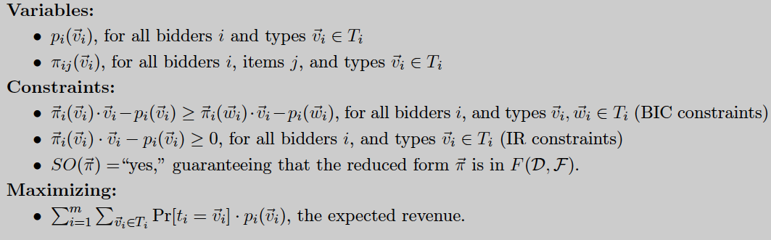



LP for Multi-Item Revenue-Optimization
expected value of bidder i of type for being given
(uses additivity of bidders)
is the separation oracle for polytope
- can be solved in time
- the allocation rule of the optimal auction has nice structure:
distribution over virtual-VCG allocation rules

Slide 44

Revenue-Optimal Multi-item Auctions
A generic reduction:
  MD for Revenue Optimization → Algorithm for Welfare Optimization
Specifically: Suppose that:
  bidder types are independent;
  given access to welfare-optimization algorithm A for ;
  [the number of bidders m, items n, and the set-system of feasible allocations are unrestricted.]
then the revenue-optimal auction* can be computed with
queries to A.
The optimal auction has the following form:
  bidders are asked to report their types;
  reported types are transformed into virtual types via bidder-specific functions;
  the virtual-welfare optimizing allocation in is chosen with a call to A;
  in Myerson’s theorem: virtual function = deterministic, closed-form
  here, randomized, computed during execution of LP.
Notes:
More specifically: For all ε>0, η>0:
The revenue is OPT-ε, and the dependence of the running time on ε is polynomial in 1/ε.
The probability of failure is η, and the dependence of the running time on η is polynomial in log1/η.

Slide 45
Summary
Mechanism design for welfare optimization is well-understood:
  the VCG auction is a reduction to the corresponding algorithmic problem;
  there is also a reduction robust to approximation [HL ’10, HKM’11]
The same is not true for revenue (or other objectives):
  Myerson’s auction optimizes revenue in single-item settings;
  but multi-item settings are not well understood.
Reduced-forms provide a framework for tractably reducing mechanism design to algorithmic social-welfare optimization.
➔A generalization of Myerson’s theorem to arbitrary multi-dimensional settings:
  “The revenue optimal auction is a virtual-welfare maximizer; it can
  be computed with polynomially many queries to a welfare-maximizing algorithm.”
Techniques: geometry, ellipsoid algorithm;
  can optimize over reduced forms using VCG as a separation oracle.

Slide 46
Thanks for your attention
Questions?

