Slide 1
Kidney Exchange - Theoretical Developments and Practical Challenges
Itai Ashlagi
Algorithmic Economics Summer Schools, CMU

Slide 2
Kidney Exchange Background
There are more than 90,000 patients on the waiting list for cadaver kidneys in the U.S. (Yesterday there were 92,786.)
In 2011 33,581 patients were added to the waiting list, and 27,066 patients were removed from the list.
In 2009 there were 11,043 transplants of cadaver kidneys performed in the U.S and more than 5,771 from living donors.
In the same year, 4,697 patients died while on the waiting list. 2,466 others were removed from the list as “Too Sick to Transplant”.
Sometimes donors are incompatible with their intended recipients.
This opens the possibility of exchange

Slide 3
Kidney Exchange
Two pair (2-way) kidney exchange
Donor 1
Blood type A
Recipient 1
Blood type B
Donor 2
Blood type B
Recipient 2
Blood type A
3-way exchanges (and larger) have been conducted

Slide 4
Paired kidney donations
Donor
Recipient
Pair 1
Donor
Recipient
Donor
Recipient
Pair 3
Pair 2

Slide 5
Non-directed donors: cycles plus chains
Pair 1
Pair 4
Pair 3
Pair 5
Pair 2
Pair 6
Non-directed donor
Pair 7

Slide 6
Kidney exchange clearinghouse design
Roth, Alvin E., Tayfun Sönmez, and M. Utku Ünver, “Kidney Exchange,” Quarterly Journal of Economics, 119, 2, May, 2004, 457-488.
____ “Pairwise Kidney Exchange,” Journal of Economic Theory, 125, 2, 2005, 151-188.
___ “A Kidney Exchange Clearinghouse in New England,” American Economic Review, Papers and Proceedings, 95,2, May, 2005, 376-380.
_____ “Efficient Kidney Exchange: Coincidence of Wants in Markets with Compatibility-Based Preferences,” American Economic Review, June 2007, 97, 3, June 2007, 828-851
___multi-hospital exchanges become common—hospitals become players in a new “kidney game”________
Ashlagi, Itai and Alvin E. Roth ”Individual rationality and participation in large scale, multi-hospital kidney exchange,” revised June 2012.
Ashlagi, Itai, David Gamarnik and Alvin E. Roth, The Need for (long) Chains in Kidney Exchange, May 2012

Slide 7
And in the medical literature
Saidman, Susan L., Alvin E. Roth, Tayfun Sönmez, M. Utku Ünver, and Francis L. Delmonico, “Increasing the Opportunity of Live Kidney Donation By Matching for Two and Three Way Exchanges,” Transplantation, 81, 5, March 15, 2006, 773-782.
Roth, Alvin E., Tayfun Sönmez, M. Utku Ünver, Francis L. Delmonico, and Susan L. Saidman, “Utilizing List Exchange and Undirected Donation through “Chain” Paired Kidney Donations,” American Journal of Transplantation, 6, 11, November 2006, 2694-2705.
Rees, Michael A., Jonathan E. Kopke, Ronald P. Pelletier, Dorry L. Segev, Matthew E. Rutter, Alfredo J. Fabrega, Jeffrey Rogers, Oleh G. Pankewycz, Janet Hiller, Alvin E. Roth, Tuomas Sandholm, Utku Ünver, and Robert A. Montgomery, “A Non-Simultaneous Extended Altruistic Donor Chain,” New England Journal of Medicine , 360;11, March 12, 2009, 1096-1101.
Ashlagi, Itai, Duncan S. Gilchrist, Alvin E. Roth, and Michael A. Rees, “Nonsimultaneous Chains and Dominos in Kidney Paired Donation – Revisited,” American Journal of Transplantation, 11, 5, May 2011, 984-994
Ashlagi, Itai, Duncan S. Gilchrist, Alvin E. Roth, and Michael A. Rees, “NEAD Chains in Transplantation,” American Journal of Transplantation, December 2011; 11: 2780–2781.

Slide 8
There’s also a growing CS literature
Abraham, D., Blum, A., and Sandholm, T. 2007. Clearing Algorithms for Barter Exchange Markets: Enabling Nationwide Kidney Exchanges. In Proceedings of the ACM Conference on Electronic Commerce (EC).
Ashlagi, Itai, Felix Fischer, Ian A. Kash, Ariel D. Procaccia,2010, Mix and Match, EC’10, June 7–11, 2010, Cambridge, MA.
Biro, Peter, and Katarina Cechlarova (2007), Inapproximability of the kidney exchange problem, Information Processing Letters, 101, 5, 16 March 2007, 199-202
Ioannis Caragiannis, Aris Filos-Ratsikas, and Ariel D. Procaccia. An Improved 2-Agent Kidney Exchange Mechanism, July 2011.
Toulis, P., and D. C. Parkes. 2011. “A Random Graph Model of Kidney Exchanges : Optimality and Incentives.” Proc of the 11th ACM Conference on Electronic Commerce, 323– 332
Dickerson, J. P., A. D. Procaccia, and T. Sandholm. 2012. “Optimizing Kidney Exchange with Transplant Chains: Theory and Reality.” Proc of the eleventh international conference on autonomous agents and multiagent systems

Slide 9
Centralized Kidney Exchange
Alliance Paired Donation (APD), Ohio – 81 hospitals
National Kidney Registry, NY - 70 hospitals
UNOS - national kidney exchange pilot in Oct 2010:
77 hospitals registered

Slide 10
Factors determining transplant opportunity
O
Blood compatibility
So type O patients are at a disadvantage in finding compatible kidneys—they can only receive O kidneys.
And type O donors will be in short supply.
Tissue type compatibility. Percentage reactive antibodies (PRA)
    Low sensitivity patients (PRA < 79)
    High sensitivity patients (80 < PRA < 100)
A
B
AB

Slide 11
A. Patient ABO Blood Type | Frequency
O | 48.14%
A | 33.73%
B | 14.28%
AB | 3.85%
B. Patient Gender | Frequency
Female | 40.90%
Male | 59.10%
C. Unrelated Living Donors | Frequency
Spouse | 48.97%
Other | 51.03%
D. PRA Distribution | Frequency
Low PRA | 70.19%
Medium PRA | 20.00%
High PRA | 9.81%

Slide 12
Random Compatibility Graphs
n hospitals, each of a size c>0
D(n) - random compatibility graph:
n pairs/nodes are randomized –compatible pairs are disregarded
Edges (crossmatches) are randomized
Random graphs will allow us to ask two related questions:
What would efficient matches look like in an “ideal” large world?
What is the efficiency loss from requiring the outcome to be individually rational for hospitals?

Slide 13
(Large) Random Graphs
G(n,p) – n nodes and each two nodes have a non directed edge with probability p
Closely related model: G(n,M): n nodes and M edges—the M edges are distributed randomly between the nodes
Erdos-Renyi: For any p(n)¸(1+²)(ln n)/n almost every large graph G(n,p(n)) has a perfect matching, i.e. as n!1 the probability that a perfect matching exists converges to 1.
Similar lemma for a random bipartite graph G(n,n,p).
Can extend also for r-partite graphs…

Slide 14
Efficient Allocations: what they would look like if we were seeing all the patients in sufficiently large markets
Theorem (Ashlagi and Roth, 2011): In almost every large graph (with p above threshhold) there exist an efficient allocation with exchanges of size at most 3.
B-A
AB-B
AB-A
A-O B-O
AB-O
A-B
B-AB A-AB
O-B
O-A
O-AB
X-X
Overdemanded pairs are shaded

Slide 15
How about when hospitals become players?
We are seeing some hospitals withhold internal matches, and contribute only hard-to-match pairs to a centralized clearinghouse.
Mike Rees (APD director) writes us: “As you predicted, competing matches at home centers is becoming a real problem. Unless it is mandated, I'm not sure we will be able to create a national system. I think we need to model this concept to convince people of the value of playing together”.

Slide 16
Hospitals have Incentives
a1,a2 are pairs from the same hospital
Pairs b and c are from different hospitals
a1
b
a1
b
(high priority)
a2
c
a2

Slide 17
Individual rationality and efficiency: an impossibility theorem with a (discouraging) worst-case bound
For every k> 3, there exists a compatibility graph such that no k-maximum allocation which is also individually rational matches more than 1/(k-1) of the number of nodes matched by a k-efficient allocation.

Slide 18
Proof (for k=3)
a₃
a₁
a₂
e
c
b
d

Slide 19
k=2
Theorem: 1. There is no efficient strategyproof mechanism (Sonmez et al.)
2. Negative: No strategyproof mechanism achieves more than 1/2 of the maximum allocation (w.r.t to k=2) and for randomized the bound is 0.75.
Postive: A randomzied mechanism that guarantees 0.5. s(Ashlagi, Fischer, Kash & Procaccia EC 10)

Slide 20
Individually Rational Allocations
Theorem: If every hospital size is regular and bounded than in almost every large graph the efficiency loss from a maximum individually rational allocation is at most (1+²)®_{AB-O}m + o(m) for any ²>0 (less than 1.5%).
So the worst-case impossibility results don’t look at all like what we could expect to achieve in large kidney exchange pools (if individually rational mechanisms are adopted).

Slide 21
B-A
AB-B
AB-A
A-O B-O
AB-O
A-B
B-AB A-AB
O-B
O-A
O-AB
X-X

Slide 22
“Cost” of IR is very small for clinically relevant sizes too - Simulations
No. of Hospitals | 2 | 4 | 6 | 8 | 10 | 12 | 14 | 16 | 18 | 20 | 22
IR,k=3 | 6.8 | 18.37 | 35.42 | 49.3 | 63.68 | 81.43 | 97.82 | 109.01 | 121.81 | 144.09 | 160.74
Efficient, k=3 | 6.89 | 18.67 | 35.97 | 49.75 | 64.34 | 81.83 | 98.07 | 109.41 | 122.1 | 144.35 | 161.07

Slide 23
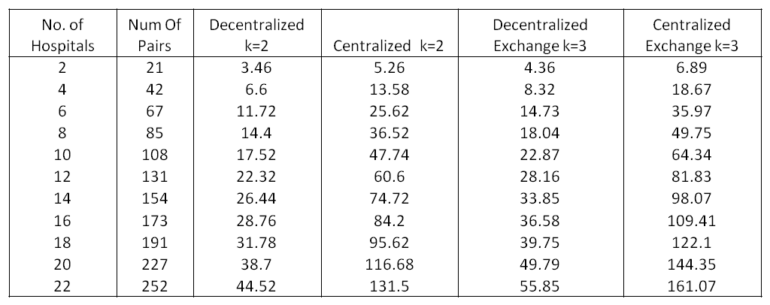
But the cost of not having IR could be very high if it causes centralized matching to break down

Slide 24
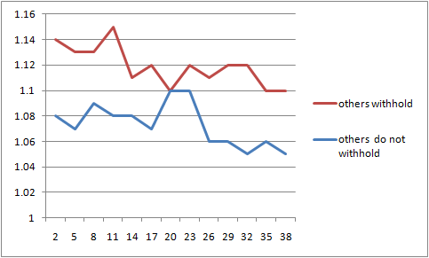
But current mechanisms aren’t IR for hospitals
Current mechanisms: Choose (~randomly) an efficient allocation.
Proposition: Withholding internal exchanges can (often) be strictly better off (non negligible) for a hospital regardless of the number of hospitals that participate.
A-O
O-A
And hospitals can withhold individual overdemanded pairs

Slide 25
IR is not sufficient
Suppose we choose a maximum allocation constraining that for each hospital we match at least the number of (underdemanded) pairs it can internally match.
Truth-telling is not a (almost) Bayes-Nash equilibrium
A-O
O-A

Slide 26
IR is not sufficient
Suppose we choose a maximum allocation constraining that for each hospital we match at least the number of (underdemanded) pairs it can internally match.
Truth-telling is not a (almost) Bayes-Nash equilibrium
A-O
O-A

Slide 27
A New Mechanism
Thm: An o(1)-Bayes-Nash incentive compatible mechanism assuming each hospital is of a “strong regular” size. The efficiency loss is up to 1%.

Slide 28
The underdemanded lottery
How to choose the underdemanded pairs that will be matched?
A-O
a
b
O-A
b2
a1
b1
a3
a2

Slide 29
The underdemanded lottery
How to choose the underdemanded pairs that will be matched?
A-O
a
b
O-A
b2
a1
b1
a3
a2

Slide 30
The underdemanded lottery
How to choose the underdemanded pairs that will be matched?
A-O
a
b
a1
b1
O-A
b2
a1
b1
a3
a2

Slide 31
The underdemanded lottery
How to choose the underdemanded pairs that will be matched?
A-O
a
b
a1
b1
O-A
b2
a1
b1
a3
a2

Slide 32
The underdemanded lottery
How to choose the underdemanded pairs that will be matched?
A-O
a
b
a1
b1
O-A
b2
a1
b1
a3
a2

Slide 33
The underdemanded lottery
How to choose the underdemanded pairs that will be matched?
A-O
a
b
a1
b1
O-A
b2
a1
b1
a3
a2
a2

Slide 34
Other sources of efficiency gains
Non-directed donors
ND-D
P1
P2-D2
P1-D1
ND-D
P3

Slide 35
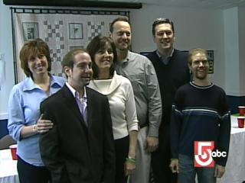
The graph theory representation doesn’t capture the whole story
Rare 6-Way Transplant Performed
Donors Meet Recipients
March 22, 2007
BOSTON -- A rare six-way surgical transplant was a success in Boston.
NewsCenter 5's Heather Unruh reported Wednesday that three people donated their kidneys to three people they did not know. The transplants happened one month ago at Massachusetts General Hospital and Beth Israel Deaconess.
The donors and the recipients met Wednesday for the first time.
Why are there only 6 people in this picture?
Simultaneity congestion: 3 transplants + 3 nephrectomies = 6 operating rooms, 6 surgical teams…

Slide 36
Non-simultaneous extended altruistic donor chains (reduced risk from a broken link)
Since NEAD chains don’t require simultaneity, they can be longer…

Slide 37
The First NEAD Chain (Rees, APD)
July
July
Sept
Sept
Feb
Feb
Feb
Feb
March
March
2007
2007
2007
2007
2008
2008
2008
2008
2008
2008
MI
AZ
OH
OH
OH
MD
MD
MD
NC
MD
OH
1
2
3
4
5
6
7
8
9
10
O
O
A
A
B
A
A
A
AB
A
AB
O
O
A
A
B
A
#
A
A
A
*
A
Recipient PRA
62
0
23
0
100
78
64
3
100
46
Recipient Ethnicity
Cauc
Cauc
Cauc
Cauc
Cauc
Hisp
Cauc
Cauc
Cauc
AA
Relationship
Husband
Wife
Mother
Daughter
Daughter
Mother
Sister
Brother
Wife
Husband
Father
Daughter
Husband
Wife
Friend
Friend
Brother
Brother
Daughter
Mother
* This recipient required desensitization to Blood Group (AHG Titer of 1/8).
# This recipient required desensitization to HLA DSA by T and B cell flow cytometry.

Slide 38
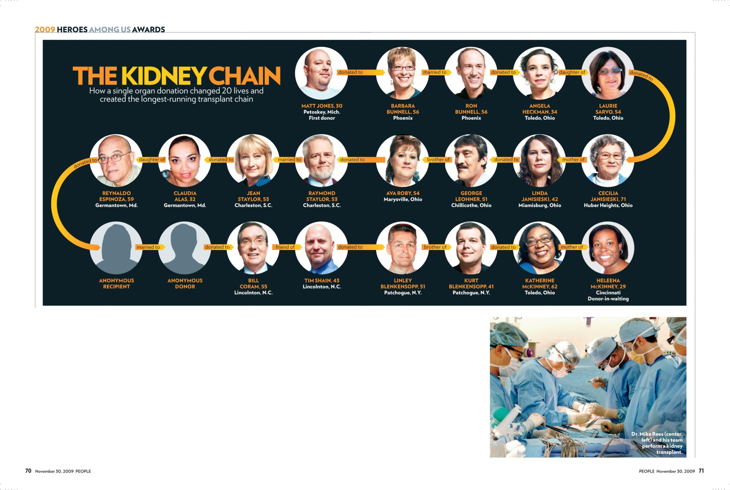

Slide 39
Recent literature about chains
Rees et al..., NEJM 2009 – story about first long chain
Gentry & Segev, AJT 2010 – long chains are not effective
?
Ashlagi, Gilchrist, Rees & Roth, AJT 2011a - long chains are effective
Gentry & Segev, AJT 2011a – honeymoon phase is over and long chains are not effective
Ashlagi, Gilchrist, Rees & Roth, AJT 2011b - letter: honeymoon is still around for a while
Dickerson, Procaccia & Sandholm , AAMAS 2012 - extensive simulation results for when chains are useful.
P2-D2
P1-D1
NDD
P3

Slide 40
Why are NEAD chains so effective?
In a really large market they wouldn’t be…

Slide 41
Chains in an efficient large dense pool
O-O
A-A
B-A
B-B
AB-AB
AB-B
AB-A
A-O B-O
AB-O
A-B
  V_{A-B}
B-AB A-AB
O-B
O-A
O-AB
It looks like a non-directed donor can increase the match size by at most 3 ☹
Non-directed donor—blood type O

Slide 42
A disconnect between model and data:
The large graph model with constant p (for each kind of patient-donor pair) predicts that only short chains are useful.
But we now see long chains in practice.
They could be inefficient—i.e. competing with short cycles for the same transplants.
But this isn’t the the case when we examine the data.

Slide 43
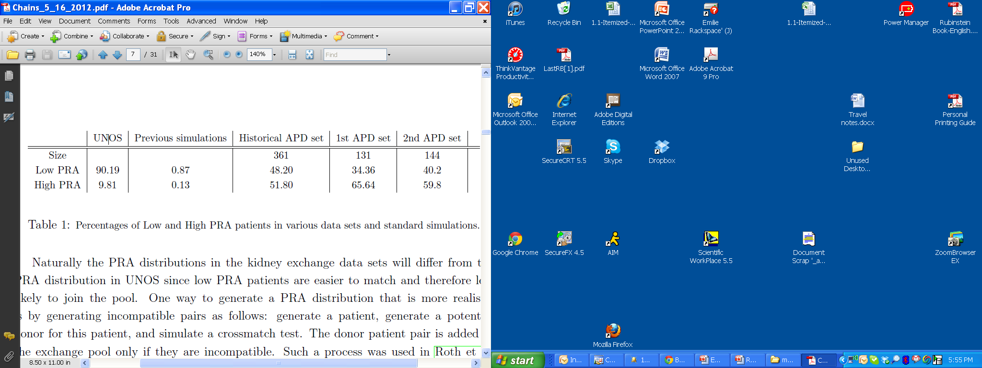
Why? Very many very highly sensitized patients
Previous simulations: sample a patient and donor from the general population, discard if compatible (simple live transplant), keep if incompatible. This yields 13% High PRA.
The much higher observed percentage of high PRA patients means compatibility graphs will be sparse

Slide 44
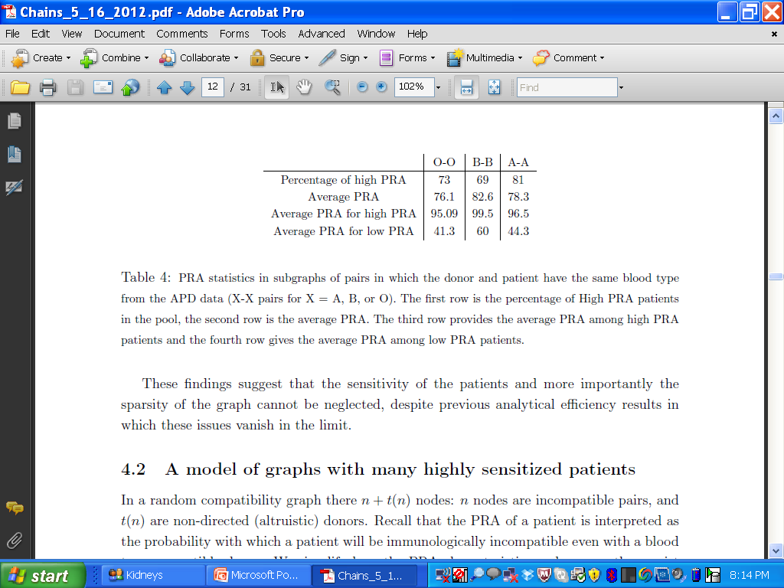

Slide 45
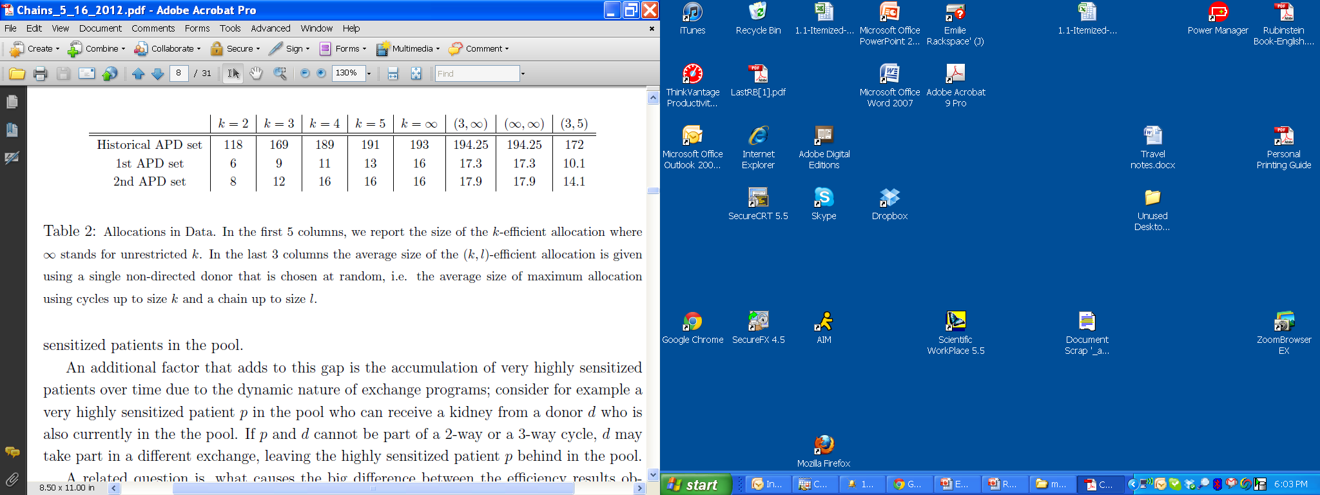
Long chains in the clinical data: even a single non-directed donor can start a long chain

Slide 46
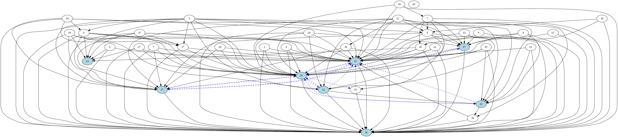
Graph induced by pairs with A patients and A donors. 38 pairs (30 high PRA).
Dashed edges are parts of cycles.
No cycle contains only high PRA patients.
Only one cycle includes a high PRA patient

Slide 47
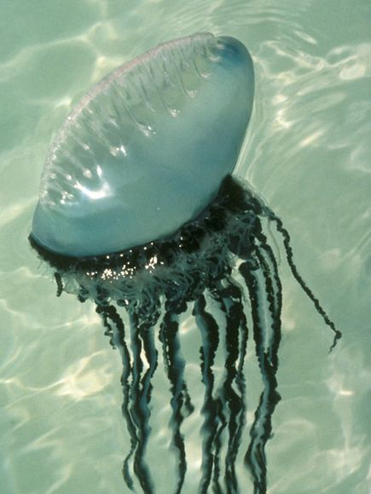
Jellyfish structure of the compatibility graph: highly connected low sensitized pairs, sparse hi-sensitized pairs

Slide 48
So we need to model sparse graphs…
We’ll consider random graphs with two kinds of nodes (patient-donor pairs): Low sensitized and high sensitized
L nodes will have a constant probability of an incoming edge (compatible kidney)
H nodes will have a probability that decreases with the size of the graph (e.g. in a simple case we’ll keep the number of compatible kidneys constant, pH = c/n)
In the H subgraph, we’ll observe trees but almost no short cycles
A non-directed donor can be modeled as a donor with a patient to whom anyone can donate—this allows non-directed donor chains to be analyzed as cycles
(We also consider the effect of different assumptions about how the number of non-directed donors grows…)

Slide 49
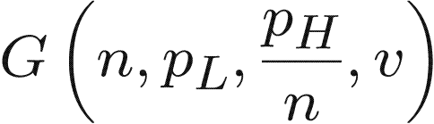


Cycles and paths in random dense-sparse graphs
n nodes. Each node is Low w.p. À·1/2 and High w.p. 1-À
incoming edges to L are drawn w.p.
incoming edges to L are drawn w.p.
L
H

Slide 50
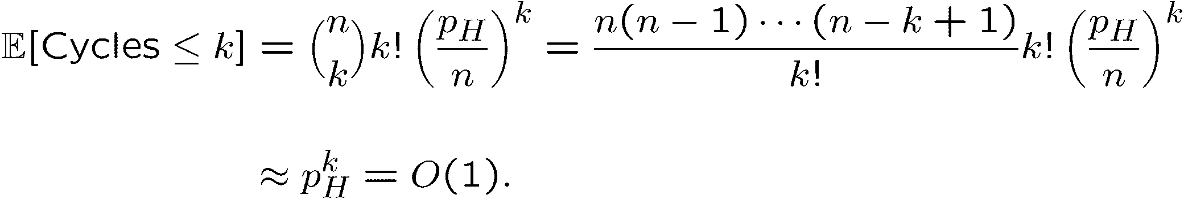
Cycles and paths in random sparse (sub)graphs (v=0, only highly sensitized patients)
Theorem
The number of cycles of length O(1) is O(1).
But when p_{H} is a large constant there is cycle with length O(n)
Proof (a):
H
To be logistically feasible, a long cycle must be a chain, i.e. contain a NDD

Slide 51
Cycles and paths in random sparse graphs (v=0)
Theorem
The number of cycles of length O(1) is O(1).
But when p_{H} is a large constant there is path with length O(n)
Since cycles need to be short (as they need to be conducted simultaneously) but chains can be long (as they can be initiated by an altruistic donor,) the value of a non-directed donor is very large!
H

Slide 52
Case v>0 (some low sensitized, easy to match patients. Why increasing cycle size helps
Theorem (Ashlagi, Gamarnik, Rees & Roth, 2012)
Let C_{k} be the largest number of transplants achievable with
cycles · k. Let D_{k} be the largest number of transplants achievable with
cycles · k plus one non-directed donor. Then for every constant k there exists ½>0
Furthermore, C_{k} and D_{k} cover almost all L nodes.
L
H

Slide 53
Case v>0. Why increasing cycle size helps
Increasing cycle lengths significantly increases transplants.
Highly sensitized patients are the principal beneficiaries.
Low sensitized patients are overdemanded: it’s easy to start a cycle from L to H since there are many H, and easy to end it back in L since most blood type compatible donors will do…

Slide 54
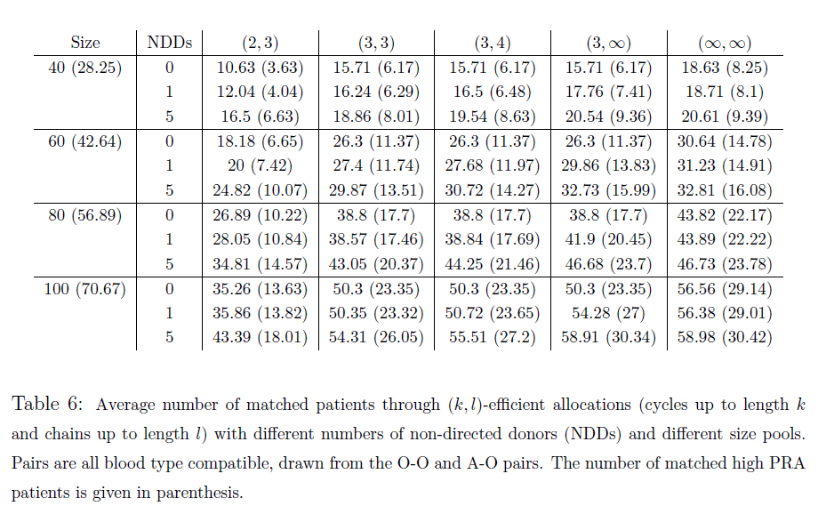
Simulations (re-sampling) with clinical data

Slide 55
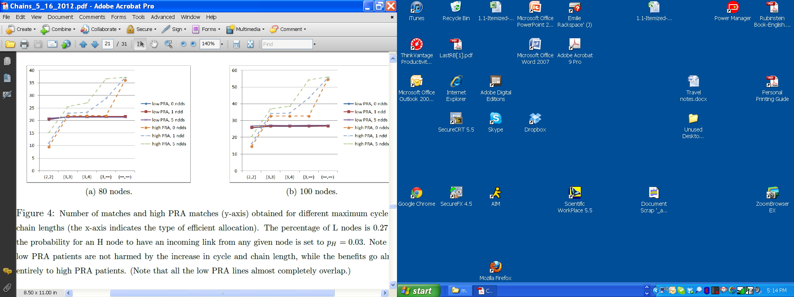
Long chains benefit highly sensitized patients (without harming low-sensitized patients)

Slide 56

NKR non-directed donor chain:2012. 60 lives, 30 kidneys: the practical implications are clear

Slide 57
But progress is still slow☹
When we started, there were only 40,000 people on the US deceased-donor waiting list, and now there are 90,000

