Slide 1
Matching and Market Design
Itai Ashlagi
Algorithmic Economics Summer School, CMU

Slide 2
Topics
Stable matching and the National Residency Matching Program (NRMP)
Kidney Exchange

Slide 3


The US Medical Resident Market
Each year over 16,000 graduates form US medical schools.
Over 23,000 residency spots.
The balance is filled with foreign-trained applicants.

Slide 4





The Match
The Match is a program administered by the National Resident Matching Program (NRMP).
A
B
C
1
2
A
1
2
1
B
C
A
B
1
2
1: A B
2: C
2
C
Notes:
Add photo, introduce stability

Slide 5
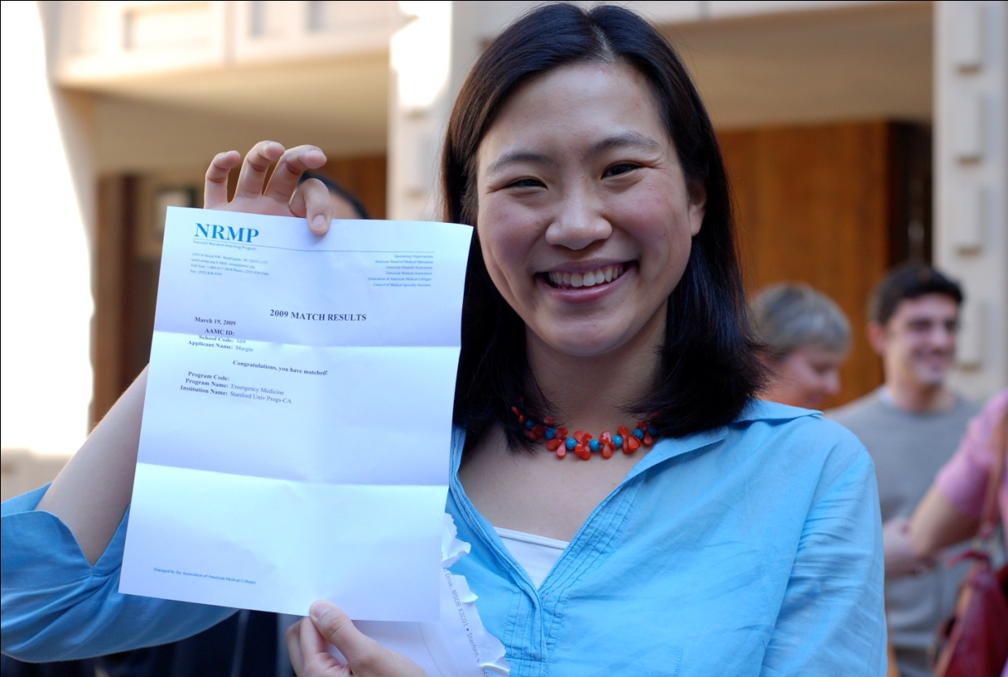
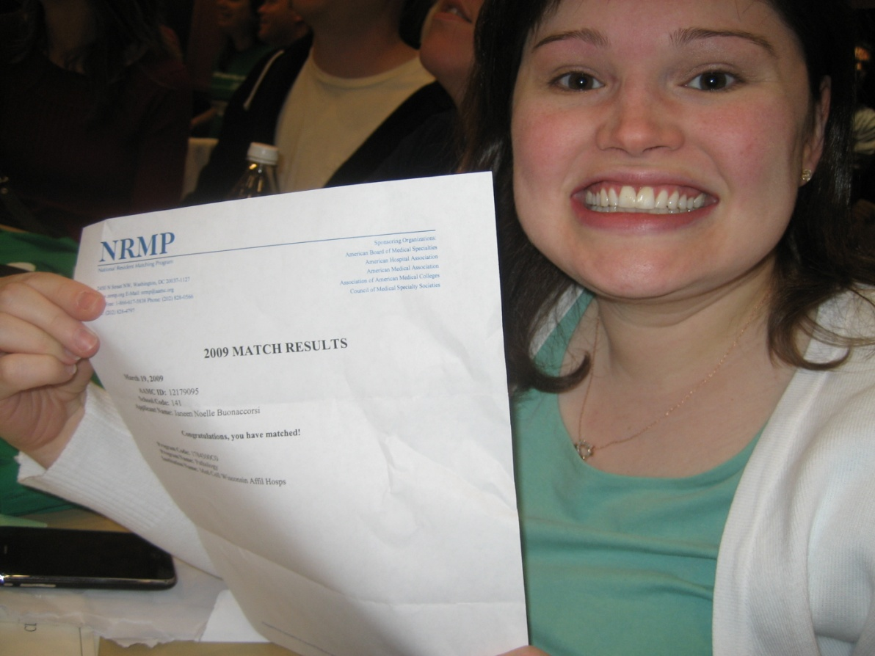
Match Day – 3rd Thursday in March
Photos attribution: madichan, noelleandmike

Slide 6
A stable match
B
A
C
C
A
B
A
B
C
1
2
3
2
1
3
1
2
3
1
3
2
C
B
A
Notes:
Mention that it’s not always the case that hospitals get their first choice.

Slide 7
The Deferred Acceptance Algorithm [Gale-Shapley’62]
Doctor-proposing Deferred Acceptance:
While there are no more applications
  Each unmatched doctor applies to the next hospital on her list.
  Any hospital that has more proposals than capacity rejects its least preferred applicants.
Notes:
Add: properties of DA

Slide 8
Properties of (doctor proposing) Deferred Acceptance
Stable (Gale & Shapley 62)
Safe for the applicants to report their true preferences (dominant strategy) (Dubins & Freedman 81, Roth 82)
Best stable match for each doctor (Knuth, Roth)

Slide 9
Market Stable Still in use
NRMP yes yes (new design 98-)
Edinburgh ('69) yes yes
Cardi yes yes
Birmingham no no
Edinburgh ('67) no no
Newcastle no no
Sheeld no no
Cambridge no yes
London Hospital no yes
Medical Specialties yes yes (1/30 no)
Canadian Lawyers yes yes
Dental Residencies yes yes (2/7 no)
Osteopaths (-'94) no no
Osteopaths ('94-) yes yes
NYC highschool yes yes

Slide 10
The Boston School Choice Mechanism
Step 0: Each student submits a preference ranking of the
schools.
Step 1: In Step 1 only the top choices of the students are
considered. For each school, consider the students who have
listed it as their top choice and assign seats of the school to
these students one at a time following their priority order until
either there are no seats left or there is no student left who
has listed it as her top choice.
Step k: Consider the remaining students. In Step k only the
kth choices of these students are considered. For each school
still with available seats, consider the students who have listed
it as their kth choice and assign the remaining seats to these
students one at a time following their priority order until
either there are no seats left or there is no student left who
has listed it as her kth
choice.

Slide 11
The Boston School Choice Mechanism
Students who didn’t get their first choice can get a very bad choice since schools fill up very quickly.
Very easy to manipulate!
=> Stability turns is important when considering preferences…

Slide 12
Stability and efficiency
When preferences are not strict (or priorities are used rather then preferences) stable matchings can be inefficient (Ergil and Erdin 08, Abdikaodroglu et al. 09).
Stable improvement cycles can be found!
There is no stable strategyproof mechanism that Pareto dominates DA (Ergil and Erdin 08, Abdikaodroglu et al. 09).
Azevedo & Leshno provide an example for a mechanism that dominates DA (had players report truthfully) but all equilibria are Pareto dominated.

Slide 13
Assignment mechanisms
1. Top Trading Cycles (Gale-shapley 62)
2. Random Serial dictatorship
3. Probabilistic serial dictatorship (Bogomolnaia & Moulin)
Theorems: 1. TTC is strategyproof and ex post efficient (Roth)
2. TTC and RS and many other are equivalent (Sonmez Pathak & Sethuraman, Caroll, Sethuraman)
3. PS is ordinal efficient and but not strategyproof (Bogomolnaia & Moulin). In large markets it is equivalent to RS (Che and Kojima, Kojima and Manea)

Slide 14
Back to the NRMP

Slide 15
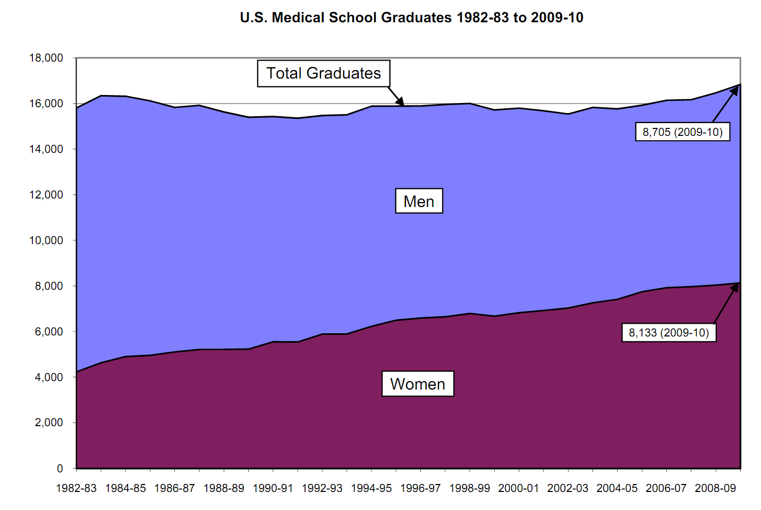
Source: https://www.aamc.org/download/153708/data/charts1982to2011.pdf

Slide 16
Two-body problems
Couples of graduates seeking a residency program together.

Slide 17
Decreasing participation of couples
In the 1970s and 1980s: rates of participation in medical clearinghouses decreases from ~95% to ~85%. The decline is particularly noticeable among married couples.
1995-98: Redesigned algorithm by Roth and Peranson (adopted at 1999)

Slide 18
Couples’ preferences
The couples submit a list of pairs. In a decreasing order of preferences over pairs of programs – complementary preferences!
Example:
Alice | Bob
NYC-A | NYC-X
NYC-A | NYC-Y
Chicago-A | Chicago-X
NYC-B | NYC-X
No Match | NYC-X

Slide 19
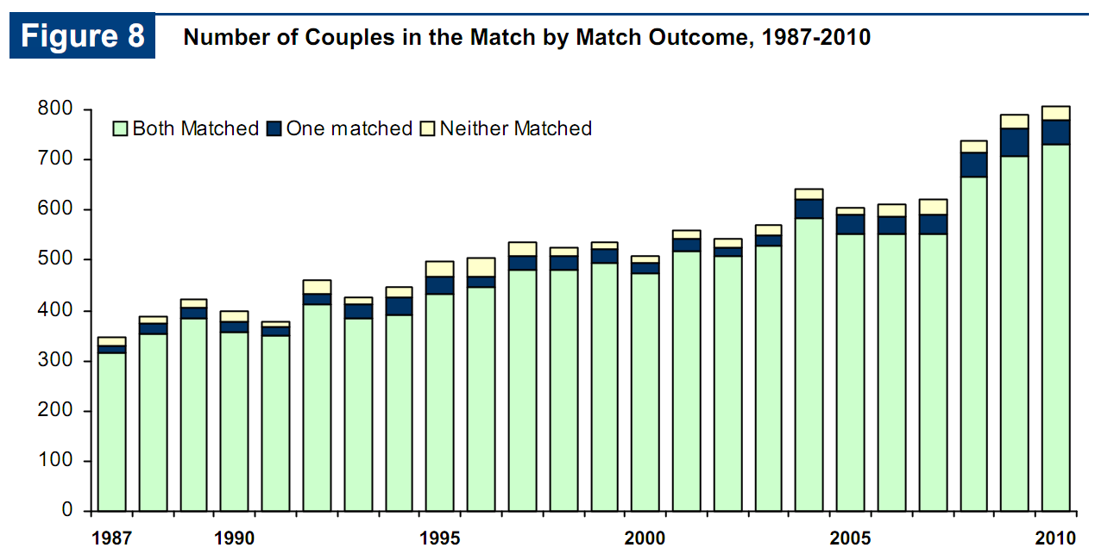
Couples in the match (n≈16,000)
Source: http://www.nrmp.org/data/resultsanddata2010.pdf

Slide 20
No stable match
[Roth’84, Klaus-Klijn’05]
A
C
C
B
1
2
A
B
1 2
1
2
C

Slide 21
Option 1: Match AB
A
C
C
B
1
2
A
B
1 2
A
B
1
2
1 2
C
C-2 is blocking

Slide 22
Option 2: Match C2
A
C
C
B
1
2
A
B
1
2
1 2
C
1
2
C
C-1 is blocking

Slide 23
Option 3: Match C1
A
C
C
B
1
2
A
B
1
2
1 2
C
1
2
C
AB-12 is blocking

Slide 24
Stable match with couples
But:
In the last 12 years, a stable match has always been found.
Only very few failures in other markets.

Slide 25
Large random market
n doctors, k=n^{1-ε} couples
λn residency spots, λ>1
Up to c slots per hospital
Doctors/couples have random preferences over hospitals (can also allow “fitness” scores)
Hospitals have arbitrary preferences over doctors.

Slide 26
Stable match with couples
Theorem [Kojima-Pathak-Roth’10]: In a large random market with n doctors and n^{0.5-ε} couples, with probability →1
  a stable match exists
  truthfulness is an approximated Bayes-Nash equilibrium

Slide 27
Main results
Theorem: In a large random market with at most n^{1-ε} couples, with probability →1:
  a stable match exists, and we find it using a new Sorted Deferred Acceptance (SoDA) algorithm
  truthfulness is an approximated Bayes-Nash equilibrium
  Ex ante, with high probability each doctor/couple gets its best stable matching

Slide 28
Main results
Theorem (Ashlagi & Braverman & Hassidim): In a large random market with αn couples and large enough λ>1 there is a constant probability that no stable matching exists.
If doctors have short preference lists, the result holds for any λ>=1.
In contrast to large market positive results….
Satterwaite & Williams 1989
Rustuchini et al. 1994
Immorlica & Mahdian 2005
Kojima & Pathak 2009
….

Slide 29
The idea for the positive result
We would like to run deferred acceptance in the following order:
  singles;
  couples: singles that are evicted apply down their list before the next couple enters.
If no couple is evicted in this process, it terminates in a stable matching.

Slide 30
What can go wrong?
Alice evicts Charlie.
Charlie evicts Bob.
H₁ regrets letting Charlie go.
A
C
C
B
1
2
1
2
A
C
B
1 2

Slide 31
Solution
Find some order of the couples so that no previously inserted couples is ever evicted.

Slide 32
The couples (influence) graph
Is a graph on couples with an edge from AB to DE if inserting couple AB may displace the couple DE.
A
B
1 2
A
B
1 2
1
2
C

Slide 33
The couples graph
G
A
B
A
B
E
F
E
F
C
D

Slide 34
The couples graph
G
A
B
A
B
E
F
E
F
C
D

Slide 35
The SoDA algorithm
The Sorted Deferred Acceptance algorithm looks for an insertion order where no couple is ever evicted.
This is possible if the couples graph is acyclic.
E
F
A
B
G
H
C
D

Slide 36
Insert the couples in the order:
AB, CD, EF, GH
or
AB, CD, GH, EF
E
F
A
B
G
H
C
D

Slide 37
Sorted Deferred Acceptance (SoDA)
Set some order π on couples.
Repeat:
Deferred Acceptance only with singles.
Insert couples according to π as in DA:
    If AB evicts CD: move AB ahead of CD in π. Add the edge AB→CD to the influence graph.
    If the couples graph contains a cycle: FAIL
If no couple is evicted: GREAT

Slide 38
Couples Graph is Acyclic
The probability of a couple AB influencing a couple CD is bounded by (log n)^{c}/n≈1/n.
With probability →1, the couples graph is acyclic.
Notes:
Describe why this is hard; add experiment graphs

Slide 39
Influence trees and the couples graph
IT(c_{i},0) - set of hospitals doctor pairs c_{i} can affect if it was inserted as the first couple
If:
(h,d’) ∈IT(c_{j},0)
(h,d) ∈IT(c_{i},0)
Hospital h prefers d to d’
c_{j}
c_{i}
h
d
d’

Slide 40
Influence trees and the couples graph
IT(c_{i},0) - set of hospitals doctor pairs c_{i} can affect if it was inserted as the first couple
c_{i}
If:
(h,d’) ∈IT(c_{j},0)
(h,d) ∈IT(c_{i},0)
Hospital h prefers d to d’
c_{j}
c_{j}
c_{i}
h
d
d’

Slide 41
Influence trees and the couples graph
IT(c_{i},0) - set of hospitals doctor pairs c_{i} can affect if it was inserted as the first couple
c_{i}
If:
(h,d’) ∈IT(c_{j},0)
(h,d) ∈IT(c_{i},0)
Hospital h prefers d to d’
c_{j}
c_{j}
c_{i}
h
d
d’
IT(c_{i},r) - similar but allow r adversarial rejections

Slide 42
Influence trees and the couples graph
To capture that other couples have already applied we “simulate” rejections:
IT(c_{i},r) - similar but allow r adversarial rejections

Slide 43
Proof Intuition
Construct the couples graph based on influence trees with r=3/ε
Lemma: with high probability the couples graph is acyclic
Lemma: influence trees of size 3/ε are conservative enough, such that with high probability no couple will evict someone outside its influence tree

Slide 44
Linear number of couples
Theorem (Ashlagi & Braverman & Hassidim): in a random market with n singles, αn couples and large enough λ>1, with constant probability no stable matching exists.
Idea:
Show that a small submarket with no stable outcome exists
No doctor outside the submarket ever enters a hospital in this submarket market

Slide 45
Results from the APPIC data
Matching of psychology postdoctoral interns.
Approximately 3000 doctors and 20 couples.
Years 1999-2007.
SoDA was successful in all of them.
Even when 160 “synthetic” couples are added.

Slide 46
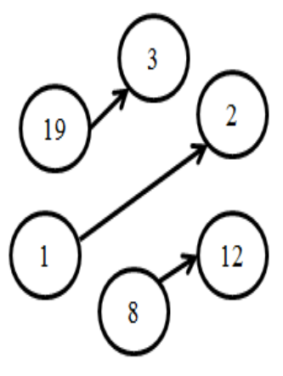
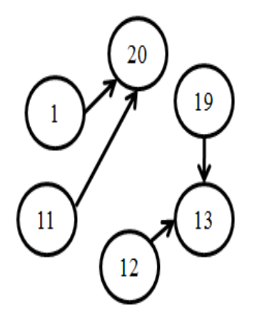
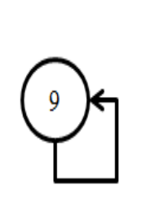
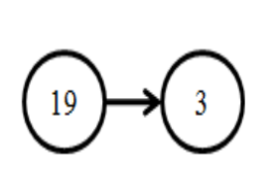
SoDA: the couples graphs
2008
2004
2006
2007
In years 1999, 2001, 2002, 2003 and 2005 the couples graph was empty.

Slide 47
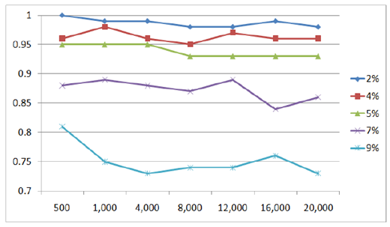
SoDA: simulation results
probability of success
808 per 16,000 ≈ 5%
number of doctors
Success Probability(n) with number of couples equal to αn. 4% means that ~8% of the individuals participate as couples.

Slide 48
Stability and efficiency
When preferences are not strict (or priorities are used rather then preferences) stable matchings can be inefficient (Ergil and Erdin 08, Abdikaodroglu et al. 09).
Stable improvement cycles can be found!
There is no stable strategyproof mechanism that Pareto dominates DA (Ergil and Erdin 08, Abdikaodroglu et al. 09).
Azevedo & Leshno provide an example for a mechanism that dominates DA (had players report truthfully) but all equilibria are Pareto dominated.

Slide 49
Assignment mechanisms
1. Top Trading Cycles (Gale-shapley 62)
2. Random Serial dictatorship
3. Probabilistic serial dictatorship (Bogomolnaia & Moulin)
Theorems: 1. TTC is strategyproof and ex post efficient (Roth)
2. TTC and RS and many other are equivalent (Sonmez Pathak & Sethuraman, Caroll, Sethuraman)
3. PS is ordinal efficient and but not strategyproof (Bogomolnaia & Moulin). In large markets it is equivalent to RS (Che and Kojima, Kojima and Manea)

Slide 50
Kidney Exchange Background
There are more than 90,000 patients on the waiting list for cadaver kidneys in the U.S.
In 2011 33,581 patients were added to the waiting list, and 27,066 patients were removed from the list.
In 2009 there were 11,043 transplants of cadaver kidneys performed in the U.S and more than 5,771 from living donor.
In the same year, 4,697 patients died while on the waiting list. 2,466 others were removed from the list as “Too Sick to Transplant”.
Sometimes donors are incompatible with their intended recipients.
This opens the possibility of exchange

Slide 51
Kidney Exchange
Two pair (2-way) kidney exchange
Donor 1
Blood type A
Recipient 1
Blood type B
Donor 2
Blood type B
Recipient 2
Blood type A
3-way exchanges (and larger) have been conducted

Slide 52
Paired kidney donations
Donor
Recipient
Pair 1
Donor
Recipient
Donor
Recipient
Pair 3
Pair 2

Slide 53
Factors determining transplant opportunity
O
Blood compatibility
Tissue type compatibility. Percentage reactive antibodies (PRA)
    Low sensitivity patients (PRA < 79)
    High sensitivity patients (80 < PRA < 100)
A
B
AB

Slide 54
Kidney exchange is progressing, but progress is still slow☹
 | 2000 | 2001 | 2002 | 2003 | 2004 | 2005 | 2006 | 2007 | 2008 | 2009 | 2010
#Kidney exchange transplants in US* | 2 | 4 | 6 | 19 | 34 | 27 | 74 | 121 | 240 | 304 | 422 (+203 +139)*
Deceased donor waiting list (active + inactive) in thousands | 54 | 56 | 59 | 61 | 65 | 68 | 73 | 78 | 83 | 88 | 89.9
In 2010: 10,622 transplants from deceased donors
6,278 transplants from living donors
*http://optn.transplant.hrsa.gov/latestData/rptData.asp Living Donor Transplants By Donor Relation
UNOS 2010: Paired exchange + anonymous (ndd?) + list exchange

Slide 55
Incentive Constraint: 2-way exchange involves 4 simultaneous surgeries.
Donor 1
Blood type A
Recipient 1
Blood type B
Donor 2
Blood type B
Recipient 2
Blood type A

Slide 56
Summary
A stable match in a random market can be found as long as the number of couples is sublinear.
A new algorithm for finding a stable match.
An isolation tool for a random market with (few) complementarities.

