Slide 1
A Scalable and Privacy-Aware IoT Service for Live Video Analytics
Junjue Wang, Brandon Amos, Anupam Das, Padmanabhan Pillai*, Norman Sadeh, Mahadev Satyanarayanan
Carnegie Mellon University and Intel Labs*

Slide 2
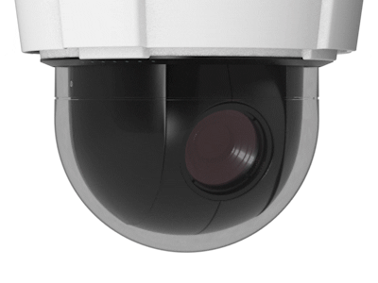
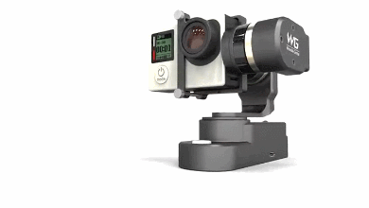
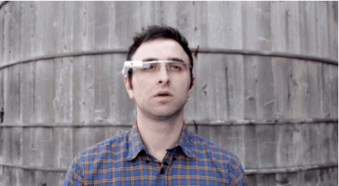
Video Cameras are Ubiquitous Today
David Barrett. 2013. “One surveillance camera for every 11 people in Britain, says CCTV survey.” Daily Telegraph (July 10, 2013).
Notes:
1. Video cameras are ubiquitous:
Surveillance camera → widely used
Lightweight portable camera → popular among adventurers and travelers
Head-mounted wearables with cameras → begin to see
2. A survey in the U.K.: one surveillance camera for every 11 people in a public space

Slide 3
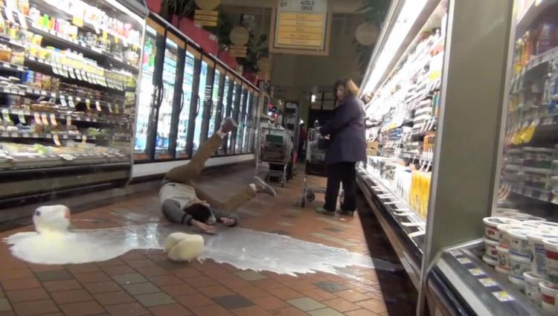
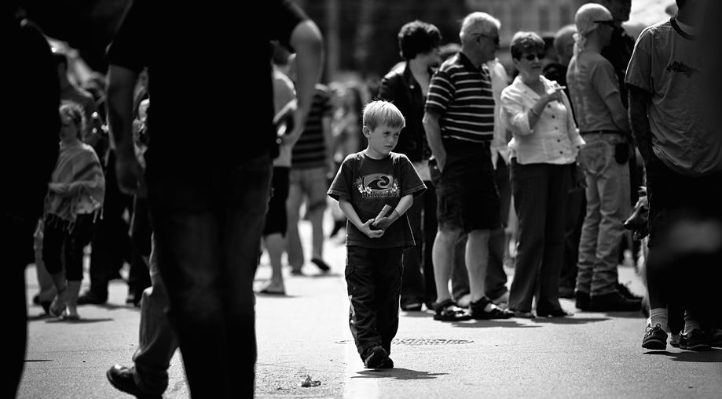
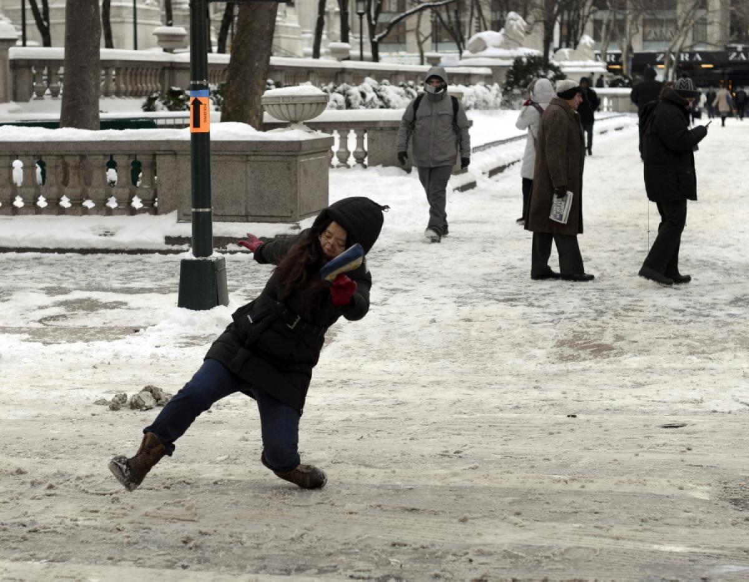
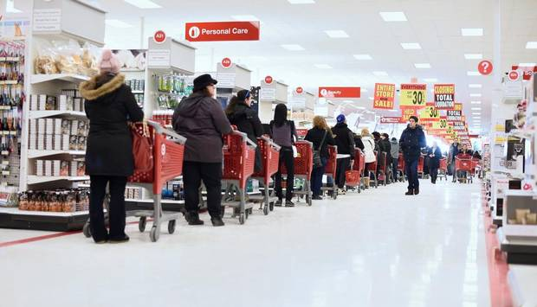
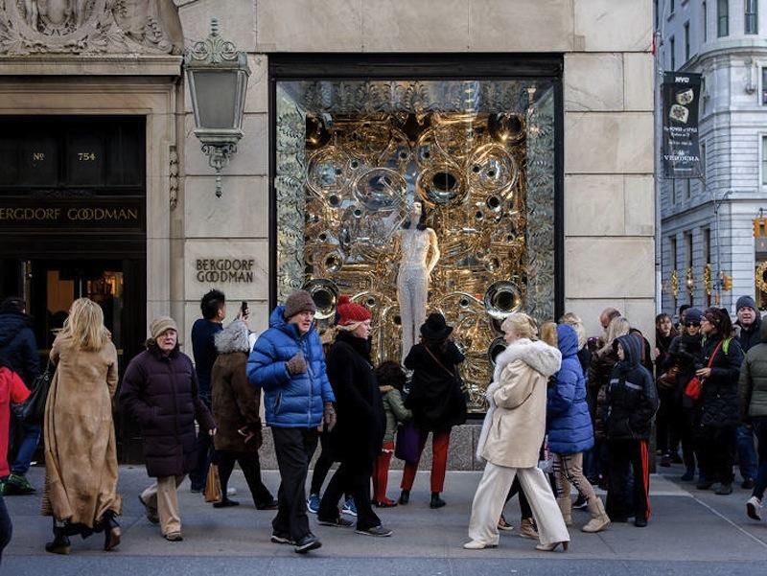
Live Video as a Service offers high value
3rd Party Analytics
Liquid Spill!
Lost Child!
Icy Patches!
Checkout line too long!
Unattractive Window Display
Notes:
Transition: With the ubiquity of cameras, live video as a service high value
two unique strength of cameras as sensing devices:
Open-end → third-party
Examples

Slide 4
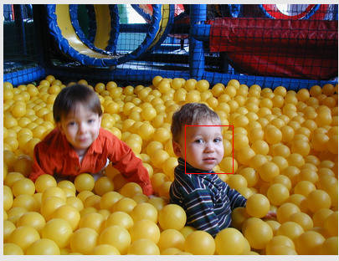
Bandwidth and Privacy Concerns
Privacy-Aware:
(Real-time, Full Resolution)
Privacy Concerns
Limited Bandwidth
Analytics
Analytics
scalable
Cloud
Extracted Output of Analytics
Cloud
Extracted Output of Analytics
Analytics
Cloudlet
Notes:
Transition: However, to achieve such reality, there are 2 major hurdles
Hurdles:
Bandwidth Consumption: stress b/w in aggregate network in cloud-computing paradigm
User’s privacy concerns: rich that sensitive data (owner of the device, but also bystander)
This project, prototype system solves this problem:
New computing paradigm, edge computing
Real-time blurring/denaturing at full-frame rate to remove sensitive data, at the correct time and volume
We focus on a particular use case of face denaturing as a proof of concept
Design Goals: scalable, real-time, full resolution of the video stream

Slide 5
Privacy Mediator Architecture
3rd Party Installable
Edge Computing
Small, multi-tenant data centers (cloudlets) close to IoT devices
Denaturing Policy
Analytics VMs
Privacy Mediator VM
Analytics
Algorithm 1
Denaturing
Algorithm
Extracted
information
sent to
cloud
Input
Video
Stream
Video
Deco-ding
Analytics
Algorithm 2
Analytics
Algorithm 3
Encrypted originals of obscured bits
…
Archived
Denatured Video
Separation of Trust
Cloudlet
Improved Scalability
Notes:
Transition: To solve the bandwidth problem, we used the privacy mediator proposed by Nigel.
Describe Privacy Mediator:
Instead of streaming videos to the cloud, videos are streamed to a computational devices nearby, referred as cloudlet. (could be in cellular tower, could be a power machine sitting in your home)
Privacy mediator VM (water treatment plants)
Video decoding
Denaturing
Store encrypted sensitive data
Denatured video streams publish to analytics running on the cloudlet.
2 benefits
Separation of Trust: can be a trusted software module. Platform integrity of a mediator is ensured by running on a cloudlet (trusted domain of the data owner)
Improved Scalability: (stress)
compare to cloud: distilled information (water treatment plants, we don’t build them at a centralized location. Build them near where the water source)
compare to mobile devices: much more computation power and not restricted battery life
Previous paper, talks about the concept. We want to make the concept concreate. We Provide the underlying service in blue

Slide 6
Denaturing, the trade-off between privacy and value
Denaturing: the process of making video “safe” from a privacy viewpoint
High Accuracy
Real-time
Full Resolution
Examples of Denatured Video Frames
Notes:
Transition: edge computing solves the b/w problem. We also tackled the privacy problem as well
The concept of Denaturing:
Definition
Trade-off between privacy and value
Different denaturing mechanism also enables different levels of protection:
Face detection → simpler
Face Recognition: mall example. A mother to track his/her own children
We focus on using face recognition to achieve real-time performance

Slide 7
Video: Remove Unknown Faces

Slide 8
Video: Remove Faces by Identity

Slide 9
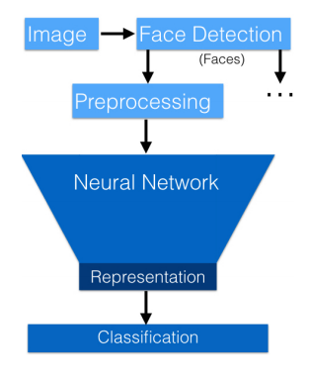
OpenFace - Accurate Face Recognition
Inspired by FaceNet (CVPR 2015)
Trained with 500K images from public dataset (CASIA-WebFace + FaceScrub)
DNN + SVM Approach
DNN to extract facial features
SVM to classify faces
Notes:
Transition: Privacy concerns, we need a highly accurate face recognition module
Problems:
state-of-art commercial system are trained with proprietary product data, for example from social networks
Trained with millions of data
Inspired by FaceNet, we built our own DNN model and trained it with public available data
DNN based model
Pipeline: image, face detection, extract facial features into 128 feature vectors. Every face turned into a vector. Classification using SVM
Benefit of combined approach:
1. Only need to train neural networks once and offline
2. Adding new identities into the system is fast, since SVM training is fast (on the orders of milli-seconds)

Slide 10
OpenFace - Accuracy on LFW benchmark
True Positive Rate
False Positive Rate
Predict whether pairs of images are of the same person
Notes:
Close to state-of-art commercial recognition, close to human accuracy. Evaluated on a standard computer vision benchmark
ROC:
Definition
Random guess
Ideal ROC Curve
AUC
More in our paper:
Show short training time
Recognition speed
Classification up to 100 people identity

Slide 11
Detection and Recognition are Slow
Bounding
Boxes
of Faces
Bounding
Boxes
With Identities
Input
Video
Stream
Face
Detection
Face Recognition
(OpenFace)
< 7 FPS
with only 1 face
127ms per
1280x720 frame
30ms per face
Processing speed in a VM running on a 4-core Intel® Core™ i7-4790 processor @3.6 GHz with Hyper-Threading, and no GPU.
Notes:
Transition: A highly accurate face recognizer is not enough. We need to steady throughput to be at real-time, full frame rate
Timing breakdown:
Detection
Recognition
Given h/w, we want to be able to support as many camera streams as possible

Slide 12
RTFace - Tracking-based Denaturing Pipeline
Denaturing Policy
Revalidation
To
Analytics
VMs
Input
Video
Stream
Dispatcher
Tracker
1 Tracked Face Initially
Denature Region of Interests
Frame Revisit Buffer
Bounding
Boxes
of Faces
(10, 15,
88, 95)
(20, 28,
87, 92)
Bounding
Boxes
With Identities
“Jason”
“Jerry”
Encrypted originals of obscured bits
Face
Detection
Face Recognition
(OpenFace)
Notes:
Transition: Driven by throughput speed and scalability, we built a tracking-based pipeline
Walk-through the common scenario
Assume: there is a face already detected
Dispatcher: determines whether to use cheap tracking or expensive detection and recognition
Tracker: put into a queue
FRB: store the image temporarily. (Similar to a water reservoir)
Detection & recognition: update tracker asynchronuously
Example: another face detected
Images in the FRB will be revalidated by the tracker
In the end, denatured region of interests

Slide 13
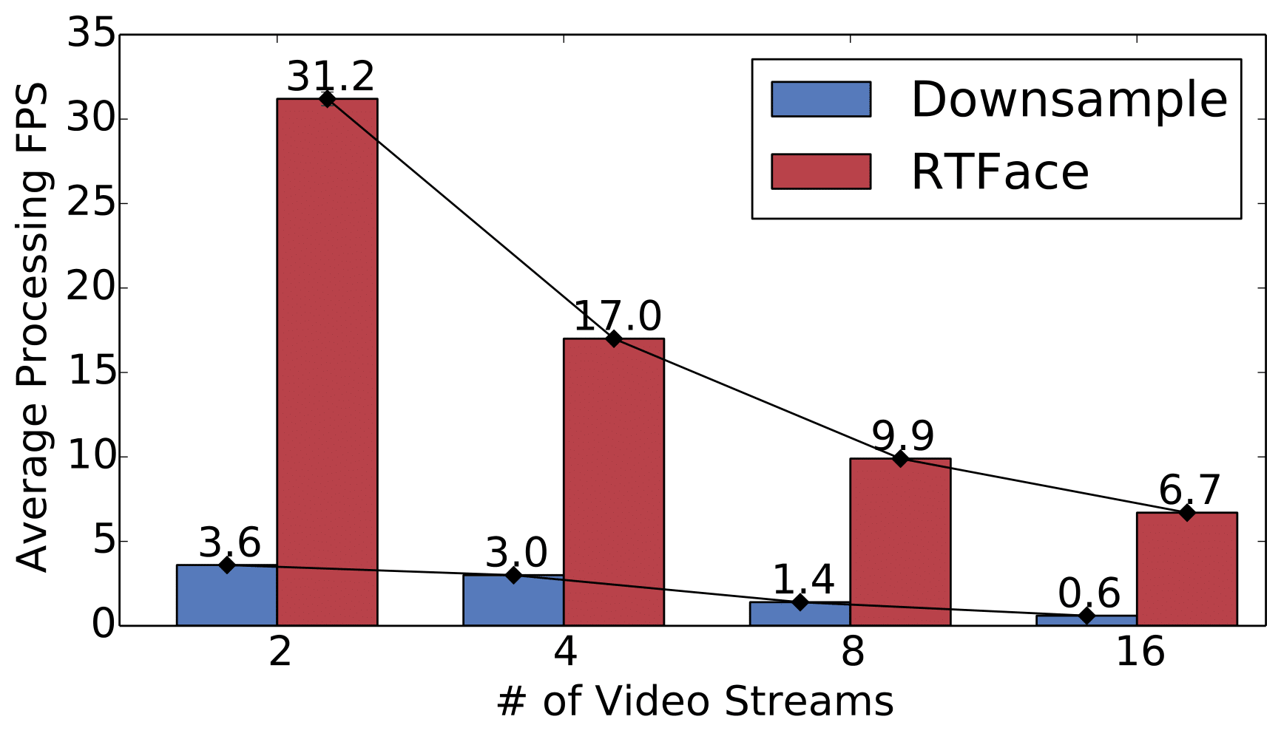
Evaluation - Scale with Number of Cameras
Multi-stream Frame Rate on 4-core Cloudlet with HD videos
Notes:
Transition: With the tracking-based pipeline, we’re able to achieve an order of magnitude improvements over baseline
Baseline: we down-sample as people usually do. With original videos, our wins will be larger
We can also support more streams given a fixed h/w

Slide 14
Summary
Privacy Mediator Architecture
OpenFace
RTFace
Optimizations to Reduce Privacy Leaks
Controlled Reversal of Denaturing
IoT Service Deployment at Enterprise Scale
Design Choices for Cloudlets
Notes:
Transitions: Highlights of our solution, other materials I didn’t cover

Slide 15
Q & A
Full Video Demo
https://goo.gl/gbtCLd

