Slide 1

Gradual Verification
Jenna Wise
Advisors: Jonathan Aldrich, Josh Sunshine
Special Thanks to: Johannes Bader & Éric Tanter
Bader, Johannes, Jonathan Aldrich, and Éric Tanter. "Gradual Program Verification." In International Conference on Verification, Model Checking, and Abstract Interpretation, pp. 25-46. Springer, Cham, 2018.
Notes:
Seamlessly and flexibly combine static and dynamic verification by drawing on the general principles from abstract interpretation to derive a gradual system from a static one
Concerned with formal verification where program correctness determined from specifications of system components drawn from a logic
Function/method pre- and postconditions (contracts)
Loop invariants
Type invariants
etc.

Slide 2

Overview & Motivation
Static Verification
(at compile time)
Dynamic Verification
(at runtime)
If sound, no static errors means no runtime errors (no extra runtime checks)
Software must be fully specified with detailed specs
Gradual Verification
Software can be partially specified with partial specs
Specs turned into runtime checks (runtime overhead)
Notes:
Programs checked for properties at compile time
Programs checked for properties at runtime
Toy programs are easy to specify and prove statically; especially for builders of static verification tools,
for software engineers in practice on real code at scale not so much
Dynamic verification allows us extra information at runtime so partial specs are an option,
Not the case for static verification
Tradeoffs
Scalability
Performance
More or less runtime overhead
Annotation burden
More or less detailed annotations
Other SE concerns
Up to speed with tool
Anticipation of changes to software over time
Modularity & Information hiding
Readability; can multiple people work on this at a time
Error detection

Slide 3
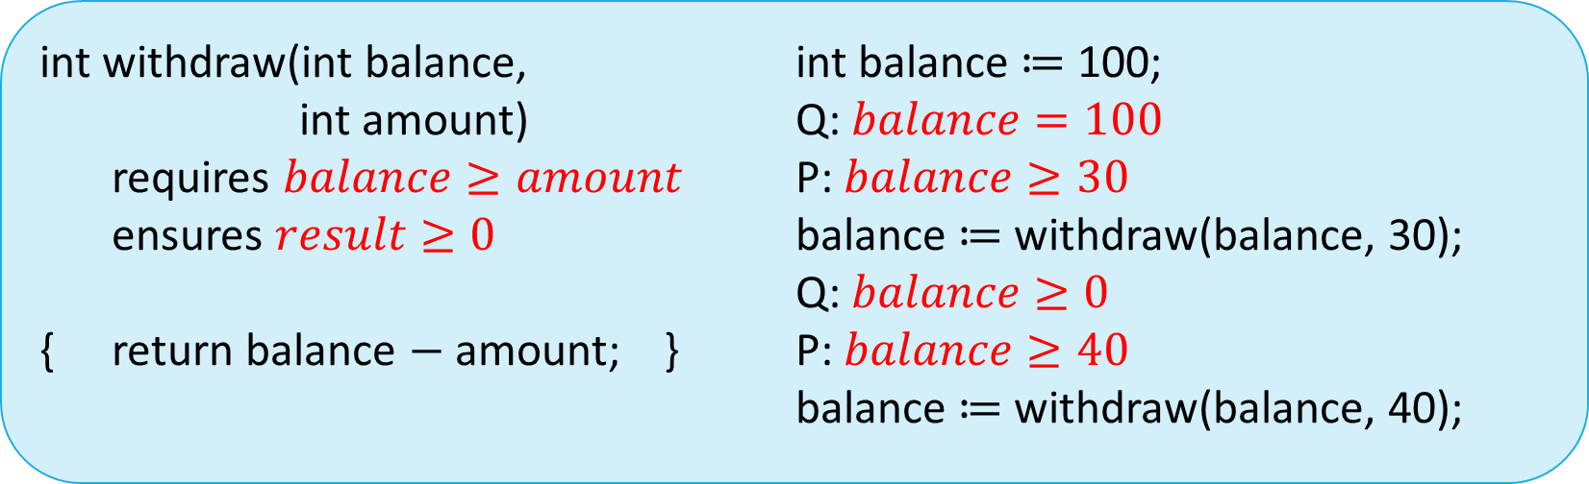


Static Verification by Example
Annotated Function
Client Program
int withdraw(int balance,
int amount)
requires $balance≥amount$
ensures $result≥0$
{ return balance $−$ amount; }
int balance $≔$ 100;
Q: $balance=100$
P: $balance≥30$
balance $≔$ withdraw(balance, 30);
Q: $balance≥0$
P: $balance≥40$
balance $≔$ withdraw(balance, 40);
Precondition: P
?
$$⇓$$
?
Postcondition: Q
$$⇓$$
Notes:
Example formal methods: Hoare logic – [brief explanation of Hoard logic]
Static verifier proves that withdraw compiles with its contract (pre & post)
Proves that two statements are valid:
- withdraw’s pre & assert sat

Slide 4
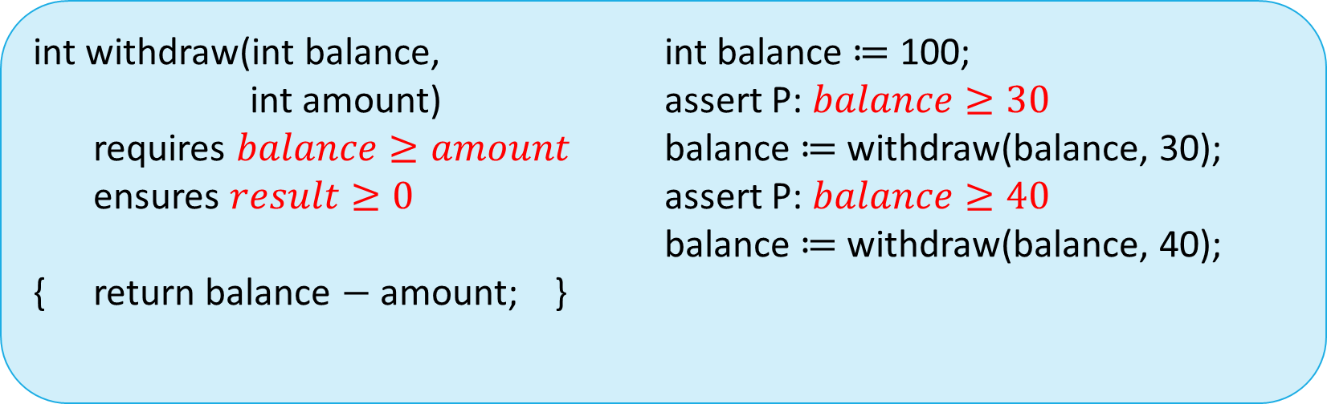
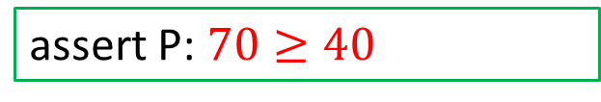
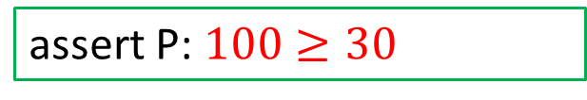
Dynamic Verification by Example
Annotated Function
Client Program
int withdraw(int balance,
int amount)
requires $balance≥amount$
ensures $result≥0$
{ return balance $−$ amount; }
int balance $≔$ 100;
assert P: $balance≥30$
balance $≔$ withdraw(balance, 30);
assert P: $balance≥40$
balance $≔$ withdraw(balance, 40);
?
assert P: $100≥30$
?
assert P: $70≥40$
Notes:
A violation at runtime causes a runtime exception to be thrown, preventing the program from entering a state that contradicts its specification

Slide 5
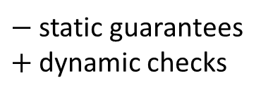
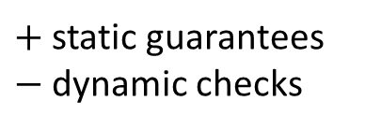
Gradual Guarantee
Reducing the precision of specifications never breaks the verifiability of a program (formalized in [1])
$−$ static guarantees
$+$ dynamic checks
Static Verification
(at compile time)
Dynamic Verification
(at runtime)
$+$ static guarantees
$−$ dynamic checks
Gradual Verification adhering to Gradual Gaurantee
[1] Bader, Johannes, Jonathan Aldrich, and Éric Tanter. "Gradual Program Verification." In International Conference on Verification, Model Checking, and Abstract Interpretation, pp. 25-46. Springer, Cham, 2018.
Notes:
Reducing the precision of contracts – ie. specifying less statically in a gradual formula (? represents more things, phi has more information in it)
Reducing the precision of specifications never breaks verifiability of a program
- Can choose desired level of precision without artificial constraints imposed by the verification tech
Verifiability monotone with respect to precision
Programmers can gradually evolve and refine static annotations
Rewarded by progressively increased static correctness guarantees and progressively decreased runtime checking
Explain why helps us leverage static and dynamic advantages
Valid program means it adheres to its specification - verified
Static Gradual Guarantee
A valid gradual program is still valid when we reduce the precisions of specifications
Dynamic Gradual Guarantee
A valid program that takes a step still takes the same step if we reduce the precision of specifications

Slide 6
Approach
Notes:
Introduce imprecision into formulas/specifications
Take static verification techniques and lift them following the abstract interpretation perspective on gradual typing to deal with imprecise specifications
Adheres to gradual guarantee
Derive a gradually verified language from a statically verified language following the abstract interpretation perspective on gradual typing
- Follows the gradual guarantee

Slide 7

Gradual Formulas
$\tilde{φ} ∷=φ | φ∧ ?$
Allow imprecision in specifications via the “?” wildcard
Notes:
? Is the unknown formula
Gradual formulas can include imprecision
Phi is the static part of an imprecise formula

Slide 8



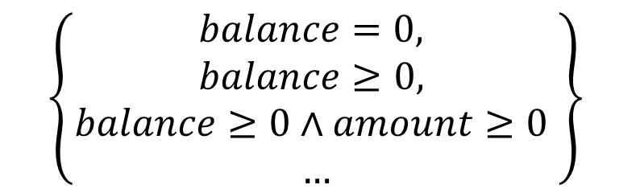
Gradual Formulas
Gradual formulas are given meaning by the set of fully precise formulas it represents
Gradual Formula
Set of Representing formulas
$$balance≥0$$
$$\left\{balance≥0\right\}$$
$$\left\{\begin{aligned}balance=0, \\ balance≥0, \\ balance≥0∧amount≥0 \\ …\end{aligned}\right\}$$
$$balance≥0∧ ?$$
$$balance≥0∧balance<0$$
Notes:
$$γ\left(φ\right)= \left\{φ\right\}$$
$$γ\left(φ∧ ?\right)= \left\{\begin{aligned}\left\{φ^{′}∈SatFormula | φ^{′}⟹φ\right\} if φ∈SatFormula \\ undefined otherwise\end{aligned}\right.$$
Is an infinite set, so any implementation will need to safely approximate this set. What does "safely" mean (guided by the gradual guarantee)?
Balance < 0 can’t be in the set since it does not imply balance \geq 0

Slide 9
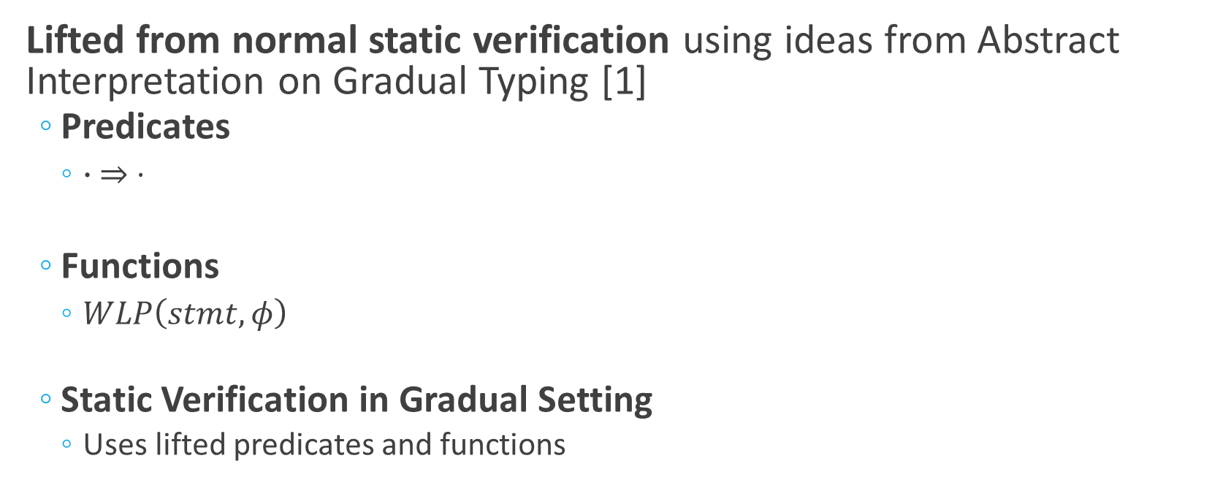
Static Verification in Gradual Setting
Lifted from normal static verification using ideas from Abstract Interpretation on Gradual Typing [1]
  Predicates
    $∙ ⇒ ⋅$
  Functions
    $WLP\left(stmt,φ\right)$
  Static Verification in Gradual Setting
    Uses lifted predicates and functions
[1] Garcia, Ronald, Alison M. Clark, and Éric Tanter. "Abstracting gradual typing." ACM SIGPLAN Notices. Vol. 51. No. 1. ACM, 2016.
Notes:
Motivate lifting!
Common static verification predicates and functions, such as implication and weakest preconditions calculus are lifted using ideas from Abstract Interpretation on Gradual Typing
Illustrated in the next slide

Slide 10

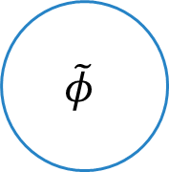

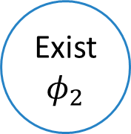


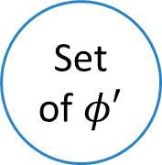
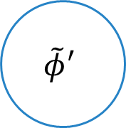
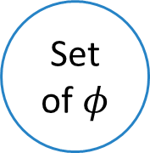

⟹ Lifting Diagram
$$\tilde{φ}$$
$$\tilde{φ}′$$
$$\tilde{⟹}$$

?
$$γ$$
$$γ$$
Set of $φ$
Exist $φ_{1}$
Exist$φ_{2}$
Set of $φ′$
$$⟹$$

Notes:
Gamma concretizes a gradual formula – computes a set of static formulas represented by the gradual formula
Gamma(phi and ?) = {phi’ | phi’ => phi} phi’ is SAT
Can get vice-versa, if we know gradual implication holds then there must have been two concrete formulas that imply one another in the concrete representation of those two formulas

Slide 11


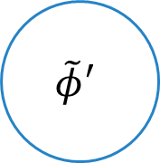

WLP Lifting Diagram
$$\tilde{φ}$$
$$\tilde{φ}′$$
??
$$\tilde{WLP}$$
$$γ$$
$$α$$
Set of $φ$
Set of $φ′$
$$WLP$$
Notes:
Gamma concretizes a gradual formula – computes a set of static formulas represented by the gradual formula
Gamma(phi and ?) = {phi’ | phi’ => phi} phi’ is SAT
Each of them are sent to WLP and a set of new formulas are computed
Alpha takes this set of phi’ and abstracts the concrete formulas to a gradual formula
The most precise gradual formula that represents all of the phi’
Alpha(set of phi’) = min_precise{tphi in tF | set of phi’ in Gamma(tphi)}

Slide 12
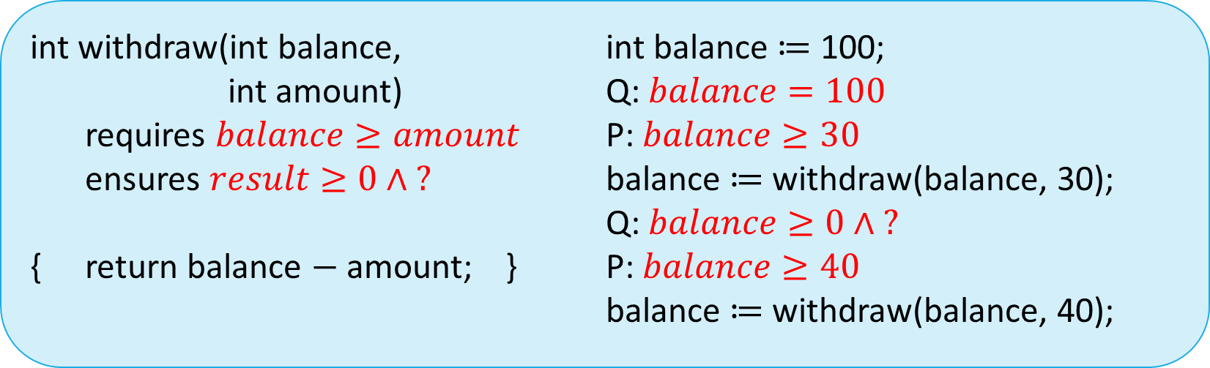
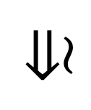

Static Verification in Gradual Setting:
An Example
Annotated Function
Client Program
int withdraw(int balance,
int amount)
requires $balance≥amount$
ensures $result≥0∧ ?$
{ return balance $−$ amount; }
int balance $≔$ 100;
Q: $balance=100$
P: $balance≥30$
balance $≔$ withdraw(balance, 30);
Q: $balance≥0∧ ?$
P: $balance≥40$
balance $≔$ withdraw(balance, 40);
?
$$⇓$$
$$\tilde{⇒}$$
?
Notes:
Thanks to our imprecise postcondition, the static checker optimistically accepts the program
Static verifier optimistically accepts an imprecise formula if some concrete formula representing it makes the formula valid
Not guaranteed that the precondition is satisfied at runtime without additional checks
GVLs runtime semantics should add such checks as appropriate – talk about this next
Will fail if timplies b < 0 since that will contradict the static part of balance >= 0 wedge ?
We also expect that imprecise formulas might not necessarily result in runtime checks if there is enough static information to ascertain the result
Ensures (result = old(balance) – old(amount)) wedge ?

Slide 13

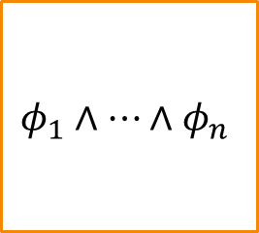

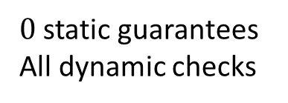

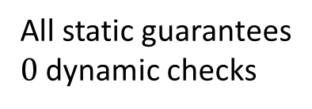

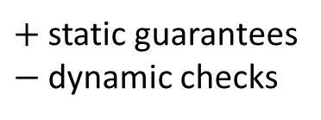

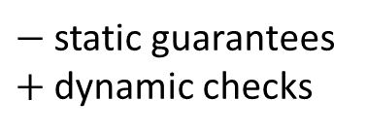
Dynamic Verification in Gradual Setting
Dynamic verification in the gradual setting must ensure that a valid instantiation of “?” in the static checker is valid at runtime
Pay-as-you-go cost model: optimized runtime checks based on statically guaranteed info
All static guarantees
$0$ dynamic checks
$−$ static guarantees
$+$ dynamic checks
$0$ static guarantees
All dynamic checks
$$φ_{1}∧…∧φ_{n}$$
$$?$$
$$…$$
$$φ_{1}∧…∧φ_{n−1}∧ ?$$
$$φ_{1}∧…∧φ_{n−2}∧ ?$$
$$φ_{1}∧ ?$$
$+$ static guarantees
$−$ dynamic checks
Notes:
Explain you can do runtime checks without optimization
The statically-guaranteed optimization means that the cost of runtime checking increases with increases in imprecision
- And decreases with increased precision; static information
Rely on static verification for fully-precise formulas
Rely on optimized runtime checks and static checks for imprecise formulas
Runtime checks optimized based on statically-guaranteed information

Slide 14
Current & Future Work

Slide 15
Current & Future Work
Building a usable, language independent, and robust gradual verification tool
  Supports verification of programs written in multiple languages
    Java, Wyvern, C0
  Supports efficient verification of many different language features
    Shared mutable state, recursive data structures, loops, etc.
Notes:
Multiple languages with extensibility for more
Robust in that it verifies many different non-trivial language features
Extend theory to these features along the way
Educational setting:
Course and number at CMU?

Slide 16
Current & Future Work
Deploy the tool in 15-122
  Teaches imperative programming and methods for ensuring the correctness of imperative programs
  Teaches process and techniques for going from algorithms to correct implementations
Research Question
  Can the incremental nature of gradual verification allow students to achieve these learning goals more easily?
Notes:
This course teaches imperative programming in a C-like language and methods for ensuring the correctness of imperative programs; teaches dynamic verification.
ability to write code that is correct by design and accounts for the needs of its application context
Learn the process and techniques needed to go from high-level descriptions of algorithms to correct imperative implementations
RQ:
Students can learn static verification techniques incrementally; they do not need to learn how to specify aliasing precisely at the start
Static verification details helpful for really understanding functional correctness

Slide 17
Summary
Static Verification
(at compile time)
Dynamic Verification
(at runtime)
If sound, no static errors means no runtime errors (no extra runtime checks)
Software must be fully specified with detailed specs
Gradual Verification adhering to Gradual Gaurantee
Software can be partially specified with partial specs
Specs turned into runtime checks (runtime overhead)
Notes:
Allows us to leverage these advantages by – explain further in words out loud
- progressively increased static correctness guarantees and progressively decreased runtime checking

Slide 18

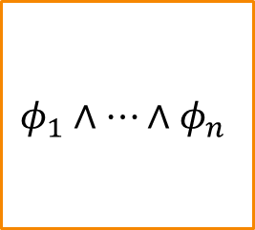

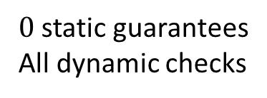

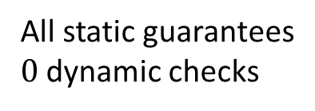

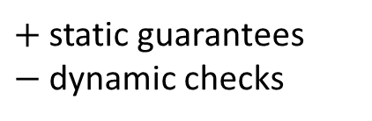

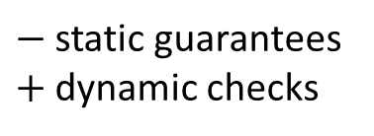
Summary
All static guarantees
$0$ dynamic checks
$−$ static guarantees
$+$ dynamic checks
$0$ static guarantees
All dynamic checks
$$φ_{1}∧…∧φ_{n}$$
$$?$$
$$…$$
$$φ_{1}∧…∧φ_{n−1}∧ ?$$
$$φ_{1}∧…∧φ_{n−2}∧ ?$$
$$φ_{1}∧ ?$$
$+$ static guarantees
$−$ dynamic checks
Gradual Verification adhering to Gradual Gaurantee
Notes:
Allows us to leverage these advantages by – explain further in words out loud
progressively increased static correctness guarantees and progressively decreased runtime checking
The Gradual guarantee allows us to support a smooth continuum between static and dynamic verification leveraging these advantages
Our Approach
Gradual static verification derived from static verification following the abstract interpretation perspective on gradual typing
Gradual dynamic verification follows a pay-as-you-go cost model – optimizing runtime checks based on statically-guaranteed information

