Slide 1

Jeannette M. Wing
President’s Professor of Computer Science and Department Head
Computer Science Department
Carnegie Mellon University
MSR-CMU Center for Computational Thinking Review
14 May 2012

Slide 2
Original Goals of Center
(Rashid and Wing, circa Fall 2005)
Foster greater ties between MSR and CMU
  Make MSR more visible at CMU
  Single POC at CMU for MS and MSR
  [Context: Intel lablet since 2002, Google lab 2005]
Help support basic research in computing at CMU
  On topics of interest to MSR
  [Context: Federal research funding of computing tight]
Promote computing
  Via small-scale education and outreach efforts
  [Context: Decline of enrollments in CS]

Slide 3
Brief History
Spring 2007: Center launched under Jeannette’s and Rick’s leadership, Jeannette first Director
  Parallel Thinking Probe, led by Guy Blelloch
  MindSwap on Privacy, led by Lorrie Cranor and Cynthia Dwork
  Seminar Series: CT + X
  Outreach: CS4HS, Women@SCS
Fall 2007-Spring 2010: Peter Lee (2007-2009) and Seth Goldstein (2009-2010) serve as Acting Directors
  Many smaller projects, rather than one probe, emphasizing CT + X and Broader Impact
  Seminar Series
  Outreach: CS4HS, Women@SCS
  2009 Final Report

Slide 4
2010-2013: Goals of Center Revisited
(agreement between MSR and Wing)
Support quality research in computer science
Encourage computer scientists to think broadly, e.g., about societal grand challenges
  CT + X
  CT in energy, sustainability, healthcare, etc.
Encourage collaborations between CMU researchers and MSR
  Engage MSR researchers on Center proposals
  Visits by CMU to MSR
  CMU@MSR seminar series, talks by CMU faculty at MSR
  Establish connections for potential collaborations, e.g., Pfenning and PL and FM researchers at MSR
  Support collaborative research, e.g., Harchol-Balter and Chayes
  MindSwap, e.g., May 14-15 on the Interface between Computer Science and Economics
Continue to support education and outreach at a small scale

Slide 5
2010-11 Projects
Power Management
of Data Centers
(Energy) [Harchol-Balter]
Algorithms for
Electronic Markets
((+ Economics)) [Blum&Gupta]
Visual Memex
(QoL) [Efros]
Societal Challenges
CT + X
Bridging Shannon & Hamming
(+ Inf Thy} [Guruswami]
Testing at Scale
[Gibson&Bryant]
Dichotomy Conjecture
(+ Math} [O’Donnell]
Basic Research
FP for Intro CS (15-150)
[Licata]
S&V for Intro CS (15-122)
[Pfenning]
Kinect Workshop
(+ Art&Design) [Levin]
Education &
Outreach
CS4HS
[Frieze]

Slide 6
2011-12 Projects
4
This Afternoon &
Tomorrow
1
Privacy in Social Networks
(Privacy) [Blum]
Kinect-Receptionist
(QoL) [Veloso&Rudnicky]
MindSwap on CS + Economics
Pricing the Cloud
(+ Economics) [Harchol-Balter]
Societal Challenges
3
CT + X
Trichotomies
(+ Math + Physics) [O’Donnell]
Approximation&Inapproximability
[Guruswami]
Basic Research
5
S&V for Intro CS (15-122)
[Pfenning]
Kinect Workshop
(+ Art&Design) [Levin]
6
Education &
Outreach
Women-CS Fit
[Frieze]
Logic for HS Students
[Sieg]

Slide 7
2010-11 Projects
2
Power Management
of Data Centers
(Energy) [Harchol-Balter]
Algorithms for
Electronic Markets
((+ Economics)) [Blum&Gupta]
Visual Memex
(QoL) [Efros]
Societal Challenges
CT + X
Bridging Shannon & Hamming
(+ Inf Thy} [Guruswami]
Testing at Scale
[Gibson&Bryant]
Dichotomy Conjecture
(+ Math} [O’Donnell]
Basic Research
FP for Intro CS (15-150)
[Licata]
S&V for Intro CS (15-122)
[Pfenning]
Kinect Workshop
(+ Art&Design) [Levin]
Education &
Outreach
CS4HS
[Frieze]

Slide 8
Collaborations: Connections
Blum and Gupta ↔ SVC
Efros ↔ Szeliski (Redmond), Blake (Cambridge)
Gibson and Bryant ↔ Godefroid (Redmond),
Yang (formerly SVC) on Simsa thesis committee
Harchol-Balter and Douroudi (PhD) ↔ Chayes, Borgs (NE)
Koenig (undergrad) → intern with Leino (Redmond) (2011, 2012)
O’Donnell and Zhou (PhD) ↔, Lu (Asia); Barak, Sudan (NE)
Pekhimenko → intern with Leino (Redmond)
Pfenning ↔ Bjorner, Leino (Redmond)
Sharma (PhD) → intern with Singh and Devanur (Redmond, 2012)
Shrivastava (PhD) → intern with Mehrota (Redmond, 2012), Bing Image Search
Zhou (PhD) → intern with Barak (NE, 2011) and Gopalan (SVC, 2012)

Slide 9
Collaborations: Visits/Talks
Guy Blelloch → Redmond (2008, 2009, 2010)
Crary → Redmond (Hawblitzel)
Douroudi (PhD) → NE
Efros → India, Cambridge
Goldstein → Redmond (2010)
Gupta → SVC, NE
Guruswami → SVC (Gopalan), Redmond (Peres’s group)
Harchol-Balter → NE*, eXtreme, Redmond
Langmead → Redmond (2009)
Levin ← McMail (MSR, 2009), Blinn and Tansley (MS, Redmond 2011)
Licata (post-doc) → Cambridge (Peyton Jones, Vytiniotis, Russo Kennedy, Beirman)
Mowry → Redmond
Naden (PhD) → Redmond
Pfenning → Redmond
Pfenning ← Leino and Jason Yang (Redmond)
Simsa (PhD) → SVC (Lamport, Terry, Yu)
Xing → Redmond
Zhou (PhD) → Asia
CMU Theory Group ←
  Gopalan (SVC), scheduled for fall 2012
  Dinur, Madry, Tauman (NE)

Slide 10
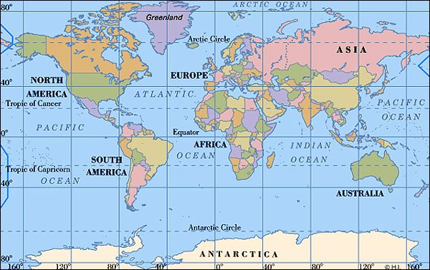
Worldwide Collaborations
Cambridge (1,2)
Asia (1,1)
Redmond (9,12*)
New England (4*,6)
SVC (3,4)
India (0,1)

Slide 11
My Grand Vision
Computational thinking will be a fundamental skill used by everyone in the world by the middle of the 21st Century.
  Just like reading, writing, and arithmetic.
  Incestuous: Computing and computers will enable the spread of computational thinking.
  In research: scientists, engineers, …, historians, artists
  In education: K-12 students and teachers, undergrads, …
J.M. Wing, “Computational Thinking,” CACM Viewpoint, March 2006, pp. 33-35.
Paper off http://www.cs.cmu.edu/~wing/
Notes:
Thinking computationally not programming
Fundamental skill not rote skill
Computing not computers: pervasive computing/computers is passe: 20th Century!
“used by” ambitious. Certainly needed to function in modern society
In research: long-term; in education: nearer-term (outreach, diversity, changing society’s view of our field)

Slide 12
Computational Thinking in Education

Slide 13
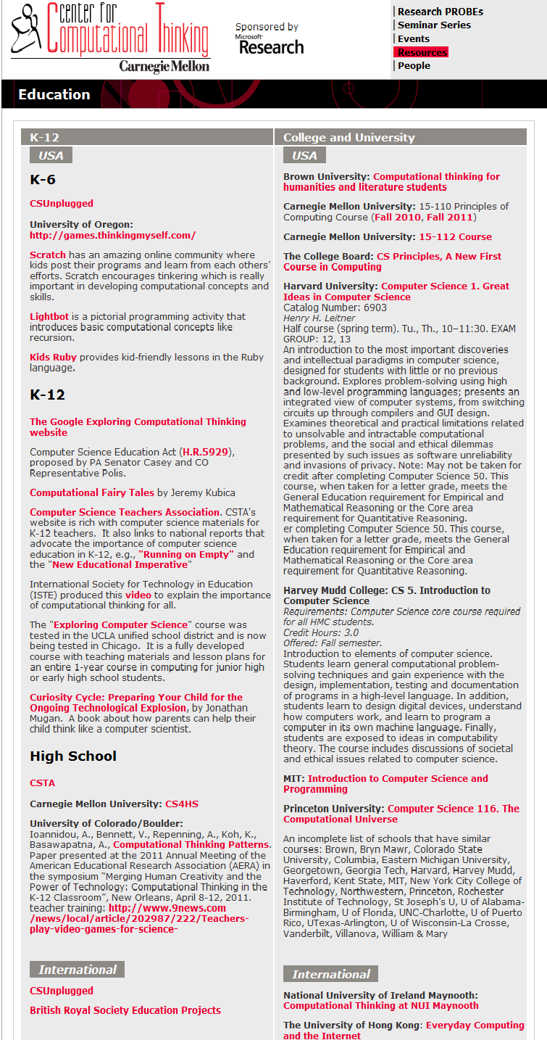
CMU-MSR Center for Computational Thinking
http://www.cs.cmu.edu/~CompThink/

Slide 14
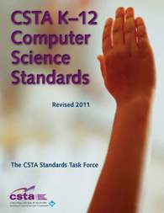



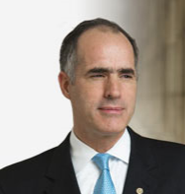
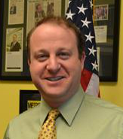
National Efforts
High School
CS Principles: http://csprinciples.org
- With NSF support, revision of CS AP courses
K-12
http://www.csta.acm.org/
- Computational Thinking Resource Set: A Problem-Solving Tool for Every Classrooom
- K-12 Computer Science Standards
CSTB Reports:
The Report of a Workshop on Pedagogical Aspects of Computational Thinking 2011
Report of a Workshop on the Scope and Nature of Computational Thinking 2010
Congress
Computer Science Education Act (H.R.5929) 2010
- proposed by PA Senator Casey and CO Representative Polis.

Slide 15
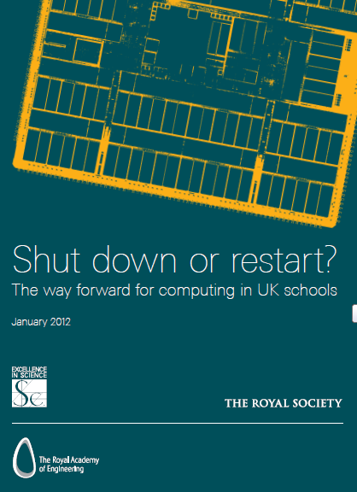

International Efforts
United Kingdom
UK Research Assessment (2009):
The Computer Science and Informatics panel said
“Computational thinking is influencing all disciplines….”
British Royal Society (2012):
Shut down or restart? report
`` “Computational thinking” offers insightful ways to view how information operates in many natural and engineered systems.
…
3. Every child should have the opportunity to learn Computing at school. We believe that:
• Every child should be expected to be ‘digitally literate’ by the end of compulsory education, in the same way that every child is expected to be able to read and write. ‘’
Ireland
National University of Ireland Maynooth
B.Sc. in Computational Thinking

Slide 16










International Efforts
Asia
Europe
“…aims to deliver enrichment courses to pre-tertiary students to deepen their infocomm skills by supporting course fees for students to take up computer science courses anchored in computational thinking.”
Latin America
Middle East
http://ctegypt.blogspot.com/

Slide 17
Thank you!

