Slide 1
ZFS & TRIM

Slide 2
Agenda
ZFS Structure and Organisation
  Overview
  MOS Layer
  Object-Set Layer
  Dnode
  Block Pointer
ZFS Operations
  Writing new data to disk
  Freeing blocks
TRIM

Slide 3
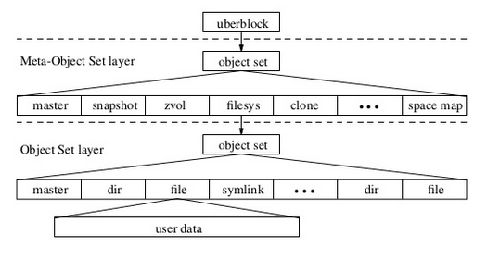
ZFS Structural Overview
uberblock points to a data structure that describes an array of meta-objects
meta-objects include filesystems, snapsots, clones, ZVOLs and the space map of free/allocated blocks in the pool
MOS object references an object-set that describes its array of objects
the objects include things like directories, files, symbolic links, etc
Finally, these objects reference an array of blocks that contain the objects' data

Slide 4
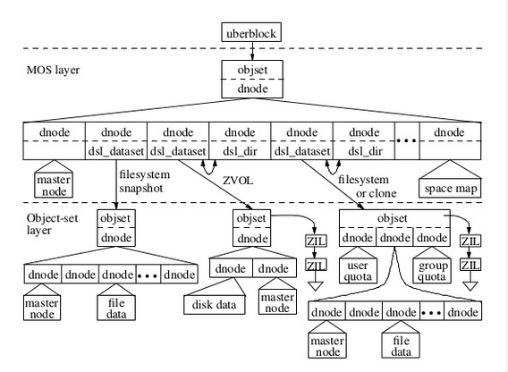
ZFS Structure

Slide 5
Meta-Object Set(MOS) Layer
Dataset and Snapshot Layer(DSL) and Storage Pool Allocator(SPA) modules implement the MOS layer
It manages the pool of space and makes it available to filesystem modules of object-set layer
DSL tracks datasets, which includes snapshots, clones, active filesystems, and ZFS Volumes(ZVOLs), and deadlists
SPA tracks allocated vs free blocks in the current pool and is also responsible for handling compression and deduplication

Slide 6
Object-Set Layer
ZVOLs - single dnode which references two dnodes
  disk data - dnode references an array of block pointers
  master node - records ZVOl-specific information
Filesystems - three dnodes
  2 dnodes record user and group space usage for a filesystem
  3rd dnode references an array of files and directories
Clones of filesystem/ZVOL have same organization as the filesystem/ZVOL

Slide 7
DNODE
Analogous to INODE but also describes objects in MOS layer.
Managed by DMU.
Describe files, directories, filesystems, snapshots, clones, space maps etc.
Size < 128 Kb -> Direct pointer to appropriate size block
else -> 1 level of indirection: points to 16Kb block -> each entry points to 128 Kb blocks.
Can increase level of indirection if required.
Reference ZAP objects

Slide 8
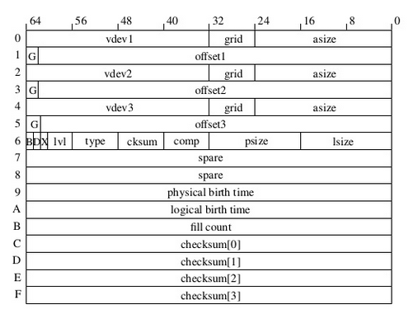
Block Pointer
Checksum for every block ( up to 3 copies of data ).
All meta-data blocks have double redundancy by default.
Birth time - counted in terms of number of checkpoints since the ZFS pool was created.
Dedup flag - quick shortcut

Slide 9
Freeing blocks
ds_deadlist_obj in dsl_dataset_phys_t
Deadlist -> I don't want this block, but a previous snapshot might.
Only free a block if:
  No references to this block
  birth_time of the block is more than the birth_time of the latest snapshot
While deleting snapshot, free those blocks that
  Are in the next snapshot's deadlist AND
  have birth_time greater than previous snapshot.

Slide 10
TRIM - Motivation
Attempt to make sure certain writes do not take very long ( as compared to other writes ).
SSD Blocks only have a limited number of erases.
Using TRIM, a FS can tell the underlying SSD that certain blocks are no longer relevant.
TRIM reduces, on average, garbage collection cost and also increases the lifetime of SSDs.
TRIM does have overhead - so use judiciously !!

