Slide 1
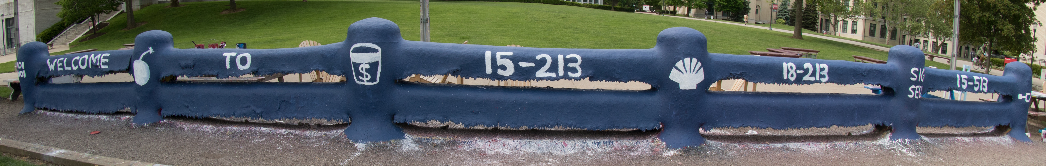
Course OverReview 15-213: Introduction to Computer Systems 28th Lecture, August 5, 2022

Slide 2
Course Theme: Abstraction Is Good But Don’t Forget Reality
Most CS and CE courses emphasize abstraction
Abstract data types
Asymptotic analysis
These abstractions have limits
Especially in the presence of bugs
Need to understand details of underlying implementations
Useful outcomes from taking 213
Become more effective programmers
Able to find and eliminate bugs efficiently
Able to understand and tune for program performance
Prepare for later “systems” classes in CS & ECE
Compilers, Operating Systems, Networks, Computer Architecture, Embedded Systems, Storage Systems, etc.

Slide 3
Computer Arithmetic
Does not generate random values
Arithmetic operations have important mathematical properties
Cannot assume all “usual” mathematical properties
Due to finiteness of representations
Integer operations satisfy “ring” properties
Commutativity, associativity, distributivity
Floating point operations satisfy “ordering” properties
Monotonicity, values of signs
Observation
Need to understand which abstractions apply in which contexts
Important issues for compiler writers and serious application programmers

Slide 4
You’ve Got to Know Assembly
Key to machine-level execution model
Behavior of programs in presence of bugs
High-level language models break down
Tuning program performance
Understand optimizations done / not done by the compiler
Understanding sources of program inefficiency
Implementing system software
Compiler has machine code as target
Operating systems must manage process state
Creating / fighting malware
x86 assembly is the language of choice!

Slide 5
Memory Isn’t Random Access
Memory is not unbounded
It must be allocated and managed
Many applications are memory dominated
Memory performance is not uniform
Cache and virtual memory effects can greatly affect program performance
Adapting program to characteristics of memory system can lead to major speed improvements
Memory referencing bugs especially pernicious
Effects are distant in both time and space

Slide 6
Memory Referencing Errors
C and C++ do not provide any memory protection
Out of bounds array references
Invalid pointer values
Abuses of malloc/free
Can lead to nasty bugs
Whether or not bug has any effect depends on system and compiler
Action at a distance
Corrupted object logically unrelated to one being accessed
Effect of bug may be first observed long after it is generated
How can I deal with this?
Program in Java, Ruby, Python, ML, …
Understand what possible interactions may occur
Use or develop tools to detect referencing errors (e.g. Valgrind)

Slide 7
Constant Factors Matter
Even exact op count does not predict performance
Easily see 10:1 performance range depending on how code written
Must optimize at multiple levels: algorithm, data representations, procedures, and loops
Must understand system to optimize performance
How programs compiled and executed
How to measure program performance and identify bottlenecks
How to improve performance without destroying code modularity and generality

Slide 8
Computers Don’t Just Compute
They need to get data in and out
I/O system critical to program reliability and performance
They communicate with each other over networks
Many system-level issues arise in presence of network
Concurrent operations by autonomous processes
Coping with unreliable media
Cross platform compatibility
Complex performance issues

Slide 9
Final Exam
August 11th (NOT the 12th)
12:20—3:20pm, location TBD (will announce on Piazza)
The focus is on the second half of the course
IO
Signals
Processes
Virtual Memory
Malloc
Threads
Thread Synchronization
Other

Slide 10
IO
In the following code, a parent opens a file twice, then the child reads a character:
char c;
int fd1 = open("foo.txt", O_RDONLY);
int fd2 = open("foo.txt", O_RDONLY);
if (!fork()) { read(fd1, &c, 1); }
Clearly, in the child, fd1 now points to the second character of foo.txt. Which of the following is now true in the parent?
fd1 and fd2 both point to the first character.
fd1 and fd2 both point to the second character.
fd1 points to the first character while fd2 points to the second character.
fd2 points to the first character while fd1 points to the second character

Slide 11
Signals
void sigint_handler(int sig)
{
jid_t fg_jid = fg_job();
/* Masking signals */
sigset_t mask, prev_mask;
Sigfillset(&mask);
Sigprocmask(SIG_BLOCK, &mask, &prev_mask);
if (fg_jid != 0) {
/* Sending a SIGINT signal for the process group.
* Deleting the job. */
pid_t pid = job_get_pid(fg_jid);
kill(-pid, SIGINT);
delete_job(pid);
}
/* Unblocking the masked signals */
Sigprocmask(SIG_SETMASK, &prev_mask, NULL);
}
Name three bugs in this code

Slide 12
Signals
errno not saved
void sigint_handler(int sig)
{
jid_t fg_jid = fg_job();
/* Masking signals */
sigset_t mask, prev_mask;
Sigfillset(&mask);
Sigprocmask(SIG_BLOCK, &mask, &prev_mask);
if (fg_jid != 0) {
/* Sending a SIGINT signal for the process group.
* Deleting the job. */
pid_t pid = job_get_pid(fg_jid);
kill(-pid, SIGINT);
delete_job(pid);
}
/* Unblocking the masked signals */
Sigprocmask(SIG_SETMASK, &prev_mask, NULL);
}
Job list API used with signals unblocked – should be here instead
delete_job takes a JID,not a PID
delete_job should be called
from the SIGCHLD handler, not here
Name three bugs in this code
errno not restored

Slide 13
Processes
What outputs are possible? Is “15213”?
pid_t Fork(void) {
pid_t pid = fork();
if (pid == -1) exit(1);
return pid;
}
int main(void) {
setvbuf(stdout, 0, _IONBF, 0); // no buffering
if (Fork() == 0) { putchar('3'); return 0; }
putchar('5');
if (Fork() == 0) { putchar('2'); }
putchar('1');
return 0;
}

Slide 14
Processes
3
What outputs are possible? Is “15213”?
pid_t Fork(void) {
pid_t pid = fork();
if (pid == -1) exit(1);
return pid;
}
int main(void) {
setvbuf(stdout, 0, _IONBF, 0); // no buffering
if (Fork() == 0) { putchar('3'); return 0; }
putchar('5');
if (Fork() == 0) { putchar('2'); }
putchar('1');
return 0;
}
2
1
fork
5
fork
1

Slide 15
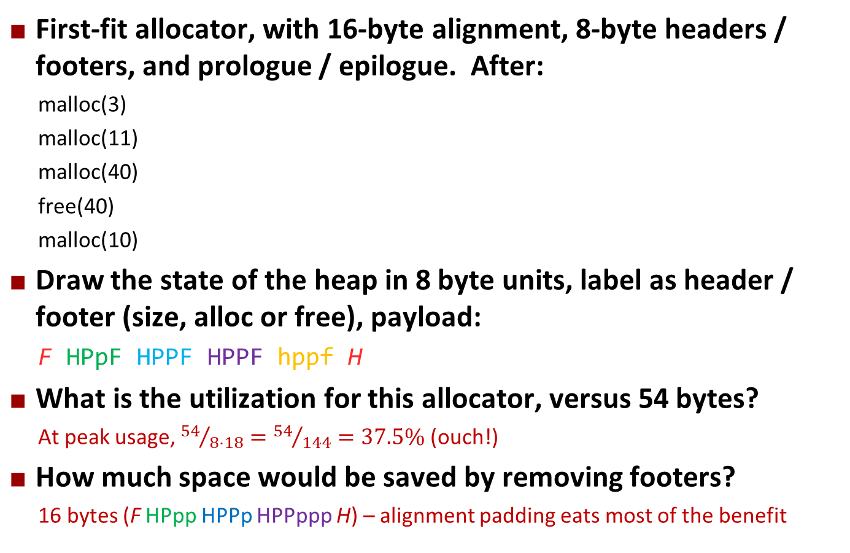
Malloc
First-fit allocator, with 16-byte alignment, 8-byte headers / footers, and prologue / epilogue. After:
malloc(3)
malloc(11)
malloc(40)
free(40)
malloc(10)
Draw the state of the heap in 8 byte units, label as header / footer (size, alloc or free), payload:
F HPpF HPPF HPPF hppf H
What is the utilization for this allocator, versus 54 bytes?
At peak usage, ${54}/{8⋅18}={54}/{144}=37.5\%$ (ouch!)
How much space would be saved by removing footers?
16 bytes (F HPpp HPPp HPPppp H) – alignment padding eats most of the benefit

Slide 16
Threads
What is the range of value(s) that main will print?
There’s no synchronization, so 1 and 2 are both possible.
If we remove i from thread and instead directly access count, does the answer change?
No, this makes no difference.
int count = 0;
void *thread(void *unused) {
int i = count;
i = i + 1;
count = i;
}
int main(void) {
pthread_t tid[2];
for (int i = 0; i < 2; i++)
pthread_create(&tid[i], NULL,
thread, NULL);
for (int i = 0; i < 2; i++)
pthread_join(tid[i]);
printf ("%d\n", count);
return 0;
}

Slide 17
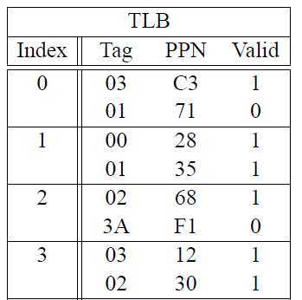
Virtual Memory
Virtual addresses are 20 bits wide
Physical addresses are 18 bits wide
Page size is 1024 bytes
TLB is 2-way set associative with 16 total entries
Label each bit of a virtual address (Virtual Page offset, Virtual page number, TLB index, TLB tag):
NNNN NNNN NNoo oooo oooo
TTTT TTTi ii
Given virtual address 0x04AA4, what happens?
VPN is 0x04A >> 2 = 0x12; TLB index is 2, tag is 02 PPN is 0x68 Phys addr is 0x68 << 10 | (0x04AA4 & 0x3FF) = 0x1A2A4

