Slide 1
The Future of Computing and the Future of 15-213
15-213: Introduction to Computer Systems
Last Lecture, Aug. 1, 2022

Slide 2
Logistics – Last Two Weeks of Class
This is the last official lecture
  Remaining class sessions are open TA+faculty office hours
Proxy lab checkpoint is due August 4
Proxy lab final is due August 11
  NO GRACE DAYS
  Any extension is technically an incomplete
Exam is August 10, here, 12:30-3:30pm
  Disability accommodations? Go to ODR Testing Center instead
Prof. Railing is on vacation
  Prof. Weinberg’s email is zackw@cmu.edu
  Prof. Weinberg’s office is GHC 4124
  I’ll be there after class till 4pm, every day this week and next, except:
    Thursday Aug. 3
    Thursday Aug. 10
    Friday Aug. 11

Slide 3
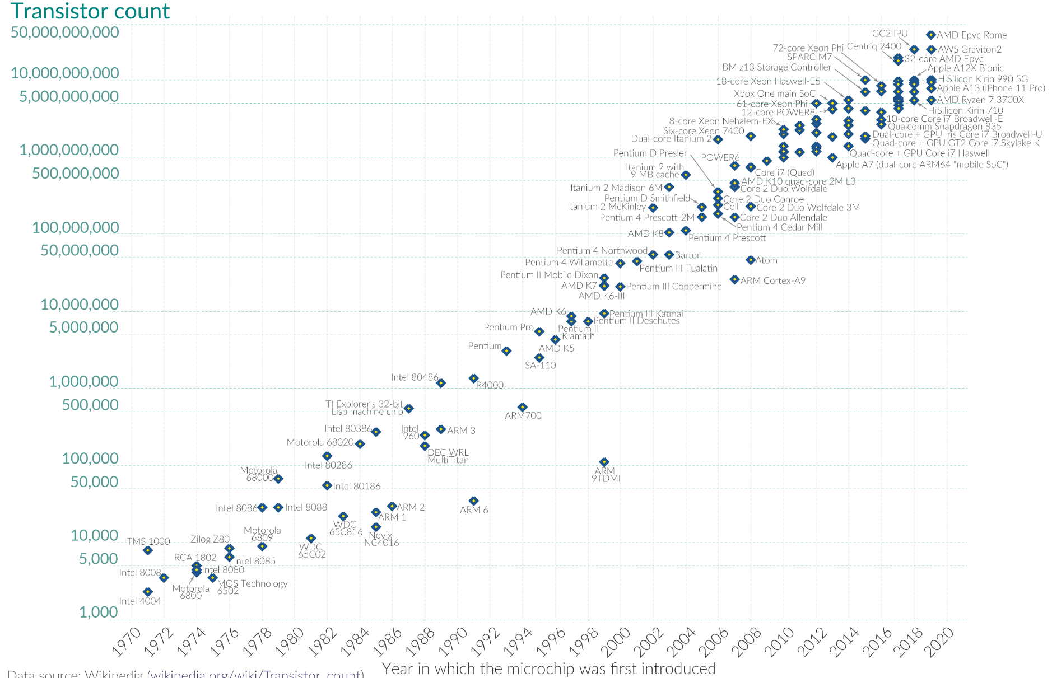
50 Years of “Moore’s Law”
Source: Our World in Data https://ourworldindata.org/technological-change
Notes:
For fifty years now, the future of computing has been dominated by one trend. Every two years or so, the number of transistors we can fit onto a single integrated circuit “chip” doubles.
It’s called “Moore’s Law”, but that makes it sound like an inevitable fact of nature, which it isn’t. Gordon Moore said this was something we could do, and chip fabrication engineers all over the world made it happen.

Slide 4
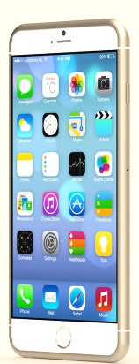
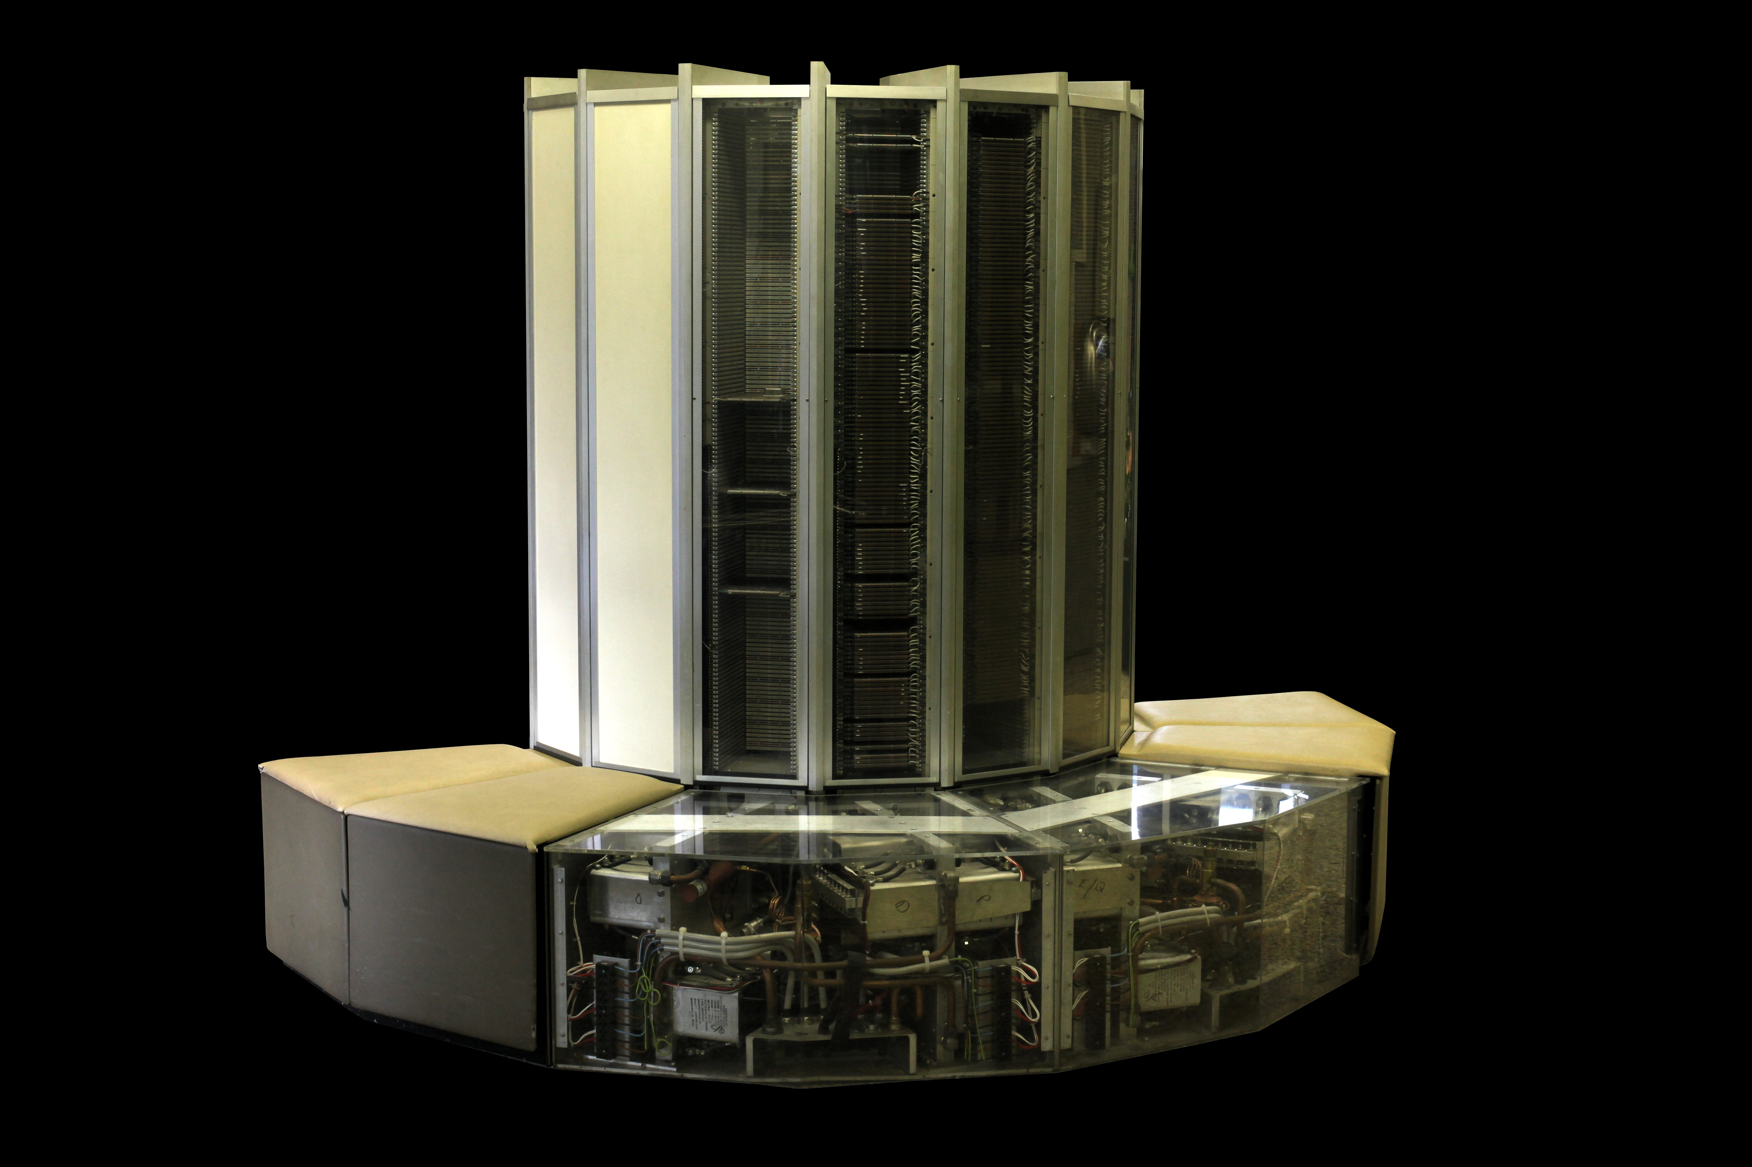
What Moore’s Law Has Meant
1976 Cray 1
  250 M Ops/second
  ~170,000 chips
  0.5B transistors
  5,000 kg, 115 KW
  $9M
  80 manufactured
2014 iPhone 6
  > 4 B Ops/second
  ~10 chips
  > 3B transistors
  120 g, < 5 W
  $649
  10 million sold in first 3 days
Notes:
Moore’s Law is why you can have a phone in your pocket today that has orders of magnitude more computational power, and working memory, and storage than the most powerful computer money could buy in 1976. And that’s not even looking at the graphics capabilities, or the networking. Oh, and it uses 23 thousand times less power and costs 15 thousand times less money.

Slide 5
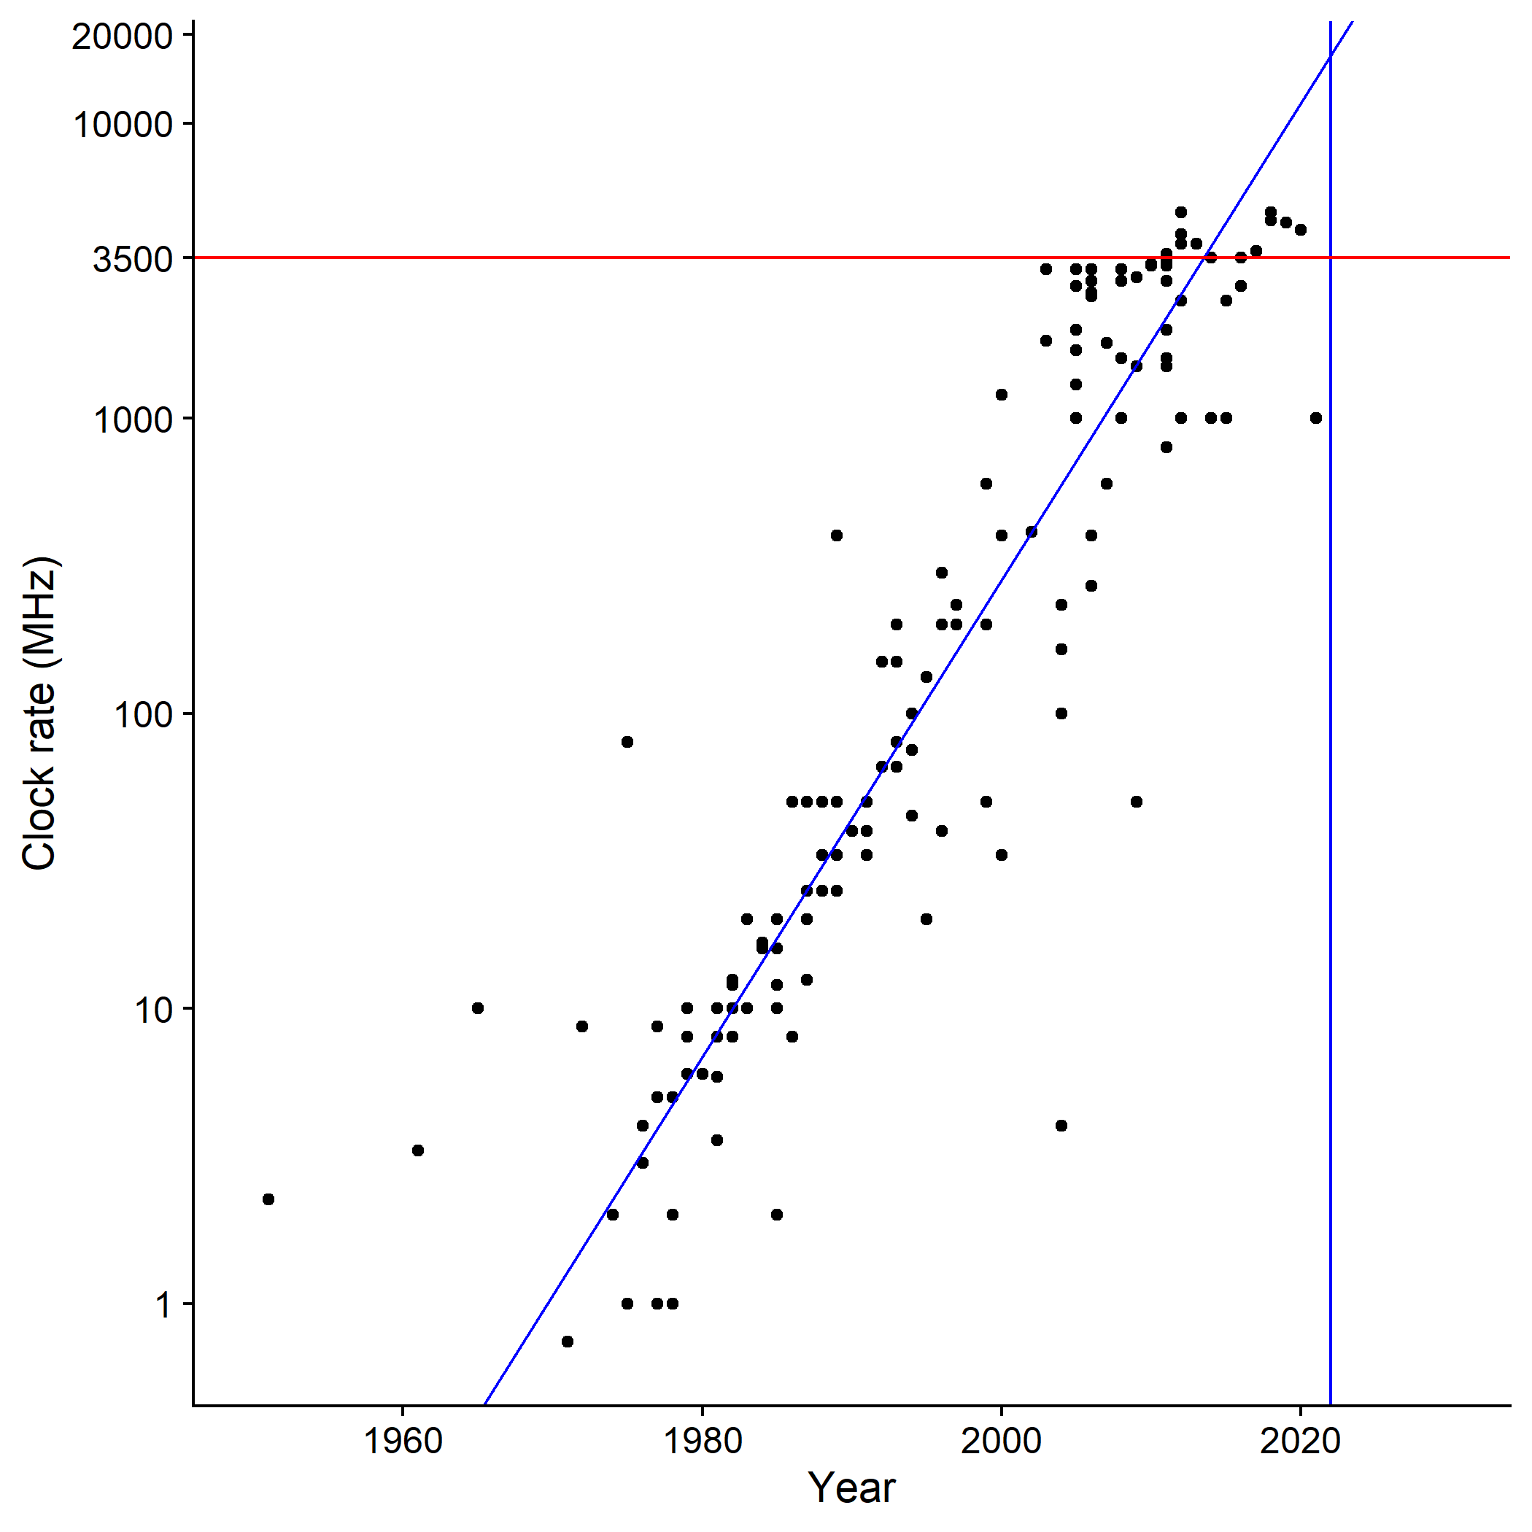
Exponential trends can’t continue forever
Source: Wikipedia https://en.wikipedia.org/wiki/Instructions_per_second#Timeline_of_instructions_per_second
Notes:
An exponential trend cannot continue forever.
Eventually you run into physical limits, and CPUs already hit one – seventeen years ago.
This is a plot of CPU clock rate versus year. In principle, every time you make the transistors smaller you can also increase the clock rate, and it sure looks like we’re still doubling every couple years…
But wait, that graph’s top has been cut off…

Slide 6
Exponential trends can’t continue forever
Notes:
Logarithmic axes can trick your eyes. See the place where the blue lines intersect? That’s how fast CPUs ought to be going today, if we were still on trend. Just shy of 20 GHz.
In reality, we’re down at three GHz, where we’ve been since roughly 2005. The red line. The physical limit. The power wall, it’s called. Run the clock faster than 3GHz and it generates so much waste heat that you can’t get rid of it fast enough anymore.

Slide 7
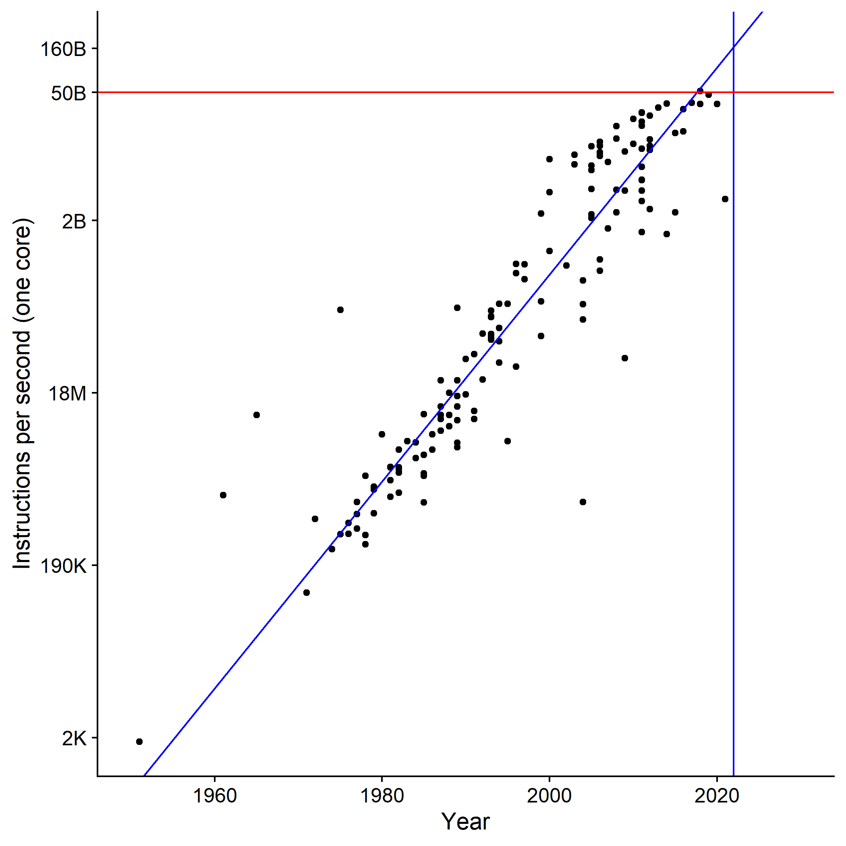
Clock rate → single thread performance
Notes:
OK, the clock can’t go any faster, is there any other way to make the CPU faster? Yes there is. We’re still getting more transistors, after all. Single-threaded performance, measured in instructions executed per second, kept going up till about 2012. This is stuff like out-of-order execution, wide issue, bigger caches, cleverer branch prediction, special-purpose instructions. But, again, if we were perfectly on trend we would be about 3x faster than we actually are.

Slide 8
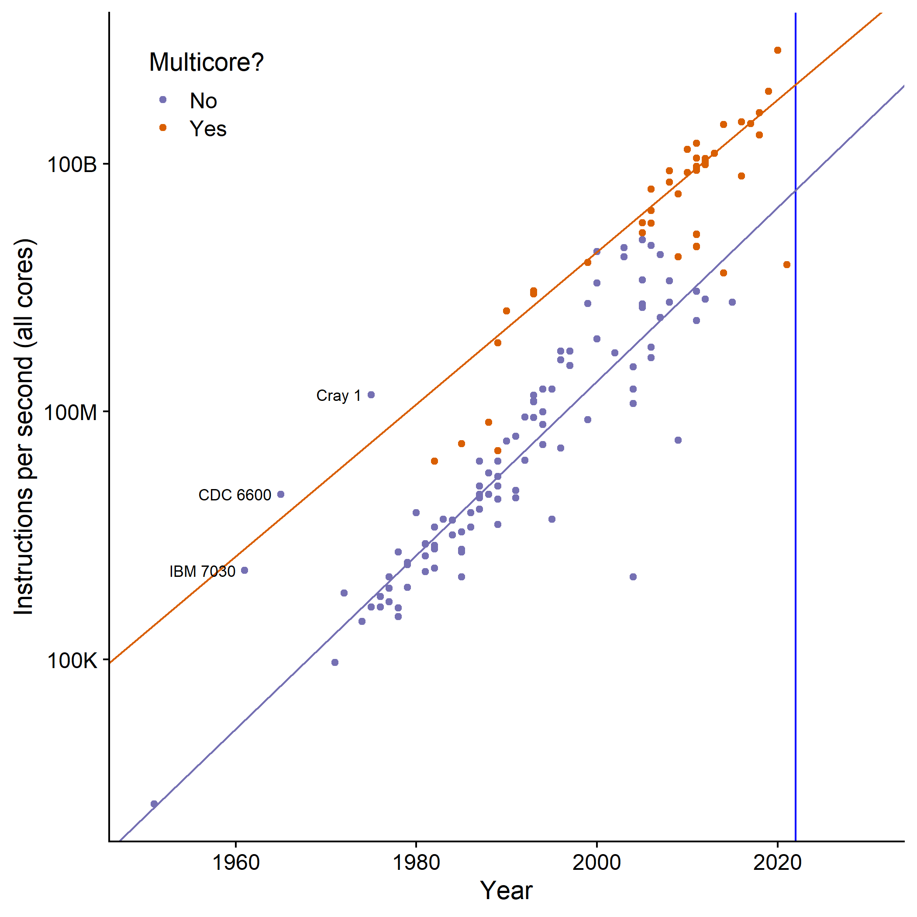
If all else fails, add parallelism…
Notes:
When you’ve exhausted all the tricks you can to squeeze out more single-threaded performance, and the fab’s still giving you more transistors every year, what do you do? You add cores. Hardware threads. Coarse-grained parallelism. For about ten years now, that’s the biggest thing CPU designers have been giving us with each new design iteration. That gave us a step change – purple line to orange line – and it’s kept the theoretical performance of CPUs going on the overall exponential trend all the way up to today… but the catch is, you gotta rewrite your code to use those cores.

Slide 9
Parallel Computation and 213
Last week we had classes on parallel programming
In shell lab you have to think about concurrent processes
In proxy lab you will use threads to serve many simultaneous clients
  But the concurrency isn’t really the point of either lab
We’re working on a new lab where concurrency is the most important thing
  Also covers file system semantics and the craft of modifying existing code
  Not done, but we’d like to show it to you anyway…

Slide 10
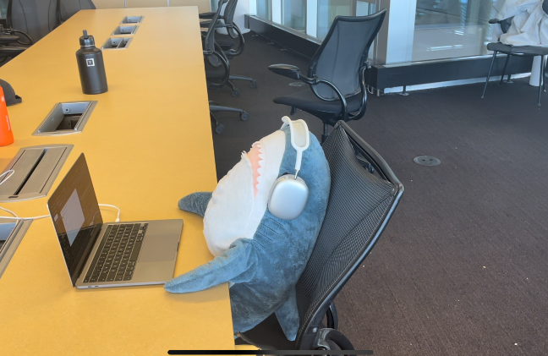
The Shark File System Lab
Requin wrote a file system to store his files
He needs your help to finish it
  Several important functions are not implemented
  Only one program can access the file system at a time
  There’s some other problems (we’ll let you discover them ;-)
Handed out on Autolab / Github Classroom as usual
  https://autolab.andrew.cmu.edu/courses/15213-m23/assessments/sfslab
  213 students only
  Released Wednesday evening
NOT FOR CREDIT, just for fun
  But it may help with the final
  You might want to finish proxy lab first
Requin hard at work

Slide 11
SFS Lab Overview
sfslab-handout $ ls
Makefile | The usual helper files…
README
check-format
helper.mk
lua/ | Interpreter for the Lua scripting language (used in traces)
sfs-disk.c | This is the file you’ll need to modify
sfs-disk.h | Interface between sfs-disk.c and sfs-tester.c
sfs-driver.py | Runs sets of traces
sfs-tester.c | Runs one trace; can also be used interactively
traces/ | Our tests for your code (more to come…)
YOUR-FEEDBACK.md | Write your thoughts on this lab here and ‘make submit’ it

Slide 12
SFS Lab Traces
Like proxy lab, traces are in four categories
S traces test single-threaded correctness
  You can pass these traces by implementing the functions sfs_getpos, sfs_seek, and sfs_rename
C traces test concurrent correctness
  To pass these traces you will need to revise sfs-disk.c and make it thread-safe
P traces test concurrent performance
  There aren’t any P traces yet
X traces test optional additional features
  For people who want to go beyond our basic expectations
  More to do with filesystem capabilities than with concurrency

Slide 13
SFS Lab Logistics
We’re still actively designing this lab
We will be updating the handout over the next two weeks
  Use “make update-handout” to pull updates
We want your suggestions and commentary
  Write whatever you want us to see in the “YOUR-FEEDBACK.md” file, “make submit” will send it to us
  Write your own trace files! “make submit” will also send those in
Feel free to change ANYTHING
  Except for the “lua” subdirectory, which we didn’t write
  (You’re encouraged to read the code in the “lua” subdirectory, especially if you are curious about how interpreters work)

Slide 14
SFS Lab Resources
Guides for concurrent programming with C and pthreads:
  https://randu.org/tutorials/threads/
  https://web.archive.org/web/20180512055837/https://www.cs.nmsu.edu/~jcook/Tools/pthreads/pthreads.html
  https://www.mit.edu/people/proven/IAP_2000/index.html
  I don’t love any of these. If you find a better one please tell us about it.
Documentation for the Lua scripting language:
  https://www.lua.org/docs.html
  https://lualanes.github.io/lanes/
The only documentation for SFS itself is the writeup and comments in sfs-disk.c, sfs-disk.h, and sfs-tester.c.
  We regret the inconvenience.
  Do not hesitate to ask questions (on Piazza, in class, in TA office hours, show up to Prof. Weinberg’s office any time the door is open)

Slide 15
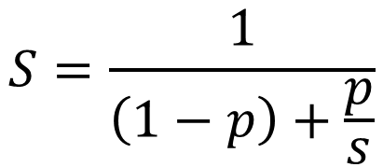
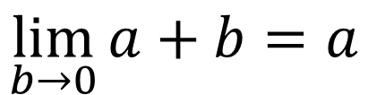
Can’t outrun Amdahl
Moore:
  Most CPU functions got faster
  simultaneously
  Memory density scaled too!
  I/O (& mem latency) was the
  primary bottleneck to work around
Multicore:
  Only some algorithms can be parallelized
GPUs / SIMD
  Only some algorithms can be vectorized
Special purpose instructions, custom ASICs
  Only good for that one thing
$$S=\frac{1}{\left(1−p\right)+\frac{p}{s}}$$
$$\lim_{b→0}{a+b}=a$$
Notes:
Amdahl’s Law says: Divide your program into the part you can speed up and the part you can’t. Suppose you can make the part you can speed up, take no time at all. Well, then you’ve still gotta wait for the part you couldn’t speed up.
Parallelism is great – for work that can be parallelized.
But no amount of parallelism will make reprocessing 50 terabytes of raw data go faster than the time it takes to read 50 terabytes of data off the disk.
(ask me how I know!)

Slide 16
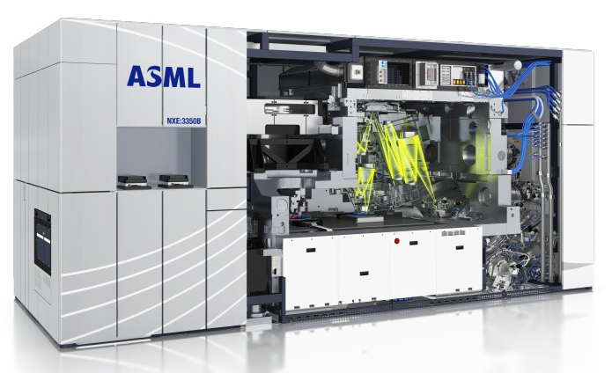
This machine costs 150 million dollars
Notes:
And there’s another problem. It’s sometimes, jokingly, called Moore’s Second Law: every time they make the transistors smaller, they have to build a whole new factory and it costs twice as much money as the previous factory.
This is just one of the machines you need for a current-generation chip fab plant. It costs 150 million dollars, give or take, and there’s only one company in the entire world that can make them.

Slide 17
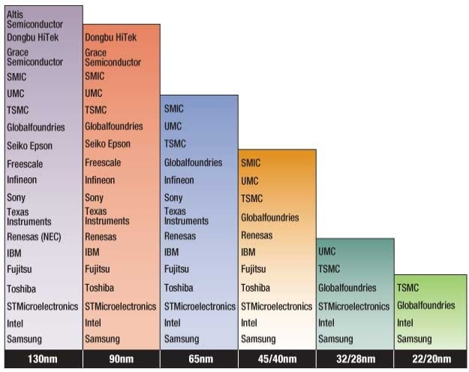
Exponential capital cost → exponentially fewer manufacturers
Notes:
Every time they have to build a new factory and spend twice as much money as the last time, some of the fab companies can’t afford to do it.
As of 2021 there’s only four companies left.

Slide 18
The future of computing isn’t (only) about speed anymore.

Slide 19
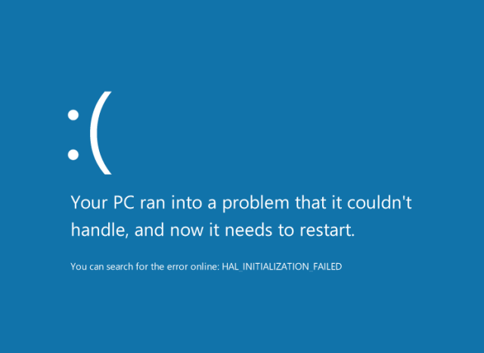

Slide 20
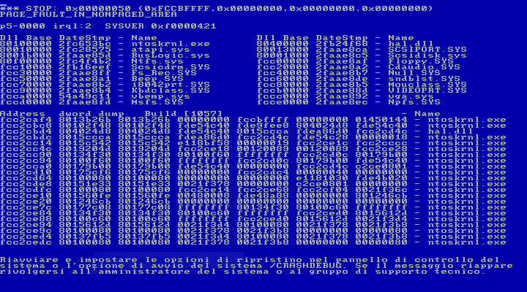

Slide 21
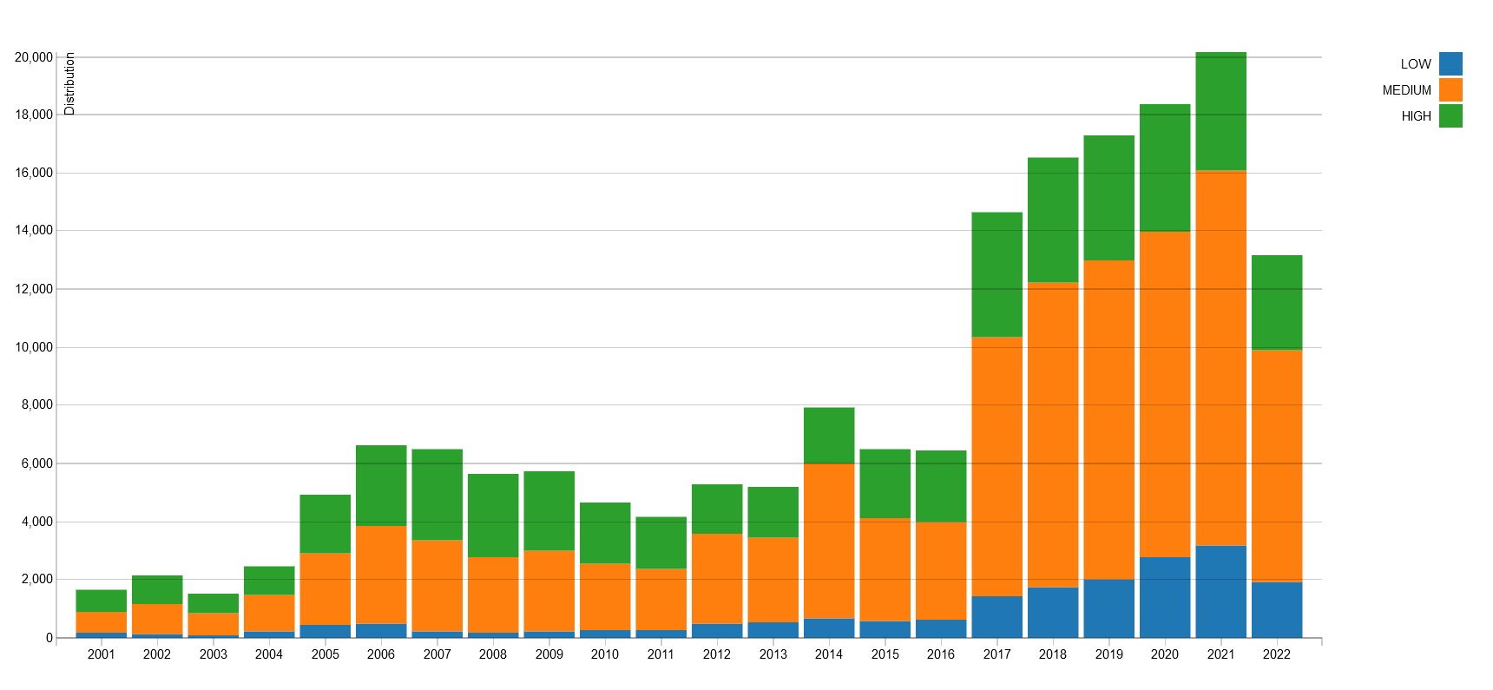
Bugs reported to the National Vulnerability Database (USA), 2001–present
(only security-critical bugs are counted)

Slide 22
Actual bug in attack lab phase 3
Buggy
Fixed
void touch3(char *sval)
{
if (hexmatch(cookie, sval)) {
printf(
"Touch3!: You called touch3(\"%s\")\n",
sval);
validate(3);
} else {
printf(
"Misfire: You called touch3(\"%s\")\n",
sval);
fail(3);
}
exit(0);
}
void touch3(char *sval)
{
if (hexmatch(cookie, sval)) {
report_touch3("Touch3!", sval);
validate(3);
} else {
report_touch3("Misfire", sval);
fail(3);
}
exit(0);
}
void report_touch3(const char *tag, const char *sval) {
const char *p;
printf("%s: You called touch3(\"", tag);
for (p = sval; *p; p++) {
unsigned char c = (unsigned char)*p;
if (c < ' ' || c > '~')
printf("\\x%02x", c);
} else if (c == '\\') {
putchar('\\');
putchar('\\');
} else if (c == '"') {
putchar('\\');
putchar('"');
} else {
putchar(c);
}
}
puts("\")");
}

Slide 23
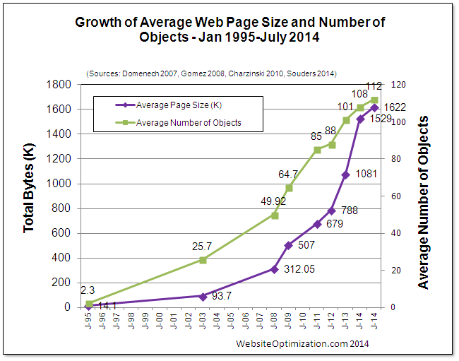
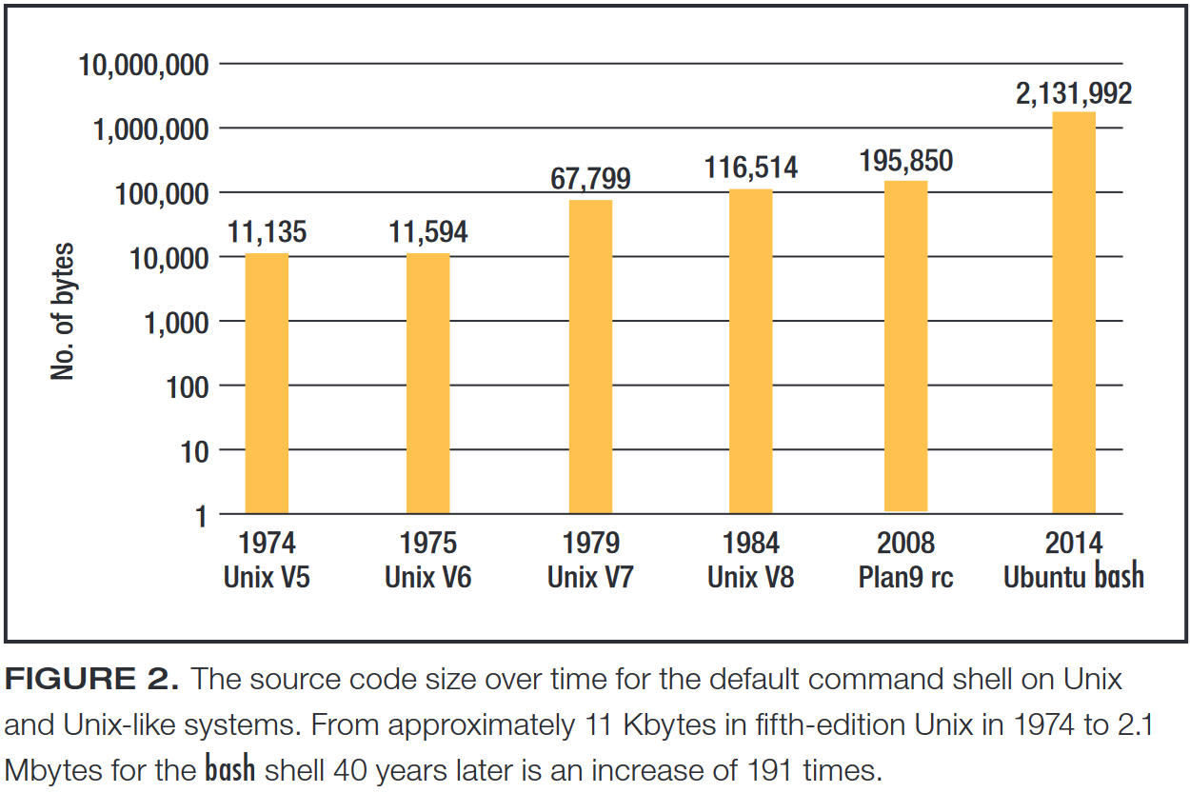
Gerald Holzmann, “Code Inflation”, IEEE Software 2015 <https://ieeexplore.ieee.org/document/7057573>

Slide 24

The local newspaper website…
1166 HTTP requests
47 MB of data transferred
Still loading stuff in the background 1 minute after this screen stabilized

Slide 25
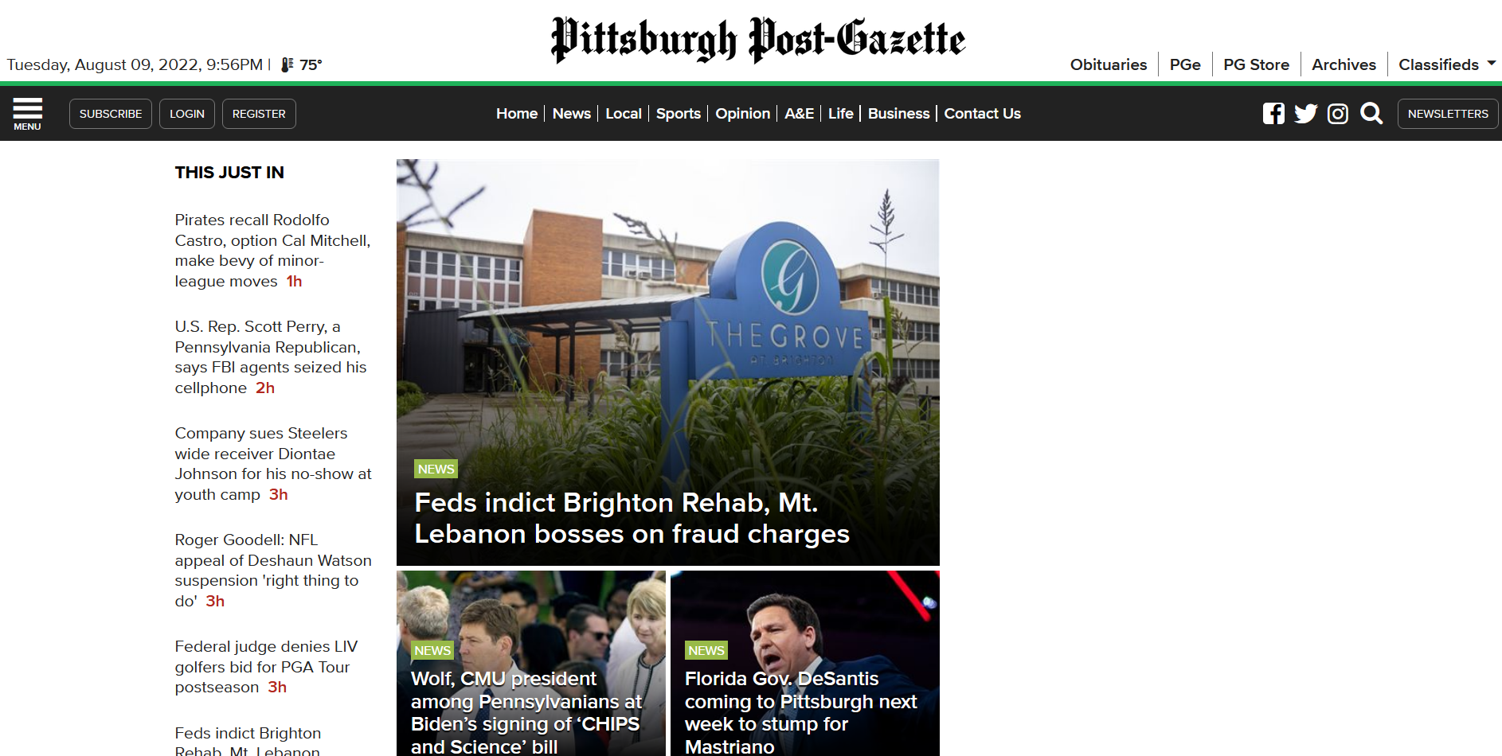
… without the ads
87 HTTP requests
7.4 MB of data transferred
No network activity after 1.5 seconds

Slide 26
Conflicting incentives
I want to read the news
  I don’t want ads distracting me from the news
  I don’t want to wait for irrelevant pictures to load
I want to discuss the news with my friends
  I want to be able to share individual articles with them
  They should be able to read the whole thing without subscribing
I want the subscription fee to be small
The newspaper needs money to operate
  Salaries for reporters, editors, photographers
  Website hosting fees
  Print and distribute paper edition
Subscription fees have never been sufficient
  Advertising makes up the difference
  Advertising means newspaper answers to advertisers

Slide 27
“algorithm???
that thing where
social media sites get money from advertisers
the more shit you click on
so they shove content at you
that is theoretically to your interest
but actually is content that will keep you clicking,
including content that enrages you,
because they don't care about giving you shit you like
just about keeping you engaged as long as possible,
and oh also did we mention
this ties into the modern lack of data privacy,
the algorithm is watching everything you interact with
to profile you better for advertising to you,
it's spying on you across platforms whenever possible,”
— @jmtorres on Tumblr

Slide 28
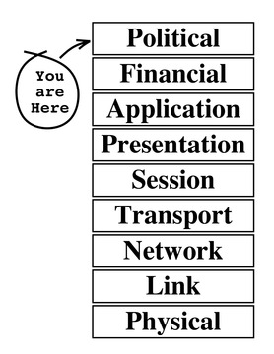
Not all problems have technical solutions
Evi Nemeth’s extended OSI protocol stack, quoted
in https://www.linuxjournal.com/article/10726

Slide 29
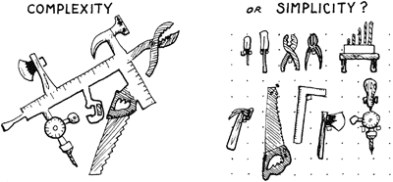
Image from ch. 11 of https://www.forth.com/starting-forth/
Notes:
Microsoft did a user study, a long time ago, to find out if there were any features of Word that nobody used, and what they found was, most people used only a tiny fraction of all the features, but every person used a different subset, and every feature was used by someone.
Forth is a programming language whose design says: every feature should be its own little program – “words”, they call them – and you should be able to put them together however you want. It’s great! If you are the sort of person who doesn’t mind writing hundreds of lines of code to get your work environment just so.

Slide 30
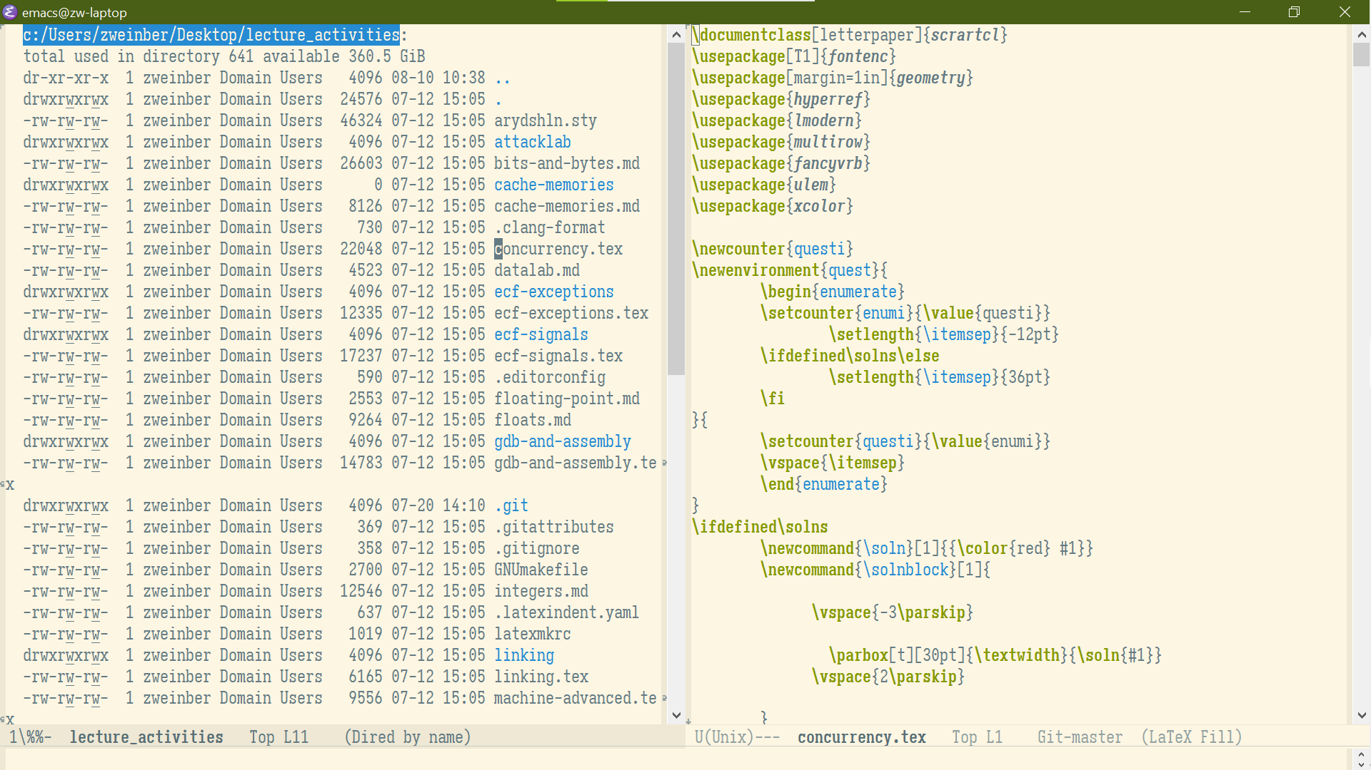
Customizability
This is what my text editor looks like.
I write everything (except PowerPoint decks ;-) in this interface.

Slide 31
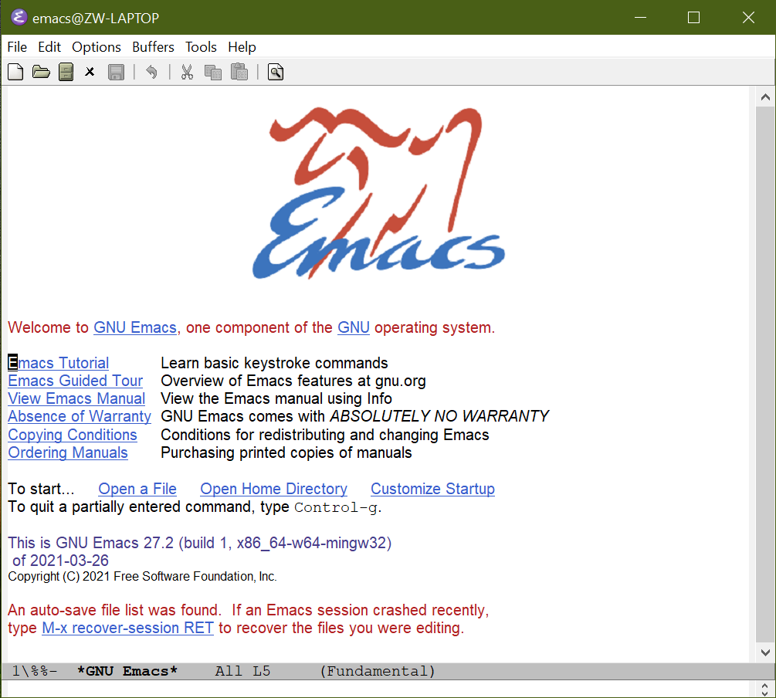
Customizability
This is what the same editor looks like if I start it up without any customization.
I’ve written hundreds of lines of Lisp to get this thing exactly the way I want it.
Most of that is about behavior, not appearance.

Slide 32
Raise your hand if you know someone who is afraid to experiment with their computer.

Slide 33
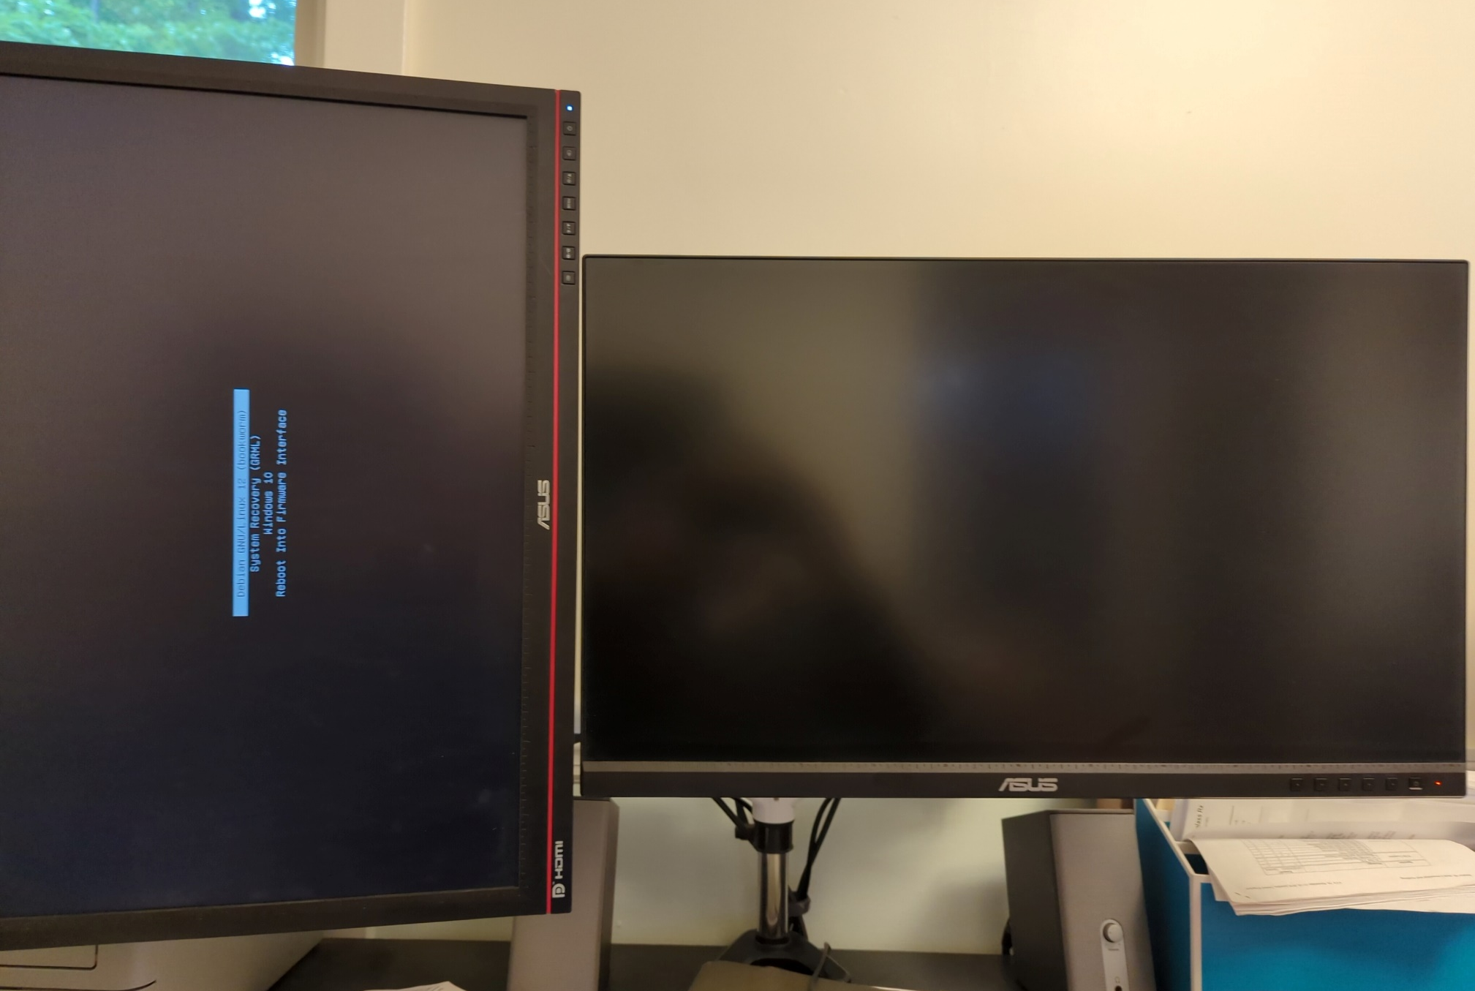

Slide 34

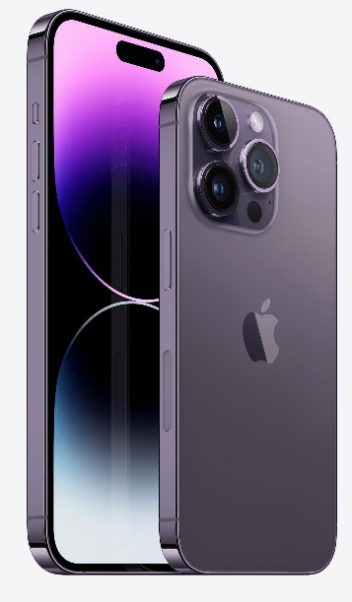

Industry prioritizes “out of box experience”
Sleek, user friendly, …
  No customization
  No replaceable parts
  Surveillance for marketing
Store everything in the cloud
  Can offload expensive computation to cloud
  Expensive paperweight if the net is down
Not programmable by end user

Slide 35


Slide 36


Ads are the #1 vector for malware
https://www.crowdstrike.com/cybersecurity-101/malware/malvertising/
https://www.malwarebytes.com/malvertising

Slide 37


App stores are the #2 vector for malware

Slide 38
Not all problems have technical solutions
(Firefox + uBlock Origin kills malvertising dead)
(but then the newspaper goes out of business…)
Evi Nemeth’s extended OSI protocol stack, quoted
in https://www.linuxjournal.com/article/10726

Slide 39
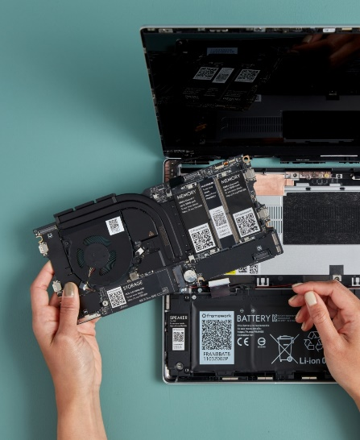
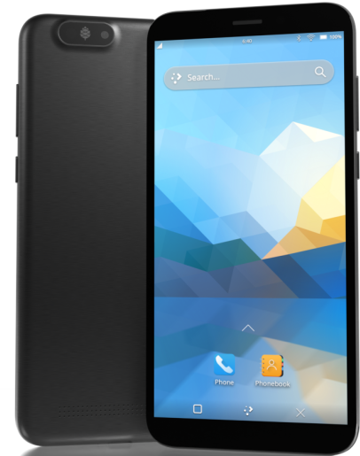
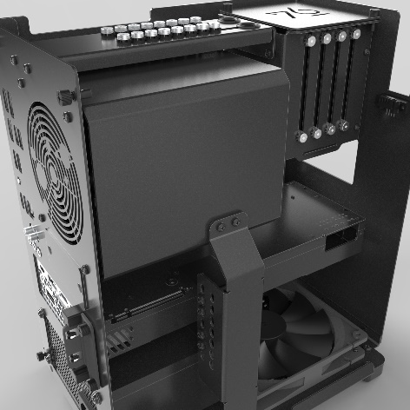
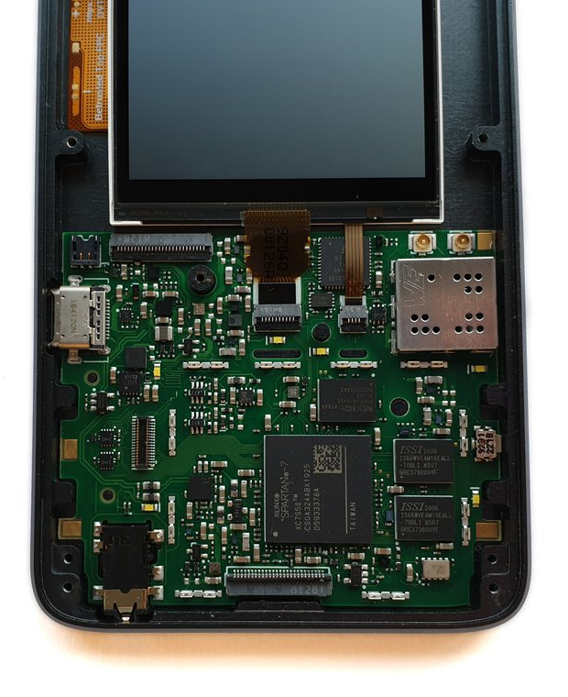
Another vision of the future
Modular
  Long design life
  Repairable and upgradable
Cloud not required
  Works if network is down
  You control your data
  Lose device? Lose data
End user programmable
  Sacrifice polish and
  out-of-box experience

Slide 40
“If you depend on proprietary mainstream mobile messenger applications, banking applications, use loyalty or travel apps, consume DRM media, or play mobile video games on your fruit or Android smartphone, then the PinePhone Pro is likely not for you.”

Slide 41
Why can’t we have it both ways?
Seamless cloud backups AND offline operation?
Easy to use out of box AND fully customizable and programmable?
Arbitrary software installation AND malware-free app store?
“Free software” operating system AND ability to run proprietary applications when necessary?
Long service life, end user repairable?

Slide 42
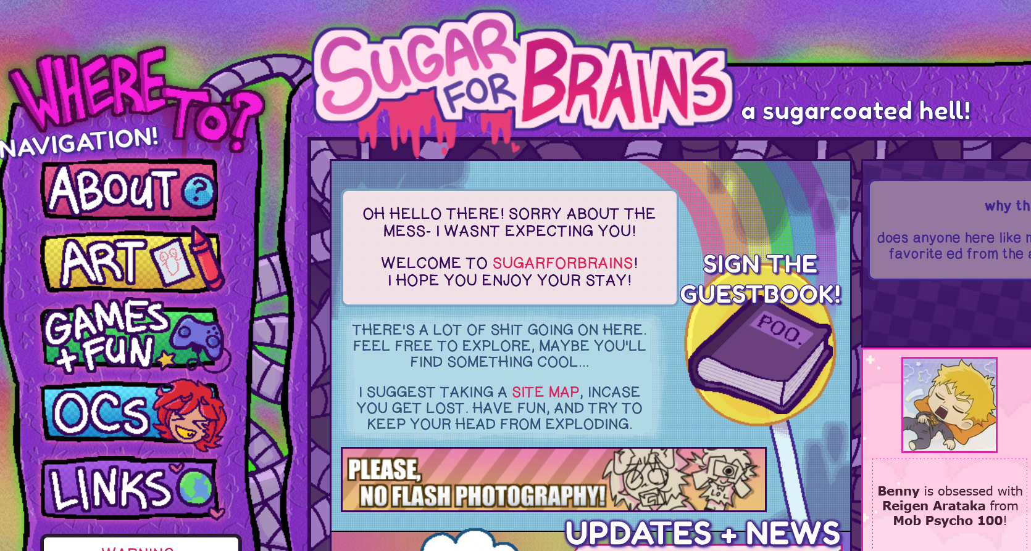
Customizability for Non-Programmers
https://sugarforbrains.neocities.org/

Slide 43
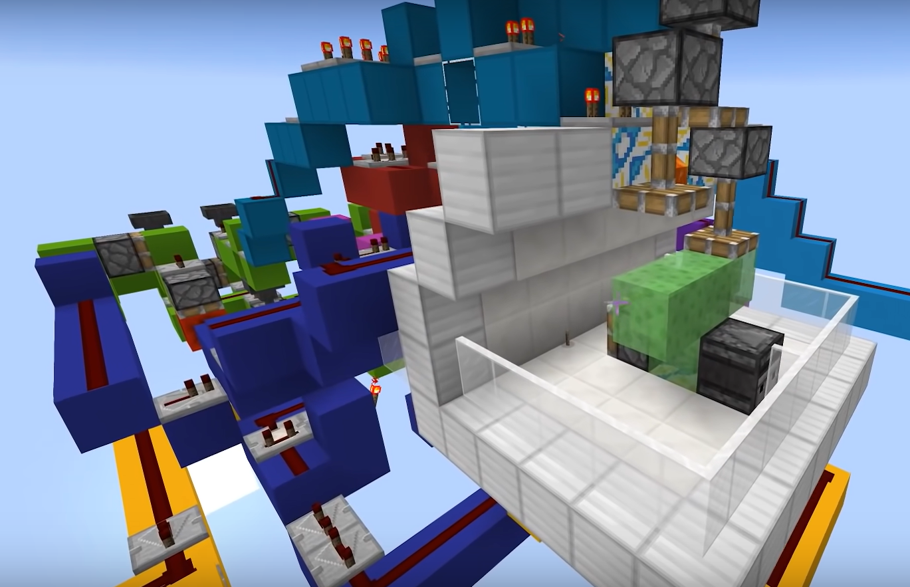
Customizability for Non-Programmers
https://www.youtube.com/watch?v=ccMwukZcv3k

Slide 44
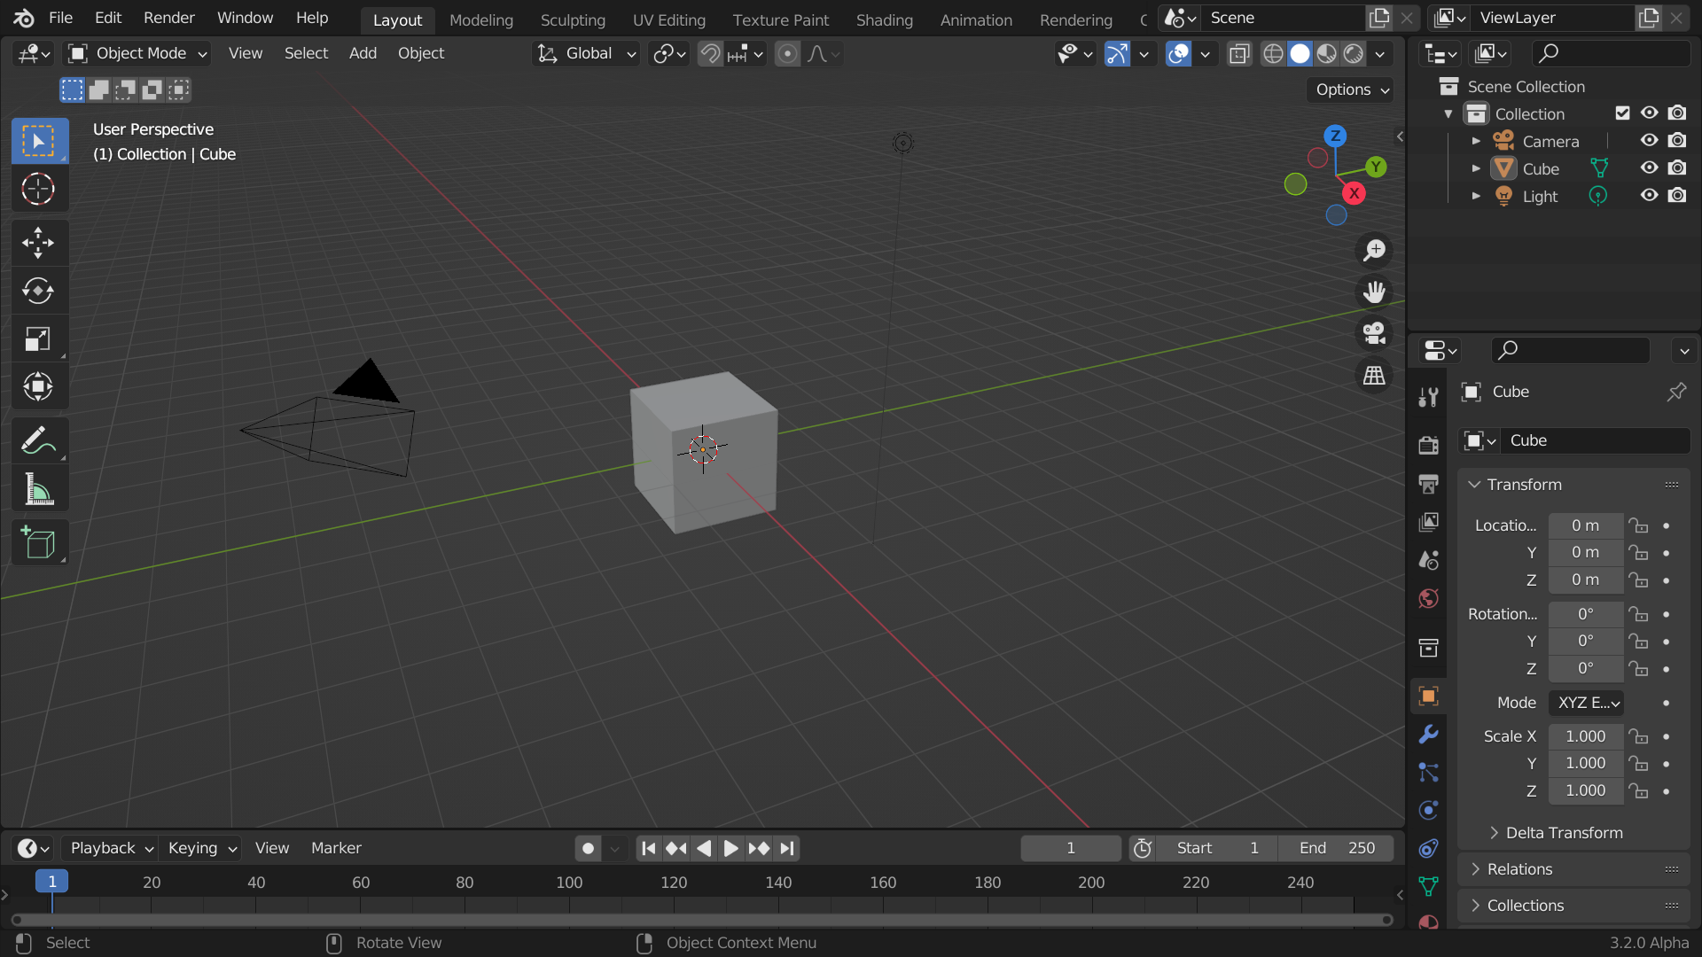
Customizability for Non-Programmers
https://docs.blender.org/manual/

Slide 45
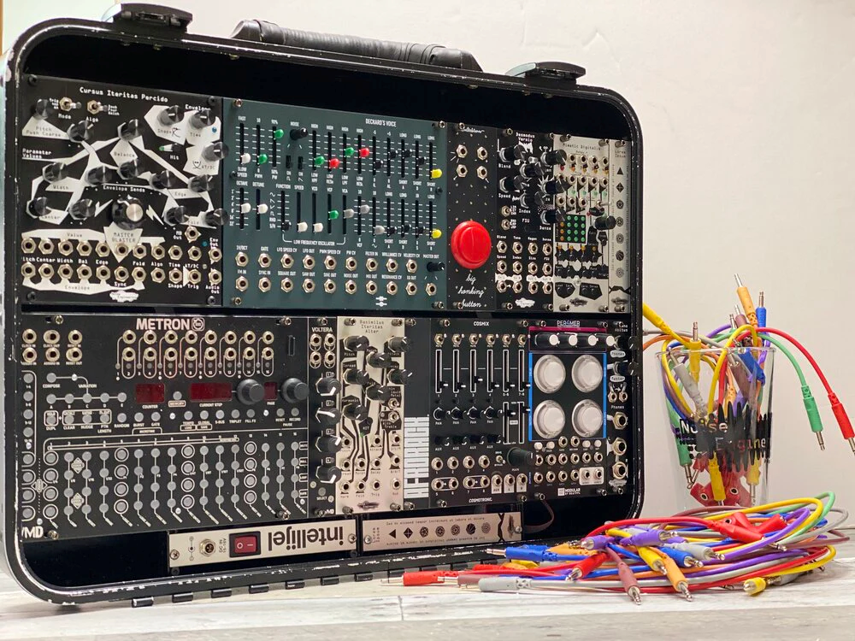
Customizability for Non-Programmers
https://noiseengineering.us/blogs/loquelic-literitas-the-blog/have-no-fear-modular-is-here-modular-synths-for-musicians

Slide 46
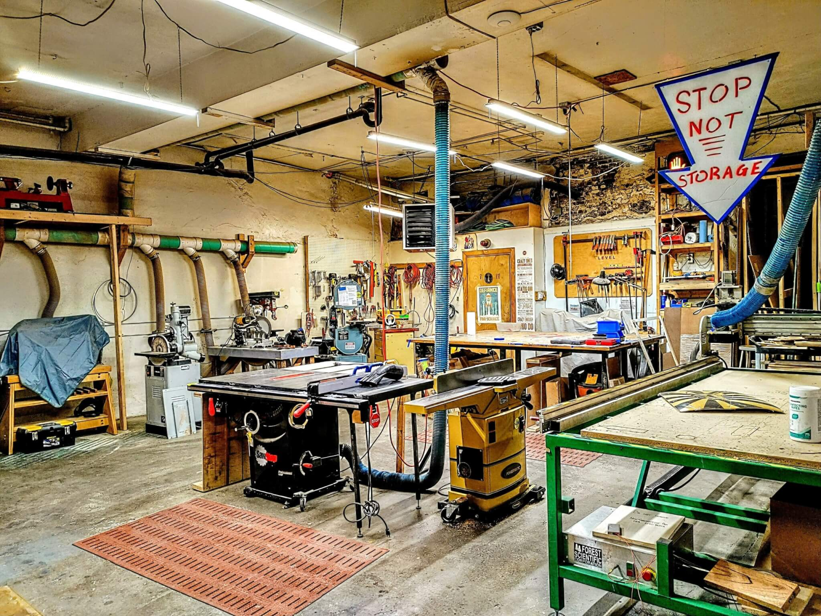
Customizability for Non-Programmers
https://hackpgh.org/

Slide 47
The Last Quiz
https://canvas.cmu.edu/courses/34989/quizzes/105559

