Slide 1
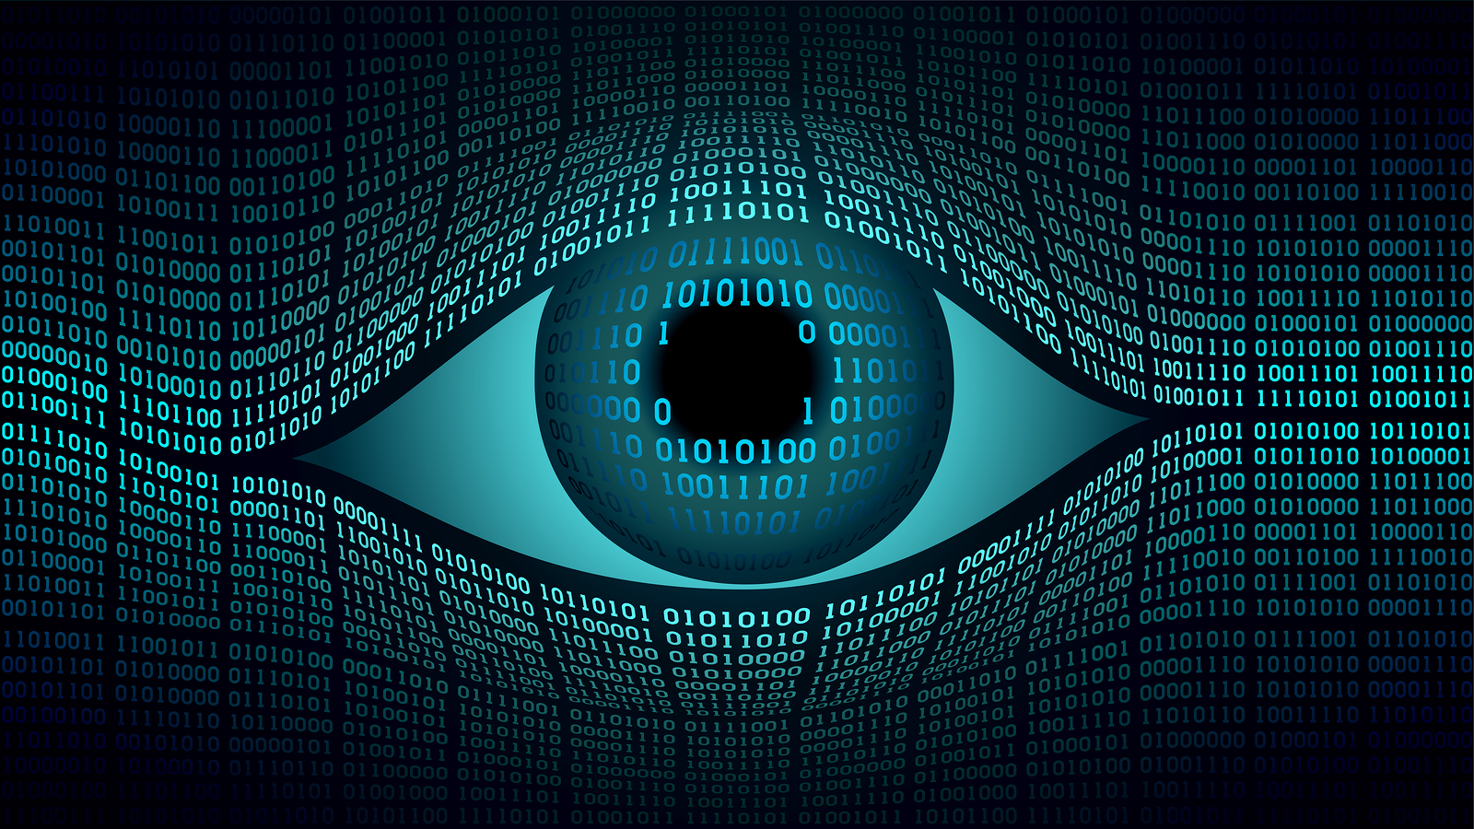
Wrap-up
16-385 Computer Vision
Spring 2018, Lecture 28
http://www.cs.cmu.edu/~16385/

Slide 2
Course announcements
Homework 7 is due on Sunday 6th.
- Any questions about homework 7?
- How many of you have looked at/started/finished the homework?
Everyone gets an extra free late day!
- You can use it either on homework 7, or retroactively for some old homework to remove the late submission penalty.

Slide 3
Class evaluation*s* – please take them!
CMU’s Faculty Course Evaluations (FCE): https://cmu.smartevals.com/
16-385 end-of-semester survey: https://docs.google.com/forms/d/e/1FAIpQLSfcIxL17cqlRrZ4uQI-8-d6KMlh2-Q_bRZNtBaFzA1o5XLT1A/viewform
Please take both, super helpful for developing future offerings of the class.
Thanks in advance!

Slide 4
Course overview
Lectures 1 – 7
See also 18-793: Image and Video Processing
Image processing.
Geometry-based vision.
Physics-based vision.
Semantic vision.
Dealing with motion.
Lectures 7 – 12
See also 16-822: Geometry-based Methods in Vision
Lectures 13 – 16
See also 16-823: Physics-based Methods in Vision
See also 15-463: Computational Photography
Lectures 17 – 21
See also 16-824: Vision Learning and Recognition
Lectures 22 – 25
See also 16-831: RoboStats

Slide 5
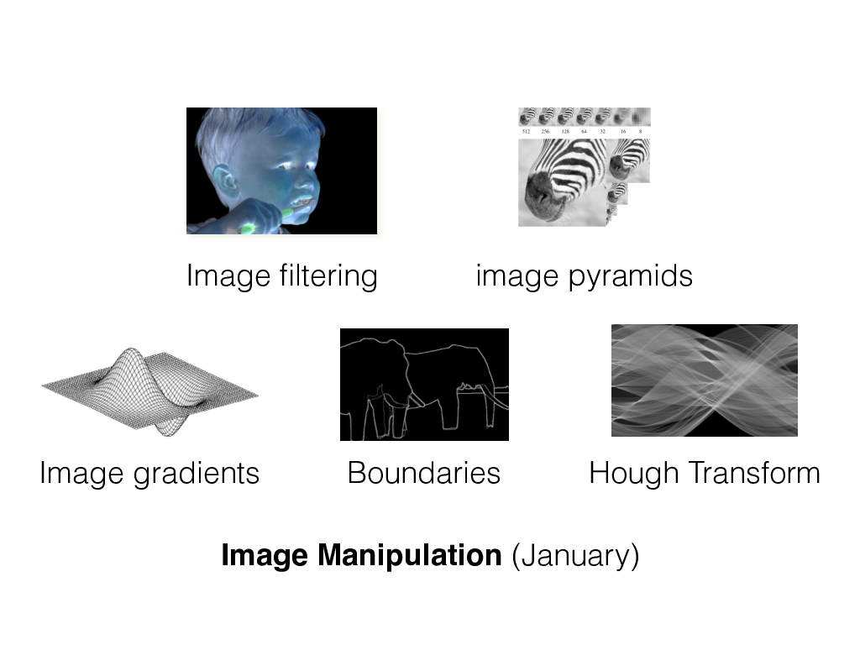
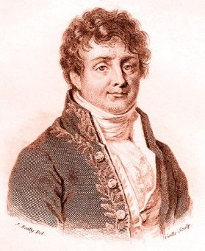
Image processing
Fourier filtering

Slide 6
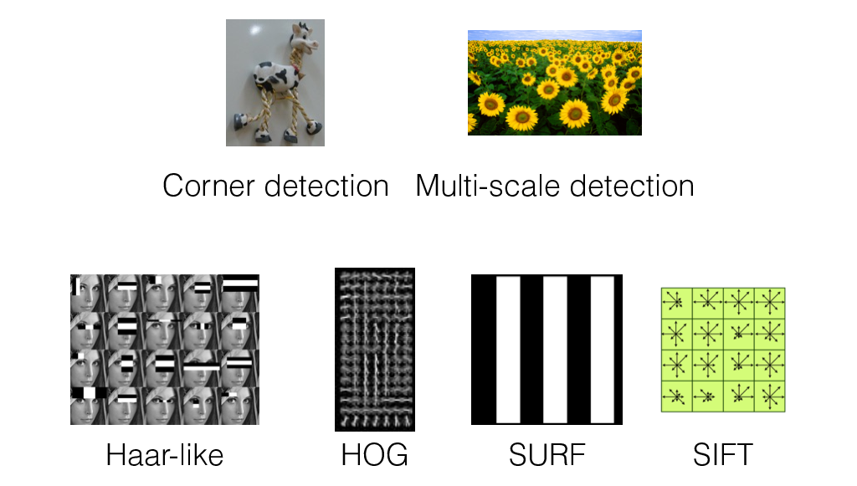
Image features

Slide 7
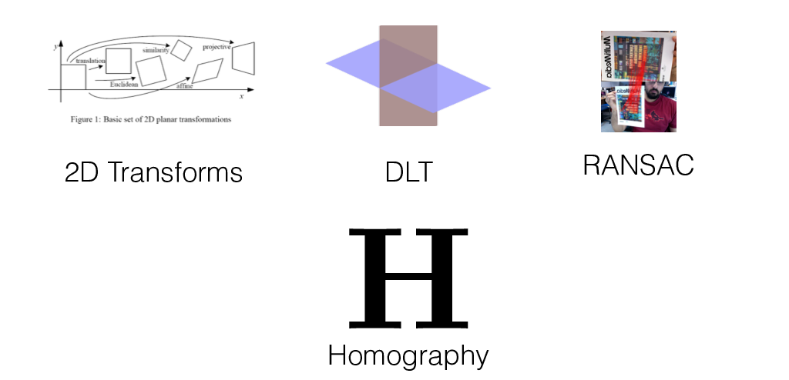
2D alignment

Slide 8
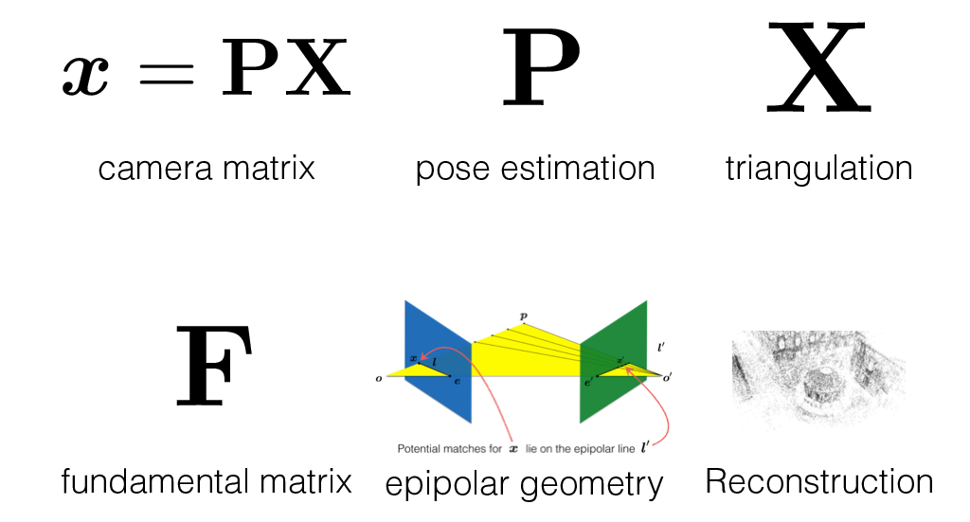
Camera and multi-view geometry

Slide 9
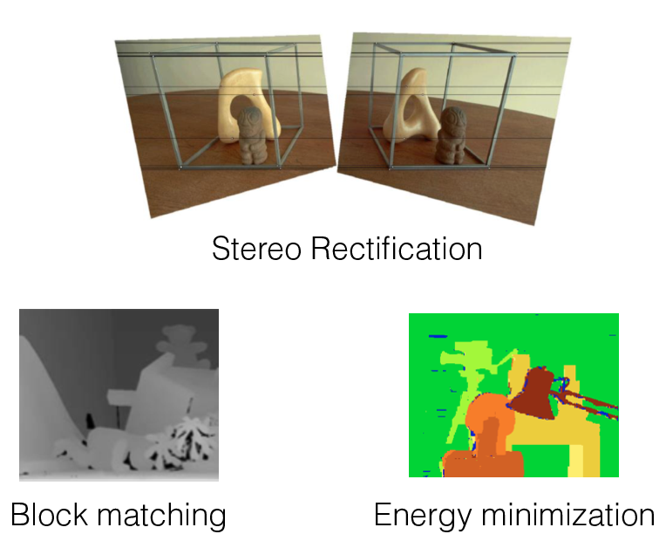
Stereo

Slide 10
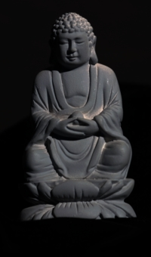

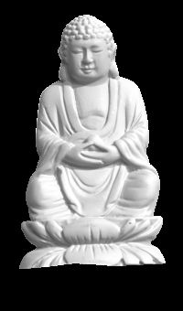

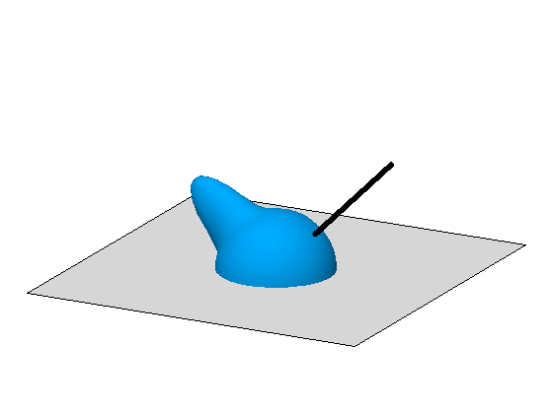

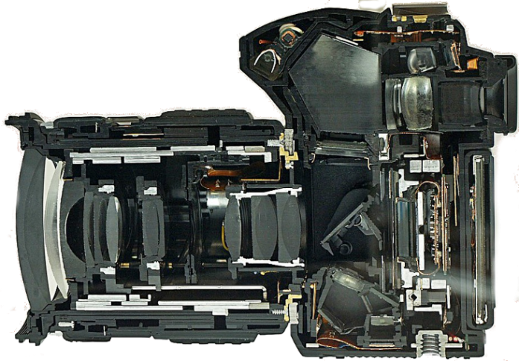
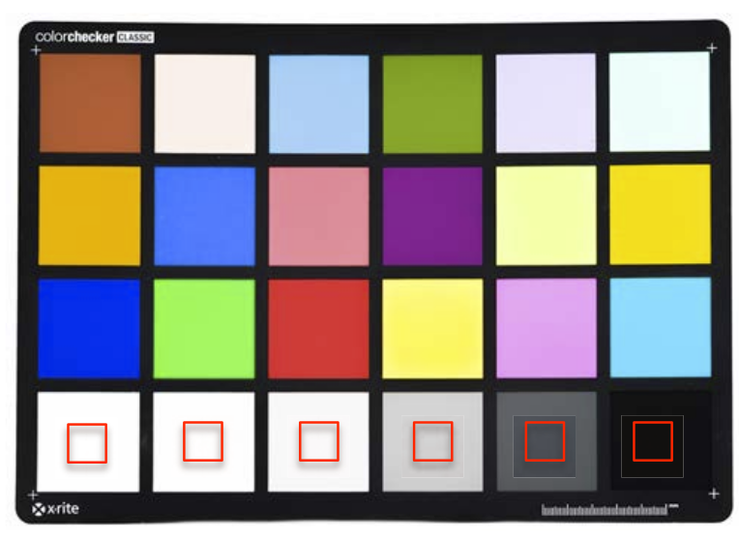
Image formation and physics
illumination
reflectance
shape
Radiometry and image formation
Photometric stereo
Color and color processing
Image processing pipeline
Radiometric and color calibration

Slide 11
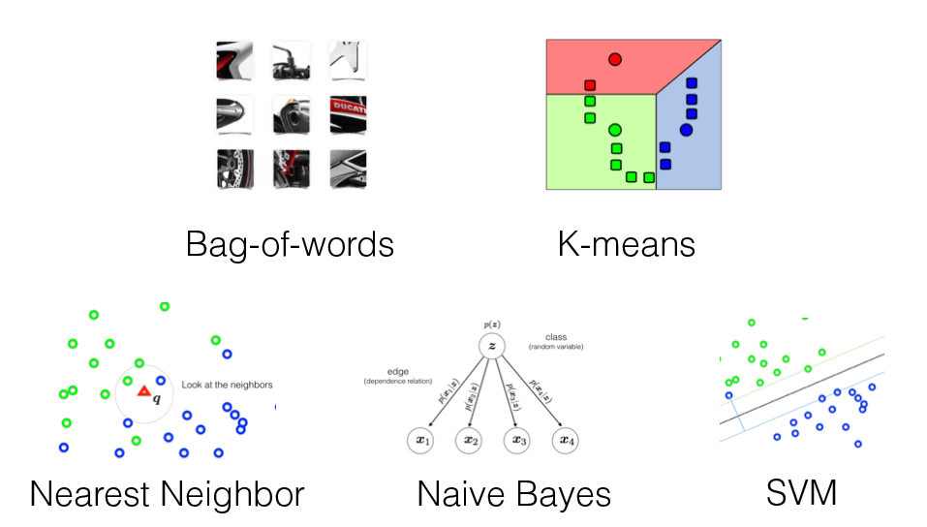
Object recognition

Slide 12
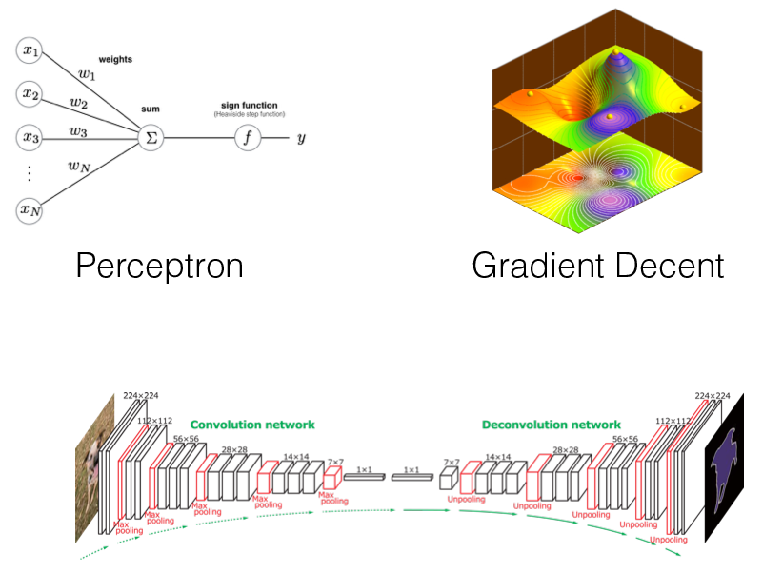
Neural networks
Convolutional Neural Networks

Slide 13
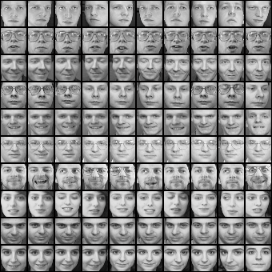
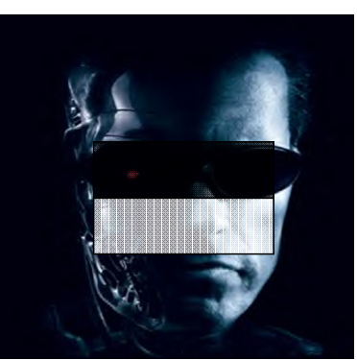
Face detection and recognition
Eigenfaces
Fisherfaces
Viola-Jones detector

Slide 14
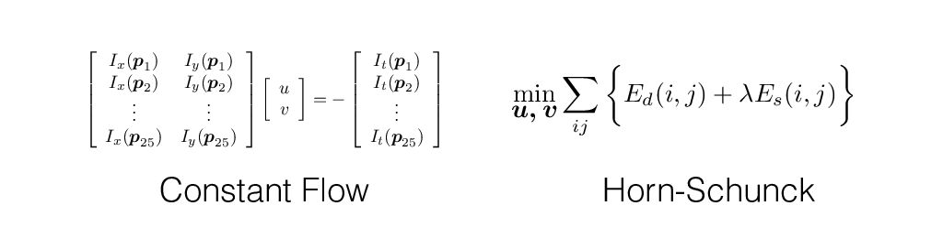
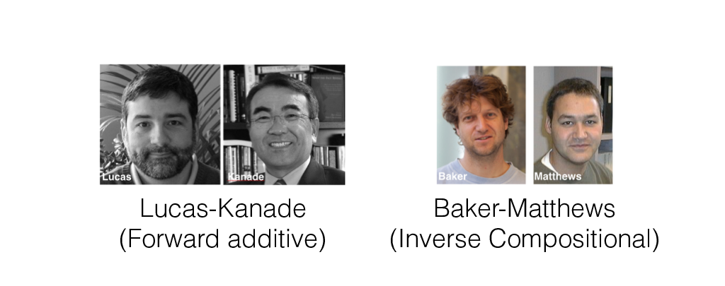
Optical flow and alignment

Slide 15
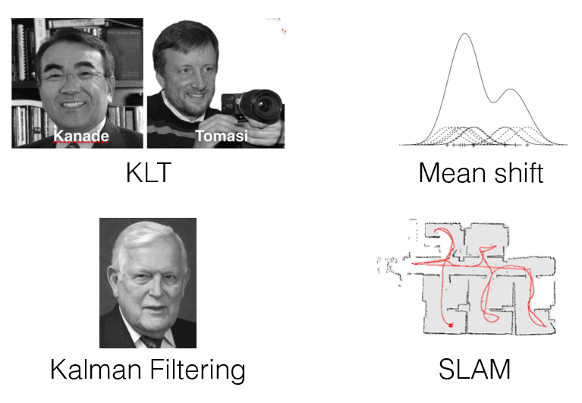
Tracking in videos

Slide 16
Segmentation

Slide 17
Things you should know how to do
Detect lines (circles, shapes) in an image.
Perform automatic image warping and basic AR.
Reconstruct 3D scene structure from two images.
Do photometric stereo and render simple images.
Recognize objects using a bag-of-words model.
Recognize objects using deep CNNs.
Track objects in video.

Slide 18
Questions?

Slide 19
Do you plan on taking any other vision courses?

Slide 20
Which part of the class did you like the most?

Slide 21
Which part of the class did you like the least?

Slide 22
Any topics you wanted to learn more about?

Slide 23
Any topics you wanted to learn less about?

Slide 24
Would the class work better if we did learning first?

Slide 25
Which was your favorite homework?

Slide 26
Which was your least favorite homework?

Slide 27
How does homework difficulty compare to other classes?

Slide 28
Would it be better if homeworks were in Python?

