Slide 1

Efficient methods for finding low-stretch spanning trees
Jakub Pachocki
Joint work with Michael Cohen, Gary Miller, Richard Peng and Shen Chen Xu
Notes:
1

Slide 2
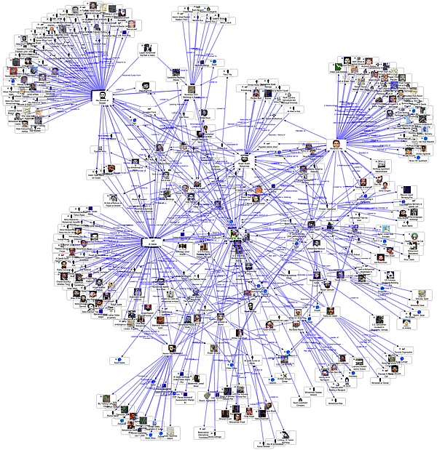
GRAPHS
Are complicated.
Notes:
In case of unit weights, can view as length of tree path

Slide 3
TREES
Are simple.
Notes:
In case of unit weights, can view as length of tree path

Slide 4
APPROXIMATING GRAPHS BY TREES
Depth-first search trees
Shortest path trees
Minimum spanning trees
Gomory – Hu trees
Treewidth
Low Stretch Spanning Trees
Notes:
In case of unit weights, can view as length of tree path

Slide 5
APPLICATIONS of lssts
k-server
Oblivious Routing
Flows
Spectral sparsification

Slide 6
SPECTRAL SPARSIFICATION
Goal: Subsample a graph while preserving spectral properties
Idea: Use a tree as guide
Notes:
In case of unit weights, can view as length of tree path

Slide 7
SPECTRAL SPARSIFICATION
Find a low stretch spanning ree
Scale up the tree
Pick a spanning tree

Slide 8
SPECTRAL SPARSIFICATION
Sample off-tree edges according to stretch

Slide 9
STRETCH
What is stretch?
Here stretch = 3

Slide 10
ULTRASPARSIFICATION
[Koutis-Miller-Peng`10]:
Can reduce number of off-tree edges to (total stretch)/ K
K is paid for in iteration cost
Reduce total stretch
Notes:
[Alon-Karp-Peleg-West ’91, [Elkin-Emek-Spielman-Teng `05], [Abraham-Bartal-Neiman ’08], Koutis-Miller-P `11,

Slide 11
STRETCH
Idea: Total stretch measures how well a tree captures the spectral properties of a graph
How to find spanning trees of low stretch?
Notes:
[Alon-Karp-Peleg-West ’91, [Elkin-Emek-Spielman-Teng `05], [Abraham-Bartal-Neiman ’08], Koutis-Miller-P `11,

Slide 12
STRETCH
Cannot obtain uniformly low stretch (cycle)
Notes:
[Alon-Karp-Peleg-West ’91, [Elkin-Emek-Spielman-Teng `05], [Abraham-Bartal-Neiman ’08], Koutis-Miller-P `11,

Slide 13
Low STRETCH In Expectation
1/n
1/n
1/n
1/n
1/n
1/n
1/n
But we can randomly sample from a distribution of trees
Notes:
[Alon-Karp-Peleg-West ’91, [Elkin-Emek-Spielman-Teng `05], [Abraham-Bartal-Neiman ’08], Koutis-Miller-P `11,

Slide 14
Low Total Stretch
Any given tree has total stretch 2(n - 1)
Views are equivalent (with some work)

Slide 15
Different Than Usual Trees
n^{1/2}-by-n^{1/2} unit weighted mesh
‘haircomb’ is both shortest path and max weight spanning tree
stretch(e)= O(1)
stretch(e)=Ω(n^{1/2})
total stretch = Ω(n^{3/2})

Slide 16
A better tree for the Grid
Recursive ‘C’ construction

Slide 17
How to Find Good Trees?
Iteratively cluster vertices
Build tree from resulting laminar family

Slide 18
CLUSTERING
Idea: For a low-diameter graph, shortest path tree is good enough
Goal: Find clusters of low diameter

Slide 19
LOW-DIAMETER DECOMPOSITIONS
Cluster the graph into pieces of diameter at most d
Cut edges with low probability β

Slide 20
LOW-DIAMETER DECOMPOSITIONS
Best tradeoff: β = O(log n / d) [Miller-Peng-Xu ‘13]
Very simple algorithm, reduces to computing single-source shortest paths

Slide 21




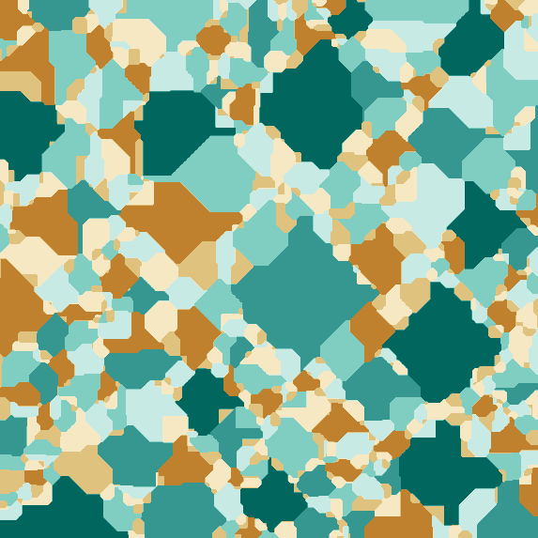
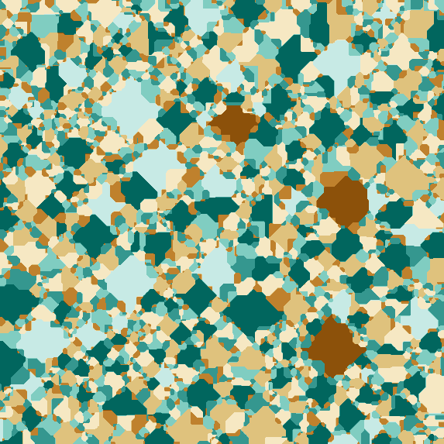
LOW-DIAMETER DECOMPOSITIONS
β = 0.002
β = 0.005
β = 0.01
β = 0.02
β = 0.05
β = 0.1

Slide 22
AKPW algorithm
Bottom-up
Iteratively cluster quotient graph
Consider choosing β = m^{-1/3}

Slide 23
AKPW algorithm
diameter m^{1/3} log n
m^{2/3} edges cut
stretch for cut edges: m^{2/3} log² n
diameter m^{2/3} log² n
m^{1/3} edges cut
stretch for cut edges: m log³ n

Slide 24
AKPW algorithm
Average stretch: O(m^{1/3} log³ n)
With optimal choice of β, AKPW achieves stretch O(exp((log n)^{1/2}))
That is too much!

Slide 25
AKPW algorithm
Large stretch, limit is
exp((log n)^{1/2})
But works well [Blelloch et al. `13]: gives O(m polylog n) time solver for SDD linear systems

Slide 26
Is Stretch What We Need?
Large stretch, limit is
exp((log n)^{1/2})
O(m polylog n) running time
Performance of algorithms related to another parameter?

Slide 27
RELAXING REQUIREMENTS
Having highly stretched edges is bad, but not that bad (Blelloch et al.)
Discount highly stretched edges: measure stretch^{p} for some p < 1
AKPW achieves polylog l^{p}-stretch
Still too much, and not enough

Slide 28
How to Find Good Trees?
[Alon-Karp-Peleg-West ’91]
…
[Bartal `96, `98]
[Fakcharoenphol-Rao-Talwar `03]
…
[Elkin-Emek-Spielman-Teng `05]
[Abraham-Bartal-Neiman ’08]
[Abraham-Neiman `12]
???

Slide 29
How to Find Good Trees?
Algorithm by Abraham and Neiman finds spanning trees of
O(log n log log n)
average stretch in
O(m log n log log n)
time.
top-down approach, many steps

Slide 30
RELAXING REQUIREMENTS
Requiring subtrees introduces combinatorial complexity
Steiner vertices are OK (Kelner et al.)

Slide 31
BARTAL’s algorithm
Top-down
Recursively partition graph

Slide 32
BARTAL’s algorithm
diameter d / 2
mlog n/d edges cut
diameter d/4
2m log n/d edges cut

Slide 33
BARTAL’s Accounting: p=1
Can show: if edge cut when diameter is d, its stretch is O(d)
m log n / d· d
2m log n / d· (d / 2)
4m log n / d· (d / 4)
…
Expected stretch log n at each level, total = O(mlog² n).

Slide 34
BARTAL’s Accounting: p<1
Can show: if edge cut when diameter is d, its stretch is O(d)
m log n / d· d^{p} = log n / d^{1-p}
2m log n / d· (d / 2)^{p} =mlog n/(d/2)^{1-p}
4m log n / d· (d / 4)^{p} =mlog n/(d/4)^{1-p}
…
Geometric series, last step (d = log n) dominates, total = O(mlog^{p} n)
Notes:
Alternatives in p = 1 are much more complicated

Slide 35
BARTAL’s algorithm
O(m log n) total l^{p}-stretch with respect to spanning trees on each level
How to combine them into one tree?

Slide 36
Tree metrics
Original idea: replace with stars on each level
1
2
2
1
2
Works when interpreting graphs as metrics

Slide 37
Tree metrics
Using stars for trees is not suitable for spectral algorithms
Edges may have high congestion, e.g. stars through one vertex

Slide 38
Embeddability
Idea: We will use all the spanning trees found by Bartal’s algorithm
Simply place them on Steiner vertices

Slide 39
Embeddability
weight 1
weight ½
weight ⅓

Slide 40
embeddability
f: vertices of H → vertices of G
Sum of weights of edges that map to e does not exceed weight of e
(weight = 1 / length)

Slide 41
Getting Embeddable Trees
Steiner vertex
length 0

Slide 42
Embeddability For Free
When p < 1, can find embeddable Steiner trees in a black-box manner
Reweigh graph
Call (normal) Bartal decomposition
Post-process result

Slide 43
embeddability
Idea: Discount stretch ‘preemptively’
Simply raise all weights to power p’, for some p’ such that p < p’< 1, compute decomposition on modified graph
Reweighing the result gives an embeddable decomposition

Slide 44
A Faster algorithm
 | Runtime | Stretch
AKPW | O(m log log n) | O(log^{O(1)} n)
Bartal | O(m log n) | O(log n)
Can we get the best of both worlds?

Slide 45
BARTAL’S RECURSIVE STEP
What if we started with a coarse approximation?

Slide 46
AKPW AND BARTAL
AKPW produces a sequence of clusterings in O(m log log n) time
Idea: Can we use it to speed up Bartal’s top-down algorithm?
Notes:
In RAM model

Slide 47
BARTAL’S RECURSIVE STEP II
Cluster on AKPW balls within a level of granularity

Slide 48
Runtime analysis
Use AKPW balls of diameter
d / polylog(n)
An edge is expected to be in O(log log n) recursive calls!
Total runtime: O(m log log n)

Slide 49
Open problems
Finding low-stretch subtrees of stretch
O(log n)
Reusing the new ideas in a 1-moment setting
Even weaker notions of support

Slide 50
THANK YOU!
Questions?

