Slide 1
Reinforcement Learning
Tai Sing Lee
15-381/681 AI Lecture 15
Read Chapter 21 of Russell & Norvig
With thanks to Dan Klein, Pieter Abbeel (Berkeley), and Past 15-381 Instructors for slide contents, particularly Ariel Procaccia, Emma Brunskill and Gianni Di Caro.

Slide 2


Policy Iteration
But maintain value of following a particular policy forever
Value Iteration
Decide optimal values if have n more actions
Drawings by Ketrina Yim

Slide 3
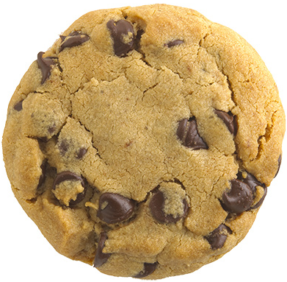
Reinforcement Learning
Transition
Model?
State
Action
Reward model?
Agent
Goal: Maximize expected sum of future rewards

Slide 4
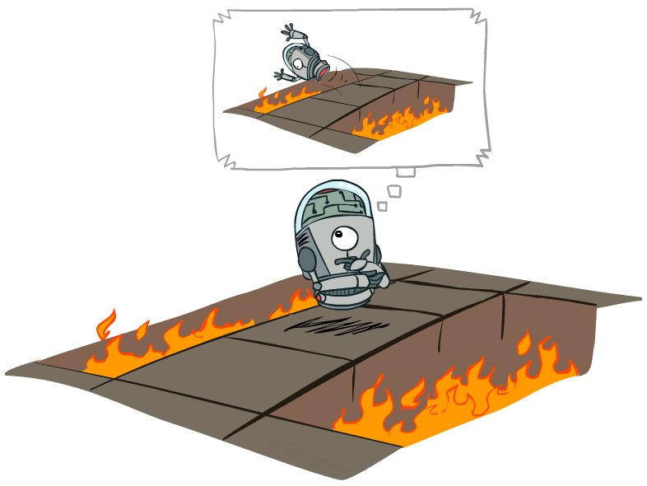
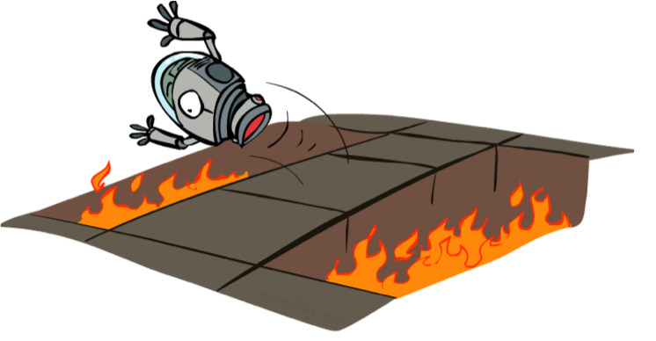
MDP Planning vs
Reinforcement Learning
Don’t have a simulator! Have to actually learn what happens if take an action in a state
Drawings by Ketrina Yim

Slide 5
Reinforcement learning problem
The agents can ”sense” the environment (it knows the state) and has goals
Learning from interaction with the environment
Trial and error search
(Delayed) Rewards (Advisory signals ≠ errors signals)
What actions to take
→ Exploration- exploitation dilemma

Slide 6
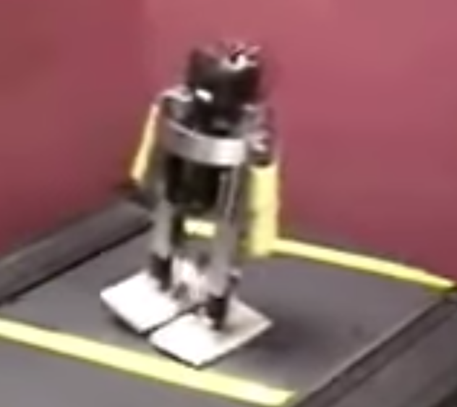
Toddler learning to walk
https://www.youtube.com/watch?v=goqWX7bC-ZY&list=PL28ekMsVlKa1mKRif05Uxn-iuP2Ms6qDL
Notes:
The following video shows research highlights from Toddler, a simple 3D dynamic biped that was able to quickly and reliably learn to walk. The beginning of the video demonstrates the robot's ability to walk passively downhill on a treadmill with the computer turned off. The robot was then placed on flat terrain with the computer switched on, and tasked with acquiring the same gait without assistance from gravity, but rather by learning a feedback controller. This learning occurred in less than 20 minutes, using only trials implemented on the real robot (no simulations). The learning algorithm continues to quickly adapt as the robot walks over different terrain. Sebastian Seung
Lab at MIT.

Slide 7
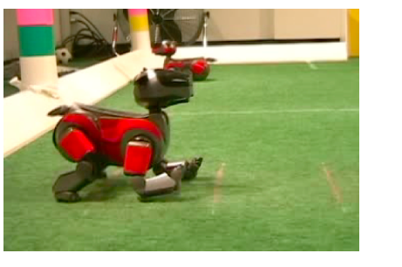
Soccer Robot learning to walk fast
Peter Stone – Robot Soccer initial walk.
Notes:
The following video shows research highlights from Toddler, a simple 3D dynamic biped that was able to quickly and reliably learn to walk. The beginning of the video demonstrates the robot's ability to walk passively downhill on a treadmill with the computer turned off. The robot was then placed on flat terrain with the computer switched on, and tasked with acquiring the same gait without assistance from gravity, but rather by learning a feedback controller. This learning occurred in less than 20 minutes, using only trials implemented on the real robot (no simulations). The learning algorithm continues to quickly adapt as the robot walks over different terrain. Sebastian Seung
Lab at MIT.

Slide 8
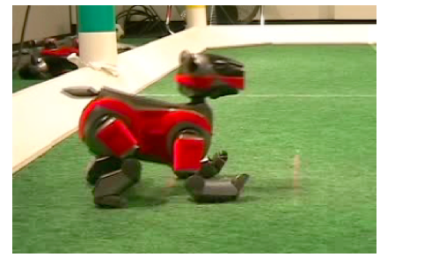
Soccer Robot learning to walk fast
Peter Stone – Robot Soccer learned walk.
Notes:
The following video shows research highlights from Toddler, a simple 3D dynamic biped that was able to quickly and reliably learn to walk. The beginning of the video demonstrates the robot's ability to walk passively downhill on a treadmill with the computer turned off. The robot was then placed on flat terrain with the computer switched on, and tasked with acquiring the same gait without assistance from gravity, but rather by learning a feedback controller. This learning occurred in less than 20 minutes, using only trials implemented on the real robot (no simulations). The learning algorithm continues to quickly adapt as the robot walks over different terrain. Sebastian Seung
Lab at MIT.

Slide 9
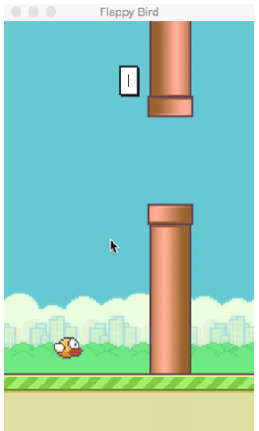
Homework 3. Flappy bird

Slide 10
Passive Reinforcement Learning
Before figuring out how to act, let’s first just try to figure out how good a particular policy is
Passive learning: agent’s policy is fixed (i.e., in state s it always execute action π(s)) and the task is to find policy’s value → Learn state values (V(s)) or state-action values (Q(s,a))
Policy evaluation in MDPs
(T,R) Model
Bellman eqs.
Passive RL: How can we find expected utility of a policy?

Slide 11
Passive Reinforcement Learning
Transition
Model?
Two Approaches
Build a model
How?
T(s,a,s’)=0., R(s,a,s’)=4,…
State
Action
Reward model?
Agent

Slide 12
Model-Based Passive Reinforcement Learning
Follow policy π, perform many experiments (sample sequences)
Estimate MDP model parameters given observed transitions and rewards
  If finite set of states and actions, can just count and average counts
Use estimated MDP to do policy evaluation of π
Notes:
Does This Give Us All the Parameters for a MDP?

Slide 13


Start at (1,1)
Adaption of drawing by Ketrina Yim

Slide 14

Start at (1,1)
s=(1,1) action= tup try up
Adaption of drawing by Ketrina Yim

Slide 15
Start at (1,1)
s=(1,1) action= tup, s’=(1,2), r = -.01
Adaption of drawing by Ketrina Yim

Slide 16
Start at (1,1)
s=(1,1) action= tup, s’=(1,2), r = -.01
s=(1,2) action= tup
Adaption of drawing by Ketrina Yim

Slide 17
Start at (1,1)
s=(1,1) action= tup, s’=(1,2), r = -.01
s=(1,2) action= tup, s’=(1,2), r = -.01
Adaption of drawing by Ketrina Yim

Slide 18
Start at (1,1)
s=(1,1) action= tup, s’=(1,2), r = -.01
s=(1,2) action= tup, s’=(1,2), r = -.01
s=(1,2) action=tup, s’=(1,3), r = -.01
s=(1,3) action=tright, s’=(2,3), r = -.01
s=(2,3) action=tright, s’=(3,3), r = -.01
s=(3,3) action=tright, s’=(3,2), r = -.01
s=(3,2) action=tup, s’=(3,3), r = -.01
s=(3,3) action=tright, s’=(4,3), r = 1
Adaption of drawing by Ketrina Yim

Slide 19
Start at (1,1)
s=(1,1) action= tup, s’=(1,2), r = -.01
s=(1,2) action= tup, s’=(1,2), r = -.01
s=(1,2) action=tup, s’=(1,3), r = -.01
s=(1,3) action=tright, s’=(2,3), r = -.01
s=(2,3) action=tright, s’=(3,3), r = -.01
s=(3,3) action=tright, s’=(3,2), r = -.01
s=(3,2) action=tup, s’=(3,3), r = -.01
s=(3,3) action=tright, s’=(4,3), r = 1
Can use experience to estimate MDP T and R models
Estimate of T(<1,2>,tup,<1,3>) = 1/2
Adaption of drawing by Ketrina Yim

Slide 20
Given estimates of the transition model T and reward model R, we can do MDP policy evaluation to compute the value of our policy

Slide 21
Does this give us all the parameters for a MDP?
But does that matter for computing policy value?
Do we have all parameters we need?
Notes:
Does This Give Us All the Parameters for a MDP? No.
But Does That Matter for Computing Policy Value? No.
Have all Parameters We Need!
(After We Visit All States at Least Once)

Slide 22
Start at (1,1)
s=(1,1) action= tup, s’=(1,2), r = -.01
s=(1,2) action= tup, s’=(1,2), r = -.01
s=(1,2) action=tup, s’=(1,3), r = -.01
s=(1,3) action=tright, s’=(2,3), r = -.01
s=(2,3) action=tright, s’=(3,3), r = -.01
s=(3,3) action=tright, s’=(3,2), r = -.01
s=(3,2) action=tup, s’=(3,3), r = -.01
s=(3,3) action=tright, s’=(4,3), r = 1
Estimate of T(<1,2>,tright,<1,3>)?
No idea! Never tried this action…
Adaption of drawing by Ketrina Yim
Notes:
Does This Give Us All the Parameters for a MDP? No.
But Does That Matter for Computing Policy Value? No.
Have all Parameters We Need!
(After We Visit All States at Least Once)

Slide 23
Start at (1,1)
s=(1,1) action= tup, s’=(1,2), r = -.01
s=(1,2) action= tup, s’=(1,2), r = -.01
s=(1,2) action=tup, s’=(1,3), r = -.01
s=(1,3) action=tright, s’=(2,3), r = -.01
s=(2,3) action=tright, s’=(3,3), r = -.01
s=(3,3) action=tright, s’=(3,2), r = -.01
s=(3,2) action=tup, s’=(3,3), r = -.01
s=(3,3) action=tright, s’=(4,3), r = 1
s=(1,1) action= tup, s’=(2,1), r = -.01
s=(2,1) action= tright, s’=(3,1), r = -.01
s=(3,1) action= tup, s’=(4,1), r = -.01
s=(4,1) action= tleft, s’=(3,1), r = -.01
s=(3,1) action= tup, s’=(3,2), r = -.01
s=(3,2) action= tup, s’=(4,2), r = -1
2 episodes of experience in MDP. Use to estimate MDP parameters & evaluate π
Adaption of drawing by Ketrina Yim

Slide 24
Start at (1,1)
s=(1,1) action= tup, s’=(1,2), r = -.01
s=(1,2) action= tup, s’=(1,2), r = -.01
s=(1,2) action=tup, s’=(1,3), r = -.01
s=(1,3) action=tright, s’=(2,3), r = -.01
s=(2,3) action=tright, s’=(3,3), r = -.01
s=(3,3) action=tright, s’=(3,2), r = -.01
s=(3,2) action=tup, s’=(3,3), r = -.01
s=(3,3) action=tright, s’=(4,3), r = 1
s=(1,1) action= tup, s’=(2,1), r = -.01
s=(2,1) action= tright, s’=(3,1), r = -.01
s=(3,1) action= tup, s’=(4,1), r = -.01
s=(4,1) action= tleft, s’=(3,1), r = -.01
s=(3,1) action= tup, s’=(3,2), r = -.01
s=(3,2) action= tup, s’=(4,2), r = -1
If you try this for 10 times, would the computed policy value likely to be correct?
(1) Yes (2) No (3) Not sure
Adaption of drawing by Ketrina Yim
Notes:
No. Why? Unles you have a large number of trials, ou will estaitme the wrong transition model and wrong values and derive a wrong policy. Rather than the true one. But if you hae a lot of samples, then it is fine?

Slide 25
Passive Reinforcement Learning
Transition
Model?
Two Approaches
Build a model
Model-free: directly estimate V^{π}
V^{π}(s₁)=1.8,
V^{π}(s₂)=2.5,…
State
Action
Reward model?
Agent
Remember, we know S and A, just not T and R.

Slide 26
Start at (1,1)
s=(1,1) action= tup, s’=(1,2), r = -.01
s=(1,2) action= tup, s’=(1,2), r = -.01
s=(1,2) action=tup, s’=(1,3), r = -.01
s=(1,3) action=tright, s’=(2,3), r = -.01
s=(2,3) action=tright, s’=(3,3), r = -.01
s=(3,3) action=tright, s’=(3,2), r = -.01
s=(3,2) action=tup, s’=(3,3), r = -.01
s=(3,3) action=tright, s’=(4,3), r = 1
Discount γ=1
V^{π}( (3,2) ) = Expected sum of rewards starting in (3,2)
following π
Estimate of V^{π}( (3,2) ) = -0.01 + 1
Direct Utility Estimation: V^{π}(s) = R(s) + discounted future reward
Notes:
Direct evaluation ignores the connections between states. D evaluation miss opportunity for learning. E.g. (3,2) earlier has lead to (3, 3), and hence we should know it has higher utility value from an earlier trial, but DE doesn’t know until it reaches the end of the trial. DE search a much larger hypothesis space with many functiosn that violate the Bellman equaions. Hence it converges slowly.
The utility of each state equals its own reward plus the expected utility of its successor states.

Slide 27
Start at (1,1)
s=(1,1) action= tup, s’=(1,2), r = -.01
s=(1,2) action= tup, s’=(1,2), r = -.01
s=(1,2) action=tup, s’=(1,3), r = -.01
s=(1,3) action=tright, s’=(2,3), r = -.01
s=(2,3) action=tright, s’=(3,3), r = -.01
s=(3,3) action=tright, s’=(3,2), r = -.01
s=(3,2) action=tup, s’=(3,3), r = -.01
s=(3,3) action=tright, s’=(4,3), r = 1
Discount γ=1
V^{π}( (3,3) ) = Expected sum of rewards starting in (3,2)
following π
Estimate of V^{π}( (3,3) ) = ½ (-0.01 + -0.01 + 1) + ½ (1)
Adaption of drawing by Ketrina Yim

Slide 28
Start at (1,1)
s=(1,1) action= tup, s’=(1,2), r = -.01
s=(1,2) action= tup, s’=(1,2), r = -.01
s=(1,2) action=tup, s’=(1,3), r = -.01
s=(1,3) action=tright, s’=(2,3), r = -.01
s=(2,3) action=tright, s’=(3,3), r = -.01
s=(3,3) action=tright, s’=(3,2), r = -.01
s=(3,2) action=tup, s’=(3,3), r = -.01
s=(3,3) action=tright, s’=(4,3), r = 1
Discount γ=1
V^{π}( (1,2) ) = Expected sum of rewards starting in (1,2)
following π
Estimate of V^{π}( (1,2) ) = [1] .94
[2] .96
[3] .945
[4] Not sure
Adaption of drawing by Ketrina Yim
Notes:
[3] .945

Slide 29
Model-Free Policy Estimation
Downside of the approach just described is have to wait until the end of an episode to update estimate of V

Slide 30
Temporal Difference Learning
No explicit model of T or R!
Estimate V and expectation through samples
Update from every experience
  Update V(s) after each state transition (s, a, s’, r)
  Likely outcomes s’ will contribute updates more often
Temporal difference learning of values
  Policy still fixed, still doing evaluation!
  Move values toward sample of V: running average
Sample of V(s):
Update to V(s):
Notes:
Policy is kept the same. Still doing evaluation.
For example, if V(1,3) = 0.84, and V(2,3) = 0.92, V(1,3) = -0.04 + V(2,3) if this happens all the time – not necessarily true. But if it does, then V(1,3) should be 0.88. So the current value of 0.84 is a bit low and should be increased.
V(s) <- V(s) + alpha (R + gamma(V(s’)) - V(s)).
Current sample - current belief on the expected value. If there is a difference, update, with certain learning rate, which should decrease over time.
Even though it should be over probability of transition states, (the actual equilibirum) rather than just the next state, it will converge because rare things do happen rarely. The average value of V will converge to the correct value. Also, alpha also needs to decrease over time. Does TD learning does not need a transition model to perform its update. Just observe what happen, and keep track of things.
Move Vs a bit toward the sample. Weighted average.

Slide 31

Exponential Moving Avg
Exponential moving average
  The running interpolation update:
  Makes recent samples more important:
  Forgets about the past
Decreasing learning rate (α) can give converging avgs
Slide adapted from Klein and Abbeel
Notes:
Weight new information more so than old information in an expoetial way. Slowly forget aobut the past.
Converge to the true value of the policy.
Evaluate policy and then update the policy.

Slide 32
TD Learning Example
State | V^{π}(s)
(1,1) | 0
(1,2) | 0
(1,3) | 0
(4,1) | 0
(2,1) | 0
(2,3) | 0
(3,1) | 0
(3,2) | 0
(3,3) | 0
Initialize all V^{π}(s) values: V^{π}(s) = 0
Adaption of drawing by Ketrina Yim

Slide 33
α=0.1, γ=1
TD Learning Example
s=(1,1) action= tup, s’=(1,2), r = -.01
Update V^{π}((1,1))
State | V^{π}(s)
(1,1) | 0
(1,2) | 0
(1,3) | 0
(4,1) | 0
(2,1) | 0
(2,3) | 0
(3,1) | 0
(3,2) | 0
(3,3) | 0
sample = -0.01 + V^{π}( (1,2)) = -0.01
V^{π}( (1,1) ) = (1-α) V^{π}( (1,1)) + α*sample
= .9*0 + 0.1*-0.01 = -0.001
Notes:
V^pi = V^pi + alpha (sample – v_pi).

Slide 34
α=0.1, γ=1
TD Learning Example
s=(1,1) action= tup, s’=(1,2), r = -.01
Update V^{π}((1,1))
State | V^{π}(s)
(1,1) | -0.001
(1,2) | 0
(1,3) | 0
(4,1) | 0
(2,1) | 0
(2,3) | 0
(3,1) | 0
(3,2) | 0
(3,3) | 0
sample = -0.01 + V^{π}( (1,2)) = -0.01
V^{π}( (1,1) ) = (1-α) V^{π}( (1,1)) + α*sample
= .9*0 + 0.1*-0.01 = -0.001

Slide 35
α=0.1, γ=1
TD Learning Example
s=(1,1) action= tup, s’=(1,2), r = -.01
s=(1,2) action= tup, s’=(1,2), r = -.01
V^{π}( (1,2) ) = (1-α) V^{π}( (1,2)) + α*sample
sample = -0.01 + V^{π}( (1,2)) = -0.011
-0.9(0.001)+ 0.1(-0.011) = -0.002
State | V^{π}(s)
(1,1) | -0.001
(1,2) | 0
(1,3) | 0
(4,1) | 0
(2,1) | 0
(2,3) | 0
(3,1) | 0
(3,2) | 0
(3,3) | 0
Notes:
0.9 V(1, 2) + alpha (-0.01 + V(1,2))
-0.0009 + 0.1 (-0.011)
= -0.0009 – 0.0011 = -0.002
V^{π}( (1,2) ) = (1-α) V^{π}( (1,2)) + α*sample
sample = -0.01 + V^{π}( (1,2)) = -0.011
-0.9(0.001)+ 0.1(-0.011) = -0.002

Slide 36
Problems with Passive Learning
Agent wants to ultimately learn to act to gather high reward in the environment.
Using a deterministic policy, gives agent no experience for other actions (that are not included in the policy)
Active reinforcement learning: the agent decides what action to take with the goal of learning an optimal policy
What would you do?

Slide 37
Active RL: Exploration issues
Consider acting randomly in the world
Can such experience allow the agent to learn the optimal values and policy?

Slide 38
Recall Model-Based Passive Reinforcement Learning
Follow policy π
Estimate MDP model parameters given observed transitions and rewards
  If finite set of states and actions, can just count and average counts
Use estimated MDP to do policy evaluation of π

Slide 39
Model-Based active RL w/Random Actions
Choose actions randomly
Estimate MDP model parameters given observed transitions and rewards
  If finite set of states and actions, can just count and average counts
Use estimated MDP to compute estimate of optimal values and policy
Will the computed values and policy converge to the true optimal values and policy in the limit of infinite data?
Notes:
Infnite data of all the states, not all states. A slong as all states can be reached.

