Slide 1
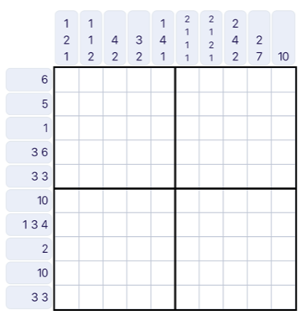
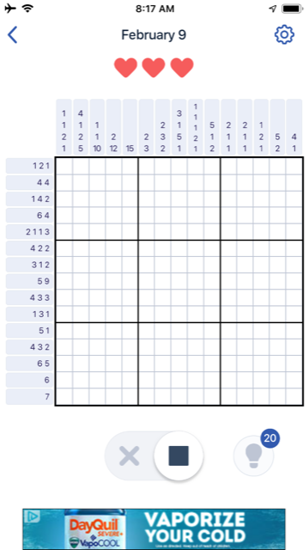
Warm-up:
Can you write these logic problems as a CSP?
What are the variables? the domains? the constraints?
What techniques could you use to solve them?
Notes:
0=7, R=4, W=6, U=2, T=8, F=1; 867 + 867 = 1734

Slide 2
Announcements
Assignments:
P2: Optimization
    Due Sat 2/22, 10 pm
HW5 out AFTER the Midterm
    Due 2/25, 10 pm
Midterm 1 Exam
Mon 2/17, in class
Recitation Fri is a review session
See Piazza post for details

Slide 3

AI: Representation and Problem Solving
Propositional Logic
Instructors: Pat Virtue & Stephanie Rosenthal
Slide credits: CMU AI, http://ai.berkeley.edu

Slide 4
Warm-up:
Can you write these logic problems as a CSP?
What are the variables? the domains? the constraints?
What techniques could you use to solve them?
Notes:
0=7, R=4, W=6, U=2, T=8, F=1; 867 + 867 = 1734

Slide 5
Warm-up:
Where is the knowledge held in CSPs? What is the goal of a CSP?
Notes:
0=7, R=4, W=6, U=2, T=8, F=1; 867 + 867 = 1734

Slide 6
Logical Agents
What assignment of variables satisfies the constraints (knowledge base)?
What new knowledge can be inferred from the KB?
Agent
Environment
Sensors
Percepts
Knowledge Base
Inference
?
Actuators
Actions

Slide 7
Logical Agents
So what do we tell our knowledge base (KB)?
  Facts (sentences)
      The grass is green
      The sky is blue
  Rules (sentences)
      Eating too much candy makes you sick
      When you’re sick you don’t go to school
  Percepts and Actions (sentences)
      Pat ate too much candy today
What happens when we query the agent?
  Inference – new sentences created from old
      Pat is not going to school today

Slide 8
Nonogram Puzzle
Logical Reasoning as a CSP
Binary variable for each square
Constraints:

Slide 9
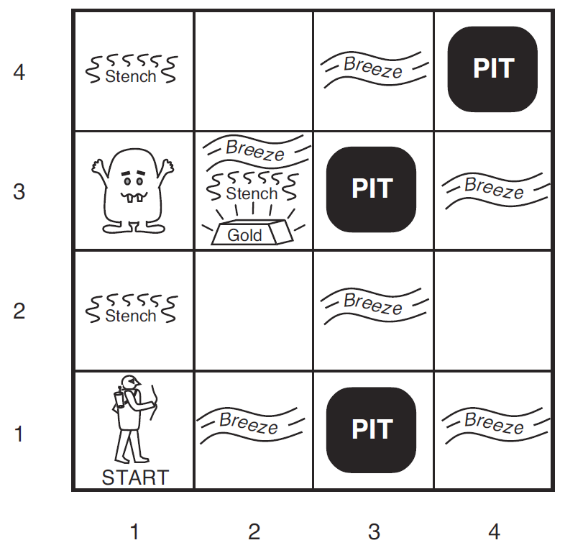
Wumpus World
Logical Reasoning as a CSP
Variables
B_{ij} = breeze felt
S_{ij} = stench smelt
P_{ij} = pit here
W_{ij} = wumpus here
G = gold
http://thiagodnf.github.io/wumpus-world-simulator/

Slide 10
Wumpus World
Constraints on Variables
B_{ij} <=> >=1 neighbor is a pit
S_{ij} <=> >=1 neighbor is wumpus
P_{ij} <=> all NSEW neighbors B=T
W_{ij} <=> all NSEW neighbors S=T
G_{ij} <=> !B_{ij} and !S_{ij} and glitter
http://thiagodnf.github.io/wumpus-world-simulator/

Slide 11
Worlds
We have a set of variables and constraints.
What are we trying to figure out?
What worlds are possible given the information that we have?

Slide 12

Models
Assignments of values to variables
How do we represent possible worlds with models and knowledge bases?
How do we then do inference with these representations?

Slide 13
Wumpus World
World has 5 locations
[1,1], [2,1], [3,1], [1,2], [2,2]
Knowledge base
Nothing in [1,1]
Breeze in [2,1]
What do we know about the pit locations?
P_{1,1} = F
P_{2,1} = F
Everything else is unknown

Slide 14
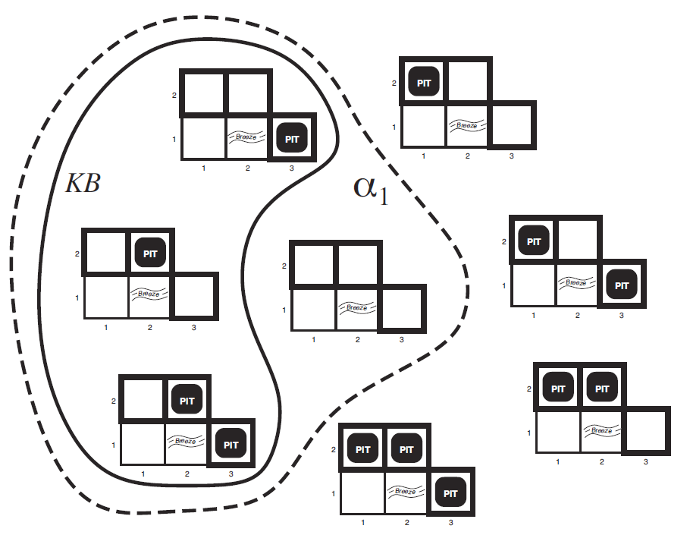

Wumpus World
World has 5 locations
[1,1], [2,1], [3,1], [1,2], [2,2]
Knowledge base
Nothing in [1,1]
Breeze in [2,1]
Possible Models for Pits
P_{1,1}=F, P_{2,1}=F, P_{1,2} ,P_{2,2} ,P_{3,1}

Slide 15

Wumpus World
World has 5 locations
[1,1], [2,1], [3,1], [1,2], [2,2]
Knowledge base
Nothing in [1,1]
Breeze in [2,1]
Possible Models for Pits
P_{1,1}=F, P_{2,1}=F, P_{1,2} ,P_{2,2} ,P_{3,1}
Using Knowledge base rules, infer some of these models aren’t possible
possible worlds that could satisfy this KB are circled

Slide 16
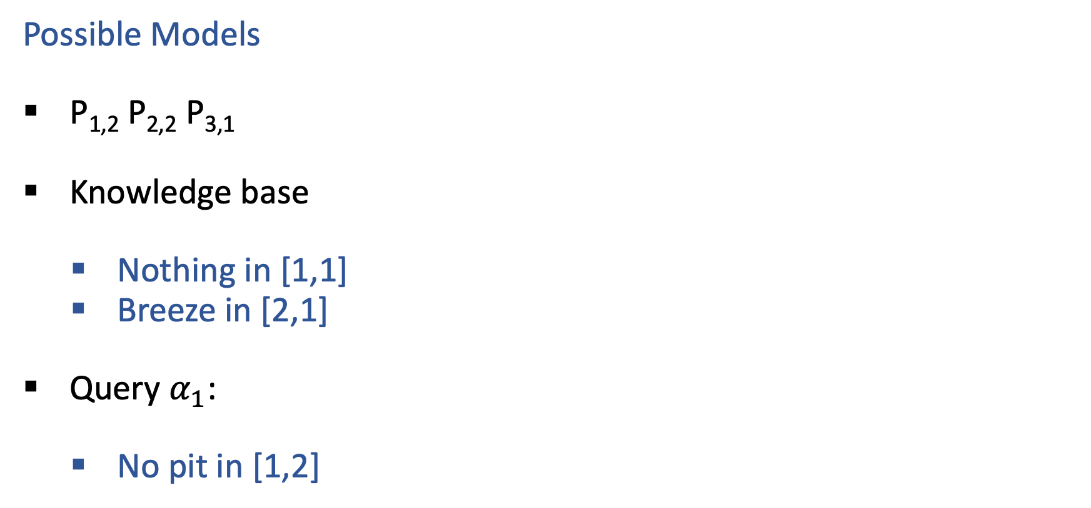
Wumpus World
Possible Models
P_{1,2} P_{2,2} P_{3,1}
Knowledge base
    Nothing in [1,1]
    Breeze in [2,1]
Query $α_{1}$:
    No pit in [1,2]

Slide 17
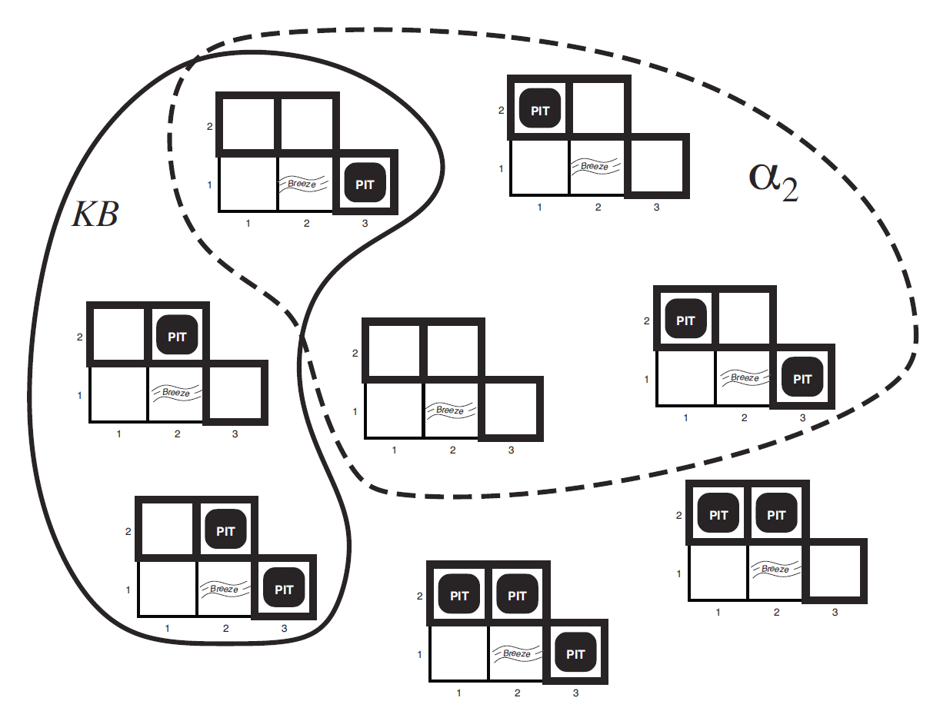
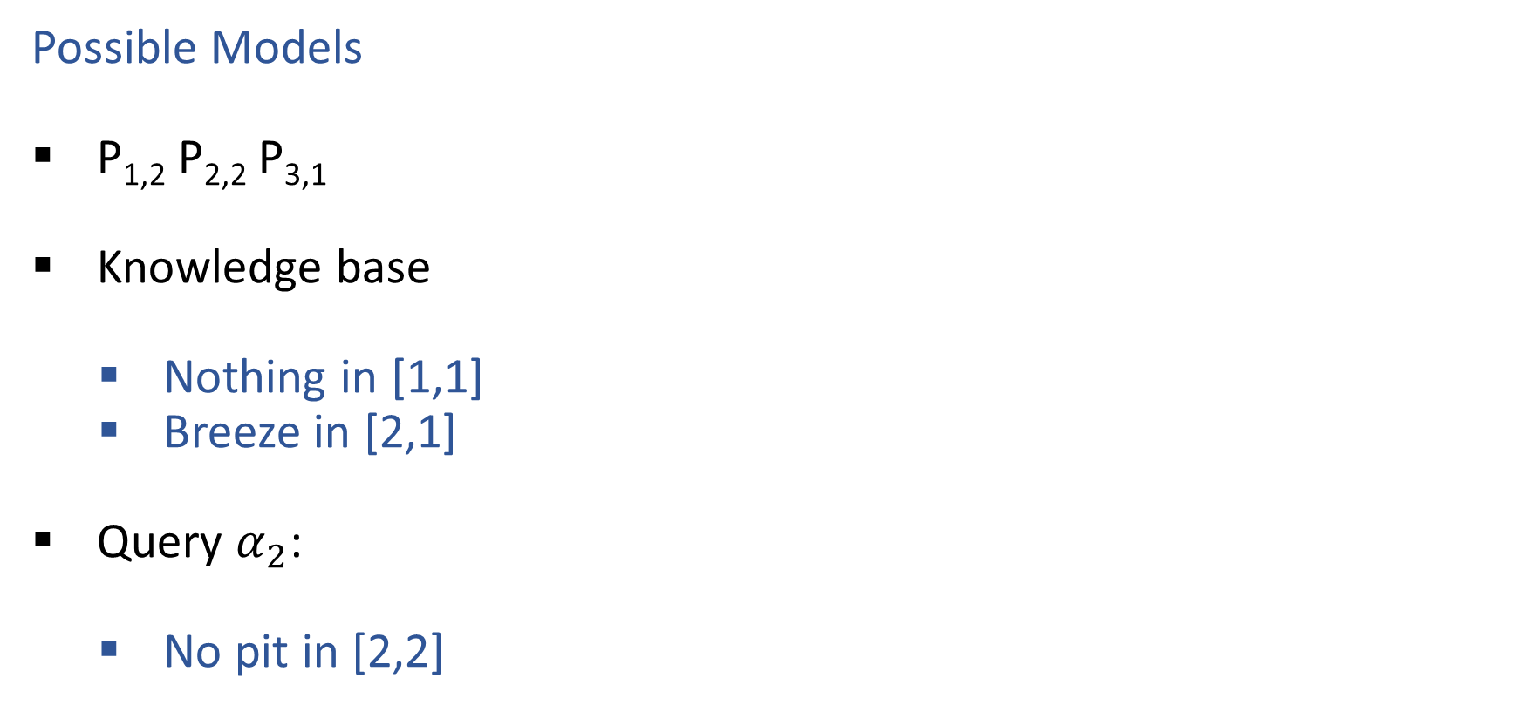
Wumpus World
Possible Models
P_{1,2} P_{2,2} P_{3,1}
Knowledge base
    Nothing in [1,1]
    Breeze in [2,1]
Query $α_{2}$:
    No pit in [2,2]

Slide 18
Role of Queries in Logical Agents
In both CSPs and logic, we can determine whether there is a satisfying assignment of values to variables
In CSPs, we use arc consistency and forward chaining to eliminate single elements of a domain, one at a time
In logic, we can query the KB to determine if every possible assignment of variables has particular properties
This allows us to “learn” or infer new information

Slide 19
Logic Language
Natural language?
Propositional logic
  Syntax: P ∨ (¬Q ∧ R); X₁ ⇔ (Raining ⇒ Sunny)
  Possible world: {P=true, Q=true, R=false, S=true} or 1101
  Semantics: α ∧ β is true in a world iff is α true and β is true (etc.)
First-order logic
  Syntax: ∀x ∃y P(x,y) ∧ ¬Q(Joe,f(x)) ⇒ f(x)=f(y)
  Possible world: Objects o₁, o₂, o₃; P holds for <o₁,o₂>; Q holds for <o₃>; f(o₁)=o₁; Joe=o₃; etc.
  Semantics: φ(σ) is true in a world if σ=o_{j} and φ holds for o_{j}; etc.

Slide 20
Propositional Logic

Slide 21
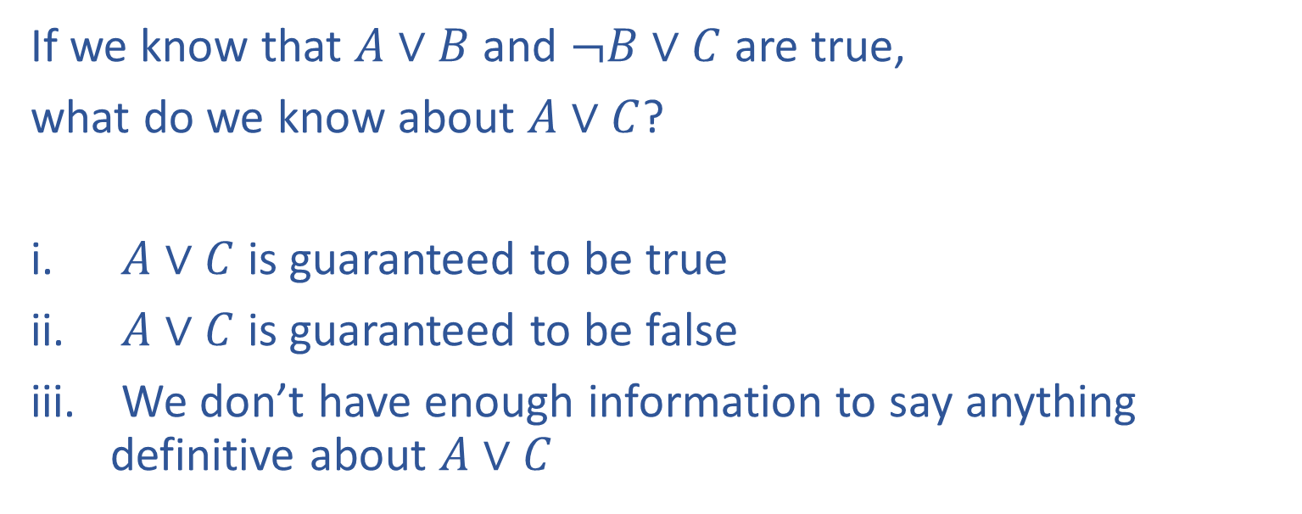
Piazza Poll 1
If we know that $A∨B$ and $¬B∨C$ are true,
what do we know about $A∨C$?
$A∨C$ is guaranteed to be true
$A∨C$ is guaranteed to be false
We don’t have enough information to say anything definitive about $A∨C$

Slide 22
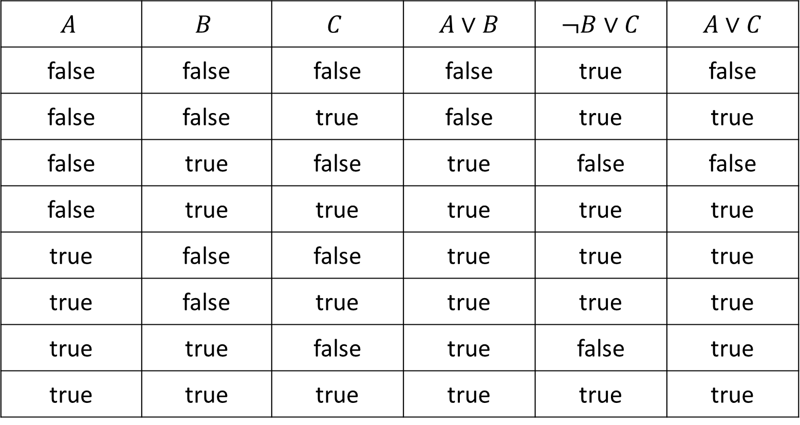
Piazza Poll 1
If we know that $A∨B$ and $¬B∨C$ are true, what do we know about $A∨C$?
$$A$$ | $$B$$ | $$C$$ | $A∨B$ | $¬B∨C$ | $A∨C$
false | false | false | false | true | false
false | false | true | false | true | true
false | true | false | true | false | false
false | true | true | true | true | true
true | false | false | true | true | true
true | false | true | true | true | true
true | true | false | true | false | true
true | true | true | true | true | true

Slide 23
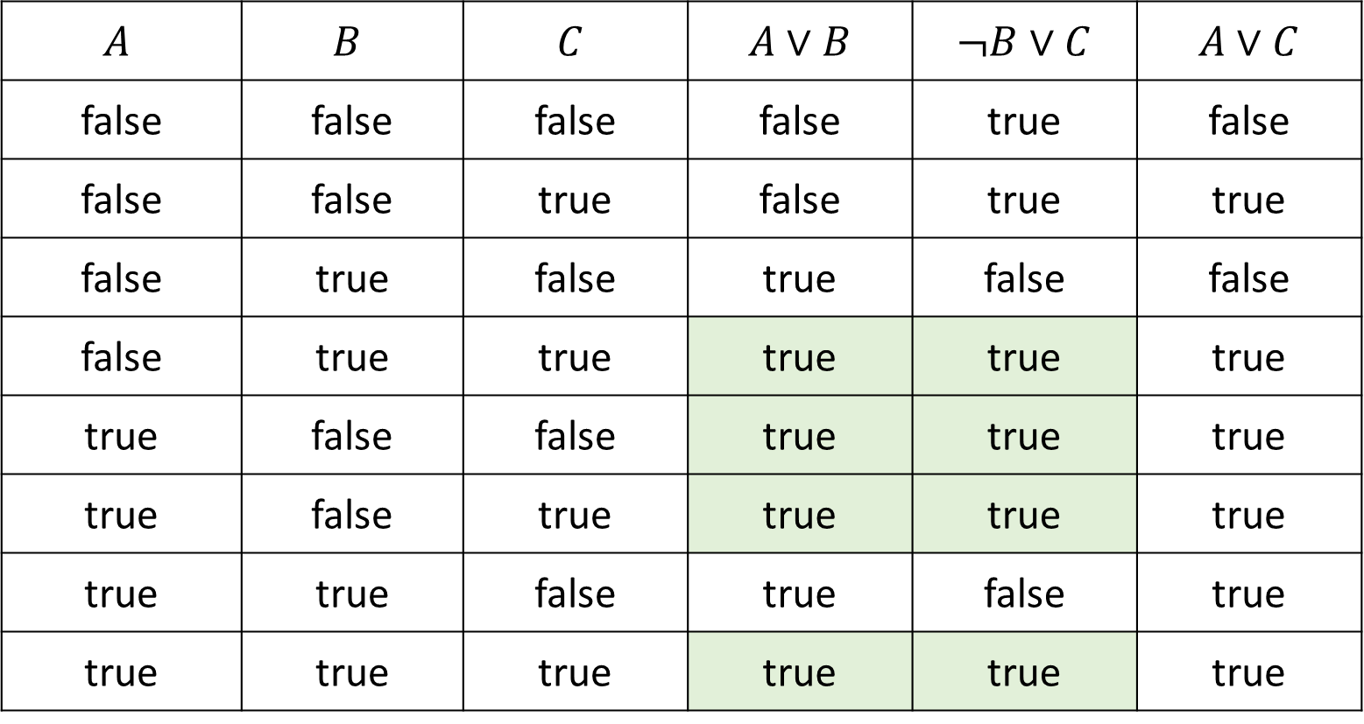
Piazza Poll 1
If we know that $A∨B$ and $¬B∨C$ are true, what do we know about $A∨C$?
$$A$$ | $$B$$ | $$C$$ | $A∨B$ | $¬B∨C$ | $A∨C$
false | false | false | false | true | false
false | false | true | false | true | true
false | true | false | true | false | false
false | true | true | true | true | true
true | false | false | true | true | true
true | false | true | true | true | true
true | true | false | true | false | true
true | true | true | true | true | true

Slide 24
Piazza Poll 1
If we know that $A∨B$ and $¬B∨C$ are true,
what do we know about $A∨C$?
$A∨C$ is guaranteed to be true
$A∨C$ is guaranteed to be false
We don’t have enough information to say anything definitive about $A∨C$

Slide 25
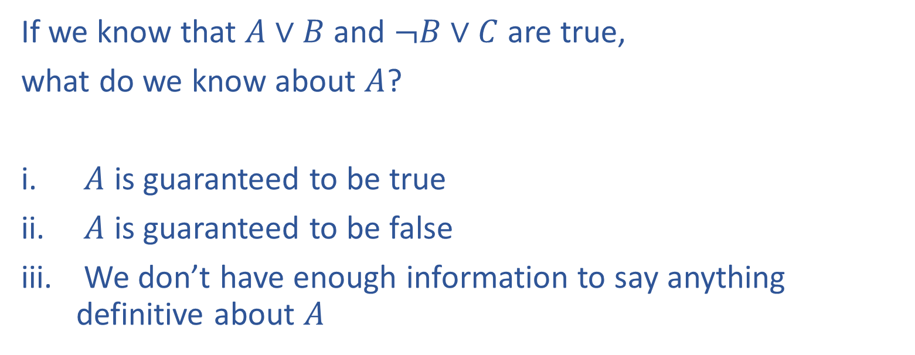
Piazza Poll 2
If we know that $A∨B$ and $¬B∨C$ are true,
what do we know about $A$?
$A$ is guaranteed to be true
$A$ is guaranteed to be false
We don’t have enough information to say anything definitive about $A$

Slide 26
Piazza Poll 2
If we know that $A∨B$ and $¬B∨C$ are true, what do we know about $A$?
$$A$$ | $$B$$ | $$C$$ | $A∨B$ | $¬B∨C$ | $A∨C$
false | false | false | false | true | false
false | false | true | false | true | true
false | true | false | true | false | false
false | true | true | true | true | true
true | false | false | true | true | true
true | false | true | true | true | true
true | true | false | true | false | true
true | true | true | true | true | true

Slide 27
Piazza Poll 2
If we know that $A∨B$ and $¬B∨C$ are true,
what do we know about $A$?
$A$ is guaranteed to be true
$A$ is guaranteed to be false
We don’t have enough information to say anything definitive about $A$

Slide 28
Propositional Logic
Symbol:
Variable that can be true or false
We’ll try to use capital letters, e.g. A, B, P_{1,2}
Often include True and False
Operators:
¬ A: not A
A ∧ B: A and B (conjunction)
A ∨ B: A or B (disjunction) Note: this is not an “exclusive or”
A ⇒ B: A implies B (implication). If A then B
A ⇔ B: A if and only if B (biconditional)
Sentences

Slide 29
Propositional Logic Syntax
Given: a set of proposition symbols {X₁, X₂, …, X_{n}}
    (we often add True and False for convenience)
X_{i} is a sentence
If α is a sentence then ¬α is a sentence
If α and β are sentences then α ∧ β is a sentence
If α and β are sentences then α ∨ β is a sentence
If α and β are sentences then α ⇒ β is a sentence
If α and β are sentences then α ⇔ β is a sentence
And p.s. there are no other sentences!

Slide 30
Notes on Operators
𝛂 ∨ 𝛃 is inclusive or, not exclusive

Slide 31
Truth Tables
𝛂 ∨ 𝛃 is inclusive or, not exclusive
𝛂 | 𝛃 | 𝛂 ∧ 𝛃
F | F | F
F | T | F
T | F | F
T | T | T
𝛂 | 𝛃 | 𝛂 ∨ 𝛃
F | F | F
F | T | T
T | F | T
T | T | T

Slide 32
Notes on Operators
𝛂 ∨ 𝛃 is inclusive or, not exclusive
𝛂 ⇒ 𝛃 is equivalent to ¬𝛂 ∨ 𝛃
Says who?

Slide 33
Truth Tables
𝛂 ⇒ 𝛃 is equivalent to ¬𝛂 ∨ 𝛃
𝛂 | 𝛃 | 𝛂 ⇒ 𝛃 | ¬𝛂 | ¬𝛂 ∨ 𝛃
F | F | T | T | T
F | T | T | T | T
T | F | F | F | F
T | T | T | F | T

Slide 34
Notes on Operators
𝛂 ∨ 𝛃 is inclusive or, not exclusive
𝛂 ⇒ 𝛃 is equivalent to ¬𝛂 ∨ 𝛃
Says who?
𝛂 ⇔ 𝛃 is equivalent to (𝛂 ⇒ 𝛃) ∧ (𝛃 ⇒ 𝛂)
Prove it!

Slide 35
Truth Tables
𝛂 ⇔ 𝛃 is equivalent to (𝛂 ⇒ 𝛃) ∧ (𝛃 ⇒ 𝛂)
𝛂 | 𝛃 | 𝛂 ⇔ 𝛃 | 𝛂 ⇒ 𝛃 | 𝛃 ⇒ 𝛂 | (𝛂⇒𝛃) ∧ (𝛃⇒𝛂)
F | F | T | T | T | T
F | T | F | T | F | F
T | F | F | F | T | F
T | T | T | T | T | T
Equivalence: it’s true in all models. Expressed as a logical sentence:
(𝛂 ⇔ 𝛃) ⇔ [(𝛂 ⇒ 𝛃) ∧ (𝛃 ⇒ 𝛂)]

Slide 36
Literals
A literal is an atomic sentence:
True
False
Symbol
¬ Symbol

Slide 37
Sentences as Constraints
Adding a sentence to our knowledge base constrains the
number of possible models:
KB: Nothing
Possible
Models
P | Q | R
false | false | false
false | false | true
false | true | false
false | true | true
true | false | false
true | false | true
true | true | false
true | true | true

Slide 38
Sentences as Constraints
Adding a sentence to our knowledge base constrains the
number of possible models:
KB: Nothing
KB: [(P ∧ ¬Q) ∨ (Q ∧ ¬P)] ⇒ R
Possible
Models
P | Q | R
false | false | false
false | false | true
false | true | false
false | true | true
true | false | false
true | false | true
true | true | false
true | true | true

Slide 39
Sentences as Constraints
Adding a sentence to our knowledge base constrains the
number of possible models:
KB: Nothing
KB: [(P ∧ ¬Q) ∨ (Q ∧ ¬P)] ⇒ R
KB: R, [(P ∧ ¬Q) ∨ (Q ∧ ¬P)] ⇒ R
Possible
Models
P | Q | R
false | false | false
false | false | true
false | true | false
false | true | true
true | false | false
true | false | true
true | true | false
true | true | true

Slide 40
Entailment
Entailment: α |= β (“α entails β” or “β follows from α”) iff in every world where α is true, β is also true
    I.e., the α-worlds are a subset of the β-worlds [models(α) ⊆ models(β)]
Usually we want to know if KB |= query
  models(KB) ⊆ models(query)
  In other words
    KB removes all impossible models (any model where KB is false)
    If β is true in all of these remaining models, we conclude that β must be true

Slide 41
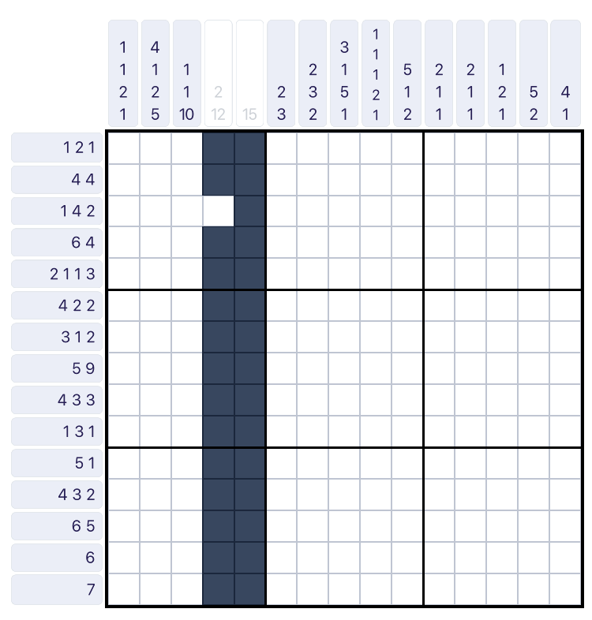
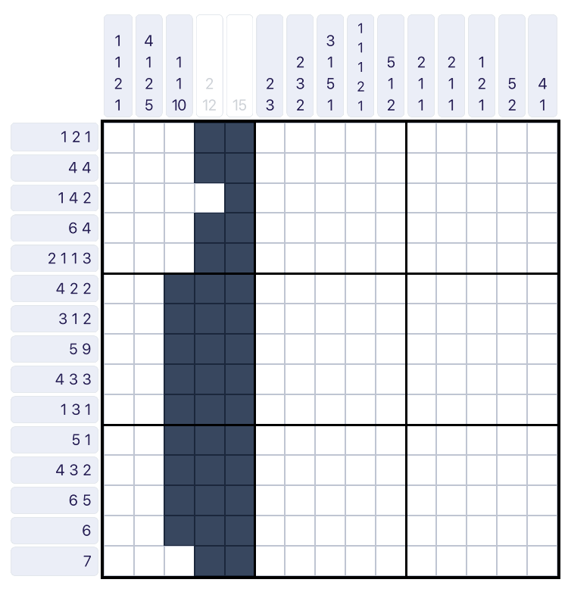
Nonogram Example
Given the KB of constraints, we can query particular squares to determine if they are true or false in all models, or if they are unknown.

Slide 42
Wumpus World
World has 5 locations
[1,1], [2,1], [3,1], [1,2], [2,2]
Knowledge base
Nothing in [1,1]
Breeze in [2,1]
Possible Models for Pits
P_{1,1}=F, P_{2,1}=F, P_{1,2} ,P_{2,2} ,P_{3,1}

Slide 43
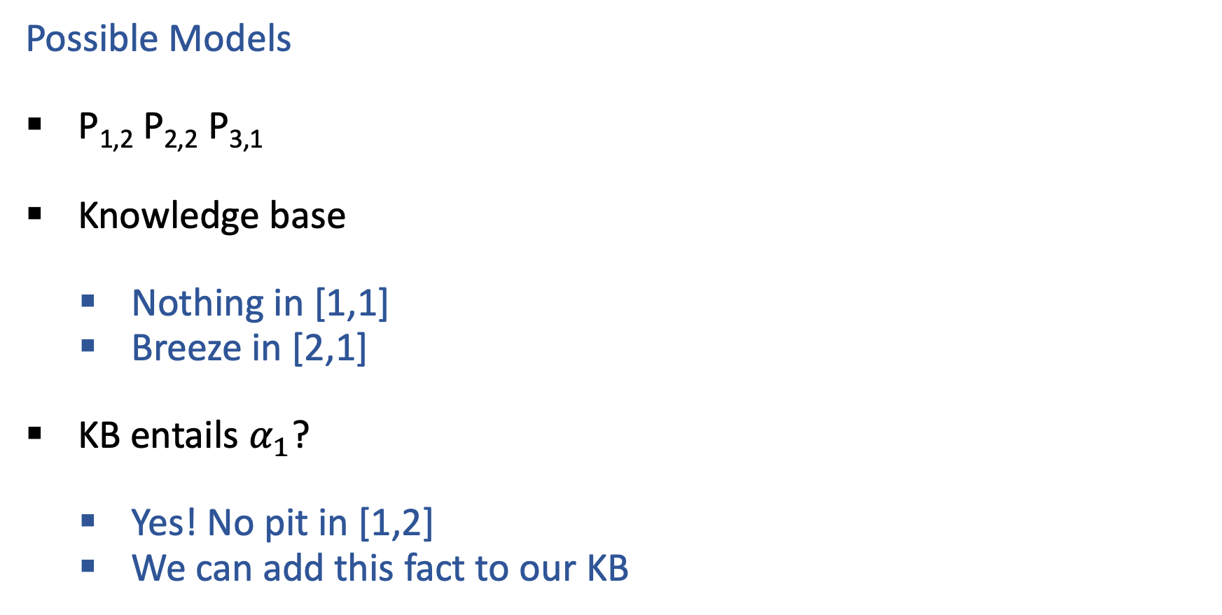
Wumpus World
Possible Models
P_{1,2} P_{2,2} P_{3,1}
Knowledge base
    Nothing in [1,1]
    Breeze in [2,1]
KB entails $α_{1}$?
    Yes! No pit in [1,2]
    We can add this fact to our KB

Slide 44
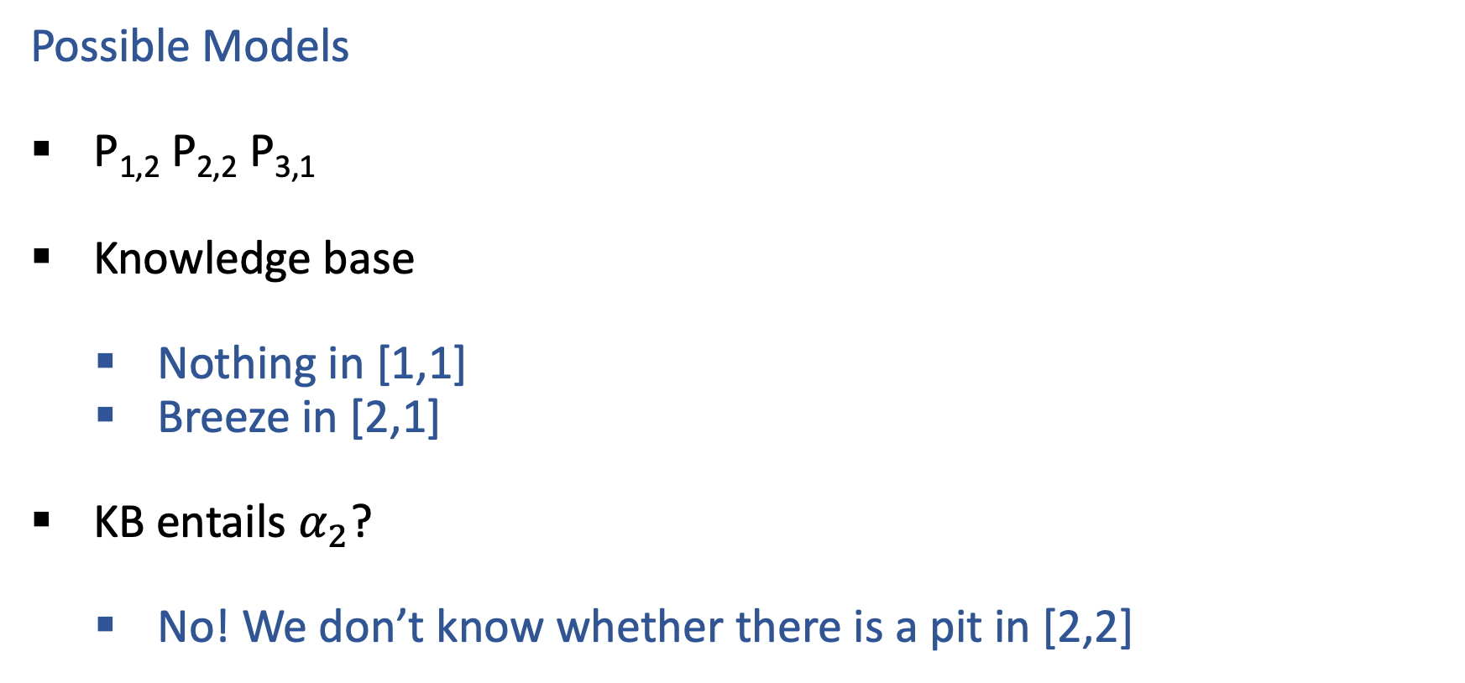
Wumpus World
Possible Models
P_{1,2} P_{2,2} P_{3,1}
Knowledge base
    Nothing in [1,1]
    Breeze in [2,1]
KB entails $α_{2}$?
    No! We don’t know whether there is a pit in [2,2]

Slide 45
Entailment
Entailment: α |= β (“α entails β” or “β follows from α”) iff in every world where α is true, β is also true
    I.e., the α-worlds are a subset of the β-worlds [models(α) ⊆ models(β)]
Usually we want to know if KB |= query
  models(KB) ⊆ models(query)
  In other words
    KB removes all impossible models (any model where KB is false)
    If β is true in all of these remaining models, we conclude that β must be true
Entailment and implication are very much related
  However, entailment relates two sentences, while an implication is itself a sentence (usually derived via inference to show entailment)

Slide 46
Propositional Logic Models
All Possible Models
A | 0 | 0 | 0 | 0 | 1 | 1 | 1 | 1
B | 0 | 0 | 1 | 1 | 0 | 0 | 1 | 1
C | 0 | 1 | 0 | 1 | 0 | 1 | 0 | 1
Model Symbols

Slide 47
Piazza Poll 3
Entailment: α |= β
“α entails β” iff in every world where α is true, β is also true
Does the KB entail query C?
All Possible Models
A | 0 | 0 | 0 | 0 | 1 | 1 | 1 | 1
B | 0 | 0 | 1 | 1 | 0 | 0 | 1 | 1
C | 0 | 1 | 0 | 1 | 0 | 1 | 0 | 1
A | 0 | 0 | 0 | 0 | 1 | 1 | 1 | 1
B⇒C | 1 | 1 | 0 | 1 | 1 | 1 | 0 | 1
A⇒B∨C | 1 | 1 | 1 | 1 | 0 | 1 | 1 | 1
C | 0 | 1 | 0 | 1 | 0 | 1 | 0 | 1
Model Symbols
Knowledge Base
Query

Slide 48
Entailment
How do we implement a logical agent that proves entailment?
  Logic language
    Propositional logic
    First order logic
  Inference algorithms
    Theorem proving
    Model checking

Slide 49
Simple Model Checking
Same recursion as backtracking
O(2^{n}) time, linear space
We can do much better!
P₁=true
P₁=false
P₂=true
P₂=false
P_{n}=true
P_{n}=false
KB?
α?
11111…1
0000…0

Slide 50
Piazza Poll 4
Which would you choose?
DFS
BFS
P₁=true
P₁=false
P₂=true
P₂=false
P_{n}=true
P_{n}=false
KB?
α?
11111…1
0000…0

Slide 51
Simple Model Checking
function TT-ENTAILS?(KB, α) returns true or false
return TT-CHECK-ALL(KB, α, symbols(KB) U symbols(α), {})
function TT-CHECK-ALL(KB, α, symbols, model) returns true or false
if empty?(symbols) then
if PL-TRUE?(KB, model) then return PL-TRUE?(α, model)
else return true
else
P ← first(symbols)
rest ← rest(symbols)
return and (TT-CHECK-ALL(KB, α, rest, model ∪ {P = true})
TT-CHECK-ALL(KB, α, rest, model ∪ {P = false }))

Slide 52
Propositional Logic
Check if sentence is true in given model
In other words, does the model satisfy the sentence?
function PL-TRUE?(α,model) returns true or false
if α is a symbol then return Lookup(α, model)
if Op(α) = ¬ then return not(PL-TRUE?(Arg1(α),model))
if Op(α) = ∧ then return and(PL-TRUE?(Arg1(α),model),
PL-TRUE?(Arg2(α),model))
etc.
(Sometimes called “recursion over syntax”)

Slide 53
Inference: Proofs
A proof is a demonstration of entailment between α and β
Method 1: model-checking
  For every possible world, if α is true make sure that is β true too
  OK for propositional logic (finitely many worlds); not easy for first-order logic
Method 2: theorem-proving
  Search for a sequence of proof steps (applications of inference rules) leading from α to β
  E.g., from P ∧ (P ⇒ Q), infer Q by Modus Ponens
Properties
Sound algorithm: everything it claims to prove is in fact entailed
Complete algorithm: every sentence that is entailed can be proved

Slide 54
Simple Theorem Proving: Forward Chaining
Forward chaining applies Modus Ponens to generate new facts:
  Given X₁ ∧ X₂ ∧ … X_{n} ⇒ Y and X₁, X₂, …, X_{n}
  Infer Y
Forward chaining keeps applying this rule, adding new facts, until nothing more can be added
Requires KB to contain only definite clauses:
  (Conjunction of symbols) ⇒ symbol; or
  A single symbol (note that X is equivalent to True ⇒ X)

Slide 55
Forward Chaining Algorithm
function PL-FC-ENTAILS?(KB, q) returns true or false
count ← a table, where count[c] is the number of symbols in c’s premise
inferred ← a table, where inferred[s] is initially false for all s
agenda ← a queue of symbols, initially symbols known to be true in KB
Clauses
Count
Inferred
Agenda
P ⇒ Q
L ∧ M ⇒ P
B ∧ L ⇒ M
A ∧ P ⇒ L
A ∧ B ⇒ L
A
B
1
2
2
2
2
0
0
A false
B false
L false
M false
P false
Q false

Slide 56
Forward Chaining Example: Proving Q
Clauses
Count
Inferred
1
2
2
2
2
0
0
A false
B false
L false
M false
P false
Q false
P ⇒ Q
L ∧ M ⇒ P
B ∧ L ⇒ M
A ∧ P ⇒ L
A ∧ B ⇒ L
A
B
// 0
xxxx true
// 1
xxxx true
// 0
// 0
xxxx true
// 1
// 0
xxxx true
// 1
xxxx true
// 0
// 1
xxxx true
Agenda
x
x
Q
x
L
x
x
x
M
P
A B
x
L

Slide 57
Forward Chaining Algorithm
function PL-FC-ENTAILS?(KB, q) returns true or false
count ← a table, where count[c] is the number of symbols in c’s premise
inferred ← a table, where inferred[s] is initially false for all s
agenda ← a queue of symbols, initially symbols known to be true in KB
while agenda is not empty do
p ← Pop(agenda)
if p = q then return true
if inferred[p] = false then
inferred[p]←true
for each clause c in KB where p is in c.premise do
decrement count[c]
if count[c] = 0 then add c.conclusion to agenda
return false

Slide 58
Properties of forward chaining
Theorem: FC is sound and complete for definite-clause KBs
Soundness: follows from soundness of Modus Ponens (easy to check)
Completeness proof:
1. FC reaches a fixed point where no new atomic sentences are derived
2. Consider the final inferred table as a model m, assigning true/false to symbols
3. Every clause in the original KB is true in m
Proof: Suppose a clause a₁∧... ∧a_{k} ⇒ b is false in m
Then a₁∧... ∧a_{k} is true in m and b is false in m
Therefore the algorithm has not reached a fixed point!
4. Hence m is a model of KB
5. If KB |= q, q is true in every model of KB, including m
A false
B false
L false
M false
P false
Q false
xxxx true
xxxx true
xxxx true
xxxx true
xxxx true
xxxx true

Slide 59

Inference Rules
Modus Ponens
$\frac{α⇒β, α}{β}$
Unit Resolution
$\frac{a∨b, ¬b∨c}{a∨c}$
General Resolution
$\frac{a_{1}∨…∨a_{m}∨b, ¬b∨c_{1}∨…∨c_{n}}{a_{1}∨…∨a_{m}∨c_{1}∨…∨c_{n}}$
Notation Alert!

Slide 60
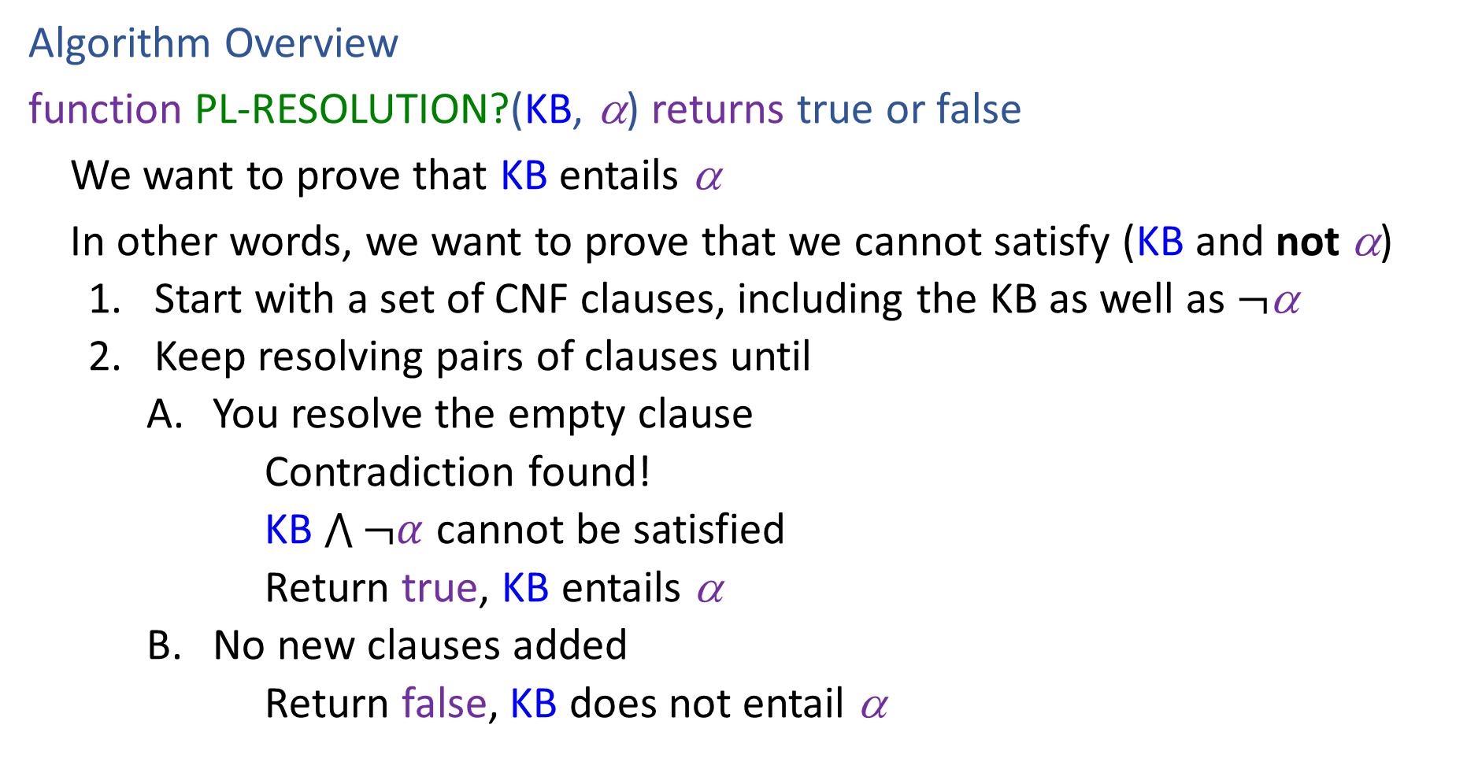
Resolution
Algorithm Overview
function PL-RESOLUTION?(KB, α) returns true or false
We want to prove that KB entails α
In other words, we want to prove that we cannot satisfy (KB and not α)
    Start with a set of CNF clauses, including the KB as well as $¬$α
    Keep resolving pairs of clauses until
        You resolve the empty clause
        Contradiction found!
        KB $\bigwedge{¬α}$ cannot be satisfied
        Return true, KB entails α
        No new clauses added
        Return false, KB does not entail α

Slide 61
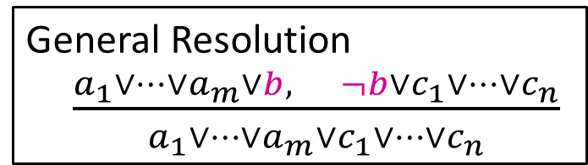






Resolution
General Resolution
$\frac{a_{1}∨…∨a_{m}∨b, ¬b∨c_{1}∨…∨c_{n}}{a_{1}∨…∨a_{m}∨c_{1}∨…∨c_{n}}$
Example trying to prove $¬P_{1,2}$
Knowledge Base
$$¬P_{2,1}∨B_{1,1}$$
$$¬B_{1,1}∨P_{1,2}∨P_{2,1}$$
$$¬P_{1,2}∨B_{1,1}$$
$$¬B_{1,1}$$
$$¬¬P_{1,2}$$

Slide 62







Resolution
General Resolution
$\frac{a_{1}∨…∨a_{m}∨b, ¬b∨c_{1}∨…∨c_{n}}{a_{1}∨…∨a_{m}∨c_{1}∨…∨c_{n}}$
Example trying to prove $¬P_{1,2}$
Knowledge Base
$$¬P_{2,1}∨B_{1,1}$$
$$¬B_{1,1}∨P_{1,2}∨P_{2,1}$$
$$¬P_{1,2}∨B_{1,1}$$
$$¬B_{1,1}$$
$$P_{1,2}$$
$$¬B_{1,1}∨P_{1,2}∨B_{1,1}$$
$$P_{1,2}∨P_{2,1}∨¬P_{2,1}$$
$$¬B_{1,1}∨P_{2,1}∨B_{1,1}$$
$$P_{1,2}∨P_{2,1}∨¬P_{1,2}$$
$$¬P_{2,1}$$
$$¬P_{1,2}$$

Slide 63
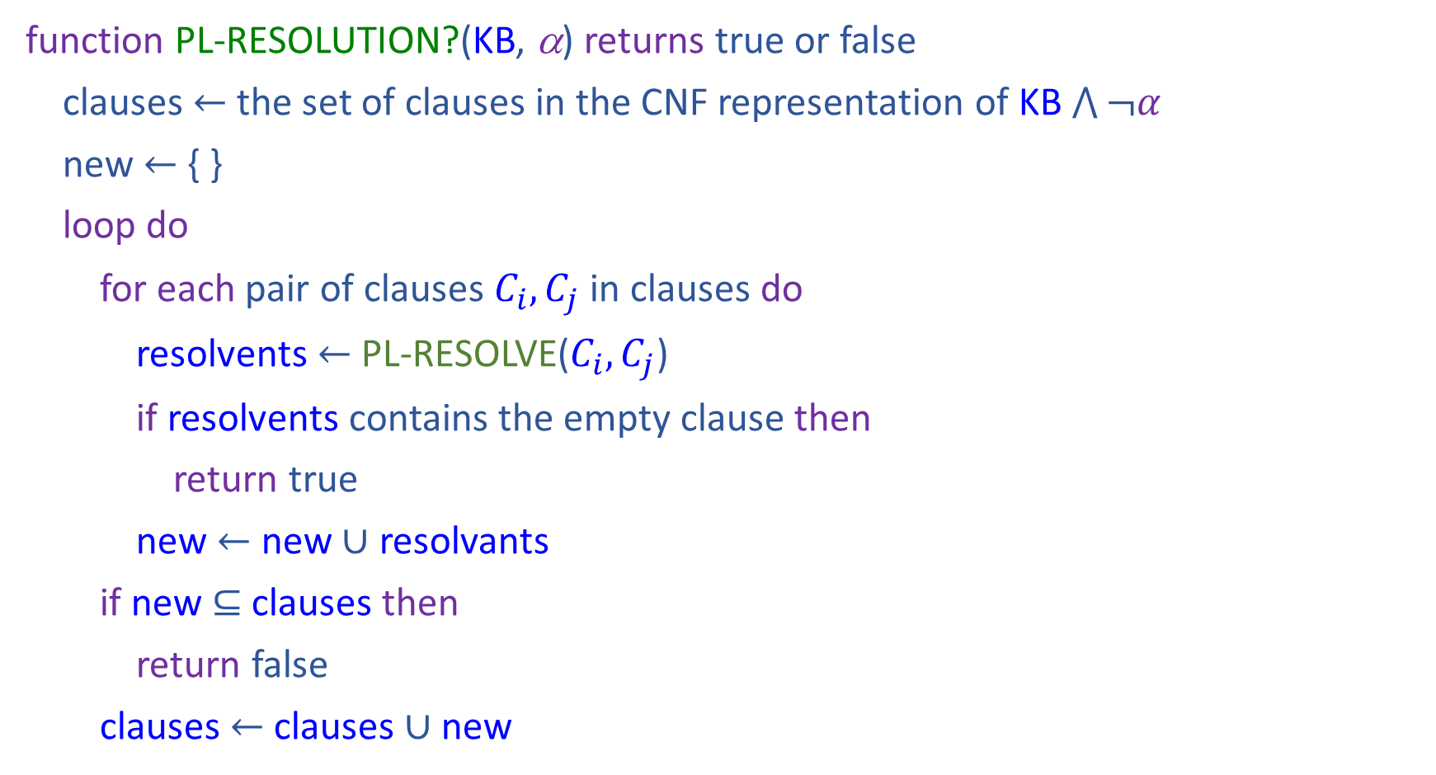
Resolution
function PL-RESOLUTION?(KB, α) returns true or false
clauses $←$ the set of clauses in the CNF representation of KB $\bigwedge{¬α}$
new $←${ }
loop do
for each pair of clauses $C_{i}, C_{j}$ in clauses do
resolvents $←$ PL-RESOLVE($C_{i}, C_{j}$)
if resolvents contains the empty clause then
return true
new $←$ new $∪$ resolvants
if new $⊆$ clauses then
return false
clauses $←$ clauses $∪$ new

Slide 64
Properties
Forward Chaining is:
Sound and complete for definite-clause KBs
Complexity: linear time
Resolution is:
Sound and complete for any PL KBs!
Complexity: exponential time ☹

