Slide 1
Warm Up: Represent this Blocks World
A robot arm (yellow) can pick up and put down blocks to form stacks.
It cannot pick up a block that has another block on top of it.
It cannot pick up more than one block at a time.
Any number of blocks can sit on the table.
Only one block fits on top of another.
How would you represent this block world to be able to run BFS?
How would you represent this block world to use logic to find a plan?
Hint: How would you represent the states, actions, goals, transitions?
Notes:
0=7, R=4, W=6, U=2, T=8, F=1; 867 + 867 = 1734

Slide 2

Announcements
Midterm 1 Exam Graded
Assignments:
HW5
    Due Tue 2/25, 10pm
P3: Logic and Classical Planning
    Out 2/22, Due Thu 3/5 10 pm before spring break!
HW6
    Out Tue 2/25, 10pm
    Due Tue 3/3, 10pm

Slide 3
AI: Representation and Problem Solving
Classical Planning
or Symbolic Planning
Instructors: Pat Virtue & Stephanie Rosenthal
Slide credits: CMU AI, http://ai.berkeley.edu

Slide 4
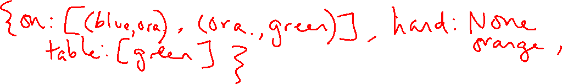
Represent this Blocks World
A robot arm (yellow) can pick up and put down blocks to form stacks.
It cannot pick up a block that has another block on top of it.
It cannot pick up more than one block at a time.
Any number of blocks can sit on the table.
How would you represent this block world to be able to run BFS?
States
Actions
Goals
Transitions
Notes:
0=7, R=4, W=6, U=2, T=8, F=1; 867 + 867 = 1734

Slide 5
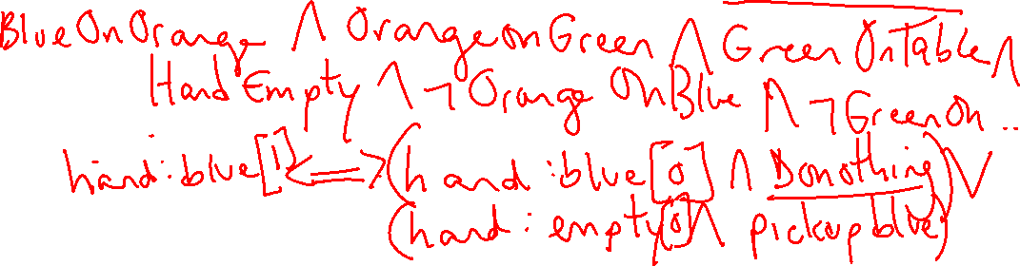
Represent this Blocks World
A robot arm (yellow) can pick up and put down blocks to form stacks.
It cannot pick up a block that has another block on top of it.
It cannot pick up more than one block at a time.
Any number of blocks can sit on the table.
How would you represent this block world to be able to run logical planning?
States
Actions
Goals
Transitions
Notes:
0=7, R=4, W=6, U=2, T=8, F=1; 867 + 867 = 1734

Slide 6

Pros and Cons of the Approaches
BFS
+ concise representation of objects
- more challenging to write a definition of the actions for each possible state
Logical Planning
+ successor-state axioms are relatively concise to write but there are many
- states and fluents are cumbersome to write and debug
Classical Planning:
+ concise object representation and clearer action definitions
- still only works for deterministic fully observable worlds

Slide 7
Symbolic Representation
In Logic, we represent each object in location as a Boolean proposition
A-on-Table A-In-Hand
B-on-Table B-In-Hand
C-on-Table C-In-Hand
Hand-Empty
A-on-B B-on-A
A-on-C C-on-A
B-on-C C-on-B
Clear-A Clear-B
Clear-C
Robot Arm
A
B
C

Slide 8

Symbolic Representation
In Logic, we represent each object in location as a Boolean proposition
The issue is that every time you add an object into this world, your number of propositions expands exponentially as do your successor-state axioms
A-on-Table A-In-Hand
B-on-Table B-In-Hand
C-on-Table C-In-Hand
D-on-Table D-In-Hand
Hand-Empty
A-on-B B-on-A
A-on-C C-on-A
B-on-C C-on-B
D-on-A D-on-B
D-on-C
D-on-A[t] <=> ?
D-on-B[t] <=> ?
D-on-C[t] <=> ?
D-In-Hand <=> ?
D-on-Table <=> ?
Robot Arm
A
B
C

Slide 9
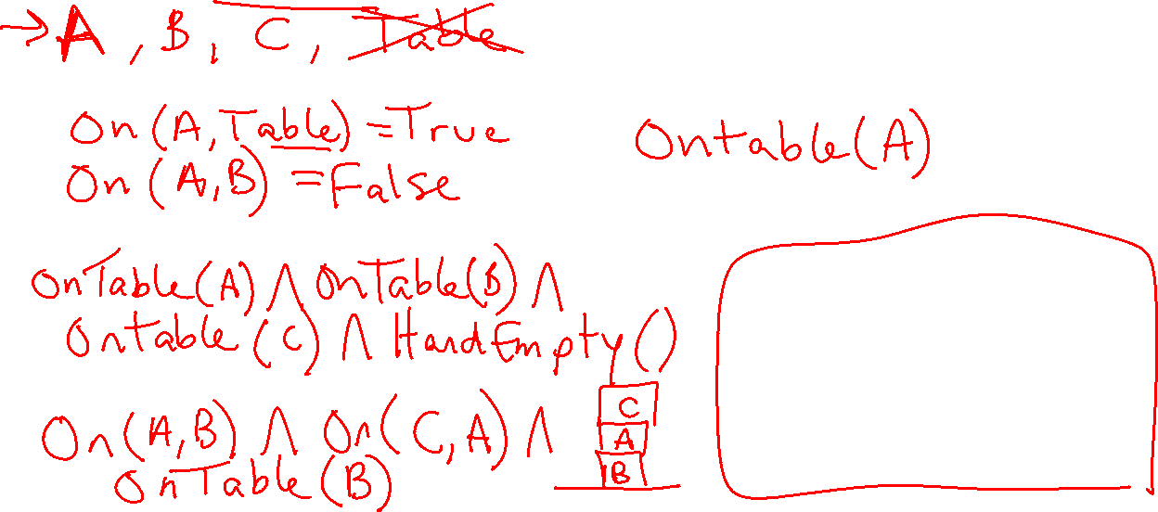
Idea of Classical Planning
Notes: We can give them any names we want!
And we can change representation too!
Represent objects/values separately from the state (instances)
Define predicates as true/false functions over the objects
States are conjunctions of predicates
Goals are conjunctions of predicates
Robot Arm
A
B
C

Slide 10
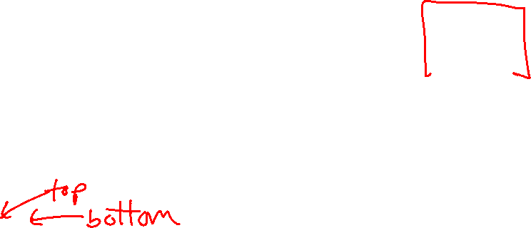
Piazza Poll 1
Which predicates apply to this state? (Select all that apply)
Instances: A, B, C
Predicates:
1) In-Hand(A)
2) In-Hand(B)
3) In-Hand(C)
4) On-Table(A)
5) On-Table(B)
6) On-Table(C)
7) On-Block(B,C)
8) On-Block(A,B)
9) HandEmpty()
A
C
B

Slide 11

Piazza Poll 1
Which predicates apply to this state? (Select all that apply)
Instances: A, B, C
Predicates:
1) In-Hand(A)
2) In-Hand(B)
3) In-Hand(C)
4) On-Table(A)
5) On-Table(B)
6) On-Table(C)
7) On-Block(B,C)
8) On-Block(A,B)
9) HandEmpty()
A
C
B

Slide 12
Full State Description
Instances: A, B, C
Predicates:
In-Hand(C)
On-Table(B)
On-Block(A,B)
Clear(A)
Clear(C)
Optional: ~HandEmpty(), ~On-Table(C), ~On-Table(A), ~On-Block(B,A), ~On-Block(C,A), ~On-Block(B,C), ~On-Block(C,B), ~On-Block(A,C), ~Clear(B), ~In-Hand(A), ~In-Hand(B)
A
C
B

Slide 13

Operators
Operators change the state by adding/deleting predicates
Preconditions:
Actions can be applied only if all precondition predicates are true in the current state
Effects:
New state is a copy of the current predicates with the addition or deletion of specified predicates
Unlike the successor-state axioms, we do not explicitly represent time and we can use our objects and predicates to more easily scale to new more complex problems (e.g., new objects, predicates, and operators).

Slide 14
Rules of Block World
Blocks are picked up and put down by the hand
Blocks can be picked up only if they are clear
Hand can pick up a block only if the hand is empty
Hand can pick up and put down blocks on blocks or on the table

Slide 15
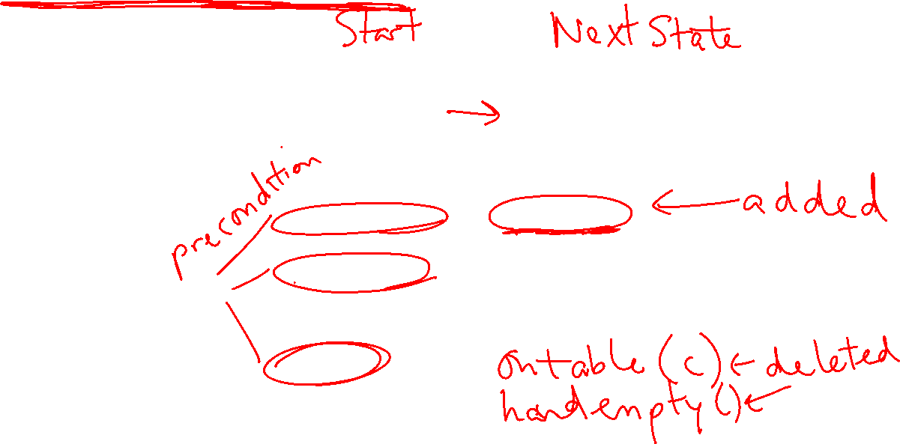
Pickup Block C from Table (State Transition)
Instances:
Blocks A, B, C
Possible Predicates:
HandEmpty()
On-Table(block)
On-Block(b1,b2)
Clear(block)
In-Hand(block)
A
B
C
State:
HandEmpty()
On-Table(B)
On-Table(C)
On-Block(A,B)
Clear(A)
Clear(C)
State:
In-Hand(C)
On-Table(B)
On-Block(A,B)
Clear(A)
Clear(C)

Slide 16

Pickup Block C from Table (Preconditions, Effects)
Instances:
Blocks A, B, C
Possible Predicates:
HandEmpty()
On-Table(block)
On-Block(b1,b2)
Clear(block)
In-Hand(block)
A
B
C
State:
HandEmpty()
On-Table(B)
On-Table(C)
On-Block(A,B)
Clear(A)
Clear(C)
State:
HandEmpty()
On-Table(B)
On-Table(C)
On-Block(A,B)
Clear(A)
Clear(C)
State:
In-Hand(C)
On-Table(B)
On-Block(A,B)
Clear(A)
Clear(C)
State:
In-Hand(C)
On-Table(B)
On-Block(A,B)
Clear(A)
Clear(C)
Delete HandEmpty()
Delete On-Table(C)

Slide 17
Operator: Pickup-Block-C from Table
Preconditions Effects
HandEmpty() Add In-Hand(C)
Clear(C) Delete HandEmpty()
On-Table(C) On-Table(C)
A
B
C

Slide 18
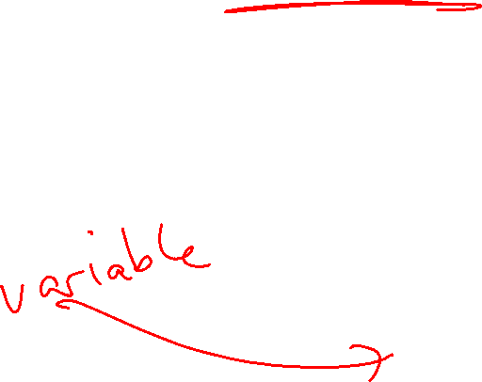
Operator: Pickup-Block from Table
Preconditions Effects
HandEmpty() Add In-Hand(block)
Clear(block) Delete HandEmpty()
On-Table(block) On-Table(block)
Create a variable that takes on the value of a particular instance for all times it appears in an operator.

Slide 19
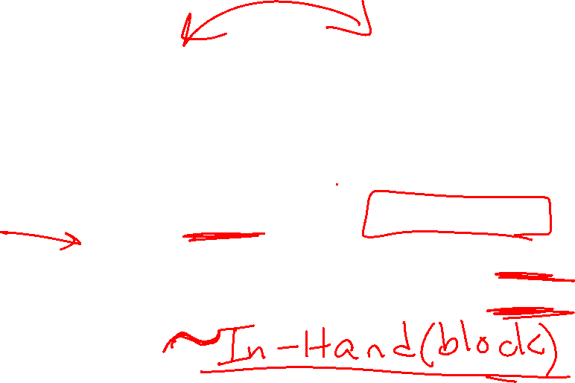
Operator: PutDown-Block on Table
Preconditions Effects
In-Hand(block) Add HandEmpty()
On-Table(block)
Delete In-Hand(block)
Why do we not need to check if ~HandEmpty() is true?

Slide 20
Full State Description
Instances: A, B, C
Predicates:
In-Hand(C)
On-Table(B)
On-Block(A,B)
Clear(A)
Clear(C)
Optional: ~HandEmpty(), ~On-Table(C), ~On-Table(A), ~On-Block(B,A), ~On-Block(C,A), ~On-Block(B,C), ~On-Block(C,B), ~On-Block(A,C), ~Clear(B), ~In-Hand(A), ~In-Hand(B)
RULE OF THUMB: If you must match that Predicate is explicitly not true, you must include ~Predicate in the state description.
A
C
B

Slide 21

Operators for Block Stacking
Pickup_Table(b):
Pre: HandEmpty(), Clear(b), On-Table(b)
Add: In-Hand(b)
Delete: HandEmpty(), On-Table(b)
Putdown_Table(b):
Pre: In-Hand(b)
Add: HandEmpty(), On-Table(b)
Delete: In-Hand(b)
Pickup_Block(b,c):
Pre: HandEmpty(), On-Block(b,c), b!=c
Add: In-Hand(b), Clear(c)
Delete: HandEmpty(), On-Block(b,c)
Putdown_Block(b,c):
Pre: In-Hand(b), Clear(c)
Add: HandEmpty(), On-Block(b,c)
Delete: Clear(c), In-Hand(b)
Why do we need separate operators for table vs on a block?

Slide 22
Example Matching Operators
HandEmpty() & On-Table(O) & On-Block(B,O) & Clear(B) & On-Table(G) & Clear(G)

Slide 23
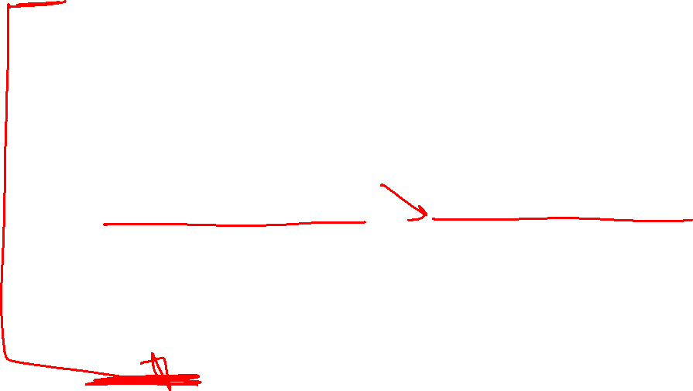
Example Matching Operators
HandEmpty() & On-Table(O) & On-Block(B,O) & Clear(B) & On-Table(G) & Clear(G)
Pickup_Block(b,c):
Pre: HandEmpty(), On-Block(b,c), b!=c
Add: In-Hand(b), Clear(c)
Delete: HandEmpty(), On(b,c)
Pickup_Table(b):
Pre: HandEmpty, Clear(b), On-Table(b)
Add: In-Hand(b)
Delete: HandEmpty(), On-Table(b)

Slide 24
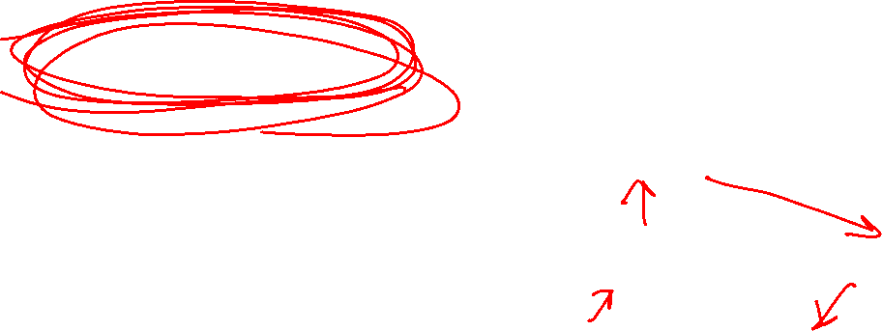
Planning Graph (sometimes called Reachability Graph)
Start
Goal

Slide 25
Example Matching Operators
HandEmpty() & On-Table(O) & On-Block(B,O) & Clear(B) & On-Table(G) & Clear(G)
Pickup_Block(B,O)
On-Table(O) & Clear(B) & On-Table(G) & Clear(G) & In-Hand(B) & Clear(O)
Putdown_Table(B)
On-Table(O) & Clear(O) & On-Table(G) & Clear(G) & Clear(B) & On-Table(B) & HandEmpty()
Pickup_Table(G)
On-Table(O) & Clear(B) & Clear(G) & Clear(O) & On-Table(B) & In-Hand(G)
Putdown_Block(G,O)
On-Table(O) & Clear(B) & Clear(G) & On-Table(B) & On-Block(G,O) & HandEmpty()

Slide 26

What kind of search can we do with a Planning Graph?
Start
Goal

Slide 27
Finding Plans with Symbolic Representations
Breadth-First Search
Sound?
Complete?
Optimal?
Yes
Yes
Yes
Soundness - all solutions found are legal plans
Completeness - a solution can be found whenever one actually exists
Optimality - the order in which solutions are found is consistent with some measure of plan quality

Slide 28
Linear Planning
Since we have a conjunction of goal predicates, let’s try to solve one at a time
  Maintain a stack of achievable goals
  Use BFS (or anything else) to find a plan to achieve that single goal
  Add a goal back on the stack if a later change makes it violated

Slide 29

Linear Planning Example 1
Goal Stack:
On-Table(B)
On-Table(O)
On-Block(G,O)
Clear(G)
Clear(B)
Action Plan:
On-Table(B)
On-Table(B)
Pickup-Block(B,O)
Put-Table(B)

Slide 30
Linear Planning Example 1
Goal Stack:
On-Table(O)
On-Block(G,O)
Clear(G)
Clear(B)
Action Plan:
On-Table(O)
On-Table(B)
Pickup-Block(B,O)
Put-Table(B)
On-Table(O)

Slide 31

Linear Planning Example 1
Goal Stack:
On-Block(G,O)
Clear(G)
Clear(B)
Action Plan:
On-Block(G,O)
On-Table(B)
Pickup-Block(B,O)
Put-Table(B)
On-Table(O)
On-Block(G,O)
Pickup-Table(G)
Put-Block(G,O)

Slide 32

Linear Planning Example 1
Goal Stack:
Clear(G)
Clear(B)
Action Plan:
Clear(G)
Clear(B)
On-Table(B)
Pickup-Block(B,O)
Put-Table(B)
On-Table(O)
On-Block(G,O)
Pickup-Table(G)
Put-Block(G,O)
Clear(G)
Clear(B)

Slide 33
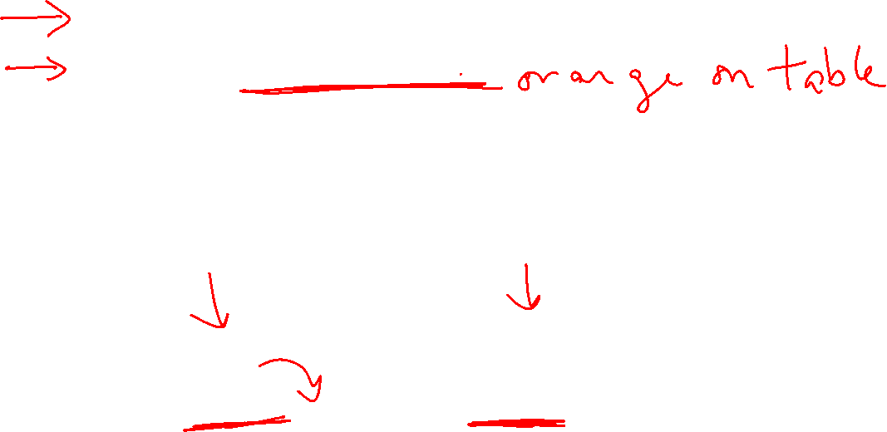
Linear Planning Example 2
Goal Stack:
On-Block(O,G)
On-Table(B)
On-Block(G,B)
Clear(O)
Action Plan:
On-Block(O,G)
On-Block(O,G)
Pickup-Block(B,O)
Put-Table(B)
Pickup-Table(O)
Put-Block(O,G)

Slide 34
Linear Planning Example 2
Goal Stack:
On-Table(B)
On-Block(G,B)
Clear(O)
Action Plan:
On-Table(B)
On-Block(O,G)
Pickup-Block(B,O)
Put-Table(B)
Pickup-Table(O)
Put-Block(O,G)
On-Table(B)

Slide 35

Linear Planning Example 2
Goal Stack:
On-Block(G,B)
Clear(O)
Action Plan:
On-Block(G,B)
On-Block(O,G)
Pickup-Block(B,O)
Put-Table(B)
Pickup-Table(O)
Put-Block(O,G)
On-Table(B)
On-Block(G,B)
Pickup-Block(O,G)
Put-Table(O)
Pickup-Table(G)
Put-Block(G,B)

Slide 36

Linear Planning Example 2
Goal Stack:
On-Block(O,G)
Clear(O)
Action Plan:
On-Block(O,G)
On-Block(O,G)
Pickup-Block(B,O)
Put-Table(B)
Pickup-Table(O)
Put-Block(O,G)
On-Block(O,G)
Pickup-Table(O)
Put-Block(O,G)
On-Table(B)
On-Block(G,B)
Pickup-Block(O,G)
Put-Table(O)
Pickup-Table(G)
Put-Block(G,B)

Slide 37
Linear Planning Example 2
Goal Stack:
Clear(O)
Action Plan:
Clear(O)
On-Block(O,G)
Pickup-Block(B,O)
Put-Table(B)
Pickup-Table(O)
Put-Block(O,G)
On-Block(O,G)
Pickup-Table(O)
Put-Block(O,G)
Clear(O)
On-Table(B)
On-Block(G,B)
Pickup-Block(O,G)
Put-Table(O)
Pickup-Table(G)
Put-Block(G,B)

Slide 38
Linear Planning Example 2
Goal Stack:
Action Plan:
On-Block(O,G)
Pickup-Block(B,O)
Put-Table(B)
Pickup-Table(O)
Put-Block(O,G)
On-Block(O,G)
Pickup-Table(O)
Put-Block(O,G)
Clear(O)
On-Table(B)
What happened?
Is linear planning sound?
Is linear planning complete?
Is linear planning optimal?
On-Block(G,B)
Pickup-Block(O,G)
Put-Table(O)
Pickup-Table(G)
Put-Block(G,B)

Slide 39
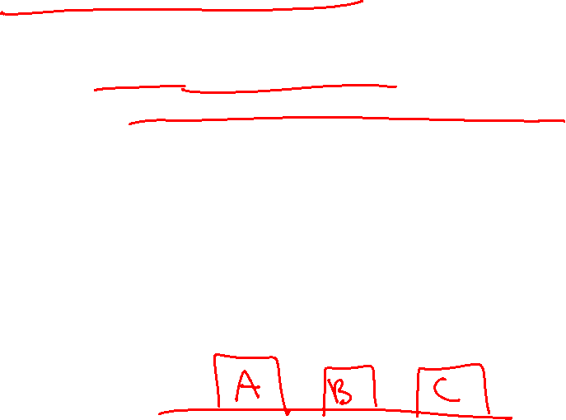
Sussman’s Anomaly
A weakness of linear planning is that sometimes you get long plans
One goal can be achieved
The second goal immediately undoes it
In fact, there are some problems for which solving goals one at a time will never result in a feasible plan.
Note: This isn’t just a choice of goals. The anomaly happens no matter which goal is first

Slide 40
Linear Planning Soundness, Completeness, Optimality
Goal Stack:
Action Plan:
On-Block(O,G)
Pickup-Block(B,O)
Put-Table(B)
Pickup-Table(O)
Put-Block(O,G)
On-Block(O,G)
Pickup-Table(O)
Put-Block(O,G)
Clear(O)
On-Table(B)
What happened?
Is linear planning sound?
Is linear planning complete?
Is linear planning optimal?
On-Block(G,B)
Pickup-Block(O,G)
Put-Table(O)
Pickup-Table(G)
Put-Block(G,B)

Slide 41
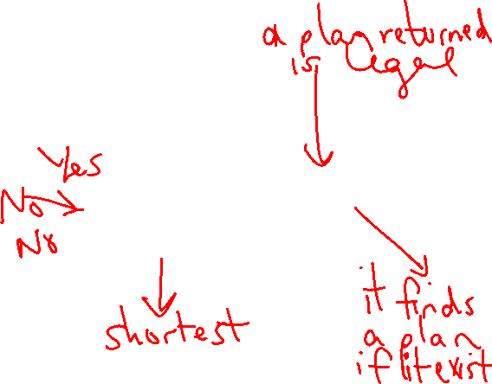
Piazza Poll 2
Goal Stack:
Action Plan:
On-Block(O,G)
Pickup-Block(B,O)
Put-Table(B)
Pickup-Table(O)
Put-Block(O,G)
On-Block(O,G)
Pickup-Table(O)
Put-Block(O,G)
Clear(O)
On-Table(B)
What happened?
Is linear planning sound?
Is linear planning complete?
Is linear planning optimal?
On-Block(G,B)
Pickup-Block(O,G)
Put-Table(O)
Pickup-Table(G)
Put-Block(G,B)

Slide 42
Non-Linear Planning
Interleave goals to achieve plans
  Maintain a set of unachieved goals
  Search all interleavings of goals
  Add a goal back to the set if a later change makes it violated

Slide 43

Non-Linear Planning Example (same as Lin Plan 2)
Goal Set:
On-Block(O,G)
On-Table(B)
On-Block(G,B)
Clear(O)
Action Plan:
On-Block(O,G)
On-Block(O,G)
Pickup-Block(B,O)
Put-Table(B)
Stop and Switch Goals!

Slide 44
Linear Planning Example 2
Goal Set:
On-Block(O,G)
On-Table(B)
On-Block(G,B)
Clear(O)
Action Plan:
On-Block(O,G)
Pickup-Block(B,O)
Put-Table(B)
On-Block(G,B)
Stop and Switch Goals!
On-Block(G,B)
Pickup-Table(G)
Put-Block(G,B)

Slide 45
Non-Linear Planning Example
Goal Set:
On-Block(O,G)
On-Table(B)
On-Block(G,B)
Clear(O)
Action Plan:
On-Block(O,G)
Pickup-Block(B,O)
Put-Table(B)
On-Block(O,G)
On-Block(O,G)
Pickup-Block(B,O)
Put-Table(B)
Stop and Switch Goals!
On-Block(G,B)
Pickup-Table(G)
Put-Block(G,B)
On-Block(O,G)
Pickup-Table(O)
Put-Block(O,G)

Slide 46

Non-Linear Planning
Interleave goals to achieve plans
  Maintain a set of unachieved goals
  Search all interleavings of goals
  Add a goal back to the set if a later change makes it violated
It is complete, but takes longer to search
It can produce shorter plans
  Optimal plans if all interleavings are searched

Slide 47

Size of the Search Tree
A planning tree’s size is exponential in the number of predicates
Even if we use linear or non-linear planning, they use this graph
Can we reduce the size of the planning graph?

Slide 48
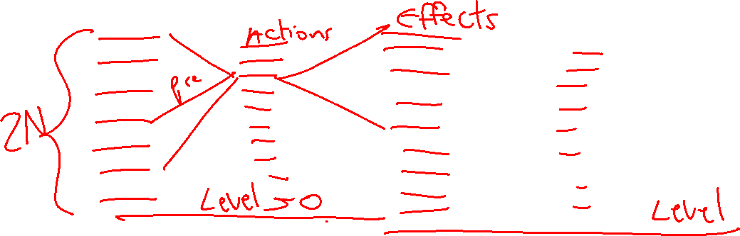
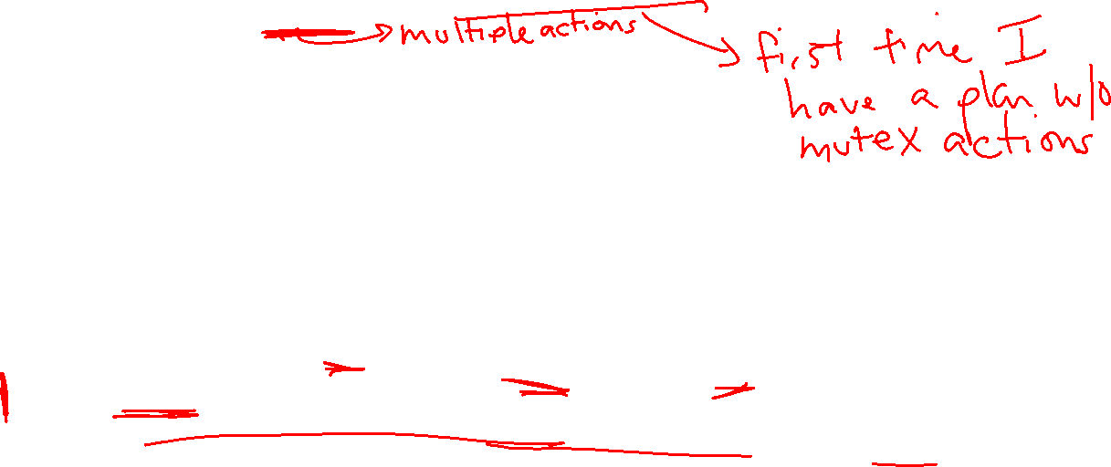
GraphPlan and GraphPlan Graph Representation
Construct an approximation of the planning graph in polynomial space
  The GraphPlan graph computes the possibly reachable states although they aren’t necessarily feasible
Planning graphs contain two types of layers
  Proposition layers – all reachable predicates
  Action layers – actions that could be taken
  Both layers represent one time step
  GraphPlan algorithm includes two subtasks
  Extend: One time step (two layers) in the planning graph
  Search: Find a valid plan in the planning graph
GraphPlan finds a plan or proves that no plan has fewer time steps
  Each time step can contain multiple actions

Slide 49


Building a GraphPlan Graph
Start the planning graph with all starting predicates
HandEmpty
On-Table(O)
On-Table(G)
On(B,O)
Clear(G)
Clear(B)

Slide 50


Building a GraphPlan Graph
Extend the graph with all applicable actions
Designate all effects (add/delete)
HandEmpty
On-Table(O)
On-Table(G)
On(B,O)
Clear(G)
Clear(B)
HandEmpty
On-Table(O)
On-Table(G)
On(B,O)
Clear(B)
Clear(G)
Clear(O)
In-Hand(B)
In-Hand(G)
Pickup-
Block(B)
Pickup-
Table(G)

Slide 51
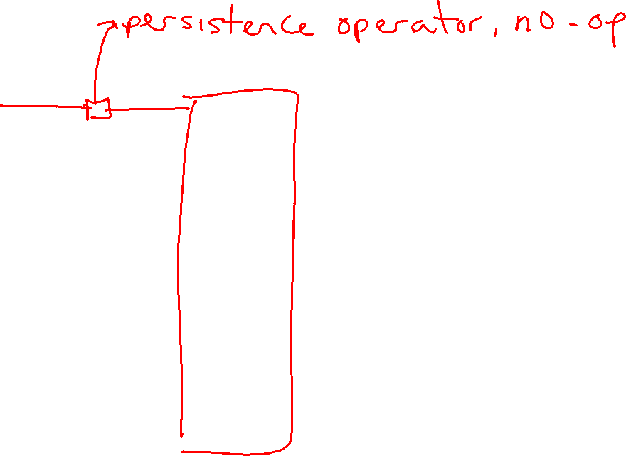
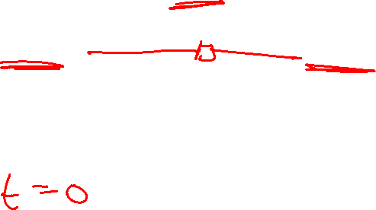
Building a GraphPlan Graph
Extend the graph with all applicable actions, noops
Designate all effects (add/delete)
HandEmpty
On-Table(O)
On-Table(G)
On(B,O)
Clear(G)
Clear(B)
HandEmpty
On-Table(O)
On-Table(G)
On(B,O)
Clear(B)
Clear(G)
Clear(O)
In-Hand(B)
In-Hand(G)
Pickup(B)
Pickup(G)

Slide 52

Building a GraphPlan Graph
Actions A and B are exclusive (mutex) at action-level i, if:
  Interference: one action effect deletes or negates a precondition of the other
  Inconsistency: one action effect deletes or negates the effect of the other
  Competing Needs: the actions have preconditions that are mutex in proposition-level i – 1
Extend the graph
Determine exclusive actions
HandEmpty
On-Table(O)
On-Table(G)
On(B,O)
Clear(G)
Clear(B)
HandEmpty
On-Table(O)
On-Table(G)
On(B,O)
Clear(B)
Clear(G)
Clear(O)
In-Hand(B)
In-Hand(G)
Pickup(B)
Pickup(G)

Slide 53
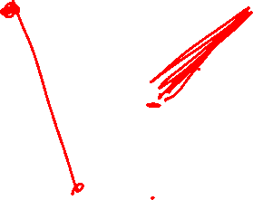
Building a GraphPlan Graph
Actions A and B are exclusive (mutex) at action-level i, if:
  Interference: one action effect deletes or negates a precondition of the other
  Inconsistency: one action effect deletes or negates the effect of the other
  Competing Needs: the actions have preconditions that are mutex in proposition-level i – 1
Extend the graph
Determine exclusive actions
HandEmpty
On-Table(O)
On-Table(G)
On(B,O)
Clear(G)
Clear(B)
HandEmpty
On-Table(O)
On-Table(G)
On(B,O)
Clear(B)
Clear(G)
Clear(O)
In-Hand(B)
In-Hand(G)
Pickup(B)
Pickup(G)

Slide 54
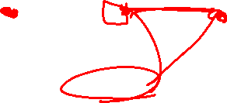
Building a GraphPlan Graph
Actions A and B are exclusive (mutex) at action-level i, if:
  Interference: one action effect deletes or negates a precondition of the other
  Inconsistency: one action effect deletes or negates the effect of the other
  Competing Needs: the actions have preconditions that are mutex in proposition-level i – 1
Extend the graph
Determine exclusive actions
HandEmpty
On-Table(O)
On-Table(G)
On(B,O)
Clear(G)
Clear(B)
HandEmpty
On-Table(O)
On-Table(G)
On(B,O)
Clear(B)
Clear(G)
Clear(O)
In-Hand(B)
In-Hand(G)
Pickup(B)
Pickup(G)

Slide 55

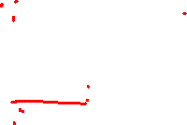
Building a GraphPlan Graph
Actions A and B are exclusive (mutex) at action-level i, if:
  Interference: one action effect deletes or negates a precondition of the other
  Inconsistency: one action effect deletes or negates the effect of the other
  Competing Needs: the actions have preconditions that are mutex in proposition-level i – 1
Extend the graph
Determine exclusive predicates
HandEmpty
On-Table(O)
On-Table(G)
On(B,O)
Clear(G)
Clear(B)
HandEmpty
On-Table(O)
On-Table(G)
On(B,O)
Clear(B)
Clear(G)
Clear(O)
In-Hand(B)
In-Hand(G)
Pickup(B)
Pickup(G)
Propositions P and Q are exclusive (mutex) at action-level i, if:
  Negation: They are the negation of each other
  Inconsistent Support: all actions that produce those propositions at i-1 are mutex

Slide 56

Searching the GraphPlan Graph
Extend until first time all goals are present at a proposition level
  May not be a solution, at that level
For each goal (predicate) present (in some arbitrary order)
  Select an action at level i-1 that achieves that goal and is not exclusive with any other action already selected at that level
  Add all its preconditions to the set of goals at level i-2
  Do this for all the goals at level i
    Use already selected actions, when possible
  Backtrack if no non-exclusive action exists
If search is exhausted, extend planning graph one more proposition level

Slide 57
Building a GraphPlan Graph
Extend the graph
Determine exclusive actions, predicates
HandEmpty
On-Table(O)
On-Table(G)
On(B,O)
Clear(G)
Clear(B)
HandEmpty
On-Table(O)
On-Table(G)
On(B,O)
Clear(B)
Clear(G)
Clear(O)
In-Hand(B)
In-Hand(G)
HandEmpty
On-Table(O)
On-Table(B)
On-Table(G)
On(G,B)
On(B,O)
On(B,G)
Clear(B)
Clear(G)
Clear(O)
In-Hand(B)
In-Hand(G)
Pickup(B)
Pickup(B)
Put(B,O)
Put(B,G)
Pickup(G)
Put-Table(B)
Pickup(G)
Put-Table(G)
Put(G,B)
Pickup(B)

Slide 58

Building a GraphPlan Graph
Extend the graph
Determine exclusive actions, predicates
HandEmpty
On-Table(O)
On-Table(G)
On(B,O)
Clear(G)
Clear(B)
HandEmpty
On-Table(O)
On-Table(G)
On(B,O)
Clear(B)
Clear(G)
Clear(O)
In-Hand(B)
In-Hand(G)
HandEmpty
On-Table(O)
On-Table(B)
On-Table(G)
On(G,B)
On(B,O)
On(B,G)
Clear(B)
Clear(G)
Clear(O)
In-Hand(B)
In-Hand(G)
Pickup(B)
Pickup(B)
Put(B,O)
Put(B,G)
Pickup(G)
Put-Table(B)
Pickup(G)
Put-Table(G)
Put(G,B)
ALL 2nd LEVEL ACTIONS ARE MUTALLY EXCLUSIVE
Pickup(B)

Slide 59
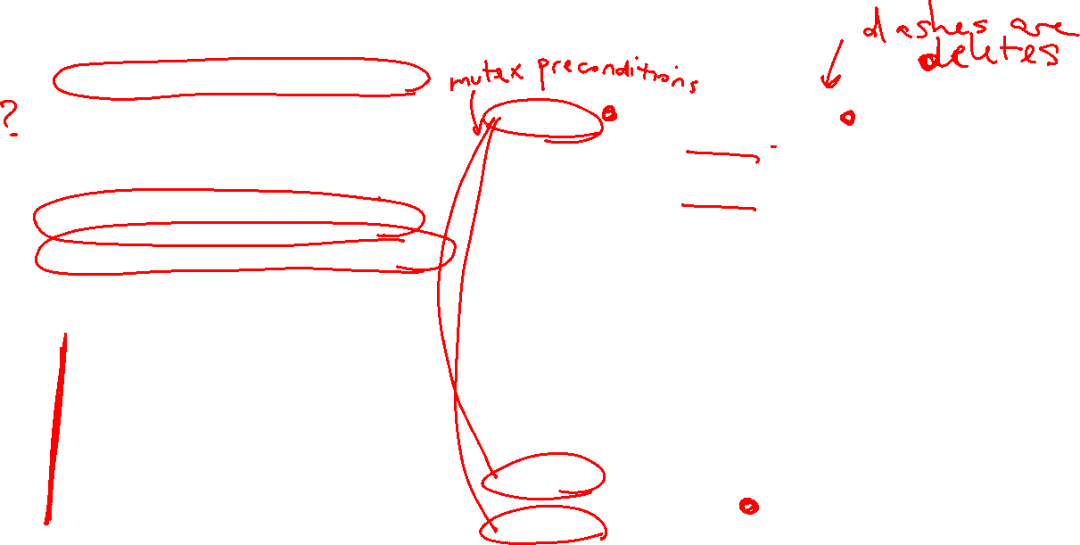
Piazza Poll 3
What kind of mutex are actions to each other? (select all that apply)
Pickup-pickup are interference
Pickup-pickup are inconsistency
Pickup-pickup are competing needs
Pickup-put are interference
Pickup-put are inconsistency
Pickup-put are competing needs
HandEmpty
On-Table(O)
On-Table(G)
On(B,O)
Clear(B)
Clear(G)
Clear(O)
In-Hand(B)
In-Hand(G)
HandEmpty
On-Table(O)
On-Table(B)
On-Table(G)
On(G,B)
On(B,O)
On(B,G)
Clear(B)
Clear(G)
Clear(O)
In-Hand(B)
In-Hand(G)
Pickup(B)
Put(B,O)
Put(B,G)
Actions A and B are exclusive (mutex) at action-level i, if:
  Interference: one action effect deletes or negates a precondition of the other
  Inconsistency: one action effect deletes or negates the effect of the other
  Competing Needs: the actions have preconditions that are mutex in proposition-level i – 1
Put-Table(B)
Pickup(G)
Put-Table(G)
Put(G,B)
Pickup(B)

Slide 60

GraphPlan Takeaways
GraphPlan is a relaxation of other classical planning search techniques like BFS
It creates a different kind of graph that allows you to decide that no plan is reachable at a given depth.
If it finds a reachable solution, it may not be a feasible solution because it allows you to perform multiple actions at the same time.
The search graph is linear space in the number of predicates
Know the differences between the mutex conditions!!

Slide 61
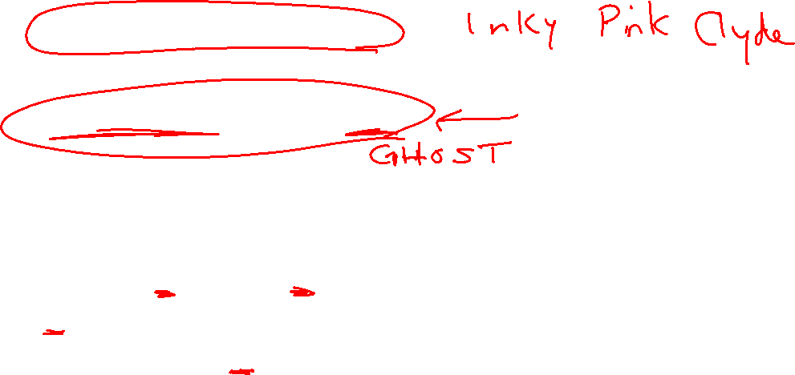
Implementing Symbolic Representations
Literals: Each thing/object in our model
i = Instance(“name”,TYPE)
Variables: Can take on any TYPE thing
v = Variable(“v_name”,TYPE)
Block World Example:
Pickup_from_Table(b):
Pre: HandEmpty(), Clear(b), On-Table(b)
Add: In-Hand(b)
Delete: HandEmpty(), On-Table(b)
Instances: “A”, “B”, “C” of type BLOCK
Variable: “b” of type BLOCK
In this operator, b can take on the value of any block instance

Slide 62

Implementing Symbolic Representations
Literals: Each thing/object in our model
i_a = Instance(“A”,BLOCK), i_b = Instance(“B”,BLOCK”)
Variables: Can take on any TYPE thing
b = Variable(“b”,BLOCK)
Block World Example:
Pickup_from_Table(b):
Pre: HandEmpty(), Clear(b), On-Table(b)
Add: In-Hand(b)
Delete: HandEmpty(), On-Table(b)
ALERT: no two literals nor variables can have the same string name!!

Slide 63
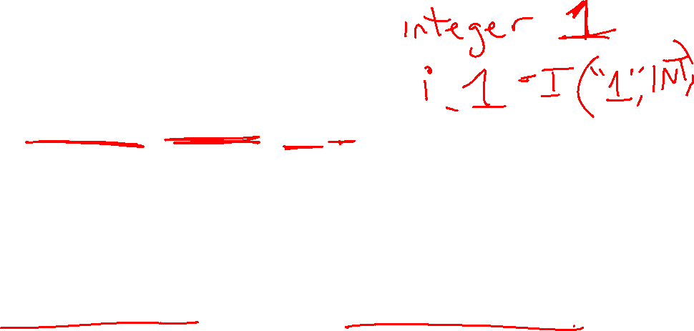
Implementing Symbolic Representations
Literals: Each thing/object in our model
i_a = Instance(“A”,BLOCK), i_b = Instance(“B”,BLOCK”)
Variables: Can take on any TYPE thing
v_block = Variable(“b”,BLOCK)
Propositions: Predicate Relationships
Proposition(“relation”, v_a, i, …)
Block World Example:
HandEmpty(), Clear(b), On-Table(b), On-Block(b1,b2)
Proposition(“handempty”), Proposition(“clear”,v_block), Proposition(“on-table”,v_block), Proposition(“on-block”,v_block, i_a)
ALERT: variables and instances do not have to start with i_ and v_

Slide 64

Initial State and Goal State
Create lists of Propositions as the initial state and goal state
initial = [Proposition(“handempty”), Proposition(“on-table”, i_c), Proposition(“on-table”, i_b), Proposition(“on-block”, i_a, i_b), Proposition(“clear”, i_a), Proposition(“clear”, i_c)]
Goal = [Proposition(“on-table”,i_b), Proposition(“on-table”,i_c), Proposition(“on-block”,i_a, i_c), Proposition(“clear”,i_a), Proposition(“clear”,”c”)]

Slide 65
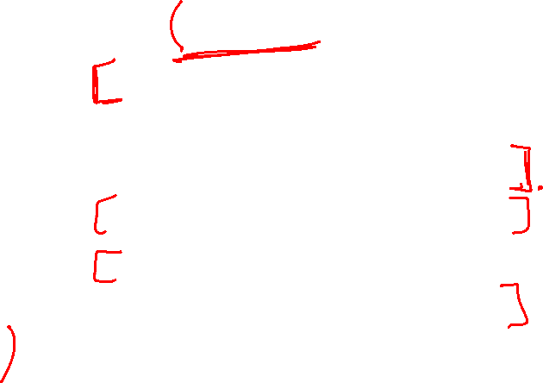
Implementing Symbolic Representations
Operators: the actions we take change state
pickup_table = Operator(“pick_table”, #name
[Proposition(“handempty”,), #preconditions
Proposition(“clear”, v_block),
Proposition(“on-table”, v_block)],
[Proposition(“in-hand”, v_block)], #add effects
[Proposition(“handempty”), #delete effects
Proposition(“on-table”, v_block]
)
Lists are conjunctions!
All propositions with a variable must take on the same instance!
Variables that don’t match name don’t have to be the same but can be unless otherwise specified!

Slide 66
We provide the GraphPlan implementation
You will create the representation, which will be passed into our GraphPlan implementation

Slide 67
Another Example - Rocket Ship
Suppose we have a rocket ship that can only be used once.
It has to carry two payloads.

Slide 68
Another Example - Rocket Ship
Suppose we have a rocket ship that can only be used once.
It has to carry two payloads.
Literals?

Slide 69
Another Example - Rocket Ship
Suppose we have a rocket ship that can only be used once.
It has to carry two payloads.
Literals: Rocket, G, O, LocA, LocB

Slide 70
Another Example - Rocket Ship
Suppose we have a rocket ship that can only be used once. It has to carry two payloads.
Literals: Rocket, G, O, LocA, LocB
Start state:
At(Rocket, LocA), Has-Fuel(),
Unloaded(G,LocA), Unloaded(O,LocA)
Goal state:
At(Rocket, LocB), Unloaded(G,LocB), Unloaded(O,LocB)
I create literals and variables as I go through the problem. In order to create the start state and the goal state, I need the literals defined.

Slide 71
Another Example - Rocket Ship
Literals: Rocket, G, O, LocA, LocB
Start state:
At(Rocket, LocA), Has-Fuel(),
Unloaded(G,LocA), Unloaded(O,LocA)
Goal state:
At(Rocket, LocB), Unloaded(G,LocB), Unloaded(O,LocB)
Move: Load: Unload:
As I create my operators, I will add variables.

Slide 72

Another Example - Rocket Ship
Literals: Rocket, G, O, LocA, LocB
Start state:
At(Rocket, LocA), Has-Fuel(),
Unloaded(G,LocA), Unloaded(O,LocA)
Goal state:
At(Rocket, LocB), Unloaded(G,LocB), Unloaded(O,LocB)
Move:
P:
A:
D:

Slide 73
Another Example - Rocket Ship
Literals: Rocket, G, O, LocA, LocB
Start state:
At(Rocket, LocA), Has-Fuel(),
Unloaded(G,LocA), Unloaded(O,LocA)
Goal state:
At(Rocket, LocB), Unloaded(G,LocB), Unloaded(O,LocB)
Variables: L
Move:
P: At(Rocket,L)
A:
D:
The rocket starts at a location, and it could be either location. I need to add a location variable

Slide 74
Another Example - Rocket Ship
Literals: Rocket, G, O, LocA, LocB
Start state:
At(Rocket, LocA), Has-Fuel(),
Unloaded(G,LocA), Unloaded(O,LocA)
Goal state:
At(Rocket, LocB), Unloaded(G,LocB), Unloaded(O,LocB)
Variables: L
Move:
P: At(Rocket,L), Has-Fuel()
A:
D:

Slide 75
Another Example - Rocket Ship
Literals: Rocket, G, O, LocA, LocB
Start state:
At(Rocket, LocA), Has-Fuel(),
Unloaded(G,LocA), Unloaded(O,LocA)
Goal state:
At(Rocket, LocB), Unloaded(G,LocB), Unloaded(O,LocB)
Variables: L, Dest
Move:
P: At(Rocket,L), Has-Fuel(), L!=Dest
A: At(Rocket,Dest)
D:
The rocket needs to go to a destination, which needs to be different from the start location. We need to define a dest variable.

Slide 76
Another Example - Rocket Ship
Literals: Rocket, G, O, LocA, LocB
Start state:
At(Rocket, LocA), Has-Fuel(),
Unloaded(G,LocA), Unloaded(O,LocA)
Goal state:
At(Rocket, LocB), Unloaded(G,LocB), Unloaded(O,LocB)
Variables: L, Dest
Move:
P: At(Rocket,L), Has-Fuel(), L!=Dest
A: At(Rocket,Dest)
D: Has-Fuel(),At(Rocket,L)

Slide 77
Another Example - Rocket Ship
Literals: Rocket, G, O, LocA, LocB
Start state:
At(Rocket, LocA), Has-Fuel(),
Unloaded(G,LocA), Unloaded(O,LocA)
Goal state:
At(Rocket, LocB), Unloaded(G,LocB), Unloaded(O,LocB)
Variables: L, Dest
Load:
P:
A:
D:

Slide 78
Another Example - Rocket Ship
Literals: Rocket, G, O, LocA, LocB
Start state:
At(Rocket, LocA), Has-Fuel(),
Unloaded(G,LocA), Unloaded(O,LocA)
Goal state:
At(Rocket, LocB), Unloaded(G,LocB), Unloaded(O,LocB)
Variables: L, Dest, Pkg
Load:
P: At(Rocket,L), Unloaded(Pkg,L)
A:
D:
The rocket needs to load a specific package G or O. The load action doesn’t care which package it is. We need a variable pkg to use.

Slide 79
Another Example - Rocket Ship
Literals: Rocket, G, O, LocA, LocB
Start state:
At(Rocket, LocA), Has-Fuel(),
Unloaded(G,LocA), Unloaded(O,LocA)
Goal state:
At(Rocket, LocB), Unloaded(G,LocB), Unloaded(O,LocB)
Variables: L, Dest, Pkg
Load:
P: At(Rocket,L), Unloaded(Pkg,L)
A: Loaded(Pkg,Rocket)
D: Unloaded(Pkg,L)

Slide 80
Another Example - Rocket Ship
Literals: Rocket, G, O, LocA, LocB
Start state:
At(Rocket, LocA), Has-Fuel(),
Unloaded(G,LocA), Unloaded(O,LocA)
Goal state:
At(Rocket, LocB), Unloaded(G,LocB), Unloaded(O,LocB)
Variables: L, Dest, Pkg
Unload:
P: At(Rocket,Dest), Loaded(Pkg,Rocket)
A: Unloaded(Pkg,Dest)
D: Loaded(Pkg,Rocket)
No new variables needed for unload.

Slide 81
Rocket Ship GraphPlan Graph
Start state
Action Layer 1
Predicate Layer 1
At(Rocket,LocA)
Has-Fuel()
Unloaded(G,LocA)
Unloaded(O,LocA)
At(Rocket,LocB)
At(Rocket,LocA)
Has-Fuel()
Unloaded(G,LocA)
Unloaded(O,LocA)
Loaded(G,Rocket)
Loaded(O,Rocket)
Move
Load(G)
Load(O)

Slide 82
Rocket Ship GraphPlan Graph
At(Rocket,LocA)
Has-Fuel()
Unloaded(G,LocA)
Unloaded(O,LocA)
At(Rocket,LocB)
At(Rocket,LocA)
Has-Fuel()
Unloaded(G,LocA)
Unloaded(O,LocA)
Loaded(G,Rocket)
Loaded(O,Rocket)
Move
Load(G)
Load(O)
Mutex Actions
Interference:
Move deletes At which is a precondition of Load
Inconsistent:
Move deletes At but noop adds it
Move deletes Has-Fuel but noop adds it
Mutex Propositions:
- At(Rocket,LocB) and
At(Rocket,LocA) because
Move and noop are mutex actions
- What else?
Notes:
Both Loaded conflict with At(B)
Both Loaded conflict with Unloaded

Slide 83
Rocket Ship GraphPlan Graph
Start state
Action Layer 1
Predicate Layer 1
Action Layer 2
Predicate Layer 2
At(Rocket,LocA)
Has-Fuel()
Unloaded(G,LocA)
Unloaded(O,LocA)
At(Rocket,LocB)
At(Rocket,LocA)
Has-Fuel()
Unloaded(G,LocA)
Unloaded(O,LocA)
Loaded(G,Rocket)
Loaded(O,Rocket)
At(Rocket,LocB)
At(Rocket,LocA)
Has-Fuel()
Unloaded(G,LocA)
Unloaded(O,LocA)
Loaded(G,Rocket)
Loaded(O,Rocket)
Move
Move
Load(G)
Load(G)
Load(O)
Load(O)

Slide 84
Rocket Ship GraphPlan Graph
At(Rocket,LocA)
Has-Fuel()
Unloaded(G,LocA)
Unloaded(O,LocA)
At(Rocket,LocB)
At(Rocket,LocA)
Has-Fuel()
Unloaded(G,LocA)
Unloaded(O,LocA)
Loaded(G,Rocket)
Loaded(O,Rocket)
At(Rocket,LocB)
At(Rocket,LocA)
Has-Fuel()
Unloaded(G,LocA)
Unloaded(O,LocA)
Loaded(G,Rocket)
Loaded(O,Rocket)
Move
Move
Load(G)
Load(G)
Load(O)
Load(O)
At time 1: Move can be performed OR both Load actions
At time 2: Possible plans include:
Load(G), Load(O), Move(LocB) ← reachable goal in two steps but feasible in three
Load(G), Move(LocB)
Load(O), Move(LocB)

