Slide 1
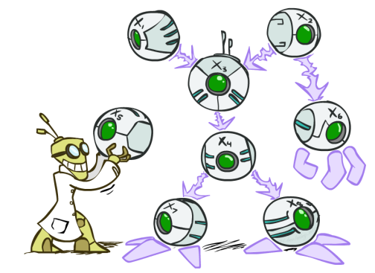
AI: Representation and Problem Solving
Bayes Nets
Instructors: Aditi Raghunathan and Vince Conitzer
Slide credits: CMU AI and http://ai.berkeley.edu

Slide 2
Announcements
Mid-term 2 11/9
  Today’s lecture
hw8 due 11/7
P4 due 11/16
Review session Sunday (Nov 5) 2-4pm: Posner A35
No lecture next Tue (democracy day)
No recitation next week

Slide 3
Bayes nets
Graphical representation of conditional probability tables
One node per random variable
Directed acyclic graph
Each node corresponds to a conditional probability distribution

Slide 4
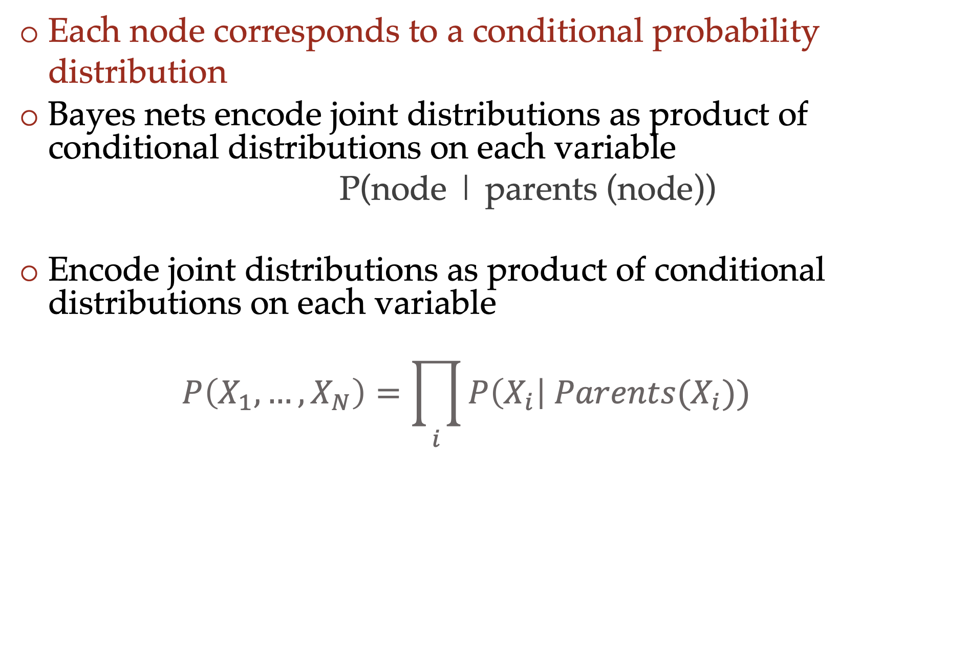
Bayes nets
Each node corresponds to a conditional probability distribution
Bayes nets encode joint distributions as product of conditional distributions on each variable
  P(node | parents (node))
Encode joint distributions as product of conditional distributions on each variable
  $$P\left(X_{1},…,X_{N}\right)=\prod_{i}{P\left(X_{i}\right| Parents(X_{i})) }$$

Slide 5
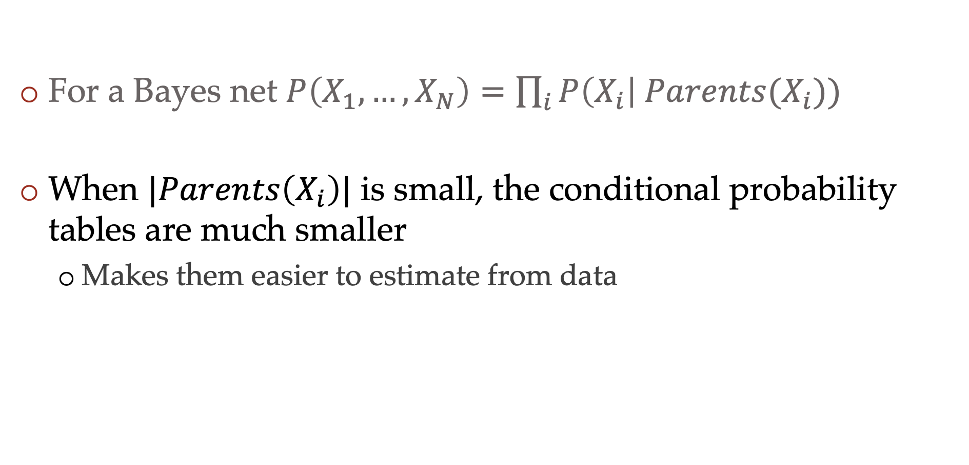
The power of conditional independencies
For a Bayes net $P\left(X_{1},…,X_{N}\right)=\prod_{i}{P\left(X_{i}\right| Parents(X_{i})) }$
When $|Parents\left(X_{i}\right)|$ is small, the conditional probability tables are much smaller
  Makes them easier to estimate from data

Slide 6


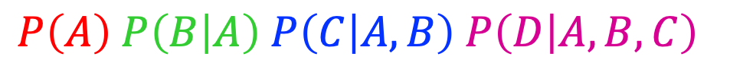
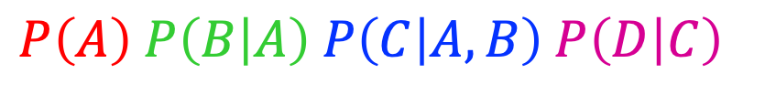


Joint distribution from Bayes nets
$$A$$
$$A$$
$$B$$
$$B$$
$$C$$
$$C$$
$$D$$
$$D$$
$$P\left(A\right) P\left(B | A\right) P\left(C | A,B\right) P\left(D | A,B,C\right)$$
$P\left(A\right) P\left(B | A\right) P\left(C | A,B\right) P\left(D | C\right)$

Slide 7
Independence
Two variables X and Y are independent if
∀x,y P(x, y) = P(x) P(y)
  This says that their joint distribution factors into a product of two simpler distributions
  Combine with product rule P(x,y) = P(x|y)P(y) we obtain another form:
  ∀x,y P(x | y) = P(x) or ∀x,y P(y | x) = P(y)

Slide 8
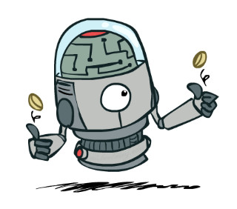
Two coin flips
Example: two dice rolls Roll₁ and Roll₂
  P(Roll₁=5, Roll₂=5) = P(Roll₁=5) P(Roll₂=5) = 1/6 x 1/6 = 1/36
  P(Roll₂=5 | Roll₁=5) = P(Roll₂=5)

Slide 9


Example: Independence
n fair, independent coin flips:
P(X₁)
P(X₂)
P(X_{n})
H | 0.5
T | 0.5
H | 0.5
T | 0.5
H | 0.5
T | 0.5
P(X₁,X₂,...,X_{n})
2^{n}

Slide 10



Poll 1
Are T and W independent?
$$P(T)$$
T | P
hot | 0.5
cold | 0.5
$$P\left(T,W\right)$$
T | W | P
hot | sun | 0.4
hot | rain | 0.1
cold | sun | 0.2
cold | rain | 0.3
$$P(W)$$
W | P
sun | 0.6
rain | 0.4

Slide 11
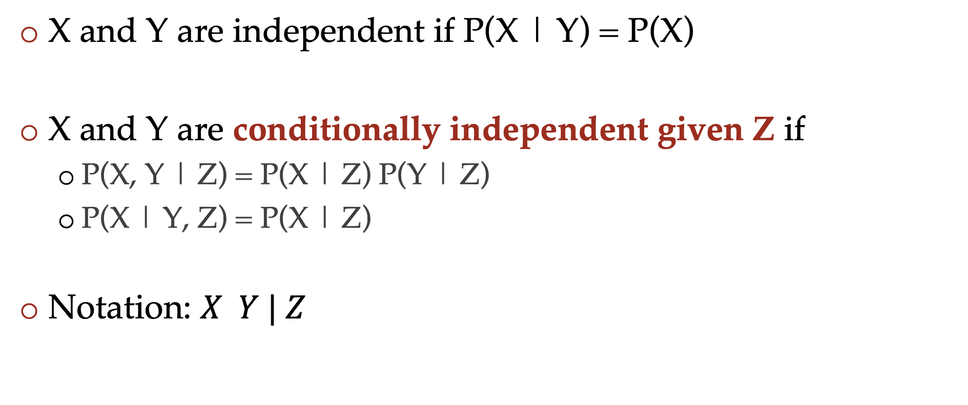
Conditional independence
X and Y are independent if P(X | Y) = P(X)
X and Y are conditionally independent given Z if
  P(X, Y | Z) = P(X | Z) P(Y | Z)
  P(X | Y, Z) = P(X | Z)
Notation: $X Y | Z$

Slide 12
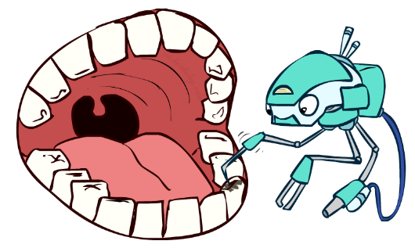
Conditional independence
P(Toothache, Cavity, (p)Robe)
If I have a cavity, the probability that the probe catches in it doesn't depend on whether I have a toothache:
  P(+r | +toothache, +cavity) = P(+r | +cavity)
The same independence holds if I don’t have a cavity:
  P(+r | +toothache, -cavity) = P(+r| -cavity)
Probe is conditionally independent of Toothache given Cavity:
  P(R | T, C) = P(R | C)

Slide 13
Conditional independence
Equivalent statements:
P(Toothache | Probe , Cavity) = P(Toothache | Cavity)
P(Toothache, Probe | Cavity) = P(Toothache | Cavity) P(Probe | Cavity)
One can be derived from the other easily

Slide 14
Conditional Independence
Absolute (unconditional) independence very rare (why?)
Conditional independence is our most basic and robust form of knowledge about uncertain environments.
X is conditionally independent of Y given Z
if and only if:
∀x,y,z P(x | y, z) = P(x | z)
or, equivalently, if and only if
∀x,y,z P(x, y | z) = P(x | z) P(y | z)

Slide 15
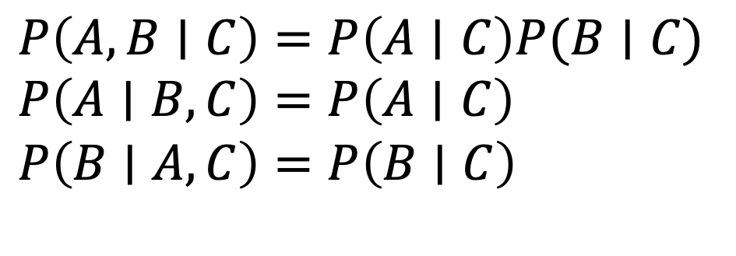
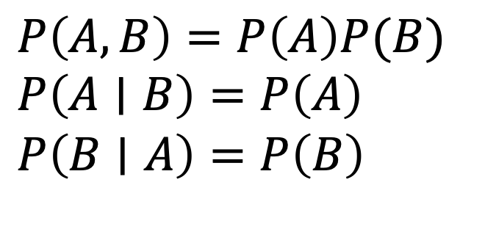
Independence Rules
Independence
If A and B are independent, then:
Conditional independence
If A and B are conditionally
independent given C, then:
$P\left(A, B\right)=P\left(A\right)P(B)$
$P\left(A∣B\right)=P\left(A\right)$
$P\left(B∣A\right)=P\left(B\right)$
$P\left(A, B∣C\right)=P\left(A∣C\right)P(B∣C)$
$P\left(A∣B, C\right)=P\left(A∣C\right)$
$P\left(B∣A, C\right)=P\left(B∣C\right)$

Slide 16
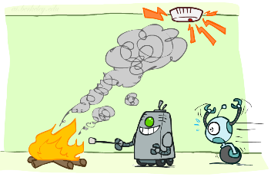
Conditional Independence and Bayes Nets
Fire, Smoke, Alarm
Causal story to create Bayes net
From Bayes Net: P(S, F, A) = P(F) P(S | F) P(A | S)
Joint distribution: P(S, F, A) = P(F) P(S | F) P(A | S, F)

Slide 17
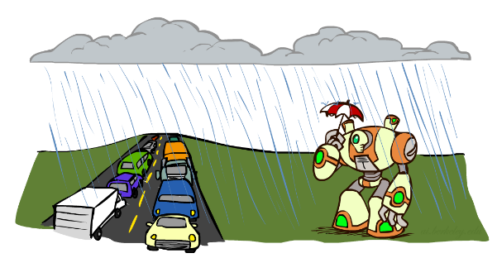
Conditional Independence and Bayes Nets
What about this domain:
  Traffic
  Umbrella
  Raining

Slide 18

Conditional Independence and the Chain Rule
Chain rule:
P(x₁, x₂,…, x_{n}) = ∏_{i} P(x_{i} | x₁,…, x_{i-1})
Trivial decomposition:
P(Rain, Traffic, Umbrella) =
With assumption of conditional independence:
P(Rain, Traffic, Umbrella) =
Bayes nets / graphical models help us express conditional independence assumptions
Notes:
Will be obvious from ghostbusters example

Slide 19
Poll 2
Choose the true statement(s):
If X and Y are conditionally independent given Z, X and Y are independent
If X and Y are independent, X and Y are also conditionally independent given Z
Neither is true

Slide 20

Example: Coin Flips
N independent coin flips
No interactions between variables: absolute independence
X₁
X₂
X_{n}

Slide 21
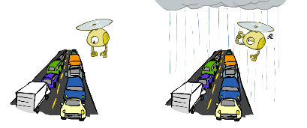
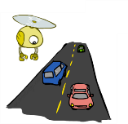
Example: Traffic
Model 2: rain and traffic are dependent
Variables:
  R: It rains
  T: There is traffic
Model 1: independence
Why is an agent using model 2 better?
R
R
T
T

Slide 22
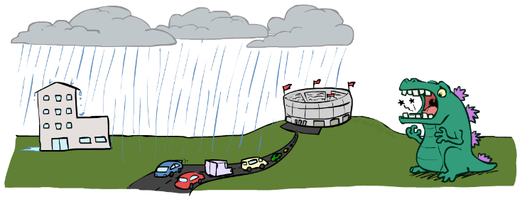

Example: Traffic II
Let’s build a causal Bayes net!
Variables
  T: Traffic
  R: It rains
  L: Low pressure
  D: Roof drips
  B: Ballgame
  C: Cavity

Slide 23
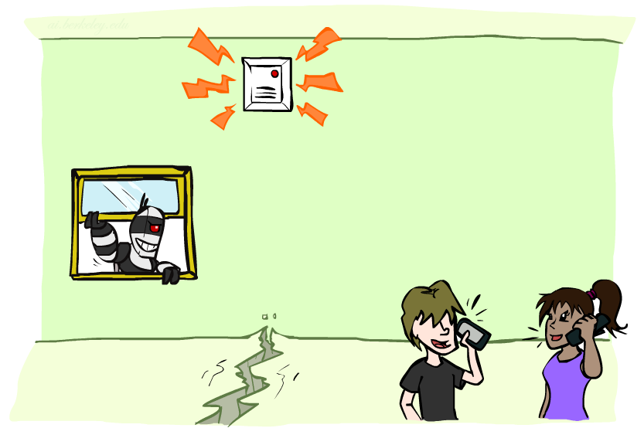
Example: alarm network
Variables
  B: Burglary
  A: Alarm goes off
  M: Mary calls
  J: John calls
  E: Earthquake!

Slide 24
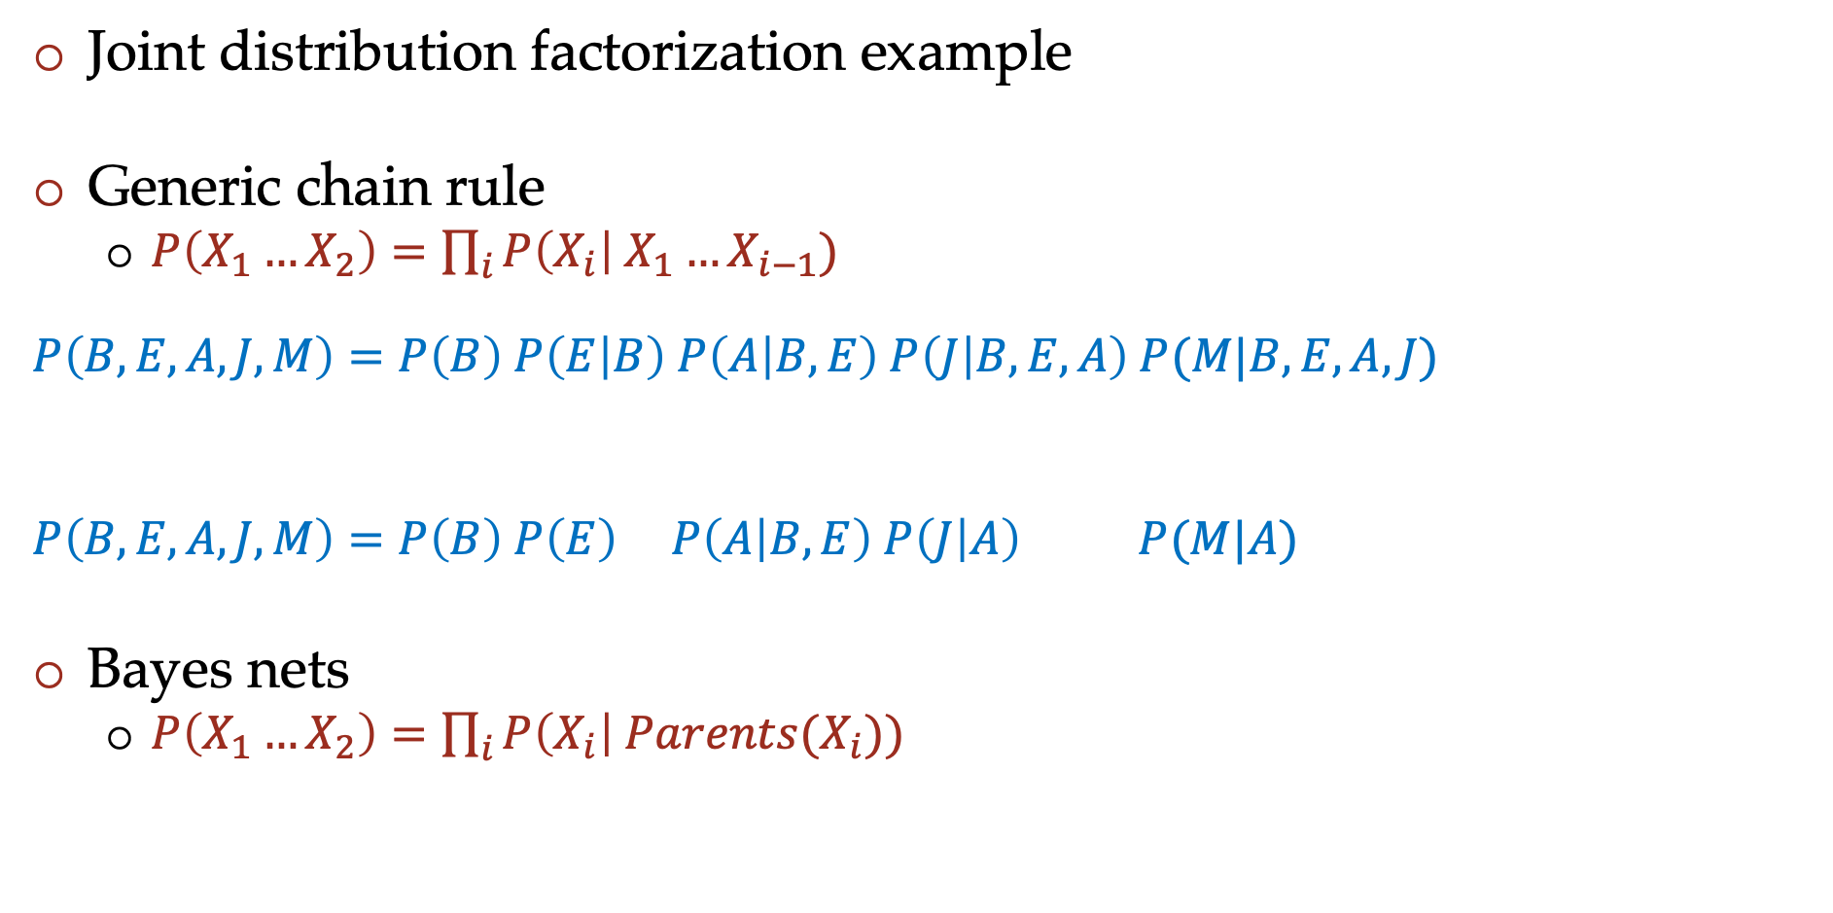
Semantic example
Joint distribution factorization example
Generic chain rule
  $P\left(X_{1}…X_{2}\right)=\prod_{i}{P\left(X_{i}\right| X_{1}…X_{i−1}) }$
  $$P\left(B,E,A,J,M\right)=P\left(B\right) P\left(E | B\right) P\left(A | B,E\right) P\left(J | B,E,A\right) P(M|B,E,A,J)$$
  $$P\left(B,E,A,J,M\right)=P\left(B\right) P\left(E\right) P\left(A | B,E\right) P\left(J | A\right) P(M|A)$$
Bayes nets
  $P\left(X_{1}…X_{2}\right)=\prod_{i}{P\left(X_{i}\right| Parents(X_{i})) }$
Burglary
Earthquake
Alarm
John calls
Mary calls

Slide 25
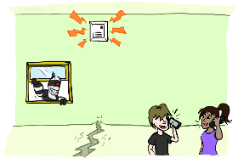
Example: Alarm Network
B | P(B)
+b | 0.001
-b | 0.999
E | P(E)
+e | 0.002
-e | 0.998
Burglary
Earthqk
Alarm
B | E | A | P(A|B,E)
+b | +e | +a | 0.95
+b | +e | -a | 0.05
+b | -e | +a | 0.94
+b | -e | -a | 0.06
-b | +e | +a | 0.29
-b | +e | -a | 0.71
-b | -e | +a | 0.001
-b | -e | -a | 0.999
John calls
Mary calls
A | J | P(J|A)
+a | +j | 0.9
+a | -j | 0.1
-a | +j | 0.05
-a | -j | 0.95
A | M | P(M|A)
+a | +m | 0.7
+a | -m | 0.3
-a | +m | 0.01
-a | -m | 0.99
Notes:
demo

Slide 26

















Poll 3: Independence from Bayes Nets
Match the product of CPTs to the Bayes net.
I.
II.
III.
$$A$$
$$A$$
$$B$$
$$A$$
$$B$$
$$C$$
$$B$$
$$C$$
$$C$$
  $$P\left(A\right) P\left(B | A\right) P\left(C | B\right)$$
  $$P\left(A\right) P\left(B | A\right) P\left(C | A\right)$$
  $$P\left(A\right) P\left(B\right) P\left(C | A, B\right)$$
  $$P\left(A\right) P\left(B\right) P\left(C | A, B\right)$$
  $$P\left(A\right) P\left(B | A\right) P\left(C | B\right)$$
  $$P\left(A\right) P\left(B | A\right) P\left(C | A\right)$$
  $$P\left(A\right) P\left(B | A\right) P\left(C | B\right)$$
  $$P\left(A|B,C\right) P\left(B\right) P(C)$$
  $$P\left(A\right) P\left(B | A\right) P\left(C | B\right)$$
Notes:
1

Slide 27
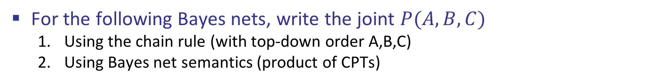
Conditional Independence Semantics
For the following Bayes nets, write the joint $P(A,B,C)$
  Using the chain rule (with top-down order A,B,C)
  Using Bayes net semantics (product of CPTs)
$$A$$
$$A$$
$$B$$
$$A$$
$$B$$
$$C$$
$$B$$
$$C$$
$$C$$

Slide 28
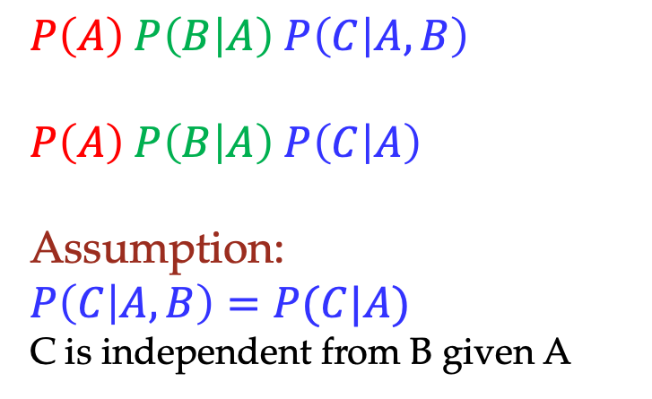
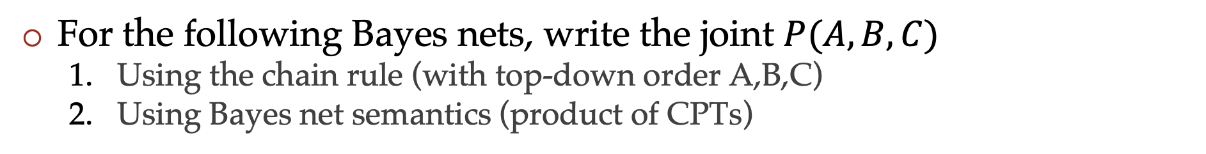
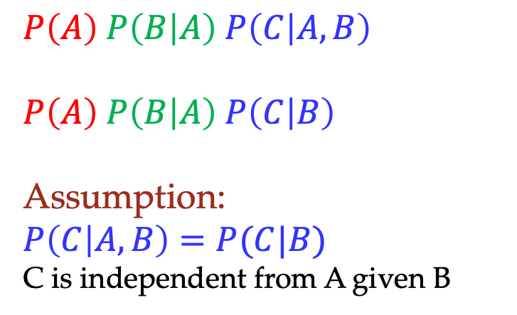
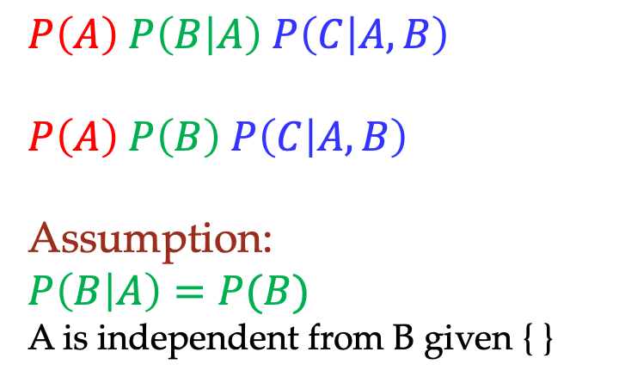
Conditional Independence Semantics
For the following Bayes nets, write the joint $P(A,B,C)$
  Using the chain rule (with top-down order A,B,C)
  Using Bayes net semantics (product of CPTs)
$$A$$
$$A$$
$$B$$
$$A$$
$$B$$
$$C$$
$$B$$
$$C$$
$$C$$
  $$P\left(A\right) P\left(B | A\right) P\left(C | A,B\right)$$
  $$P\left(A\right) P\left(B | A\right) P\left(C | B\right)$$
  Assumption:
  $$P\left(C | A,B\right)=P(C|B)$$
  C is independent from A given B
  $$P\left(A\right) P\left(B | A\right) P\left(C | A,B\right)$$
  $$P\left(A\right) P\left(B | A\right) P\left(C | A\right)$$
  Assumption:
  $$P\left(C | A,B\right)=P(C|A)$$
  C is independent from B given A
  $$P\left(A\right) P\left(B | A\right) P\left(C | A,B\right)$$
  $$P\left(A\right) P\left(B\right) P\left(C | A, B\right)$$
  Assumption:
  $$P\left(B | A\right)=P(B)$$
  A is independent from B given { }

Slide 29
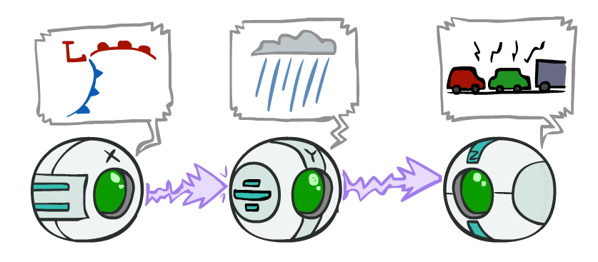
Causal Chains
Guaranteed X independent of Z ?
No!
One example set of CPTs for which X is not independent of Z is sufficient to show this independence is not guaranteed
  Low pressure always causes rain
  Rain always causes traffic
  High pressure always causes no rain
  No rain always causes no traffic
  In numbers:
  P( +y | +x ) = 1 P( +z | +y ) = 1
  P( -y | -x ) = 1 P( -z | -y ) = 1
This configuration is a “causal chain”
X: Low pressure Y: Rain Z: Traffic

Slide 30
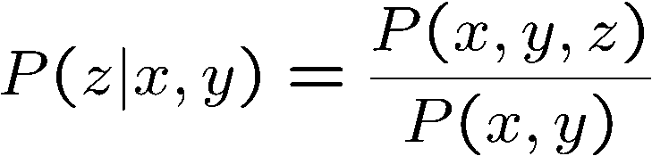
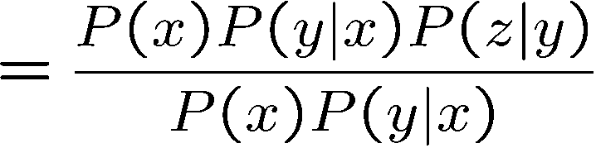

Causal Chains
This configuration is a “causal chain”
Guaranteed X independent of Z given Y?
  Evidence along the chain “blocks” the influence
X: Low pressure Y: Rain Z: Traffic
Yes!

Slide 31
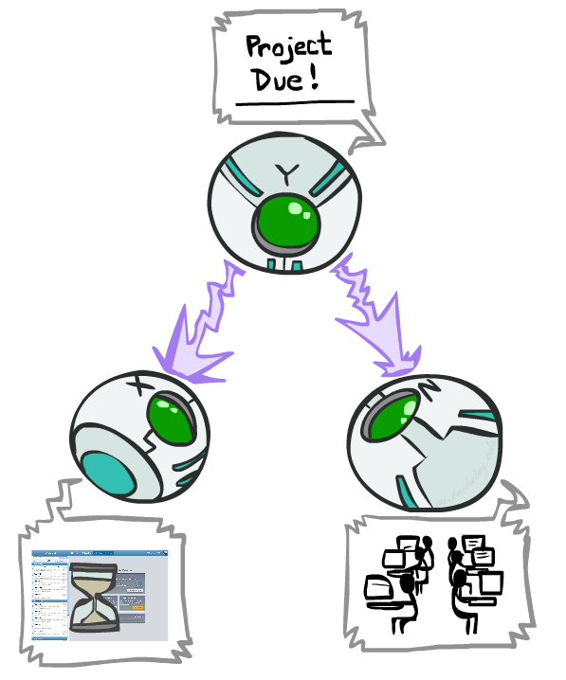
Common Cause
This configuration is a “common cause”
Guaranteed X independent of Z ? No!
  One example set of CPTs for which X is not independent of Z is sufficient to show this independence is not guaranteed.
  Example:
    Project due always causes both forums busy and lab full
    In numbers:
    P( +x | +y ) = 1 P( -x | -y ) = 1,
    P( +z | +y ) = 1 P( -z | -y ) = 1
Y: Project due
X: Forums busy
Z: Lab full

Slide 32
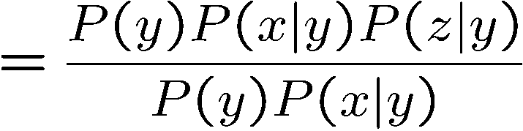
Common Cause
This configuration is a “common cause”
Guaranteed X and Z independent given Y?
  Observing the cause blocks influence between effects.
Y: Project due
X: Forums busy
Z: Lab full
Yes!

Slide 33
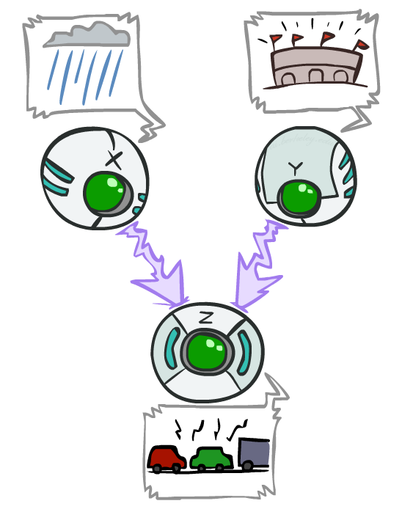
Common Effect
Last configuration: two causes of one effect (v-structures)
Are X and Y independent?
  Yes: the ballgame and the rain cause traffic, but they are not correlated
  Still need to prove they must be (try it!)
Are X and Y independent given Z?
  No: seeing traffic puts the rain and the ballgame in competition as explanation.
This is backwards from the other cases
  Observing an effect activates influence between possible causes.
X: Burglary
Y: Earthquake
Z: Alarm

Slide 34
The explaining away effect
Suppose two causes positively influence an effect. Conditioned on the effect, further conditioning on one cause reduces the probability of the other cause
The effect is “explained away” by one cause

Slide 35
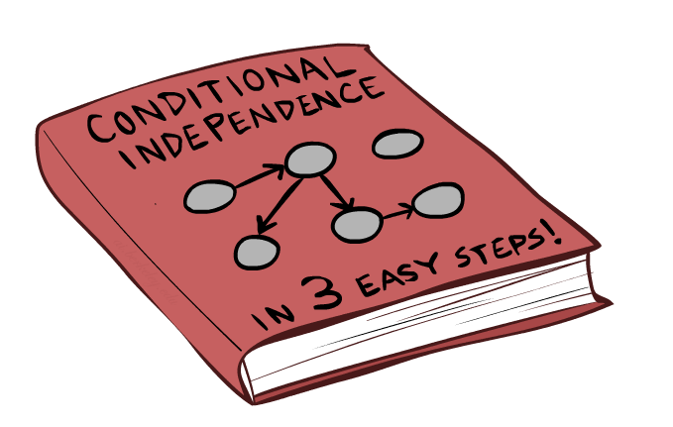
Bayes Net Independence
35

Slide 36
Summary from before
Causal chain
Common cause
Common effect
$$A$$
$$A$$
$$B$$
$$A$$
$$B$$
$$C$$
$$B$$
$$C$$
$$C$$

Slide 37
Broad recipe
Questions: Are X and Y independent given “evidence” (E, F, G…)
Influence is generally exerted via edges in Bayes net
Idea: trace undirected paths from X to Y and see if X and Y exert influence on each other via any path
  No active paths => independence

Slide 38
Active and inactive paths
A path is active if each triple is active
  If we get independence at any point, the influence of X on Y is blocked
Shaded nodes are evidence (or “given” nodes)
Causal chain
Knowing about intermediate parent causes independence
Active
Inactive

Slide 39
Active and inactive paths
A path is active if each triple is active
  If we get independence at any point, the influence of X on Y is blocked
Shaded nodes are evidence (or “given” nodes)
Common cause
Children are dependent, but become independent when conditioned on parent
Active
Inactive

Slide 40
Active and inactive paths
A path is active if each triple is active
  If we get independence at any point, the influence of X on Y is blocked
Shaded nodes are evidence (or “given” nodes)
Common effect
Parents were independent, but become dependent if the child is known (think explaining away)
Active
Inactive

Slide 41
Active and inactive paths
A path is active if each triple is active
  If we get independence at any point, the influence of X on Y is blocked
Shaded nodes are evidence (or “given” nodes)
Common effect
Also true if descent of child is known
Active
Inactive

Slide 42
Summary
Question: Are X and Y conditionally independent given evidence variables {Z}?
Consider all (undirected) paths from X to Y
A path is active if each triple is active:
  Causal chain A → B → C where B is unobserved (either direction)
  Common cause A ← B → C where B is unobserved
  Common effect (aka v-structure) A → B ← C where B or one of its descendents is observed
No active paths => independence

Slide 43
Important note
We look at all paths using undirected edges
But when going down a path and looking at triplets, we need to look at the direction of the edges
Common cause and common effect induce opposite effects: observing parent causes independence, observing child causes dependence

Slide 44

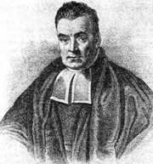
Bayes Ball
Question: Are X and Y conditionally independent given evidence variables {Z}?
Active Paths
Inactive Paths
Shachter, Ross D. "Bayes-Ball: Rational Pastime (for Determining Irrelevance and Requisite Information in Belief Networks and Influence Diagrams)." Proceedings of the Fourteenth conference on Uncertainty in Artificial Intelligence. 1998.
44

Slide 45
Bayes Ball
Question: Are X and Y conditionally independent given evidence variables {Z}?
  Shade in Z
  Drop a ball at X
  The ball can pass through any active path and is blocked by any inactive path (ball can move either direction on an edge)
  If the ball reaches Y, then X and Y are NOT conditionally independent given Z
Active Paths
Inactive Paths

Slide 46
Bayes Ball
Active Paths
Inactive Paths
46

Slide 47
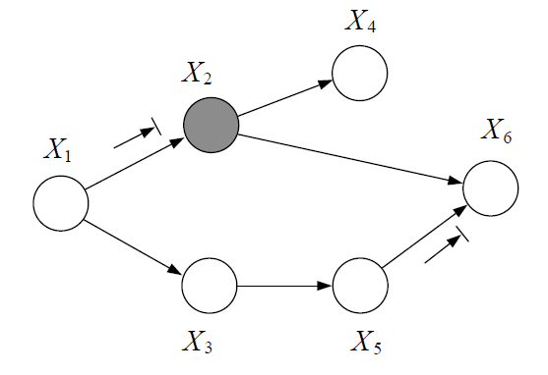
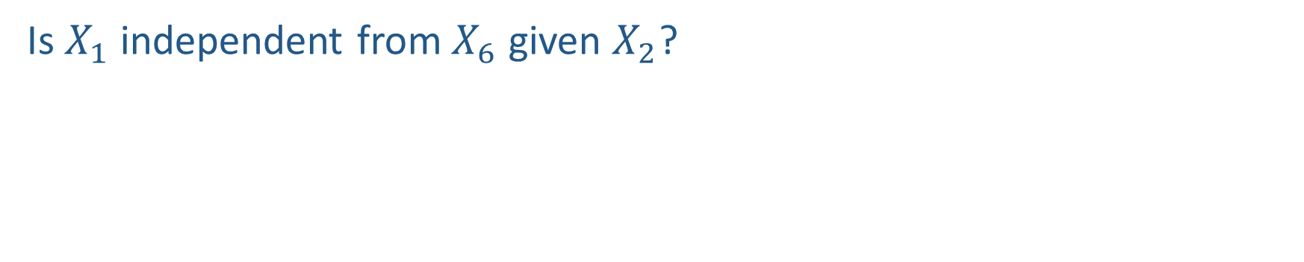
Question
Is $X_{1}$ independent from $X_{6}$ given $X_{2}$?
47

Slide 48
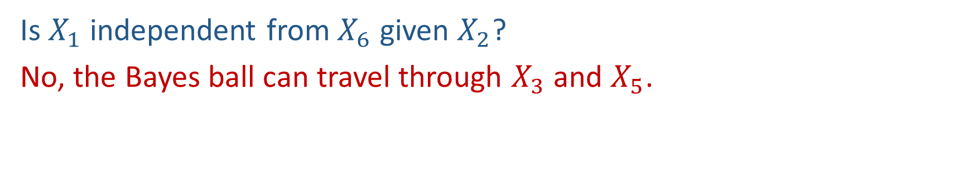
Question
Is $X_{1}$ independent from $X_{6}$ given $X_{2}$?
No, the Bayes ball can travel through $X_{3}$ and $X_{5}$.
48

Slide 49
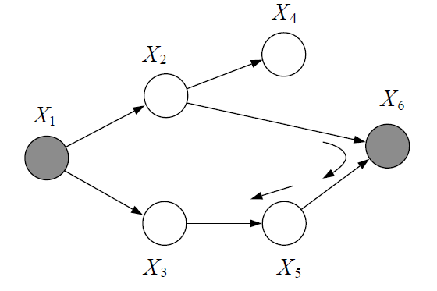
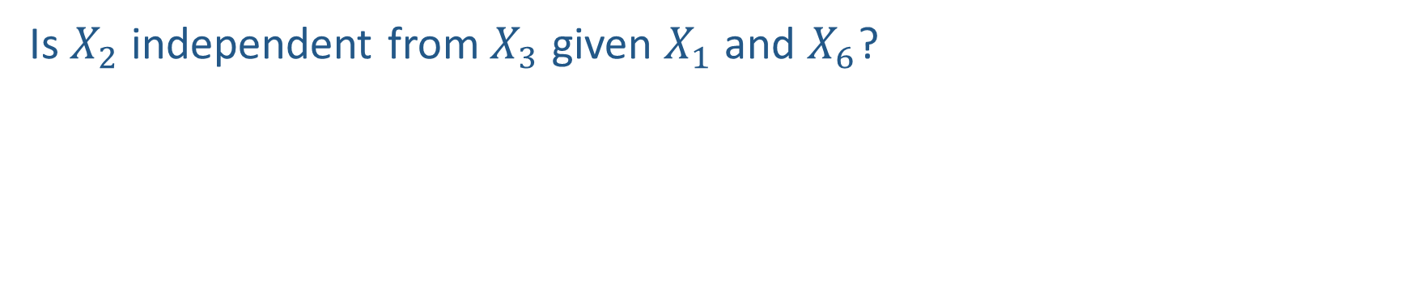
Poll 4
Is $X_{2}$ independent from $X_{3}$ given $X_{1}$ and $X_{6}$?
49

Slide 50
What if?
Is $X_{2}$ independent from $X_{3}$ given $X_{1}$ and $X_{6}$?
50

Slide 51
Conditional independence semantics
Every variable is conditionally independent of its non-descendants given its parents
GP3
P2
P1
P3
X
W
Z
A
C1
C2
GC2
51

Slide 52
Markov blanket
Markov blanket of X - subset of variables such that all other variables are independent of X conditioned on the blanket

Slide 53
Markov blanket
A variable’s Markov blanket consists of parents, children, children’s other parents
Every variable is conditionally independent of all other variables given its Markov blanket
GP3
P2
P1
P3
C
B
X
W
Z
A
C1
C2
GC2
53

Slide 54
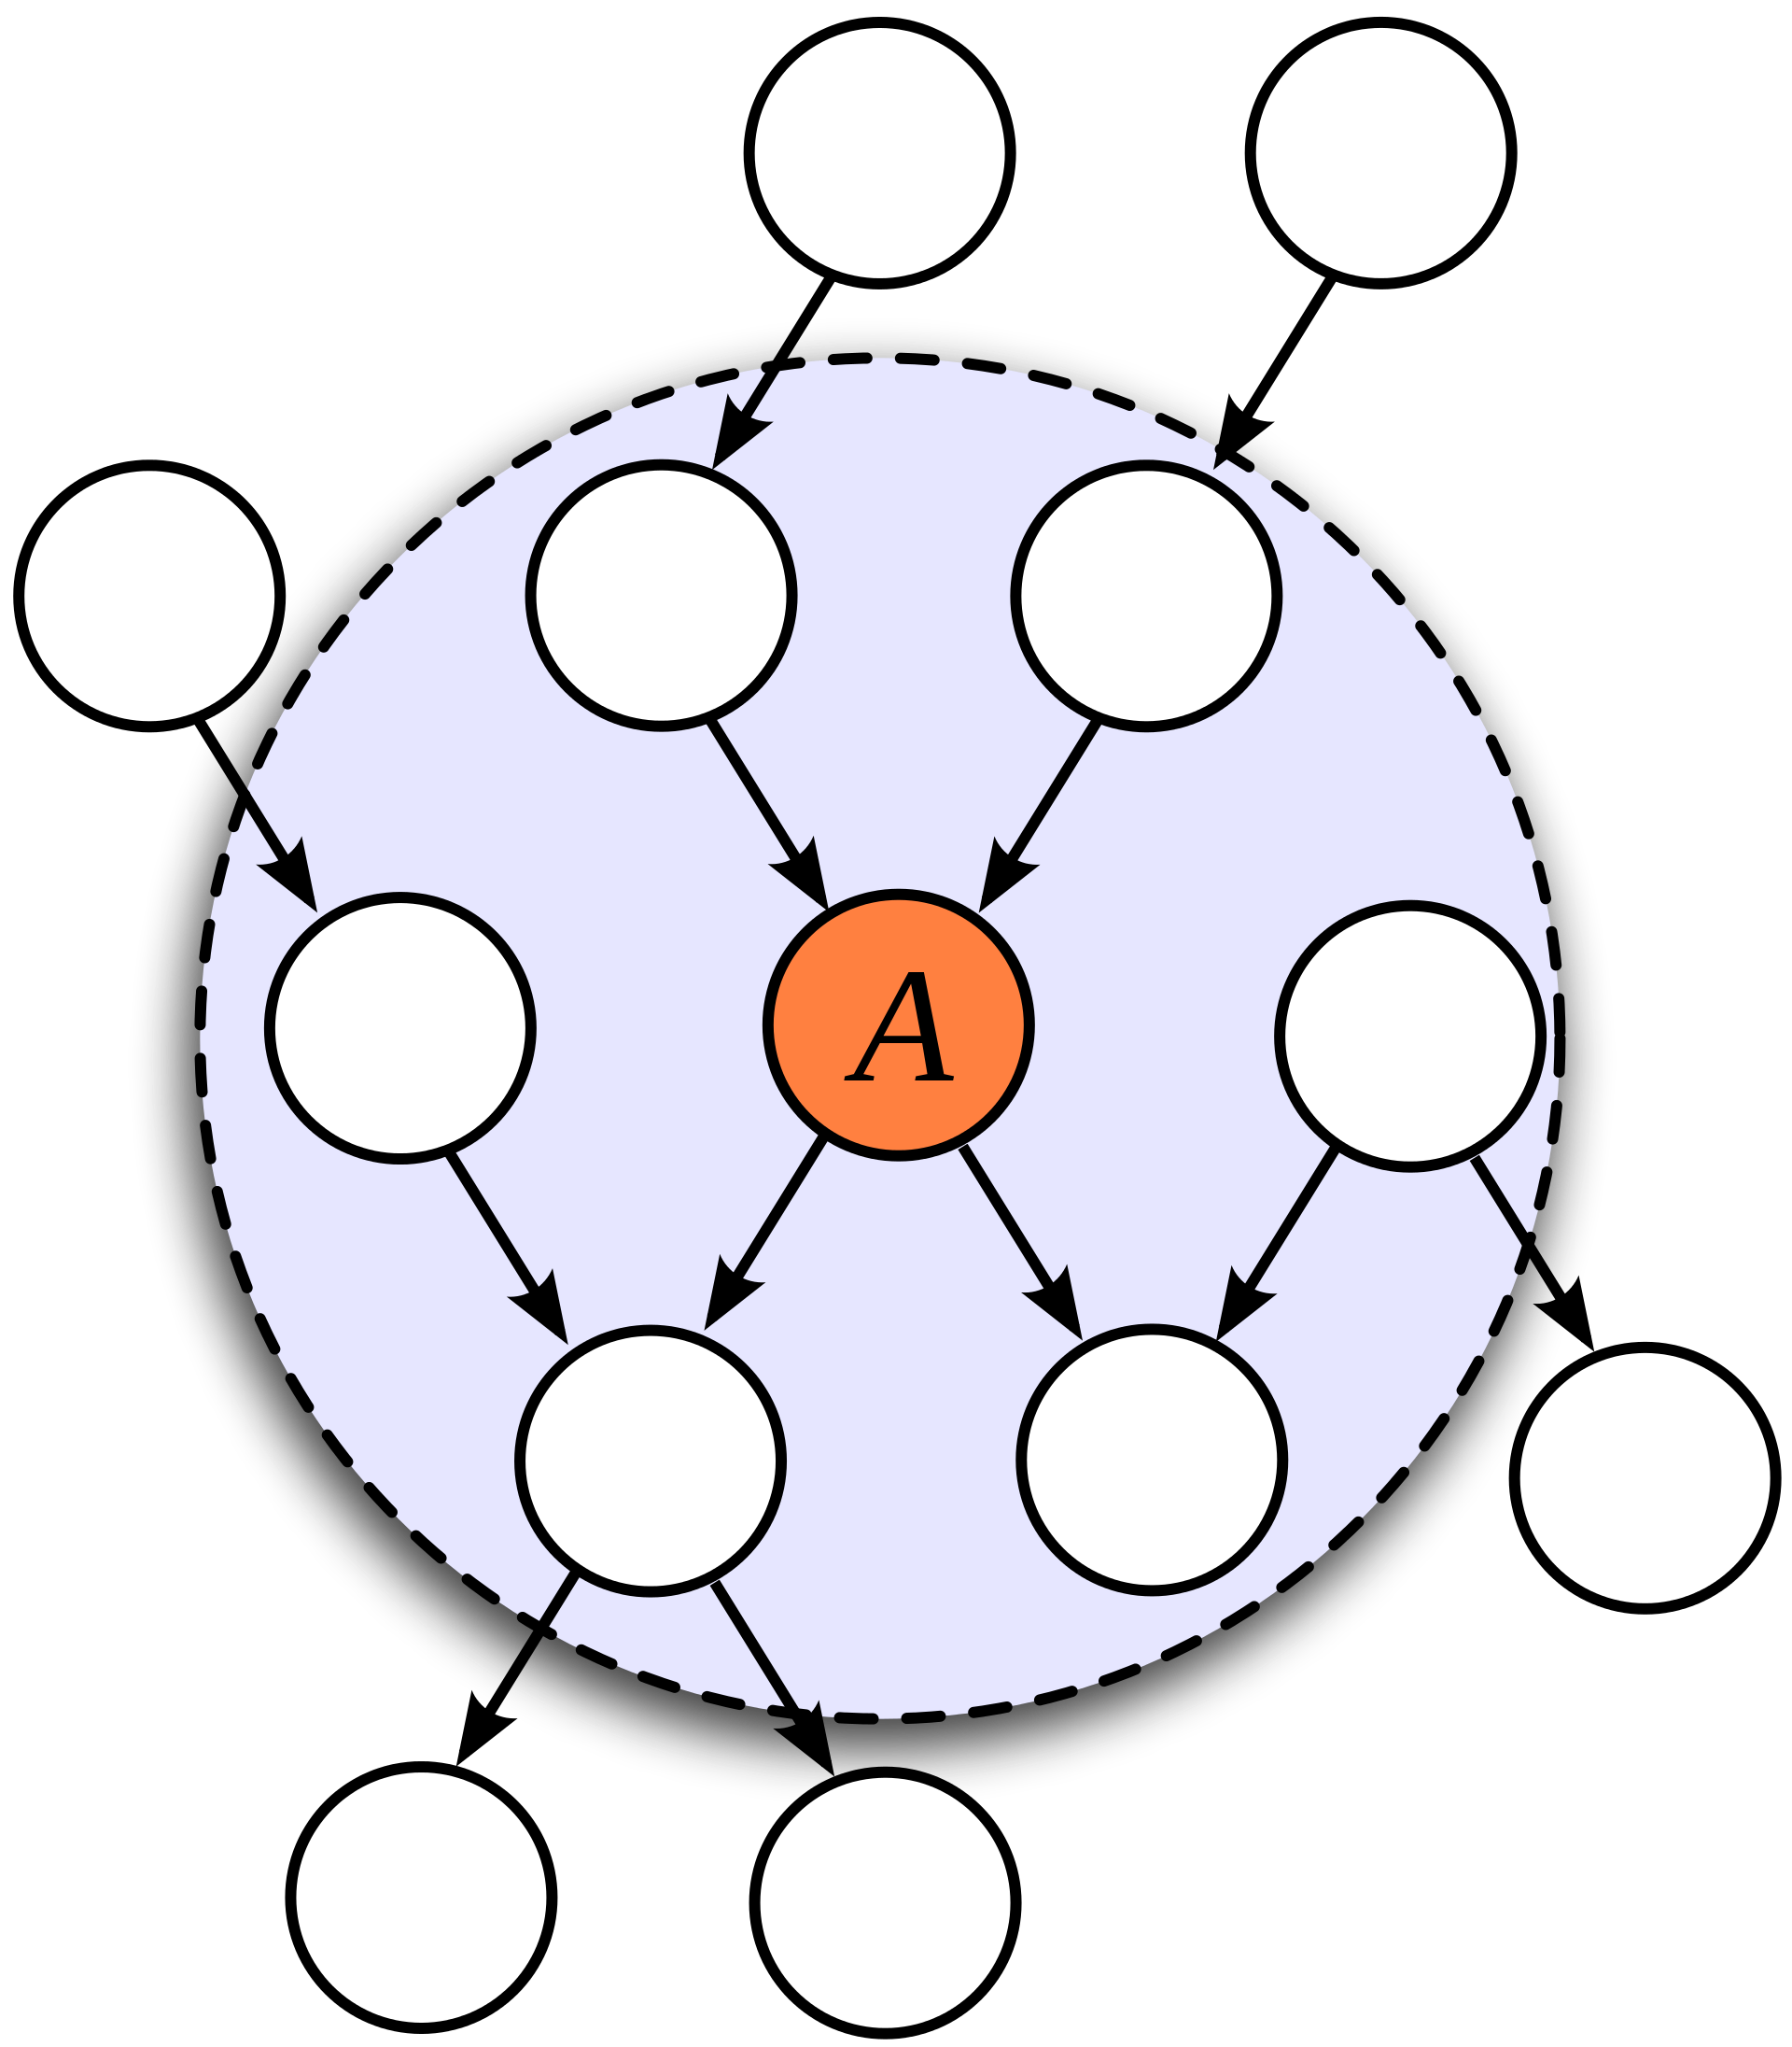
Markov blanket

Slide 55
Summary – things to know
Answer queries from joint distribution (marginalization, conditioning)
Independence, conditional independence implied by a Bayes net
  “Bayes ball” method
  Reasoning about causal chain, common cause, common effect

