Slide 1
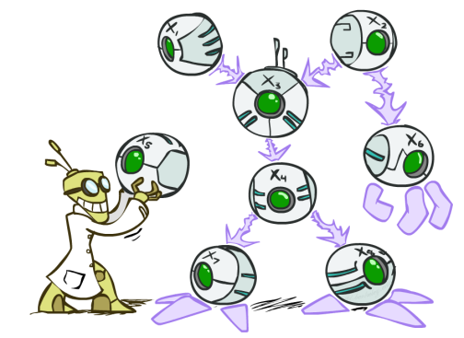
AI: Representation and Problem Solving
Bayes Nets
Instructors: Aditi Raghunathan and Vince Conitzer
Slide credits: CMU AI and http://ai.berkeley.edu

Slide 2
Announcements
Mid-term 2 11/9
  covers Classical Planning, Propositional Logic, MDPs, RL, Bayes 1, Bayes 2
  80 minutes in class, same general rules
HW7 due 10/31
HW8 due 11/7
P4 being released 11/2, due 11/16

Slide 3
MDPs and RL (things to be familiar with)
Formulation
Algorithms to solve MDPs
  Try to really understand where these algorithms come from
  Be able to do a few iterations yourself
RL (formulation – what’s known and what’s unknown)
Direct policy evaluation, TD learning, Q-learning, approximate Q-learning
Exploration-exploitation tradeoff, regret

Slide 4
Bayes nets

Slide 5



Omega Pizzeria!
What is the probability of getting a slice with:
  No mushrooms
  Spinach and no mushrooms
  Spinach, when asking for slice with no mushrooms
Icons: CC, https://openclipart.org/detail/296791/pizza-slice

Slide 6
Omega Pizzeria!
What is the probability of getting a slice with:
  Mushrooms
  Spinach
  No spinach
  No spinach and mushrooms
  No spinach when asking for no mushrooms
  No spinach when asking for mushrooms
  Spinach when asking for mushrooms
  No mushrooms and no spinach
Icons: CC, https://openclipart.org/detail/296791/pizza-slice

Slide 7
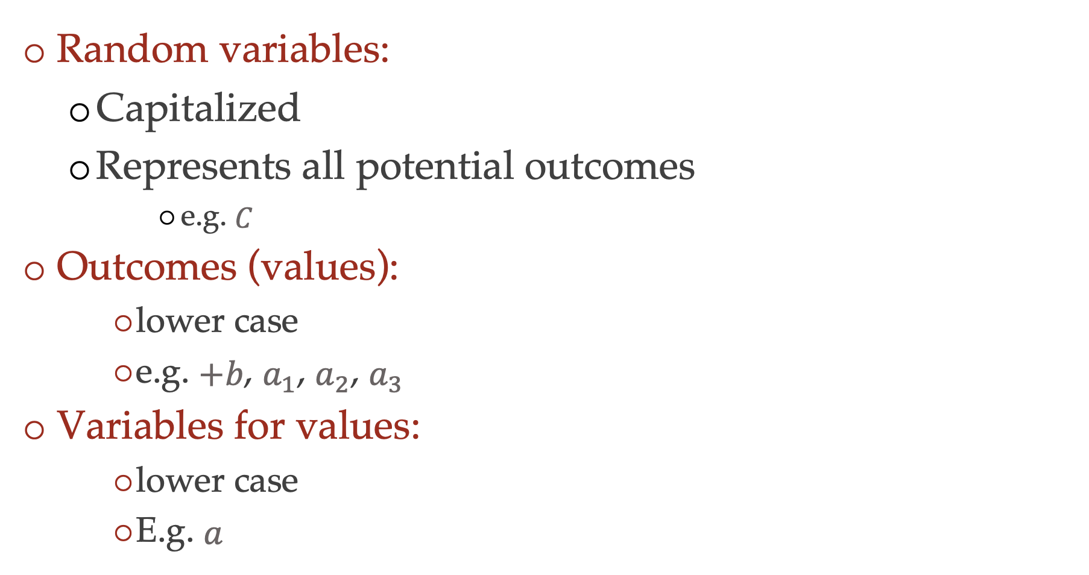
Notations and conventions in the course
Random variables:
  Capitalized
  Represents all potential outcomes
      e.g. $C$
Outcomes (values):
    lower case
    e.g. $+b$, $a_{1}$, $a_{2}$, $a_{3}$
Variables for values:
    lower case
    E.g. $a$

Slide 8
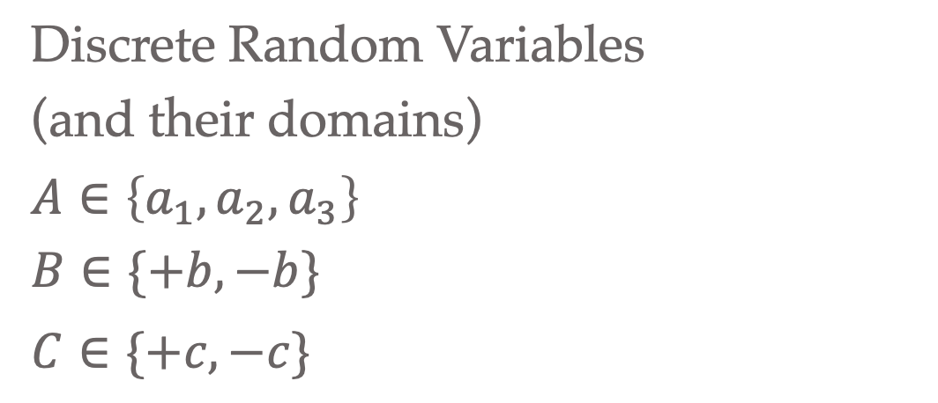
Discrete Probability Distributions
  For each random variable
  Discrete outcomes
  Disjoint outcomes
  Accounts for entire event space
  Not always binary
Discrete Random Variables
(and their domains)
$A∈\left\{a_{1},a_{2}, a_{3}\right\}$
$B∈\{+b, −b\}$
$C∈\{+c, −c\}$

Slide 9
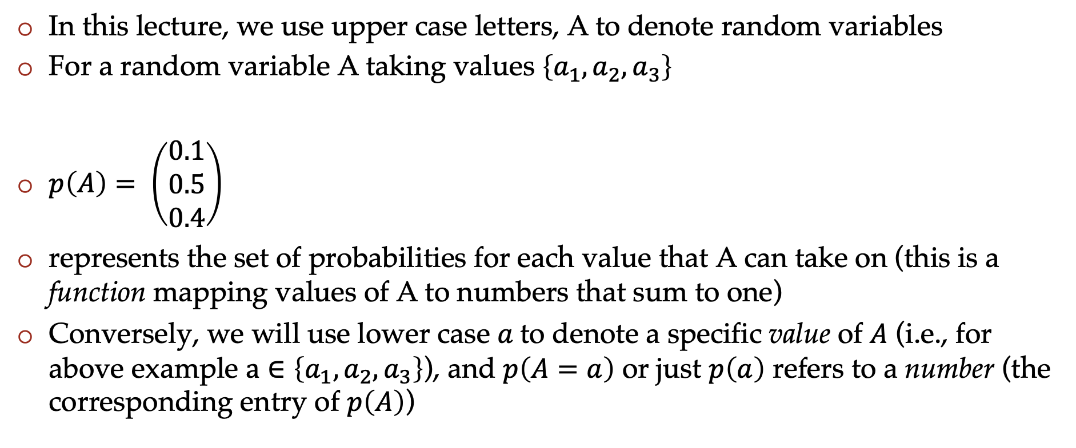
Probability notation
In this lecture, we use upper case letters, A to denote random variables
For a random variable A taking values $\left\{a_{1},a_{2},a_{3}\right\}$
$p\left(A\right)= \left(\begin{matrix}0.1 \\ 0.5 \\ 0.4\end{matrix}\right)$
represents the set of probabilities for each value that A can take on (this is a function mapping values of A to numbers that sum to one)
Conversely, we will use lower case $a$to denote a specific value of $A$ (i.e., for above example $a∈\left\{a_{1},a_{2},a_{3}\right\}$), and $p\left(A=a\right)$ or just $p\left(a\right)$ refers to a number (the corresponding entry of $p\left(A\right)$)

Slide 10
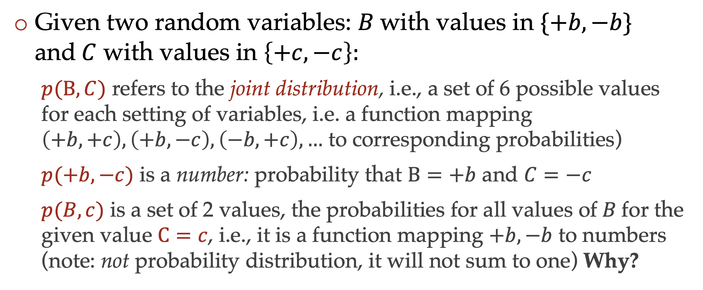
Probability notation
Given two random variables: $B$with values in $\{+b, −b\}$ and$C$ with values in $\left\{+c,−c\right\}:$
  $p(B,C)$ refers to the joint distribution, i.e., a set of 6 possible values for each setting of variables, i.e. a function mapping $\left(+b,+c\right), \left(+b,−c\right),\left(−b,+c\right),…$ to corresponding probabilities)
  $p(+b,−c)$ is a number: probability that $B=+b$ and $C=−c$
  $p(B,c)$ is a set of 2 values, the probabilities for all values of$B$for the given value $C=c$, i.e., it is a function mapping $+b, −b$ to numbers (note: not probability distribution, it will not sum to one) Why?

Slide 11
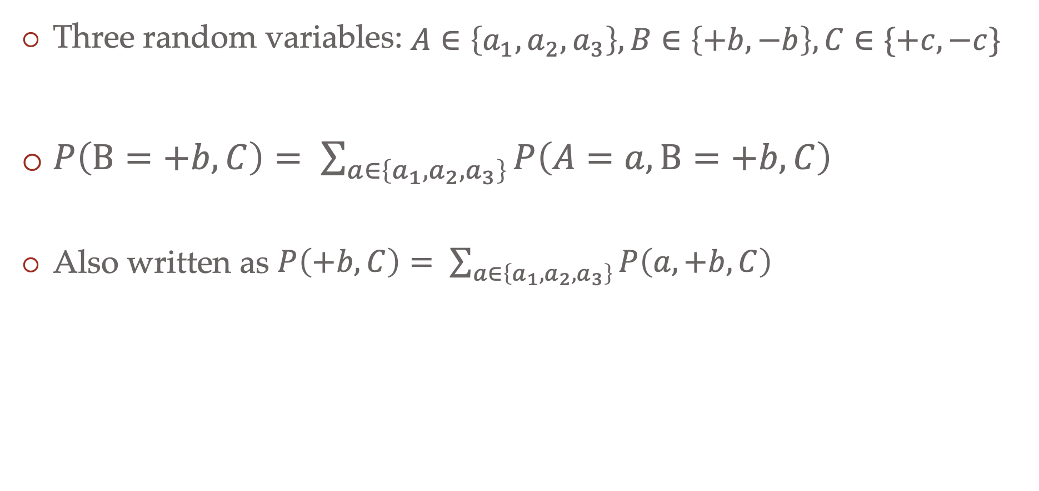
Probability notation
Three random variables: $A∈\left\{a_{1},a_{2}, a_{3}\right\}, B∈\left\{+b, −b\right\}, C∈\{+c, −c\}$
$P\left(B=+b, C\right)= \sum_{a∈\left\{a_{1}, a_{2},a_{3}\right\}}{P\left(A=a, B=+b, C\right)}$
Also written as $P\left(+b, C\right)= \sum_{a∈\left\{a_{1}, a_{2},a_{3}\right\}}{P\left(a, +b, C\right)}$

Slide 12
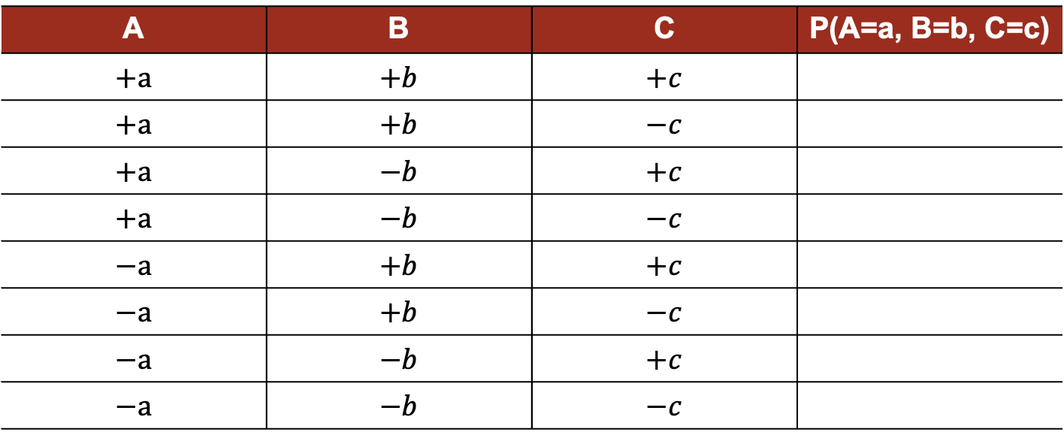

Joint probability distribution
Table representing all values
$A∈\left\{+a, −a \right\}$
$B∈\{+b, −b\}$
$C∈\{+c, −c\}$
A | B | C | P(A=a, B=b, C=c)
$$+a$$ | $$+b$$ | $$+c$$
$$+a$$ | $$+b$$ | $$−c$$
$$+a$$ | $$−b$$ | $$+c$$
$$+a$$ | $$−b$$ | $$−c$$
$$−a$$ | $$+b$$ | $$+c$$
$$−a$$ | $$+b$$ | $$−c$$
$$−a$$ | $$−b$$ | $$+c$$
$$−a$$ | $$−b$$ | $$−c$$

Slide 13
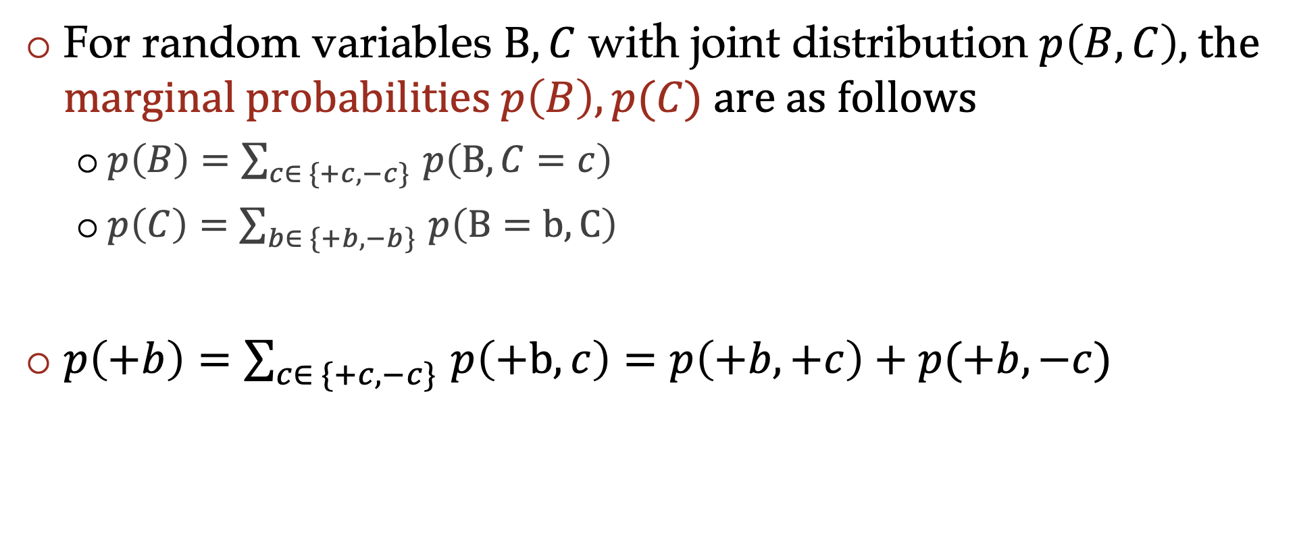
Marginalization
For random variables $B, C$ with joint distribution $p\left(B, C\right)$, the marginal probabilities $p\left(B\right), p(C)$ are as follows
  $p\left(B\right)=\sum_{c∈ \{+c, −c\} }{p\left(B,C=c\right)}$
  $p\left(C\right)=\sum_{b∈ \{+b, −b\} }{p\left(B=b, C\right)}$
$p\left(+b\right)=\sum_{c∈ \{+c, −c\} }{p\left(+b, c\right)}=p\left(+b, +c\right)+p(+b, −c)$

Slide 14

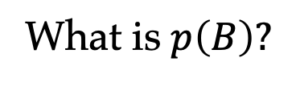
Marginalization from table
A | B | C | P(A=a, B=b, C=c)
$$+a$$ | $$+b$$ | $$+c$$
$$+a$$ | $$+b$$ | $$−c$$
$$+a$$ | $$−b$$ | $$+c$$
$$+a$$ | $$−b$$ | $$−c$$
$$−a$$ | $$+b$$ | $$+c$$
$$−a$$ | $$+b$$ | $$−c$$
$$−a$$ | $$−b$$ | $$+c$$
$$−a$$ | $$−b$$ | $$−c$$
$A∈\left\{+a, −a \right\}$
$B∈\{+b, −b\}$
$C∈\{+c, −c\}$
What is $p\left(B\right)?$

Slide 15
Marginalization from table
A | B | C | P(A=a, B=b, C=c)
$$+a$$ | $$+b$$ | $$+c$$
$$+a$$ | $$+b$$ | $$−c$$
$$+a$$ | $$−b$$ | $$+c$$
$$+a$$ | $$−b$$ | $$−c$$
$$−a$$ | $$+b$$ | $$+c$$
$$−a$$ | $$+b$$ | $$−c$$
$$−a$$ | $$−b$$ | $$+c$$
$$−a$$ | $$−b$$ | $$−c$$
$A∈\left\{+a, −a \right\}$
$B∈\{+b, −b\}$
$C∈\{+c, −c\}$
Marginalization to get $p(B)$ : aggregating rows that share the same value of$B$

Slide 16
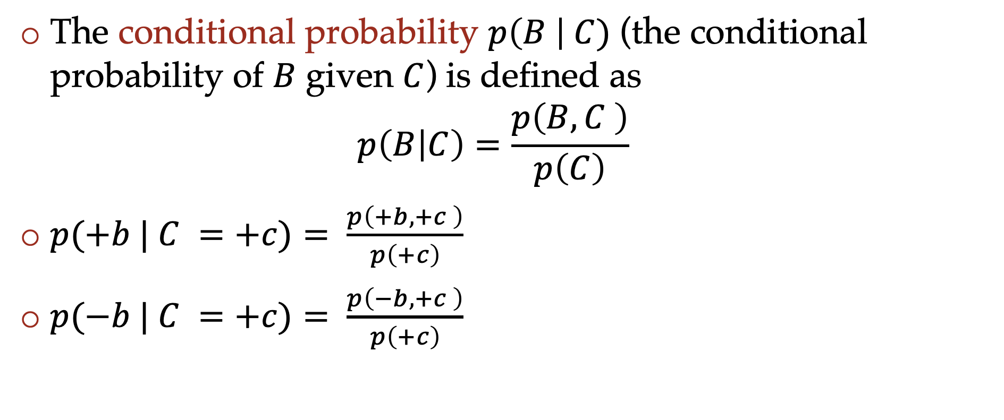
Conditional probability
The conditional probability $p\left(B \right| C)$ (the conditional probability of $B$ given $C$) is defined as
$p\left(B | C\right)=\frac{p\left(B, C \right)}{p\left(C\right)}$
$p(+b | C =+c)= \frac{p\left(+b, +c \right)}{p\left(+c\right)}$
$p(−b | C =+c)= \frac{p\left(−b, +c \right)}{p\left(+c\right)}$

Slide 17
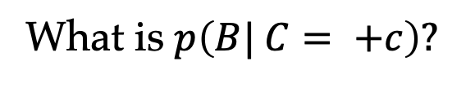
Conditional probability from table
A | B | C | P(A=a, B=b, C=c)
$$+a$$ | $$+b$$ | $$+c$$
$$+a$$ | $$+b$$ | $$−c$$
$$+a$$ | $$−b$$ | $$+c$$
$$+a$$ | $$−b$$ | $$−c$$
$$−a$$ | $$+b$$ | $$+c$$
$$−a$$ | $$+b$$ | $$−c$$
$$−a$$ | $$−b$$ | $$+c$$
$$−a$$ | $$−b$$ | $$−c$$
$A∈\left\{+a, −a \right\}$
$B∈\{+b, −b\}$
$C∈\{+c, −c\}$
What is $p\left(B| C= +c\right)?$

Slide 18
Conditional probability from table
A | B | C | P(A=a, B=b, C=c)
$$+a$$ | $$+b$$ | $$+c$$
$$+a$$ | $$+b$$ | $$−c$$
$$+a$$ | $$−b$$ | $$+c$$
$$+a$$ | $$−b$$ | $$−c$$
$$−a$$ | $$+b$$ | $$+c$$
$$−a$$ | $$+b$$ | $$−c$$
$$−a$$ | $$−b$$ | $$+c$$
$$−a$$ | $$−b$$ | $$−c$$
$A∈\left\{+a, −a \right\}$
$B∈\{+b, −b\}$
$C∈\{+c, −c\}$
We restrict our attention to rows that satisfy the “given” condition, and then normalize the values so that they sum to 1 (form a distribution)

Slide 19
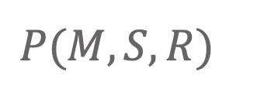
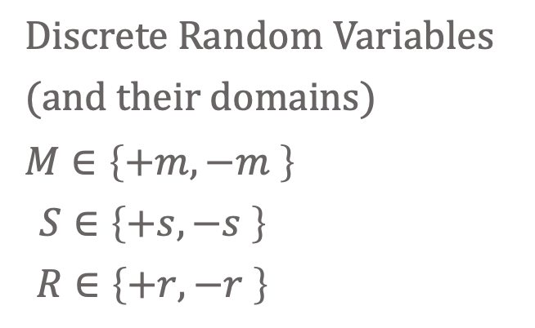
Discrete probability distributions
Joint distribution
$$P(M, S, R)$$
Discrete Random Variables
(and their domains)
$M∈\left\{+m, −m \right\}$
$S∈\left\{+s, −s \right\}$
$R∈\left\{+r, −r \right\}$
Icons: CC, https://openclipart.org/detail/296791/pizza-slice

Slide 20
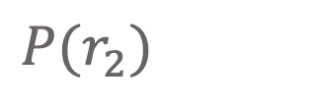
Discrete probability distributions
Marginal distribution
$P(r_{2})$
Discrete Random Variables
(and their domains)
$M∈\left\{+m, −m \right\}$
$S∈\left\{+s, −s \right\}$
$R∈\left\{+r, −r \right\}$
Icons: CC, https://openclipart.org/detail/296791/pizza-slice

Slide 21
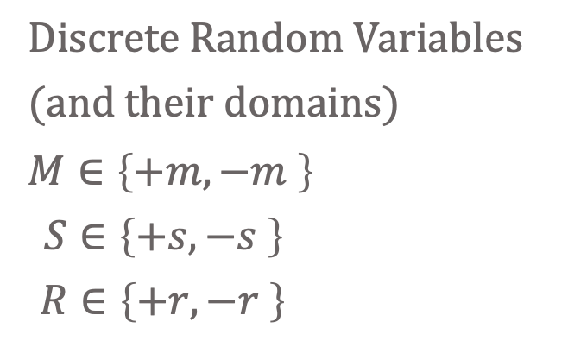
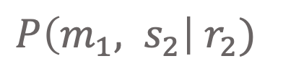
Discrete probability distributions
Conditional distribution
$P\left(m_{1}, s_{2}\right| r_{2})$
Discrete Random Variables
(and their domains)
$M∈\left\{+m, −m \right\}$
$S∈\left\{+s, −s \right\}$
$R∈\left\{+r, −r \right\}$
Icons: CC, https://openclipart.org/detail/296791/pizza-slice

Slide 22
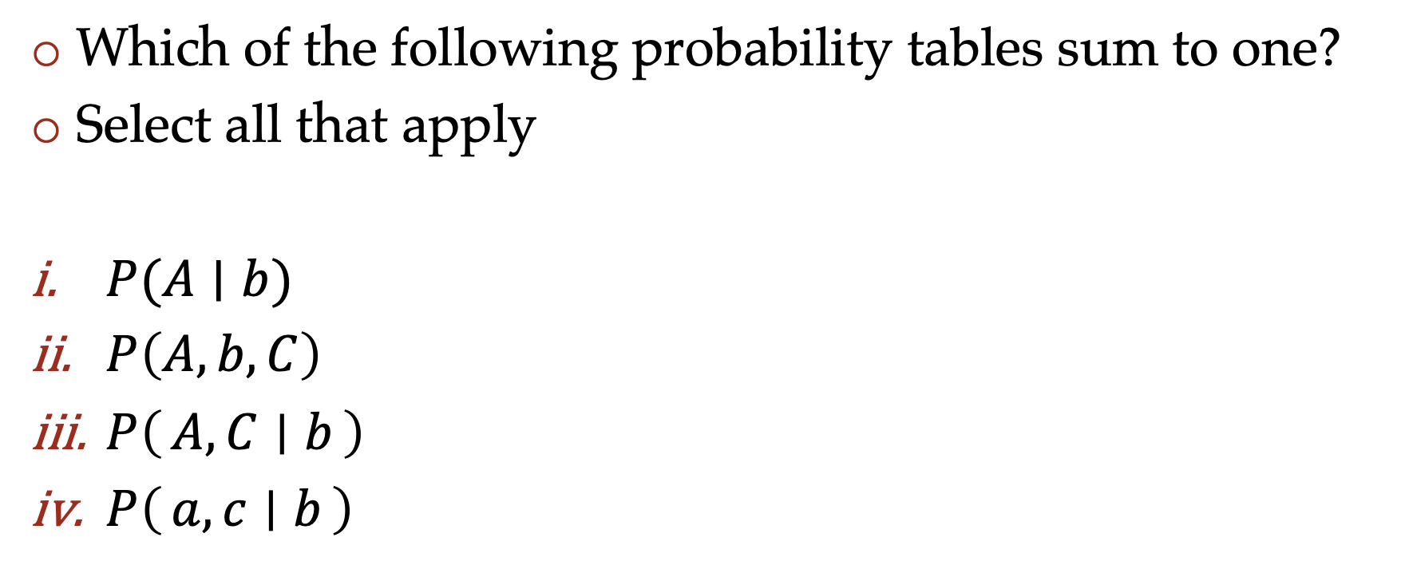
Poll 1
Which of the following probability tables sum to one?
Select all that apply
$P(A∣b)$
$P\left(A, b, C\right)$
$P\left(A, C ∣ b\right)$
$P\left(a, c ∣ b\right)$

Slide 23
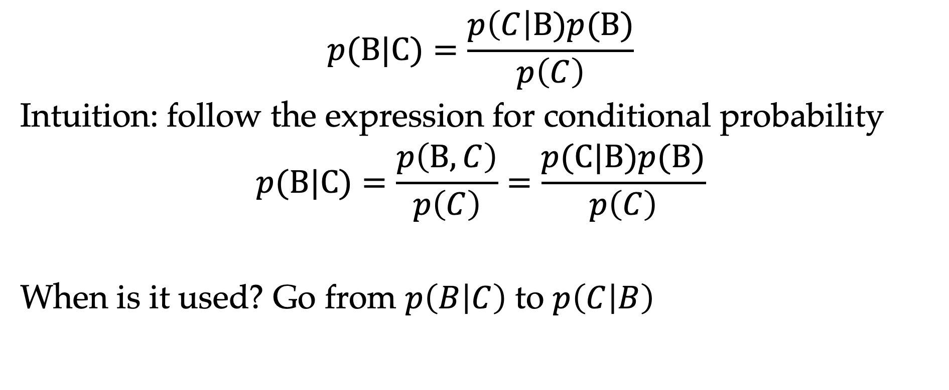
Bayes rule
$$p(B|C)=\frac{p\left(C\right|B)p(B)}{p\left(C\right)}$$
Intuition: follow the expression for conditional probability
$$p(B|C)=\frac{p\left(B, C\right)}{p\left(C\right)}=\frac{p(C|B)p(B)}{p\left(C\right)}$$
When is it used? Go from $p\left(B | C\right)$ to $p\left(C | B\right)$

Slide 24
Poll 2
I want to know if I have come down with a rare strain of flu (occurring in only 1/10,000 people). There is an “accurate” test for the flu: if I have the flu, it will tell me I have 99% of the time, and if I do not have it, it will tell me I do not have it 99% of the time. I go to the doctor and test positive. What is the probability I have this flu?
  (A) ≈ 99%
  (B) ≈ 10%
  (C) ≈ 1%
  (D) ≈ 0.1%

Slide 25
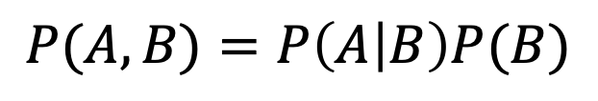
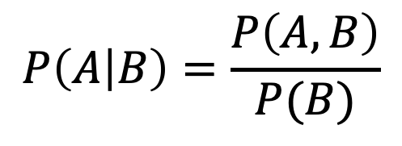
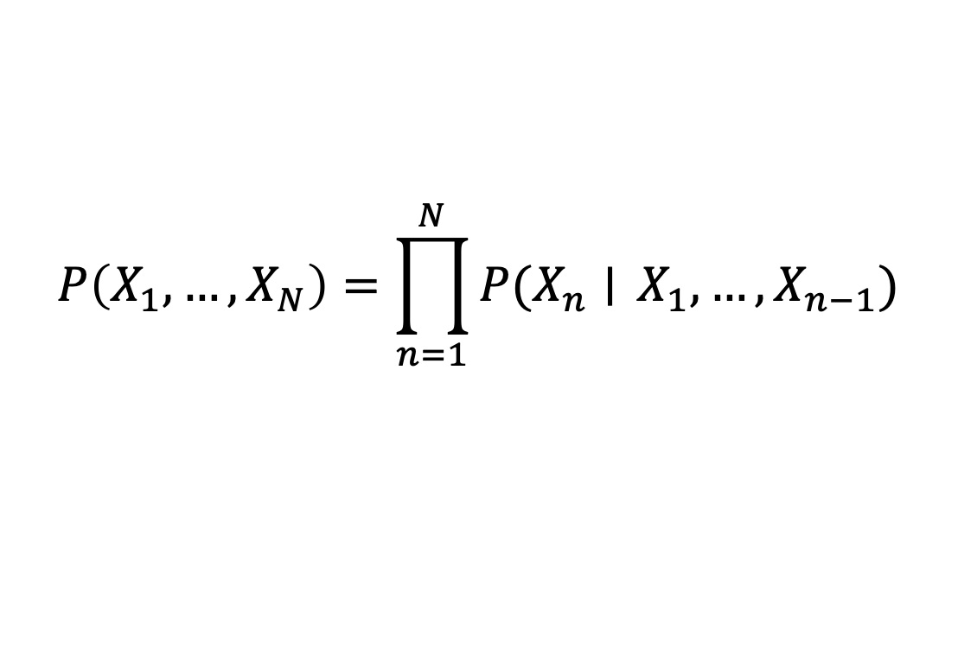
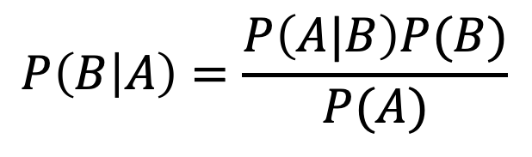
Probability Tools Summary
Definition of conditional probability
Product Rule
Bayes’ theorem
Chain Rule
$$P\left(A | B\right)=\frac{P\left(A, B\right)}{P(B)}$$
$$P(A,B)=P\left(A | B\right)P(B)$$
$$P\left(B | A\right)=\frac{P\left(A|B\right)P(B)}{P(A)}$$
$$P\left(X_{1}, …, X_{N}\right)=\prod_{n=1}^{N}{P(X_{n}∣} X_{1},…, X_{n−1})$$

Slide 26

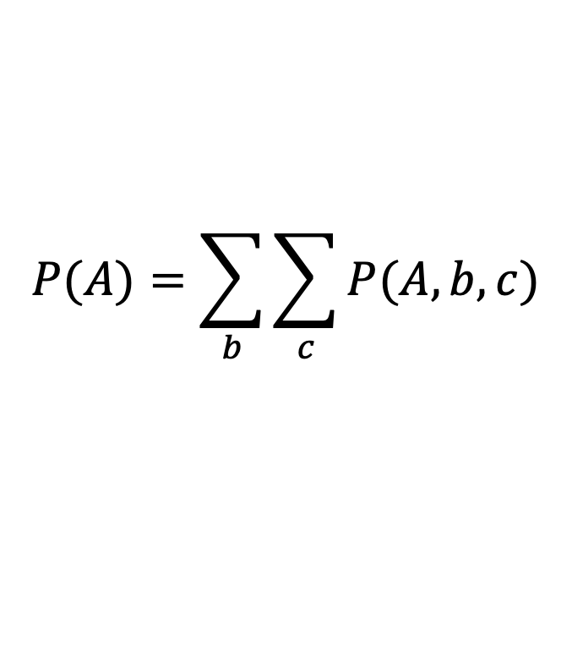
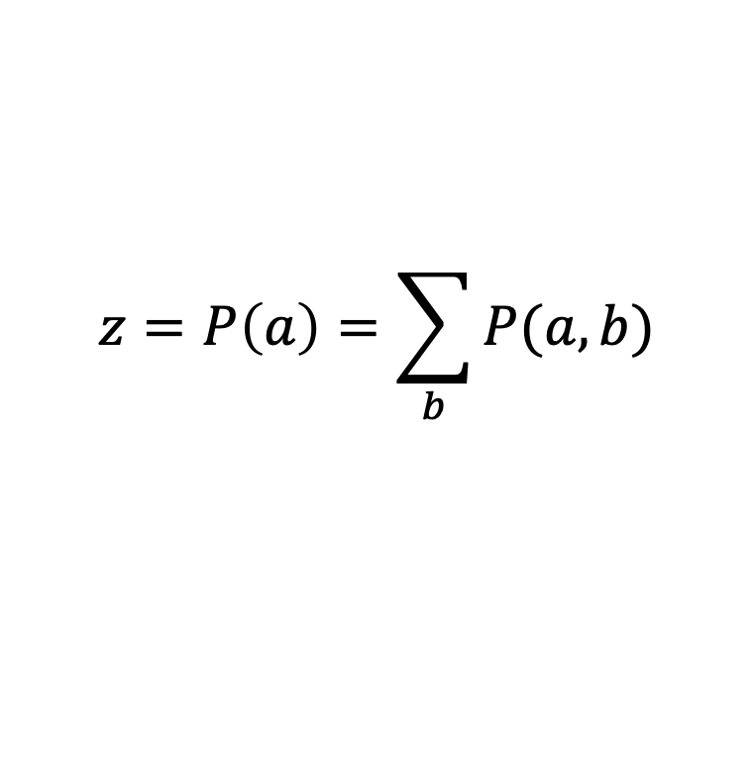
Additional probability tools
Marginalization (law of total probability) (summing out)
Normalization
$$P(A)=\sum_{b}{\sum_{c}{P(A, b, c)}}$$
$$P\left(B | a\right)=\frac{P(a,B)}{P(a)}$$
$P\left(B | a\right)∝P(a,B)$
$P\left(B | a\right)=\frac{1}{z}P(a,B)$
$$z=P\left(a\right)=\sum_{b}{P(a,b)}$$

Slide 27
More practice
What is the probability of getting a slice with:
Icons: CC, https://openclipart.org/detail/296791/pizza-slice

Slide 28
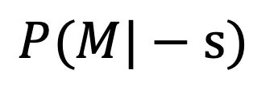

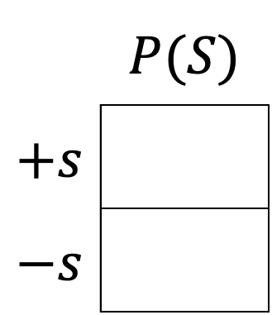
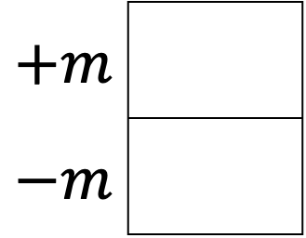
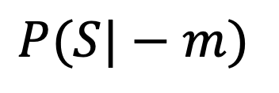
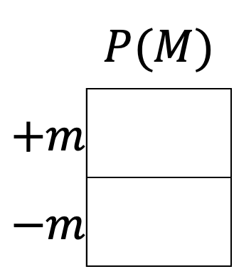

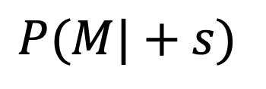
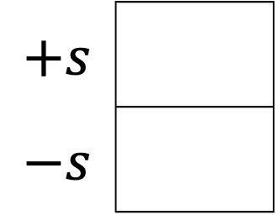
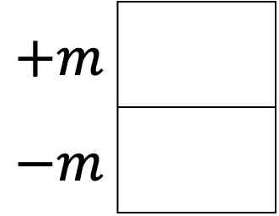
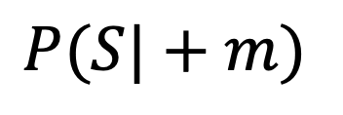
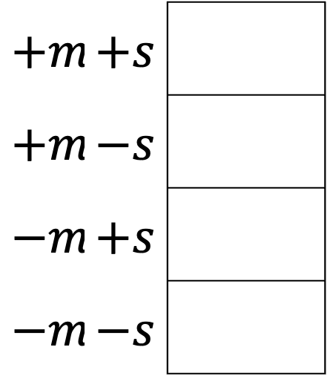
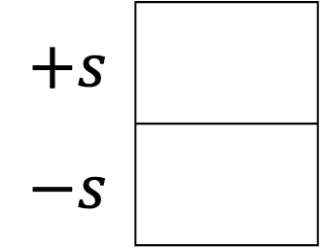

Answer queries from joint distribution
You can answer all of these questions:
$P(M|+s)$
$P(M|−s)$
 | $$P(M)$$
$$+m$$
$$−m$$
$P(M,S)$
$$+m$$
$$−m$$
$$+m$$
$$−m$$
$$12/20$$
$$+m$$ | $$+s$$
$$+m$$ | $$−s$$
$$−m$$ | $$+s$$
$$−m$$ | $$−s$$
$P(S|+m)$
$P(S|−m)$
 | $$P(S)$$
$$+s$$
$$−s$$
$$+s$$
$$−s$$
$$+s$$
$$−s$$
$$6/12$$

Slide 29
More practice
P(Weather)?
P(Weather | winter)?
P(Weather | winter, hot)?
Season | Temp | Weather | P(S, T, W)
summer | hot | sun | 0.30
summer | hot | rain | 0.05
summer | cold | sun | 0.10
summer | cold | rain | 0.05
winter | hot | sun | 0.10
winter | hot | rain | 0.05
winter | cold | sun | 0.15
winter | cold | rain | 0.20

Slide 30
Answer Any Query from Joint Distribution
P(Weather)?
Season | Temp | Weather | P(S, T, W)
summer | hot | sun | 0.30
summer | hot | rain | 0.05
summer | cold | sun | 0.10
summer | cold | rain | 0.05
winter | hot | sun | 0.10
winter | hot | rain | 0.05
winter | cold | sun | 0.15
winter | cold | rain | 0.20

Slide 31
Answer Any Query from Joint Distribution
P(Weather | winter)?
Season | Temp | Weather | P(S, T, W)
summer | hot | sun | 0.30
summer | hot | rain | 0.05
summer | cold | sun | 0.10
summer | cold | rain | 0.05
winter | hot | sun | 0.10
winter | hot | rain | 0.05
winter | cold | sun | 0.15
winter | cold | rain | 0.20

Slide 32
Answer Any Query from Joint Distribution
P(Weather | winter, hot)?
Season | Temp | Weather | P(S, T, W)
summer | hot | sun | 0.30
summer | hot | rain | 0.05
summer | cold | sun | 0.10
summer | cold | rain | 0.05
winter | hot | sun | 0.10
winter | hot | rain | 0.05
winter | cold | sun | 0.15
winter | cold | rain | 0.20

Slide 33
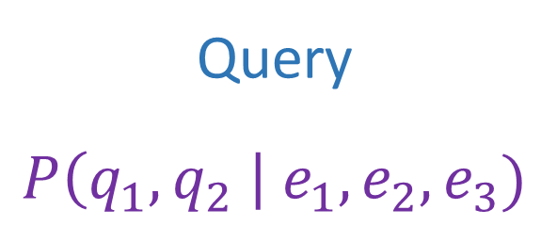
Answer Any Query from Joint Distribution
Joint distributions are the best!
Joint
Query
$$P\left(q_{1},q_{2} \right| e_{1}, e_{2},e_{3})$$

Slide 34
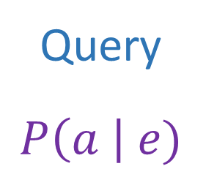
Joint distributions
Joint distributions are the best!
Problems with joints
We aren’t given the joint table
    Usually some set of conditional probability tables
Joint
Query
$$P\left(a \right| e)$$

Slide 35
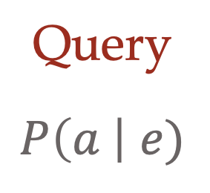
Build joint distribution using CPTs
Conditional Probability Tables and Chain Rule
Joint
Query
$$P\left(a \right| e)$$
$P\left(A\right) P\left(B | A\right) P\left(C | A,B\right) P\left(D | A,B,C\right)$ $P(E|A, B,C,D)$

Slide 36
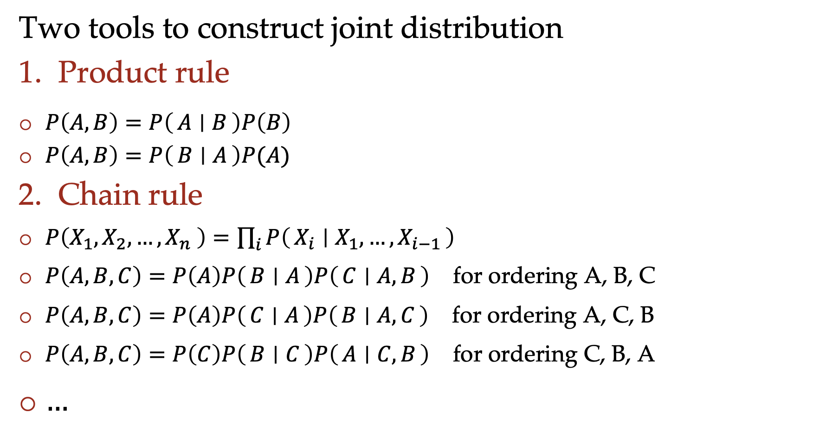
Build joint distribution using chain rule
Two tools to construct joint distribution
Product rule
$P\left(A,B\right)=P\left(A ∣ B\right)P\left(B\right)$
$P\left(A,B\right)=P\left(B ∣ A\right)P(A)$
Chain rule
$P\left(X_{1},X_{2},…,X_{n} \right)=\prod_{i}{P\left(X_{i} ∣ X_{1},…,X_{i−1}\right)}$
$P\left(A,B,C\right)=P\left(A\right)P\left(B ∣ A\right)P\left(C ∣ A, B\right)$ for ordering A, B, C
$P\left(A,B,C\right)=P\left(A\right)P\left(C ∣ A\right)P\left(B ∣ A,C\right)$ for ordering A, C, B
$P\left(A,B,C\right)=P\left(C\right)P\left(B ∣ C\right)P\left(A ∣ C,B\right)$ for ordering C, B, A
$…$

Slide 37
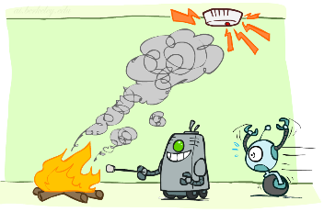
Build joint distribution using chain rule
Binary random variables
  Fire
  Smoke
  Alarm

Slide 38
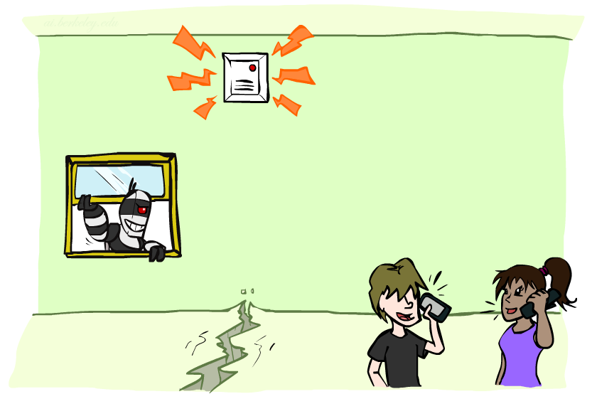
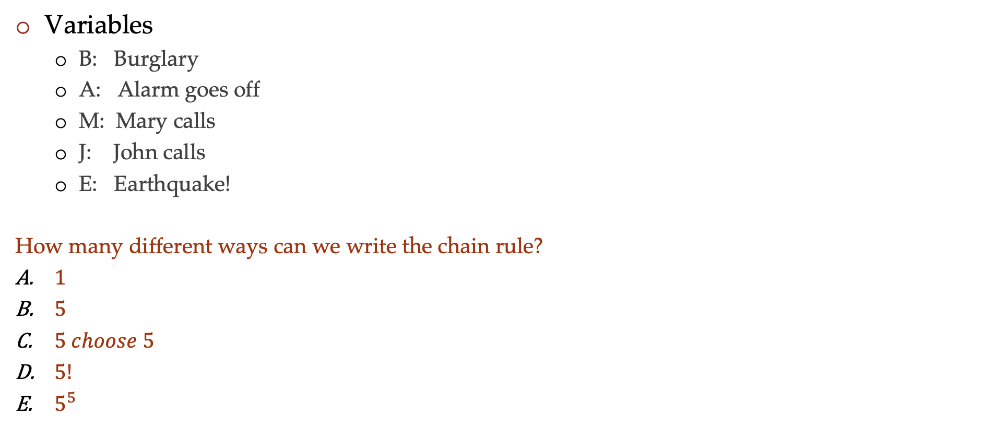
Poll 3
Variables
  B: Burglary
  A: Alarm goes off
  M: Mary calls
  J: John calls
  E: Earthquake!
  How many different ways can we write the chain rule?
  $1$
  $5$
  $5 choose 5$
  $5!$
  $5^{5}$

Slide 39
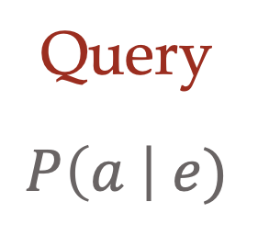
Build joint distribution using chain rule
Conditional Probability Tables and Chain Rule
Joint
Query
$$P\left(a \right| e)$$
$P\left(A\right) P\left(B | A\right) P\left(C | A,B\right) P\left(D | A,B,C\right)$ $P(E|A, B,C,D)$

Slide 40
Queries from CPTs
Process to go from (specific) conditional probability tables to query
Construct the joint distribution
    Product Rule or Chain Rule
Answer query from joint
    Definition of conditional probability
    Law of total probability (marginalization, summing out)

Slide 41
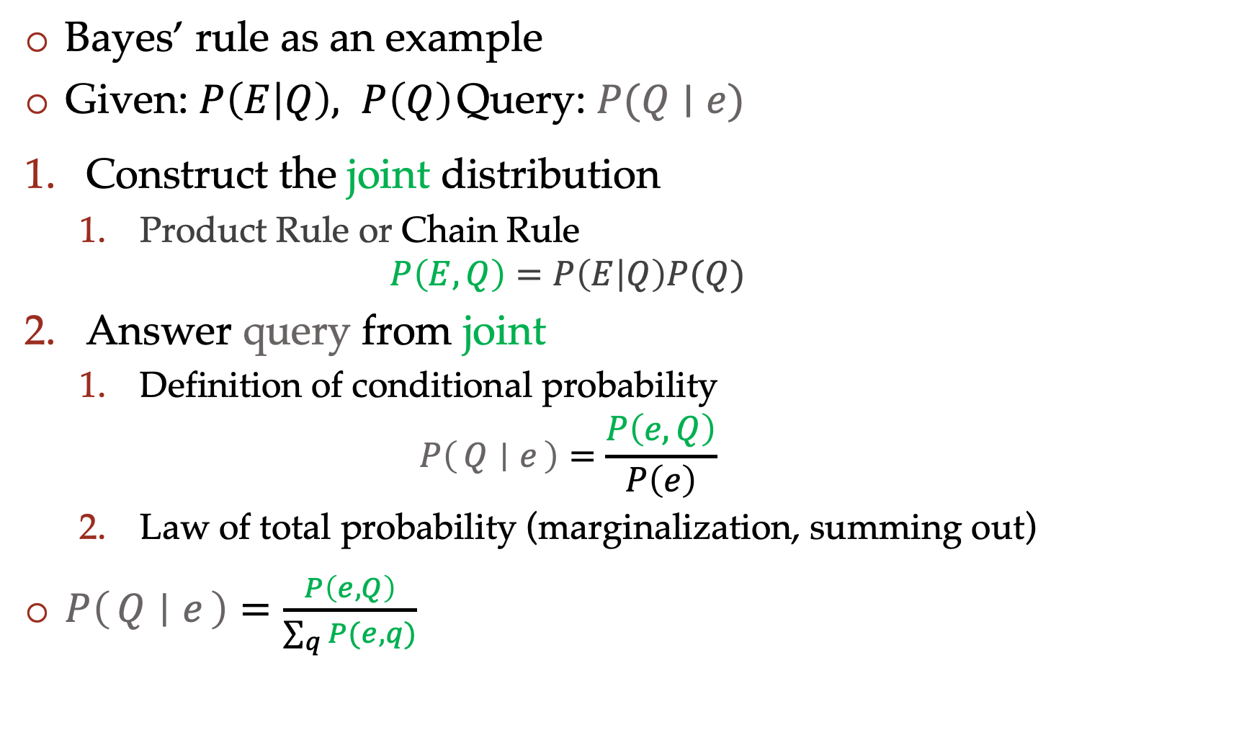
Queries from CPTs
Bayes’ rule as an example
Given: $P\left(E | Q\right), P\left(Q\right)$ Query: $P(Q∣e)$
Construct the joint distribution
    Product Rule or Chain Rule
    $$P\left(E,Q\right)=P\left(E | Q\right)P(Q)$$
Answer query from joint
    Definition of conditional probability
    $$P\left(Q ∣ e\right)=\frac{P\left(e, Q\right)}{P\left(e\right)}$$
    Law of total probability (marginalization, summing out)
$P\left(Q ∣ e\right)=\frac{P\left(e, Q\right)}{\sum_{q}{P(e,q)}}$

Slide 42
Bayes nets
Graphical representation of conditional probability tables
One node per random variable
Directed acyclic graph
Each node corresponds to a conditional probability distribution

Slide 43
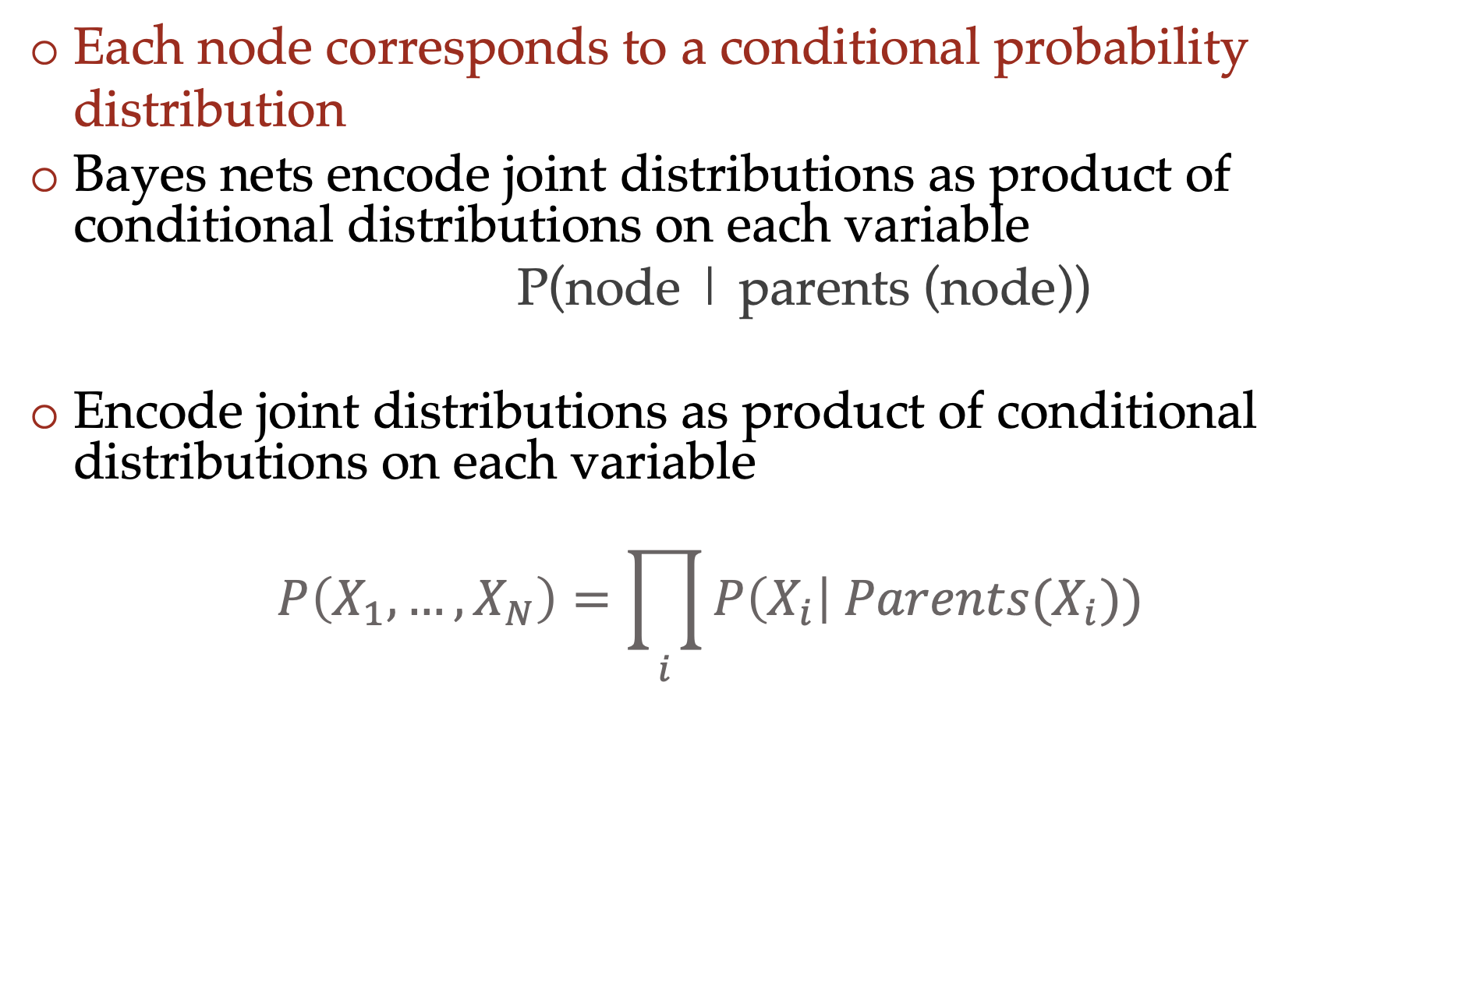
Bayes nets
Each node corresponds to a conditional probability distribution
Bayes nets encode joint distributions as product of conditional distributions on each variable
  P(node | parents (node))
Encode joint distributions as product of conditional distributions on each variable
  $$P\left(X_{1},…,X_{N}\right)=\prod_{i}{P\left(X_{i}\right| Parents(X_{i})) }$$

Slide 44




Bayes nets
$$A$$
$$B$$
$$C$$
$$D$$
$$P\left(A, B, C, D\right)=P\left(A\right) P\left(B | A\right) P\left(C | A,B\right) P\left(D | A,B,C\right)$$

Slide 45
Build Bayes Net Using Chain Rule
Binary random variables
  Fire
  Smoke
  Alarm

Slide 46





Question
Variables
  B: Burglary
  A: Alarm goes off
  M: Mary calls
  J: John calls
  E: Earthquake!
$$B$$
$$A$$
$$M$$
$$E$$
$$J$$

Slide 47

Answer Any Query from Bayes Net
Joint
Bayes Net and
Conditional Probability Tables
$$A$$
Query
$$P\left(a \right| e)$$
$$B$$
$$C$$
$$D$$

Slide 48
Answer any query from CPTs
Conditional Probability Tables and Chain Rule
Joint
Query
$$P\left(a \right| e)$$
$P\left(A\right) P\left(B | A\right) P\left(C | A,B\right) P\left(D | A,B,C\right)$ $P(E|A, B,C,D)$

Slide 49
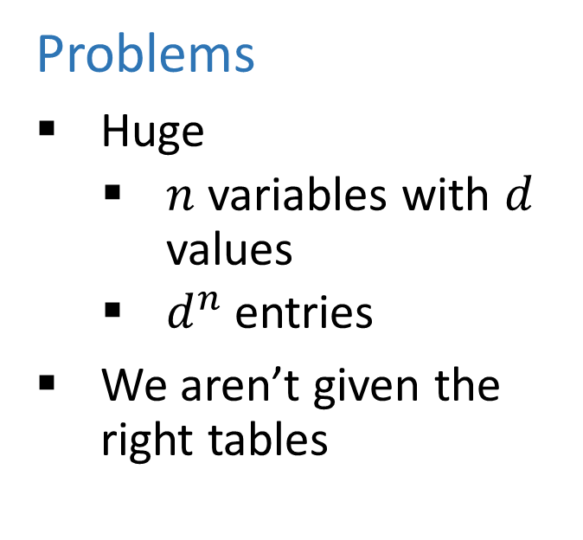
Answer Any Query from Condition Probability Tables
Conditional Probability Tables and Chain Rule
Problems
Huge
    $n$ variables with $d$ values
    $d^{n}$ entries
We aren’t given the right tables
$P\left(A\right) P\left(B | A\right) P\left(C | A,B\right) P\left(D | A,B,C\right)$ $P(E|A, B,C,D)$

Slide 50
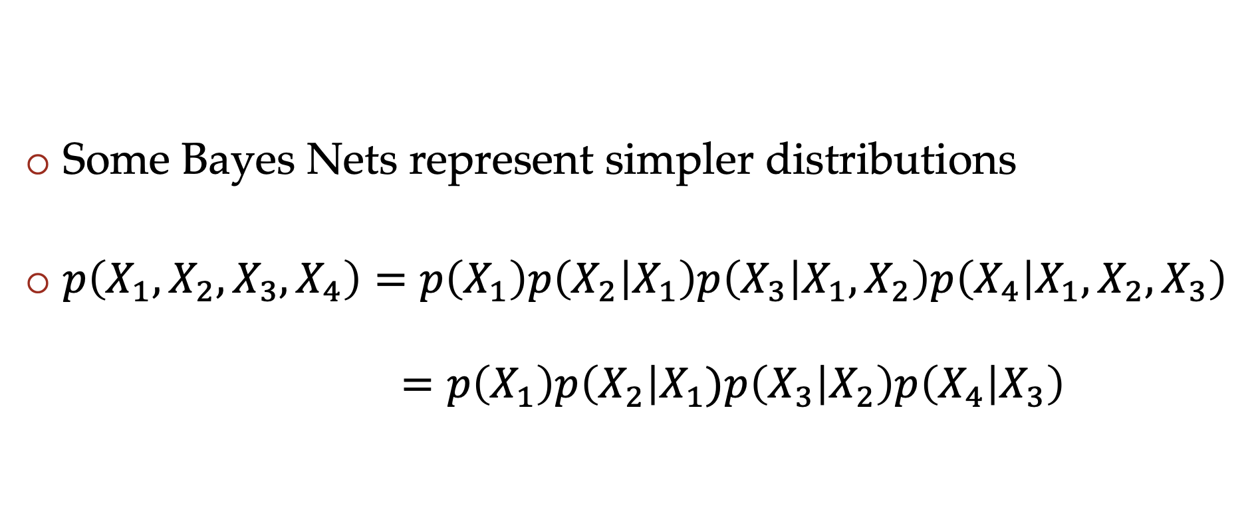
Do we need the full chain rule?
Some Bayes Nets represent simpler distributions
$p\left(X_{1},X_{2},X_{3},X_{4}\right)=p\left(X_{1}\right)p\left(X_{2} | X_{1}\right)p\left(X_{3} | X_{1},X_{2}\right)p\left(X_{4} | X_{1},X_{2},X_{3}\right)$
$=p\left(X_{1}\right)p\left(X_{2}\right|X_{1})p\left(X_{3} | X_{2}\right)p\left(X_{4} | X_{3}\right)$

Slide 51

The power of onditional independencies
For a Bayes net $P\left(X_{1},…,X_{N}\right)=\prod_{i}{P\left(X_{i}\right| Parents(X_{i})) }$
When $Parents\left(X_{i}\right)$ is small, the conditional probability tables are much smaller
  Makes them easier to estimate from data
This and much more in the next class

