Slide 1
microRNA computational prediction and analysis

Slide 2
Resources
Lecture notes from previous years: Takis Benos and Ziv Bar-Joseph
Slides from: www.bioalgorithms.info

Slide 3
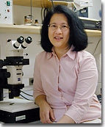
Discovery of small RNAs
Rosalind Lee
The first small RNA:
  In 1993 Rosalind Lee (Victor Ambros lab) was studying a non-
  coding gene in C. elegans, lin-4, that was involved in silencing of another gene, lin-14, at the appropriate time in the
  development of the worm C. elegans.
  Two small transcripts of lin-4 (22nt and 61nt) were found to be complementary to a sequence in the 3' UTR of lin-14.
  Because lin-4 encoded no protein, she deduced that it must be these transcripts that are causing the silencing by RNA-RNA interactions.
  The second small RNA wasn't discovered until 2000!

Slide 4
What are small ncRNAs?
Two flavors of small non-coding RNA:
  micro RNA (miRNA)
  short interfering RNA (siRNA)
Properties of small non-coding RNA:
  Involved in silencing other mRNA transcripts.
  Called “small” because they are usually only about 21-24 nucleotides long.
  Synthesized by first cutting up longer precursor sequences (like the 61nt one that Lee discovered).
  Silence an mRNA by base pairing with some sequence on the mRNA.

Slide 5
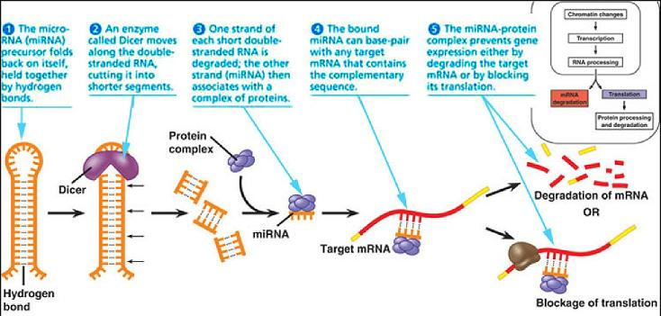
miRNA Pathway Illustration

Slide 6
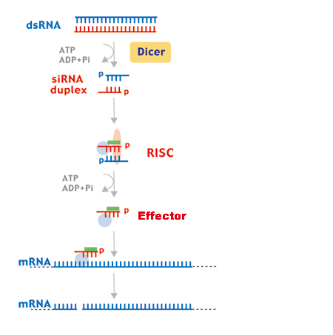
siRNA Pathway Illustration
Complementary base pairing facilitates the mRNA cleavage

Slide 7
Features of miRNAs
Hundreds miRNA genes are already identified in human genome.
Most miRNAs start with a U
The second 7-mer on the 5' end is known as the “seed.”
  When an miRNAs bind to their targets, the seed sequence has perfect or near-perfect alignment to some part of the target sequence.
  Example: UGAGCUUAGCAG...

Slide 8
Features of miRNAs
Many miRNAs are conserved across species:
  For half of known human miRNAs, >18% of all occurrences of one of these miRNA seeds are conserved among human, dog, rat, and mouse.
As a rule, the full sequence of miRNAs is almost never completely complementary to the target sequence.
  Common to see a loop or bulge after the seed when binding.
  Loop/bulge is often a hairpin because of stability.
The site at which miRNAs attack is often in their target's 3' UTR.

Slide 9
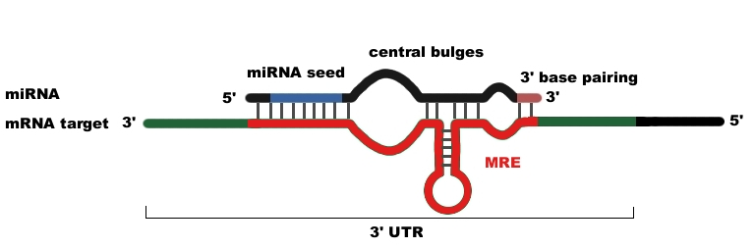
miRNA Binding
Bulges
The MRE is known as the “miRNA recognition element.” This is simply the sequence in the target that an miRNA binds to
Hairpin is more stable
than a simple bulge

Slide 10
Locating miRNA Genes: Experimentally
Locating miRNA experimentally is difficult.
Procedure:
  Find a gene that causes down-regulation of another gene.
  Determine if no protein is encoded.
  Analyze the sequence to determine if it is complementary to its target.

Slide 11
Locating miRNA Genes: Comparative Genomics
Idea: Find the seed binding sites.
  Examine well-conserved 3' UTRs among species to find well-conserved 8-mers (A + seed) that might be an miRNA target sequence.
  Look for a sequence complementary to this 8-mer to identify a potential miRNA seed. Once found, check flanking sequence to see if any stable hairpin structures can form—these are potentially pre-miRNAs.
  To determine the possibility of secondary RNA structure, use RNAfold.

Slide 12
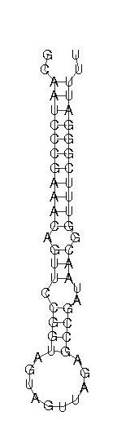
Locating miRNA Genes: Example
Suppose you found a well-conserved 8-mer in 3' UTRs (this could be where an miRNA seed binds in its target).
  Example: AGACTAGG
Look elsewhere in genome for complementary sequence (this could be an miRNA seed).
  Example: TCTGATCC
When TCTGATCC is found, check to see (with RNAfold) if the sequences around it could form hairpin; if so, this could be an miRNA gene.

Slide 13
Finding miRNA Targets: Method 1
Now we know of some miRNAs, but where do they attack?
Goal: Find the targets of a set of miRNAs that are shared between human and mouse.
  Looking for the miRNA recognition element (MRE), not whole mRNA. This is just the part that the miRNA would bind to.
Basic Assumption: Whole miRNA:MRE interactions (binding) are likely to have highly energetically favorable base pairing.
Basic Method: Look through the conserved 3' UTRs—this is where the MREs are most likely to be located—and try to make an alignment that minimizes the binding energy between the miRNA sequence and the UTRs (most favorable).

Slide 14
Finding miRNA Targets: Method 1
Method:
  First look at the binding energies of all 38-mers of the mRNA when binding to the miRNA. Subsequently apply several filters to pick alignments that “look” like miRNA binding.
  Why 38-mers? ~22 nt for the miRNA and the rest to allow for bulges, loops, etc.
Algorithm: Use a modified dynamic programming sequence alignment algorithm to calculate the binding energies for each 38-mer.
Modifications: Scoring and speedup

Slide 15
Finding miRNA Targets: Method 1
Scoring:
  Mismatches and indels allowed.
  Matrix based on RNA-RNA binding energies.
    Use known binding energies of Watson-Crick pairing and wobble (G-U) pairing.
  Binding energy (score) calculated for every two adjacent pairings (unlike the standard alignment algorithm which just takes into account the “score” for one pair at a time).
    Adds dimensions to scoring matrix.
    Adds complexity to recurrence relation.

Slide 16
Finding miRNA targets: Method 2
Goal: Find the set of miRNA targets for miRNAs shared across multiple species
  Trying to identify which genes have 3' UTRs are attacked by miRNAs
Basic Assumptions:
  There is perfect binding to the miRNA seed.
  Any leftover sequence wants to achieve optimal RNA secondary structure.
Basic Method: For each species’ set of 3' UTRs, find sites where there is perfect binding of the miRNA seed and “optimal folding” nearby. Look for agreement among all the species.

Slide 17
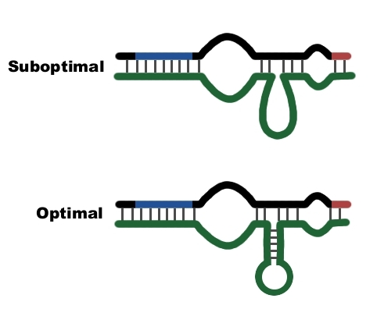
Method 2: Example

Slide 18
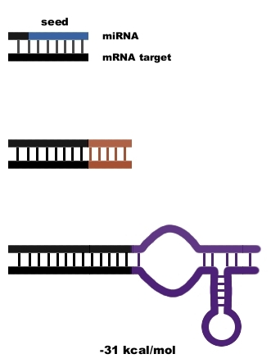
Method 2: Steps
Find a perfect match to the miRNA seed.
Extend the matching region if possible.
Find the optimal folding for the remaining sequences.
Calculate the energy of this interaction.

Slide 19
Method 2: Details
Input: A set of miRNAs conserved among species and a set of 3' UTR sequences for those species.
Method: For each organism:
  Find all occurrences in the UTR sequences that match the miRNA seed exactly.
  Extend this region with perfect or wobble pairings.
  With the remaining sequence of the miRNA, use the program RNAfold to find optimal folding with the next 35 bases of the UTR sequence.
  Calculate a score for this interaction based on the free energy of the interaction given by RNAfold.

Slide 20
Method 2: Details
Method Cont.:
  Sum up the scores of all interactions for each UTR.
  Rank all the organism's gene's UTRs by this score (sum of all interactions in that UTR).
  Repeat the above steps for each organism.
  Create a cutoff score and a cutoff rank for the UTRs.
  Select the set of genes where the orthologous genes across all the sampled species have UTR's that score and rank above this cutoff.

Slide 21
Method 2: Details
Verification:
  Find the number of predicted binding sites per miRNA.
  Compare it to number of binding sites for a randomly generated miRNA.
  The result is much higher.

Slide 22
Analysis of the Two Methods
Method 1:
  Good at identifying very strong, highly complementary miRNA targets.
  Found gene targets with one miRNA binding site, failed to identify genes with multiple weaker binding sites.
Method 2:
  Good at identifying gene targets that have many weaker interactions.
  Fails to identify single-site genes.

Slide 23
Analysis of the Two Methods
Both Methods:
  Speed is an issue.
  Won't find targets that aren't in the 3' UTR of a gene.
We need more species sequenced!
  Conserved sequences are used to discover small RNAs.
  Conserved small RNAs are used to discover targets.
  Confidence in prediction of small RNAs and targets.
  Allows for broader scope with different combinations of species.

Slide 24
Results
Predicted a large portion of already known targets and provided direction for identifying undiscovered targets.
Found that it is more common that genes are regulated by multiple small RNAs.
Found that many small RNAs have multiple targets.

Slide 25
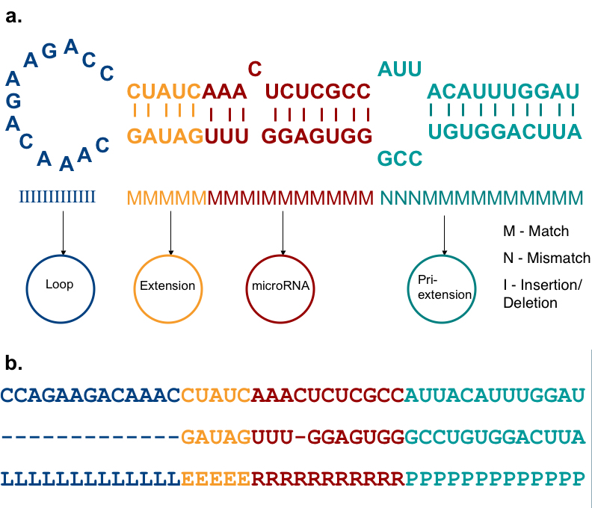
HHMMiR: hierarchical HMMs for miR (Kadri et al 2009)
Notes:
The miRNA hairpin. (a) Template: In our model, the
miRNA precursor has four regions- "Loop" is the bulge and
the loop state outputs indels only; "Extension" is a variable
length region between the miRNA duplex and the loop;
"microRNA" represents the duplex, without 3' overhangs;
"Pri-extension" is the rest of the hairpin. The latter three
states can output matches, mismatches and indels. (The nucleotides
distribution and lengths are not to scale) (b) Labelled
precursor: The precursor shown in (a) is labelled according to
the regions it represents. This is the input format of training
data for HHMMiR. L: Loop; E: Extension; R: MiRNA; P: PrimiRNA.

Slide 26
Notes:
HP: Hairpin length; LP: Loop length; MIR: MiRNA length; EXT:
Distance of miRNA duplex from end of loop; PRI: Length of extension
from end of miRNA to end of precursor. The list of organisms used
for this Table is provided as Supplementary Data.

Slide 27
Notes:
The HHMM state model (based on the microRNA hairpin template). The oval shaped nodes represent the internal
states. The colours correspond to the biological region presented in Figure 2a. The circular solid lined nodes correspond to the
production states. The dotted lined states correspond to the silent end states. M: Match states, N: Mismatch states, I: Indel
states, Lend: Loop end state, Rend: miRNA end state, Pend: pri-extension end state.

Slide 28
Training: 527 human miRNA precursors (positive dataset) & ~500 random hairpins (negative dataset)
Hairpin processing…
Modified Baum/Welch and MLE

Slide 29
Notes:
Data flow for hairpin extraction from the genome. The genome is first folded using windows of 500 nts with 150 nts
overlap between consecutive windows. Hairpins are then extracted from the folded windows using the parameters described
in the text. Hairpins are pre-processed into a suitable format for training/testing using the states shown in Figure 3 (L: Loop; E:
Extension; R: miRNA; P: pri-miRNA extension). For the purpose of testing, the folded sequence is pre-processed into 2 lines of
input representing the 2 stems of the hairpin. An example is given in Figure 2b.

Slide 31
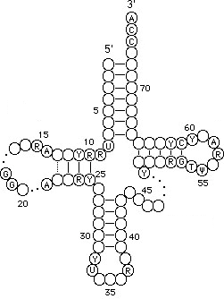
Various types of RNA
messenger RNA (mRNA)
transfer RNA (tRNA)
Ribosomal RNA (rRNA)
small interfering RNA (siRNA)
micro RNA (miRNA)
small nuclear RNA (snRNA)
small nucleolar RNA (snoRNA)

Slide 33
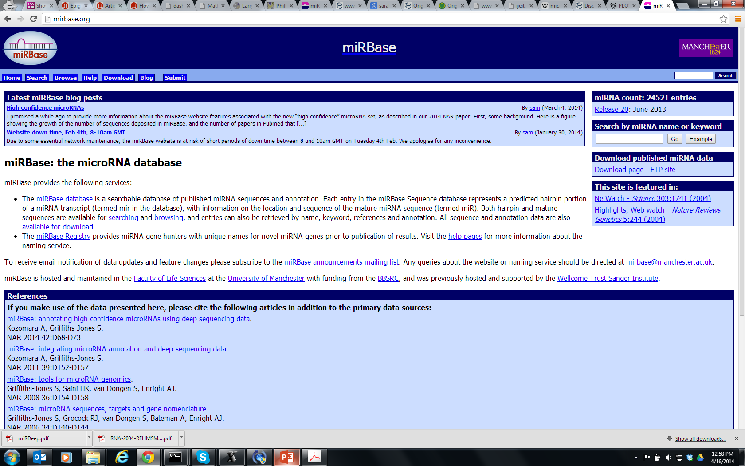
Notes:
Check the miRBase online

Slide 34
Notes:
miRNA biogenesis and target recognition:
Transcriptions of miRNAs are regulated by TFs binding
In the promoter region of the miRNA genes.
Primary transcripts of miRNA (pri-miRNA)
are transcribed mostly from introns of protein
coding genes and are several kilobases long.
Pri-mRNAs are then clopped by Rnase-III enzyme Drosha
Into ~70 base pairs (bp) long hair-pin-looped precursor
miRNAs (pre-miRNAs). These are further cleaved by another
Rnase-III enzyme Dicer to produce a ~20 bp double stranded
Intermediate species. One strand of the duplex has low
Thermodynamic energy that ends up becoming mature
miRNA.

Slide 36
Fabbri, The Cancer Journal, 14:1, 2008
Notes:
CLL chromic lymphocytic leukemia
DLBCL diffuse large b-cell lymphoma
Let-7 : lethal -7
Lin-4: lineage -4

Slide 37
Outline
Introduction
  history
  miRNA biogenesis
Computational Methods
  mature and precursor miRNA prediction
  miRNA target gene prediction

Slide 38
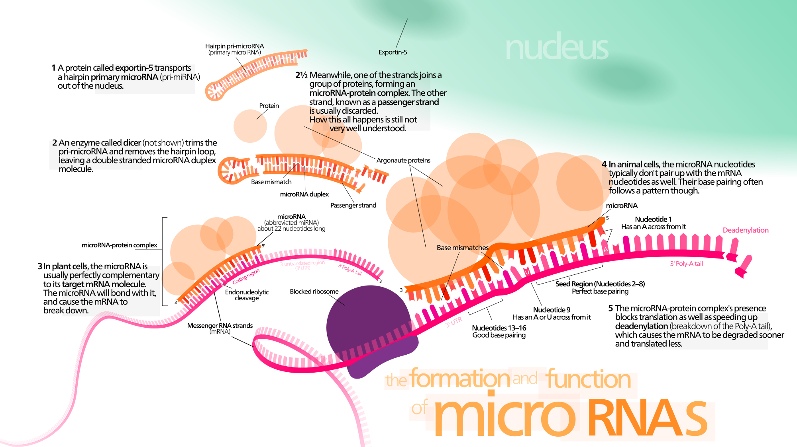
Image: wiki

Slide 39
miRNA transcription and maturation

Slide 40
miRNA transcription and maturation
Nuclear gene to primary-miRNA
Cleavage to miRNA precursor by Drosha Rnase III
Transported to cytoplasm by Ran-GTP/Exportin 5
Loop cut by DICE
*duplex is short-lived and cut by helicase to single strand RNA forming RNA-induced silencing complex (RISC)/maturation
Kadri et al 2009

Slide 41
Enabling machinery

Slide 44
3 examples of miRNAs
Size: 60-80 bp pre-miRNA
2—24 nt mature miRNA
Role: translation regulation, cancer diagnosis
Location: intergenic or intronic

Slide 45
miRNA function

Slide 46
Challenging the dogma
Mattick, BioEssays, 25:930-939, 2003.
Notes:
Primary xscripts may be (alternatively) spliced and further
Processed to produce a range of protein isoforms
And/or ncRNAs of various types, which are involved
In complex networks of structural, functional
And regulatory interactions.

Slide 47
How to find microRNA genes?
Given a miRNA gene, how to find its targets?
Target-driven approach:
  Xie et al (2005) analyzed conserved motifs overrepresented in 3’ UTR’s of genes
  Motifs found to complement the sequences of known miRNAs
  120 new miRNAs predicted in humans

Slide 48
How to find miRNA gene?
Biological approach
  Small RNA-cloning to identify new small RNAs
Most miRNA genes are tissue specific (picture)
miR-124a is restricted to the brain and spinal cord in fish and mouse or to the ventral nerve cord in fly
miR-1 restricted to the muscles and the heart in the mouse

Slide 49
wiki

Slide 50
Principles of microRNA-mRNA interactions
Filipowicz et al Nature Reviews Genetics 2008

Slide 51
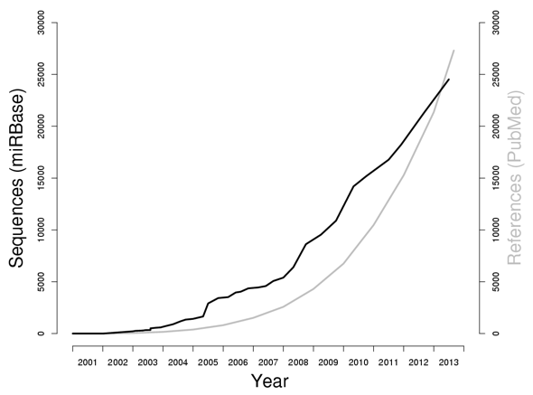
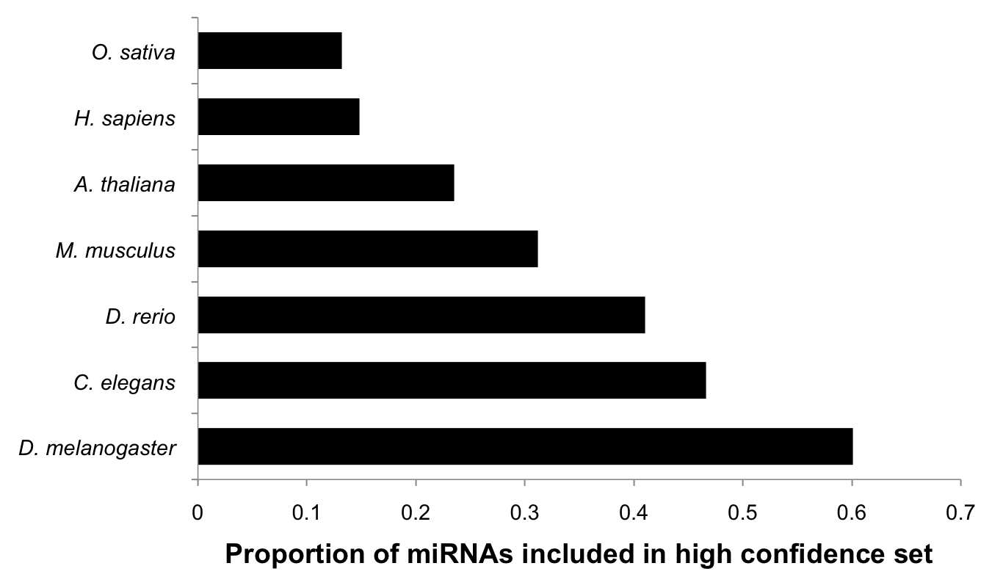
High-quality miRNAs story
miRBase: ~25K entries; issues with quality

Slide 52
Need for computational methods
Experimental identification of miRNAs is slow because some miRNAs are difficult to isolate by cloning:
  Low expressions
  Instability
  Specific to tissue
  Trouble with cloning procedures
=> computational methods can aid experiments

Slide 53
20- to 24-nt RNAs derived from endogenous transcripts that form local hairpin structures
Processing of miRNA leads to single (sometimes 2) mature miRNA molecules
Mature and pre-miRNA evolutionary conserved

Slide 54
C. elegans miRNA genes
Scan for hairpin structures (RNAfold: free energy < -25 kcal/mole) within sequences that were conserved between C. elegans and C. briggsae (WU-BLAST cut-off E < 1.8)
36K pairs of hairpins identified capturing 50/53 miRNAs previously reported to be conserved between the two species
50 miRNAs used as training set for the program MiRscan
Run miRscan to evaluate 36K hairpins
Notes:
WU-Blast Washington university – local alignment tools
Now sold commercially!!

Slide 55
MiRscan evaluates features of a hairpin in a 21-nt window
Total score = sum of individual feature scores
Scores are relative: frequency of the given value in the training set divided by the overall frequency
mir-232 prediction circled in purple
13.9 total score
Lim et al, Genes and Development, 2003

Slide 56
Blue: score distribution for 36K sequences
Red: training set of ~50 sequences
Yellow and purple: verified by cloning and other evidence
Green arrow: 13.9

Slide 57
Drosophila miRNA genes
Two drosophila species: D. melanogaster and D. pseudoobscura
3-part computational pipeline: miRseeker
Test on 24 known drosophila miRNAs

Slide 58
Drosophila mRNA genes

Slide 59
Conserved stem-loop properties - 1

Slide 60
Conserved stem-loop properties -2

Slide 62
Results

Slide 63
Detection by homology
Entire set of human and mouse pre- and mature miRNA from the miRNA registry was submitted to the BLAT search engine to compare against both the human and mouse genomes
Sequences with high % identity were examined for hairpin structure using MFOLD and 16-nt stretch base pairing

Slide 64
Found 60 new putative miRNAs (15: human and 45: mouse)
Mature miRNAs were either perfectly conserved or differed by 1 nt between human and mouse
Antisense miR: portion of the hairpin precursor that is base-paired with miR, as predicted by MFOLD

Slide 65
Drawbacks
Pipeline structure: use cut-offs and filtering/eliminating sequences as pipeline proceeds
Sequence alignment alone used to infer conservation (limited because areas of miRNA precursors are often not conserved)
Limited to closely related species (e.g., C. elegans and C. briggsae)

Slide 66
Profile-based approach
593 sequences form miRNA registry (513 animal and 50 plant)
CLUSTAL generated 18 most prominent miRNA clusters
Each cluster used to deduce consensus secondary structure using ALIFOLD program
Feed the training set to ERPIN: profile scan algorithm that reads sequence alignment and secondary structure
Scanned 14.3 Gb database of 20 genomes

Slide 67
Results: 270/553 top scoring ERPIN candidates previously unidentified
Takes into account secondary structure conservation profiles
But only applicable to miRNA families with sufficient large known samples
Legendre et al Bioinformatics, 2005

Slide 72
Use principles of microRNA-mRNA interactions to predict targets
Filipowicz et al Nature Reviews Genetics 2008

Slide 75
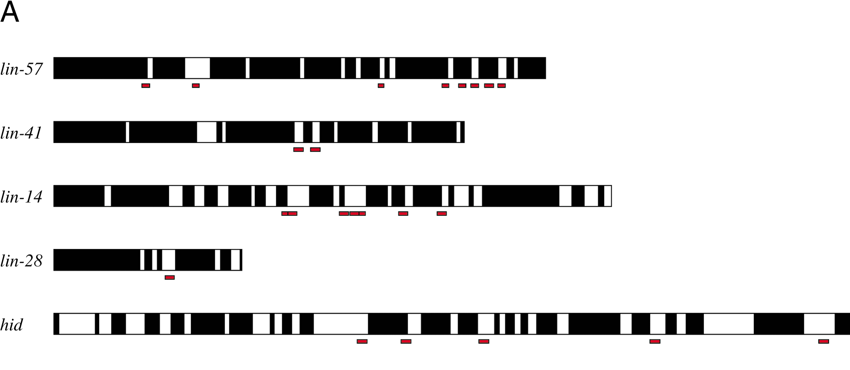
miRNA targets are often conserved across species (Stark et al PLoS Biology, 2003)
For lins, compare C. elegans and c. briggsae
For hid, compare D. melanogaster and D. pseudoobscura

Slide 76
Other properties
Better complementarity to 5’ ends of miRNAs
Clusters of microRNA targets
  Extensive co-occurrence of sites for different miRNAs in target 3’ UTR
Presence and absence of target sites correlates with gene function

Slide 79
