Slide 1
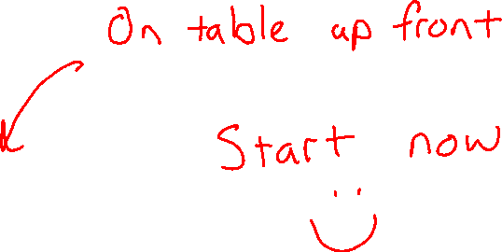
Candy Grab Game
As you walk in:
Grab a pack of game pieces (candy)
Form groups of 2 (or 3 with an observer)
Play the game!
  11 pieces on the table
  Take turns taking either 1 or 2 pieces
  Person that takes the last piece wins!
Think about how you might implement an Agent to play this in code:
class Agent
function getAction(state)
return action

Slide 2

AI: Representation and Problem Solving
Introduction
Instructors: Fei Fang & Pat Virtue
Slide credits: CMU AI & http://ai.berkeley.edu

Slide 3




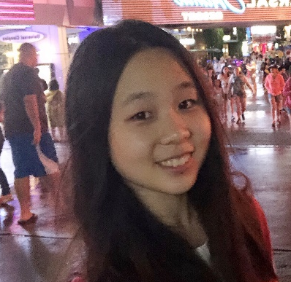





Course Staff
Instructors
Teaching Assistants
Fei Fang
Angela Yang
Claire Wang (Head TA)
George Brown
Michelle Ma
Pat Virtue
Sean Pereira
Chakara (Tian) Owarang
Tina Wu
Vicky Zeng

Slide 4



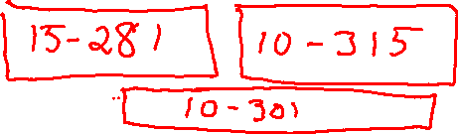
Course Information
Website: https://www.cs.cmu.edu/~15281
Canvas: canvas.cmu.edu
Gradescope: gradescope.com
Communication: piazza.com
E-mail: feifang@cmu.edu
pvirtue@cmu.edu
Prerequisites/Corequisites
Course Scope

Slide 5
Announcements
Recitation starting this Friday
  Recommended. Materials are fair game for exams
  Choosing sections
Assignments:
HW1 (online)
    Released at the end of lecture
    Due Tue 9/3, 10 pm
P0: Python & Autograder Tutorial
    Required, but worth zero points
    Released at the end of lecture
    Due Thu 9/5, 10 pm

Slide 6
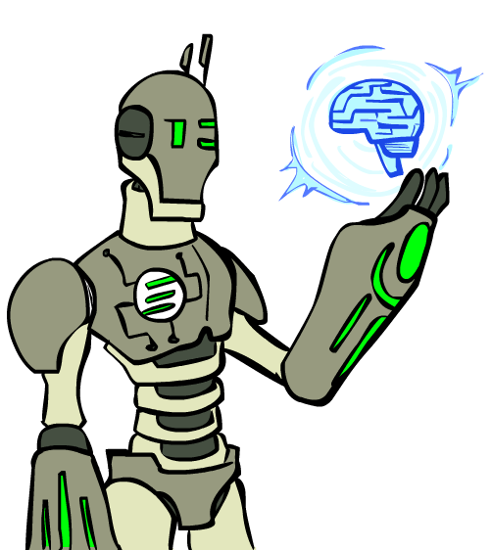
Today
What is artificial intelligence?
A brief history of AI
AI applications and techniques

Slide 7
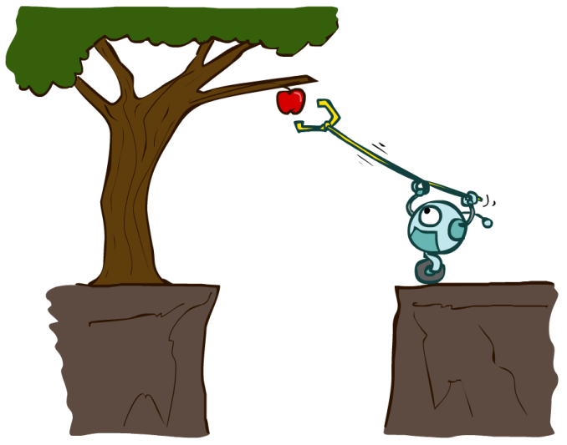
Designing Agents
An agent is an entity that perceives and acts.
Characteristics of the percepts, environment, and action space dictate techniques for selecting actions
This course is about:
  General AI techniques for a variety of problem types
  Learning to recognize when and how a new problem can be solved with an existing technique
Sensors
Agent
Percepts
Environment
?
Actuators
Actions

Slide 8
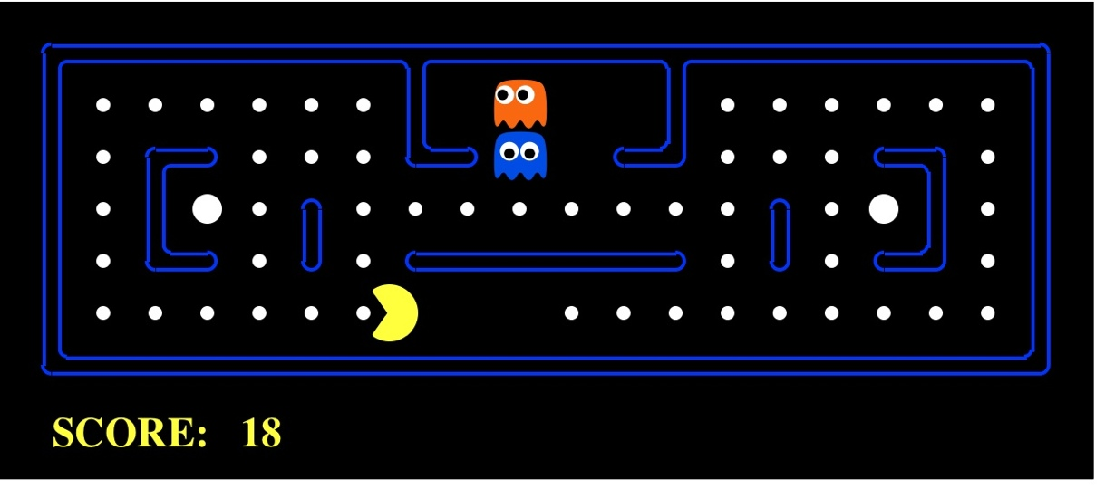
Pac-Man as an Agent
Agent
Environment
Sensors
Percepts
?
Actuators
Actions
Pac-Man is a registered trademark of Namco-Bandai Games, used here for educational purposes

Slide 9
Candy Grab Agent
class Agent
function getAction(state)
return action

Slide 10
Candy Grab Agent
Agent 001 – Always choose 1
function getAction( numPiecesAvailable )
return 1

Slide 11
Candy Grab Agent
Agent 002 – Always choose 2
function getAction( numPiecesAvailable )
return 2

Slide 12
Candy Grab Agent
Agent 004 – Choose the opposite of opponent
function getAction( numPiecesAvailable )
return ?

Slide 13
Candy Grab Agent
Agent 007 – Whatever you think is best
function getAction( numPiecesAvailable )
return ?

Slide 14
Candy Grab Agent
Agent 007 – Whatever you think is best
function getAction( numPiecesAvailable )
if numPiecesAvailable % 3 == 2
return 2
else
return 1

Slide 15
Games – Three “Intelligent” Agents
Piazza Poll question
Which agent code is the most “intelligent”?

Slide 16

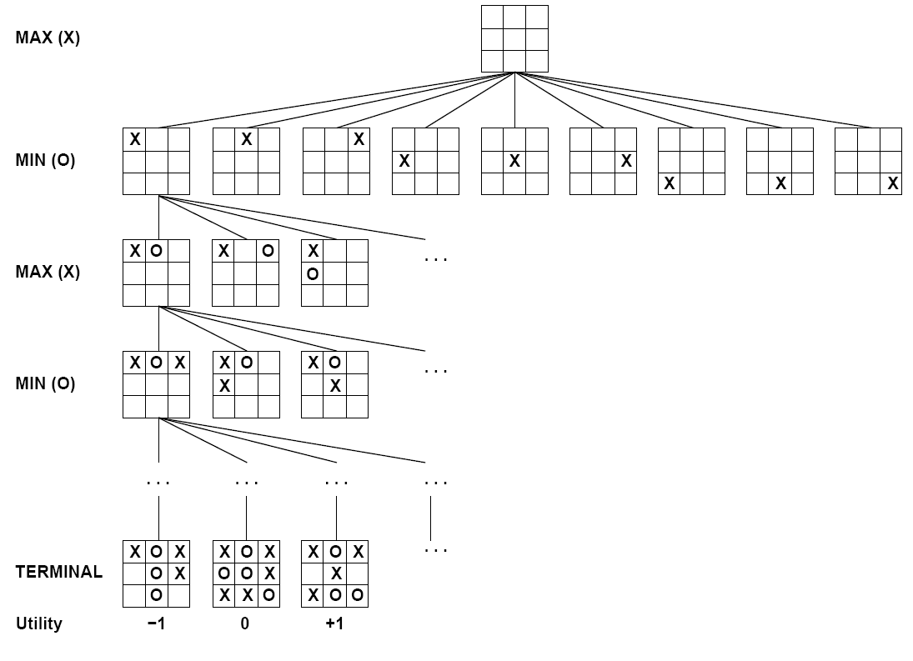

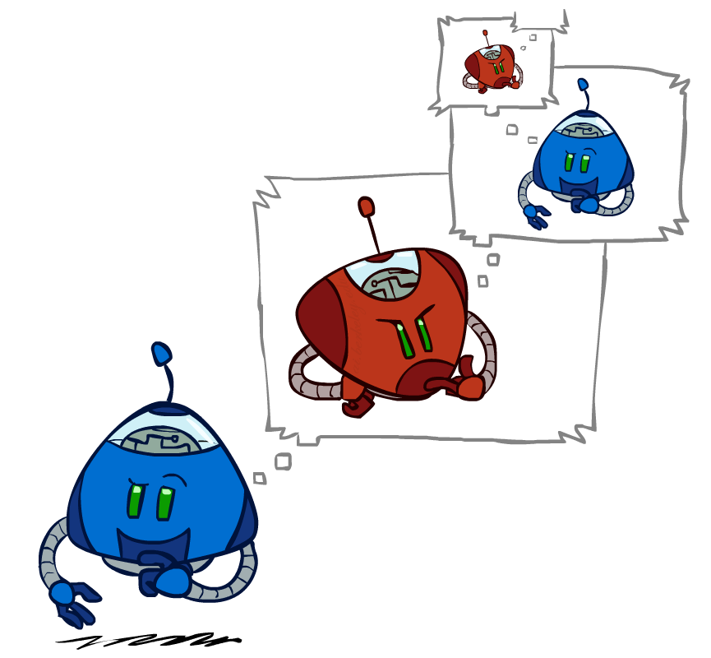
Games – Three “Intelligent” Agents
A: Search / Recursion

Slide 17
Games – Three “Intelligent” Agents
B: Encode the pattern
10's value:Win
9's value:Lose
8's value:Win
7's value:Win
6's value:Lose
5's value:Win
4's value:Win
3's value:Lose
2's value:Win
1's value:Win
0's value:Lose
function getAction( numPiecesAvailable )
if numPiecesAvailable % 3 == 2
return 2
else
return 1

Slide 18
Games – Three “Intelligent” Agents
C: Record statistics of winning positions
Pieces Available | Take 1 | Take 2
2
3
4
5
6
7
Pieces Available | Take 1 | Take 2
2 |  | 100%
3
4 | 100%
5
6
7 |  | 100%
Pieces Available | Take 1 | Take 2
2 |  | 100%
3 | 0%
4 | 100%
5
6
7 |  | 50%
Pieces Available | Take 1 | Take 2
2 | 0% | 100%
3 | 2% | 0%
4 | 75% | 2%
5 | 4% | 68%
6 | 5% | 6%
7 | 60% | 5%

Slide 19
Piazza Poll question
Games – Three “Intelligent” Agents
Which agent code is the most “intelligent”?
Search / Recursion
Encode multiple of 3 pattern
Keep stats on winning positions
Which agent code is the most “intelligent”?

Slide 20
Games – Three “Intelligent” Agents
C: Record statistics of winning positions
Pieces Available | Take 1 | Take 2
2
3
4
5
6
7
Pieces Available | Take 1 | Take 2
2 |  | 100%
3
4 | 100%
5
6
7 |  | 100%
Pieces Available | Take 1 | Take 2
2 |  | 100%
3 | 0%
4 | 100%
5
6
7 |  | 50%
Pieces Available | Take 1 | Take 2
2 | 0% | 100%
3 | 2% | 0%
4 | 75% | 2%
5 | 4% | 68%
6 | 5% | 6%
7 | 60% | 5%

Slide 21
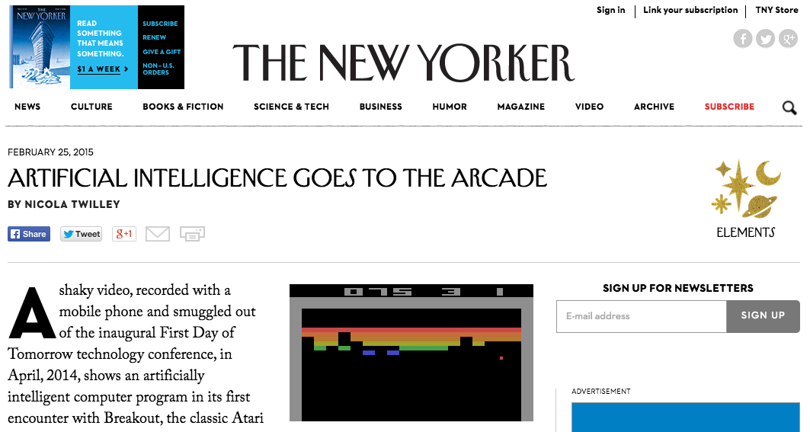
AI in the News
https://www.youtube.com/watch?v=EfGD2qveGdQ

Slide 22
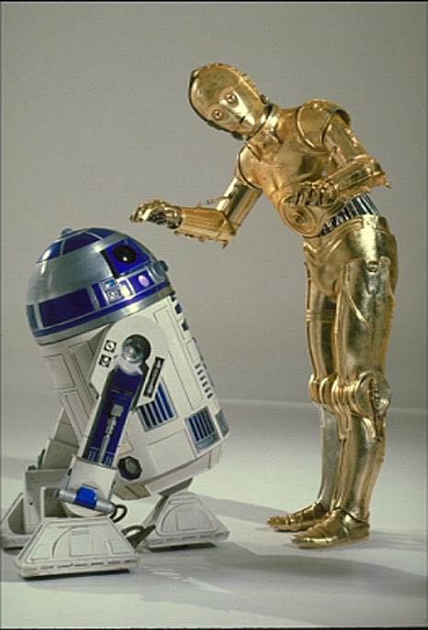
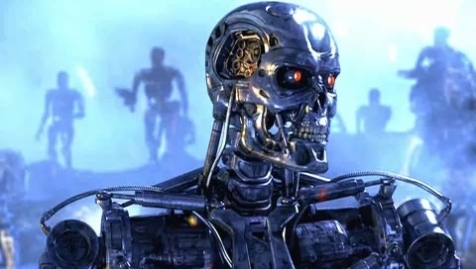
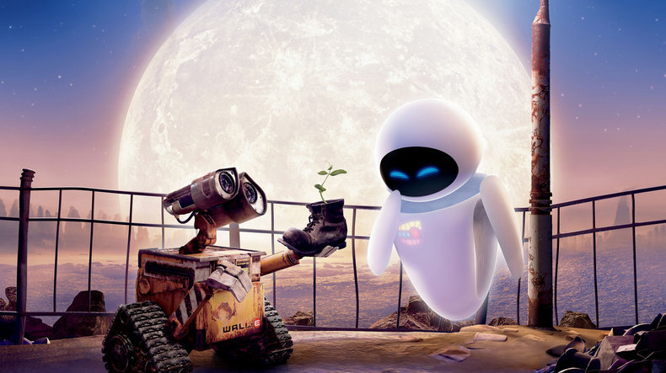
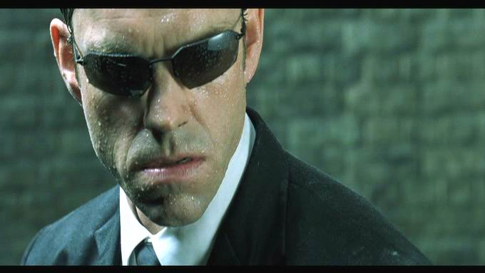
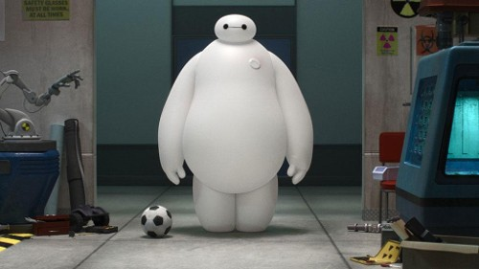
Sci-Fi AI?
Notes:
Who are these? C3PO, what does he do? Essentially google translate, (but with anxiety!)
Little guy? R2D2 – what does he do, yeah, not so sure
Things got darker: machines come back from the future – to kill us!
90’s : software is scary
Basic fear about what technology might do ?
What if we can’t even tell technology apart from ourselves?
OR maybe it’ll look really different and snarky
Some exceptions like wall-E, positive view of technology (but maybe not of us humans!)
But mostly a worry
[not very worried myself, at least at present]

Slide 23
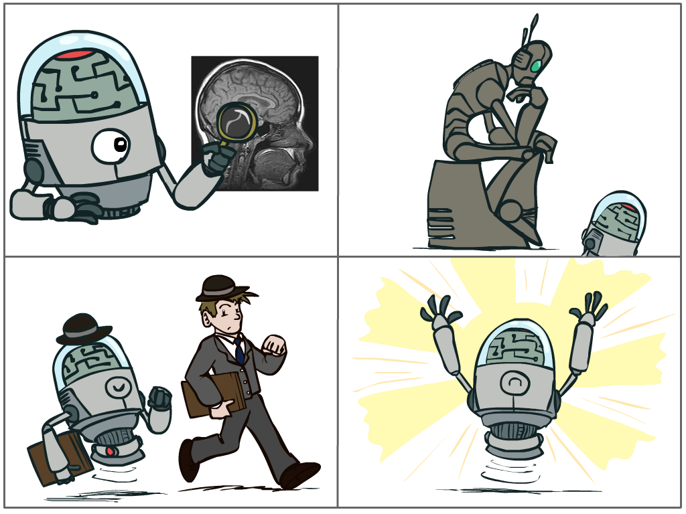
Piazza Poll: What is AI?
The science of making machines that:
A: Think like people
C: Think rationally
B: Act like people
D: Act rationally
Notes:
Top left: Think like people --- cognitive science, neuroscience
Bottom left: act like people --- actually very early definition, dating back to Alan Turing --- Turing test; problem to do really well you start focusing on things like don’t answer too quickly what the square root of 1412 is, don’t spell too well, and make sure you have a favorite movie etc. So it wasn’t really leading us to build intelligence
Think rationally – long tradition dating back to Aristotle --- but not a winner, because difficult to encode how to think, and in the end it’s not about how you think, it’s about how you end up acting

Slide 24

Turing Test
In 1950, Turing defined a test of whether a machine could “think”
“A human judge engages in a natural language conversation with one human and one machine, each of which tries to appear human. If judge can’t tell, machine passes the Turing test”
en.wikipedia.org/wiki/Turing_test

Slide 25
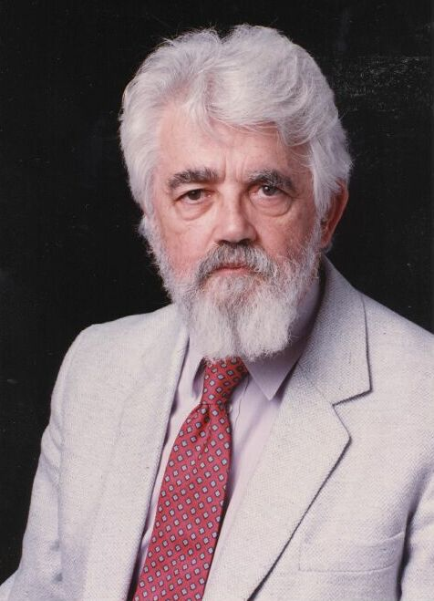
AI Definition by John McCarthy
What is artificial intelligence
  It is the science and engineering of making intelligent machines, especially intelligent computer programs
What is intelligence
  Intelligence is the computational part of the ability to achieve goals in the world
http://www-formal.stanford.edu/jmc/whatisai/whatisai.html

Slide 26
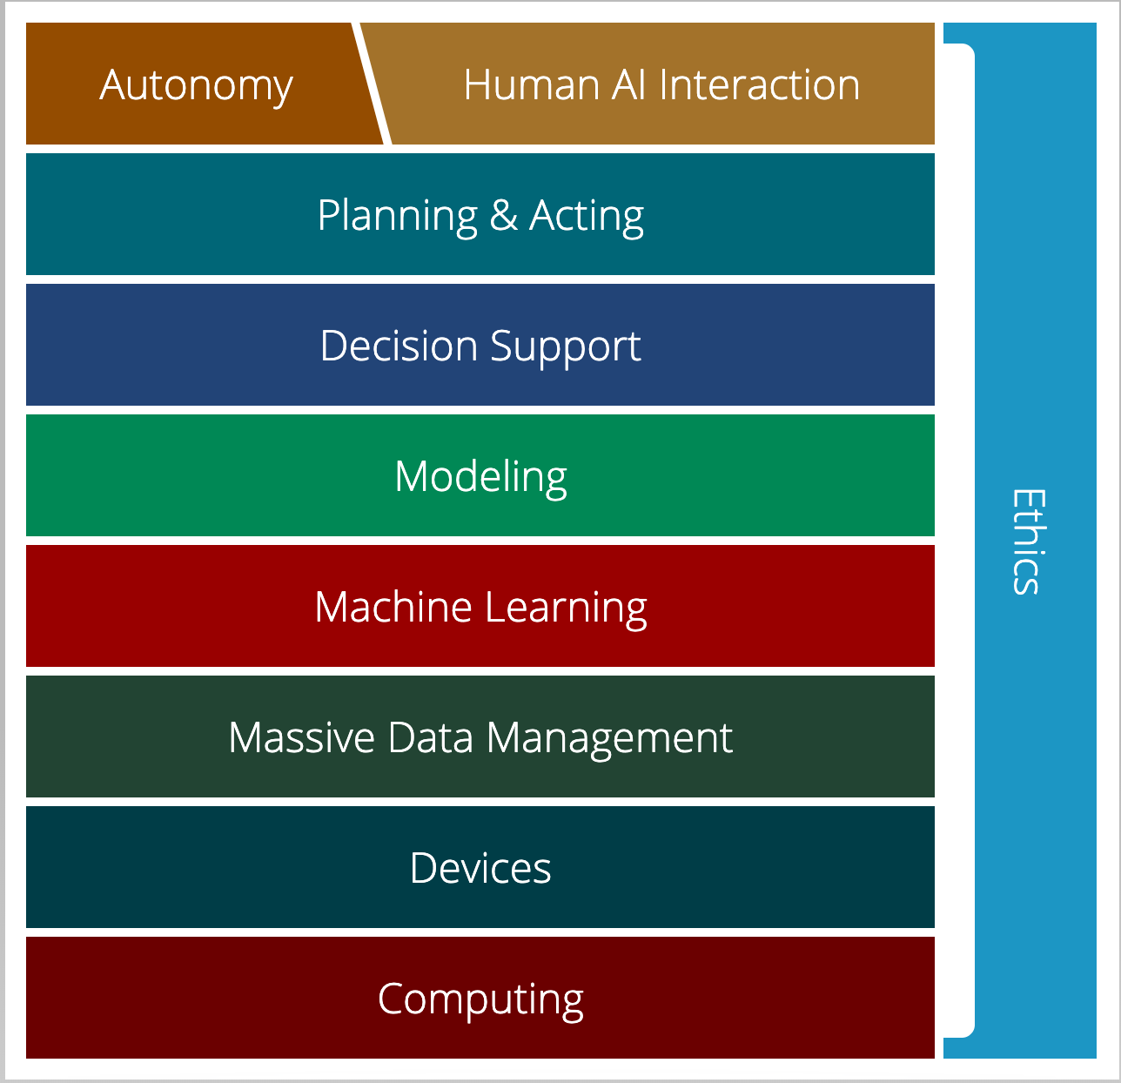
AI Stack for CMU AI
“AI must understand the human needs and it must make smart design decisions based on that understanding”
AI Stack
https://ai.cs.cmu.edu/about
Notes:
Proposed by Andrew Moore, CMU is using AI Stack to illustrate what they consider as AI. AI must understand the human needs and it must make smart design decisions based on that understanding. Despite the simple definition, though, AI isn't just one thing. It's a giant thing, built from technology blocks we call the AI Stack. At Carnegie Mellon, we view it as a toolbox — each block houses a set of technologies that scientists and researchers can reach for as they work on new initiatives. Expertise in all areas? Not required. Instead, we believe you can focus on one area and draw on other parts of the stack for help. Each block depends on the other for support. And AI endeavors that ignore parts of the stack won't succeed.

Slide 27
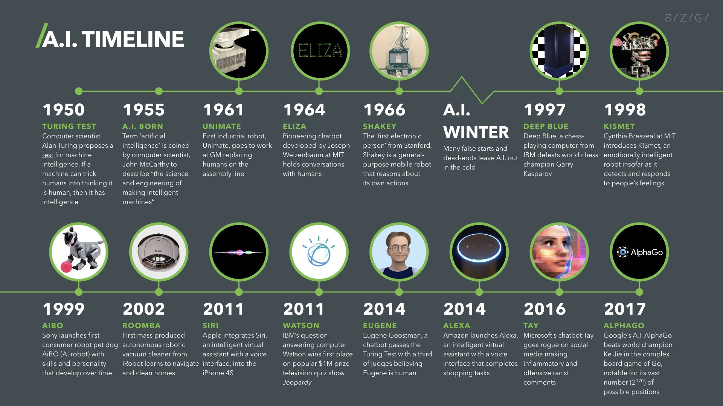
https://digitalwellbeing.org/artificial-intelligence-timeline-infographic-from-eliza-to-tay-and-beyond/

Slide 28
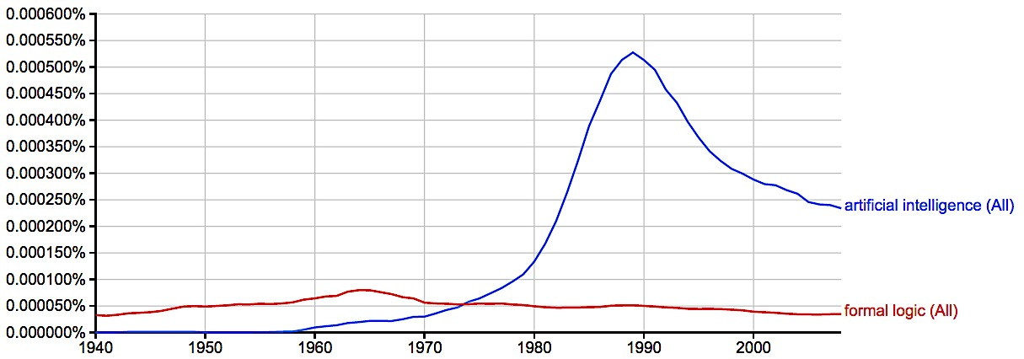
A Brief History of AI
Knowledge Based
Systems
1970-1990
AI
Excitement!
1950-1970
artificial intelligence
formal logic
https://books.google.com/ngrams

Slide 29
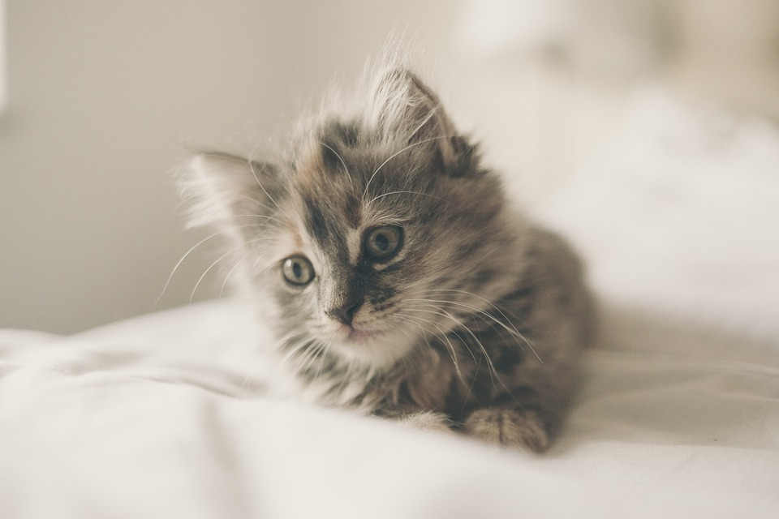
AI Winter
Russell & Norvig 2003, p. 24: "AI industry boomed from a few million dollars in 1980 to billions of dollars in 1988. Soon after that came a period called the 'AI Winter'".
Expert systems became difficult to update, they could not learn, they were "brittle" (i.e., make grotesque mistakes when given unusual inputs)
Over optimism leads to disappointment
Cat
  Has ears
  Has Fur
  Has four legs

Slide 30
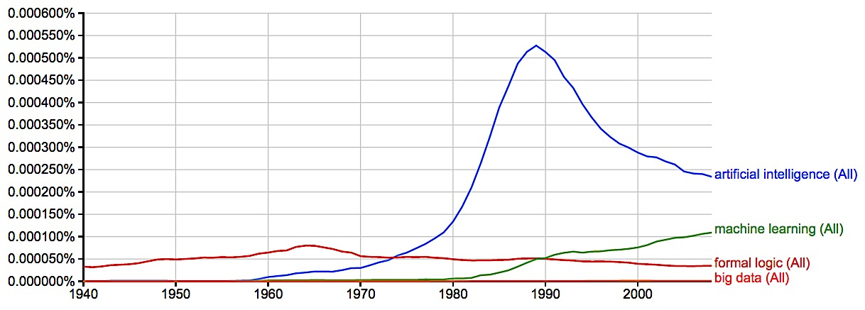
A Brief History of AI
Knowledge Based
Systems
1970-1990
AI
Excitement!
1950-1970
Statistical Approaches
1990--
artificial intelligence
machine learning
formal logic
big data
2008
https://books.google.com/ngrams

Slide 31
Evolution of AI Research
1980s

Slide 32
Evolution of AI Research
1990s

Slide 33
Evolution of AI Research
2000s

Slide 34
Evolution of AI Research
2010s

Slide 35
Artificial Intelligence vs Machine Learning?
Artificial Intelligence
Focus of this course
Machine Learning
Deep Learning

Slide 36
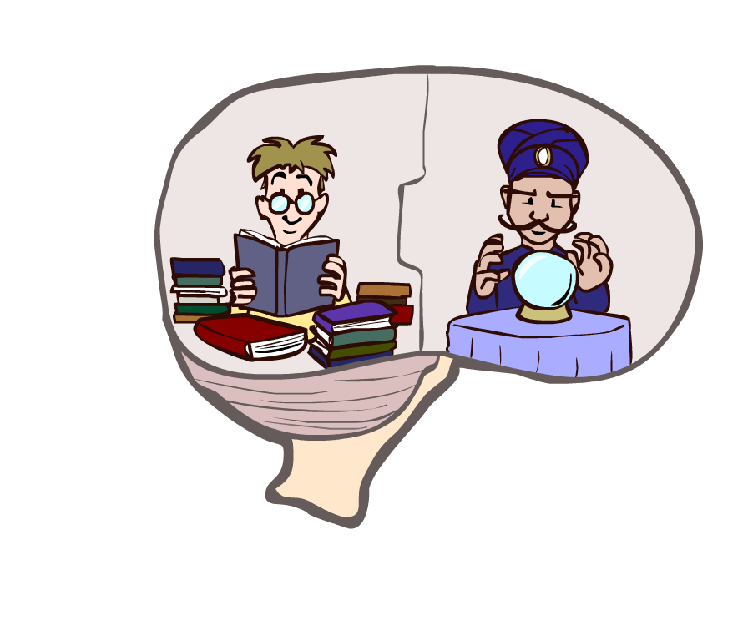
Course Topics
Part I: Making Decisions
  Fast search / planning
  Constraint satisfaction and optimization
  Adversarial and uncertain search
  Logic
Part II: Reasoning under Uncertainty
  Reinforcement learning
  Bayes’ nets
  Game theory
  Human compatible AI
Throughout
  Representation and reasoning

Slide 37
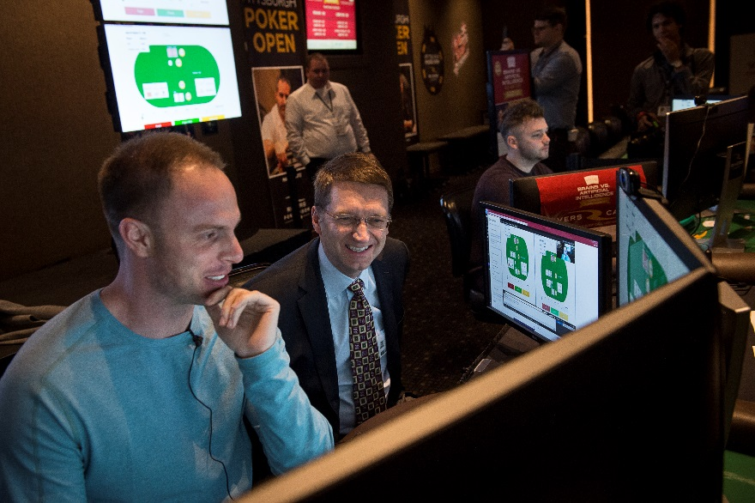



Applications
Language, vision, robotics, games, …
Super-human performance in various tasks
AI for Social Good
Libratus (Poker, January 2017)

Slide 38
How Machine Learning Works
While it is NOT the focus of this course, a brief introduction may help

Slide 39






Neural Network
$$w_{211}$$
$$w_{111}$$
#bedrooms
$$w_{311}$$
#bathrooms
House price
sqft
$$w_{341}$$
$$w_{134}$$
$$w_{244}$$

Slide 40
Gradient Descent
https://saugatbhattarai.com.np/what-is-gradient-descent-in-machine-learning/

Slide 41
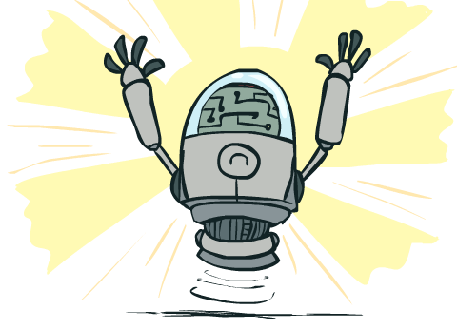
What Can AI Do?
Quiz: Which of the following can be done at present?
Play a decent game of table tennis?
Play a decent game of Jeopardy?
Drive safely along a curving mountain road?
Drive safely across Pittsburgh?
Buy a week's worth of groceries on the web?
Buy a week's worth of groceries at Giant Eagle?
Discover and prove a new mathematical theorem?
Converse successfully with another person for an hour?
Perform a surgical operation?
Put away the dishes and fold the laundry?
Translate spoken Chinese into spoken English in real time?
Write an intentionally funny story?

