Slide 1
Anticipatory information & planning agent
ANTIPA
Jean Oh
Felipe Meneguzzi
Katia Sycara
Carnegie Mellon University
Timoyhy Norman
Univ. of aberdeen

Slide 2
Outline
Motivation
Technical challenges
Related work
ANTIPA architecture: integrated AI
Recognizing user plan to determine relevant context
Reasoning to decide what to do
Planning to decide how to do
Scheduling to decide when to do with what
Learning to adapt to changing environment
Applications
Current and future work

Slide 3
Motivation
Planning in dynamic environment involves:
Information
Time constraints
Unexpected changes
Shared goals
Inter-dependent activities
Optimal plan
Policy violation
Cognitive overload
Coalition partners
Software agents to assist cognitively overloaded users

Slide 4
Agent is expected to provide:
Information management:
Finds relevant information
Disseminates information
Reasoning support:
Checks policies to see if user plan follows the guidelines
Verifies resource assignment if there are any constraint violations
Negotiation support:
Identifies a set of options that work for everyone
Responds on behalf of user
And more.

Slide 5
Reactive vs. Proactive assistants
Reactive assistants: act upon specific cues
Let me know if you need help.
Wait until cues
Proactive assistants: act upon prognosis
Thought this would be helpful.
Act early to prevent delays
Cost-based autonomy: trades off costs for rewards

Slide 6
Related work
Plan recognition
Plan library survey [Armentano & Amandi 2007]
Hidden Markov Model [Sukthankar 2007, Bui et al. 2002]
Inverse reinforcement learning [Ziebart et al. 2008, Ng & Russel 2001, Abbeel & Ng 2004]
Decision-theoretic approaches [Baker et al. 2009, Ramirez & Geffner 2009, Fern et al. 2007, Boger et al. 2005]
Assistant agents
Reactive information agents [Knoblock et al. 2001]
Speculative plan execution [Barish & Knoblock 2008]
Visitor hosting assistant [Chalupsky et al. 2002]
Email management for conference organizer [Freed et al. 2008]
Intelligent task management [Yorke-Smith et al. 2009]
ANTIPA uniquely:
identifies new goals; and
plans to achieve the goals
persistently.

Slide 7

General idea of ANTIPA
General agent architecture
Needs
Unsatisfied
Needs
Satisfied
Initial state
Goal state
planning
Actions

Slide 8
ANTIPA
Plan to get information
Information needed
Information retrieved
Policy violation
Plan to resolve violation
Violation resolved
Predicted initial states
Desired goal states
i
i
Plan recognition
Reasoning
Planning, scheduling & execution
Predict user plan by observing user and her environment
Evaluate predicted user plan to identify unmet needs
Find a satisfying state for each need
Proactively take actions to satisfy the identified needs

Slide 9
ANTIPA
Plan to get information
Information needed
Information retrieved
Policy violation
Plan to resolve violation
Violation resolved
Predicted initial states
Desired goal states
i
i
Plan recognition
Reasoning
Planning, scheduling & execution
Predict user plan by observing user and her environment
Evaluate predicted user plan to identify unmet needs
Find a satisfying state for each need
Proactively take actions to satisfy the identified needs

Slide 10
Decision theoretic user model
plan recognition
Assumption: users will try to maximize long-term expected reward.
Effect of taking an action is a stochastic transition to a new state
.1
High reward
Terminate
.9
Current state
Negotiate
.8
Low reward
Cooperate
.2

Slide 11
Markov Decision Process (MDP)
plan recognition
Formalism representing decision making process in stochastic environment.
<S, A, r, T, γ>
S: states
A: actions
T: state transition: state × action → state’
r: reward: state, action, state’ → reward
γ: discount factor (current value of future reward)
Markov assumption: state transition depends only on the current state and action (don’t care how you got here).
Solution: policy mapping: state → action, such that discounted long-term expected reward is maximized
Bellman equation: V(s) = max _{a} T(s’|s,a) [r(s,a,s’) + γ V(s’)]
Dynamic programming algorithms exist to solve exact solutions albeit still suffering from the curse of dimensionality

Slide 12
Predicting user plan
plan recognition
Model user’s planning problem as an MDP
Solve MDP user model → stochastic policy π
Policy maps: state → probability distribution over actions
From the current state, sample highly likely future plans according to policy π
Generate a plan-tree of predicted user actions
Prune unlikely plans by applying a threshold

Slide 13
Generating plan tree of predicted actions
Example: Emergency response scenario
.4
Area map (required),
Live traffic (optional)
Toxic gas attack
identified
Briefing to police unit
i
Dispatch ambulance:0.05
Call Police: 0.25
Report to Police unit
Medical history documents (required),
Picture of wounds (optional)
Briefing to paramedic unit
Determine
symptoms: 0.7
.6
Assessing injuries
Briefing to medical unit
i
Call hospital
Report: to
medical unit
Report: to
paramedic unit
Locations of wounded
i
Dispatch ambulance
Area map (required),
Live traffic (optional)
Priority: 0.15
Deadline: time step 1
Medical history documents (required),
Picture of wounds (optional)
Priority: 0.707
Deadline: time step 2
0.05
root
i
0.25
Call police
0.25
Report to
police unit
0.7
i
Determine symptoms
0.7
Call hospital
0.7
Report to
medical unit
Time step 0 1 2 3

Slide 14
ANTIPA
Plan to get information
Information needed
Information retrieved
Policy violation
Plan to resolve violation
Violation resolved
Predicted initial states
Desired goal states
i
i
Plan recognition
Reasoning
Planning, scheduling & execution
Predict user plan by observing user and her environment
Evaluate predicted user plan to identify unmet needs
Find a satisfying state for each need
Proactively take actions to satisfy the identified needs

Slide 15
Identify user needs from predicted plan
Reasoning
Information needs
Information gathering plan.
Scheduling problem: determine when to retrieve data, and which information source to use.
Policy management
Normative reasoning to detect potential violations
Planning problem: determine a sequence of actions to resolve violations.

Slide 16
Optimize information gathering
Reasoning
Given information-gathering-task, determine:
information source
the time of retrieval that satisfy deadline constraints and resource budget (not to interfere with user’s usage)
Information source properties:
Delay
Availability
Data accuracy
Capabilities

Slide 17
Scheduling information gathering tasks
Example: Emergency response scenario
Area map
Priority: high
Deadline: 1
Live traffic
Priority: low
Deadline: 1
Medical history
Priority: highest
Deadline: 2
root
Picture of wounds
Priority: low
Deadline: 2
Live traffic
Priority: low
Deadline: 1
Area map
Priority: high
Deadline: 1
Maximum bandwidth agent can use
Picture of wounds
Priority: low
Deadline: 2
Network bandwidth
Medical history
Priority: highest
Deadline: 2
Time step
1
2

Slide 18
Normative reasoning to identify user needs
Reasoning
Norm rules define prohibitions or obligations
e.g. You need an armed escort to enter dangerous region R.
Evaluate predicted plan using normative reasoning
Identify potential policy violations
Finding norm-compliant states for each violated state
Generates a set of planning problems, e.g.,
Norm-violating state [area=R, escort=null],
Compliant state [area=R, escort=granted],
Contrary-to-duty obligation [area=R, escort=user is warned]

Slide 19
ANTIPA
Plan to get information
Information needed
Information retrieved
Policy violation
Plan to resolve violation
Violation resolved
Predicted initial states
Desired goal states
i
i
Planning, scheduling & execution
Plan recognition
Reasoning
Predict user plan by observing user and her environment
Evaluate predicted user plan to identify unmet needs
Find a satisfying state for each need
Proactively take actions to satisfy the identified needs

Slide 20
Example: Agent’s plan in MDP
Planning
init
(0)
Alert
alerted
(+4)
.9
.9
Send request
Alert
requested
(0)
.9
.9
Receive reply
Alert
.8
.1
granted
(+5)
Send request
denied
(0)
.8
A: Alert-the-user, S: send-request, R: receive-reply

Slide 21
Interleaved planning & execution
Planning
Norm reasoner generates a new planning problem for the agent
Plan recognizer
Norm Reasoner
Initial state
Goal states
Planner
(MDP solver)
Solves the planning problem
Policy:
state→ action
Variable
Observer
Notify()
Plan Executor
Wait()
Current state
Execute optimal action in current state
Executable
Action

Slide 22
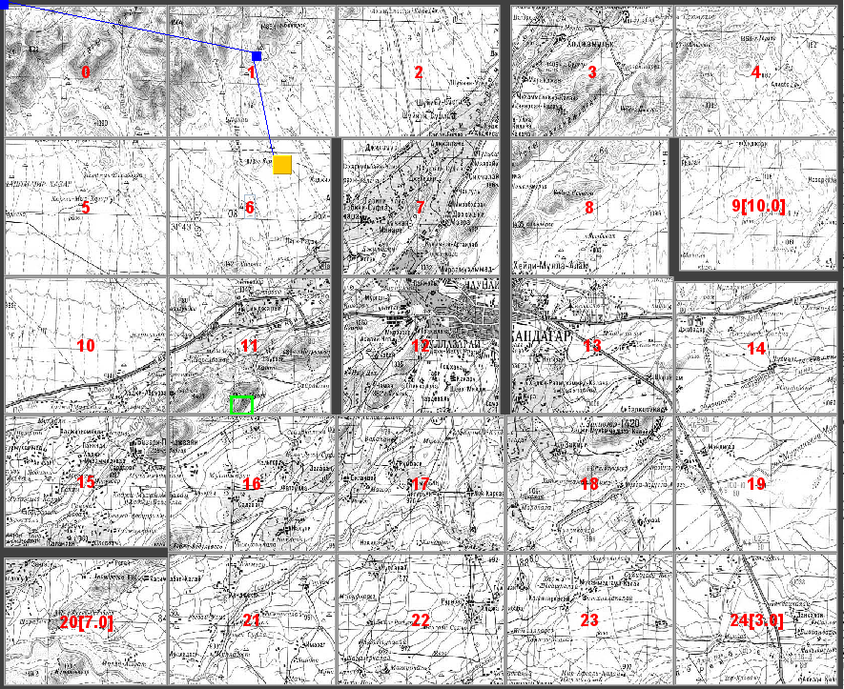
Predicting information needs & policy violations
Example: Peacekeeping scenario
User’s real plan
Predicted user plan
Brings information about safe route
Norm violation at area 16 in predicted plan.
Norm rule: Armed escort is required in area 16.
Norm rule: Armed escort is required in area 21.

Slide 23
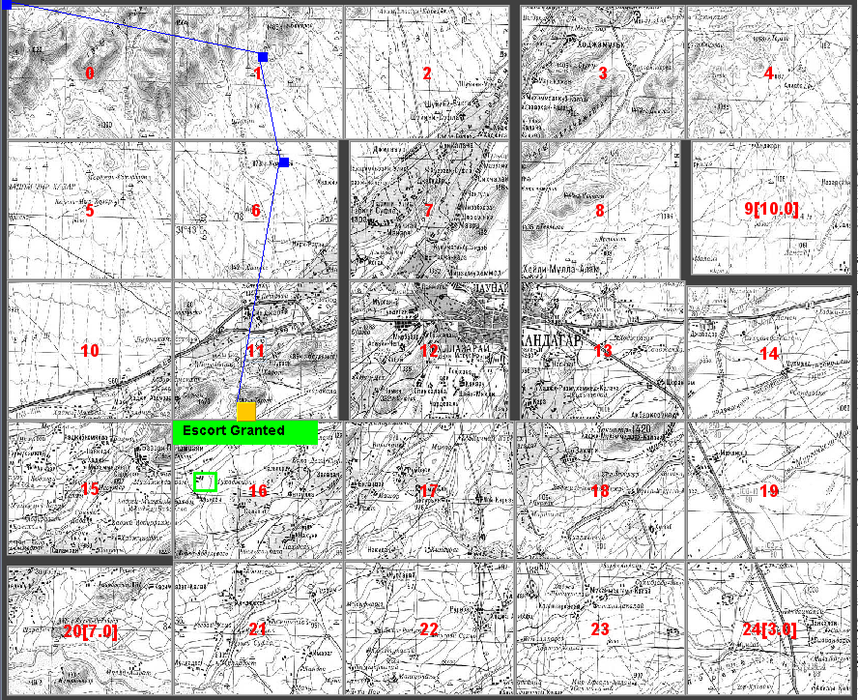
Proactive policy management: norm compliance
Example: Peacekeeping scenario
Agent arranges an escort: Escort Granted.

Slide 24
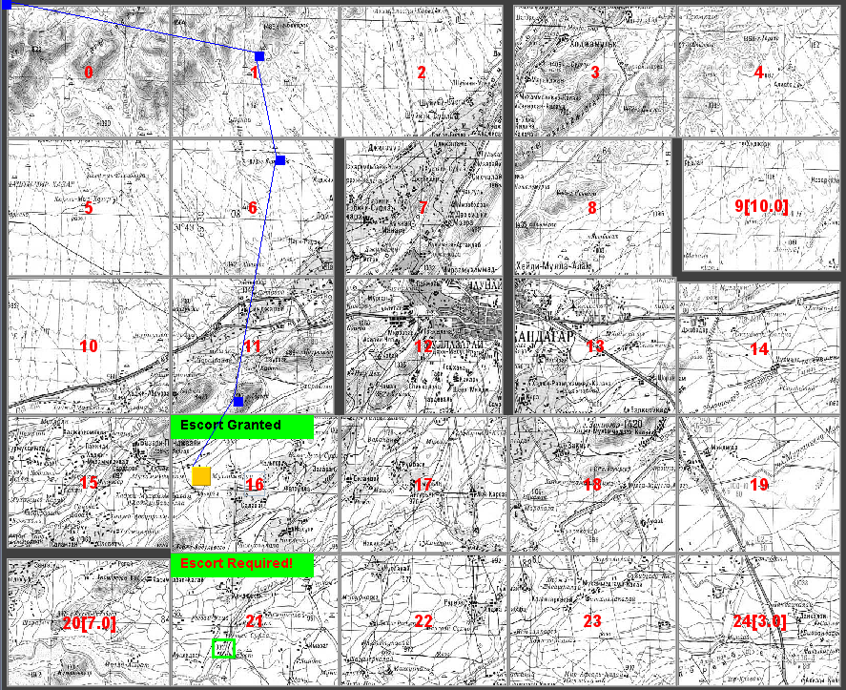
Warning: contrary-to-duty obligation
Example: Peacekeeping scenario
Norm violation at area 21 still active;
Party Bravo has not responded.
Agent alerts the user: Escort Required!

Slide 25
Practical applications
Military applications
Planning assistant
Peacekeeping escort scheduling
Disaster response
Demo session
Quality of life technologies
Elderly care
Smart homes
Education support
Intelligent tutoring systems

Slide 26
Current & future work
Proposed proactive assistant agent architecture
Proactively identify tasks (goals) that the agent can assist with
Plan assistive actions to accomplish the identified goals
Optimizing information gathering
Using inference network to identify information needs (as opposed to predefined information-dependent actions)
Multi-user multi-agent settings
Evaluation metrics for integrated systems

Slide 27
Thank you!
Questions?

Slide 28
Settings & preliminary results
User experiments
1 6x6, and 2 7x7 mazes with varying degree of difficulty
7 information sources
Observations: room color (5 available colors)
7 human subjects
13 runs
 | Without agent | With agent
Total time (sec) | 300 | 262.2
Total query time (sec) | 48.1 | 10.7
Query time ratio | 0.16 | 0.04
# of moves | 13.2 | 14.6
# of steps away from goal | 6.3 | 3

Slide 29
Handling partial observability
Agent may have only partial observations regarding user’s current state
What agent observes: sensory data from environment
Visual observations, e.g., background color;
Audio observations, e.g., noise level;
Keyboard and mouse activities, etc.
Agent’s task: estimate probability distribution over set of states, given a history of observations

Slide 30
Updating belief state
Estimating belief state b: probability distribution over states in S
T’(s’|s) = ∑_{a∈A} [π_{s(a)} T(s’|s,a)]
Given a sequence of observations z₁,…, z_{t} estimate probability of being in state s:
p(s_{t}=s|z₁,…,z_{t})
Dynamic programming [Rabiner 1989]
α_{s(t)} = p(z,…z_{t} ^ s_{t} = s|S,T’,O)
Initialize α_{s(1)} = O(z₁|s₁=s)b(s)
α_{s(t+1)} = O(z|s) ∑_{s’∈S} T’(s’,s) α_{s’(t)}
b(s) = α_{s(t)} / ∑_{s’∈S} α_{s’(t)}

Slide 31
Plan prediction under partial observability
Plan tree is constructed from a belief state instead of a state
Dispatch ambulance
0.05
p(s) = 1
0.95
i
Call police
1.0
Report to
police unit

Slide 32
Plan prediction under partial observability
Architecture: Plan predictor
Plan tree is constructed from a belief state instead of a state
Dispatch ambulance
p(s) =.3
.3
Report to
police unit
Call police
i
Report to paramedic unit
Dispatch ambulance
i
p(s’) =.7
.7
Call police
p(s’’) = 0
0

Slide 33
Information presenter
Information presenter
Retrieved information is stored in local cache until presented to the user
Relevance: Given belief state, determine when to present certain information
Appropriate format: Assess user’s cognitive load to determine how to present certain information
User feedback as a reinforcement

