Slide 1
Team B – Computing in Our Student’s Lives
“If you could take your students on a field trip to a location that illustrates the importance of computing in their lives, identify 4 such locations that would be near most schools.”
Retail – Phil Marchal (Loveland, OH)
Hospital – Laura Wojick (Milford, NJ)
Banking – Tawanda Wright (Pittsburgh, PA)
Police – Bill MacDonald (Holmdel, NJ)

Slide 2
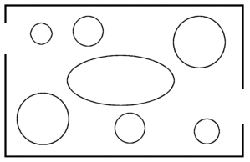
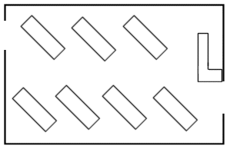
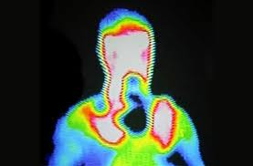
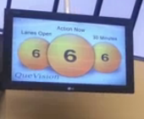
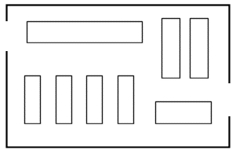
Retail Computing Field Trip
Grocery Store, Food Service, Electronics Store, Clothing Store
Familiar uses:
Purchases of products/advertising
Bar codes/tracking or products/inventory
Human Component:
Layout/Design
Innovation

Slide 3
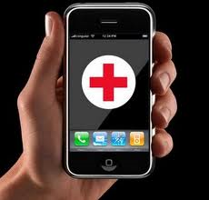
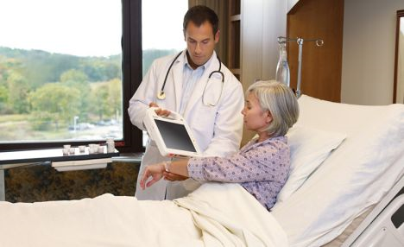
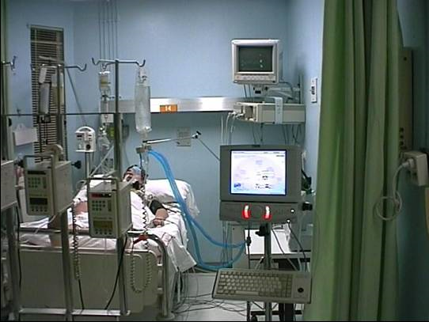
Hospital Computing Field Trip
Familiar uses:
Receptionist
Medical records
Other uses:
Treatment rooms
Surgery
Health care apps for smart phones
Something profound:
Some computers are even used now for diagnosing decease.

Slide 4
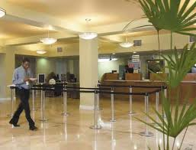
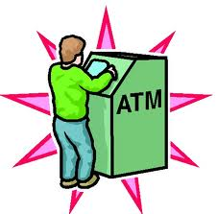
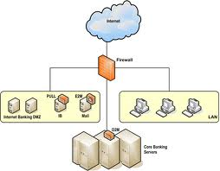
Banking Computing Field Trip

Slide 5
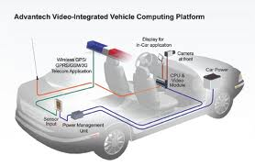
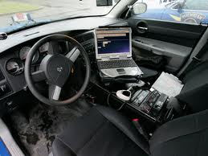
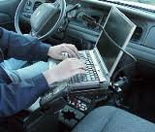
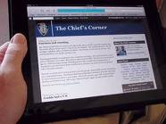
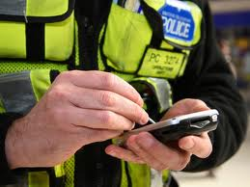
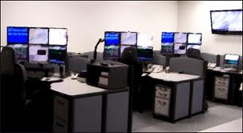
Police Mobile Computing Field Trip
Familiar uses:
In car computers, handhelds, back-office

