Slide 1
Solving
Graph Problems with
Boolean Methods
Randal E. Bryant
Carnegie Mellon University
http://www.cs.cmu.edu/~bryant

Slide 2
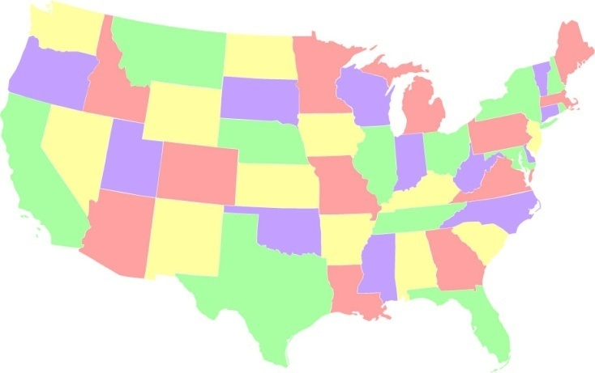
The Graph Coloring Problem
Color the regions of a planar graph
  Use only 4 colors
  No two adjacent regions can have the same color
Example: Color the states of a U.S. map

Slide 3
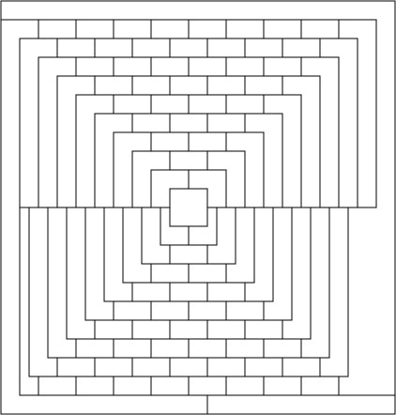
The MacGregor Graph
Scientific American, April 1975
  Said to be proof that some planar graphs could not be colored with just 4 colors
  An April-fool’s joke, but still difficult to solve by hand

Slide 4
Boolean SAT Solvers
What They Do
  Express problem as a set of constraints
  Search for solution that satisfies all constraints
Encoding Graph Coloring with SAT
  Encode each region with two 0/1-valued variables:
    00 Blue
    01 Green
    10 Red
    11 Yellow
  For each adjacent region, require at least one of the corresponding variables to have opposite values

Slide 5
Encoding Coloring Constraints
a_{i}, b_{i}
a_{j}, b_{j}
  Encode region i with variables a_{i}, b_{i}
  For adjacent regions i and j, want:
    a_{i} ≠ a_{j} ∨ b_{i} ≠ b_{j}
  Clausal form (and of or’s):
    (c ∨ a_{i} ∨ a_{j}) ∧ (c ∨ ¬a_{i} ∨ ¬a_{j}) ∧ (¬c ∨ b_{i} ∨ b_{j}) ∧ (¬c ∨ ¬b_{i} ∨ ¬b_{j})
c = 0 ➔ a_{i} ≠ a_{j}
c = 1 ➔ b_{i} ≠ b_{j}

Slide 6
The ZChaff SAT Solver
  From Princeton University
  Algorithm by Davis Putnam Logemann & Loveland
  With many refinements
Based on backtracking search
  Try assigning values to variables
  When hit contradiction
    Create new constraint encoding conflict
    Backtrack by undoing some of the most recent assignments
    Resume search with new variable assignments

Slide 7
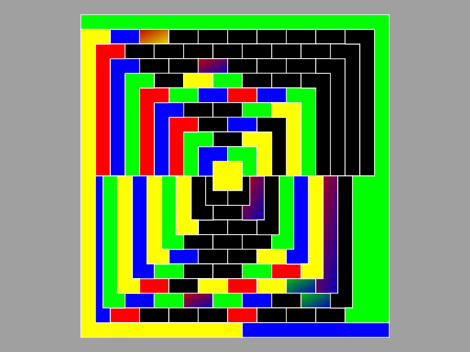
Visualizing the Search Process
  Black: Neither variable assigned value
  Single color: Both variables assigned, giving unique color.
  Blended colors: One variable assigned, the other unassigned, indicating two possible colors
  YouTube: http://www.youtube.com/watch?v=0gt503wK7AI

Slide 8
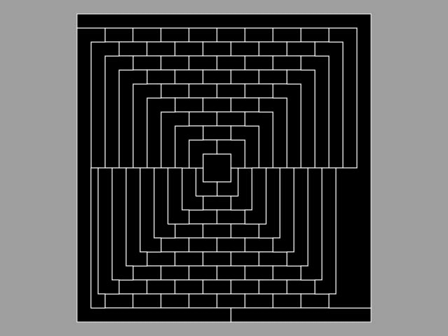

Slide 9
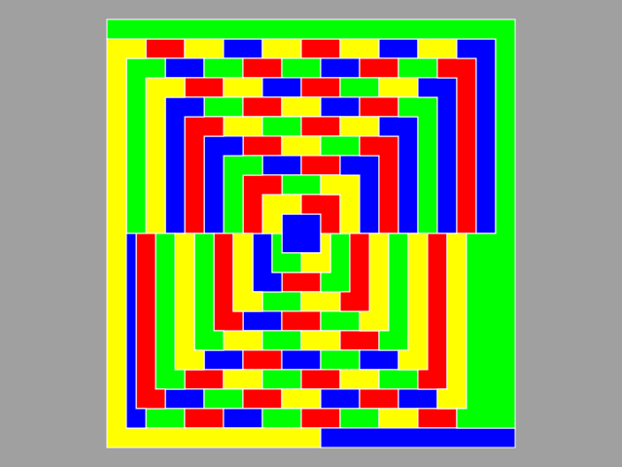
The Final Result

Slide 10
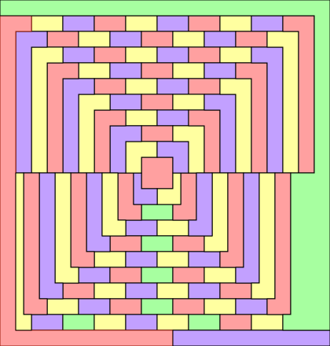
Another Solution
  Minimum use of greeen (7 times)

Slide 11
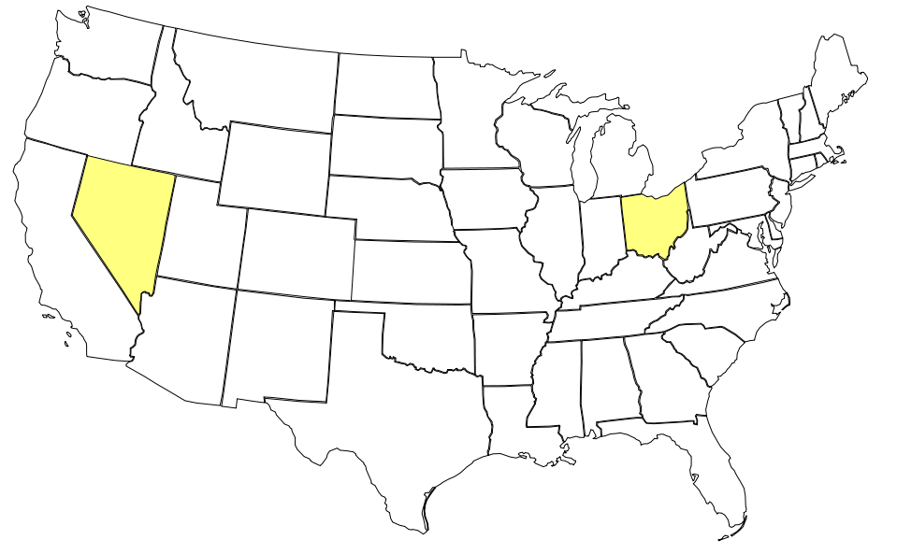
Try It Yourself
Color the rest of the map using 3 colors

Slide 12
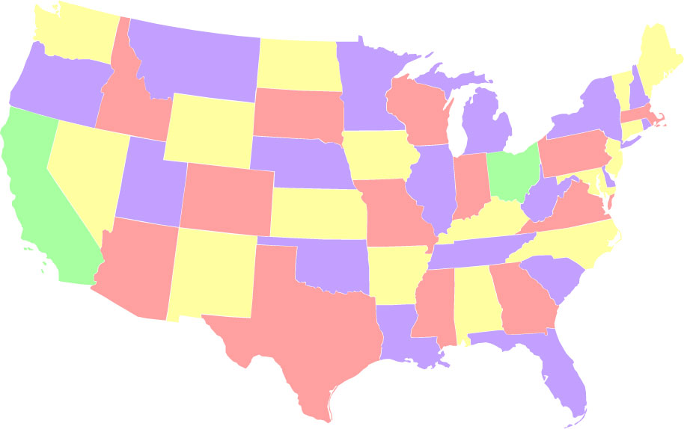
Minimum Colorings of US Map
Only need to use green twice

Slide 13
Odd Cycles
Can this be colored with just 3 colors?

Slide 14
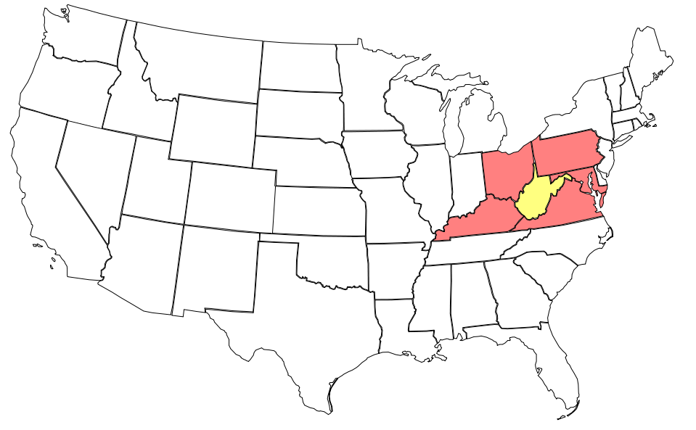
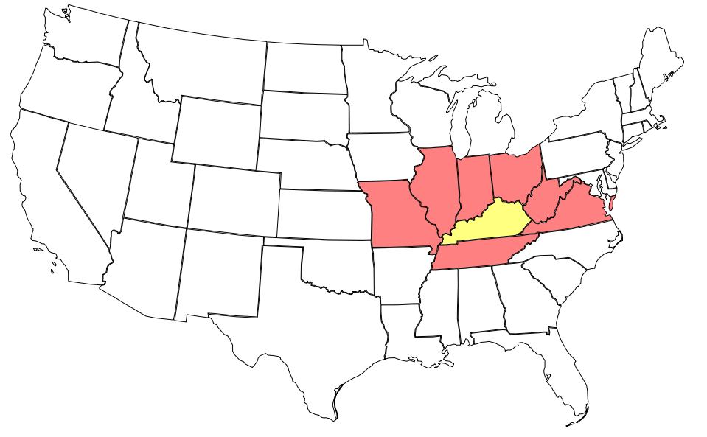
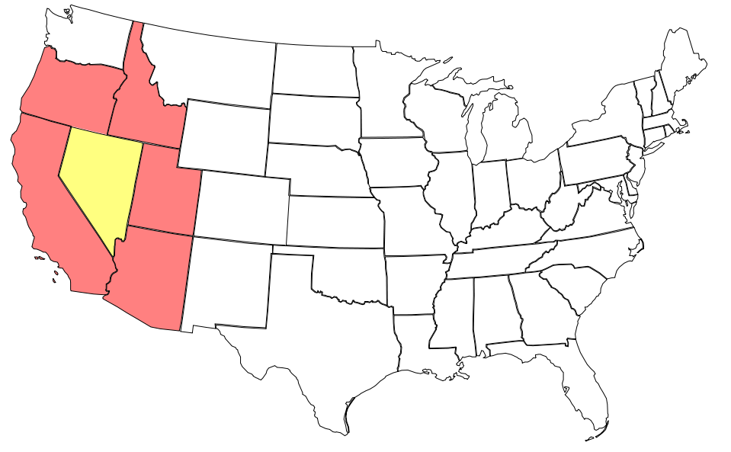
Odd Cycles in US Map

Slide 15
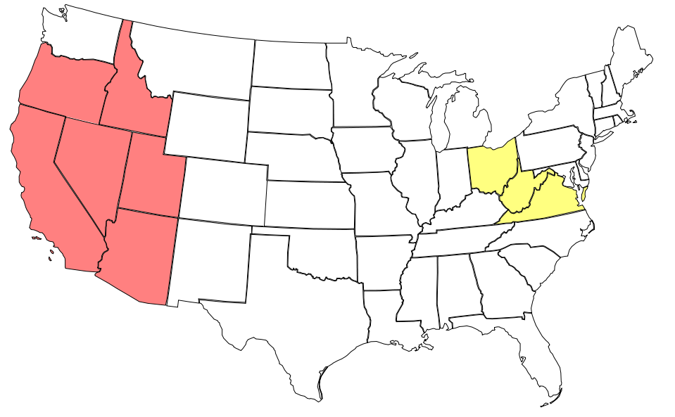
Overlapping Odd Cycles

Slide 16
Breaking Odd Cycles

Slide 17
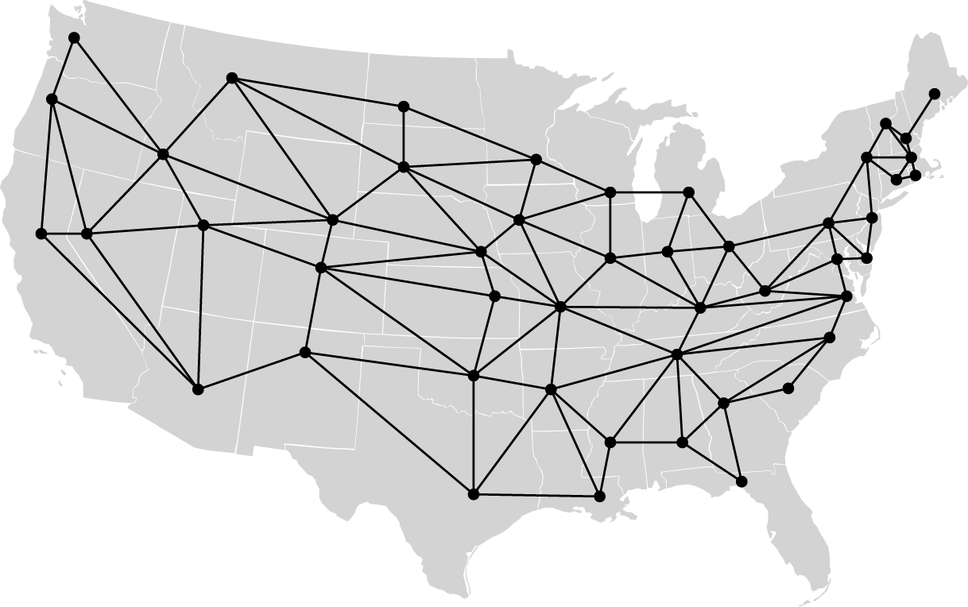
Viewing Maps as Graphs
48 nodes
105 edges

Slide 18
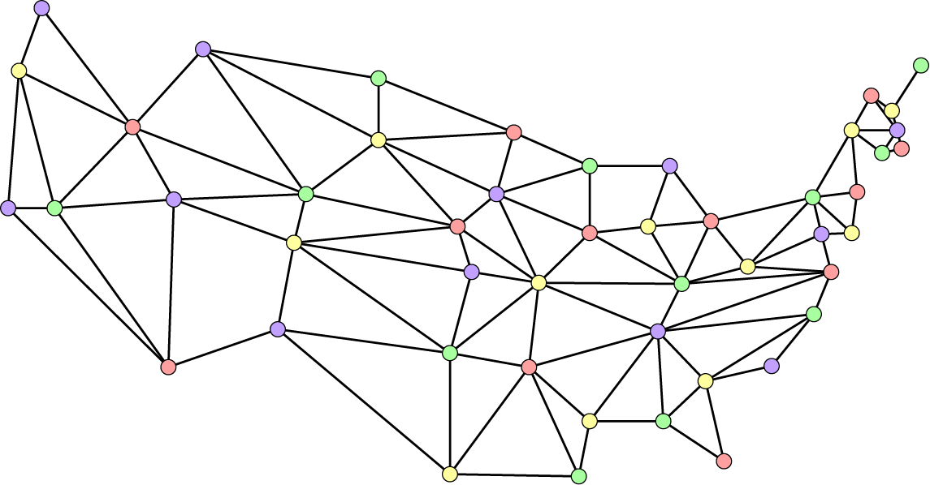
Coloring a Graph

Slide 19
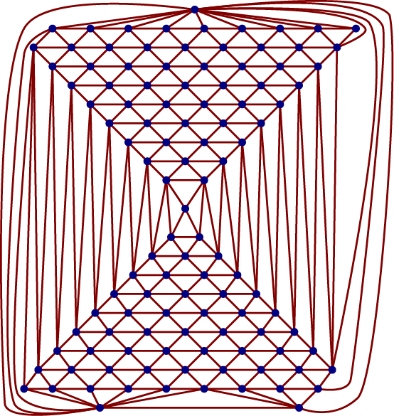
The Macgregor Graph
110 nodes
324 edges

Slide 20

The Four Color Theorem
  Can color any planar graph with just 4 colors.
History
  Conjectured in 1852
  1890: it was shown that 5 colors would suffice
  1976: Appel & Haken claimed they had proof

Slide 21
Proof of Four Color Theorem
Proof Method
  Appel & Haaken showed there were 1,936 graphs that covered all possibities
  Wrote computer program to check all of them
Reaction
  Many mathematicians didn’t like this kind of proof
  Program has been rewritten and rechecked multiple times, and so the proof is generally accepted.

Slide 22
Coloring Other Graph Types
Sphere: same as plane
  Plane → sphere
    Reduce exterior edges to points
  Sphere → plane
    Cut hole and stretch out flat

Slide 23
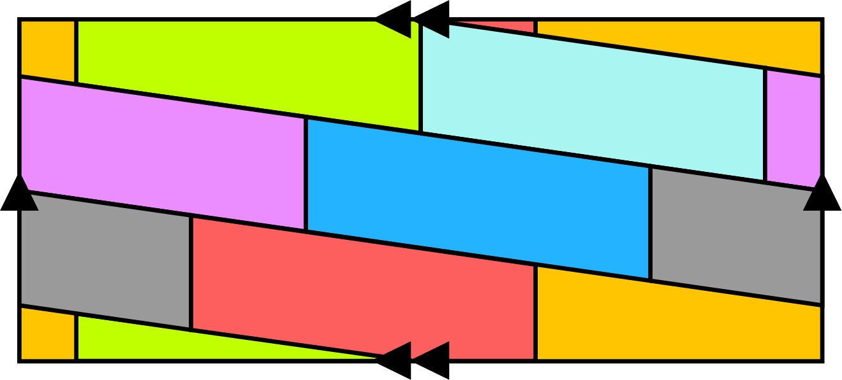
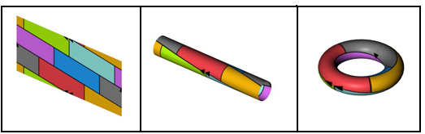
Coloring A Torus
Torus
  7 colors necessary
    7 regions, each with 6 neighbors
  Also sufficient

Slide 24
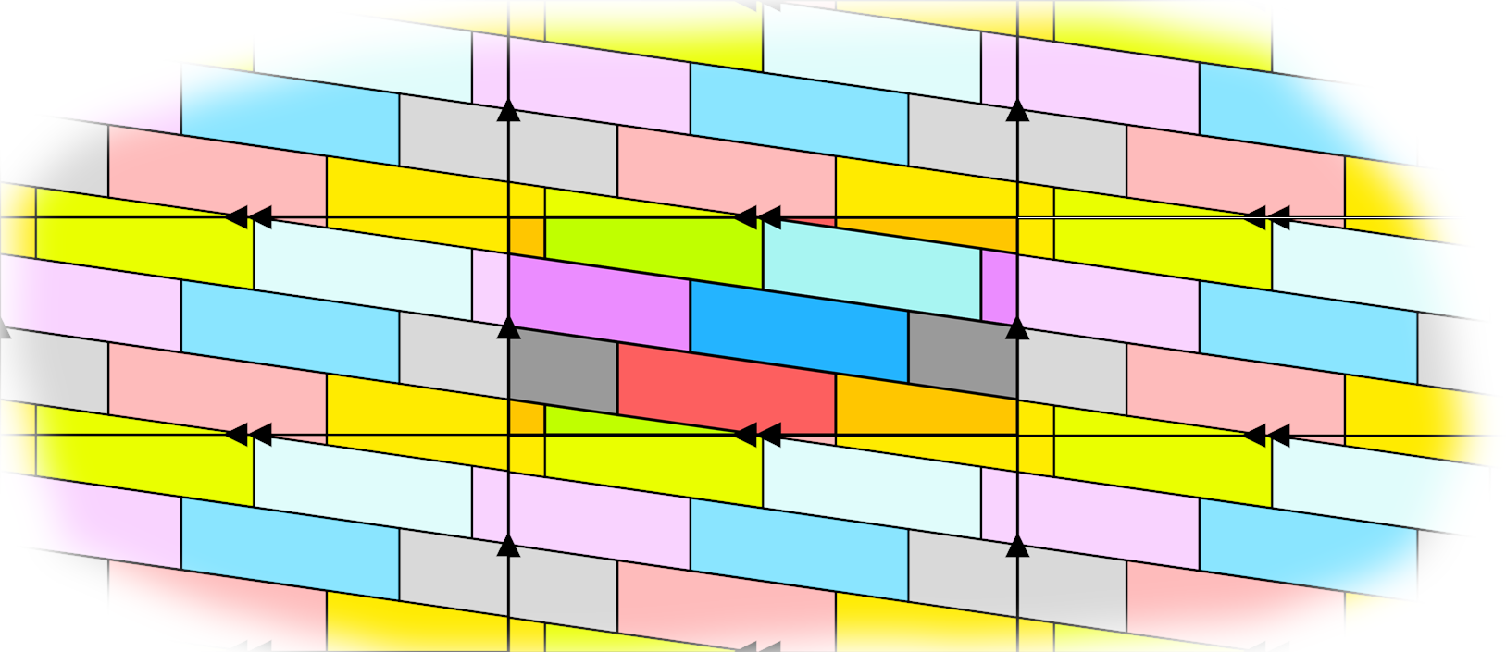
Torus: An Infinite Wallpaper Pattern

Slide 25
Sudoku as a Graph Coloring Problem
3
9
6
7
4
1
2
5
8
3
9
6
7
4
1
2
5
8
8
5
7
2
3
9
1
4
6
8
5
7
2
3
9
1
4
6
1
2
4
5
8
6
7
9
3
1
2
4
5
8
6
7
9
3
5
7
1
6
2
3
9
8
4
5
7
1
6
2
3
9
8
4
6
8
3
4
9
7
5
1
2
6
8
3
4
9
7
5
1
2
9
4
2
1
5
8
3
6
7
9
4
2
1
5
8
3
6
7
2
3
9
8
1
4
6
7
5
2
3
9
8
1
4
6
7
5
4
6
5
9
7
2
8
3
1
4
6
5
9
7
2
8
3
1
7
1
8
3
6
5
4
2
9
7
1
8
3
6
5
4
2
9

Slide 26
Adding Colors
1
3
9
6
7
4
1
2
5
8
2
8
5
7
2
3
9
1
4
6
3
1
2
4
5
8
6
7
9
3
4
5
7
1
6
2
3
9
8
4
5
6
8
3
4
9
7
5
1
2
6
9
4
2
1
5
8
3
6
7
7
2
3
9
8
1
4
6
7
5
8
4
6
5
9
7
2
8
3
1
9
7
1
8
3
6
5
4
2
9

Slide 27
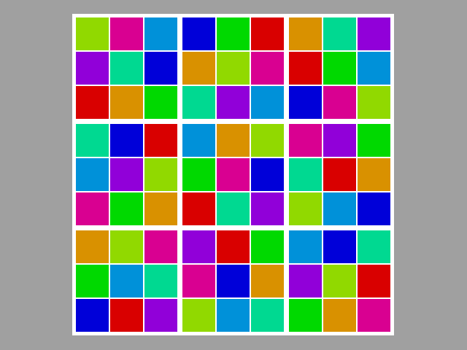
Taking Away Numbers
3
9
6
7
4
1
2
5
8
8
5
7
2
3
9
1
4
6
1
2
4
5
8
6
7
9
3
5
7
1
6
2
3
9
8
4
6
8
3
4
9
7
5
1
2
9
4
2
1
5
8
3
6
7
2
3
9
8
1
4
6
7
5
4
6
5
9
7
2
8
3
1
7
1
8
3
6
5
4
2
9

Slide 28
Graph Structure of Sudoku
1
3
4
2
4
2
1
3
2
4
3
1
3
1
2
4
4 X 4 Sudoku
Column constraints

Slide 29
Graph Structure of Sudoku
1
3
4
2
4
2
1
3
2
4
3
1
3
1
2
4
4 X 4 Sudoku
Row constraints

Slide 30
Graph Structure of Sudoku
1
3
4
2
4
2
1
3
2
4
3
1
3
1
2
4
4 X 4 Sudoku
Block constraints

Slide 31
Graph Structure of Sudoku
1
3
4
2
4
2
1
3
2
4
3
1
3
1
2
4
4 X 4 Sudoku
16 nodes
All constraints
56 edges
9 x 9 Sudoku: 81 nodes, 810 edges

Slide 32
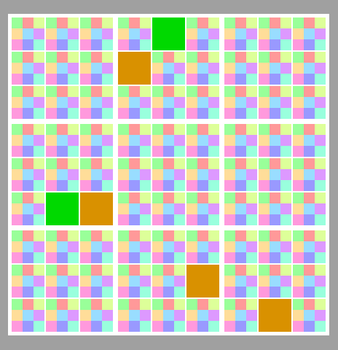
Visualizing Solution Process

Slide 33
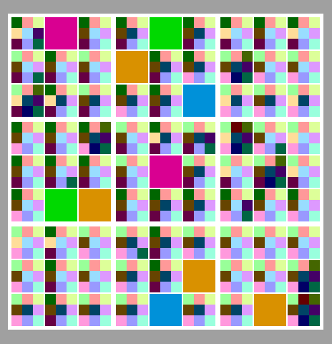
Visualizing Solution Process

Slide 34
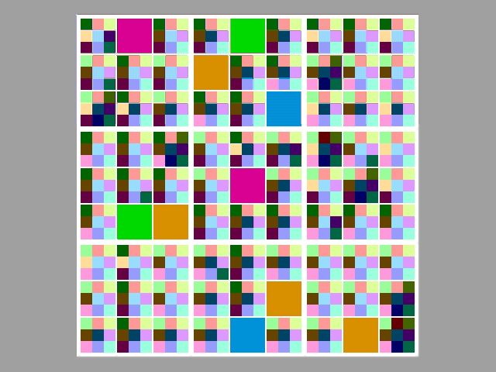
Solving A Sudoku Puzzle

Slide 35
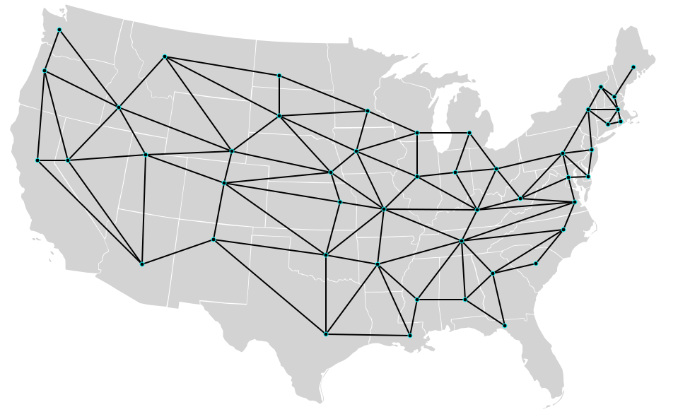
Touring the US

Slide 36
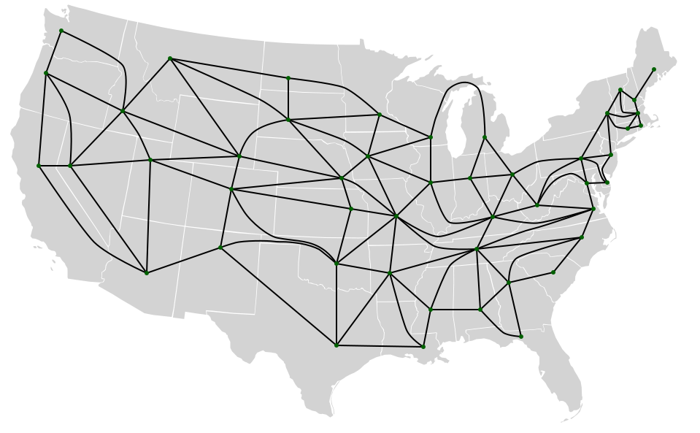
Touring the US

Slide 37
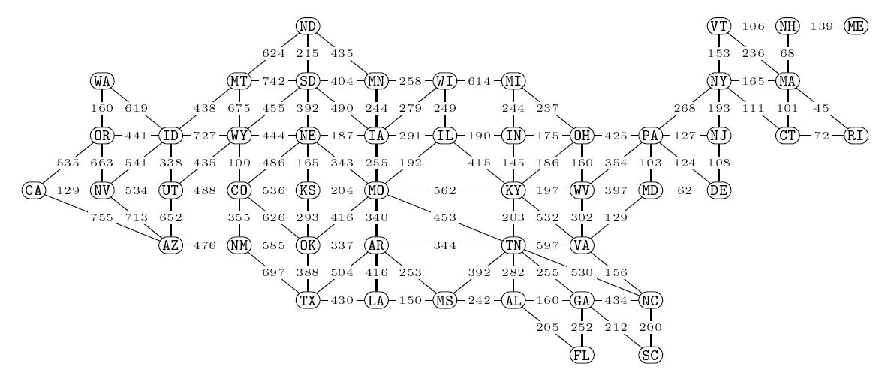
Weighted US Graph
  Shortest driving distances between capitol cities
    Staying within source and destination states
    Computed by Don Knuth using Mapquest

Slide 38
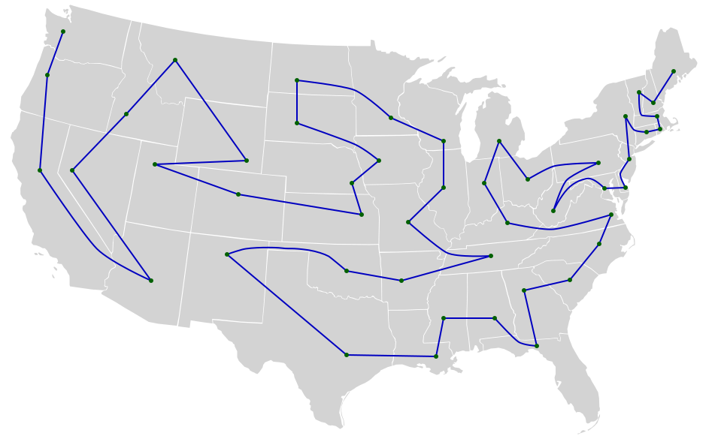
A Capitol Tour
A Hamiltonian Path
15,136 miles (24,359 km) total
68,656,026 possible tours

Slide 39

Limiting Node Degree

Slide 40
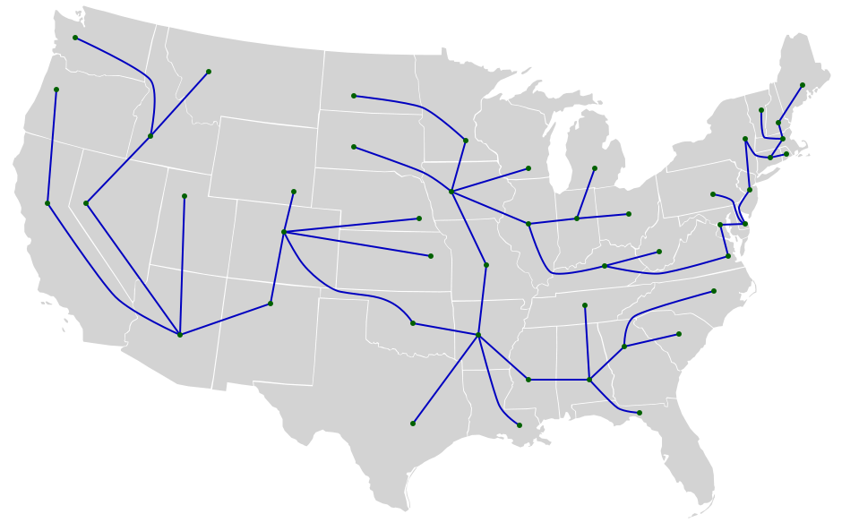
A Spanning Tree

Slide 41
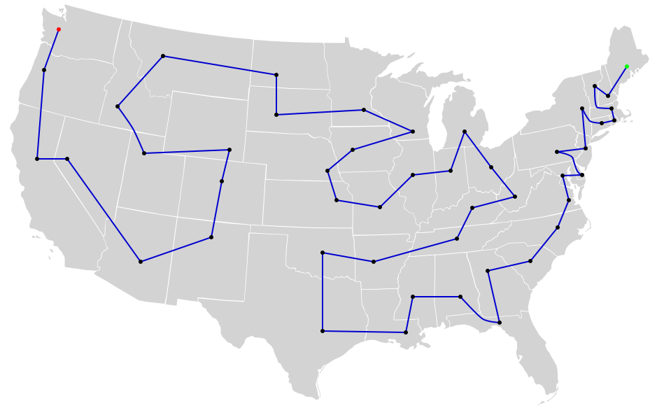
The Shortest Capitol Tour
A Traveling Salesman Path
11,698 miles (18,826 km) total

Slide 42
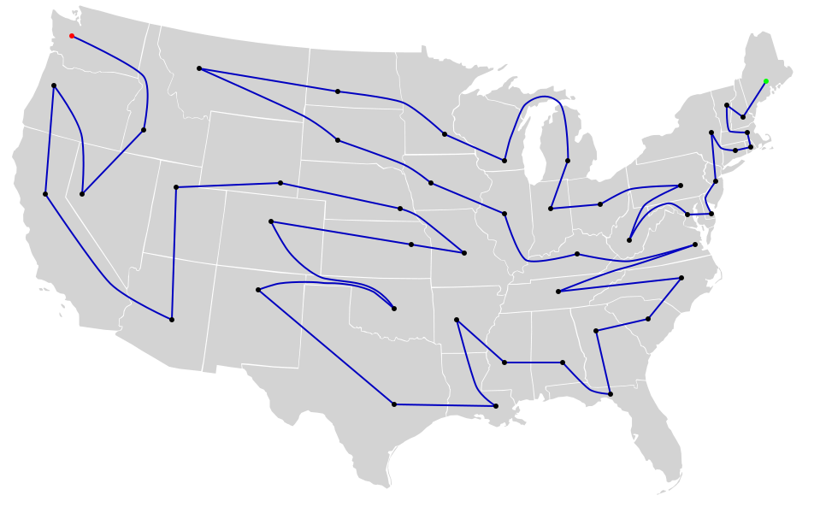
The Longest Capitol Tour
18,040 miles (29,033 km) total

Slide 43
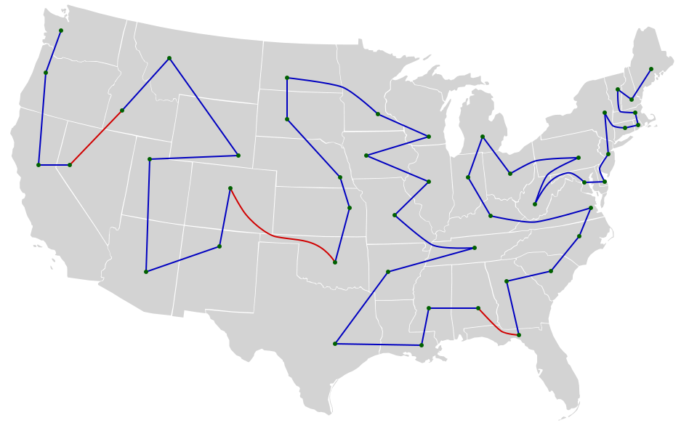
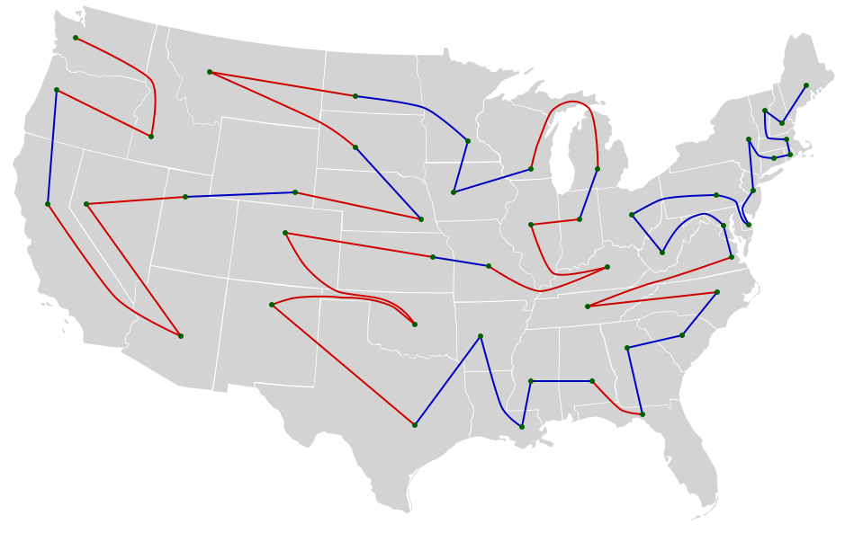
Two Interesting Capitol Tours

Slide 44
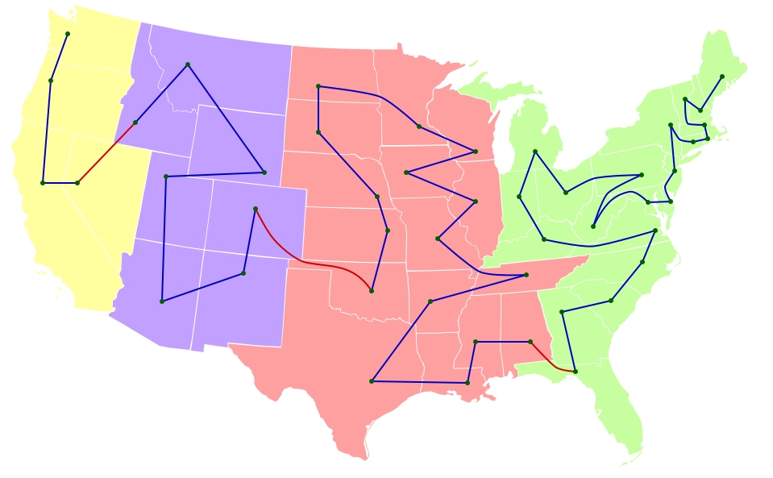
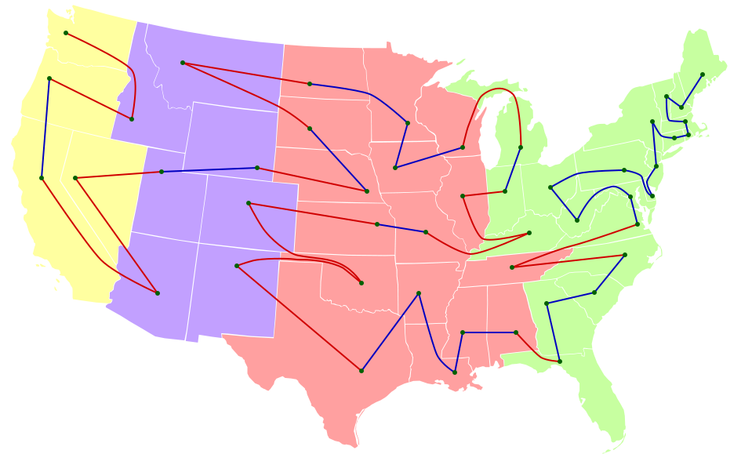
Two Interesting Capitol Tours
3 time changes
19 time changes

Slide 45
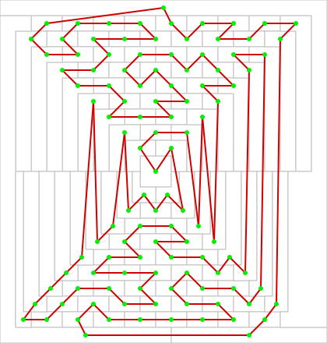
Touring MacGregor
A Hamiltonian Cycle

Slide 46
Lessons Learned
Graph Coloring
  Maps are a kind of graph
  Sudoku is a graph coloring problem
Hamiltonian Paths
  Find a path in graph that goes through every node once
  Considered a difficult problem
Boolean Methods
  Can encode wide variety of graph problems
  Can find solution using SAT solver
  In worst case, has exponential performance
    But gets solution for many interesting problems

