Slide 1
Lecture 5: Conventional Input Models for Window Managers and Toolkits
Brad Myers
05-830 Advanced User Interface Software

Slide 2
Quotes
“One of the most complex aspects of Xlib programming is designing the event loop, which must take into account all of the possible events that can occur in a window.” -- Nye & O'Reilly X Toolkit Intrinsics Programming Manual, vol. 4, 1990, p. 241.
“The dispatching and handling of events is rather complicated.” -- Galaxy Reference Manual, v1.2, p. 20-5.

Slide 3
How Keyboard and Mouse Events are Handled
Most window manager and toolkits use the same model
Quite old and has problems

Slide 4
First issue: Which Window?
Called “focus”
Old name: “active” window
Click to Type
Move to Type
Affects what kinds of interactions are possible
Mac single menubar not possible with move-to-type

Slide 5
Event Records
Structures (records) composed of all information about events
Created by window manager, sent to a queue for each window
X defines 33 different types of events
Except for selectionRequest, the X/11 “*request” events are only for window managers

Slide 6
X Event Types
visibilityNotify (become covered)
resizeRequest
circulateNotify (stacking order)
configureNotify (resize or move)
destroyNotify (was destroyed)
gravityNotify (moved due to gravity)
mapNotify (became visible)
createNotify
reparentNotify (in diff. window)
unmapNotify (invisible)
circulateRequest
configureRequest
mapRequest
mappingNotify (keyboard mapping)
clientMessage
selectionClear (for cut and paste)
selectionNotify
selectionRequest
buttonPress
keyPress
keyRelease
buttonRelease
motionNotify
enterNotify
leaveNotify
focusIn
focusOut
keymapNotify (change keymap)
Expose
graphicsExpose (source of copy not available)
noExpose (source of copy is available)
colormapNotify
propertyNotify (some property changed)

Slide 7
Windows .Net 4.5 Events
AutoSizeChanged
BackColorChanged
BackgroundImageChanged
BackgroundImageLayoutChanged
BindingContextChanged
CausesValidationChanged
ChangeUICues
Click
ClientSizeChanged
ContextMenuChanged
ContextMenuStripChanged
ControlAdded
ControlRemoved
CursorChanged
Disposed
DockChanged
DoubleClick
DragDrop
DragEnter
DragLeave
DragOver
EnabledChanged
Enter
FontChanged
ForeColorChanged
GiveFeedback
GotFocus
HandleCreated
HandleDestroyed
HelpRequested
ImeModeChanged
Invalidated
KeyDown
KeyPress
KeyUp
Layout
Leave
LocationChanged
LostFocus
MarginChanged
MouseCaptureChanged
MouseClick
MouseDoubleClick
MouseDown
MouseEnter
MouseHover
MouseLeave
MouseMove
MouseUp
MouseWheel
Move
PaddingChanged
Paint
ParentChanged
PreviewKeyDown
QueryAccessibilityHelp
QueryContinueDrag
RegionChanged
Resize
RightToLeftChanged
SizeChanged
StyleChanged
SystemColorsChanged
TabIndexChanged
TabStopChanged
TextChanged
Validated
Validating
VisibleChanged
Source: http://msdn.microsoft.com/en-us/library/1dk48x94.aspx

Slide 8
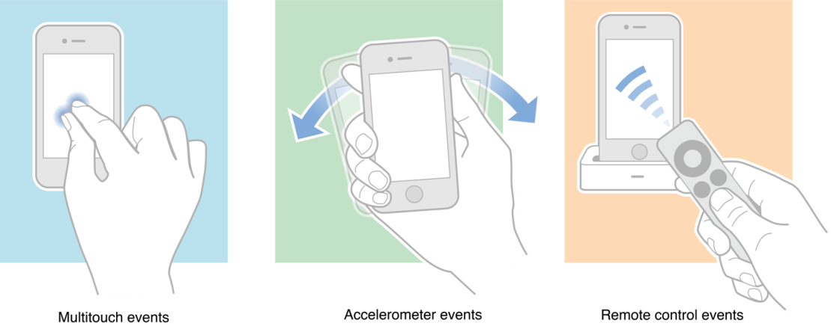
Other events
Java has events for:
MouseMove vs.
MouseDrag
Java event hierarchy starts from java.awt.AWTEvent
Many special events: PaintEvent, WindowEvent, HierarchyEvent, etc.
Java event tutorial
Visual Basic has events for:
Drag
Drop
Timer
MouseWheel
iOS (iPhone): accelerometer; remote controls
HTML/CSS supports Hover
In X, a window specifically declares which events they want to receive using event masks
Reduces network traffic and unnecessary processing
Event masks also used for other things in X
“pointerGrab”
Source: http://developer.apple.com/library/ios/#documentation/EventHandling/Conceptual/EventHandlingiPhoneOS/Introduction/Introduction.html

Slide 9
Event Modifiers
Which “modifier” keys
Shift, Control, Alt, Function, Command (Mac), Num-Lock
Various combinations
Can get events when Shift, etc. goes down, but usually ignored
Single click, double-click, triple-click, etc.
Click vs. Down vs. Drag
Amulet supports string parsing of names:
“SHIFT_CONTROL_DOUBLE_LEFT_DOWN”

Slide 10
Gestural “Events”
Gestures might come in as if they were regular events
So lower-level code doesn’t need to distinguish
Android has separate “gesture” classes
iOS: Gesture Recognizers
Amulet: added at higher level, as “commands” (see next lecture)

Slide 11
Event Handling
Toolkits (e.g., Visual Basic) automatically handle expose and some other events for the widgets.
Structured graphics systems (e.g., Amulet) automatically handle many of the events.
Events (in X) are C-language union type of many event structures that are all the same size but with different field names.
Key and mouse events contain (at least):
x position of the mouse
y position of the mouse
window of the mouse
event type
event code
event modifiers
timestamp

Slide 12
Examples
Amulet lowest levels:
Big switch statement
gemW_draw.cc (see MainWndProc)
gemX_input.cc (see Am_Handle_Event_Received)
Issue: new types of events
E.g, tablet eraser on stylus, proximity
Gesture, mouse wheel events, like scroll
New types of devices: e.g., hardware widgets

Slide 13
Waiting for Events
Low-level routine that waits for event wants to be blocking rather than polling for efficiency
Calls specified routines when events arrive
Macintosh (used to?) use polling for mouse location
Toolkits provide this internally, e.g.:
XtAppMainLoop(...)
Am_Main_Event_Loop() in Amulet
Can specify timeouts so notified after certain time if no events
Can ask X to flush multiple motion events
If not handled fast enough, get weird lag
Garnet tries to do extra flushing to avoid this
Not an issue if polling for motion events
Problem for polylines, gestures, etc.
Java listeners for events

Slide 14
Architectures
Old: giant switch statement per window
Branch for each event
But not dependent on mode, which object, etc.
“MainEventLoop” in Amulet’s implementation
Global event handlers for each type of event
No matter where that event happens in the window
E.g., per Activity in Android
Specific event handlers per object
Java Swing: button1.addActionListener(this);
Android: View event listeners (since widgets are views)
But only works if knows where the objects are
Lots of issues with multiple threading

Slide 15
Propagation
Events sent to the lowest level window containing the pointer.
If event not selected with event-mask, then sent to the container window, etc.
Can't specify individual keys (get all keys and may have to explicitly resend events)
Handlers often will get to say whether they handled the event or not
Android: onXXXX() handlers return booleans

Slide 16
Issue: Covering
Which objects get an event when overlapping
“Z” order vs. containment
What about when top object doesn’t want event?
Can’t necessarily use obj.contains(eventX, eventY)
Input mechanism must know about graphical objects
Bounding box vs. on object
Complexities: http://developer.apple.com/library/ios/#documentation/EventHandling/Conceptual/EventHandlingiPhoneOS/event_delivery_responder_chain/event_delivery_responder_chain.html#//apple_ref/doc/uid/TP40009541-CH4-SW2

Slide 17
Issue: Event Priorities
When already interacting, need to give priority to current interaction
While dragging, who gets mouse move events?
Issue: if mouse is moved too fast & gets outside of the object
While text editing
Current field gets all text events, no matter where mouse is
What if leave the window?
Interacts with Click vs. move to type
Cross-window drag & drop

Slide 18
Translation Tables
So particular mouse key or keyboard key not hard-wired into application.
Allows user customization and easier changes
Supported in Motif by the resources mechanism
e.g. Shift<Btn1Down>: doit() can be put in .Xdefaults, and then application deals with doit, and user can change bindings.
Keyboard translation is 2 step process in X:
Hardware "keycodes" numbers mapped to "keysyms"
"Keysyms" translated to events
For double-clicking, Motif does translation, but not Xlib
For non-widgets, have to do it yourself
Always also get the single click events
Java – no built-in double click support
Does have click vs. drag

Slide 19
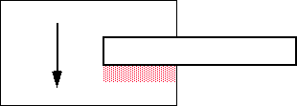
Issue: Scrolling Refresh
Race condition when copy from an area that might be covered
X/11 provides graphicsExpose and noExpose events

