Slide 1

14-513
18-613

Slide 2
Network Programming: Part I
18-213/18-613: Introduction to Computer Systems
20th Lecture, November 12, 2024

Slide 3
Today
Networking Overview
Global IP Internet CSAPP 11.3
Sockets Interface CSAPP 11.4

Slide 4
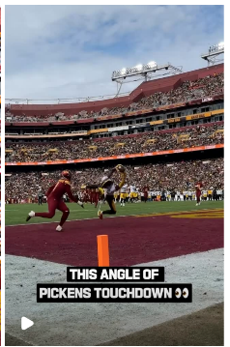


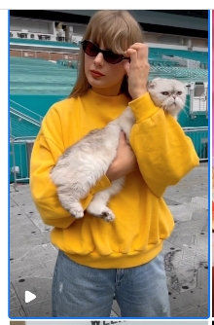



This lecture may be boring,
let me check IG for cool reelz!

Slide 5
Wait, how does the
“Internet”
actually work to
watch reelz?

Slide 6
How does my app/browser know?
Who is IG?
Where is IG?
How do I get to IG?
Get bytes from IG?
“Stream” from IG?
Not mix up things?
….

Slide 7
A First Thought Experiment for Design:
“Internet is a Series of (Dedicated) Tubes”
Let me pay attention ☺
Greg/Vyas are more entertaining

Slide 8
Series of Tubes Doesn’t Work ☺
Deployment
  Every “App” needs to install “copper” “fiber” end to end to its users
Heterogeneity of Users
  IG needs to worry about “pipe” inside CMU, my home, airport, SBUX, …
Geography/Society/Politics
  What about users in India, China, UK, how do I get pipes?
Scale/Cost
  More users come in? More devices come in?
Efficiency
  I paused to listen to lecture, but pipe is still costing me!
Fault Tolerance
  What if pipe bursts ☺ insta fails
…..

Slide 9

Great Ideas in Networking:
Statistical Multiplexing not Dedicated Tubes
“The Internet”
Is a Shared Resource

Slide 10
Great Ideas in Networking:
Datagrams/Packet-Switched Networks
1
2
3

Slide 11

Great Ideas in Networking: Federation
Still paying
attention ☺

Slide 12
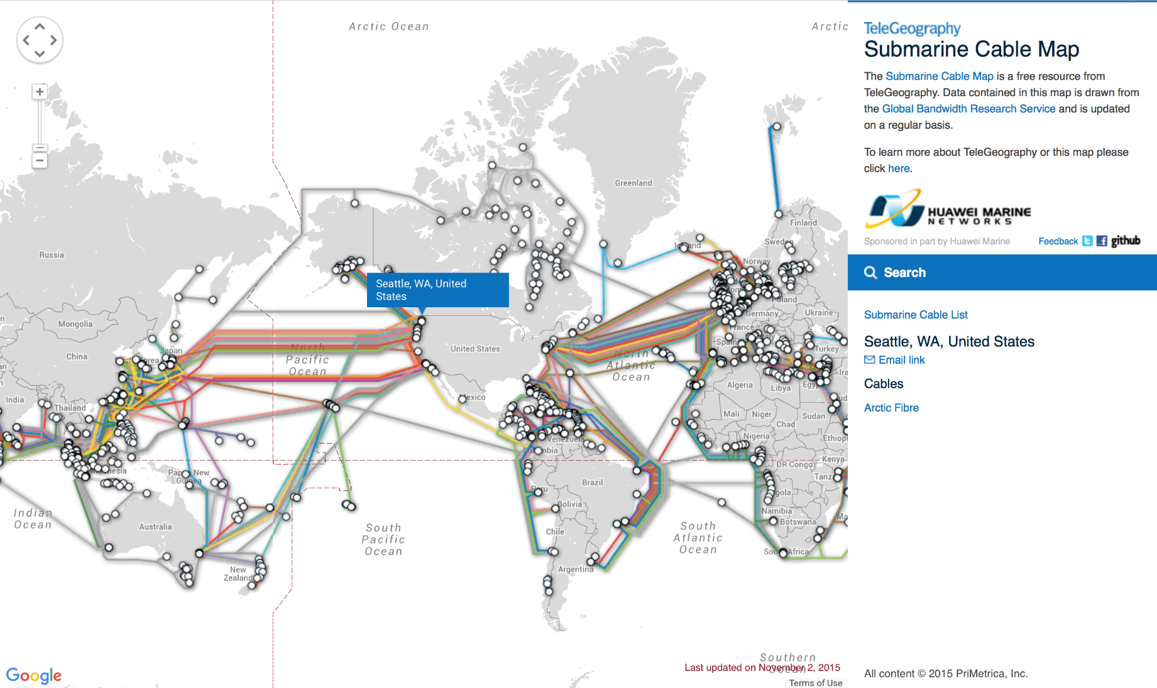
Well, the Internet does actually have tubes at physical level ☺

Slide 13

Great Ideas in Networking: Protocols

Slide 14
Great Ideas in Networking: Layering
Application
Application
Channel
Host to
Host
Hardware

Slide 15
Physical Layer: Establishes the Channel
Medium? Light? Radio frequency? Electrical signals?
  What color(s) of light? How bright?
  What RF frequencies? How powerful?
  What signals represent what values?
  What shape are the connectors?
  How far can cables run?
  Etc.
We have a functioning physical layer once we can send and receive signals.

Slide 16
Physical Layer: Bandwidth vs. Latency
Bandwidth = bits/second
  Improved with parallelism or faster clock rate
Latency = Function of signal propagation speed
  Limited by speed of light
  Major paradigm shift would be needed to make traffic to India or China less latent
Latency tends to be limiting at a global scale
  Speed of light over long distances
Bandwidth may be limited at local scale, e.g. data center
  How to divide up and recombine messages to utilize parallelism?
  How to clock faster without losing signal to noise.
Physical

Slide 17
Link Layer: Manages the Channel
When do we start transmitting? When do we stop?
When do we start receiving? When do we stop?
Who is sending? Who is receiving?
How do we know if it is correct?
What happens if there is contention for, or collision in, a shared channel?
Key contributions: Framing, among others
We have a functioning link layer once we can build a functioning local area network (LAN) of at least two stations.
Data link
Physical

Slide 18
Network layer: Scaling up
Passing messages among multiple networks
  For scale
  Of different types (wired, wireless, fiber, infrared, etc)
  Managed by different domains, etc.
Globally meaningful addressing: IPv4, IPv6
Ability to choose paths among multiple options
We have a functioning network layer once we can connect multiple networks, identify hosts among them, and messages can find their way across networks from source to destination.
Network
Data link
Physical

Slide 19
Transport Layer: Meaningful endpoints
Hosts don’t do communication – various aspects of software systems do
  Consider how many different sessions your Web browser has with servers. Now add for your IM sessions, upgrades-in-progress, music streaming, etc.
Endpoints enable the establishment of sessions
  Classic model is <IPaddress:port>:<IPaddress:port>
  Client: Ephemeral port. Host: Well-known port
Character of communication
  Reliable/session-oriented, e.g. TCP
  Unreliable/datagram, e.g. UDP
  Etc.
The transport layer exists once we have the ability
to establish communication from end-point to end-point
with well-understood properties.
Transport
Network
Data link
Physical

Slide 20
Application Layer: Purposeful Communication
Defined by the messaging we, as programs, bake into our applications, shaped by our applications
  e.g., client-server interactions, peer-to-peer interactions, etc.
E.g., HTTP: PUT, GET, POST, etc.
E.g., DNS: queries, responses, updates, etc.
MIME, VOIP protocols, etc.
Application protocols exist when applications can communicate
Application
Application
Transport
Transport
Network
Network
Network
Network
Data link
Data link
Data link
Data link
Physical
Physical
Physical
Physical

Slide 21
How does my app/browser know?
What is IG?
Who is IG?
Where is IG?
How do I get to IG?
Get bytes from IG?
“Stream” from IG?
Not mix up things?
….

Slide 22
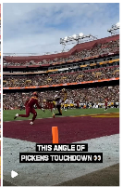


A Client-Server Transaction
Most network applications are based on the client-server model:
  A server process and one or more client processes
  Server manages some resource
  Server provides service by manipulating resource for clients
  Server activated by request from client (vending machine analogy)
1. Client sends request
Client
process
Server
process
Resource
4. Client
handles
response
3. Server sends response
2. Server
handles
request
Note: clients and servers are processes running on hosts
(can be the same or different hosts)

Slide 23

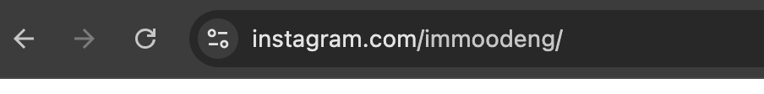
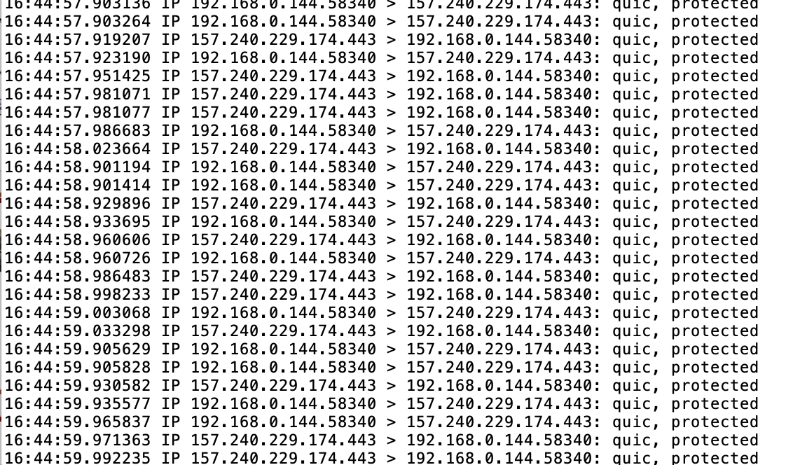
What is IG really?
vyass-mbp-2:Desktop vsekar$ sudo tcpdump -nn > insta_pcap
Anything on
The Global Internet
is just an
“IP” address
e.g., 157.240.229.174

Slide 24
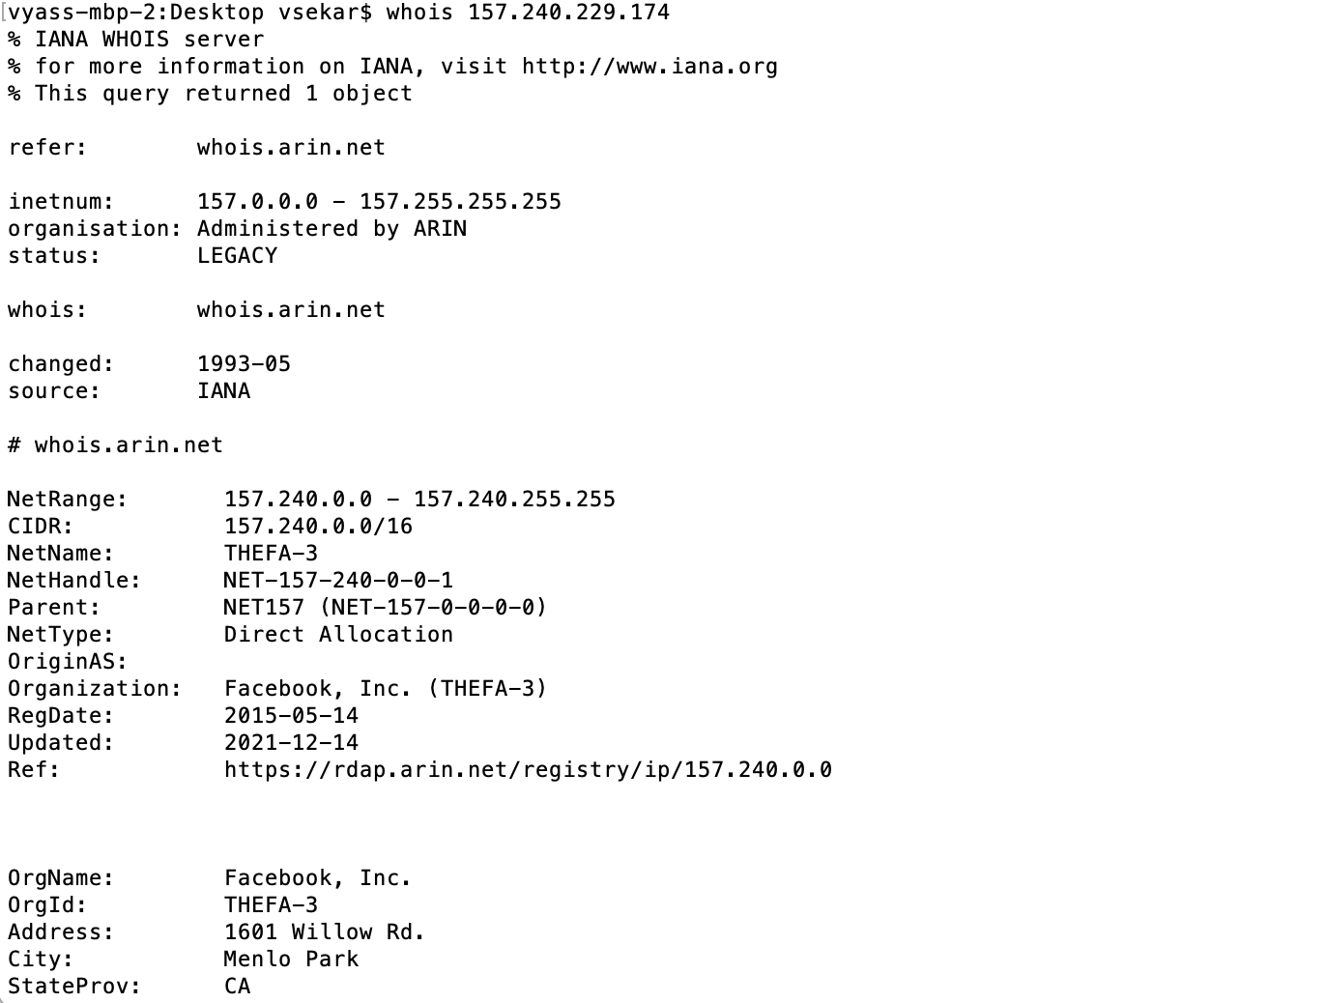
Who is IG = 157.240.229.174?
“IP” addresses
Assignment
And ownership

Slide 25
Global IP Internet
Based on the TCP/IP protocol family
  IP (Internet Protocol)
    Provides basic naming scheme and unreliable delivery capability
    of packets (datagrams) from host-to-host
  UDP (Unreliable Datagram Protocol)
    Uses IP to provide unreliable datagram delivery from
    process-to-process
  TCP (Transmission Control Protocol)
    Uses IP to provide reliable byte streams from process-to-process over connections
Accessed via a mix of Unix file I/O and functions from the sockets interface
Notes:
IP: host2host
UDP/TCP: proc2proc

Slide 26
Hardware and Software Organization of a Client-Server Internet Application
Internet client host
Internet server host
Client
User code
Server
Sockets interface
(system calls)
TCP/IP
Kernel code
TCP/IP
Hardware interface
(interrupts)
Network
adapter
Hardware
and firmware
Network
adapter
Global IP Internet

Slide 27
A Programmer’s View of the Internet
1. Hosts are mapped to a set of 32-bit IP addresses
  128.2.203.179
  127.0.0.1 (always localhost)
2. The set of IP addresses is mapped to a set of identifiers called Internet domain names
  128.2.217.3 is mapped to www.cs.cmu.edu
3. A process on one Internet host can communicate with a process on another Internet host over a connection

Slide 28
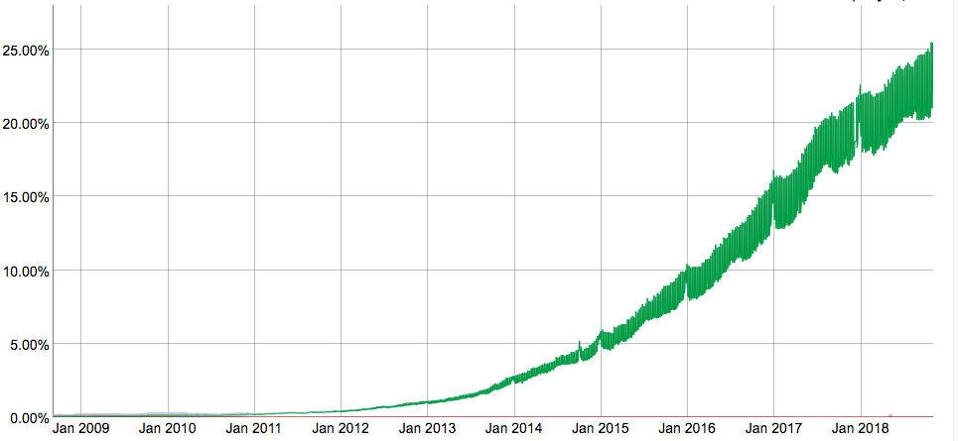
Aside: IPv4 and IPv6
The original Internet Protocol, with its 32-bit addresses, is known as Internet Protocol Version 4 (IPv4)
1996: Internet Engineering Task Force (IETF) introduced Internet Protocol Version 6 (IPv6) with 128-bit addresses
  Intended as the successor to IPv4
Majority of Internet traffic still carried by IPv4
We will focus on IPv4, but will show you how to write networking code that is protocol-independent.
IPv6 traffic at Google

Slide 29
(1) IP Addresses
32-bit IP addresses are stored in an IP address struct
  IP addresses are always stored in memory in network byte order
  (big-endian byte order)
  True in general for any integer transferred in a packet header from one machine to another.
    E.g., the port number used to identify an Internet connection.
/* Internet address structure */
struct in_addr {
uint32_t s_addr; /* network byte order (big-endian) */
};

Slide 30
Dotted Decimal Notation
By convention, each byte in a 32-bit IP address is represented by its decimal value and separated by a period
    IP address: 0x8002C2F2 = 128.2.194.242
Use getaddrinfo and getnameinfo functions
(described later) to convert between IP addresses
and dotted decimal format.

Slide 31
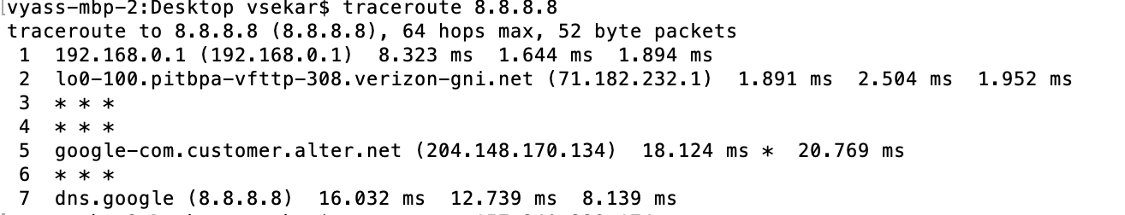
How do I get to some IP (e.g., IG)?
Routing Protocols

Slide 32
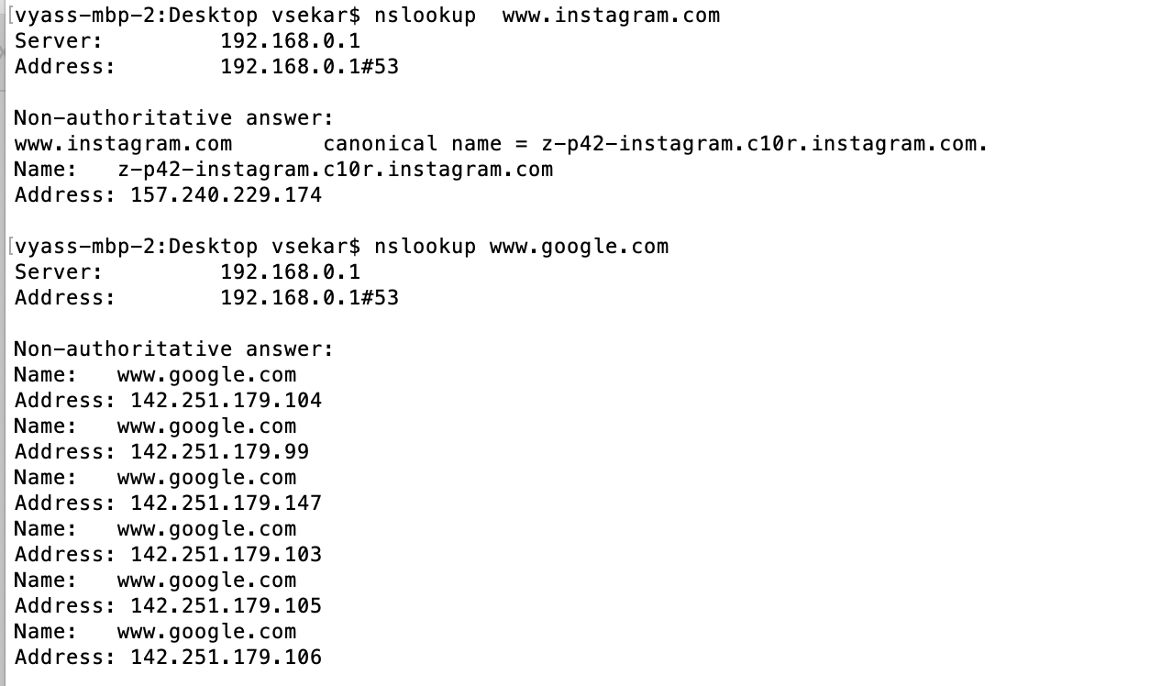
Why don’t I need to know this IP thing?
Domain Name System (DNS)
Names → “IP” addresses

Slide 33
(2) Internet Domain Names
unnamed root
.net
.edu
.gov
.com
First-level domain names
mit
cmu
berkeley
amazon
Second-level domain names
cs
ece
www
54.230.48.28
Third-level domain names
ics
pdl
whaleshark
128.2.210.175
www
128.2.131.66

Slide 34
Domain Naming System (DNS)
The Internet maintains a mapping between IP addresses and domain names in a huge worldwide distributed database
called DNS
Conceptually, programmers can view the DNS database as a collection of millions of host entries.
  Each host entry defines the mapping between a set of domain names
  and IP addresses.
  In a mathematical sense, a host entry is an equivalence class of domain names and IP addresses.

Slide 35
Properties of DNS Mappings
Can explore properties of DNS mappings using nslookup
  (In our examples, the output is edited for brevity)
Each host has a locally defined domain name localhost which always maps to the loopback address 127.0.0.1
Use hostname to determine real domain name of local host:
linux> nslookup localhost
Address: 127.0.0.1
linux> hostname
whaleshark.ics.cs.cmu.edu

Slide 36
Properties of DNS Mappings (cont)
Simple case: one-to-one mapping between domain name and IP address:
Multiple domain names mapped to the same IP address:
linux> nslookup whaleshark.ics.cs.cmu.edu
Address: 128.2.210.175
linux> nslookup cs.mit.edu
Address: 18.62.1.6
linux> nslookup eecs.mit.edu
Address: 18.62.1.6

Slide 37
(3) Internet Connections
Clients and servers communicate by sending streams of bytes over connections. Each connection is:
  Point-to-point: connects a pair of processes.
  Full-duplex: data can flow in both directions at the same time,
  Reliable: stream of bytes sent by the source is eventually received by the destination in the same order it was sent.
A socket is an endpoint of a connection
  Socket address is an IPaddress:port pair
A port is a 16-bit integer that identifies a process:
  Ephemeral port: Assigned automatically by client kernel when client makes a connection request.
  Well-known port: Associated with some service provided by a server (e.g., port 80 is associated with Web servers)

Slide 38
Well-known Service Names and Ports
Popular services have permanently assigned well-known ports and corresponding well-known service names:
  echo servers: echo 7
  ftp servers: ftp 21
  ssh servers: ssh 22
  email servers: smtp 25
  Web servers: http 80
Mappings between well-known ports and service names is contained in the file /etc/services on each Linux machine.

Slide 39
Anatomy of a Connection
A connection is uniquely identified by the socket addresses of its endpoints (socket pair)
  (cliaddr:cliport, servaddr:servport)
Client socket address
128.2.194.242:51213
Server socket address
208.216.181.15:80
Client
Server
(port 80)
Connection socket pair
(128.2.194.242:51213, 208.216.181.15:80)
Client host address
128.2.194.242
Server host address
208.216.181.15
51213 is an ephemeral port
allocated by the kernel
80 is a well-known port
associated with Web servers

Slide 40
Using Ports to Identify Services
Server host 128.2.194.242
Client host
Service request for
128.2.194.242:80
(i.e., the Web server)
Web server
(port 80)
Client
Kernel
Echo server
(port 7)
Service request for
128.2.194.242:7
(i.e., the echo server)
Web server
(port 80)
Client
Kernel
Echo server
(port 7)

Slide 41
Today
Network Layers: Bird’s Eye View
Global IP Internet
Sockets Interface

Slide 42
Sockets Interface
Set of system-level functions used in conjunction with Unix I/O to build network applications.
Created in the early 80’s as part of the original Berkeley distribution of Unix that contained an early version of the Internet protocols.
Available on all modern systems
  Unix variants, Windows, OS X, IOS, Android, ARM

Slide 43
Sockets
What is a socket?
  To the kernel, a socket is an endpoint of communication
  To an application, a socket is a file descriptor that lets the application read/write from/to the network
    Remember: All Unix I/O devices, including networks, are modeled as files
Clients and servers communicate with each other by reading from and writing to socket descriptors
The main distinction between regular file I/O and socket I/O is how the application “opens” the socket descriptors
Client
Server
clientfd
serverfd

Slide 44
Socket Programming Example
Echo server and client
Server
  Accepts connection request
  Repeats back lines as they are typed
Client
  Requests connection to server
  Repeatedly:
    Read line from terminal
    Send to server
    Read reply from server
    Print line to terminal

Slide 45
Echo Server/Client Session Example
Client
bambooshark: ./echoclient whaleshark.ics.cs.cmu.edu 6616 (A)
This line is being echoed (B)
This line is being echoed
This one is, too (C)
This one is, too
^D
bambooshark: ./echoclient whaleshark.ics.cs.cmu.edu 6616 (D)
This one is a new connection (E)
This one is a new connection
^D
Server
whaleshark: ./echoserveri 6616
Connected to (BAMBOOSHARK.ICS.CS.CMU.EDU, 33707) (A)
server received 26 bytes (B)
server received 17 bytes (C)
Connected to (BAMBOOSHARK.ICS.CS.CMU.EDU, 33708) (D)
server received 29 bytes (E)

Slide 46
Echo
Server
+ Client
Structure
2. Start client
1. Start server
Client
Server
open_clientfd
open_listenfd
Connection
request
Await connection
request from client
accept
3. Exchange
data
Client / Server
Session
terminal read
socket write
socket read
socket read
terminal write
socket write
4. Disconnect client
EOF
5. Drop client
close
socket read
close

Slide 47
Echo
Server
+ Client
Structure
2. Start client
1. Start server
Client
Server
open_clientfd
open_listenfd
Connection
request
Await connection
request from client
accept
3. Exchange
data
Client / Server
Session
fgets
rio_writen
rio_readlineb
rio_readlineb
fputs
rio_writen
4. Disconnect client
EOF
5. Drop client
close
rio_readlineb
close

Slide 48
Recall: Unbuffered RIO Input/Output
Same interface as Unix read and write
Especially useful for transferring data on network sockets
  rio_readn returns short count only if it encounters EOF
    Only use it when you know how many bytes to read
  rio_writen never returns a short count
  Calls to rio_readn and rio_writen can be interleaved arbitrarily on the same descriptor
#include "csapp.h"
ssize_t rio_readn(int fd, void *usrbuf, size_t n);
ssize_t rio_writen(int fd, void *usrbuf, size_t n);
Return: num. bytes transferred if OK, 0 on EOF (rio_readn only), -1 on error

Slide 49
Recall: Buffered RIO Input Functions
Efficiently read text lines and binary data from a file partially cached in an internal memory buffer
  rio_readlineb reads a text line of up to maxlen bytes from file fd and stores the line in usrbuf
    Especially useful for reading text lines from network sockets
  Stopping conditions
    maxlen bytes read
    EOF encountered
    Newline (‘\n’) encountered
#include "csapp.h"
void rio_readinitb(rio_t *rp, int fd);
ssize_t rio_readlineb(rio_t *rp, void *usrbuf, size_t maxlen);
ssize_t rio_readnb(rio_t *rp, void *usrbuf, size_t n);
Return: num. bytes read if OK, 0 on EOF, -1 on error

Slide 50
Echo Server: echo function
The server uses RIO to read and echo text lines until EOF (end-of-file) condition is encountered.
  EOF condition caused by client calling close(clientfd)
void echo(int connfd)
{
size_t n;
char buf[MAXLINE];
rio_t rio;
Rio_readinitb(&rio, connfd);
while((n = Rio_readlineb(&rio, buf, MAXLINE)) != 0) {
printf("server received %d bytes\n", (int)n);
Rio_writen(connfd, buf, n);
}
}
echo.c

Slide 51
Echo Client: Main Routine
#include "csapp.h"
int main(int argc, char **argv)
{
int clientfd;
char *host, *port, buf[MAXLINE];
rio_t rio;
host = argv[1];
port = argv[2];
clientfd = Open_clientfd(host, port);
Rio_readinitb(&rio, clientfd);
while (Fgets(buf, MAXLINE, stdin) != NULL) {
Rio_writen(clientfd, buf, strlen(buf));
Rio_readlineb(&rio, buf, MAXLINE);
Fputs(buf, stdout);
}
Close(clientfd);
exit(0);
}
echoclient.c

Slide 52
Echo
Server
+ Client
Structure
2. Start client
1. Start server
Client
Server
open_clientfd
open_listenfd
Connection
request
Await connection
request from client
accept
3. Exchange
data
Client / Server
Session
fgets
rio_writen
rio_readlineb
rio_readlineb
fputs
rio_writen
4. Disconnect client
EOF
5. Drop client
close
rio_readlineb
close

Slide 53
Iterative Echo Server: Main Routine
#include "csapp.h”
void echo(int connfd);
int main(int argc, char **argv)
{
int listenfd, connfd;
socklen_t clientlen;
struct sockaddr_storage clientaddr; /* Enough room for any addr */
char client_hostname[MAXLINE], client_port[MAXLINE];
listenfd = Open_listenfd(argv[1]);
while (1) {
clientlen = sizeof(struct sockaddr_storage); /* Important! */
connfd = Accept(listenfd, (SA *)&clientaddr, &clientlen);
Getnameinfo((SA *) &clientaddr, clientlen,
client_hostname, MAXLINE, client_port, MAXLINE, 0);
printf("Connected to (%s, %s)\n", client_hostname, client_port);
echo(connfd);
Close(connfd);
}
exit(0);
}
echoserveri.c

Slide 54
Socket Address Structures
Generic socket address:
  For address arguments to connect, bind, and accept (next lecture)
  Necessary only because C did not have generic (void *) pointers when the sockets interface was designed
  For casting convenience, we adopt the Stevens convention:
  typedef struct sockaddr SA;
struct sockaddr {
uint16_t sa_family; /* Protocol family */
char sa_data[14]; /* Address data */
};
sa_family
Family Specific
Notes:
Sa_family = AF_INET
Address data is address

Slide 55
Socket Address Structures
Internet (IPv4) specific socket address:
  Must cast (struct sockaddr_in *) to (struct sockaddr *) for functions that take socket address arguments.
struct sockaddr_in {
uint16_t sin_family; /* Protocol family (always AF_INET) */
uint16_t sin_port; /* Port num in network byte order */
struct in_addr sin_addr; /* IP addr in network byte order */
unsigned char sin_zero[8]; /* Pad to sizeof(struct sockaddr) */
};
sin_port
sin_addr
AF_INET
0
0
0
0
0
0
0
0
sa_family
sin_family
Family Specific

Slide 56
Host and Service Conversion: getaddrinfo
getaddrinfo is the modern way to convert string representations of hostnames, host addresses, ports, and service names to socket address structures.
  Replaces obsolete gethostbyname and getservbyname funcs.
Advantages:
  Reentrant (can be safely used by threaded programs).
  Allows us to write portable protocol-independent code
    Works with both IPv4 and IPv6
Disadvantages
  Somewhat complex
  Fortunately, a small number of usage patterns suffice in most cases.

Slide 57
Host and Service Conversion: getaddrinfo
Given host and service, getaddrinfo returns result that points to a linked list of addrinfo structs, each of which points to a corresponding socket address struct, and which contains arguments for the sockets interface functions.
Helper functions:
  freeadderinfo frees the entire linked list.
  gai_strerror converts error code to an error message.
int getaddrinfo(const char *host, /* Hostname or address */
const char *service, /* Port or service name */
const struct addrinfo *hints,/* Input parameters */
struct addrinfo **result); /* Output linked list */
void freeaddrinfo(struct addrinfo *result); /* Free linked list */
const char *gai_strerror(int errcode); /* Return error msg */

Slide 58
Linked List Returned by getaddrinfo
addrinfo structs
result
Socket address structs
ai_canonname
ai_addr
ai_next
NULL
ai_addr
ai_next
NULL
ai_addr
NULL

Slide 59
addrinfo Struct
struct addrinfo {
int ai_flags; /* Hints argument flags */
int ai_family; /* First arg to socket function */
int ai_socktype; /* Second arg to socket function */
int ai_protocol; /* Third arg to socket function */
char *ai_canonname; /* Canonical host name */
size_t ai_addrlen; /* Size of ai_addr struct */
struct sockaddr *ai_addr; /* Ptr to socket address structure */
struct addrinfo *ai_next; /* Ptr to next item in linked list */
};
Each addrinfo struct returned by getaddrinfo contains arguments that can be passed directly to socket function.
Also points to a socket address struct that can be passed directly to connect and bind functions.
(socket, connect, bind to be discussed next lecture)

Slide 60
Host and Service Conversion: getnameinfo
getnameinfo is the inverse of getaddrinfo, converting a socket address to the corresponding host and service.
  Replaces obsolete gethostbyaddr and getservbyport funcs.
  Reentrant and protocol independent.
int getnameinfo(const SA *sa, socklen_t salen, /* In: socket addr */
char *host, size_t hostlen, /* Out: host */
char *serv, size_t servlen, /* Out: service */
int flags); /* optional flags */

Slide 61
Conversion Example
#include "csapp.h"
int main(int argc, char **argv)
{
struct addrinfo *p, *listp, hints;
char buf[MAXLINE];
int rc, flags;
/* Get a list of addrinfo records */
memset(&hints, 0, sizeof(struct addrinfo));
// hints.ai_family = AF_INET; /* IPv4 only */
hints.ai_socktype = SOCK_STREAM; /* Connections only */
if ((rc = getaddrinfo(argv[1], NULL, &hints, &listp)) != 0) {
fprintf(stderr, "getaddrinfo error: %s\n", gai_strerror(rc));
exit(1);
}
hostinfo.c

Slide 62
Conversion Example (cont)
/* Walk the list and display each IP address */
flags = NI_NUMERICHOST; /* Display address instead of name */
for (p = listp; p; p = p->ai_next) {
Getnameinfo(p->ai_addr, p->ai_addrlen,
buf, MAXLINE, NULL, 0, flags);
printf("%s\n", buf);
}
/* Clean up */
Freeaddrinfo(listp);
exit(0);
}
hostinfo.c

Slide 63
Running hostinfo
whaleshark> ./hostinfo localhost
127.0.0.1
whaleshark> ./hostinfo whaleshark.ics.cs.cmu.edu
128.2.210.175
whaleshark> ./hostinfo twitter.com
199.16.156.230
199.16.156.38
199.16.156.102
199.16.156.198
whaleshark> ./hostinfo google.com
172.217.15.110
2607:f8b0:4004:802::200e

Slide 64
Today
Network Layers
Global IP Internet
Sockets Interface
Next time
Using getaddrinfo for host and service conversion
Writing clients and servers
Writing Web servers!

Slide 65
Additional slides

Slide 66
Basic Internet Components
Internet backbone:
  collection of routers (nationwide or worldwide) connected by high-speed point-to-point networks
Internet Exchange Points (IXP):
  router that connects multiple backbones (often referred to as peers)
  Also called Network Access Points (NAP)
Regional networks:
  smaller backbones that cover smaller geographical areas
  (e.g., cities or states)
Point of presence (POP):
  machine that is connected to the Internet
Internet Service Providers (ISPs):
  provide dial-up or direct access to POPs

Slide 67
Internet Connection Hierarchy
Private
“peering”
agreements
between
two backbone
companies
often bypass
IXP
IXP
IXP
IXP
Colocation
sites
Backbone
Backbone
Backbone
Backbone
POP
POP
POP
POP
POP
POP
POP
T3
Regional net
ISP
Big Business
POP
POP
POP
POP
POP
POP
POP
Cable
modem
DSL
T1
T1
ISP (for individuals)
Small Business
Pgh employee
DC employee

Slide 68
IP Address Structure
IP (V4) Address space divided into classes:
Network ID Written in form w.x.y.z/n
  n = number of bits in host address
  E.g., CMU written as 128.2.0.0/16
    Class B address
Unrouted (private) IP addresses:
  10.0.0.0/8 172.16.0.0/12 192.168.0.0/16
0 1 2 3 8 16 24 31
Class A
0
Net ID
Host ID
Class B
1
0
Net ID
Host ID
Class C
1
1
0
Net ID
Host ID
Class D
1
1
1
0
Multicast address
Class E
1
1
1
1
Reserved for experiments

Slide 69
Evolution of Internet
Original Idea
  Every node on Internet would have unique IP address
    Everyone would be able to talk directly to everyone
  No secrecy or authentication
    Messages visible to routers and hosts on same LAN
    Possible to forge source field in packet header
Shortcomings
  There aren't enough IP addresses available
  Don't want everyone to have access or knowledge of all other hosts
  Security issues mandate secrecy & authentication

Slide 70
Evolution of Internet: Naming
Dynamic address assignment
  Most hosts don't need to have known address
    Only those functioning as servers
  DHCP (Dynamic Host Configuration Protocol)
    Local ISP assigns address for temporary use
Example:
  Laptop at CMU (wired connection)
    IP address 128.2.213.29 (bryant-tp4.cs.cmu.edu)
    Assigned statically
  Laptop at home
    IP address 192.168.1.5
    Only valid within home network

Slide 71
Evolution of Internet: Firewalls
1
176.3.3.3
10.2.2.2
4
Firewall
2
3
216.99.99.99
Corporation X
Internet
Firewalls
  Hides organizations nodes from rest of Internet
  Use local IP addresses within organization
  For external service, provides proxy service
    Client request: src=10.2.2.2, dest=216.99.99.99
    Firewall forwards: src=176.3.3.3, dest=216.99.99.99
    Server responds: src=216.99.99.99, dest=176.3.3.3
    Firewall forwards response: src=216.99.99.99, dest=10.2.2.2

Slide 72
Hardware Organization of a Network Host
CPU chip
register file
ALU
system bus
memory bus
main
memory
MI
I/O
bridge
Expansion slots
I/O bus
USB
controller
graphics
adapter
disk
controller
network
adapter
mouse
keyboard
monitor
disk
network

Slide 73
Computer Networks
A network is a hierarchical system of boxes and wires organized by geographical proximity
  BAN (Body Area Network) spans devices carried / worn on body
  SAN* (System Area Network) spans cluster or machine room
    Switched Ethernet, Quadrics QSW, …
  LAN (Local Area Network) spans a building or campus
    Ethernet is most prominent example
  WAN (Wide Area Network) spans country or world
    Typically high-speed point-to-point phone lines
An internetwork (internet) is an interconnected set of networks
  The Global IP Internet (uppercase “I”) is the most famous example of an internet (lowercase “i”)
Let’s see how an internet is built from the ground up
* Not to be confused with a Storage Area Network

Slide 74
Lowest Level: Ethernet Segment
host
host
host
100 Mb/s
100 Mb/s
hub
port
Ethernet segment consists of a collection of hosts connected by wires (twisted pairs) to a hub
Spans room or floor in a building
Operation
  Each Ethernet adapter has a unique 48-bit address (MAC address)
    E.g., 00:16:ea:e3:54:e6
  Hosts send bits to any other host in chunks called frames
  Hub slavishly copies each bit from each port to every other port
    Every host sees every bit
  [Note: Hubs are obsolete. Bridges (switches, routers) became cheap enough to replace them]

Slide 75
Next Level: Bridged Ethernet Segment
A
B
host
host
host
host
host
X
hub
100 Mb/s
bridge
100 Mb/s
hub
1 Gb/s
host
host
hub
100 Mb/s
bridge
100 Mb/s
hub
Y
host
host
host
host
host
C
Spans building or campus
Bridges cleverly learn which hosts are reachable from which ports and then selectively copy frames from port to port

Slide 76
Conceptual View of LANs
For simplicity, hubs, bridges, and wires are often shown as a collection of hosts attached to a single wire:
host
host
...
host

Slide 77
Next Level: internets
Multiple incompatible LANs can be physically connected by specialized computers called routers
The connected networks are called an internet (lower case)
host
host
...
host
host
host
...
host
LAN 1
LAN 2
router
router
router
WAN
WAN
LAN 1 and LAN 2 might be completely different, totally incompatible
(e.g., Ethernet, Fibre Channel, 802.11*, T1-links, DSL, …)

Slide 78
Logical Structure of an internet
host
host
router
router
router
router
router
router
Ad hoc interconnection of networks
  No particular topology
  Vastly different router & link capacities
Send packets from source to destination by hopping through networks
  Router forms bridge from one network to another
  Different packets may take different routes

Slide 79
The Notion of an internet Protocol
How is it possible to send bits across incompatible LANs and WANs?
Solution: protocol software running on each host and router
  Protocol is a set of rules that governs how hosts and routers should cooperate when they transfer data from network to network.
  Smooths out the differences between the different networks

Slide 80
What Does an internet Protocol Do?
Provides a naming scheme
  An internet protocol defines a uniform format for host addresses
  Each host (and router) is assigned at least one of these internet addresses that uniquely identifies it
Provides a delivery mechanism
  An internet protocol defines a standard transfer unit (packet)
  Packet consists of header and payload
    Header: contains info such as packet size, source and destination addresses
    Payload: contains data bits sent from source host

Slide 81
Transferring internet Data Via Encapsulation
LAN1
Host A
Host B
LAN2
client
server
(1)
data
(8)
data
protocol
software
protocol
software
internet packet
(2)
data
PH
FH1
(7)
data
PH
FH2
LAN1 frame
LAN1
adapter
LAN2
adapter
Router
(3)
data
PH
FH1
(6)
data
PH
FH2
LAN1
adapter
LAN2
adapter
LAN2 frame
(4)
data
PH
FH1
data
PH
FH2
(5)
PH: internet packet header
FH: LAN frame header
protocol
software

Slide 82
Other Issues
We are glossing over a number of important questions:
  What if different networks have different maximum frame sizes? (segmentation)
  How do routers know where to forward frames?
  How are routers informed when the network topology changes?
  What if packets get lost?
These (and other) questions are addressed by the area of systems known as computer networking

