Slide 1
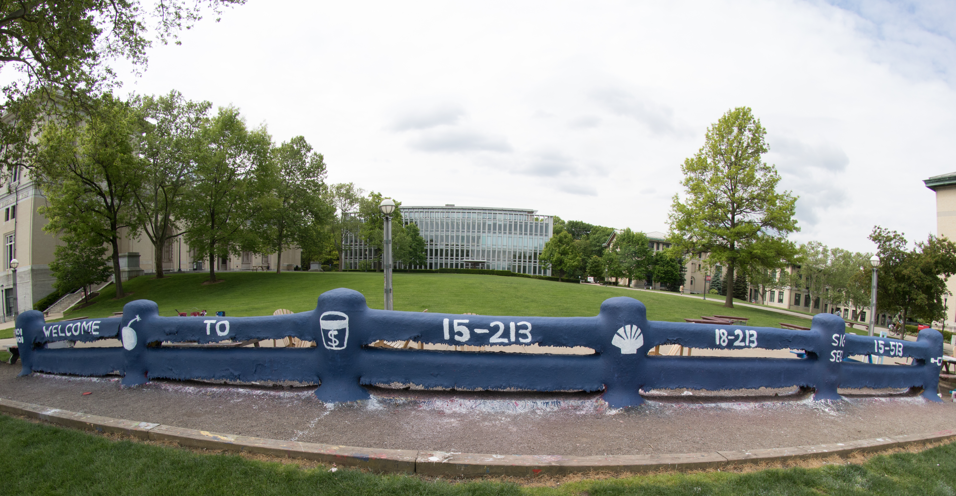
14-513
18-613

Slide 2
From Bits through Integers
18-213/18-613
Introduction to Computer Systems
2nd Lecture, August 31st, 2023

Slide 3
Bits, Bytes, and Integers
Representing information as bits CSAPP 2.1
Bit-level manipulations
Integers CSAPP 2.2
  Representation: unsigned and signed
  Conversion, casting
  Expanding, truncating
  Addition, negation, multiplication, shifting CSAPP 2.3
Byte Ordering CSAPP 2.1.3

Slide 4
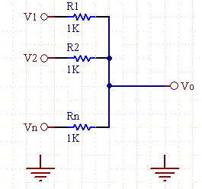
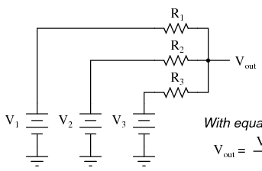
Analog Computers
Before digital computers there were analog computers.
Consider a couple of simple analog computers:
  A simple circuit can allow one to adjust voltages using variable resistors and measure the output using a volt meter:
  A simple network of adjustable parallel resistors can allow one to find the average of the inputs.
https://www.daycounter.com/Calculators/Voltage-Summer/Voltage-Summer-Calculator.phtml
https://www.quora.com/What-is-the-most-basic-voltage-adder-circuit-without-a-transistor-op-amp-and-any-external-supply

Slide 5
Needing Less Accuracy, Precision is Better
We don’t try to measure exactly
  We just ask, is it high enough to be “On”, or
  Is it low enough to be “Off”.
We have two states, so we have a binary, or 2-ary, system.
  We represent these states as 0 and 1
Now we can easily interpret, communicate, and duplicate signals well enough to know what they mean.
0
1
0
1.1V
0.9V
0.2V
0.0V

Slide 6
Binary Representation
Binary representation leads to a simple binary, i.e. base-2, numbering system
  0 represents 0
  1 represents 1
  Each “place” represents a power of two, exactly as each place in our usual “base 10”, 10-ary numbering system represents a power of 10
By encoding/interpreting sets of bits in various ways, we can represent different things:
  Operations to be executed by the processor, numbers, enumerable things, such as text characters
As long as we can assign it to a discrete number, we can represent it in binary

Slide 7
Binary Representation:
Simple Numbers
For example, we can count in binary, a base-2 numbering system
  000, 001, 010, 011, 100, 101, 110, 111, …
    000 = 0*2² + 0*2¹ ⁺ 0*2⁰ = 0 (in decimal)
    001 = 0*2² + 0*2¹ ⁺ 1*2⁰ = 1 (in decimal)
    010 = 0*2² + 1*2¹ ⁺ 0*2⁰ = 2 (in decimal)
    011 = 0*2² + 1*2¹ ⁺ 1*2⁰ = 3 (in decimal)
    Etc.
For reference, consider some base-10 examples:
    000 = 0*10² + 0*10¹ ⁺ 0*10⁰
    001 = 0*10² + 0*10¹ ⁺ 1*10⁰
    357 = 3*10² + 5*10¹ ⁺ 7*10⁰

Slide 8
Hexadecimal and Octal
Writing out numbers in binary takes too many digits
We want a way to represent numbers more densely such that fewer digits are required
  But also such that it is easy to get at the bits that we want
Any power-of-two base provides this property
  Octal, e.g. base-8, and hexadecimal, e.g. base-16 are the closest to our familiar base-10.
  Each has been used by “computer people” over time
  Hexadecimal is often preferred because it is denser.

Slide 9
Hexadecimal
Decimal
Hex
Binary
Hexadecimal 0016 to FF16
  Base 16 number representation
  Use characters ‘0’ to ‘9’ and ‘A’ to ‘F’
Consider 1A2B in Hexadecimal:
  1*16³ + A*16² + 2*16¹ + B*16⁰
  1*16³ + 10*16² + 2*16¹ + 11*16⁰ = 6699 (decimal)
  The C Language prefixes hexadecimal numbers with “0x” so they aren’t confused with decimal numbers
  Write FA1D37B16 in C as
    0xFA1D37B
    0xfa1d37b
0
0
0000
1
1
0001
2
2
0010
3
3
0011
4
4
0100
5
5
0101
6
6
0110
7
7
0111
8
8
1000
9
9
1001
A
10
1010
B
11
1011
C
12
1100
D
13
1101
E
14
1110
F
15
1111
18213: 0100 0111 0010 0101
4
7
2
5

Slide 10
Today: Bits, Bytes, and Integers
Representing information as bits
Bit-level manipulations
Integers
  Representation: unsigned and signed
  Conversion, casting
  Expanding, truncating
  Addition, negation, multiplication, shifting
Byte Ordering

Slide 11
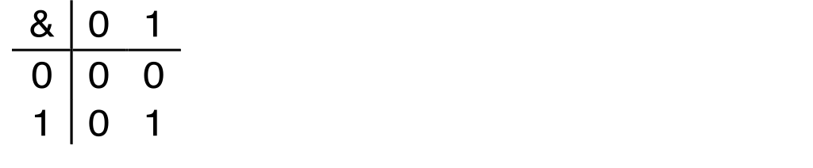
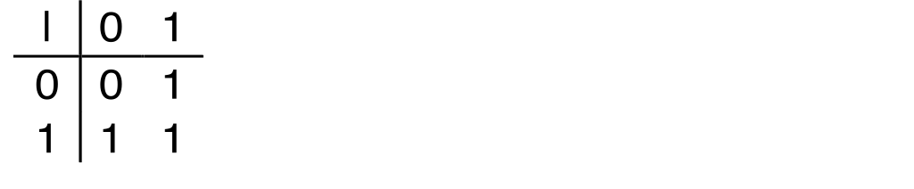
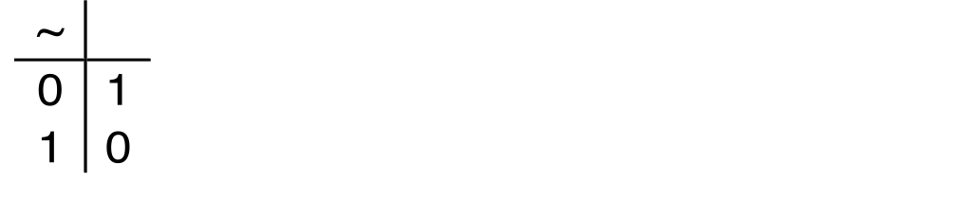
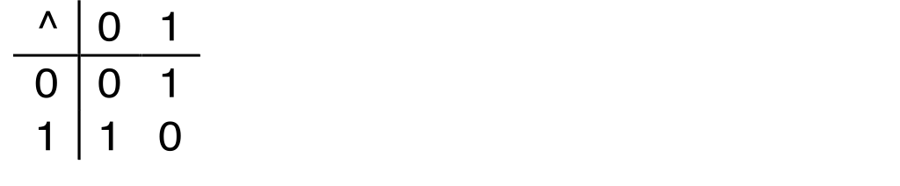
Boolean Algebra
Developed by George Boole in 19th Century
  Algebraic representation of logic
    Encode “True” as 1 and “False” as 0
And
A&B = 1 when both A=1 and B=1
Or
A|B = 1 when either A=1 or B=1
Not
~A = 1 when A=0
Exclusive-Or (Xor)
A^B = 1 when either A=1 or B=1, but not both

Slide 12
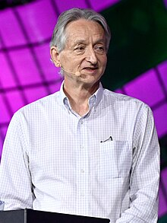
Fun fact: Modern Deep learning to Boole
Hinton received the 2018 Turing Award, often referred to as the "Nobel Prize of Computing", together with Yoshua Bengio and Yann LeCun, for their work on deep learning
Hinton is the of the great-great-grandson of mathematician and educator Mary Everest Boole and her husband, the logician George Boole
https://en.wikipedia.org/wiki/Geoffrey_Hinton

Slide 13
General Boolean Algebras
Operate on Bit Vectors
  Operations applied bitwise
All of the Properties of Boolean Algebra Apply
01101001
& 01010101
01000001
01101001
| 01010101
01111101
01101001
^ 01010101
00111100
~ 01010101
10101010
01000001
01111101
00111100
10101010

Slide 14
Example: Representing & Manipulating Sets
Representation
  Width w bit vector represents subsets of {0, …, w–1}
  a_{j} = 1 if j ∈ A
    01101001 { 0, 3, 5, 6 }
    76543210
    01010101 { 0, 2, 4, 6 }
    76543210
Operations
  & Intersection 01000001 { 0, 6 }
  | Union 01111101 { 0, 2, 3, 4, 5, 6 }
  ^ Symmetric difference 00111100 { 2, 3, 4, 5 }
  ~ Complement 10101010 { 1, 3, 5, 7 }

Slide 15
Bit-Level Operations in C
Decimal
Hex
Binary
Operations &, |, ~, ^ Available in C
  Apply to any “integral” data type
    long, int, short, char, unsigned
  View arguments as bit vectors
  Arguments applied bit-wise
Examples (Char data type)
  ~0x41 → 0xBE
    ~010000012 → 101111102
  ~0x00 → 0xFF
    ~000000002 → 111111112
  0x69 & 0x55 → 0x41
    011010012 & 010101012 → 010000012
  0x69 | 0x55 → 0x7D
    011010012 | 010101012 → 011111012
0
0
0000
1
1
0001
2
2
0010
3
3
0011
4
4
0100
5
5
0101
6
6
0110
7
7
0111
8
8
1000
9
9
1001
A
10
1010
B
11
1011
C
12
1100
D
13
1101
E
14
1110
F
15
1111

Slide 16
Bit-Level Operations in C
Decimal
Hex
Binary
Operations &, |, ~, ^ Available in C
  Apply to any “integral” data type
    long, int, short, char, unsigned
  View arguments as bit vectors
  Arguments applied bit-wise
Examples (Char data type)
  ~0x41 → 1011 11100xBE~010000012 → 101111102
  ~0x00 → 1111 11110xF~000000002 → 1111112
  0x69 & 0x55: 0x69 | 0x55:
  0110 1001 0110 1001
  & 0101 0101 | 0101 0101
  ----------------- -----------------
  0100 0001011010 0111 1101011010012 012 & 010101012 → 010000012
  0x7D
    011010012 | 010101012 → 011111012
0
0
0000
1
1
0001
2
2
0010
3
3
0011
4
4
0100
5
5
0101
6
6
0110
7
7
0111
8
8
1000
9
9
1001
A
10
1010
B
11
1011
C
12
1100
D
13
1101
E
14
1110
F
15
1111

Slide 17
Contrast: Logic Operations in C
Contrast to Bit-Level Operators
  Logic Operations: &&, ||, !
    View 0 as “False”
    Anything nonzero as “True”
    Always return 0 or 1
    Early termination
Examples (char data type)
  !0x41 → 0x00
  !0x00 → 0x01
  !!0x41→ 0x01
  0x69 && 0x55 → 0x01
  0x69 || 0x55 → 0x01
  p && *p (avoids null pointer access)
Watch out for && vs. & (and || vs. |)…
Super common C programming pitfall!

Slide 18
Shift Operations
Left Shift: x << y
  Shift bit-vector x left y positions
      Throw away extra bits on left
    Fill with 0’s on right
Right Shift: x >> y
  Shift bit-vector x right y positions
    Throw away extra bits on right
  Logical shift
    Fill with 0’s on left
  Arithmetic shift
    Replicate most significant bit on left
Undefined Behavior
  Shift amount < 0 or ≥ word size
Argument x
01100010
<< 3
00010000
00010000
00010000
Log. >> 2
00011000
00011000
00011000
Arith. >> 2
00011000
00011000
00011000
Argument x
10100010
<< 3
00010000
00010000
00010000
Log. >> 2
00101000
00101000
00101000
Arith. >> 2
11101000
11101000
11101000

Slide 19
Today: Bits, Bytes, and Integers
Representing information as bits
Bit-level manipulations
Integers
  Representation: unsigned and signed
  Conversion, casting
  Expanding, truncating
  Addition, negation, multiplication, shifting

Slide 20
Binary Number Lines
In binary, the number of bits in the data type size determines the number of points on the number line.
  We can assign the points any meaning we’d like
Consider the following examples:
  1 bit number line
  0 1
  2 bit number line
  00 01 10 11
  3 bit number line
  000 001 010 011 100 101 110 111

Slide 21
Some Purely Imaginary Examples
3 bit number line
  -1/16 -1/8 -1/4 0 1/16 1/8 1/4 1/2
  0 1 2 3 4 5 6 7
  -4 -3 -2 -1 0 1 2 3
  A B C D E F G H

Slide 22
Overflow
Let’s consider a simple 3 digit number line:
0 1 2 3 4 5 6 7
000 001 010 011 100 101 110 111
What happens if we add 1 to 7?
  In other words, what happens if we add 1 to 111?
111+ 001 = 1 000
  But, we only get 3 bits – so we lose the leading-1.
  This is called overflow
The result is 000

Slide 23
Modulus Arithmetic
Let’s explore this idea of overflow some more
  111 + 001 = 1 000 = 000
  111 + 010 = 1 001 = 001
  111 + 011 = 1 010 = 010
  111 + 100 = 1 011 = 011
  …
  111 + 110 = 1 101 = 101
  111 + 111 = 1 110 = 110
So, arithmetic “wraps around” when it gets “too positive”

Slide 24
Unsigned and Non-Negative Integers
We’ll use the term “ints” to mean the finite set of integer numbers that we can represent on a number line enumerated by some fixed number of bits, i.e. bit width.
We normally represent unsigned and non-negative int using simple binary as we have already discussed
  An “unsigned” int is any int on a number line, e.g. of a data type, that doesn’t contain any negative numbers
  A non-negative number is a number greater than or equal to (>=) 0 on a number line, e.g. of a data type, that does contain negative numbers

Slide 25
How represent negative Numbers?
We could use the leading bit as a sign bit:
  0 means non-negative
  1 means negative
  000 001 010 011 100 101 110 111
  0 1 2 3 -0 -1 -2 -3
This has some benefits
  It lets us represent negative and non-negative numbers
  0 represents 0
It also has some drawbacks
  There is a -0, which is the same as 0, except that it is different
  How to add such numbers 1 + -1 should equal 0
    But, by simple math, 001 + 101 = 110, which is -2?

Slide 26
A Magic Trick!
Let’s just start with three ideas:
  1 should be represented as 1
  -1 + 1 = 0
  We want addition to work in the familiar way, with simple rules.
We want a situation where “-1” + 1 = 0
Consider a 3 bit number:
  001 + “-1” = 0
  001 + 111 = 0
    Remember 001 + 111 = 1 000, and the leading one is lost to overflow.
“-1” = 111
  Yep!

Slide 27
Negative Numbers
Well, if 111 is -1, what is -2?
  -1 - 1
  111 – 001 = 110
Does that really work?
  If it does -2 + 2 = 0
  110 + 010 = 1 000 = 000
-2 + 5 should be 3, right?
  110 + 101 = 1 011 = 011

Slide 28
Finding –x the easy way
Given a non-negative number in binary, e.g. 5, represented with a fixed bit width, e.g. 4
  0101
We can find its negative by flipping each bit and adding 1
  0101 This is 5
  1010 This is the “ones complement of 5”, e.g. 5 with bits flipped
  1011 This is the “twos complement of 5”, e.g. 5 with the bits flipped and 1 added
  0101 + 1011 = 1 0000 = 0000
  -x = ~x+1
Because of the fixed width, the “two’s complement” of a number can be used as its negative.

Slide 29
Why Does This Work?
Consider any number and its (ones) complement:
  0101
  1010
They are called complements because complementary bits are set. As a result, if they are added, all bits are necessarily set:
  0101 + 1010 = 1111
Adding 1 to the sum of a number and its complement necessarily results in a 0 due to overflow
  (0101 + 1010) + 1 = 1111 + 1 = 1 0000 = 0000
And if x + y = 0, y must equal –x

Slide 30
Why Does This Work? Cont.
If x + y = 0
  y must equal –x
So if x + (Complement(x) + 1) = 0
  Complement(x) + 1 must equal –x
Another way of looking at it:
  if x + (Complement(x) + 1) = 0
  x + Complement(x) = -1
  x = -1 - Complement(x)
  -x = 1 + Complement(x)

Slide 31
Visualizing Two’s Complement
Numbers “wrap around” with -1 at the very end
  000 001 010 011 100 101 110 111
  0 1 2 3 -4 -3 -2 -1
A few things to note:
  All negative numbers start with a ”1”
    E.g. 100 is “-4”
  You can view the leading “1” as introducing a “-4”
    E.g. 101 = 1*-4+0*2+1*1= -3
    But 010 = 0*-4+1*2+0*1 = 2
  -4 is missing a positive partner

Slide 32
Complement & Increment Examples
x = 0
x = Tmin (The most negative two’s complement number)
Canonical counter example

Slide 33
Encoding Integers: Dense Form
Unsigned
Two’s Complement
short int x = 15213;
short int y = -15213;
Sign Bit
C does not mandate using two’s complement
  But, most machines do, and we will assume so
C short (2 bytes long)
Sign Bit
  For 2’s complement, most significant bit indicates sign
    0 for nonnegative, 1 for negative

Slide 34
Numeric Ranges
Unsigned Values
  UMin = 0
    000…0
  UMax = 2^{w} – 1
    111…1
Two’s Complement Values
  TMin = –2^{w–1}
    100…0
  TMax = 2^{w–1} – 1
    011…1
  Minus 1
    111…1
Values for W = 16

Slide 35
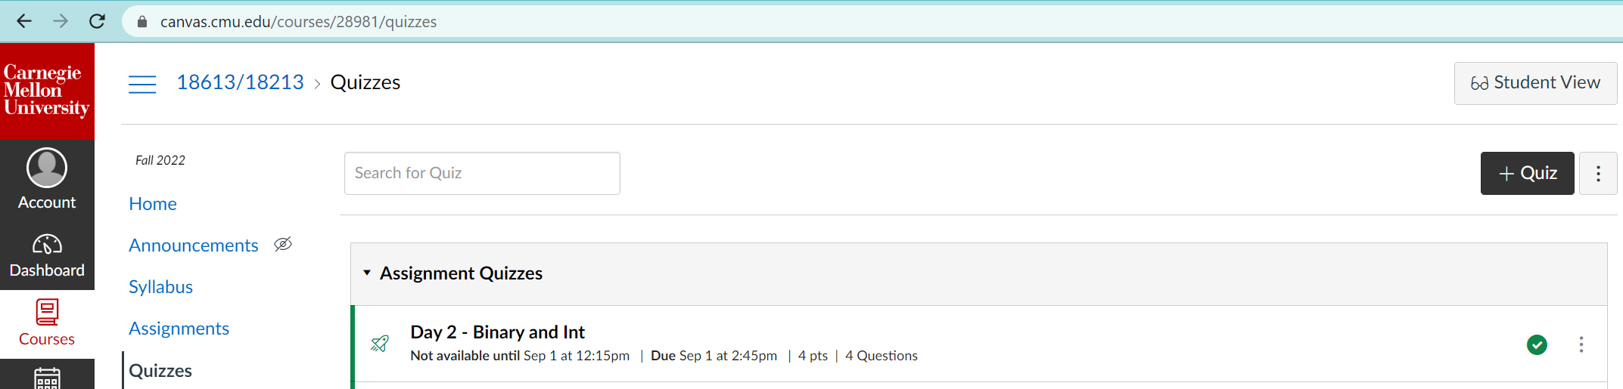
Quiz Time!

Slide 36
Today: Bits, Bytes, and Integers
Representing information as bits
Bit-level manipulations
Integers
  Representation: unsigned and signed
  Conversion, casting
  Expanding, truncating
  Addition, negation, multiplication, shifting
Byte Ordering

Slide 37
Mapping Signed ↔ Unsigned
Bits
0000
0001
0010
0011
0100
0101
0110
0111
1000
1001
1010
1011
1100
1101
1110
1111
Signed
0
1
2
3
4
5
6
7
-8
-7
-6
-5
-4
-3
-2
-1
Unsigned
0
1
2
3
4
5
6
7
8
9
10
11
12
13
14
15
=
+/- 16

Slide 38
Relation between Signed & Unsigned
Two’s Complement
Unsigned
T2U
x
T2B
B2U
ux
X
Maintain Same Bit Pattern
w–1
0
ux
+
+
+
• • •
+
+
+
x
-
+
+
• • •
+
+
+
Large negative weight
becomes
Large positive weight

Slide 39
Conversion Visualized
2’s Comp. → Unsigned
  Ordering Inversion
  Negative → Big Positive
UMax
UMax – 1
TMax + 1
Unsigned
Range
TMax
TMax
2’s Complement Range
0
0
–1
–2
TMin

Slide 40
Signed vs. Unsigned in C
Constants
  By default are considered to be signed integers
  Unsigned if have “U” as suffix
    0U, 4294967259U
Casting
  Explicit casting between signed & unsigned same as U2T and T2U
    int tx, ty;
    unsigned ux, uy;
    tx = (int) ux;
    uy = (unsigned) ty;
  Implicit casting also occurs via assignments and procedure calls
    tx = ux; int fun(unsigned u);
    uy = ty; uy = fun(tx);

Slide 41
Casting Surprises
Expression Evaluation
  If there is a mix of unsigned and signed in single expression,
  signed values implicitly cast to unsigned
  Including comparison operations <, >, ==, <=, >=
  Examples for W = 32: TMIN = -2,147,483,648 , TMAX = 2,147,483,647
Constant₁ Constant₂ Relation Evaluation
  0 0U
  -1 0
  -1 0U
  2147483647 -2147483647-1
  2147483647U -2147483647-1
  -1 -2
  (unsigned)-1 -2
  2147483647 2147483648U
  2147483647 (int) 2147483648U
  0 0U == unsigned
  -1 0 < signed
  -1 0U > unsigned
  2147483647 -2147483648 > signed
  2147483647U -2147483648 < unsigned
  -1 -2 > signed
  (unsigned) -1 -2 > unsigned
  2147483647 2147483648U < unsigned
  2147483647 (int) 2147483648U > signed

Slide 42
Summary
Casting Signed ↔ Unsigned: Basic Rules
Bit pattern is maintained
But reinterpreted
Can have unexpected effects: adding or subtracting 2^{w}
Expression containing signed and unsigned int
  int is cast to unsigned!!

Slide 43
Today: Bits, Bytes, and Integers
Representing information as bits
Bit-level manipulations
Integers
  Representation: unsigned and signed
  Conversion, casting
  Expanding, truncating
  Addition, negation, multiplication, shifting
Byte Ordering

Slide 44
Sign Extension
Task:
  Given w-bit signed integer x
  Convert it to w+k-bit integer with same value
Rule:
  Make k copies of sign bit:
  X’ = x_{w–1} ,…, x_{w–1} , x_{w–1} , x_{w–2} ,…, x₀
k copies of MSB
w
X
• • •
• • •
X’
• • •
• • •
k
w

Slide 45
Sign Extension: Simple Example
Positive number
Negative number
-16 | 8 | 4 | 2 | 1
0 | 1 | 0 | 1 | 0
-16 | 8 | 4 | 2 | 1
1 | 0 | 1 | 1 | 0
10 =
-10 =
-32 | 16 | 8 | 4 | 2 | 1
0 | 0 | 1 | 0 | 1 | 0
-32 | 16 | 8 | 4 | 2 | 1
1 | 1 | 0 | 1 | 1 | 0
10 =
-10 =

Slide 46
Truncation
Task:
  Given k+w-bit signed or unsigned integer X
  Convert it to w-bit integer X’ with same value for “small enough” X
Rule:
  Drop top k bits:
  X’ = x_{w–1} , x_{w–2} ,…, x₀
k
w
X
• • •
• • •
• • •
X’
• • •
w

Slide 47
Truncation: Simple Example
No sign change
Sign change
-16 | 8 | 4 | 2 | 1
0 | 0 | 0 | 1 | 0
-16 | 8 | 4 | 2 | 1
0 | 1 | 0 | 1 | 0
2 =
10 =
 | -8 | 4 | 2 | 1
 | 0 | 0 | 1 | 0
 | -8 | 4 | 2 | 1
 | 1 | 0 | 1 | 0
2 =
-6 =
2 mod 16 = 2
10 mod 16 = 10U mod 16 = 10U = -6
-16 | 8 | 4 | 2 | 1
1 | 1 | 0 | 1 | 0
-16 | 8 | 4 | 2 | 1
1 | 0 | 1 | 1 | 0
-6 =
-10 =
 | -8 | 4 | 2 | 1
 | 1 | 0 | 1 | 0
 | -8 | 4 | 2 | 1
 | 0 | 1 | 1 | 0
-6 =
6 =
-6 mod 16 = 26U mod 16 = 10U = -6
-10 mod 16 = 22U mod 16 = 6U = 6

Slide 48
Summary:
Expanding, Truncating: Basic Rules
Expanding (e.g., short int to int)
  Unsigned: zeros added
  Signed: sign extension
  Both yield expected result
Truncating (e.g., unsigned to unsigned short)
  Unsigned/signed: bits are truncated
  Result reinterpreted
  Unsigned: mod operation
  Signed: similar to mod
  For small (in magnitude) numbers yields expected behavior

Slide 49
Today: Bits, Bytes, and Integers
Representing information as bits
Bit-level manipulations
Integers
  Representation: unsigned and signed
  Conversion, casting
  Expanding, truncating
  Addition, negation, multiplication, shifting
Byte Ordering

Slide 50
Unsigned Addition
u
Operands: w bits
• • •
+
v
• • •
True Sum: w+1 bits
u + v
• • •
Discard Carry: w bits
UAdd_{w}(u , v)
• • •
Decimal
Hex
Binary
Standard Addition Function
  Ignores carry output
Implements Modular Arithmetic
  s = UAdd_{w}(u , v) = u + v mod 2^{w}
0
0
0000
1
1
0001
2
2
0010
3
3
0011
4
4
0100
5
5
0101
6
6
0110
7
7
0111
unsigned char
1110 1001
+ 1101 0101
E9
+ D5
223
+ 213
8
8
1000
9
9
1001
A
10
1010
1 1011 1110
1BE
446
B
11
1011
C
12
1100
1011 1110
BE
190
D
13
1101
E
14
1110
F
15
1111

Slide 51
Two’s Complement Addition
Operands: w bits
u
• • •
+
v
• • •
True Sum: w+1 bits
u + v
• • •
Discard Carry: w bits
TAdd_{w}(u , v)
• • •
TAdd and UAdd have Identical Bit-Level Behavior
  Signed vs. unsigned addition in C:
  int s, t, u, v;
  s = (int) ((unsigned) u + (unsigned) v);
  t = u + v
  Will give s == t
1110 1001
+ 1101 0101
E9
+ D5
-23
+ -43
1 1011 1110
1BE
-66
1011 1110
BE
-66

Slide 52
Visualizing “True Sum” Integer Addition
Integer Addition
  4-bit integers u, v
  Compute true sum Add₄(u , v)
  Values increase linearly with u and v
  Forms planar surface
Add₄(u , v)
v
u

Slide 53
Visualizing Unsigned Addition
Wraps Around
  If true sum ≥ 2^{w}
  At most once
Overflow
UAdd₄(u , v)
True Sum
2^{w+1}
Overflow
2^{w}
v
0
Modular Sum
u

Slide 54
Visualizing 2’s Complement Addition
NegOver
Values
  4-bit two’s comp.
  Range from -8 to +7
Wraps Around
  If sum ≥ 2^{w–1}
    Becomes negative
    At most once
  If sum < –2^{w–1}
    Becomes positive
    At most once
TAdd₄(u , v)
v
u
PosOver

Slide 55
Multiplication
Goal: Computing Product of w-bit numbers x, y
  Either signed or unsigned
Result: Same as computing ideal, exact result x*y and keeping w lower bits.
Ideal,exact results can be bigger than w bits
  Worst case is up to 2w bits
    Unsigned, because all bits are magnitude
    Signed, but only for Tmin*Tmin, because anything added to Tmin reduces its magnitude and Tmax is less than Tmin.
So, maintaining exact results…
  would need to keep expanding word size with each product computed
  Impossible in hardware (at least without limits), as all resources are finite
  In practice, is done in software, if needed
    e.g., by “arbitrary precision” arithmetic packages

Slide 56
Power-of-2 Multiply with Shift
Operation
  u << k gives u * 2^{k}
  Both signed and unsigned
Examples
  u << 3 == u * 8
  (u << 5) – (u << 3) == u * 24
  Most machines shift and add faster than multiply
    Compiler generates this code automatically
k
u
• • •
Operands: w bits
*
2^{k}
0
•••
0
1
0
•••
0
0
True Product: w+k bits
u · 2^{k}
• • •
0
•••
0
0
Discard k bits: w bits
UMult_{w}(u , 2^{k})
•••
0
•••
0
0
TMult_{w}(u , 2^{k})

Slide 57
Unsigned Power-of-2 Divide with Shift
Quotient of Unsigned by Power of 2
  u >> k gives ⎣ u / 2^{k} ⎦
    Uses logical shift
k
u
•••
•••
Binary Point
Operands:
/
2^{k}
0
•••
0
1
0
•••
0
0
Division:
u / 2^{k}
0
.
0
•••
0
0
•••
•••
Result:
⎣ u / 2^{k} ⎦
0
0
•••
0
0
•••

Slide 58
Signed Power-of-2 Divide with Shift
Quotient of Signed by Power of 2
  x >> k gives ⎣ x / 2^{k} ⎦
    Uses arithmetic shift
    Rounds to the left, not towards zero (Unlikely to be what is expected, introduces a bias).
k
x
•••
•••
Binary Point
Operands:
/
2^{k}
0
•••
0
1
0
•••
0
0
Division:
x / 2^{k}
0
•••
•••
.
•••
Result:
RoundDown(x / 2^{k})
0
•••
•••

Slide 59
Round-toward-0 Divide
Quotient of Negative Number by Power of 2
  Want ⎡ x / 2^{k} ⎤ (Round Toward 0)
  Compute as ⎣ (x+(2^{k}-1))/ 2^{k} ⎦
    In C: (x + (1<<k)-1) >> k
    Biases dividend toward 0
Case 1: No rounding
k
Dividend:
u
1
•••
0
•••
0
0
+2^{k} –1
0
•••
0
0
1
•••
1
1
Binary Point
1
•••
1
•••
1
1
Divisor:
/
2^{k}
0
•••
0
1
0
•••
0
0
⎡ u / 2^{k} ⎤
0
.
1
•••
1
1
1
•••
1
•••
1
1
    Biasing has no effect

Slide 60
Correct Power-of-2 Divide (Cont.)
Case 2: Rounding
k
Dividend:
x
1
•••
•••
+2^{k} –1
0
•••
0
0
1
•••
1
1
1
•••
•••
Incremented by 1
Binary Point
Divisor:
/
2^{k}
0
•••
0
1
0
•••
0
0
⎡ x / 2^{k} ⎤
.
0
1
•••
1
1
1
•••
•••
Incremented by 1
    Biasing adds 1 to final result

Slide 61
Today: Bits, Bytes, and Integers
Representing information as bits
Bit-level manipulations
Integers
  Representation: unsigned and signed
  Conversion, casting
  Expanding, truncating
  Addition, negation, multiplication, shifting
Byte Ordering

Slide 62
Byte Ordering
So, how are the bytes within a multi-byte word ordered in memory?
Conventions
  Big Endian: Sun (Oracle SPARC), PPC Mac, Internet
    Least significant byte has highest address
  Little Endian: x86, ARM processors running Android, iOS, and Linux
    Least significant byte has lowest address
Becomes a concern when data is communicated
  Over a network, via files, etc.
Important notes
  Bits are not reversed, as the low order bit is the reference point.
  Doesn’t affect chars, or strings (arrays of chars), as chars are only one byte

Slide 63
Byte Ordering Example
Example
  Variable x has 4-byte value of 0x01234567
  Address given by &x is 0x100
Big Endian
0x100
0x101
0x102
0x103
01
01
23
23
45
45
67
67
Little Endian
0x100
0x101
0x102
0x103
67
67
45
45
23
23
01
01

Slide 64

Fun Fact: Endianness
The adjective endian has its origin in the writings of 18th century Anglo-Irish writer Jonathan Swift. In the 1726 novel Gulliver's Travels, he portrays the conflict between sects of Lilliputians divided into those breaking the shell of a boiled egg from the big end or from the little end.
https://en.wikipedia.org/wiki/Endianness

Slide 65
Reading Byte-Reversed Listings
Disassembly
  Text representation of binary machine code
  Generated by program that reads the machine code
Example Fragment
Deciphering Numbers
  Value: 0x12ab
  Pad to 32 bits: 0x000012ab
  Split into bytes: 00 00 12 ab
  Reverse: ab 12 00 00
Address Instruction Code Assembly Rendition
8048365: 5b pop %ebx
8048366: 81 c3 ab 12 00 00 add $0x12ab,%ebx
804836c: 83 bb 28 00 00 00 00 cmpl $0x0,0x28(%ebx)

Slide 66
Today: Bits, Bytes, and Integers
Representing information as bits CSAPP 2.1
Bit-level manipulations
Integers CSAPP 2.2
  Representation: unsigned and signed
  Conversion, casting
  Expanding, truncating
  Addition, negation, multiplication, shifting CSAPP 2.3
Byte Ordering CSAPP 2.1.3
Questions?

