Slide 1
Optical Computing for Fast Light Transport Analysis, 2010
Authors: Matthew O’Toole and Kiriakos Kutulakos Presented by: Allen Hawkes and Sida Wang

Slide 2
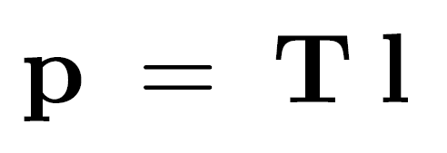
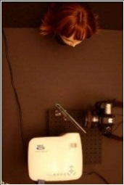
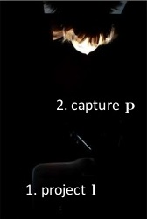
Basic Concept
T-reconstruct pipeline: set up cameras/light sources, come up with sampling scheme, come up with algorithm to reconstruct T
Similar pipeline, estimation of T via “optical computing”
Iterative numerical methods for matrix estimation
Scene lighting + image capture can replace a matrix-vector in these methods
Use this T-estimation as previously seen (scene relighting, light source detection)

Slide 3
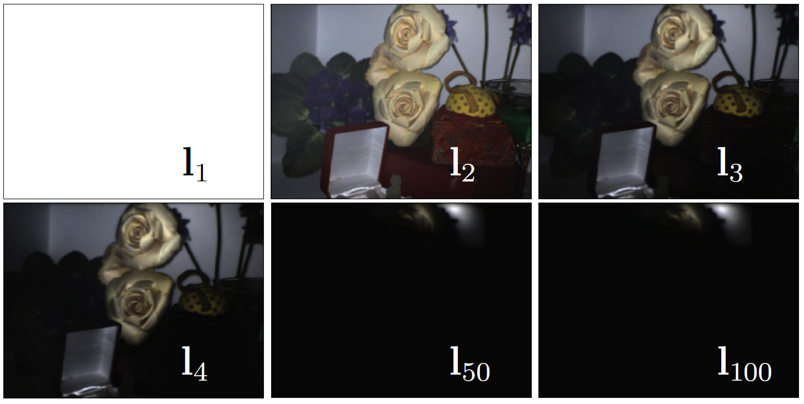
Example: Optical Power Iteration
want to get principal eigenvector of T
use current photo as basis for illumination of next image capture
iterate until convergence
final image is principal eigenvector of T [Trefethen and Bau 1997, non-optical]
only 1 eigenvector, can be slow

Slide 4
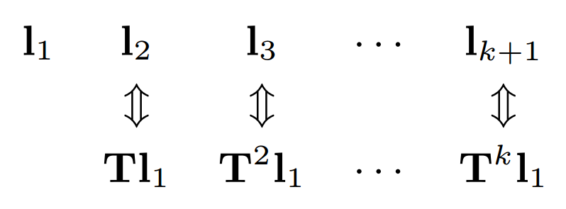
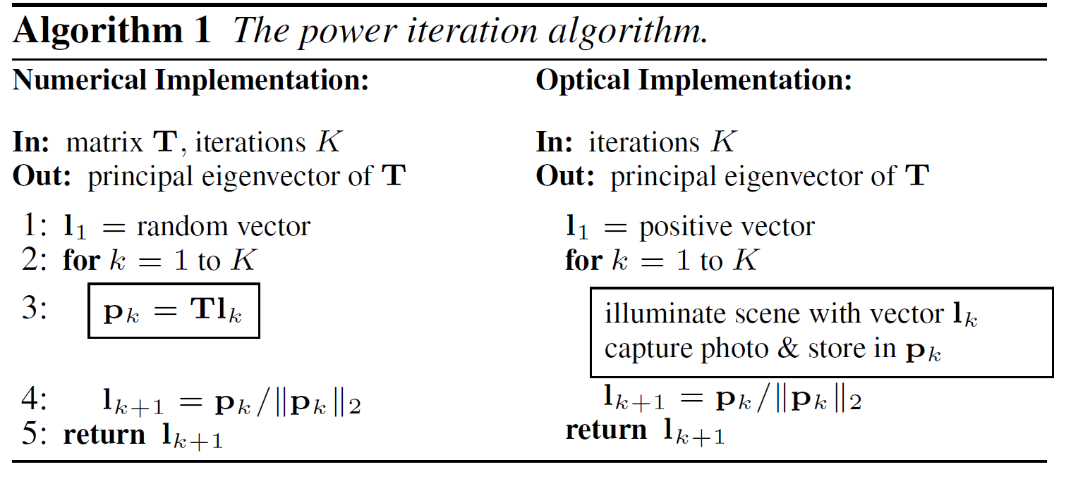
Krylov Subspace Methods
Power iteration after k steps gives a span of vectors
This span of vectors is the k-dim Krylov subspace
span of vectors given initial illumination and T
(optical case)

Slide 5
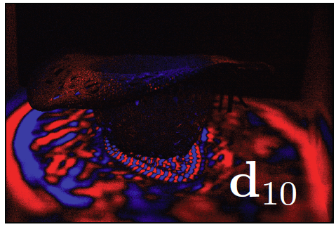
Krylov Subspace Methods
Optical Matrix-vector products for general vectors
need to multiply T with negative vectors, can’t have negative light
create a general vector as difference between positive, negative
positive/negative light can be assigned to 2 different colors, for example

Slide 6
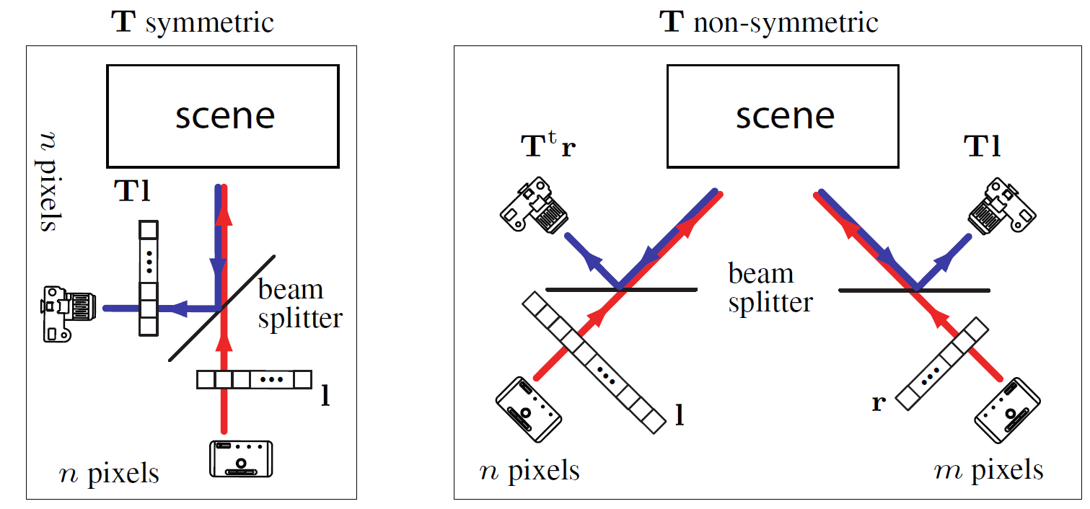
Krylov Subspace Methods
Symmetric vs. non-symmetric transport matrices
Convergence of some methods dependent on T-symmetry
2 ways to enforce symmetry:
optically multiply by a different matrix which is symmetric

Slide 7
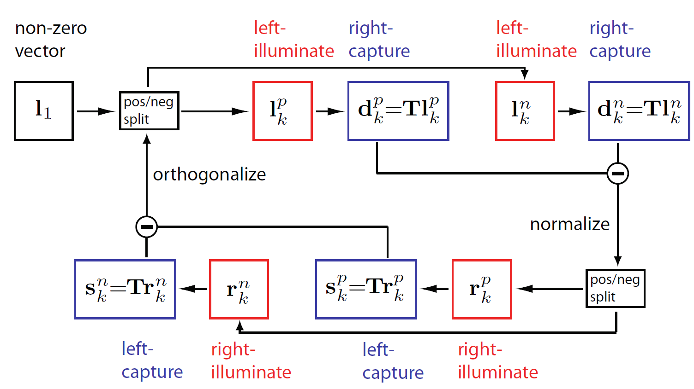
Transport Acquisition - Optical Arnoldi
Builds rank k approximation of T

Slide 8
Transport Acquisition - Optical Arnoldi
Output T is dense, low-rank (good for natural lighting scenes with minimal mirror reflection and sharp shadows)
reverse of previous methods: eigenvectors of T used to acquire it
relighting:

Slide 9
Inverse Transport - Optical GMRES
Least squares problem
Difference with Arnoldi’s: Initial illumination vector is a photo p

Slide 10
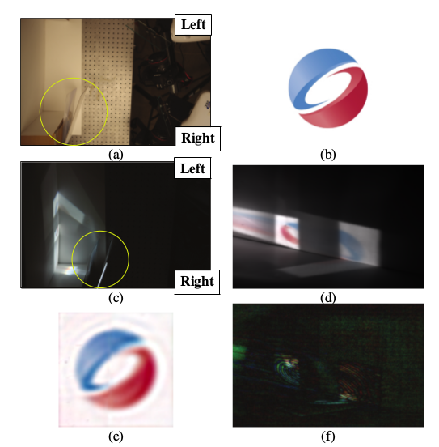
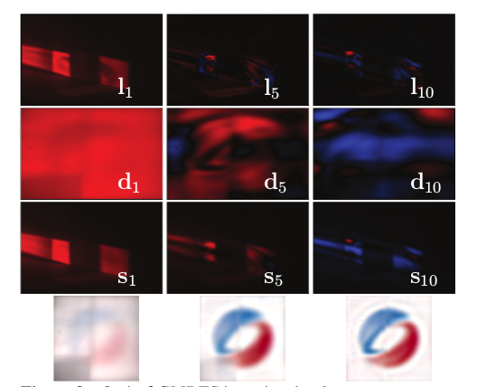
Inverse Transport - Optical GMRES

Slide 11
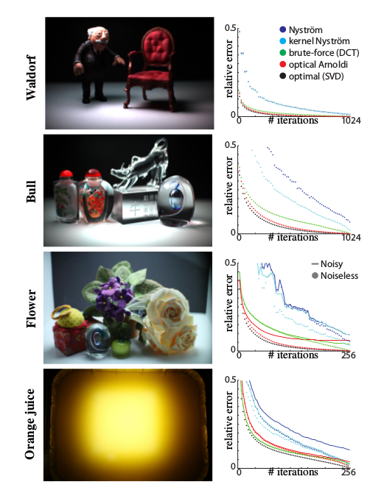
Result-Acquiring Transport Matrices with Optical Arnoldi
T: ground truth matrix

Slide 12
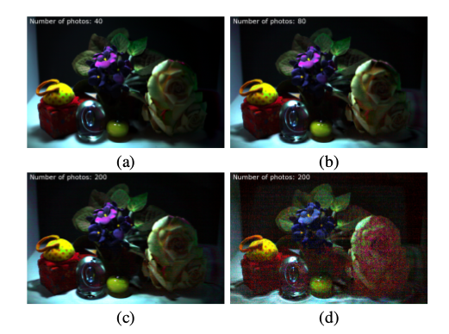
Results-Acquiring Transport Matrices with Optical Arnoldi
10 iterations for Arnoldi, 200 photos
20 iterations for Arnoldi, 200 photos
50 iterations for Arnoldi, 200 photos
Nystrom

Slide 13
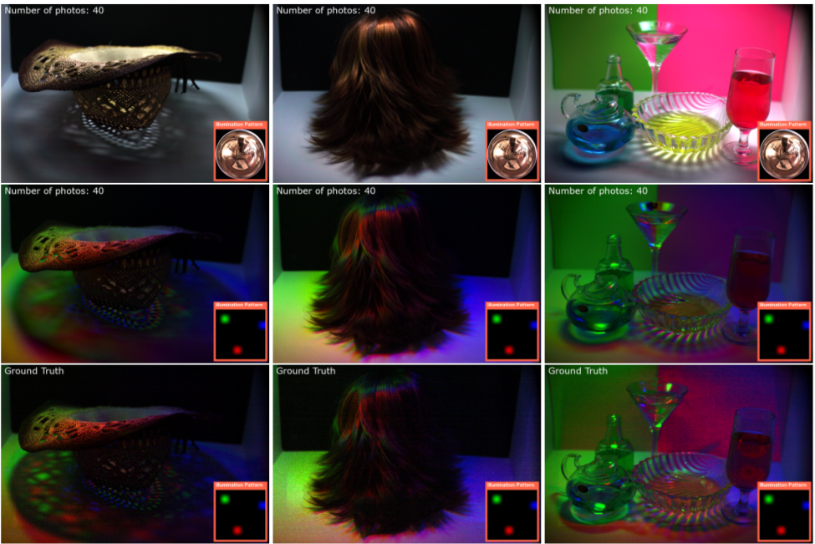
rank 10
rank 10
spatially -
localized
Actual photo

Slide 14
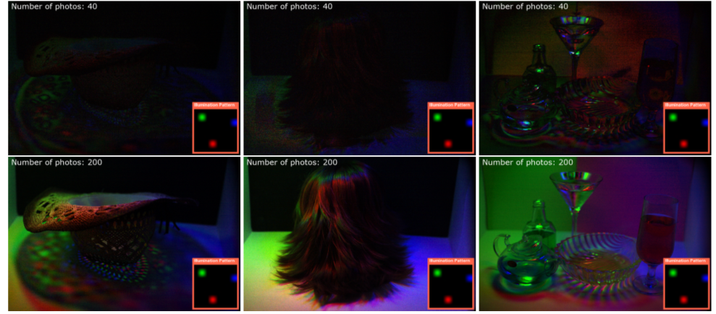
Difference between actual photo and relit image
rank 50

Slide 15
Conclusions
Built optical methods from existing numerical methods
Have theoretical bounds on convergence rate
Methods applied easily to large matrices (i.e. T)
Limitations:
Optical Arnoldi performs poorly for high-rank matrices
Optical GMRES inverts only 1 image (at a time)

Slide 16
Pros and Cons
Grade: 1.1
Pros:
simple, intuitive method requires relatively few photos
is fast for relighting/inverse transport
Cons:
leave most technical details in previous works

Slide 17
Questions?

