Slide 1
A Dictionary-based Approach for Estimating Shape and Spatially-Varying Reflectance Zhuo Hui and Aswin C. Sankaranarayanan ECE Department, Carnegie Mellon University
Shumian Xin
Chao Liu

Slide 2
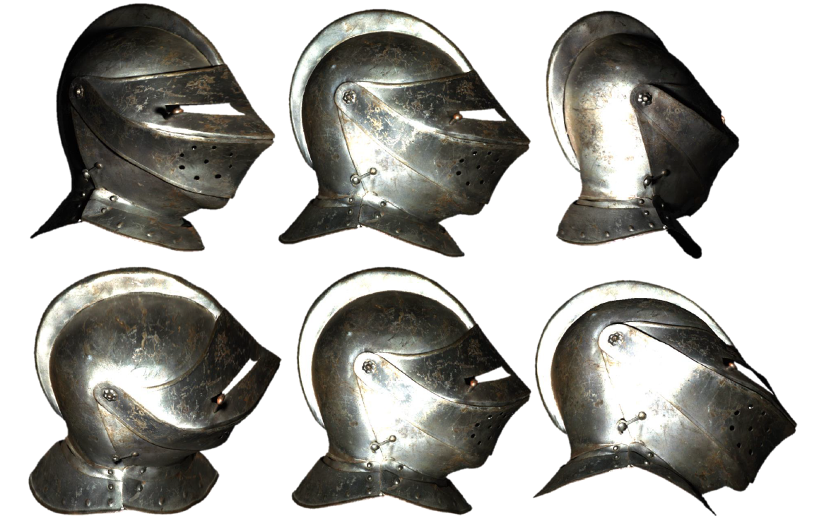
Per-pixel estimation of the shape (surface normals) and reflectance (spatially-varying BRDF) of an object.
Notes:
Spatially invariant BRDF

Slide 3
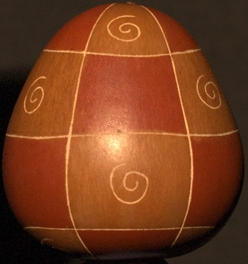
Given images captured with known light sources,
Estimate spatially variant BRDF and surface normals.

Slide 4
Assumptions
Distant point light source (incidence are parallel),
known direction;
Constant viewing direction ${v∈ℝ}^{3}$ across scene points
Convex shape: no shadows, inter-reflection
Isotropic material
source
camera
normal
surface
element

Slide 5
BRDF representation
$$ρ(θ_{i},φ_{i};θ_{o},φ_{o})$$
$$ρ(θ_{h},φ_{h};θ_{d},φ_{d})$$
S. Rusinkiewicz. A new change of variables for efficient brdf representation. In Rendering techniques, pages 11–22. 1998.

Slide 6
BRDF representation
Isotropic: $ρ\left(θ_{h},φ_{h};θ_{d},φ_{d}\right) →ρ\left(θ_{h}, θ_{d},φ_{d}\right)$
$θ_{h},θ_{d}∈\left[0, π/2\right), φ_{d}∈[0, 2π)$
Helmholtz’s reciprocity:
$ρ\left(θ_{h}, θ_{d},φ_{d}\right)$ = $ρ\left(θ_{h}, θ_{d},φ_{d}+π\right)$
$θ_{h},θ_{d}∈\left[0, π/2\right), φ_{d}∈[0, π)$
$1°$sampling: a BRDF $→$ a point in a
$T=90×90×180$ dimensional space

Slide 7
Problem formulation
$p=(x, y)$, surface normal $n_{p}$, BRDF $ρ_{p}$, lighting $l_{i}$,
Intensity value $I_{p}^{i}$
s : sampling function
dot product ~ integration
shading
$ρ_{p}→$ a point in a $T=90×90×180$ dimensional space
Notes:
Image formation

Slide 8
Problem formulation
Multiple images $\left\{I^{1},…, I^{Q}\right\}$:
varying lighting direction ${l_{i}∈ℝ}^{3}$ in the i-th image $I^{i}$
same viewing direction $v$
Intractable without additional assumptions!
Notes:
Q<<T

Slide 9
Model for BRDF
Key assumption
Constrain the BRDF to M-dimension, M << T = 90x90x180

Slide 10
Solution outline
A non-convex optimization problem

Slide 11
Solution Methodology
Surface Normal $n_{p}$ Estimation
coarse-to-fine search
BRDF estimation
fix $n_{p}$, optimize $c_{p}$

Slide 12
Surface Normal Estimation
2 Spheres, one diffuse, one specular:
a collection of candidate normals $𝒩$
F$or \tilde{n}$, we have $I_{D}(\tilde{n})$, $I_{s}(\tilde{n})$
$$I_{p}={a_{1}I}_{D}\left(\tilde{n}\right)+{a_{2}I}_{s}(\tilde{n})$$
A. Hertzmann and S. Seitz. Example-based photometric stereo: Shape reconstruction with general, varying BRDFs. PAMI, 27:1254–1264, 2005.
Notes:
The surface normal estimation now reduces to finding the candidate normal that can best explain the intensity profile.

Slide 13
Virtual example-based Normal Estimation
$$I_{p}={a_{1}I}_{D}\left(\tilde{n}\right)+{a_{2}I}_{s}(\tilde{n})$$
Render virtual spheres
lighting $\left\{l^{1},…, l^{Q}\right\}$, $D=\left[ρ^{1}, …,ρ^{M}\right]$;
Two spheres -> Q x $M$ spheres
$$B\left(\tilde{n}\right)=[b_{ij}\left(\tilde{n}\right)]∈ℝ^{Q×M}$$
Notes:
the intensity observed at a surface with normal n and BRDF, under lighting li .
For each candidate normal, we have such a B matrix.

Slide 14
Virtual example-based Normal Estimation
Render virtual spheres
lighting $\left\{l^{1},…, l^{Q}\right\}$, $D=\left[ρ^{1}, …,ρ^{M}\right]$; for each $\tilde{n} ∈𝒩$,
$$B\left(\tilde{n}\right)=[b_{ij}\left(\tilde{n}\right)]∈ℝ^{Q×M}$$
Two spheres -> Many virtually rendered spheres
Dictionary D: MERL database (100 materials)
Notes:
the intensity observed at a surface with normal n and BRDF , under lighting li .
For each candidate normal, we have such a B matrix.

Slide 15
$$B\left(\tilde{n}\right)=A\left(\tilde{n}\right)D$$
$$B\left(\tilde{n}\right)=[b_{ij}\left(\tilde{n}\right)]$$
$\left|𝒩\right|↑ :$accuracy $↑$ ☺ computational cost $↑$ ☹
$\left|𝒩\right|↓ :$computational cost $↓$ ☺ accuracy $↓$ ☹
Notes:
Drop the sparsity term for computational efficiency

Slide 16
Coarse-to-fine search for n
Coarse-to-fine search for n
$$B\left(\tilde{n}\right)=A\left(\tilde{n}\right)D$$
Notes:
Evaluate $\tilde{n}$ at a coarser sampling -> finer samplings

Slide 17
Coarse-to-fine search for n
$𝒩_{θ}$ : set of equi-angular sampling on the unit-sphere, $θ$-degree spacing
Notes:
Evaluate $\tilde{n}$ at a coarser sampling -> finer samplings

Slide 18
BRDF Estimation for c
BRDF Estimation for c
A convex optimization problem
Notes:
Solve for each color channel separately

Slide 19
Results
Synthetic experiments
MERL Database ^{[1]}
leave-one-out scheme: 100 materials in total
Lighting directions ^{[2]} : USC light stage data
[1] M. . Wojciech, P. Hanspeter, B. Matt, and M. Leonard. A data-driven reflectance model. TOG, 22:759–769, 2003.
[2] P. Einarsson, C. Chabert, A. Jones, W. Ma, B. Lamond, T. Hawkins, M. Bolas, S. Sylwan, and P. Debevec. Relighting human locomotion with flowed reflectance fields. In Rendering techniques, 2006.

Slide 20
Varying number of images
Surface normal 20,000 random orientations
100 materials

Slide 21
Surface normal estimation for varying BRDF
Surface normal 50,000 random orientations
100 materials
# of input images = 253
Notes:
“The worst case error is less than 2 and the error tapers down to 0:5 which is the finest sampling that we used for generating candidate normals. This can presumably be reduced by either choosing a finer sampling grid or using gradient descent techniques.”

Slide 22
BRDF estimations
BRDF Error
Surface normal 100 random orientations
100 materials
# of input images = 253
Notes:
‘when the information at the 100 normals are pooled’: error = sum over all known normals in eq.5

Slide 23
Comparison with other methods
Notes:
253 input images [how about less images ?]

Slide 24
Results
Real data
USC Light Stage dataset ^{[1]}
Gourd Dataset from UCSD^{[2]}
[1] P. Einarsson, C. Chabert, A. Jones, W. Ma, B. Lamond, T. Hawkins, M. Bolas, S. Sylwan, and P. Debevec. Relighting human locomotion with flowed reflectance fields. In Rendering techniques, 2006.
[2] N. Alldrin, T. Zickler, and D. Kriegman. Photometric stereo with non-parametric and spatially-varying reflectance. In CVPR, 2008.
Notes:
Gourd dataset: http://vision.ucsd.edu/~nalldrin/research/cvpr08/datasets/

Slide 25
- 100 input images

Slide 26
Robustness of per-pixel estimation
Difficulties: various materials, inter-reflections, shadows
- 250 input images

Slide 27
Pros and Cons
Pros
Use of dictionary simplify the inverse problem
Per-pixel normal and BRDF estimation technique, may further speed up
Handle arbitrary complex spatial variations in the BRDF
Cons
Time-consuming
Noisy estimation: also because of the per-pixel estimation
Limitations
The dictionary needs to be sufficient
Require light calibration

Slide 28
Possible future works
Per-pixel based –> Segments based
A more clever way to compromise between smoothness and BRDF estimations
Experiment: Less input images required; different $λ$ for sparsity
Maybe estimate the surface normal and BRDF iteratively to get more precise results?

Slide 29
Q & A

