Slide 1
Algorithms for Large Sequential Incomplete-Information Games
Tuomas Sandholm
Professor
Carnegie Mellon University
Computer Science Department

Slide 2
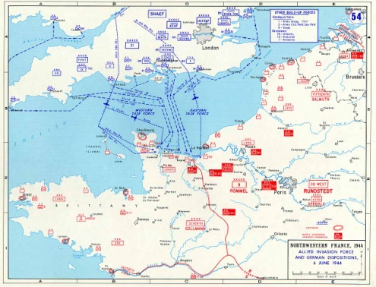
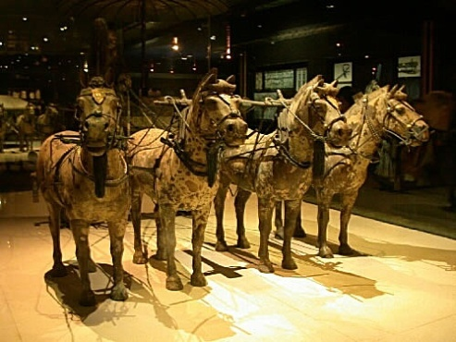

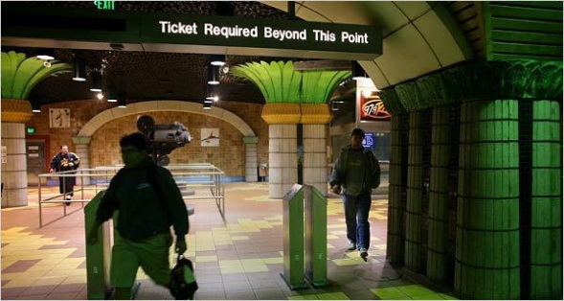
Most real-world games are incomplete-information games with sequential (& simultaneous) moves
Negotiation
Multi-stage auctions (e.g., FCC ascending, combinatorial auctions)
Sequential auctions of multiple items
  A robot facing adversaries in uncertain, stochastic envt
Card games, e.g., poker
Currency attacks
International (over-)fishing
Political campaigns (e.g., TV spending in each region)
Ownership games (polar regions, moons, planets)
Allocating (and timing) troops/armaments to locations
  US allocating troops in Afghanistan & Iraq
  Military spending games, e.g., space vs ocean
  Airport security, air marshals, coast guard, rail [joint w Tambe]
  Cybersecurity ...
Notes:
(e.g., China owns US reserves)
Has bluffs: Pas de Calais, Israel’s war with Lebanon, Qin’s army, forts
Combat

Slide 3
Sequential incomplete-information games
Challenges
  Imperfect information
  Risk assessment and management
  Speculation and counter-speculation:
  Interpreting signals and avoiding signaling too much
Techniques for complete-info games don’t apply
Techniques I will discuss are domain-independent

Slide 4
Game theory
Definition. Strategy is a mapping from known history to action
In multi-agent systems, an agent’s outcome depends on the actions of others’
  =>Agent’s optimal strategy depends on others’ strategies
Definition. A (Bayes) Nash equilibrium is a strategy (and beliefs) for each agent such that no agent benefits from using a different strategy
Notes:
Game theory is the mathematical study of such environments.
Does EGT/CFR compute BNE or PBE?

Slide 5
Simple example
Player 2
Rock
Paper
Scissors
1/3
1/3
1/3
Rock
1/3
0, 0 | -1, 1 | 1, -1
1, -1 | 0, 0 | -1, 1
-1, 1 | 1, -1 | 0, 0
Player 1
Paper
1/3
Scissors
1/3

Slide 6
Basics about Nash equilibria
In 2-person 0-sum games,
  Nash equilibria are minimax equilibria => no equilibrium selection problem
  If opponent plays a non-equilibrium strategy, that only helps me
Any finite sequential game (satisfying perfect recall) can be converted into a matrix game
  Exponential blowup in #strategies
Sequence form: More compact representation based on sequences of moves rather than pure strategies [Romanovskii 62, Koller & Megiddo 92, von Stengel 96]
  2-person 0-sum games with perfect recall can be solved in time polynomial in size of game tree using LP
  Cannot solve Rhode Island Hold’em (3.1 billion nodes) or Texas Hold’em (10¹⁸ nodes)
Notes:
Exponential blowup in #strategies (even in reduced normal form).

Slide 7
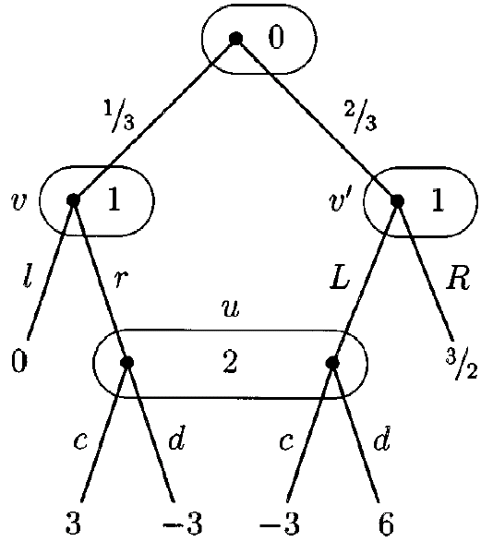
Extensive form representation
Players I = {0, 1, …, n}
Tree (V,E)
  Terminals Z ⊆ V
Controlling player P: V \ Z H
Information sets H={H₀,…, H_{n}}
Actions A = {A₀, …, A_{n}}
Payoffs u : Z R^{n}
Chance probabilities p
Perfect recall assumption: Players never forget information
Game from: Bernhard von Stengel. Efficient Computation of Behavior
Strategies. In Games and Economic Behavior 14:220-246, 1996.

Slide 8
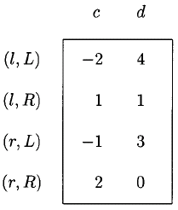
Computing equilibria via normal form
Normal form exponential, in worst case and in practice (e.g. poker)

Slide 9
Sequence form
[Romanovskii 62, re-invented in English-speaking literature: Koller & Megiddo 92, von Stengel 96]
Instead of a move for every information set, consider choices necessary to reach each information set and each leaf
These choices are sequences and constitute the pure strategies in the sequence form
S₁ = {{}, l, r, L, R}
S₂ = {{}, c, d}

Slide 10
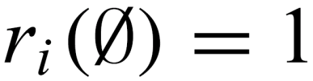
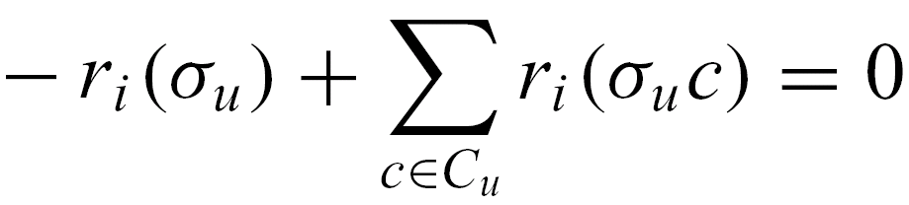
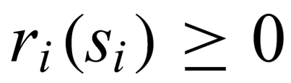
Realization plans
Players’ strategies are specified as realization plans over sequences:
Prop. Realization plans are equivalent to behavior strategies.

Slide 11
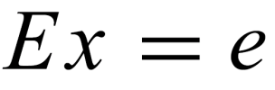
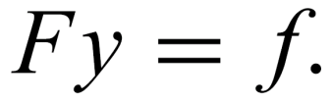

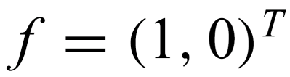
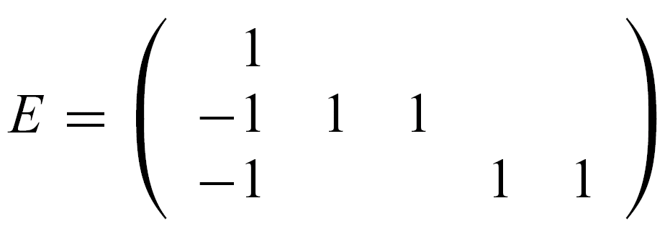
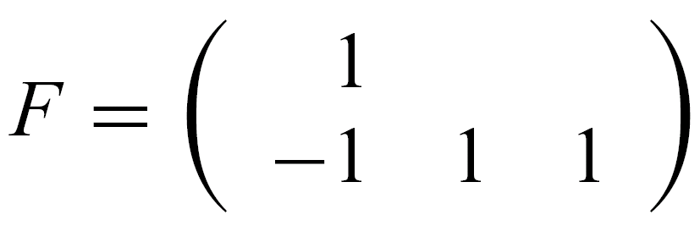
Computing equilibria via sequence form
Players 1 and 2 have realization plans x and y
Realization constraint matrices E and F specify constraints on realizations
{} l r L R
{}
v
v’
{} c d
{}
u

Slide 12
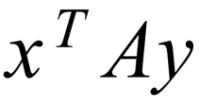
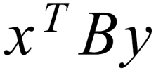
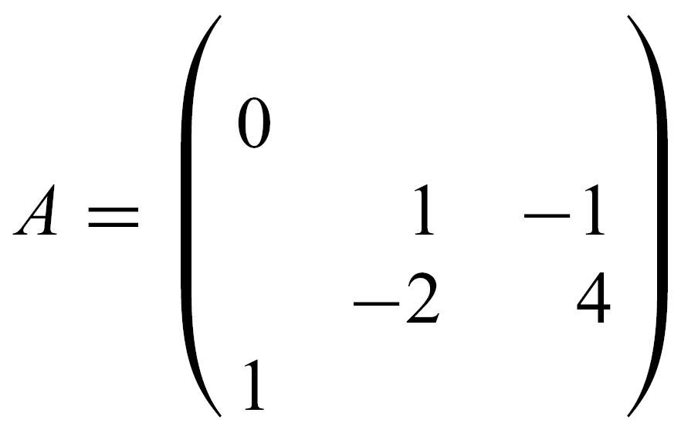
Computing equilibria via sequence form
Payoffs for player 1 and 2 are: and
for suitable matrices A and B
Creating payoff matrix:
  Initialize each entry to 0
  For each leaf, there is a (unique) pair of sequences corresponding to an entry in the payoff matrix
  Weight the entry by the product of chance probabilities along the path from the root to the leaf
{} c d
{}
l
r
L
R

Slide 13
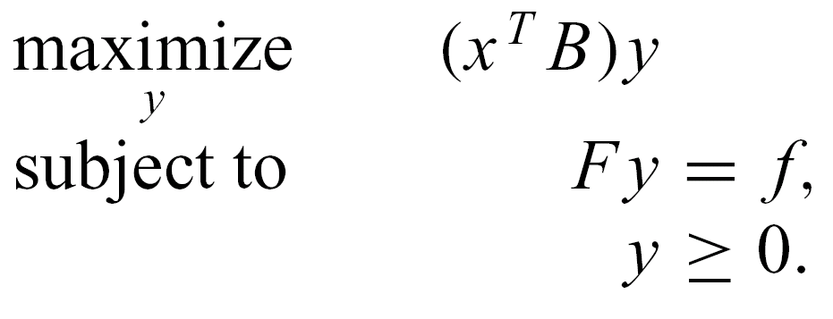
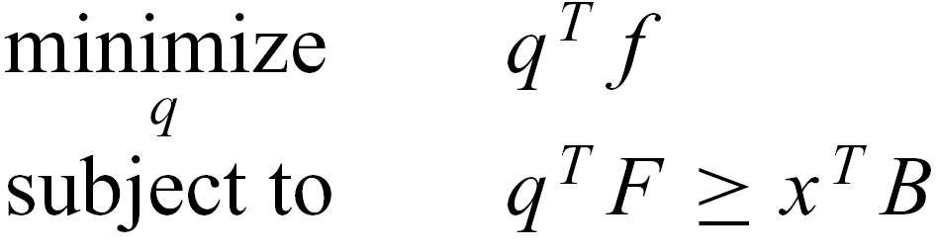
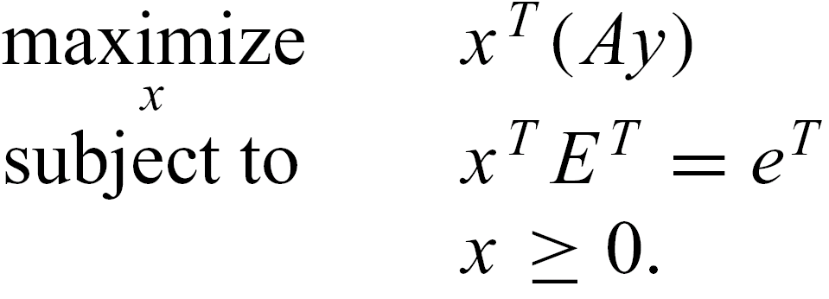
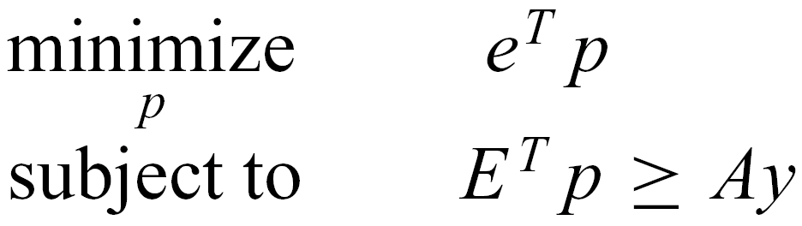
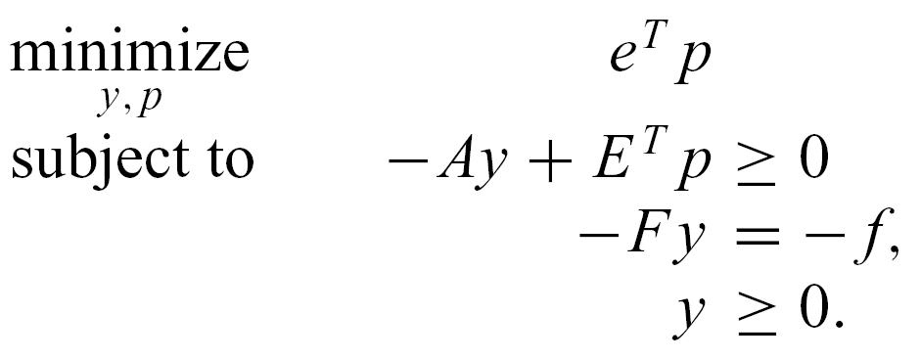
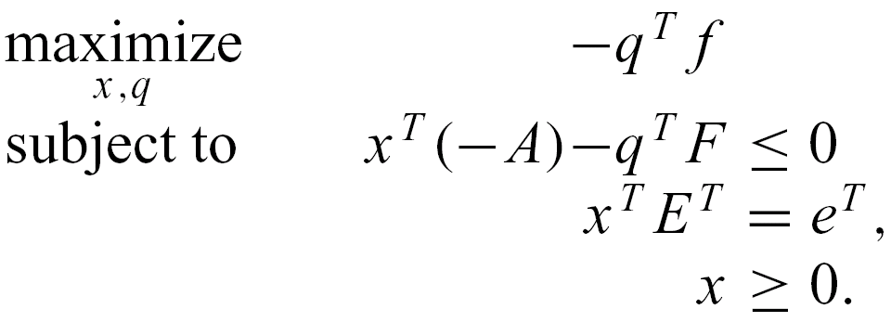
Computing equilibria via sequence form
Primal
Dual
Holding x fixed,
compute best response
Holding y fixed,
compute best response
Now, assume 0-sum. The latter primal and dual must have same optimal value e^{T}p.
That is the amount that player 2, if he plays y, has to give to player 1, so player 2 tries to minimize it:
Primal
Dual

Slide 14



Computing equilibria via sequence form:
An example
min p1
subject to
x1: p1 - p2 - p3 >= 0
x2: 0y1 + p2 >= 0
x3: -y2 + y3 + p2 >= 0
x4: 2y2 - 4y3 + p3 >= 0
x5: -y1 + p3 >= 0
q1: -y1 = -1
q2: y1 - y2 - y3 = 0
bounds
y1 >= 0 y2 >= 0 y3 >= 0
p1 Free p2 Free p3 Free

Slide 15
Sequence form summary
Polytime algorithm for finding a Nash equilibrium in 2-player zero-sum games
Polysize linear complementarity problem (LCP) for computing Nash equilibria in 2-player general-sum games
Major shortcomings:
  Not well understood when more than two players
  Sometimes, polynomial is still slow and or large (e.g. poker)…

Slide 16
Games and information
Games can be differentiated based on the information available to the players
  Perfect information games: players have complete knowledge about the state of the world
    Examples: Chess, Go, Checkers
  Imperfect information games: players face uncertainty about the state of the world
    Examples:
      A robot facing adversaries in an uncertain, stochastic environment
      Almost any economic situation in which the other participants possess private information (e.g. valuations, quality information)
      Almost any card game in which the other players’ cards are hidden
    This class of games presents several challenges for AI
      Imperfect information
      Risk assessment and management
      Speculation and counter-speculation

Slide 17
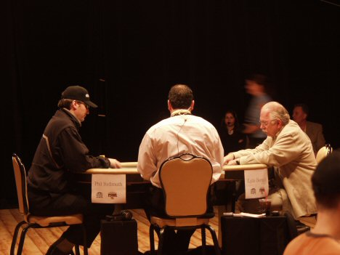
Poker
Recognized challenge problem in AI
  Hidden information (other players’ cards)
  Uncertainty about future events
  Deceptive strategies needed in a good player
Very large game trees
Texas Hold’em is the most popular variant
On NBC:
Notes:
Heads-Up is highly complex & difficult to play well.
Picture is a Heads-Up competition televised by NBC.

Slide 18
Outline
Abstraction
Equilibrium finding in 2-person 0-sum games
Strategy purification
Opponent exploitation
Multiplayer stochastic games
Leveraging qualitative models

Slide 19
Other methods for finding equilibria
Fictitious play
  Convergence only guaranteed for zero-sum games
Tabu best-response search [Sureka & Wurman 2005]
  Finds pure strategy equilibria
  Does not require game to be completely specified
Lemke-Howson algorithm
  Pivoting algorithm for finding one Nash equilibrium
  Very similar to the simplex algorithm for LP
Support enumeration methods
  Porter-Nudelman-Shoham [2004]
  Mixed-Integer Programming Nash [Sandholm et al 2005]

Slide 20
Our approach
Automated abstraction + equilibrium finding

Slide 21
Our approach [Gilpin & S., EC’06, JACM’07…]
Now used by all competitive Texas Hold’em programs
Original game
Abstracted game
Automated abstraction
Custom
equilibrium-finding
algorithm
Nash equilibrium
Reverse model
Nash equilibrium
Notes:
Reverse model is straightforward if only signals are abstracted, but an interesting problem if also actions are abstracted, as in No-Limit Texas Hold’em.

Slide 22
Outline
Automated abstraction
  Lossless
  Lossy
New equilibrium-finding algorithms

Slide 23
Outline
Automated abstraction
  Lossless
  Lossy
New equilibrium-finding algorithms
Stochastic games with >2 players, e.g., poker tournaments
Current & future research

Slide 24
Outline
Lossless automated abstraction
  Optimal strategies for Rhode Island Hold’em
Approximate automated abstraction
  “Greedy” (GS1)
  Clustering and integer programming (GS2)
  Potential-aware (GS3)
Equilibrium-finding algorithms
  Adapting Nesterov’s excessive gap technique to sequential games
  Making it scalable
  New related algorithm with exponentially better speed
Future research
Thoughts on application games of national importance

Slide 25
Our approach
We introduce automated abstraction techniques that result in smaller, (nearly) equivalent games
  For the optimal version of our algorithm:
    We prove that a Nash equilibrium in the smaller game corresponds to a Nash equilibrium in the original game
    The smaller game can then be solved using standard techniques
  For the approximate versions of our algorithm:
    We demonstrate their effectiveness by applying the algorithm to Texas Hold’em poker and comparing with other poker-playing programs
We also improve the equilibrium-finding algorithms themselves

Slide 26
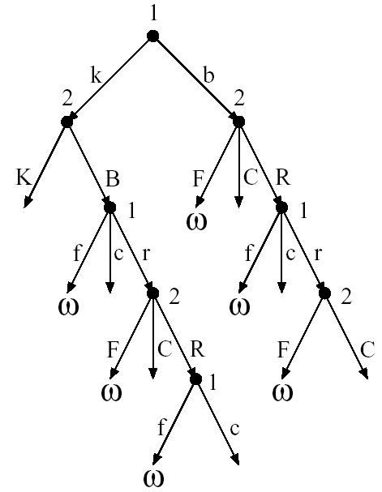
Game with ordered signals
(a.k.a. ordered game)
I = {1,2}
Players I = {1,…,n}
Stage games G = G₁,…,G_{r}
Player label L
Game-ending nodes ω
Signal alphabet Θ
Signal quantities κ = κ₁,…,κ_{r} and γ = γ₁,…,γ_{r}
Signal probability distribution p
Partial ordering ≥ of subsets of Θ
Utility function u (increasing in private signals)
κ = (0,1,1)
γ = (1,0,0)
Θ = {2♠,…,A♦}
Uniform
Hand rank

Slide 27
Reasons to abstract
Scalability (computation speed & memory)
Game may be so complicated that can’t model without abstraction
Existence of equilibrium, or solving algorithm, may require a certain kind of game, e.g., finite
Notes:
All modeling is abstraction!

Slide 28
Lossless abstraction
[Gilpin & S., EC’06, JACM’07]

Slide 29
Information filters
Observation: We can make games smaller by filtering the information a player receives
Instead of observing a specific signal exactly, a player instead observes a filtered set of signals
  E.g. receiving signal {A♠,A♣,A♥,A♦} instead of A♥
Notes:
Information filters isolate signal history from action history

Slide 30
Signal tree
Each edge corresponds to the revelation of some signal by nature to at least one player
Our lossless abstraction algorithm operates on it
  Don’t load full game into memory

Slide 31
Isomorphic relation
Captures the notion of strategic symmetry between nodes
Defined recursively:
  Two leaves in signal tree are isomorphic if for each action history in the game, the payoff vectors (one payoff per player) are the same
  Two internal nodes in signal tree are isomorphic if they are siblings and there is a bijection between their children such that only ordered game isomorphic nodes are matched
We compute this relationship for all nodes using a DP plus custom perfect matching in a bipartite graph

Slide 32
Abstraction transformation
Merges two isomorphic nodes
Theorem. If a strategy profile is a Nash equilibrium in the abstracted (smaller) game, then its interpretation in the original game is a Nash equilibrium
Assumptions
  Observable player actions
  Players’ utility functions rank the signals in the same order
Notes:
Interpretation into the original game is straightforward.

Slide 33
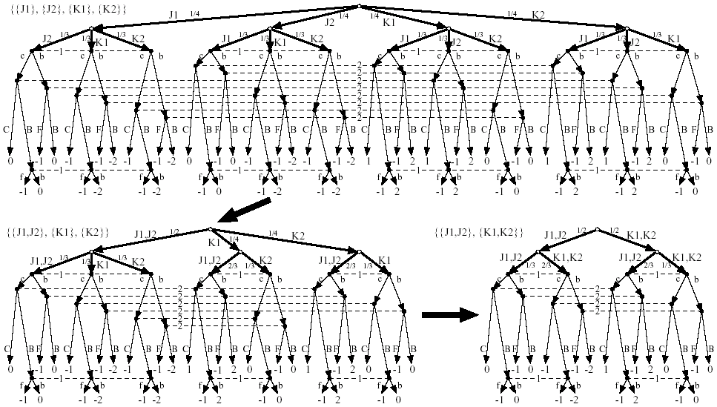

Slide 36
GameShrink algorithm
Bottom-up pass: Run DP to mark isomorphic pairs of nodes in signal tree
Top-down pass: Starting from top of signal tree, perform the transformation where applicable
Theorem. Conducts all these transformations
  Õ(n²), where n is #nodes in signal tree
  Usually highly sublinear in game tree size

Slide 37
Algorithmic techniques for making GameShrink faster
Union-Find data structure for efficient representation of the information filter (unioning finer signals into coarser signals)
  Linear memory and almost linear time
Eliminate some perfect matching computations using easy-to-check necessary conditions
  Compact histogram databases for storing win/loss frequencies to speed up the checks
Notes:
E.g., unioning ace of spades and ace of clubs into{ace of spades or ace of clubs.

Slide 38
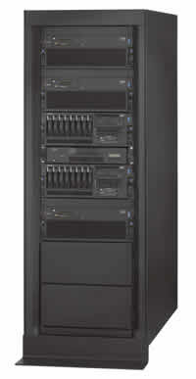
Solved Rhode Island Hold’em poker
AI challenge problem [Shi & Littman 01]
  3.1 billion nodes in game tree
Without abstraction, LP has 91,224,226 rows and columns => unsolvable
GameShrink runs in one second
After that, LP has 1,237,238 rows and columns
Solved the LP
  CPLEX barrier method took 8 days & 25 GB RAM
Exact Nash equilibrium
Largest incomplete-info game solved
by then by over 4 orders of magnitude

Slide 39
Lossy abstraction

Slide 40
Prior game abstractions
(automated or manual)
Lossless [Gilpin & Sandholm, EC’06, JACM’07]
Lossy without bound [Shi and Littman CG-02; Billings et al. IJCAI-03; Gilpin & Sandholm, AAAI-06, -08, AAMAS-07; Gilpin, Sandholm & Soerensen AAAI-07, AAMAS-08; Zinkevich et al. NIPS-07; Waugh et al. AAMAS-09, SARA-09;…]
  Exploitability can sometimes be checked ex post [Johanson et al. IJCAI-11]
Notes:
Sometimes have to use lossy abstraction if lossless abstraction is too large to solve.

Slide 41
We developed many lossy abstraction algorithms
Scalable to large n-player, general-sum games, e.g., Texas Hold’em
Gilpin, A. and Sandholm, T. 2008. Expectation-Based Versus Potential-Aware Automated Abstraction in Imperfect Information Games: An Experimental Comparison Using Poker. AAAI.
Gilpin, A., Sandholm, T., Troels Bjerre Sørensen 2008. A heads-up no-limit Texas Hold'em poker player: Discretized betting models and automatically generated equilibrium-finding programs. AAMAS.
Gilpin, A., Sandholm, T., Soerensen, T. 2007. Potential-Aware Automated Abstraction of Sequential Games, and Holistic Equilibrium Analysis of Texas Hold'em Poker. AAAI.
Gilpin, A., Sandholm, T. 2007. Better automated abstraction techniques for imperfect information games, with application to Texas Hold'em poker. In AAMAS.
Gilpin, A., Sandholm, T. 2006. A competitive Texas Hold'em Poker player via automated abstraction and real-time equilibrium computation. AAAI.

Slide 42
Texas Hold’em poker

Slide 43
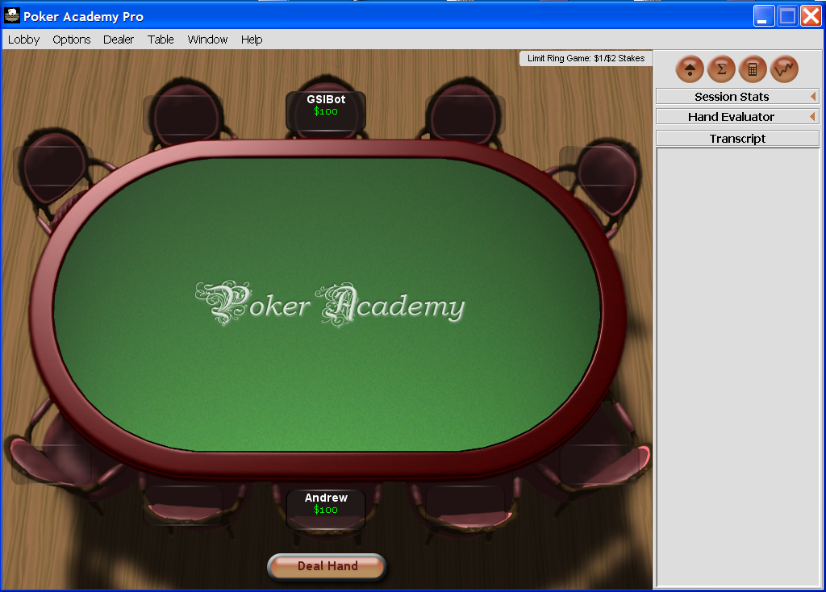

Slide 44
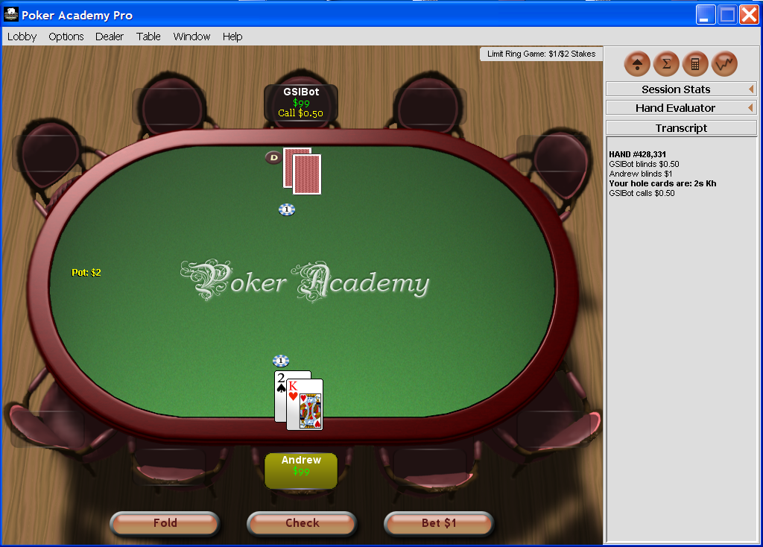

Slide 45
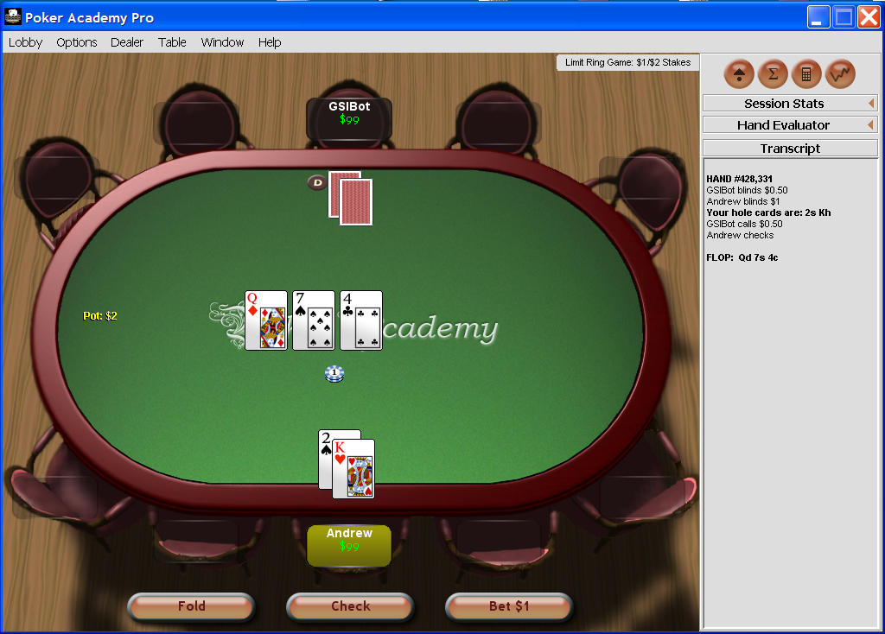

Slide 46
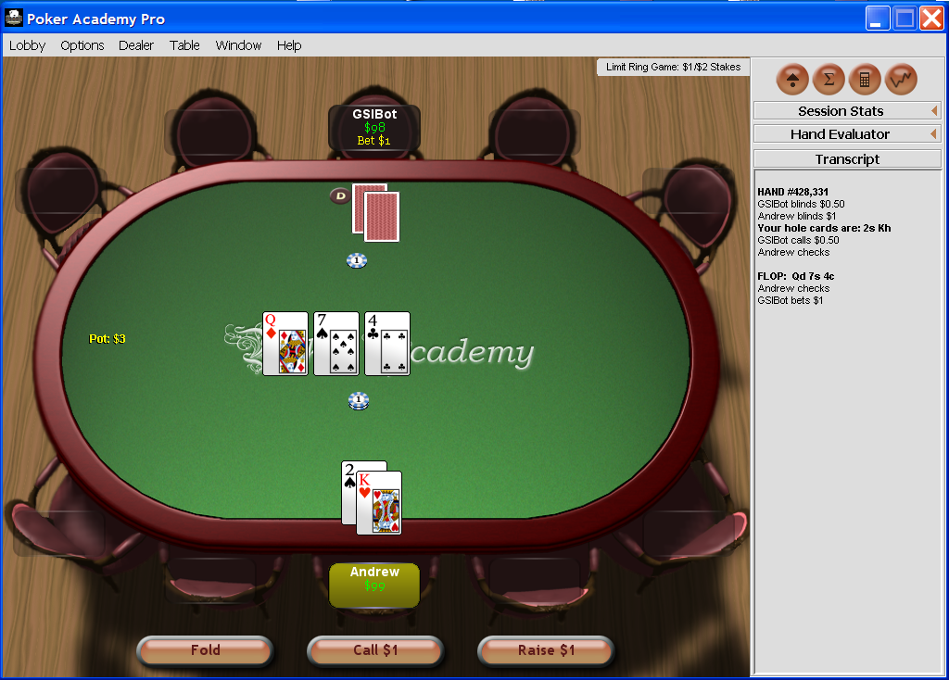

Slide 47
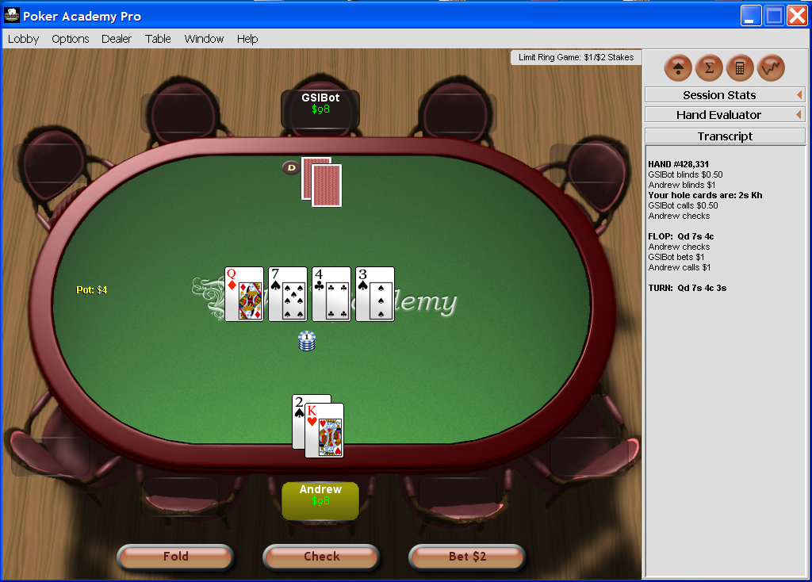

Slide 48
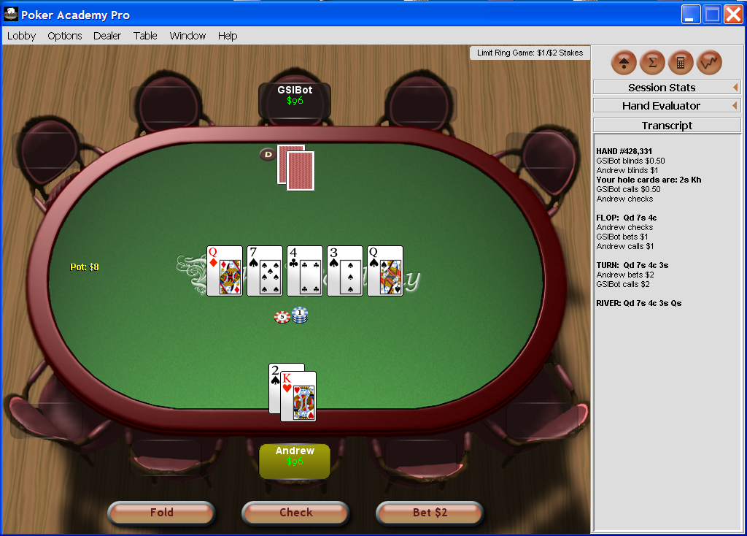

Slide 49
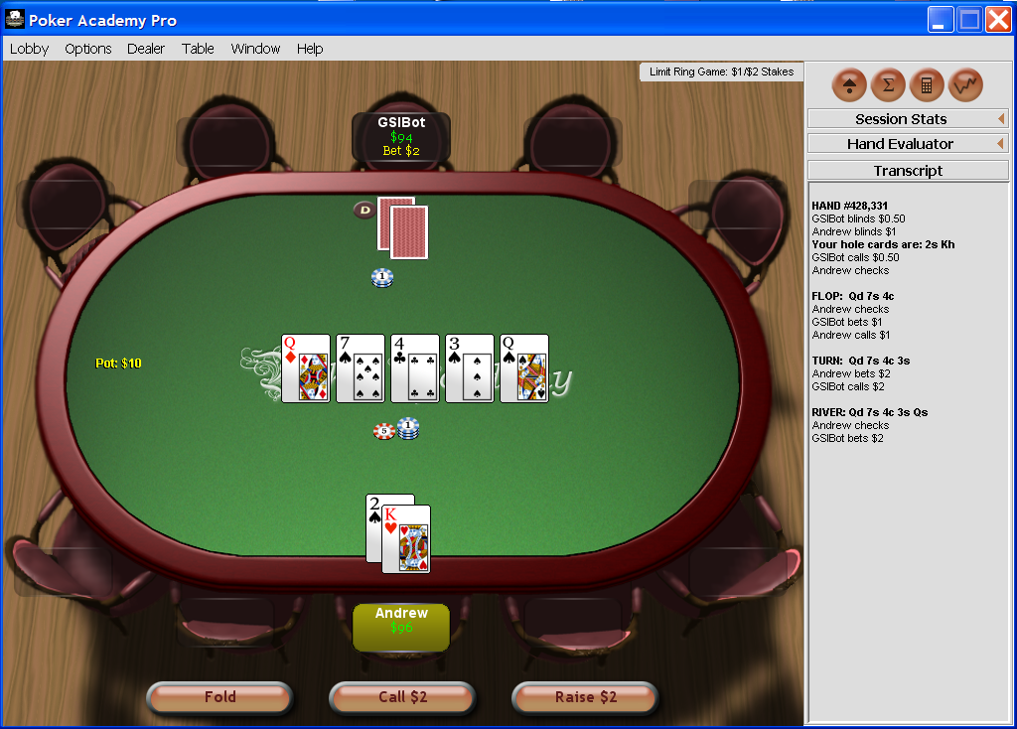

Slide 50
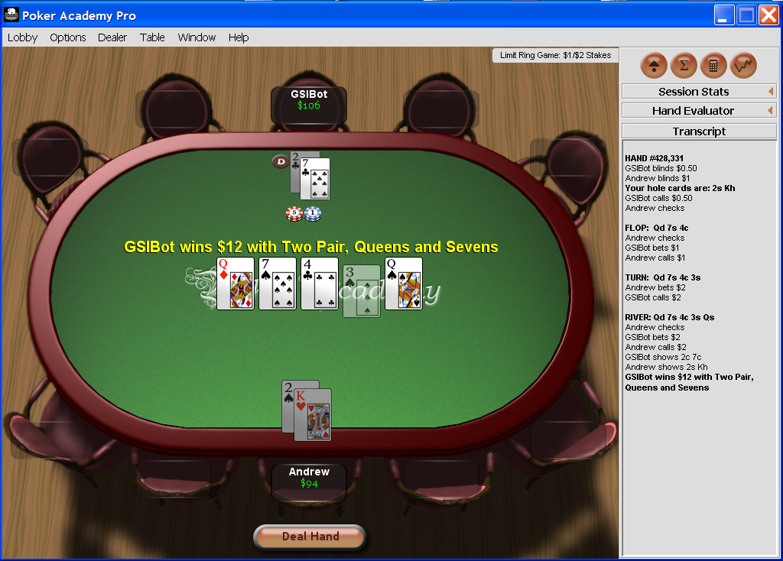

Slide 51
Texas Hold’em poker
2-player Limit Texas Hold’em has ~10¹⁸ leaves in game tree
Losslessly abstracted game too big to solve => abstract more => lossy
Nature deals 2 cards to each player
Round of betting
Nature deals 3 shared cards
Round of betting
Nature deals 1 shared card
Round of betting
Nature deals 1 shared card
Round of betting

Slide 52
GS1 [Gilpin & S., AAAI’06]
First Texas Hold’em program to use automated abstraction
  Lossy version of Gameshrink
    Instead of requiring perfect matching of children, require a matching with a penalty below threshold
Abstracted game’s LP solved by CPLEX
Phase I (rounds 1 & 2) LP solved offline
  Assuming rollout for the rest of the game
Phase II (rounds 3 & 4) LP solved in real time
  Starting with hand probabilities that are updated using Bayes rule based on Phase I equilibrium and observations
Notes:
Our first program for 2-person Limit Texas Hold’em, 1/2005 - 1/2006

Slide 53
GS1
1/2005 - 1/2006

Slide 54
GS1
We split the 4 betting rounds into two phases
  Phase I (first 2 rounds) solved offline using approximate version of GameShrink followed by LP
    Assuming rollout
  Phase II (last 2 rounds):
    abstractions computed offline
      betting history doesn’t matter & suit isomorphisms
    real-time equilibrium computation using anytime LP
      updated hand probabilities from Phase I equilibrium (using betting histories and community card history):
      s_{i} is player i’s strategy, h is an information set

Slide 55
Some additional techniques used
Precompute several databases
Conditional choice of primal vs. dual simplex for real-time equilibrium computation
  Achieve anytime capability for the player that is us
Dealing with running off the equilibrium path

Slide 56
GS1 results
Sparbot: Game-theory-based player, manual abstraction
Vexbot: Opponent modeling, miximax search with statistical sampling
GS1 performs well, despite using very little domain-knowledge and no adaptive techniques
  No statistical significance

Slide 57
GS2 [Gilpin & S., AAMAS’07]
Original GameShrink is “greedy” when used as an approximation algorithm => lopsided abstractions
GS2 instead finds abstraction via clustering & IP
  Round by round starting from round 1
  Operates in signal tree of one player’s & common signals at a time
Other ideas in GS2:
  Overlapping phases so Phase I would be less myopic
    Phase I = round 1, 2, and 3; Phase II = rounds 3 and 4
  Instead of assuming rollout at leaves of Phase I (as was done in SparBot and GS1), use statistics to get a more accurate estimate of how play will go
Notes:
2/2006-7/2006
Statistics from 100,000’s hands of SparBot in self-play

Slide 58
GS2
2/2006 – 7/2006
[Gilpin & S., AAMAS’07]

Slide 59
Optimized approximate abstractions
Original version of GameShrink is “greedy” when used as an approximation algorithm => lopsided abstractions
GS2 instead finds an abstraction via clustering & IP
For round 1 in signal tree, use 1D k-means clustering
  Similarity metric is win probability (ties count as half a win)
For each round 2..3 of signal tree:
  For each group i of hands (children of a parent at round – 1):
    use 1D k-means clustering to split group i into k_{i} abstract “states”
    for each value of k_{i}, compute expected error (considering hand probs)
  IP decides how many children different parents (from round – 1) may have: Decide k_{i}’s to minimize total expected error, subject to ∑_{i} k_{i} ≤ K_{round}
    K_{round} is set based on acceptable size of abstracted game
    Solving this IP is fast in practice
Notes:
Solves generalized knapsack problem, though computationally difficult it is solved quickly in practice

Slide 60
Phase I (first three rounds)
Allowed 15, 225, and 900 abstracted states in rounds 1, 2, and 3, respectively
Optimizing the approximate abstraction took 3 days on 4 CPUs
LP took 7 days and 80 GB using CPLEX’s barrier method

Slide 61
Phase I (first three rounds)
Optimized abstraction
  Round 1
    There are 1,326 hands, of which 169 are strategically different
    We allowed 15 abstract states
  Round 2
    There are 25,989,600 distinct possible hands
      GameShrink (in lossless mode for Phase I) determined there are ~10⁶ strategically different hands
    Allowed 225 abstract states
  Round 3
    There are 1,221,511,200 distinct possible hands
    Allowed 900 abstract states
Optimizing the approximate abstraction took 3 days on 4 CPUs
LP took 7 days and 80 GB using CPLEX’s barrier method

Slide 62
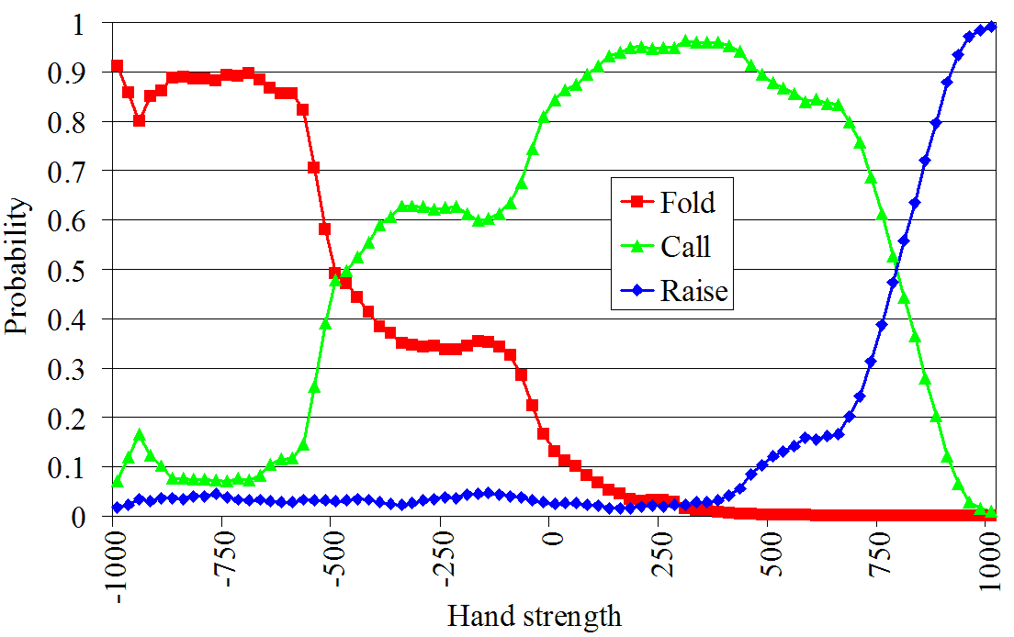
Mitigating effect of round-based abstraction (i.e., having 2 phases)
For leaves of Phase I, GS1 & SparBot assumed rollout
Can do better by estimating the actions from later in the game (betting) using statistics
For each possible hand strength and in each possible betting situation, we stored the probability of each possible action
  Mine history of how betting has gone in later rounds from 100,000’s of hands that SparBot played
  E.g. of betting in 4th round
    Player 1 has bet. Player 2’s turn

Slide 63
Example of betting in 4th round
Player 1 has bet. Player 2 to fold, call, or raise

Slide 64
Phase II (rounds 3 and 4)
Abstraction computed using the same optimized abstraction algorithm as in Phase I
Equilibrium solved in real time (as in GS1)
  Beliefs for the beginning of Phase II determined using Bayes rule based on observations and the computed equilibrium strategies from Phase I

Slide 65
Precompute several databases
db5: possible wins and losses (for a single player) for every combination of two hole cards and three community cards (25,989,600 entries)
  Used by GameShrink for quickly comparing the similarity of two hands
db223: possible wins and losses (for both players) for every combination of pairs of two hole cards and three community cards based on a roll-out of the remaining cards (14,047,378,800 entries)
  Used for computing payoffs of the Phase I game to speed up the LP creation
handval: concise encoding of a 7-card hand rank used for fast comparisons of hands (133,784,560 entries)
  Used in several places, including in the construction of db5 and db223
Colexicographical ordering used to compute indices into the databases allowing for very fast lookups

Slide 66
GS2 experiments
Opponent | Series won by GS2 | Win rate (small bets per hand)
GS1 | 38 of 50 p=.00031 | +0.031
Sparbot | 28 of 50 p=.48 | +0.0043
Vexbot | 32 of 50 p=.065 | -0.0062

Slide 67
GS3
8/2006 – 3/2007
[Gilpin, S. & Sørensen AAAI’07]
Our poker bots 2008-2011 were generated with same abstraction algorithm

Slide 68
Entire game solved holistically
We no longer break game into phases
  Because our new equilibrium-finding algorithms can solve games of the size that stem from reasonably fine-grained abstractions of the entire game
=> better strategies & real-time end-game computation optional

Slide 69
Clustering + integer programming for abstraction
[Gilpin & Sandholm AAMAS’07]
GameShrink is “greedy” when used as an approximation algorithm => lopsided abstractions
For constructing GS2, abstraction was created via clustering & IP
Operates in signal tree of one player’s & common signals at a time
Notes:
Round by round starting from round 1

Slide 70
Potential-aware automated abstraction
[Gilpin, S. & Sørensen AAAI’07]
All prior abstraction algorithms had EV (myopic probability of winning in poker) as the similarity metric
  Doesn’t capture potential
Potential not only positive or negative, but also “multidimensional”
GS3’s abstraction algorithm captures potential …
Notes:
Hands like flush draws where although the probability of winning is small, the payoff could be high

Slide 71
Idea: similarity metric between hands at round R should be based on the vector of probabilities of transitions to abstracted states at round R+1
  E.g., L₁ norm
In the last round, the similarity metric is simply probability of winning (assuming rollout)
This enables a bottom

Slide 72
Bottom-up pass to determine abstraction for round 1
Round r-1
.3
.2
0
.5
Round r
Clustering using L₁ norm
  Predetermined number of clusters, depending on size of abstraction we are shooting for
In the last (4th) round, there is no more potential => we use probability of winning (e.g., assuming rollout) as similarity metric

Slide 73
Determining abstraction for round 2
For each 1st-round bucket i:
  Make a bottom-up pass to determine 3rd-round buckets, considering only hands compatible with i
  For k_{i} ϵ {1, 2, …, max}
    Cluster the 2nd-round hands into k_{i} clusters
      based on each hand’s histogram over 3rd-round buckets
IP to decide how many children each 1st-round bucket may have, subject to ∑_{i} k_{i} ≤ K₂
  Error metric for each bucket is the sum of L₂ distances of the hands from the bucket’s centroid
  Total error to minimize is the sum of the buckets’ errors
    weighted by the probability of reaching the bucket

Slide 74
Determining abstraction for round 3
Done analogously to how we did round 2

Slide 75
Determining abstraction for round 4
Done analogously, except that now there is no potential left, so clustering is done based on probability of winning
Now we have finished the abstraction!
Notes:
probability of winning (assuming rollout)

Slide 76
Potential-aware vs win-probability-based abstraction
[Gilpin & S., AAAI-08]
Both use clustering and IP
Experiment on Rhode Island Hold’em => Abstracted game solved exactly
Finer-grained
abstraction
13 buckets in first round is lossless
Potential-aware becomes lossless,
win-probability-based is as good as it gets, never lossless

Slide 77
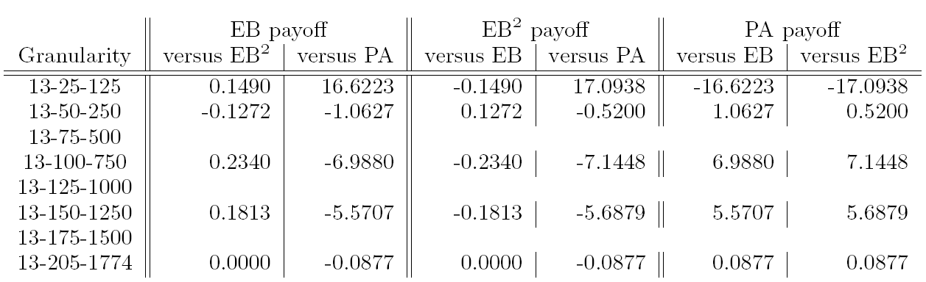
Potential-aware vs win-probability-based abstraction
[Gilpin & S., AAAI-08 & new]
Both use clustering and IP
Experiment conducted on Heads-Up Rhode Island Hold’em
  Abstracted game solved exactly
13 buckets in first round is lossless
Potential-aware becomes lossless,
win-probability-based is as good as it gets, never lossless

Slide 78
Other forms of lossy abstraction
Phase-based abstraction
  Uses observations and equilibrium strategies to infer priors for next phase
  Uses some (good) fixed strategies to estimate leaf payouts at non-last phases [Gilpin & Sandholm AAMAS-07]
  Supports real-time equilibrium finding [Gilpin & Sandholm AAMAS-07]
    Grafting [Waugh et al. 2009] as an extension
Action abstraction
  What if opponents play outside the abstraction?
  Multiplicative action similarity and probabilistic reverse model [Gilpin, Sandholm, & Sørensen AAMAS-08, Risk & Szafron AAMAS-10]

Slide 79
Game abstraction is nonmonotonic
Defender
A
Between
B
A
0, 2 | 1, 1 | 2, 0
2, 0 | 1, 1 | 0, 2
In each equilibrium:
Attacker randomizes 50-50 between A and B
Defender plays A w.p. p, B w.p. p, and Between w.p. 1-2p
There is an equilibrium for each p ∈ [0, ½]
Attacker
B
An abstraction:
A
Between
B
A
0, 2 | 1, 1 | 2, 0
Defender would choose A, but that is far from equilibrium in the original game where attacker would choose B
Coarser abstraction:
Between
B
A
1, 1 | 2, 0
Defender would choose Between. That is an equilibrium in the original game
Such “abstraction pathologies” also in small poker games [Waugh et al. AAMAS-09]
We present the first lossy game abstraction algorithm with bounds
  Contradiction?
Notes:
Nonmonotonicity occurs already in a 1-stage game, which is a special case of a stochastic game.
(In this example, the reward error epsilon^R (defined later) is 2 in each of the two abstractions.)

Slide 80
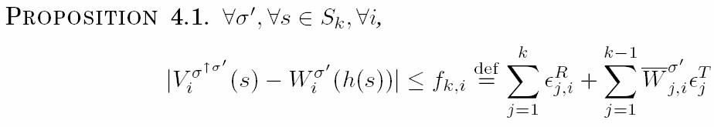
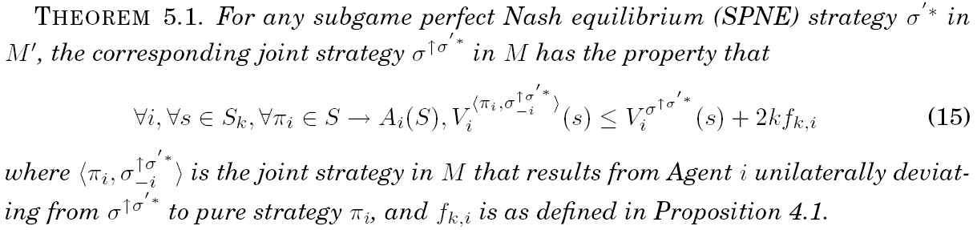
First lossy game abstraction algorithms with bounds
[Sandholm and Singh EC-12]
Recognized open problem; tricky due to pathologies
For both action and state abstraction; for finite stochastic games
Evaluations from abstract game are near accurate:
Regret is bounded:
Notes:
Explain relationship to abstraction pathology.

Slide 81
First lossy game abstraction methods with bounds
[Sandholm and Singh EC-12]
Recognized open problem; tricky due to pathologies
For both action and state abstraction
For stochastic games
Notes:
Explain relationship to abstraction pathology.

Slide 82
Strategy evaluation in M and M’
LEMMA. If game M and abstraction M’ are “close”,
then the value for every strategy in M’ (when evaluated in M’)
is close to the value of any corresponding lifted strategy in M when evaluated in M. Formally:
joint strategy

Slide 83
Main abstraction theorem
Given a subgame perfect Nash equilibrium in M’
Let lifted strategy in M be
Then maximum gain by unilateral deviation by agent i is

Slide 84
First lossy game abstraction algorithms with bounds
Greedy algorithm that proceeds level by level from end of game
  At each level, does either action or state abstraction first, then the other
  Polynomial time (versus equilibrium finding being PPAD-complete)
Integer linear program
  Proceeds level by level from end of game; one ILP per level
    Optimizing all levels simultaneously would be nonlinear
  Does action and state abstraction simultaneously
  Splits the allowed total error within level optimally
    between reward error and transition probability error, and
    between action abstraction and state abstraction
Proposition. Both algorithms satisfy the given bounds on regret
Proposition. Even with just action abstraction and just one level, finding the abstraction with the smallest number of actions that respects the regret bound is NP-complete (even with 2 agents)
One of the first action abstraction algorithms
  Totally different than the prior one [Hawkin et al. AAAI-11]

Slide 85
Role of this in modeling
All modeling is abstraction!
These are the first results that tie game modeling choices to solution quality in the actual setting

Slide 86
Strategy-based abstraction [unpublished]
Abstraction
Equilibrium finding
Notes:
Good abstraction as hard as equilibrium finding?

Slide 87
Equilibrium-finding algorithms
Solving the (abstracted) game

Slide 88
Outline
Abstraction
Equilibrium finding in 2-person 0-sum games
Strategy purification
Opponent exploitation
Multiplayer stochastic games
Leveraging qualitative models

Slide 89
Scalability of (near-)equilibrium finding in 2-person 0-sum games
Manual approaches can only solve games with a handful of nodes
AAAI poker competition announced
Gilpin, Sandholm
& Sørensen
Scalable EGT
Zinkevich et al.
Counterfactual regret
Gilpin, Hoda,
Peña & Sandholm
Scalable EGT
Koller & Pfeffer
Using sequence form
& LP (simplex)
Billings et al.
LP (CPLEX interior point method)
Gilpin & Sandholm
LP (CPLEX interior point method)

Slide 90
(Un)scalability of LP solvers
Rhode Island Hold’em LP
  91,000,000 rows and columns
  After GameShrink,1,200,000 rows and columns, and 50,000,000 non-zeros
  CPLEX’s barrier method uses 25 GB RAM and 8 days
Texas Hold’em poker much larger
  => would need to use extremely coarse abstraction
Instead of LP, can we solve the equilibrium-finding problem in some other way?

Slide 91
Excessive gap technique (EGT)
Best general LP solvers only scale to10⁷..10⁸ nodes. Can we do better?
Usually, gradient-based algorithms have poor O(1/ ε²) convergence, but…
Theorem [Nesterov 05]. Gradient-based algorithm, EGT (for a class of minmax problems) that finds an ε-equilibrium in O(1/ ε) iterations
Theorem [Hoda, Gilpin, Pena & S., Mathematics of Operations Research 2010]. Nice prox functions can be constructed for sequential games

Slide 92
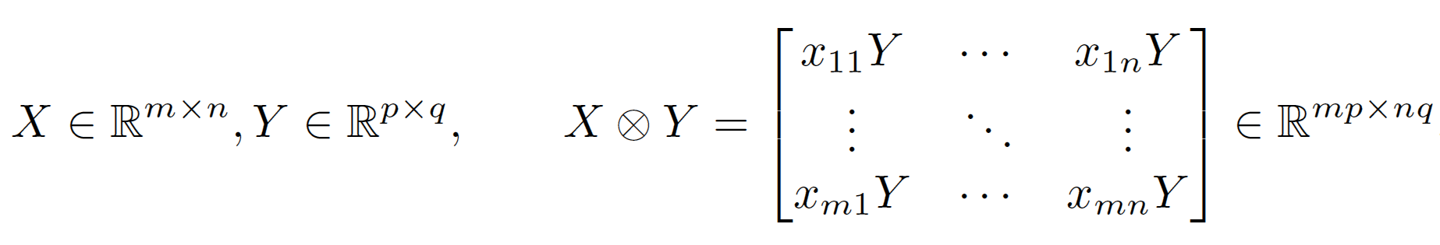
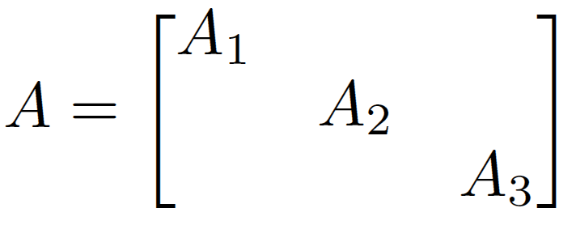
Scalable EGT [Gilpin, Hoda, Peña, S., WINE’07, Math. Of OR 2010]
Memory saving in poker & many other games
Main space bottleneck is storing the game’s payoff matrix A
Definition. Kronecker product
In Rhode Island Hold’em:
Using independence of card deals and betting options, can represent this as A₁ = F₁ ⊗ B₁ A₂ = F₂ ⊗ B₂ A₃ = F₃ ⊗ B₃ + S ⊗ W
F_{r} corresponds to sequences of moves in round r that end in a fold
S corresponds to sequences of moves in round 3 that end in a showdown
B_{r} encodes card buckets in round r
W encodes win/loss/draw probabilities of the buckets

Slide 93
Memory usage
Instance | CPLEX barrier | CPLEX simplex | Our method
Losslessly abstracted Rhode Island Hold’em | 25.2 GB | >3.45 GB | 0.15 GB
Lossily abstracted Texas Hold’em | >458 GB | >458 GB | 2.49 GB
Notes:
Space usage drops to about a square root of the original space use.

Slide 94
Memory usage
Instance | CPLEX barrier | CPLEX simplex | Our method
10k | 0.082 GB | >0.051 GB | 0.012 GB
160k | 2.25 GB | >0.664 GB | 0.035 GB
Losslessly abstracted RI Hold’em | 25.2 GB | >3.45 GB | 0.15 GB
Lossily abstracted TX Hold’em | >458 GB | >458 GB | 2.49 GB
Notes:
Space usage drops to about a square root of the original space use.

Slide 95
Scalable EGT [Gilpin, Hoda, Peña, S., WINE’07, Math. Of OR 2010]
Speed
Fewer iterations
  With Euclidean prox fn, gap was reduced by an order of magnitude more (at given time allocation) compared to entropy-based prox fn
  Heuristics that speed things up in practice while preserving theoretical guarantees
    Less conservative shrinking of μ₁ and μ₂
      Sometimes need to reduce (halve) τ
    Balancing μ₁ and μ₂ periodically
      Often allows reduction in the values
    Gap was reduced by an order of magnitude (for given time allocation)
Faster iterations
  Parallelization in each of the 3 matrix-vector products in each iteration => near-linear speedup

Slide 96
Our successes with these approaches in 2-player Texas Hold’em
AAAI-08 Computer Poker Competition
  Won Limit bankroll category
  Did best in terms of bankroll in No-Limit
AAAI-10 Computer Poker Competition
  Won bankroll competition in No-Limit
Notes:
GS4 Played 4-4 in the pairwise comparisons. 4th of 9 in elimination category
Tartanian 3rd out of 4 in elimination category

Slide 97
Iterated smoothing
[Gilpin, Peña & S., AAAI-08, Mathematical Programming, to appear]
Input: Game and ε_{target}
Initialize strategies x and y arbitrarily
ε ← ε_{target}
repeat
  ε ← gap(x, y) / e
  (x, y) ← SmoothedGradientDescent(f, ε, x, y)
  until gap(x, y) < ε_{target}
O(1/ε)
→ O(log(1/ε))
Caveat: condition number.
Algorithm applies to all linear programming.
Matches iteration bound of interior point methods, but unlike them, is scalable for memory.

Slide 98
Solving GS3’s four-round model
[Gilpin, Sandholm & Sørensen AAAI’07]
Computed abstraction with
  20 buckets in round 1
  800 buckets in round 2
  4,800 buckets in round 3
  28,800 buckets in round 4
Our version of excessive gap technique used 30 GB RAM
  (Simply representing as an LP would require 32 TB)
  Outputs new, improved solution every 2.5 days
  4 1.65GHz CPUs: 6 months to gap 0.028 small bets per hand

Slide 99
AAAI Computer Poker Competitions won
2008
  GS4 won Limit Texas Hold’em bankroll category
    Played 4-4 in pairwise comparisons. 4th of 9 in elimination category
  Tartanian did best in terms of bankroll in No-Limit Texas Hold’em
    3rd out of 4 in elimination category
2010
  Tartanian4 won Heads-Up No-Limit Texas Hold'em bankroll category
    3rd in Heads-Up No-Limit Texas Hold'em bankroll instant run-off category

Slide 100
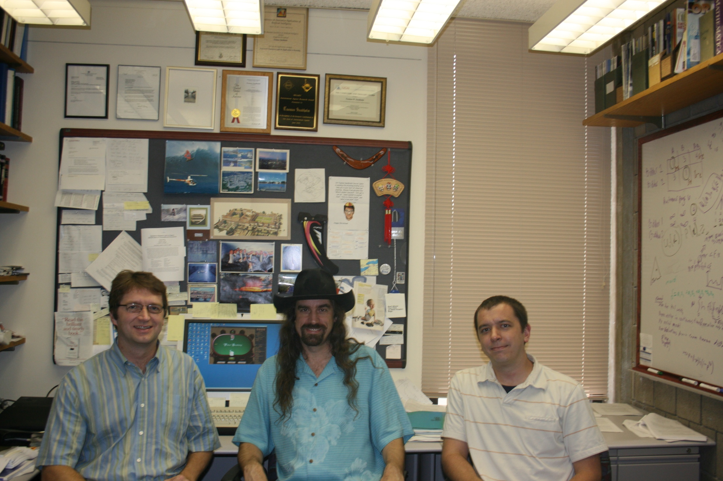

Slide 101
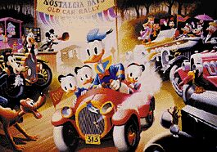
Going live with $313 million on PokerStars.com
April fools!

Slide 102
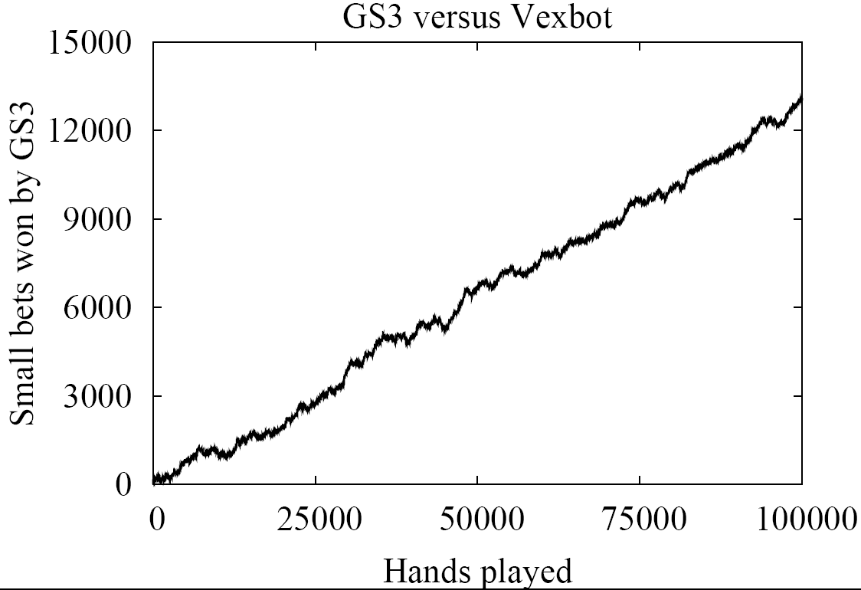
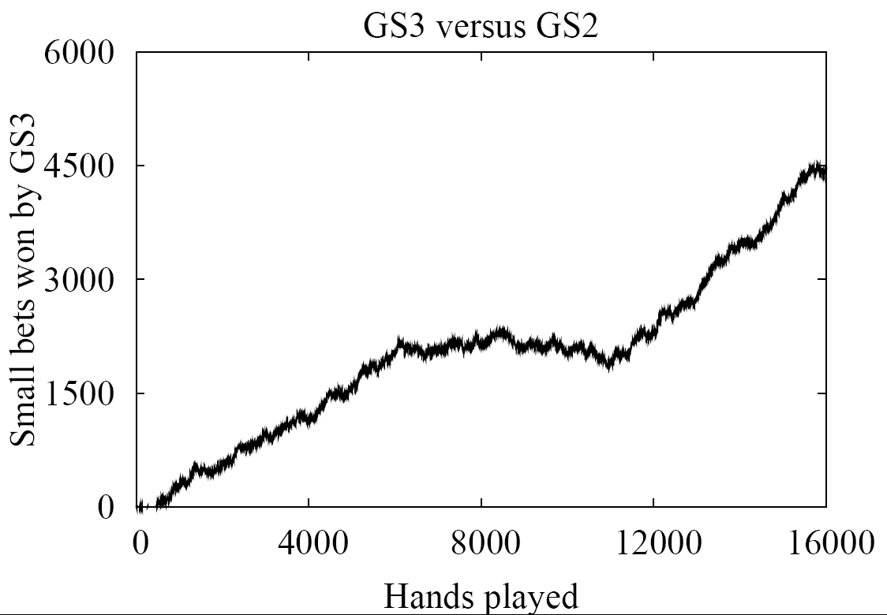
Money (unit = small bet)
All wins are statistically significant at the 99.5% level

Slide 103
Comparison to prior poker AI
Rule-based
  Limited success in even small poker games
Simulation/Learning
  Do not take multi-agent aspect into account
Game-theoretic
  Small games
  Manual abstraction [Billings et al. IJCAI-03]
  Ours
    Automated abstraction
    Custom solver for finding Nash equilibrium
    Domain independent

Slide 104
Outline
Abstraction
Equilibrium finding in 2-person 0-sum games
Strategy purification
Opponent exploitation
Multiplayer stochastic games
Leveraging qualitative models

Slide 105
Purification and thresholding
[Ganzfried, S. & Waugh, AAMAS-12]
Thresholding: Rounding the probabilities to 0 of those strategies whose probabilities are less than c (and rescaling the other probabilities)
  Purification is thresholding with c=0.5
Proposition (performance of strategy from abstract game against equilibrium strategy in actual game):
Any of the 3 approaches (standard approach, thresholding (for any c), purification) can beat any other by arbitrarily much depending on the game
  Holds for any equilibrium-finding algorithm for one approach and any equilibrium-finding algorithm for the other

Slide 106
Experiments on random matrix games
2-player 4x4 zero-sum games
Abstraction that simply ignores last row and last column
Purified eq strategies from abstracted game beat
non-purified eq strategies from abstracted game
at 95% confidence level when played on the unabstracted game

Slide 107
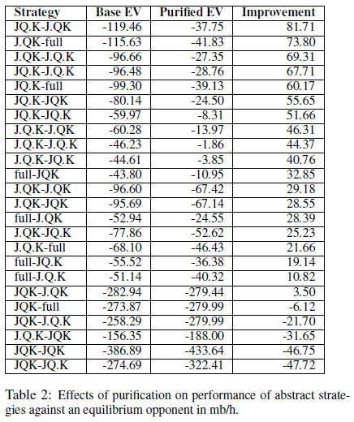
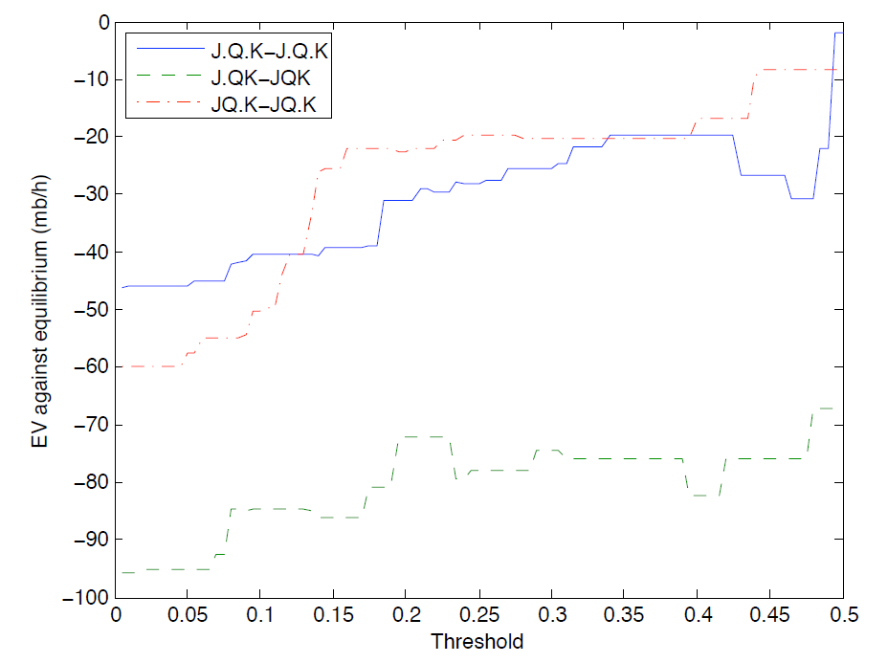
Experiments on Leduc Hold’em

Slide 108
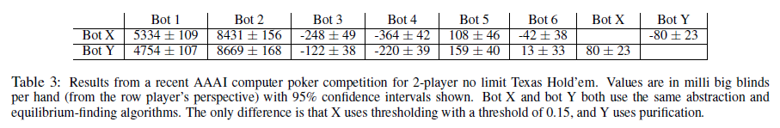
Experiments on no-limit Texas Hold’em
We submitted bot Y to the AAAI-10 bankroll competition; it won
We submitted bot X to the instant run-off competition; finished 3rd

Slide 109
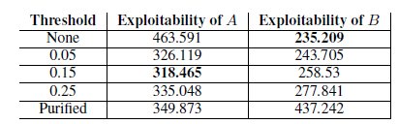
Experiments on limit Texas Hold’em
Worst-case exploitability
Too much thresholding => not enough randomization
=> signal too much to the opponent
Too little thresholding => strategy is overfit to the particular abstraction
Our 2010 competition bot
U. Alberta 2010 competition bot

Slide 110
Outline
Abstraction
Equilibrium finding in 2-person 0-sum games
Strategy purification
Opponent exploitation
Multiplayer stochastic games
Leveraging qualitative models

Slide 111
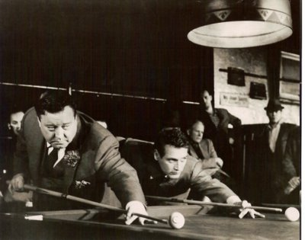
Traditionally two approaches
Game theory approach (abstraction+equilibrium finding)
  Safe in 2-person 0-sum games
  Doesn’t maximally exploit weaknesses in opponent(s)
Opponent modeling
  Get-taught-and-exploited problem [Sandholm AIJ-07]
  Needs prohibitively many repetitions to learn in large games (loses too much during learning)
    Crushed by game theory approach in Texas Hold’em, even with just 2 players and limit betting
    Same tends to be true of no-regret learning algorithms

Slide 112
Let’s hybridize the two approaches
[Ganzfried & Sandholm AAMAS-11]
Start playing based on game theory approach
As we learn opponent(s) deviate from equilibrium, start adjusting our strategy to exploit their weaknesses

Slide 113
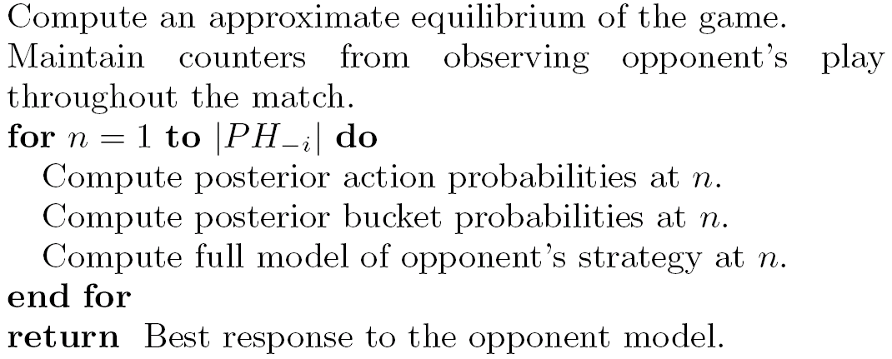
Deviation-Based Best Response (DBBR) algorithm
(can be generalized to multi-player non-zero-sum)
Public history
sets
Dirichlet prior
Many ways to determine opponent’s “best” strategy that is consistent with bucket probabilities
  L₁ or L₂ distance to equilibrium strategy
  Custom weight-shifting algorithm
  ...
Notes:
Diffs to Alberta algorithms (at least one of these applies to each of theirs): 1) they worked on tiny games like Kuhn poker or rock-scissors paper, 2) they precomputed a hadful of strategies and used an experts algorithm to just choose among them, 3) they assumed massive amounts of hand histories available before play, or 4) they assumed opponent’s private information was observable.

Slide 114

Experiments
Significantly outperforms game-theory-based base strategy (GS5) in 2-player limit Texas Hold’em against
  trivial opponents
  weak opponents from AAAI computer poker competitions
Don’t have to turn this on against strong opponents
Examples of winrate evolution:
Opponent:
Opponent:
Opponent:

Slide 115
Safe opponent exploitation
[Ganzfried & Sandholm EC-12]
Definition. Safe strategy achieves at least the value of the (repeated) game in expectation
Is safe exploitation possible (beyond selecting among equilibrium strategies)?

Slide 116


When can opponent be exploited safely?
Opponent played an (iterated weakly) dominated strategy?
Opponent played a strategy that isn’t in the support of any eq?
Definition. We received a gift if the opponent played a strategy such that we have an equilibrium strategy for which the opponent’s strategy is not a best response
Theorem. Safe exploitation is possible in a game iff the game has gifts
E.g., rock-paper-scissors doesn’t have gifts
Can determine in polytime whether a game has gifts

Slide 117

Exploitation algorithms (both for matrix and sequential games)
Risk what you’ve won so far
  Doesn’t differentiate whether winnings are due to opponent’s mistakes (gifts) or our luck
Risk what you’ve won so far in expectation (over nature’s & own randomization), i.e., risk the gifts received
  Assuming the opponent plays a nemesis in states where we don’t know
Best(-seeming) equilibrium strategy
Regret minimization between an equilibrium and opponent modeling algorithm
Regret minimization in the space of equilibria
Best equilibrium followed by full exploitation
Best equilibrium and full exploitation when possible
Theorem. A strategy for a 2-player 0-sum game is safe iff it never risks more than the gifts received according to #2
Can be used to make any opponent modeling algorithm safe
No prior (non-eq) opponent exploitation algorithms are safe
Experiments on Kuhn poker: #2 > #7 > #6 > #3
Suffices to lower bound opponent’s mistakes

Slide 118
Outline
Abstraction
Equilibrium finding in 2-person 0-sum games
Strategy purification
Opponent exploitation
Multiplayer stochastic games
Leveraging qualitative models

Slide 119
>2 players
(Actually, our abstraction algorithms and opponent exploitation, presented earlier in this talk, apply to >2 players)

Slide 120
Computing Equilibria in Multiplayer Stochastic Games of Imperfect Information
Sam Ganzfried and Tuomas Sandholm
Computer Science Department
Carnegie Mellon University

Slide 121
Stochastic games
N = {1,…,n} is finite set of players
S is finite set of states
A(s) = (A₁(s),…, A_{n}(s)), where A_{i}(s) is set of actions of player i at state s
p_{s,t}(a) is probability we transition from state s to state t when players follow action vector a
r(s) is vector of payoffs when state s is reached
Undiscounted vs. discounted
A stochastic game with one agent is a Markov Decision Process (MDP)
Notes:
Existence of Nash equilibrium open for undiscounted stochastic games with >2 players

Slide 122
Stochastic game example: poker tournaments
Important challenge problem in artificial intelligence and computational game theory
Enormous strategy spaces:
  Two-player limit Texas hold’em game tree has ~10¹⁸ nodes
  Two-player no-limit Texas hold’em has ~ 10⁷¹ nodes
Imperfect information (unlike, e.g., chess)
Many players
  Computing a Nash equilibrium in matrix games PPAD-complete for > 2 players
Poker tournaments are undiscounted stochastic games

Slide 123
Rules of poker
No-limit Texas hold’em
Two private hole cards, five public community cards
  Only best 5-card hand matters
4 rounds of betting: preflop, flop, turn, river
Preflop investments: small blind (SB) & big blind (BB)
Actions: fold, call, raise (any amount), go all-in

Slide 124
Poker tournaments
Players pay entry fee (e.g., $10)
Players given some number of chips (e.g., 1500)
A player is eliminated when he has no more chips
  The order of elimination determines the payouts
  E.g., winner gets $50, 2nd place $30, 3rd place $20
  Blinds escalate quickly
Tournaments are stochastic games: each game state corresponds to a vector of stack sizes
We study 3-player endgame with fixed high blinds
  Potentially infinite duration

Slide 125
Jam/fold strategies
All-in or fold preflop: no postflop play
169 strategically distinct starting hands (pocket pairs, unsuited non-pairs, suited non-pairs)
For any given stack vector, the sizes of the players’ strategy spaces are 2¹⁶⁹, 2^{2*169}, and 2^{3*169}
With two players left, jam/fold strategies are near-optimal when blinds sufficiently high [Miltersen/Sörensen AAMAS ’07]
  They show that probability of winning is approximately equal to fraction of chips player has

Slide 126

VI-FP: Prior algorithm for equilibrium finding in multiplayer stochastic games
[Ganzfried & Sandholm AAMAS ’08]
Initialize payoffs V₀ for all game states using ICM
Repeat
  Run “inner loop”:
    Assuming the payoffs V_{t} , compute an approximate equilibrium s_{t} at each non-terminal state (stack vector) using an extension of smoothed fictitious play to imperfect information games
  Run “outer loop”:
    Compute the values V_{t +1} at all non-terminal states by using the probabilities from s_{t} and values from V_{t}
until outer loop converges

Slide 127
Drawbacks of VI-FP
Neither the inner nor outer loop guaranteed to converge
Possible for outer-loop to converge to a non-equilibrium
  Initialize the values to all three players of stack vectors with all three players remaining to $100
  Initialize the stack vectors with only two players remaining according to ICM
  Then everyone will fold (except the short stack if he is all-in), payoffs will be $100 to everyone, and the algorithm will converge in one iteration to a non-equilibrium profile

Slide 128
Ex post check
Determine how much each player can gain by deviating from strategy profile s* computed by VI-FP
For each player, construct MDP M induced by the components of s* for the other players
Solve M using variant of policy iteration for our setting (next slide)
Look at difference between the payoff of optimal policy in M and payoff under s*
Converged in just two iterations of policy iteration.
No player can gain more than $0.049 (less than 0.5% of tournament entry fee) by deviating from s*

Slide 129

Optimal MDP solving in our setting
Our setting:
  Objective is expected total reward
  For all states s and policies p, the value of s under p is finite
  For each state s there exists at least one available action a that gives nonnegative reward
Value iteration: must initialize pessimistically
Policy iteration:
  Choose initial policy with nonnegative total reward
  Choose minimal non-negative solution to system of equations in
  evaluation step (if there is a choice):
  If the action chosen for some state in the previous iteration is still
  among the optimal actions, select it again

Slide 130
New algorithms for equilibrium finding in multiplayer stochastic games

Slide 131
One algorithm from [Ganzfried & S., AAMAS-08, IJCAI-09]
Repeat until ε-equilibrium
  At each state
    Run fictitious play until regret < thres, given values of possible future states
  Adjust values of all states (using modified policy iteration) in light of the new payoffs obtained
First algorithms for ε-equilibrium in large stochastic games for small ε
Proposition. If outer loop converges, the strategy profile is an equilibrium
Found ε-equilibrium for tiny ε in jam/fold strategies in 3-player No-Limit Texas Hold’em tournament (largest multiplayer game solved to small ε?)
Algorithms converged to an ε-equilibrium consistently and quickly despite not being guaranteed to do so
-- new convergence guarantees?
Notes:
modified policy iteration:
In the matrix inversion step, always choose the minimal solution
If there are multiple optimal actions at a state, prefer the action chosen last period if possible

Slide 132


PI-FP: Policy Iteration as outer loop
Similar to VI-FP except value updates follow the evaluation step of policy iteration in our setting
Proposition: if the outer loop of PI-FP converges, then the final strategy profile
is an equilibrium
Can recover from poor initialization since it uses values resulting from
evaluating the policy, not the values from the initialization

Slide 133

FP-MDP: switching the roles of fictitious play and MDP-solving
Again we prefer policy iteration to value iteration because it allows us to get a good warm start more easily
Use policy iteration to perform best response calculation
Use fictitious play to combine new best response with previous strategy
Like VI-FP, FP-MDP can recover from poor initializations and can provably never converge to a non-equilibrium

Slide 134

FTPL-MDP: a polynomial-time algorithm for regret minimization
Similar to FP-MDP
Polynomial-time LP algorithm for MDP-solving in inner loop
Follow-the-perturbed-leader algorithm for outer loop: like fictitious play, but add random noise before computing best response [Kalai & Vempala, JCSS ’05]
Minimizes external regret in repeated game

Slide 135

Experimental Results
Each data point corresponds to an outer loop iteration
Target accuracy: $0.05 = 0.1% of first place payoff
PI-FP first to reach target accuracy, followed by VI-FP
FP-MDP never reached target accuracy

Slide 136
Conclusions and future work
Presented first algorithm for provably computing an ε-equilibrium of large stochastic games for small ε
First provable near-equilibrium strategies for jam/fold poker tournament with more than 2 players
Algorithms converged to an ε-equilibrium consistently and quickly despite not being guaranteed to do so
Hopefully can lead to investigation of more general settings under which convergence properties can be proven
  Fictitious play converged consistently despite not being guaranteed to do so
  Outer loop of VI-FP converged despite not being guaranteed to do so
  Maybe value iteration for solving MDP’s can be proven to converge for some optimal initializations in this setting

Slide 137
Games with >2 players
Matrix games:
  2-player zero-sum: solvable in polytime
  >2 players zero-sum: PPAD-complete [Chen & Deng, 2006]
  No previously known algorithms scale beyond tiny games with >2 players
Stochastic games (undiscounted):
  2-player zero-sum: Nash equilibria exist
  3-player zero-sum: Existence of Nash equilibria still open

Slide 138
Poker tournaments
Players buy in with cash (e.g., $10) and are given chips (e.g., 1500) that have no monetary value
Lose all you chips => eliminated from tournament
Payoffs depend on finishing order (e.g., $50 for 1st, $30 for 2nd, $20 for 3rd)
Computational issues:
  >2 players
  Tournaments are stochastic games (potentially infinite duration): each game state is a vector of stack sizes (and also encodes who has the button)
Notes:
Blinds usually escalate quickly. We assume constant blinds.

Slide 139
Jam/fold strategies
Jam/fold strategy: in the first betting round, go all-in or fold
In 2-player poker tournaments, when blinds become high compared to stacks, provably near-optimal to play jam/fold strategies [Miltersen & Sørensen 2007]
Solving a 3-player tournament [Ganzfried & Sandholm AAMAS’2008]
  Compute an approximate equilibrium in jam/fold strategies
  Strategy spaces 2¹⁶⁹, 2 • 2¹⁶⁹, 3 • 2¹⁶⁹
  Algorithm combines
    an extension of fictitious play to imperfect-information games
    with a variant of value iteration
  Our solution challenges Independent Chip Model (ICM) accepted by poker community
  Unlike in 2-player case, tournament and cash game strategies differ substantially
Notes:
946 non-terminal states

Slide 140
Our first algorithm
Initialize payoffs for all game states using heuristic from poker community (ICM)
Repeat until “outer loop” converges
  “Inner loop”:
    Assuming current payoffs, compute an approximate equilibrium at each state using fictitious play
    Can be done efficiently by iterating over each player’s information sets
  “Outer loop”:
    Update the values with the values obtained by new strategy profile
    Similar to value iteration in MDPs

Slide 141
Ex-post check
Our algorithm is not guaranteed to converge, and can converge to a non-equilibrium (we constructed example)
We developed an ex-post check to verify how much any player could gain by deviating [Ganzfried & Sandholm draft]
  Constructs an undiscounted MDP from the strategy profile, and solves it using variant of policy iteration
  Showed that no player could gain more than 0.1% of highest possible payoff by deviating from our profile

Slide 142
New algorithms [Ganzfried & Sandholm draft]
Developed 3 new algorithms for solving multiplayer stochastic games of imperfect information
  Unlike first algorithm, if these algorithms converge, they converge to an equilibrium
  First known algorithms with this guarantee
  They also perform competitively with the first algorithm
The algorithms combine fictitious play variant from first algorithm with techniques for solving undiscounted MDPs (i.e., maximizing expected total reward)

Slide 143
Best one of the new algorithms
Initialize payoffs using ICM as before
Repeat until “outer loop” converges
  “Inner loop”:
    Assuming current payoffs, compute an approximate equilibrium at each state using our variant of fictitious play as before
  “Outer loop”: update the values with the values obtained by new strategy profile S_{t} using a modified version of policy iteration:
    Create the MDP M induced by others’ strategies in S_{t} (and initialize using own strategy in S_{t}):
    Run modified policy iteration on M
      In the matrix inversion step, always choose the minimal solution
      If there are multiple optimal actions at a state, prefer the action chosen last period if possible
Notes:
This is the first new algorithm in AAAI-08 submission.
Each non-terminal state of M corresponds to non-terminal state of the tournament and a table position: so 946 • 3 = 2838 non-terminal states of M.

Slide 144
Second new algorithm
Interchanging roles of fictitious play and policy iteration:
  Policy iteration used as inner loop to compute best response
  Fictitious play used as outer loop to combine BR with old strategy
Initialize strategies using ICM
Inner loop:
  Create MDP M induced from strategy profile
  Solve M using policy iteration variant (from previous slide)
Outer loop:
  Combine optimal policy of M with previous strategy using fictitious play updating rule

Slide 145
Third new algorithm
Using value iteration variant as the inner loop
Again we use MDP solving as inner loop and fictitious play as outer loop
Same as previous algorithm except different inner loop
New inner loop:
  Value iteration, but make sure initializations are pessimistic (underestimates of optimal values in the MDP)
  Pessimistic initialization can be accomplished by matrix inversion using outer loop strategy as initialization in induced MDP

Slide 146
Outline
Abstraction
Equilibrium finding in 2-person 0-sum games
Strategy purification
Opponent exploitation
Multiplayer stochastic games
Leveraging qualitative models

Slide 147
Computing Equilibria by Incorporating Qualitative Models
Sam Ganzfried and Tuomas Sandholm
Computer Science Department
Carnegie Mellon University

Slide 148
Introduction
Key idea: often it is much easier to come up with some aspects of an equilibrium than to actually compute one
E.g., threshold strategies are optimal in many settings:
  Sequences of take-it-or-leave-it offers
  Auctions
  Partnerships/contracts
  Poker…
We develop an algorithm for computing an equilibrium in imperfect-information games given a qualitative model of the structure of equilibrium strategies
  Applies to both infinite and finite games, with 2 or more players

Slide 149
Continuous (i.e., infinite) games
Games with infinite number of pure strategies
  E.g., strategies correspond to amount of time, money, space (such as computational billiards)
N is finite set of players
S_{i} is (a potentially infinite) pure strategy space of player i
u_{i}: S → R is utility function of player i
Theorem [Fudenberg/Levine]: If strategy spaces are nonempty compact subsets of a metric space and payoff functions are continuous, then there exists a Nash equilibrium

Slide 150
Poker example
Two players given private signals x₁, x₂ independently and uniformly at random from [0,1]
Pot initially has size P
Player 1 can bet or check
If player 1 checks, game is over and lower signal wins
If player 1 bets, player 2 can call or fold
If player 2 folds, player 1 wins
If player 2 calls, player with lower private signal wins P+1, while other player loses 1

Slide 151
Example cont’d
Strategy space of player 1: Set of measurable functions from [0,1] to {bet, check}
  Similar for player 2
Proposition. The strategy spaces are not compact
Proposition. All strategies surviving iterated dominance must follow a specific threshold structure (on next slide)
New strategy spaces are compact subsets of R
Proposition. The utility functions are continuous
Game can be solved by extremely simple procedure…

Slide 152

Example cont’d
Worst hand
Best hand

Slide 153
Setting:
Continuous Bayesian games
[Ganzfried & Sandholm AAMAS-10 & newer draft]
Finite set of players
For each player i:
  X_{i} is space of private signals (compact subset of R or discrete finite set)
  C_{i} is finite action space
  F_{i}: X_{i} → [0,1] is a piece-wise linear CDF of private signal
  u_{i}: C x X → R is continuous, measurable, type-order-based utility function: utilities depend on the actions taken and order of agents’ private signals (but not on the private signals themselves)

Slide 154



Qualitative models
Worst
hand
Best
hand
Analogy to air combat
Qualitative models can enable proving existence of equilibrium
Theorem. Given F₁, F₂, and a qualitative model, we have a complete mixed-integer linear feasibility program for finding an equilibrium
Notes:
Which of these 3 models we expect to be right depends on the private signal distributions at the beginning of the fourth round.

Slide 155
Parametric models
Way of dividing up signal space qualitatively into “action regions”
P = (T, Q, <)
T_{i} is number of regions of player i
Q_{i} is sequence of actions of player i
< is partial ordering of the region thresholds across agents
We saw that forcing strategies to conform to a parametric model can allow us to guarantee existence of an equilibrium and to compute one, when neither could be accomplished by prior techniques

Slide 156
Computing an equilibrium given a parametric model
Parametric models => can prove existence of equilibrium
Mixed-integer linear feasibility program
Let {t_{i}} denote union of sets of thresholds
Real-valued variables: x_{i} corresponding to F₁(t_{i}) and y_{i} to F₂(t_{i})
0-1 variables: z_{i,j} = 1 implies j-1 ≤ t_{i} ≤ j
  For this slide we assume that signals range 1, 2, …, k, but we have a MILFP for continuous signals also
  Easy post-processor to get mixed strategies in case where individual types have probability mass
Several types of constraints:
  Indifference, threshold ordering, consistency
Theorem. Given a candidate parametric model P, our algorithm outputs an equilibrium consistent with P if one exists. Otherwise it returns “no solution”

Slide 157
Works also for
>2 players
  Nonlinear indifference constraints => approximate by piecewise linear
    Theorem & experiments that tie #pieces to ε
    Gives an algorithm for solving multiplayer games without qualitative models too
Multiple qualitative models (with a common refinement) only some of which are correct
Dependent types

Slide 158


Slide 159
Multiple players
With more than 2 players, indifference constraints become nonlinear
We can compute an ε-equilibrium by approximating products of variables using linear constraints
  We provide a formula for the number of breakpoints per piecewise linear curve needed as a function of ε
Our algorithm uses a MILFP that is polynomial in #players
Can apply our technique to develop a MIP formulation for finding ε-equilibria in multiplayer normal and extensive-form games without qualitative models

Slide 160
Multiple parametric models
Often have several models and know at least one is correct, but not sure which
We give an algorithm for finding an equilibrium given several parametric models that have a common refinement
  Some of the models can be incorrect
  If none of the models are correct, our algorithm says so

Slide 161
Experiments
Games for which algs didn’t exist become solvable
  Multi-player games
Previously solvable games solvable faster
  Continuous approximation sometimes a better alternative than abstraction (e.g., n-card Kuhn poker)
Works in the large
  Improved performance of GS4 when used for last betting round

Slide 162
Experiments

Slide 163
Texas Hold’em experiments
Once river card dealt, no more information revealed
Use GS4 and Bayes’ rule to generate distribution over possible hands both players could have
We developed 3 parametric models that have a common refinement (for 1-raise-per-player version)
  All three turned out necessary

Slide 164
Texas Hold’em experiments cont’d
We ran it against top 5 entrants from 2008 AAAI Computer Poker Competition
Performed better than GS4 against 4
Beat GS4 by 0.031 (± 0.011) small bets/hand
Averaged 0.25 seconds/hand overall

Slide 165
Multiplayer experiments
Simplified 3-player poker game
Rapid convergence to ε-equilibrium for several CDFs
Obtained ε = 0.01 using 5 breakpoints
  Theoretical bound ε ≈ 25
Notes:
Verified using ex post check

Slide 166
Approximating large finite games with continuous games
Traditional approach: abstraction
Suppose private signals in {1,..,n} in first poker example
  Runtime of computing equilibrium grows large as n increases
  Runtime of computing x∞ remains the same
Our approach can require much lower runtime to obtain given level of exploitability

Slide 167
Approximating large finite games with continuous games
Experiment on Generalized Kuhn poker [Kuhn ’50]
Compared value of game vs. payoff of x∞ against its nemesis
Agree to within .0001 for 250 signals
Traditional approach required very fine abstraction to obtain such low exploitability

Slide 168
Conclusions
Qualitative models can significantly help equilibrium finding
  Solving classes of games for which no prior algorithms exist
  Speedup
We develop an algorithm for computing an equilibrium given qualitative models of the structure of equilibrium strategies
  Sound and complete
  Some of the models can be incorrect
  If none are correct, our algorithm says so
Applies to both infinite and large finite games
  And to dependent type distributions
Experiments show practicality
  Endgames of 2-player Texas Hold’em
  Multiplayer games
  Continuous approximation superior to abstraction in some games

Slide 169
Future research
How to generate parametric models? Can this be automated?
Can this infinite projection approach compete with abstraction for large real-world games of interest?
In the case of multiple parametric models, can correctness of our algorithm be proven without assuming a common refinement?

Slide 170
Summary
Domain-independent techniques
Automated lossless abstraction
  Exactly solved game with 3.1 billion nodes
Automated lossy abstraction
  k-means clustering & integer programming
  Potential-aware
  Phase-based abstraction & real-time endgame solving
  Action abstraction & reverse models
  First lossy game abstraction algorithms with bounds
  Strategy-based abstraction
Equilibrium-finding for 2-person 0-sum games
  O(1/ε²) -> O(1/ε) -> O(log(1/ε))
  Can solve games with over 10¹⁴ nodes to small ε
Purification and thresholding help – surprising
Scalable practical online opponent exploitation algorithm
Fully characterized safe exploitation & provided algorithms
Solved large multiplayer stochastic games
Leveraging qualitative models => existence, computability, speed

Slide 171
Summary
Domain-independent techniques
Game abstraction
  Automated lossless abstraction -- exactly solved game with 3.1 billion nodes
  Automated lossy abstraction with bounds
    For action and state abstraction
    Also for modeling
Equilibrium-finding for 2-person 0-sum games
  O(1/ε²) -> O(1/ε) -> O(log(1/ε))
  Can solve games with over 10¹⁴ nodes to small ε
Purification and thresholding help – surprising
Scalable practical online opponent exploitation algorithm
Fully characterized safe exploitation & provided algorithms
Solved large multiplayer stochastic games
Leveraging qualitative models => existence, computability, speed

Slide 172
Did not discuss…
DBs, data structures, …

Slide 173
Some of our current & future research
Lossy abstraction with bounds
  Extensive form
  With structure
  With generated abstract states and actions
Equilibrium-finding algorithms for 2-person 0-sum games
  Can CFR be parallelized or fast EGT made to work with imperfect recall?
  Fast implementations of our O(log(1/ε)) algorithm and understanding how #iterations depends on matrix condition number
  Making interior-point methods usable in terms of memory
New game classes where our algs for stochastic multiplayer games (and their components) are guaranteed to converge
Other solution concepts: sequential equilibrium, coalitional deviations,…
Actions beyond the ones discussed in the rules:
  Explicit information-revelation actions
  Timing, …
Understanding exploration vs exploitation vs safety
Theoretical understanding of thresholding and purification
Using & adapting these techniques to other games, esp. (cyber)security
Notes:
Ex ante & ex post

