Slide 1
Confidence Based Autonomy:
Policy Learning by Demonstration
Manuela M. Veloso
Thanks to Sonia Chernova
Computer Science Department
Carnegie Mellon University
Grad AI – Spring 2013

Slide 2
Task Representation
sensor data
Robot state
Robot actions
Training dataset:
Policy as classifier
  (e.g., Gaussian Mixture Model, Support Vector Machine)
  policy action
  decision boundary with greatest confidence for the query
  classification confidence w.r.t. decision boundary
f₂
s
f₁
Notes:
2

Slide 3
Confidence-Based Autonomy Assumptions
Teacher understands and can demonstrate the task
High-level task learning
  Discrete actions
  Non-negligible action duration
State space contains all information necessary to learn the task policy
Robot is able to stop to request demonstration
  … however, the environment may continue to change
Notes:
3

Slide 4

Confident Execution
Policy
Request
Demonstration
?
s_{i}
Current
State
No
Yes
Request
Demonstration
a_{d}
s₁
s₂
s₃
s₄
…
s_{i}
…
s_{t}
Add Training
Point (s_{i}, a_{d})
Execute
Action
a_{p}
Time
Relearn Classifier
Execute
Action a_{d}
Notes:
4

Slide 5
Demonstration Selection
When should the robot request a demonstration?
  To obtain useful training data
  To restrict autonomy in areas of uncertainty
Notes:
5

Slide 6
Fixed Confidence Threshold
Why not apply a fixed classification confidence threshold?
  Example: τ_{conf} = 0.5
  Simple
  How to select good threshold value?
s
s
Notes:
6

Slide 7
Confident Execution Demonstration Selection
Distance parameter τ_{dist}
  Used to identify outliers and unexplored regions of state space
Set of confidence parameters τ_{conf}
  Used to identify ambiguous state regions in which more than one action is applicable

Slide 8
Confident Execution Distance Parameter
Distance parameter τ_{dist}
  Given
s
where
Given state query , request demonstration if
Notes:
8

Slide 9
Confident Execution Confidence Parameters
Set of confidence parameters τ_{conf}
  One for each decision boundary
  Given
s
  and classifier
where
Given state query , request demonstration if
Notes:
9

Slide 10
Confident Execution
s_{i}
Policy
Request
Demonstration
?
No
Yes
or
Request
Demonstration
a_{d}
Execute
Action
a_{p}
Add Training
Point (s_{i}, a_{d})
Relearn Classifier
Execute
Action a_{d}
Notes:
10

Slide 11

Confidence-Based Autonomy
Confident
Execution
s_{i}
Policy
Request
Demonstration
?
No
Yes
Corrective
Demonstration
Request
Demonstration
a_{d}
a_{c}
Execute
Action
a_{p}
Add Training
Point (s_{i}, a_{d})
Add Training
Point (s_{i}, a_{c})
Relearn
Classifier
Teacher
Relearn Classifier
Execute
Action a_{d}
Notes:
11

Slide 12
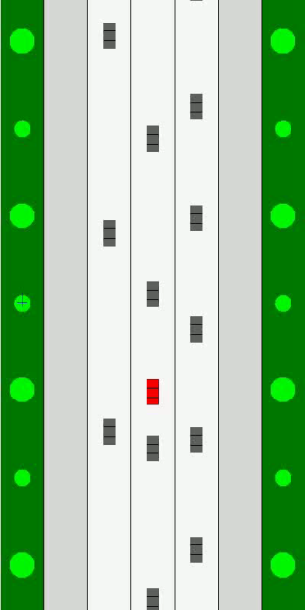
Evaluation in Driving Domain
Task: Teach the agent to drive on the highway
  Fixed driving speed
  Pass slower cars and avoid collisions
current lane
nearest car lane 1
nearest car lane 2
nearest car lane 3
merge left
merge right
stay in lane
Introduced by
Abbeel and Ng, 2004
state
actions
Notes:
12

Slide 13
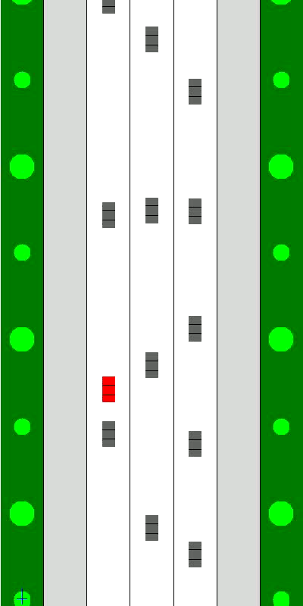
Evaluation in Driving Domain
Demonstration Selection Method | # Demonstrations | Collision Timesteps
“Teacher knows best” | 1300 | 2.7%
Confident Execution fixed τ_{conf} | 1016 | 3.8%
Confident Execution τ_{dist} & mult.τ_{conf} | 504 | 1.9%
CBA | 703 | 0%
CBA Final Policy
Notes:
13

Slide 14
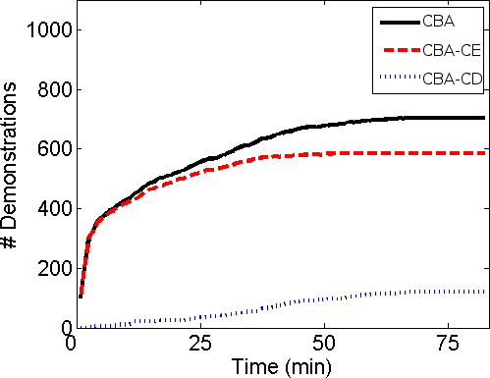
Demonstrations Over Time
Total Demonstrations
Confident Execution
Corrective Demonstration
Notes:
14

Slide 15
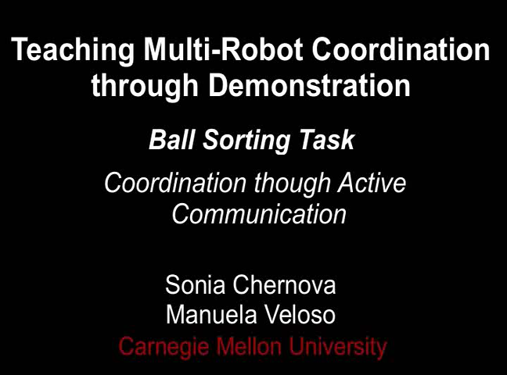

Slide 16
Summary
Confidence-Based Autonomy algorithm
  Confident Execution demonstration selection
  Corrective Demonstration
Notes:
16

Slide 17
What did we do today?
(PO)MDPs: need to generate a good policy
  Assumes the agent has some method for estimating its state (given current belief state and action, observation, where do I think I am now?)
  How do we estimate this?
Discrete latent states → HMMs (simplest DBNs)
Continuous latent states, observed states drawn from Gaussian, linear dynamical system → Kalman filters
  (Assumptions relaxed by Extended Kalman Filter, etc)
Not analytic → particle filters
  Take weighted samples (“particles”) of an underlying distribution
We’ve mainly looked at policies for discrete state spaces
For continuous state spaces, can use LfD:
  ML gives us a good-guess action based on past actions
  If we’re not confident enough, ask for help!

