Slide 1
Exploiting Parallelism on GPUs
Se-Joon Chung

Slide 2
Background and Key Challenges
The trend in computing hardware is parallel systems.
It is challenging for programmers is to develop applications that transparently scales its parallelism to leverage the increasing number of processor cores.
CUDA is a programming model which facilitates development of scalable parallel programs for data parallel applications.

Slide 3
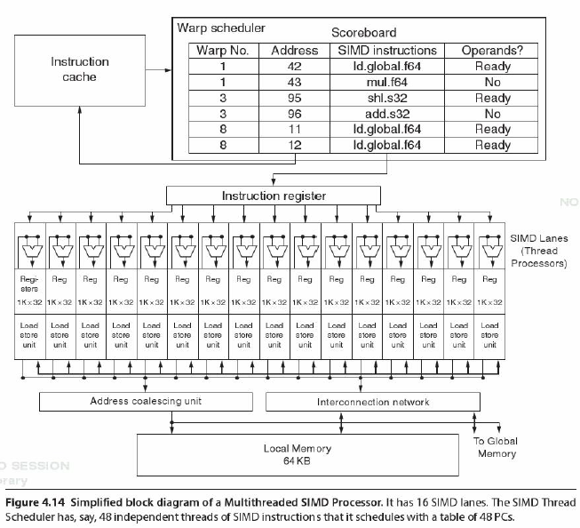
Graphics Processing Unit Overview

Slide 4
Graphics Processing Unit Overview
GPUs consist of many multithreaded SIMD processors that have many lanes per processor.
GPUs rely on extensive multithreading of threads of SIMD instructions to hide the long latency to DRAM.
Therefore, they have large number of registers to hold the state of many threads of SIMD instructions.

Slide 5
CUDA’s Key Abstractions
Providing a hierarchy of thread groups for better scalability
Shared memories between threads in the same block
Barrier synchronization between threads in the same block

Slide 6
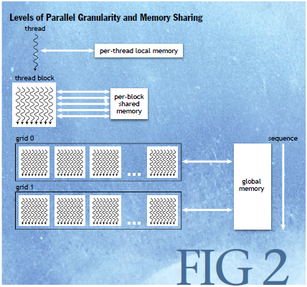
CUDA Threads and Memory

Slide 7
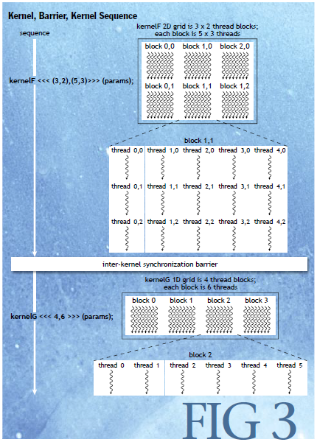
CUDA Threads and Memory

Slide 8
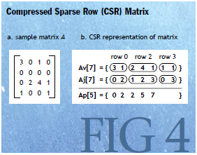
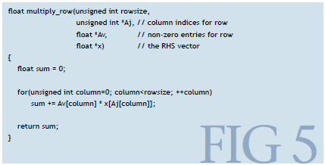
Example: Compressed Sparse Matrix

Slide 9
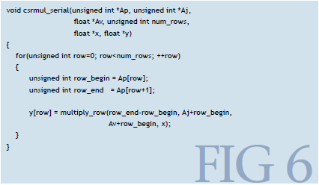
Example: Compressed Sparse Matrix

Slide 10
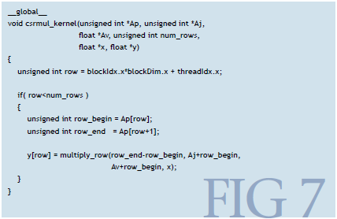
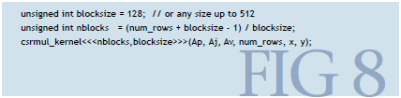
Example: Compressed Sparse Matrix

Slide 11
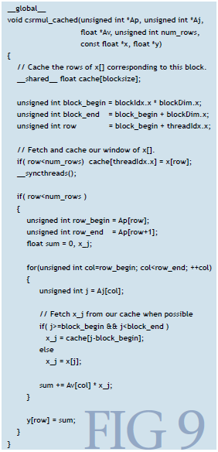
Example: Compressed Sparse Matrix

Slide 12
Argument for CUDA
Examples of CUDA programs that were able to achieve 50-250 times speedup: MRI reconstruction, molecular dynamics, n-body simulation
Ease of programming for programmers

Slide 13
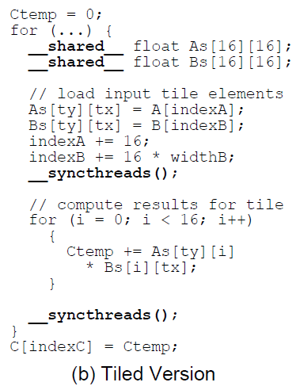
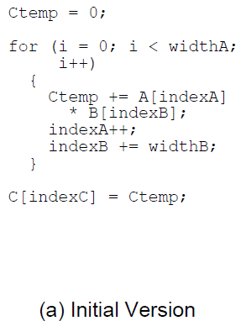
Further Improving CUDA Performance
Tiling can be used to reduce global memory accesses by improving locality of data

Slide 14
Further Improving CUDA Performance
C(1,1)
=
*
A(1,1)
B(1,1)

Slide 15
Further Improving CUDA Performance
C(1,1)
=
*
A(1,2)
B(2,1)

Slide 16
Further Improving CUDA Performance
C(1,1)
=
*
A(1,3)
B(3,1)

Slide 17
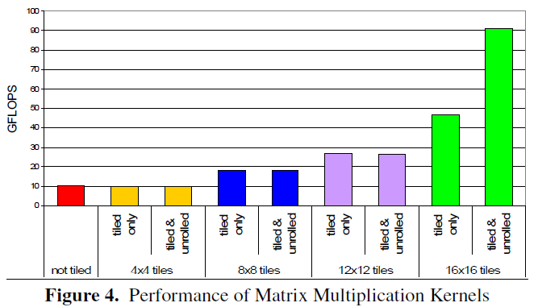
Further Improving CUDA Performance

Slide 18
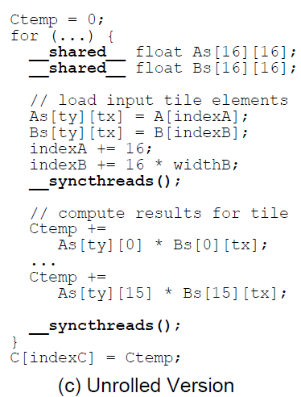
Further Improving CUDA Performance
We can also unroll smaller inner loops to reduce test/branch.

Slide 19
Benefits of CUDA
Coarse-grained thread blocks map naturally to separate processor cores and fine-grained threads map to multiple-thread contexts making it easy to scale with increasing parallel resources in system.
It is easy to transform serial programs into parallel CUDA programs by transforming loop operations into kernels.
Having very fast shared memory between threads in a block can provide substantial performance improvements by being used as software-managed cache.

Slide 20
Restrictions of CUDA
Threads and thread blocks may not be created within a parallel kernel due to simple hardware scheduler.
Thread blocks must be able to run independently and no communication is allowed. In order to combine results from multiple blocks, a second kernel must be launched.
Recursive function calls are not allowed in CUDA kernels due to limited per-thread resource (there can be thousands of threads executing at one time).
CUDA programs must explicitly copy data and results between CPU and GPU to support a heterogeneous system architecture.

Slide 21
Conclusions
CUDA provides an easy-to-program model for parallel applications.
Unlike their argument that CUDA abstractions are general and can extend to any parallel systems, many benefits such as shared memory is specific to NVIDIA’s GPU architecture.
Other parallel programming libraries such as OpenMP or Intel’s C++ Threading Building Blocks provide similar features for multicore CPUs.
Their examples do not show how they harness the benefits of CPU-GPU heterogeneous system.
CUDA makes it easier to program data parallel applications, but it doesn’t necessarily guide the programmer in choosing the right grid and block sizes.

