Slide 1

Image Processing

Slide 2
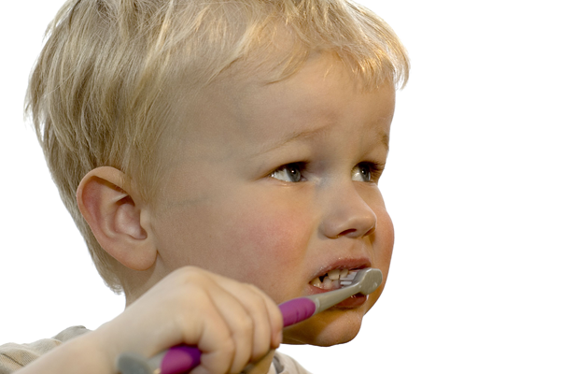
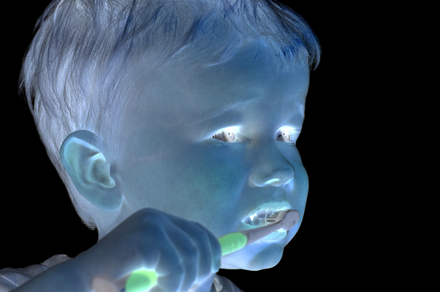
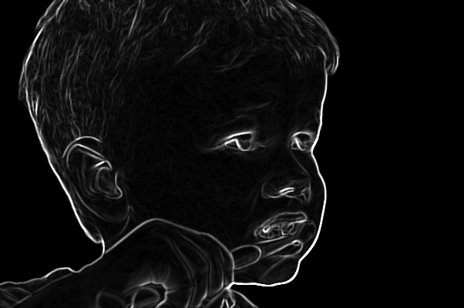
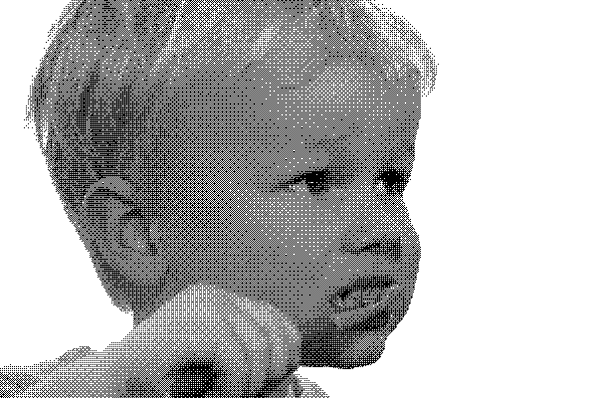
Overview
Images
Pixel Filters
Neighborhood Filters
Dithering

Slide 3
Image as a Function
We can think of an image as a function, f,
f: R² → R
f (x, y) gives the intensity at position (x, y)
Realistically, we expect the image only to be defined over a rectangle, with a finite range:
f: [a,b]x[c,d] → [0,1]
A color image is just three functions pasted together. We can write this as a “vector-valued” function:

Slide 4
Image as a Function

Slide 5

Image Processing
Define a new image g in terms of an existing image f
We can transform either the domain or the range of f
Range transformation:
What kinds of operations can this perform?

Slide 6
Image Processing
Some operations preserve the range but change the domain of f :
What kinds of operations can this perform?
Still other operations operate on both the domain and the range of f .

Slide 7
Point Operations

Slide 8
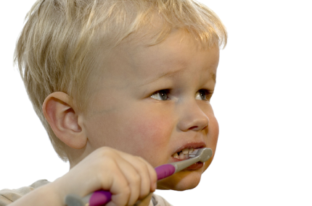
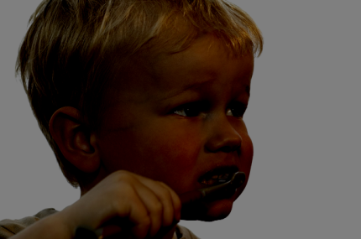
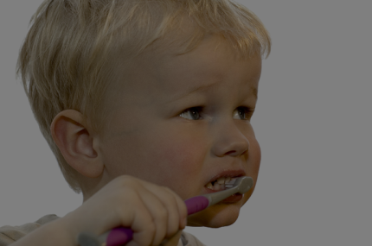
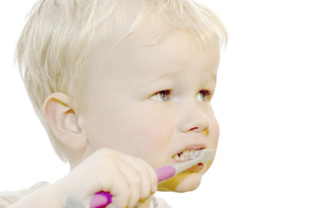

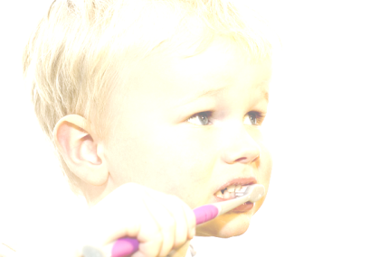

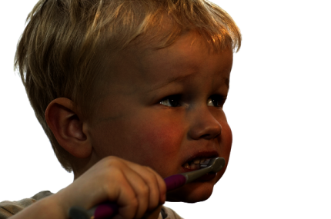
Point Processing
Nonlinear Lower Contrast
Original
Darken
Lower Contrast
Nonlinear Raise Contrast
Invert
Lighten
Raise Contrast

Slide 9

Point Processing
Nonlinear Lower Contrast
Original
Darken
Lower Contrast
x
x - 128
x / 2
((x / 255.0) ^ 0.33) * 255.0
Nonlinear Raise Contrast
Invert
Lighten
Raise Contrast
255 - x
x + 128
x * 2
((x / 255.0) ^2) * 255.0

Slide 10
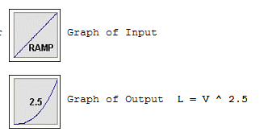
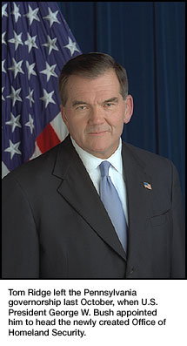
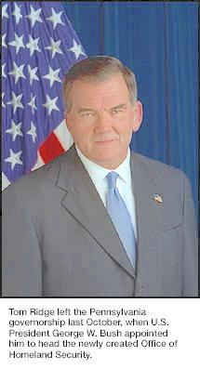
Gamma correction
Monitors have a intensity to voltage response curve which is roughly a 2.5 power function
Send v → actually display a pixel which has intensity equal to v^{2.5}
Γ = 1.0; f(v) = v
Γ = 2.5; f(v) = v^{1/2.5} = v^{0.4}

Slide 11
Neighborhood Operations

Slide 12
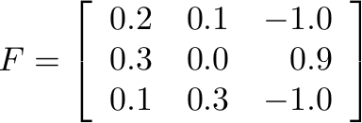
Convolution
0.2
0.1
-1.0
0.3
0.0
0.9
0.1
0.3
-1.0

Slide 13
Properties of Convolution
Commutative
Associative
Cascade system

Slide 14
Convolution
LSIS is doing convolution; convolution is linear and shift invariant
kernel h

Slide 15
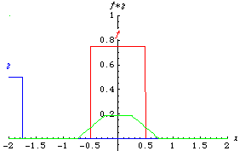
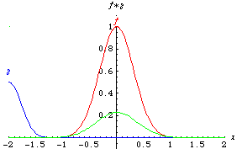
Convolution - Example
Eric Weinstein’s Math World

Slide 16
Convolution - Example
1
1
-1
1
-1
1
1
-2
-1
1
2

Slide 17
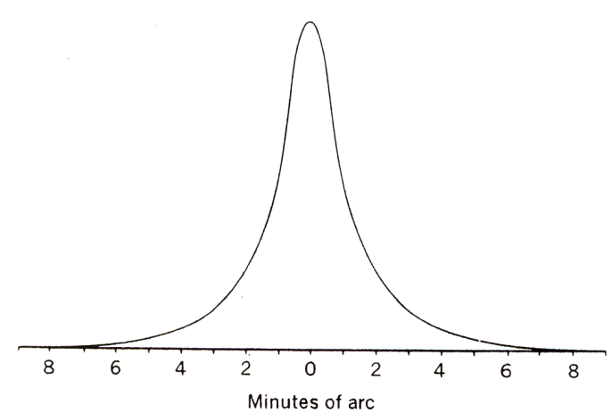
Point Spread Function
scene
Optical
System
image
Ideally, the optical system should be a Dirac delta function.
However, optical systems are never ideal.
Optical
System
point source
point spread function
Point spread function of Human Eyes

Slide 18
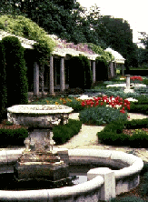
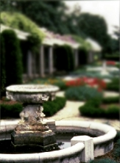
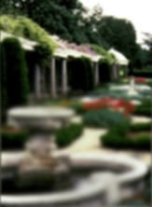
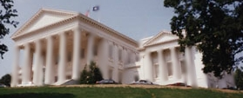
Point Spread Function
normal vision
myopia
hyperopia
astigmatism
Images by Richmond Eye Associates

Slide 19
Original Image

Slide 20
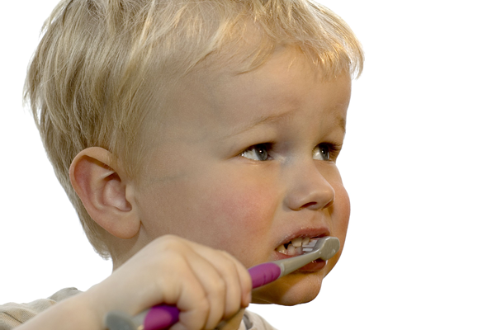
Shifted Image

Slide 21
Original Image

Slide 22

Blurred Image

Slide 23
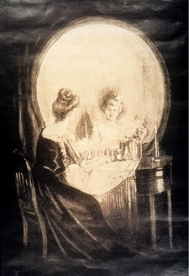
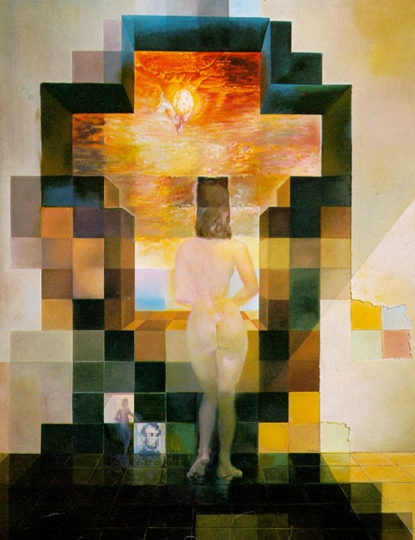
Gaussian Smoothing
by Charles Allen Gillbert
by Harmon & Julesz
http://www.michaelbach.de/ot/cog_blureffects/index.html

Slide 24

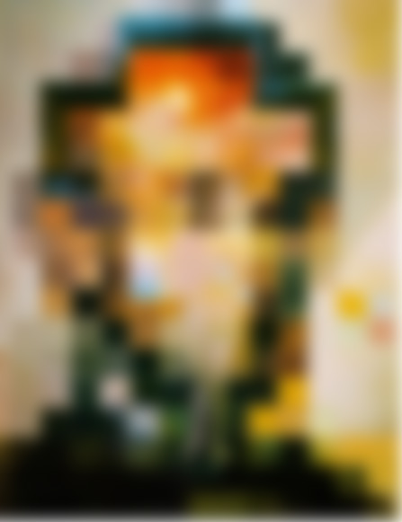
Gaussian Smoothing
http://www.michaelbach.de/ot/cog_blureffects/index.html

Slide 25
Original Image

Slide 26

Sharpened Image

Slide 27
Sharpened Image

Slide 28
Original Image

Slide 29

Noise

Slide 30

Blurred Noise

Slide 31
Median Filter
Smoothing is averaging
(a) Blurs edges
(b) Sensitive to outliers
(a)
(b)
Median filtering
Sort values around the pixel
Select middle value (median)
Non-linear (Cannot be implemented with convolution)
sort
median

Slide 32

Median Filter
Can this be described as a convolution?

Slide 33
Original Image

Slide 34
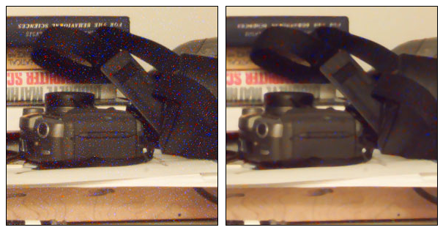
Example: Noise Reduction
Image with noise
Median filter (5x5)

Slide 35
Salt and pepper noise
Gaussian noise
3x3
5x5
7x7

Slide 36
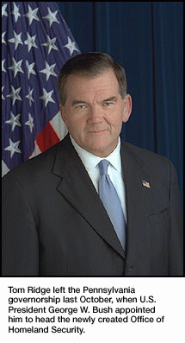
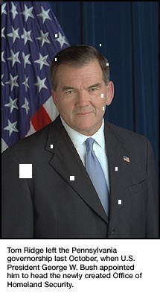
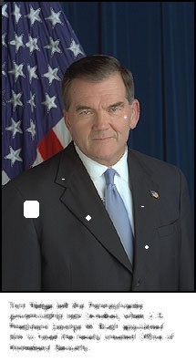
Example: Noise Reduction
Original image
Image with noise
Median filter (5x5)

Slide 37
Original Image

Slide 38
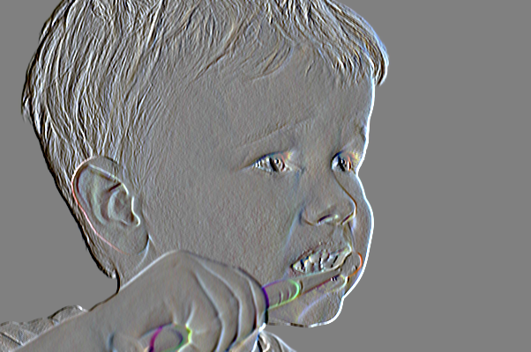
X-Edge Detection

Slide 39
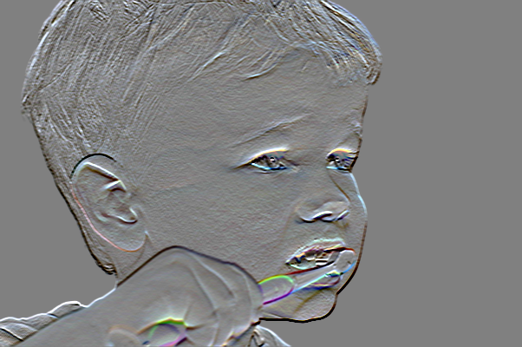
Y-Edge Detection

Slide 40
General Edge Detection
Can this be described as a convolution?

Slide 41
Image Processing
Some operations preserve the range but change the domain of f :
What kinds of operations can this perform?
Still other operations operate on both the domain and the range of f .

Slide 42
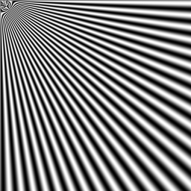
Aliasing

Slide 43
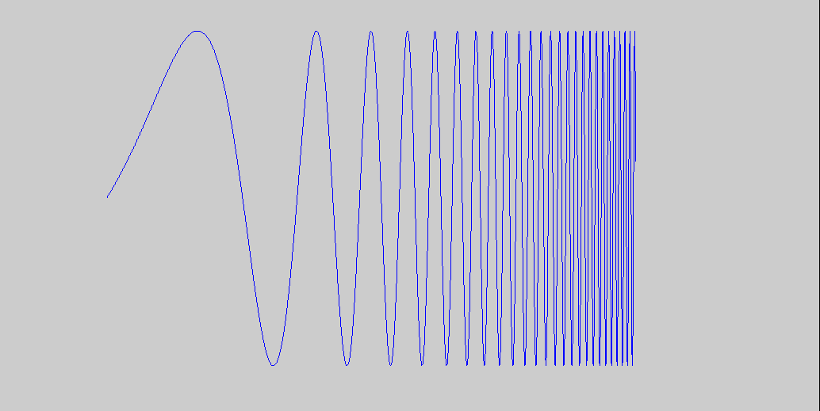
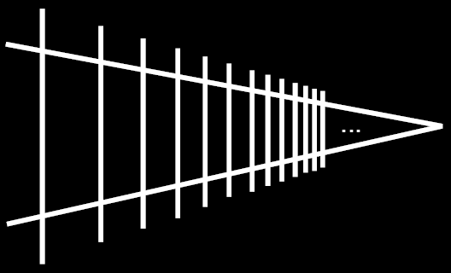
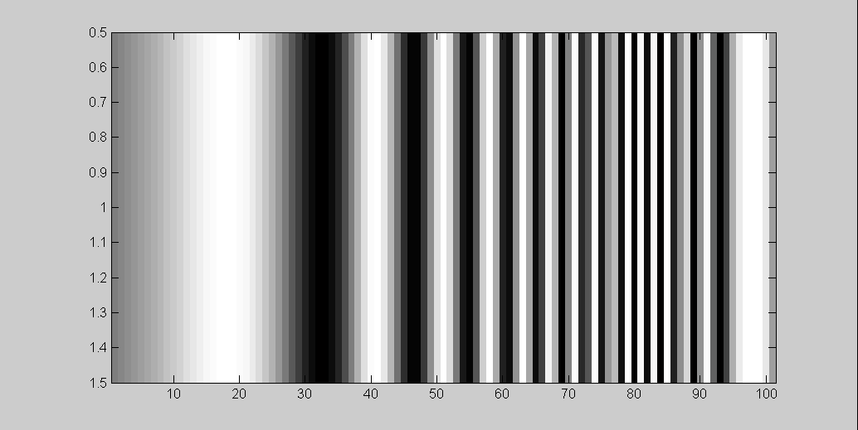
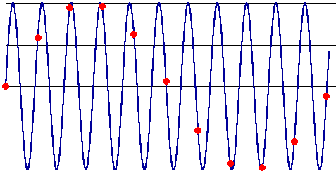
Alias: n., an assumed name
Input signal:
Matlab output:
Picket fence receding
into the distance will
produce aliasing…
WHY?
x = 0:.05:5; imagesc(sin((2.^x).*x))
Alias!
Not enough samples

Slide 44
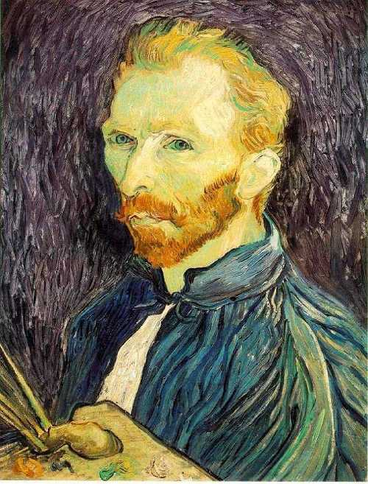
Image Scaling
This image is too big to
fit on the screen. How
can we reduce it?
How to generate a half-
sized version?

Slide 45

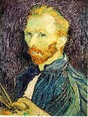

Image Sub-Sampling
1/8
1/4
Throw away every other row and column to create a 1/2 size image
- called image sub-sampling

Slide 46
Image Sub-Sampling
1/2
1/4 (2x zoom)
1/8 (4x zoom)

Slide 47
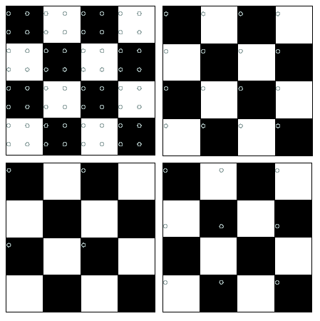
Good and Bad Sampling
Good sampling:
Sample often or,
Sample wisely
Bad sampling:
see aliasing in action!

Slide 48
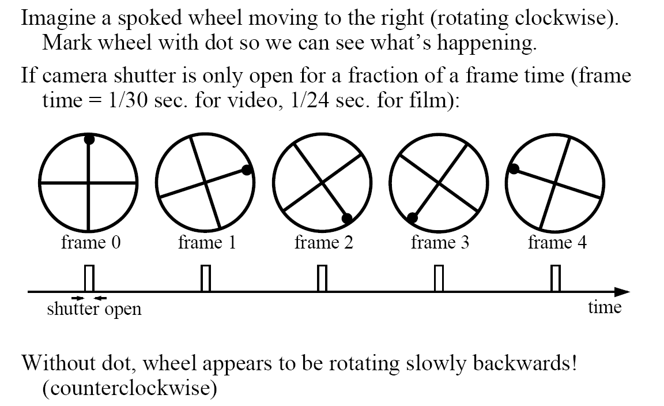
Really bad in video

Slide 49



Sub-Sampling with Gaussian Pre-Filtering
G 1/8
G 1/4
Gaussian 1/2
Solution: filter the image, then subsample
Filter size should double for each ½ size reduction. Why?

Slide 50
Sub-Sampling with Gaussian Pre-Filtering
Gaussian 1/2
G 1/4
G 1/8

Slide 51
Compare with...
1/2
1/4 (2x zoom)
1/8 (4x zoom)

Slide 52
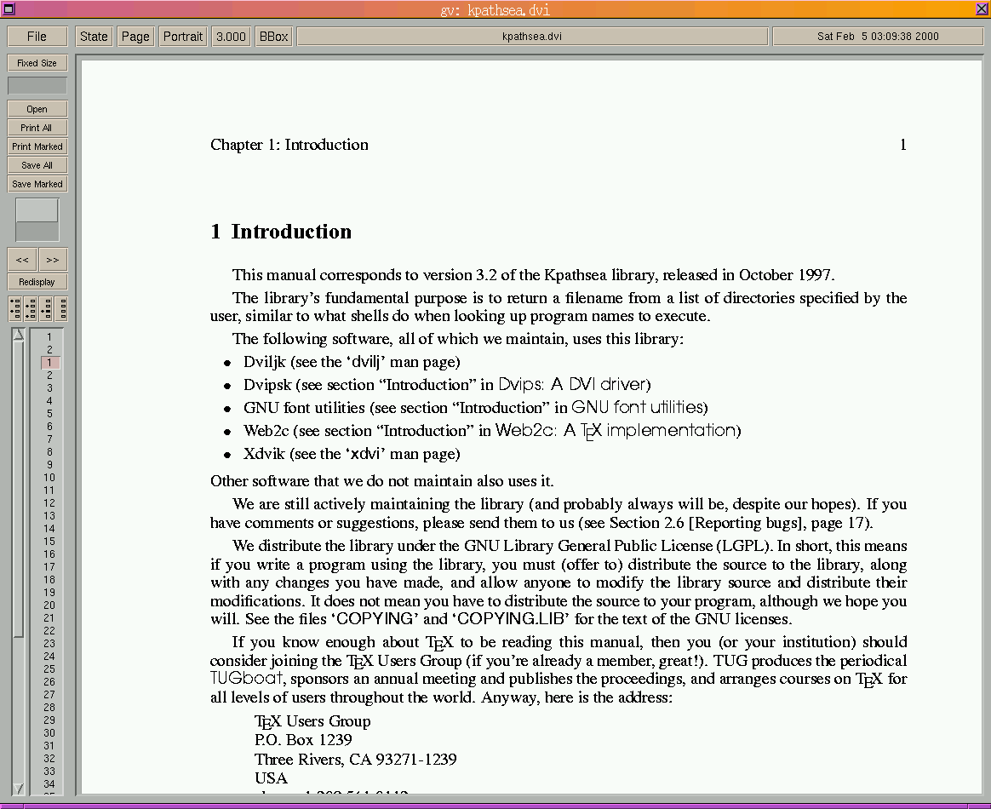
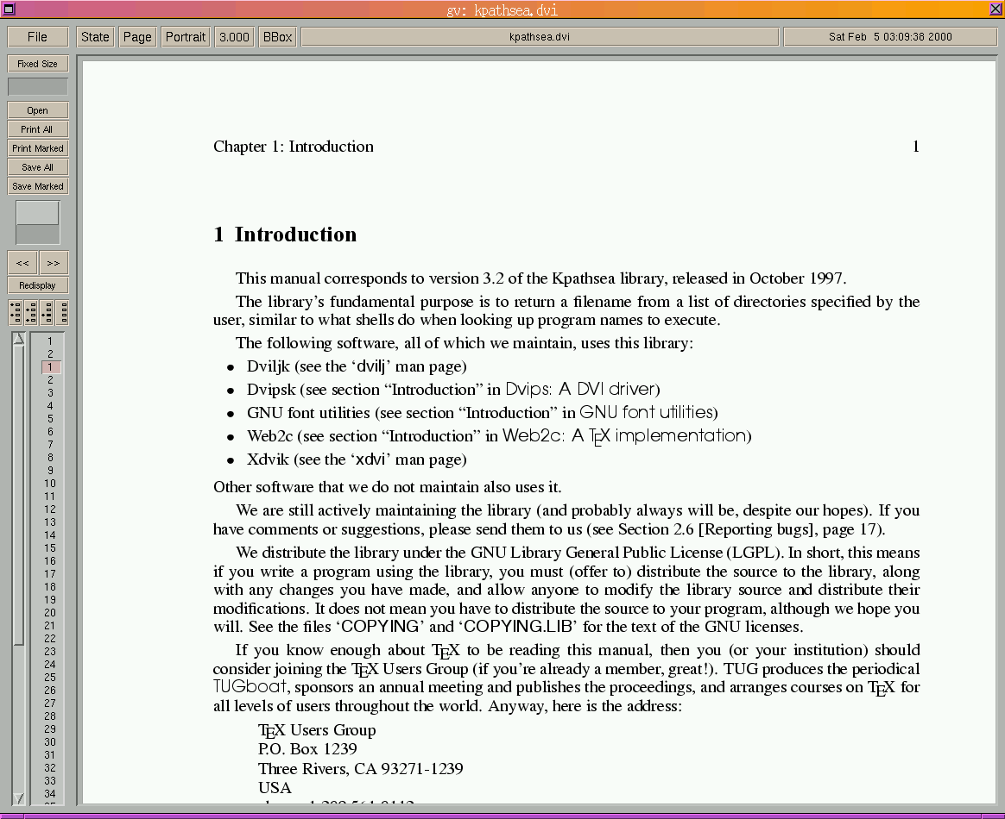
Aliasing

Slide 53
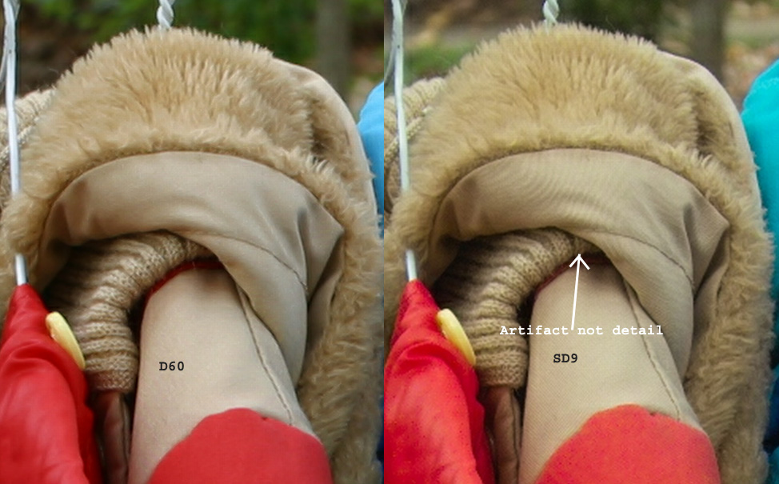
Canon D60 (w/ anti-alias filter)
Sigma SD9 (w/o anti-alias filter)
From Rick Matthews website, images by Dave Etchells

Slide 54
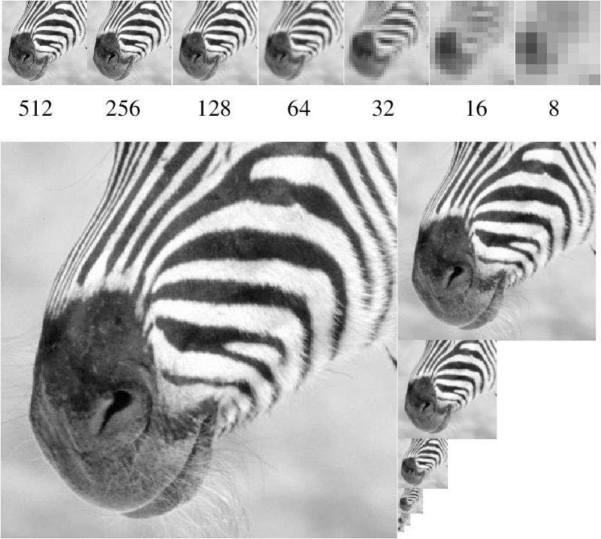
Figure from David Forsyth

Slide 55
Original Image

Slide 56
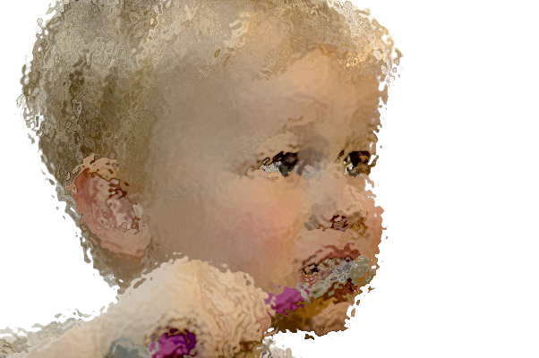
Warped Image

Slide 57
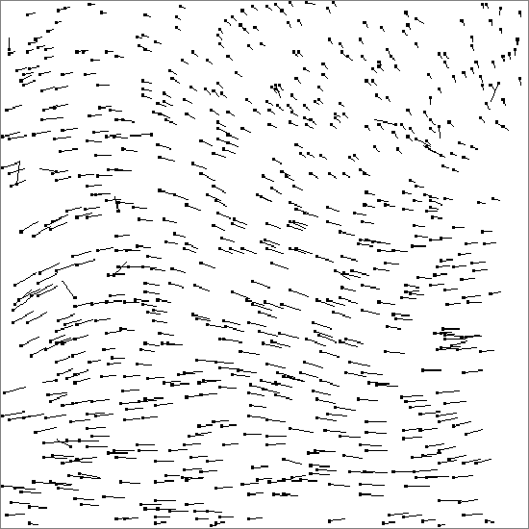
Warped Image
+
=
orig
vector field
warped
how?

Slide 58

Advection (just like a fluid)

