Slide 1
Computer Vision
Spring 2012 15-385,-685
Instructor: S. Narasimhan
WH 5409
T-R 10:30am – 11:50am
Lecture #23

Slide 2
Classification and SVM
Credits: Guru Krishnan and Shree Nayar
Eric P. Xing

Slide 3



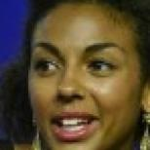
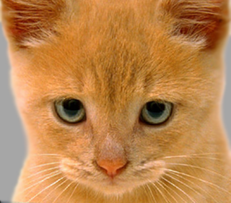
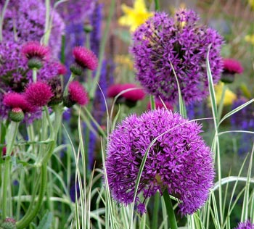
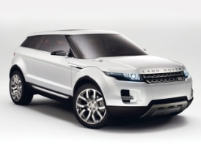

Classification (Supervised Learning)
Data:
X = {X₁, X₂, … , X_{n}}
Label:
Y = {y₁, y₂, … , y_{n}}, yi ∈ {-1,1}
Test:
X_{t} → -1 or 1?
Classifier:
f: X → Y
X =
Y = 1 1 1 -1 -1 -1
X_{t}
Face or not?

Slide 4
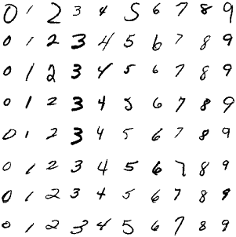

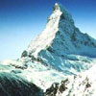

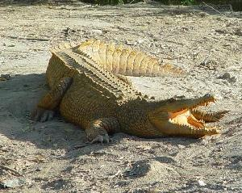
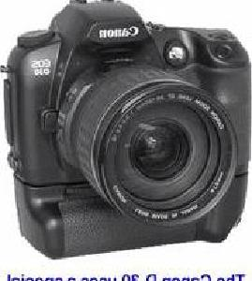
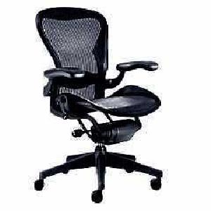
Classification and Computer Vision
Handwritten
characters
Face
Scene classification
Object recognition

Slide 5
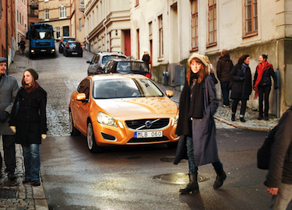
Classification and Computer Vision
Pedestrian detection
Yes / No

Slide 6


Procedure of Classification
(1) Gather positive / negative training data
(2) Feature Extraction
X =
Y = 1 1 1 -1 -1 -1
Very challenging in reality…
∈ R^{n}
$$⋮$$
$$⋮$$
$$⋮$$
$$⋮$$
$$⋮$$
$$⋮$$

Slide 7

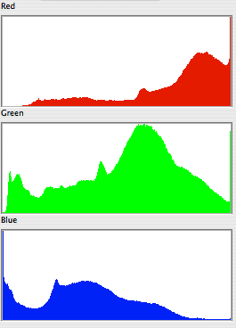
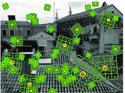
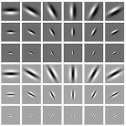

Feature Extraction
∈ R^{n}
$$⋮$$
Binary codes are available !
Color histogram
Texture
filters
Haar
filter
SIFT
Pixel

Slide 8

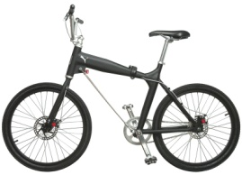
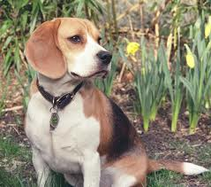
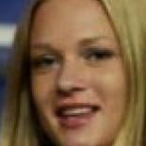
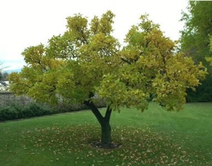
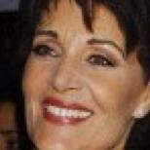
Feature Space
Let the n-dimensional feature vector F be a point an n-D space R^{n}(Feature space)
f₂
°
°
°
°
°
°
f₁
f_{N}
Training Data of Face
Training Data of Non-Face
(3) Learn classifier!

Slide 9
Nearest Neighbor Classifier
Nearest samples decide the result of the classifier.
f₂
°
°
°
°
°
°
f₁
f_{N}
Training Data of Face
Training Data of Non-Face
Test Image

Slide 10
Nearest Neighbor Classifier
Nearest samples decide the result of the classifier.
f₂
°
°
°
°
°
°
f₁
f_{N}
Training Data of Face
Training Data of Non-Face
Face

Slide 11

Nearest Neighbor Classifier
Nearest samples decide the result of the classifier.
f₂
°
°
°
°
°
°
f₁
f_{N}
Training Data of Face
Training Data of Non-Face
Not Face

Slide 12
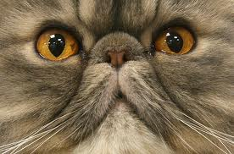
Nearest Neighbor Classifier
Larger the training set, more robust the NN classifier
f₂
°
°
°
°
°
°
f₁
f_{N}
Training Data of Face
Training Data of Non-Face
False Positive

Slide 13
Nearest Neighbor Classifier
Larger the training set, slower the NN classifier
f₂
°
°
°
°
°
°
f₁
f_{N}
Training Data of Face
Training Data of Non-Face

Slide 14
Decision Boundary
A simple decision boundary separating the face and non-face classes will suffice.
f₂
°
°
°
°
°
°
f₁
f_{N}
Training Data of Face
Training Data of Non-Face

Slide 15
Decision Boundary
Find Decision Boundary in feature space
Decision Boundary
W^{T}F+b=0
°
°
°
°
Faces
°
°
W^{T}F+b>0
°
°
°
°
°
Non-Faces
W^{T}F+b<0

Slide 16
Decision Boundary
How to find the optimal decision boundary?
°
°
°
°
Face Class
°
°
°
°
°
°
°
Non-Face Class

Slide 17
Evaluating a Decision Boundary
Margin
°
°
°
°
°
°
°
°
°
°
°
Margin or Safe Zone: The width that the boundary could be increased by before hitting a data point.

Slide 18
Evaluating a Decision Boundary
Margin I
Margin II
+
+
°
°
°
°
°
°
°
°
°
°
°
°
°
°
°
°
Decision I: Face
Decision II: Non-Face
Choose Decision Boundary with the Maximum Margin!

Slide 19
Support Vector Machine (SVM)
Classifier optimized to maximize Margin
Margin
°
°
°
°
°
°
°
°
°
°
°
Support Vectors: Closest data samples to the boundary.
Decision Boundary and the Margin depend only on the Support Vectors.

Slide 20
Finding Decision Boundary
ρ
-ρ
Distance between a point x to a plan
W^{T}F+b=0
°
w^{T}x + b
W^{T}F+b=c
°
d=
(Hessian normal form)
°
||w||
°
°
°
w^{T}x_{s} + b
ρ=
where
w^{T}x_{s} + b=c
||w||
W^{T}F+b=0
W^{T}F+b=-c
c
ρ=
||w||
max
2c
w
||w||
w^{T}x_{i} + b
c
w^{T}x_{i} + b
-c
s.t
≥
for all X_{i} with y_{i}=1
≤
for all X_{i} with y_{i}=-1
||w||
||w||
||w||
||w||

Slide 21
Founding Decision Boundary
max
2c
w
||w||
w^{T}x_{i} + b
c
w^{T}x_{i} + b
-c
s.t
≥
for all X_{i} with y_{i}=1
≤
for all X_{i} with y_{i}=-1
||w||
||w||
||w||
||w||
max
2c
w
min
||w||
||w||
w
w^{T}x_{i} + b
c
s.t
y_{i}
(w^{T}x_{i} + b)
1
s.t
y_{i}
≥
for all X_{i}
≥
for all X_{i}
||w||
||w||
Learning classifier
Compute w by solving the QP

Slide 22
Kernel Trick
How about these points in 1-D?
°
°
°
°
°
°
°
0
°
°
No!
Linearly separable
Think about a quadratic mapping Φ(x)=x².
°
°
°
0
Yes!

Slide 23
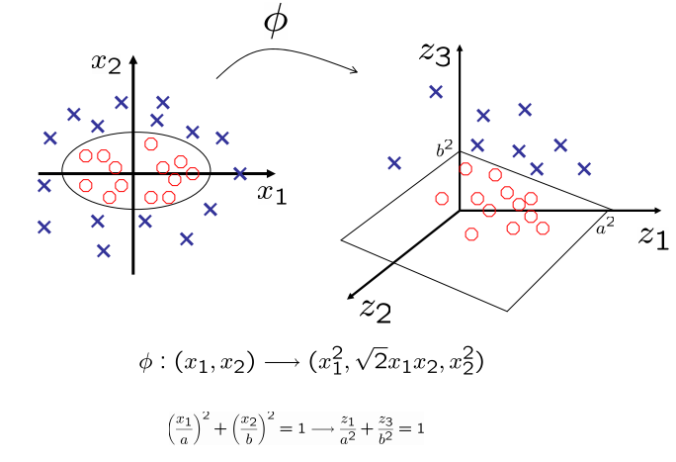
Kernel Trick
Φ(x)
°
°
°
°
°
°
°
°
°
°
°
°
°
°
°
°
Mathematically hard to describe!

