Slide 1
Computer Vision
Spring 2010 15-385,-685
Instructor: S. Narasimhan
WH 5409
T-R 10:30am – 11:50am
Lecture #22

Slide 2
Face Detection
Thanks to Guru Krishnan and Shree Nayar

Slide 3
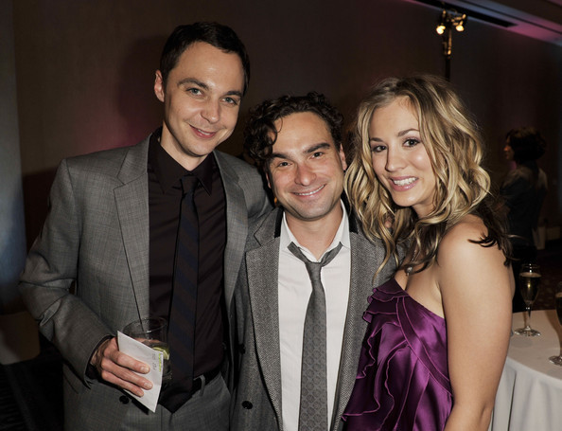
What is Face Detection?
Locate human faces in images.
I.1

Slide 4
Face Detection
Locate human faces in images.
Topics:
Features for Face Detection
Integral Images
Nearest Neighbor Classifier
Support Vector Machine

Slide 5
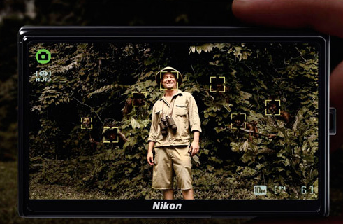
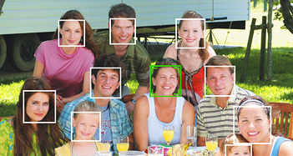
Where is Face Detection Used?
I.16
Cameras (for Autofocus)

Slide 6
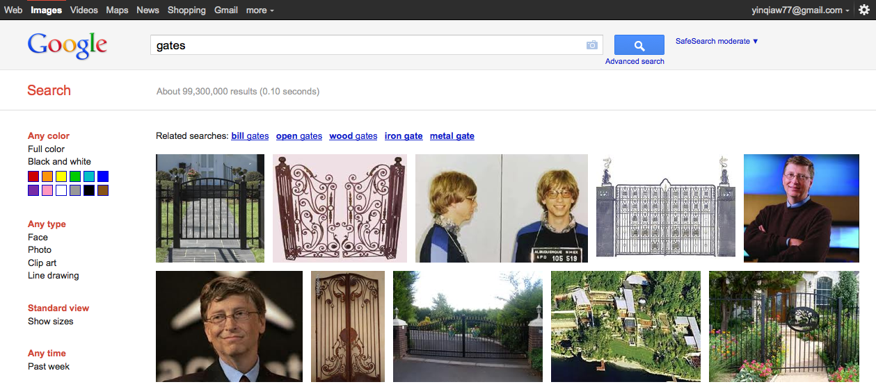
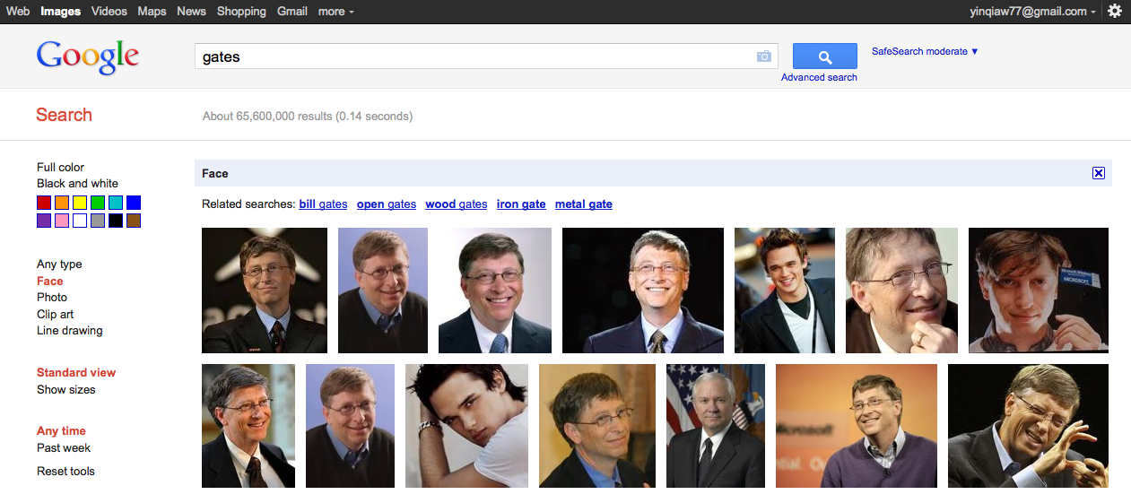
Where is Face Detection Used?
I.2
Face Detection Function
Search Engine

Slide 7
Where is Face Detection Used?
I.3
Only Faces of Gates now!
Search Engine

Slide 8
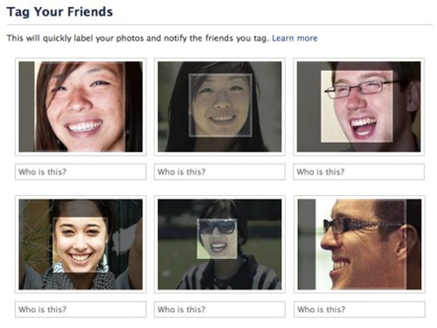
Where is Face Detection Used?
I.4
Photo Tagging in Social Networks

Slide 9
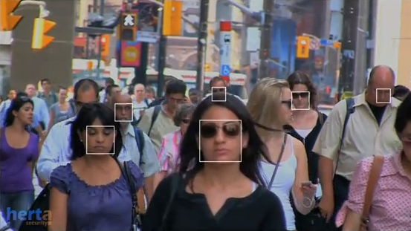
Where is Face Detection Used?
I.6
Security Surveillance in Public

Slide 10
How Humans Detect Faces?
We do not know yet!
Some Conjectures:
Memory-prediction model
Match faces with the face model in memory.
Parallel computing
Detect faces at multiple location/scale combination.

Slide 11
Face Detection in Computers
Basic Idea:
Slide windows of different sizes across image.
At each location match the window to a face model.
I.1
Notes:
http://images2.fanpop.com/images/photos/4700000/TBBT-Cast-the-big-bang-theory-4701578-594-455.jpg

Slide 12
Face Detection in Computers
Basic Idea:
Slide windows of different sizes across image.
At each location match the window to a face model.
I.1

Slide 13

Basic Framework
For each window
Extract
Features
Match
Face Model
F
Yes / No
I.12
Features: Which features represent faces well?
Classifier: How to construct/match the face model?

Slide 14
What are Good Features?
SIFT?
Facial Components?

Slide 15
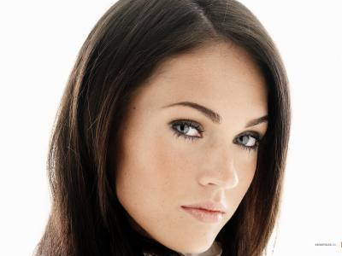
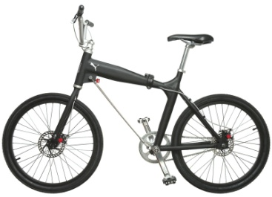
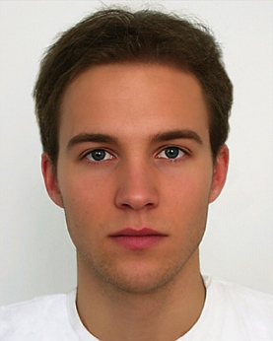

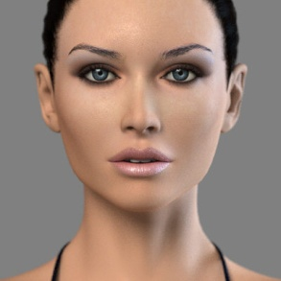
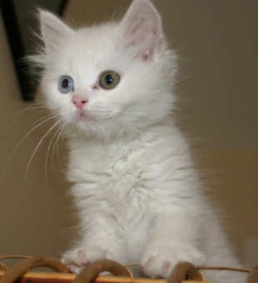
Characteristics of Good Features
Discriminate Face/Non-Face
I.7
≠
I.10
I.8
I.12
I.9
I.11
Extremely Fast to Compute
Need to evaluate tens of thousands windows in an image.

Slide 16





Haar Features
A Set of Responses to Rectangular Haar Filters
$$H_{A}$$
$$H_{B}$$
*
$$H_{C}$$
$$H_{D}$$
$$⋮$$

Slide 17


Response to Haar Filter
*
$$H_{A}$$
White = 1, Black = -1
Response to Filter $H_{A}$ at location $(i,j)$:
$$V_{A}\left[i,j\right]=\sum_{m}{\sum_{n}{I\left[i−m,j−n\right]H_{A}\left[m,n\right]}}$$
$V_{A}\left[i,j\right]=$ ∑ (pixels in white area) – ∑ (pixels in black area)

Slide 18
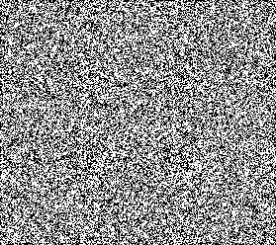

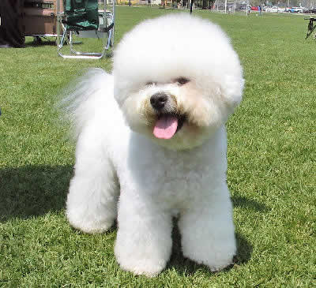
Haar Feature: Discriminative Ability
V_{A} = 64
V_{A} ≈ 0
I.12
V_{A} = 16
V_{A} = -127
I.13
I.14
Haar features capture the Directional Pattern

Slide 19











Haar Features
Feature Vector
$$H_{A}$$
$$V_{A}[i,j]$$
$$H_{B}$$
$$V_{B}[i,j]$$
*
$$F[i,j]=$$
$$H_{C}$$
$$V_{C}[i,j]$$
$$H_{D}$$
$$V_{D}[i,j]$$
$$⋮$$
$$⋮$$

Slide 20




Face Detection at Different Scales
Use filters of different sizes to find faces at corresponding scale
$$⋮$$
$$⋮$$
$$⋮$$
$$⋮$$

Slide 21
Haar Feature: Computation Cost
Value = ∑ (pixels in white) – ∑ (pixels in black)
= Pixel sum in White Rect – Pixel sum in Black Rect
If filter size is N×M pixels: Computation cost = (N×M-1) additions
Still too expensive!
Integral Image to the Rescue!

Slide 22
Integral Image
A table that holds the sum of all pixel values
to the left and top of a given pixel, inclusive.
For example:
98 | 110 | 121 | 125 | 122 | 129
99 | 110 | 120 | 116 | 116 | 129
97 | 109 | 124 | 111 | 123 | 134
98 | 112 | 132 | 108 | 123 | 133
97 | 113 | 147 | 108 | 125 | 142
95 | 111 | 168 | 122 | 130 | 137
96 | 104 | 172 | 130 | 126 | 130
98 | 208 | 329 | 454 | 576 | 705
197 | 417 | 658 | 899 | 1137 | 1395
294 | 623 | 988 | 1340 | 1701 | 2093
392 | 833 | 1330 | 1790 | 2274 | 2799
489 | 1043 | 1687 | 2255 | 2864 | 3531
584 | 1249 | 2061 | 2751 | 3490 | 4294
680 | 1449 | 2433 | 3253 | 4118 | 5052
Image
Integral Image

Slide 23
Integral Image
A table that holds the sum of all pixel values
to the left and top of a given pixel, inclusive.
For example:
98 | 110 | 121 | 125 | 122 | 129
99 | 110 | 120 | 116 | 116 | 129
97 | 109 | 124 | 111 | 123 | 134
98 | 112 | 132 | 108 | 123 | 133
97 | 113 | 147 | 108 | 125 | 142
95 | 111 | 168 | 122 | 130 | 137
96 | 104 | 172 | 130 | 126 | 130
98 | 208 | 329 | 454 | 576 | 705
197 | 417 | 658 | 899 | 1137 | 1395
294 | 623 | 988 | 1340 | 1701 | 2093
392 | 833 | 1330 | 1790 | 2274 | 2799
489 | 1043 | 1687 | 2255 | 2864 | 3531
584 | 1249 | 2061 | 2751 | 3490 | 4294
680 | 1449 | 2433 | 3253 | 4118 | 5052
Image
Integral Image

Slide 24
Integral Image
A table that holds the sum of all pixel values
to the left and top of a given pixel, inclusive.
For example:
98 | 110 | 121 | 125 | 122 | 129
99 | 110 | 120 | 116 | 116 | 129
97 | 109 | 124 | 111 | 123 | 134
98 | 112 | 132 | 108 | 123 | 133
97 | 113 | 147 | 108 | 125 | 142
95 | 111 | 168 | 122 | 130 | 137
96 | 104 | 172 | 130 | 126 | 130
98 | 208 | 329 | 454 | 576 | 705
197 | 417 | 658 | 899 | 1137 | 1395
294 | 623 | 988 | 1340 | 1701 | 2093
392 | 833 | 1330 | 1790 | 2274 | 2799
489 | 1043 | 1687 | 2255 | 2864 | 3531
584 | 1249 | 2061 | 2751 | 3490 | 4294
680 | 1449 | 2433 | 3253 | 4118 | 5052
Image
Integral Image

Slide 25
Integral Image
A table that holds the sum of all pixel values
to the left and top of a given pixel, inclusive.
For example:
98 | 110 | 121 | 125 | 122 | 129
99 | 110 | 120 | 116 | 116 | 129
97 | 109 | 124 | 111 | 123 | 134
98 | 112 | 132 | 108 | 123 | 133
97 | 113 | 147 | 108 | 125 | 142
95 | 111 | 168 | 122 | 130 | 137
96 | 104 | 172 | 130 | 126 | 130
98 | 208 | 329 | 454 | 576 | 705
197 | 417 | 658 | 899 | 1137 | 1395
294 | 623 | 988 | 1340 | 1701 | 2093
392 | 833 | 1330 | 1790 | 2274 | 2799
489 | 1043 | 1687 | 2255 | 2864 | 3531
584 | 1249 | 2061 | 2751 | 3490 | 4294
680 | 1449 | 2433 | 3253 | 4118 | 5052
Image
Integral Image

Slide 26
Summation Within a Rectangle
Fast summations of arbitrary rectangles using integral images.
98 | 110 | 121 | 125 | 122 | 129
99 | 110 | 120 | 116 | 116 | 129
97 | 109 | 124 | 111 | 123 | 134
98 | 112 | 132 | 108 | 123 | 133
97 | 113 | 147 | 108 | 125 | 142
95 | 111 | 168 | 122 | 130 | 137
96 | 104 | 172 | 130 | 126 | 130
98 | 208 | 329 | 454 | 576 | 705
197 | 417 | 658 | 899 | 1137 | 1395
294 | 623 | 988 | 1340 | 1701 | 2093
392 | 833 | 1330 | 1790 | 2274 | 2799
489 | 1043 | 1687 | 2255 | 2864 | 3531
584 | 1249 | 2061 | 2751 | 3490 | 4294
680 | 1449 | 2433 | 3253 | 4118 | 5052
Image
Integral Image (II)

Slide 27
Summation Within a Rectangle
Fast summations of arbitrary rectangles using integral images.
98 | 110 | 121 | 125 | 122 | 129
99 | 110 | 120 | 116 | 116 | 129
97 | 109 | 124 | 111 | 123 | 134
98 | 112 | 132 | 108 | 123 | 133
97 | 113 | 147 | 108 | 125 | 142
95 | 111 | 168 | 122 | 130 | 137
96 | 104 | 172 | 130 | 126 | 130
98 | 208 | 329 | 454 | 576 | 705
197 | 417 | 658 | 899 | 1137 | 1395
294 | 623 | 988 | 1340 | 1701 | 2093
392 | 833 | 1330 | 1790 | 2274 | 2799
489 | 1043 | 1687 | 2255 | 2864 | 3531
584 | 1249 | 2061 | 2751 | 3490 | 4294
680 | 1449 | 2433 | 3253 | 4118 | 5052
P
Image
Integral Image (II)
Sum = II_{P} +…
= 3490 + …

Slide 28
Summation Within a Rectangle
Fast summations of arbitrary rectangles using integral images.
98 | 110 | 121 | 125 | 122 | 129
99 | 110 | 120 | 116 | 116 | 129
97 | 109 | 124 | 111 | 123 | 134
98 | 112 | 132 | 108 | 123 | 133
97 | 113 | 147 | 108 | 125 | 142
95 | 111 | 168 | 122 | 130 | 137
96 | 104 | 172 | 130 | 126 | 130
98 | 208 | 329 | 454 | 576 | 705
197 | 417 | 658 | 899 | 1137 | 1395
294 | 623 | 988 | 1340 | 1701 | 2093
392 | 833 | 1330 | 1790 | 2274 | 2799
489 | 1043 | 1687 | 2255 | 2864 | 3531
584 | 1249 | 2061 | 2751 | 3490 | 4294
680 | 1449 | 2433 | 3253 | 4118 | 5052
Q
P
Image
Integral Image (II)
Sum = II_{P} – II_{Q} + …
= 3490 – 1137 + …

Slide 29
Summation Within a Rectangle
Fast summations of arbitrary rectangles using integral images.
98 | 110 | 121 | 125 | 122 | 129
99 | 110 | 120 | 116 | 116 | 129
97 | 109 | 124 | 111 | 123 | 134
98 | 112 | 132 | 108 | 123 | 133
97 | 113 | 147 | 108 | 125 | 142
95 | 111 | 168 | 122 | 130 | 137
96 | 104 | 172 | 130 | 126 | 130
98 | 208 | 329 | 454 | 576 | 705
197 | 417 | 658 | 899 | 1137 | 1395
294 | 623 | 988 | 1340 | 1701 | 2093
392 | 833 | 1330 | 1790 | 2274 | 2799
489 | 1043 | 1687 | 2255 | 2864 | 3531
584 | 1249 | 2061 | 2751 | 3490 | 4294
680 | 1449 | 2433 | 3253 | 4118 | 5052
Q
S
P
Image
Integral Image (II)
Sum = II_{P} – II_{Q} – II_{S} + …
= 3490 – 1137 – 1249 + …

Slide 30
Summation Within a Rectangle
Can be computed in constant time with only 4 references
98 | 110 | 121 | 125 | 122 | 129
99 | 110 | 120 | 116 | 116 | 129
97 | 109 | 124 | 111 | 123 | 134
98 | 112 | 132 | 108 | 123 | 133
97 | 113 | 147 | 108 | 125 | 142
95 | 111 | 168 | 122 | 130 | 137
96 | 104 | 172 | 130 | 126 | 130
98 | 208 | 329 | 454 | 576 | 705
197 | 417 | 658 | 899 | 1137 | 1395
294 | 623 | 988 | 1340 | 1701 | 2093
392 | 833 | 1330 | 1790 | 2274 | 2799
489 | 1043 | 1687 | 2255 | 2864 | 3531
584 | 1249 | 2061 | 2751 | 3490 | 4294
680 | 1449 | 2433 | 3253 | 4118 | 5052
R
Q
S
P
Image
Integral Image (II)
Sum = II_{P} – II_{Q} – II_{S} + II_{R}
= 3490 – 1137 – 1249 + 417 = 1521

Slide 31
Haar Response using Integral Image
T
98 | 110 | 121 | 125 | 122 | 129
99 | 110 | 120 | 116 | 116 | 129
97 | 109 | 124 | 111 | 123 | 134
98 | 112 | 132 | 108 | 123 | 133
97 | 113 | 147 | 108 | 125 | 142
95 | 111 | 168 | 122 | 130 | 137
96 | 104 | 172 | 130 | 126 | 130
98 | 208 | 329 | 454 | 576 | 705
197 | 417 | 658 | 899 | 1137 | 1395
294 | 623 | 988 | 1340 | 1701 | 2093
392 | 833 | 1330 | 1790 | 2274 | 2799
489 | 1043 | 1687 | 2255 | 2864 | 3531
584 | 1249 | 2061 | 2751 | 3490 | 4294
680 | 1449 | 2433 | 3253 | 4118 | 5052
R
Q
S
P
O
Image
Integral Image (II)
V_{A} = ∑ (pixels in white area) – ∑ (pixels in black area)
= (II_{O} – II_{T} + II_{R} – II_{S}) – (II_{P} – II_{Q} + II_{T} – II_{O})
= (2061–329+98–584) – (3490–576+329–2061) = 64

Slide 32
Computing Integral Image
Raster
Scanning
D
B
C
A
Let I_{A} and II_{A} be the values of the Image and Integral Image, respectively, at pixel A.
II_{A} = II_{B} + II_{C} – II_{D} + I_{A}

Slide 33
Haar Features for Face Detection
Feature Vector
$$H_{A}$$
$$V_{A}[i,j]$$
$$H_{B}$$
$$V_{B}[i,j]$$
*
$$F[i,j]=$$
$$H_{C}$$
$$V_{C}[i,j]$$
$$H_{D}$$
$$V_{D}[i,j]$$
$$⋮$$
$$⋮$$

Slide 34
Classifier for Face Detection
Given the features for a window, how to decide whether it contains a face or not?
?
?
?
?

Slide 35

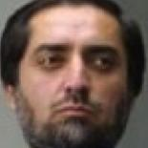
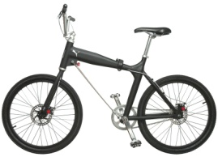
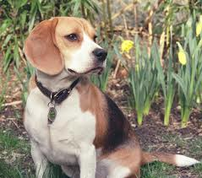
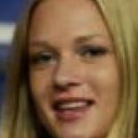
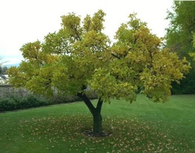
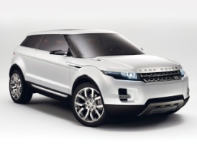
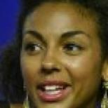
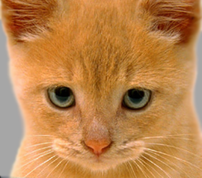
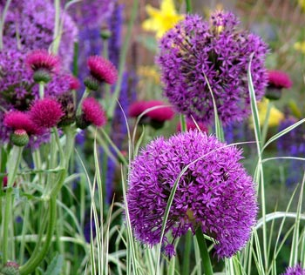
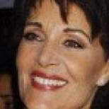


Feature Space
Let the n-dimensional feature vector $F$ be a point in an n-D space, $F∈ℝ^{n}$ (Feature space)
f₂
°
°
°
°
°
°
f₁
f_{N}
Training Data of Face
Training Data of Non-Face

Slide 36
Nearest Neighbor Classifier
Nearest samples decide the result of the classifier.
f₂
°
°
°
°
°
°
f₁
f_{N}
Training Data of Face
Training Data of Non-Face
Test Image

Slide 37
Nearest Neighbor Classifier
Nearest samples decide the result of the classifier.
f₂
°
°
°
°
°
°
f₁
f_{N}
Training Data of Face
Training Data of Non-Face
Face

Slide 38

Nearest Neighbor Classifier
Nearest samples decide the result of the classifier.
f₂
°
°
°
°
°
°
f₁
f_{N}
Training Data of Face
Training Data of Non-Face
Test Image

Slide 39
Nearest Neighbor Classifier
Nearest samples decide the result of the classifier.
f₂
°
°
°
°
°
°
f₁
f_{N}
Training Data of Face
Training Data of Non-Face
Not Face

Slide 40
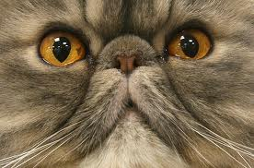
Nearest Neighbor Classifier
Nearest samples decide the result of the classifier.
f₂
°
°
°
°
°
°
f₁
f_{N}
Training Data of Face
Training Data of Non-Face
Test Image

Slide 41
Nearest Neighbor Classifier
Larger the training set, more robust the NN classifier
f₂
°
°
°
°
°
°
f₁
f_{N}
Training Data of Face
Training Data of Non-Face
False Positive

Slide 42
Nearest Neighbor Classifier
Larger the training set, slower the NN classifier
f₂
°
°
°
°
°
°
f₁
f_{N}
Training Data of Face
Training Data of Non-Face

Slide 43
Decision Boundary
A simple decision boundary separating the face and non-face classes will suffice.
f₂
°
°
°
°
°
°
f₁
f_{N}
Training Data of Face
Training Data of Non-Face

Slide 44



Decision Boundary
Find Decision Boundary $\left(W, b\right)$ in feature space
Decision Boundary
$$W^{T}F+b=0$$
°
°
°
°
Faces
°
°
$$W^{T}F+b>0$$
°
°
°
°
°
Non-Faces
$$W^{T}F+b<0$$

Slide 45
Decision Boundary
How to find the optimal decision boundary?
°
°
°
°
Face Class
°
°
°
°
°
°
°
Non-Face Class

Slide 46
Evaluating a Decision Boundary
Margin
°
°
°
°
°
°
°
°
°
°
°
Margin or Safe Zone: The width that the boundary could be increased by before hitting a data point.

Slide 47
Evaluating a Decision Boundary
Margin I
Margin II
+
+
°
°
°
°
°
°
°
°
°
°
°
°
°
°
°
°
Decision I: Face
Decision II: Non-Face
Choose Decision Boundary with the Maximum Margin!

Slide 48
Support Vector Machine (SVM)
Classifier optimized to maximize Margin
Margin
°
°
°
°
°
°
°
°
°
°
°
Support Vectors: Closest data samples to the boundary.
Decision Boundary and the Margin depend only on the Support Vectors.

Slide 49





Support Vector Machine (SVM)
Suppose we are given a Training Set ${\text{\{(}F_{i},λ_{i}\text{)\}}}_{i=1..k}$
where:
$F_{i}∈ℝ^{n}$ is the feature vector and
$λ_{i}∈\{+1,−1\}$ indicates the corresponding class label (Face/Non-Face)
Margin $ρ$
Find:
Equation of Boundary:
$$W^{T}F+b=0$$
°
Width of Margin: $ρ$
°
°
°
°
°
$$W^{T}F+b=0$$

Slide 50


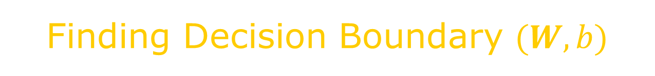







Finding Decision Boundary $(W, b)$
For each training example $\text{(}F_{i},λ_{i}\text{)}$:
For $λ_{i}=+1$:
$$W^{T}F_{i}+b≥ρ/2$$
$$λ_{i}\left(W^{T}F_{i}+b\right)≥ρ/2$$
For $λ_{i}=−1$:
$$W^{T}F_{i}+b≤−ρ/2$$
Margin $ρ$
$$W^{T}F+b>ρ/2$$
°
°
°
°
$$W^{T}F+b=ρ/2$$
°
$$W^{T}F+b=−ρ/2$$
°
$$W^{T}F+b=0$$
$$W^{T}F+b=−ρ/2$$

Slide 51




Finding Decision Boundary $(W, b)$
For each training example $\text{(}F_{i},λ_{i}\text{)}$:
For $λ_{i}=+1$:
$$W^{T}F_{i}+b≥ρ/2$$
$$λ_{i}\left(W^{T}F_{i}+b\right)≥ρ/2$$
For $λ_{i}=−1$:
$$W^{T}F_{i}+b≤−ρ/2$$
If $S$ is the set of support vectors,
Then for every support vector $s∈S$:
$$λ_{s}\left(W^{T}F_{s}+b\right)=ρ/2$$
Numerical methods exist to find
$W$, $b$ and $S$ that maximize $ρ$!

Slide 52

Application：Game
iPhone App using Face Detection
I.15

Slide 53
Comments
Current face detection system: mature but not perfect
Critical to face-related vision/graphics tasks
Increasing requirement on accuracy and speed

Slide 54
References
[Viola 2004] Viola, P. and Jones, M.J. “Robust real-time face detection”. 2004.
[Burges 1998] Burges, C. J. C. “A Tutorial on Support Vector Machines for Pattern Recognition”. 1998
[Freund 1996] Freund, Y. and Schapire, R.E. “Experiments with a new boosting algorithm”. 1996

Slide 55
Image Credits
I.1 http://images2.fanpop.com/images/photos/4700000/TBBT-Cast-the- big-bang-theory-4701578-594-455.jpg
I.2 http://www.google.com/search?q=gates
I.3 http://www.google.com/search?q=gates
I.4 http://pictures.labho.com/facebook-launches-facial-recognition- worldwide/
I.5 http://www.youtube.com/watch?v=jsjf3IDXef8&feature=related
I.6 http://www.youtube.com/watch?v=meRSKCSod-A
I.7 http://www.wallpaperez.org/celebrities/Megan-Fox-face-758.html
I.8 http://www.arizonafoothillsmagazine.com/features/on-the-scene- with-nadine/2110-what-your-face-says-about-you.html
I.9 http://www.changeface.me/?c=cs
I.10 http://www.wired.com/gadgetlab/2008/06/four-crazy-conc/
I.11 http://www.pets-and-all.com/?p=49

Slide 56
Image Credits
I.12 http://stereogum.com/48421scarlett_johansson_covers_jeff_buckley/ mp3s/
I.13 http://www.slashgear.com/apples-iphone-os-4-0-brings-full-on- solution-for-multitasking-1177436/
I.14 http://animal-world.com/dogs/Non-Sporting-Dog-Breeds/ NonSportingDogBreeds.php
I.15 http://www.visionhacker.com
I.16 http://www.wired.com/images_blogs/photos/uncategorized/ 2008/12/23/nikons60_2.jpg

