Slide 1
Computer Vision
Spring 2010 15-385,-685
Instructor: S. Narasimhan
WH 5409
T-R 10:30am – 11:50am
Lecture #21

Slide 2
Scale-Invariant Feature Transform (SIFT)
Thanks to Shree Nayar and Guru Krishnan
(Columbia University)

Slide 3
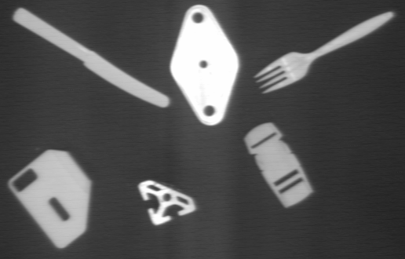
A Little Quiz
How would you recognize the following types of objects?
Objects on an assembly line
Notes:
using binary processing methods

Slide 4
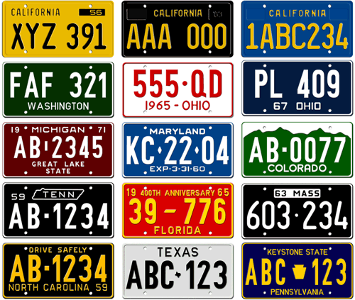
A Little Quiz
How would you recognize the following types of objects?
License plates
Notes:
using binary processing,
template matching

Slide 5

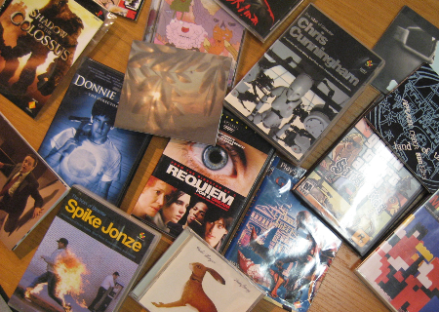
A Little Quiz
How would you recognize the following types of objects?
Template
Rich 2D Image
Match “Interesting Points or Features”

Slide 6
2D Recognition Using SIFT
Recognize 2D objects in real-world cluttered scenes using the Scale Invariant Feature Transform (SIFT).
Topics:
Local Appearance and Interest Points
Blob Detection
Scale-Space
The SIFT interest point detector
Matching and Results

Slide 7
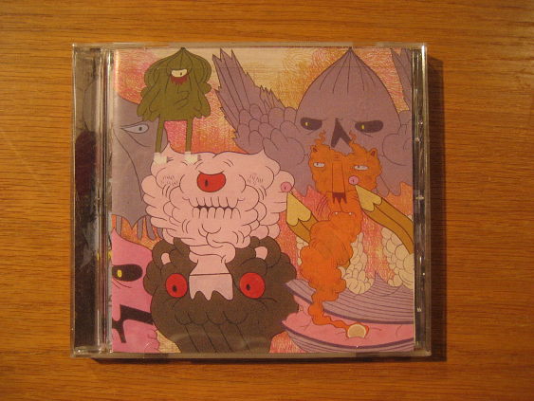
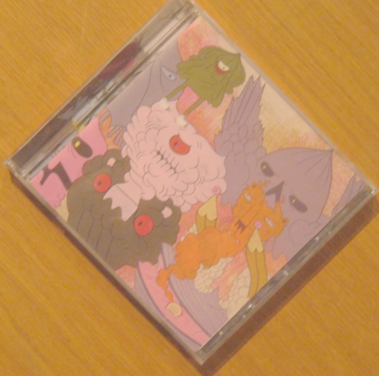
Raw Images are Hard to Match
Different Size, Orientation, Lighting, Brightness, …
Notes:
Two images of the same object…
Whatever algorithm we come up with it has to cross all these barriers

Slide 8
Removing Sources of Variation
Matching becomes easier if we can
remove variations like size and orientation.
Notes:
Two images of same pattern.
if we know their relative scale and orientation

Slide 9
Some Patches are not “Interesting”
Notes:
Some patches of the images that are just not interesting enough…
that’s fine…we just hope that there are atleast a few interesting patches

Slide 10
What is an Interesting Point/Feature?
Has rich image content (color variations, gradient variations, …) within the local window
Has well defined representation (signature) for matching/comparing with other points
Has a well defined position in the image
Should be invariable to image rotation and scaling
Should be relatively invariable to lighting changes
Notes:
point should have a unique mathematical description

Slide 11
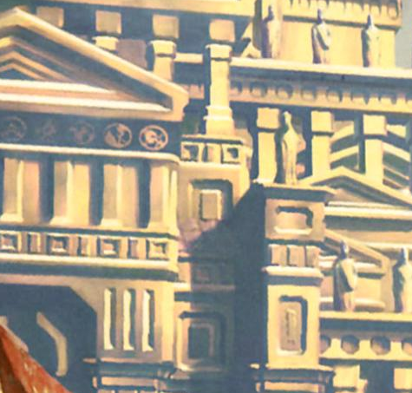



Are Lines Interesting?
Cannot “Localize” a Line

Slide 12



Are Blobs Interesting?
Yes! Blobs have fixed position and definite size.
Notes:
So we need a way to detect a blob i.e., its position.
And then we need to describe its properties in some way.

Slide 13

Blobs as Interest Points
We will use Blob-like Features for 2D recognition.
We need to:
Locate a blob
Determine its size
Determine its orientation
Formulate a description or signature that is independent of size and orientation
Notes:
So we need a way to detect a blob i.e., its position.
And then we need to describe its properties in some way.

Slide 14
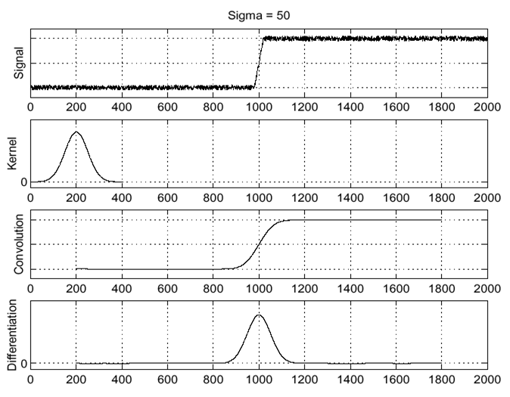



Review: Gaussian Filter
$$f$$
$$n_{σ}$$
Gaussian
$$n_{σ}∗f$$
Gaussian Filter is used for removing noise by smoothing
Notes:
Inertia (in binary image processing)
Make the optimization more difficult

Slide 15
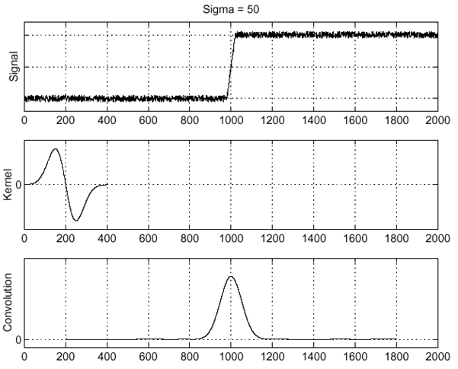



Review: Derivative of Gaussian
$$f$$
$$∇\left(n_{σ}\right)$$
Derivative of
Gaussian
$$∇\left(n_{σ}\right)∗f$$
Extremum of Derivative of Gaussian denotes an Edge
Notes:
Inertia (in binary image processing)
Make the optimization more difficult

Slide 16
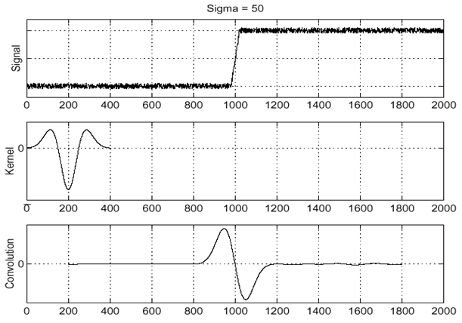



Review: 2nd Derivative of Gaussian
$$f$$
$$∇^{2}\left(n_{σ}\right)$$
2nd Derivative of
Gaussian
$$∇^{2}\left(n_{σ}\right)∗f$$
Zero Crossings in 2nd Derivative of Gaussian denotes an Edge
Notes:
Inertia (in binary image processing)
Make the optimization more difficult

Slide 17
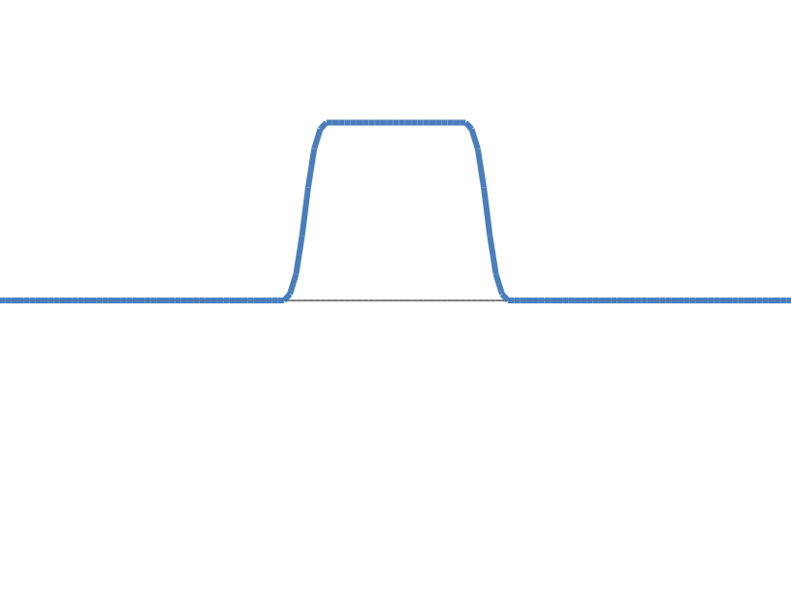
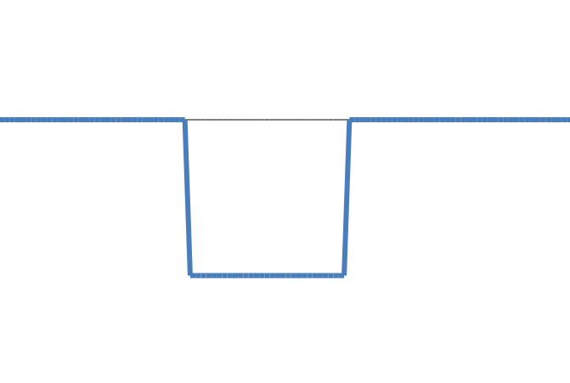
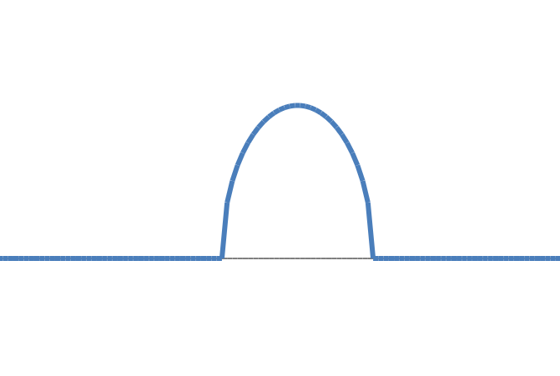
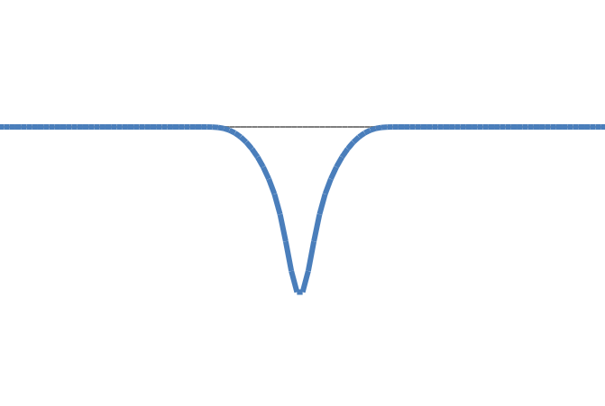
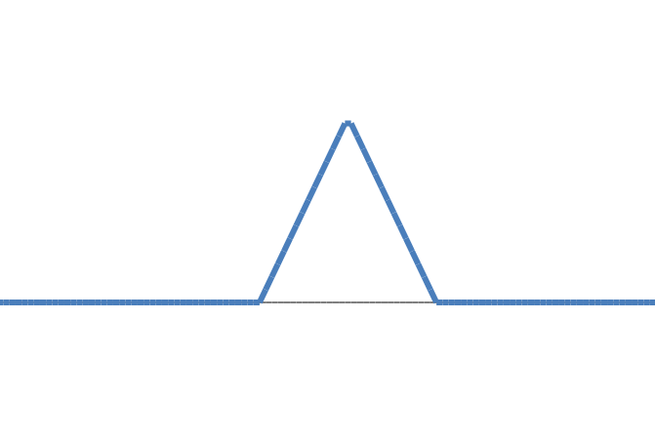
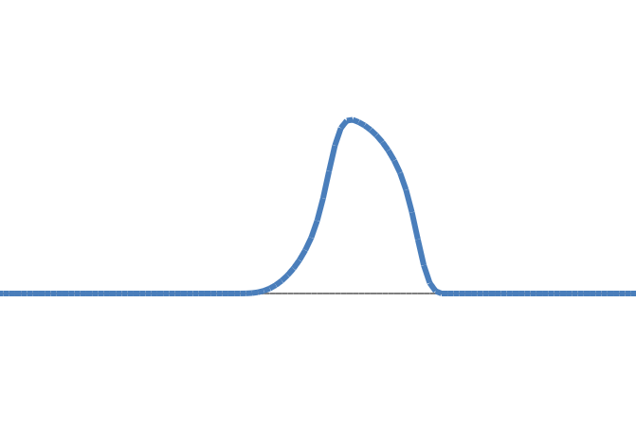
1D Blobs
Examples of 1D Blob-like structures

Slide 18
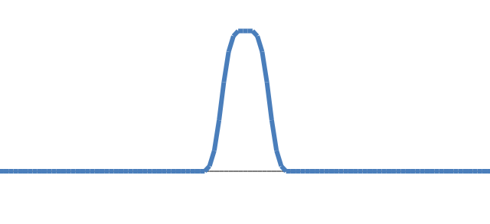
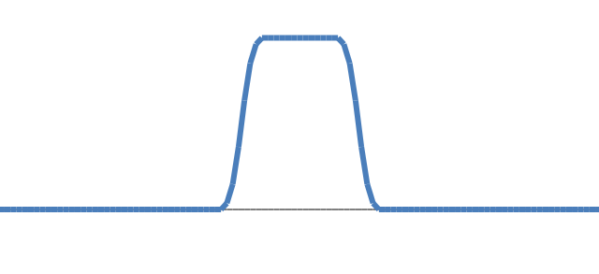
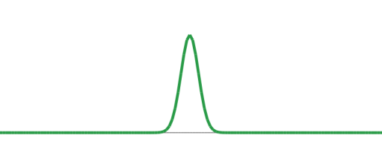
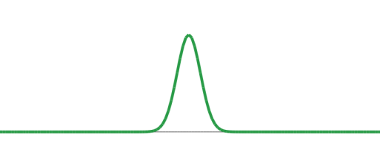
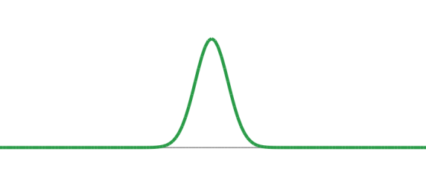
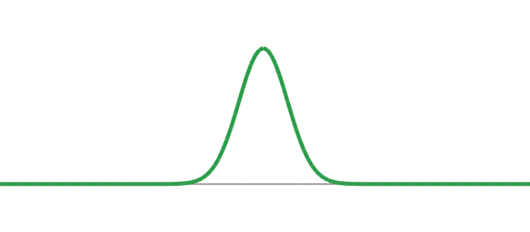
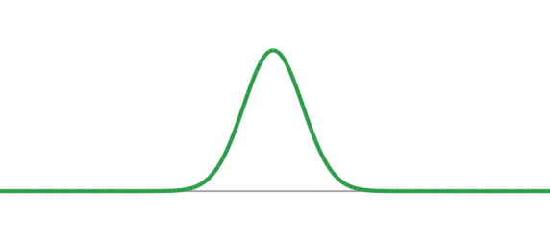
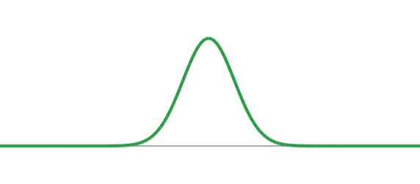
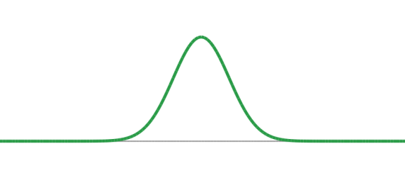
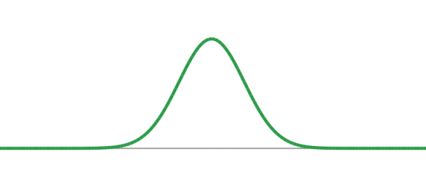
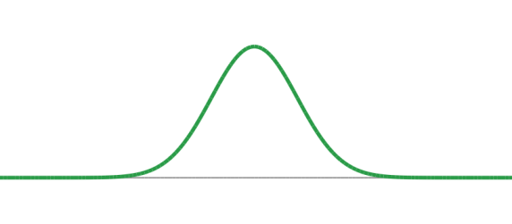
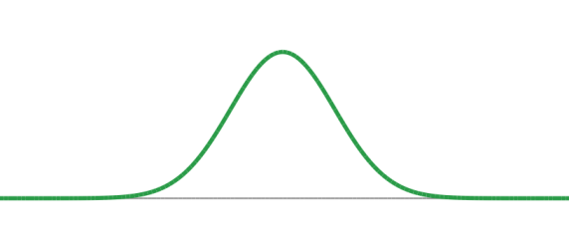
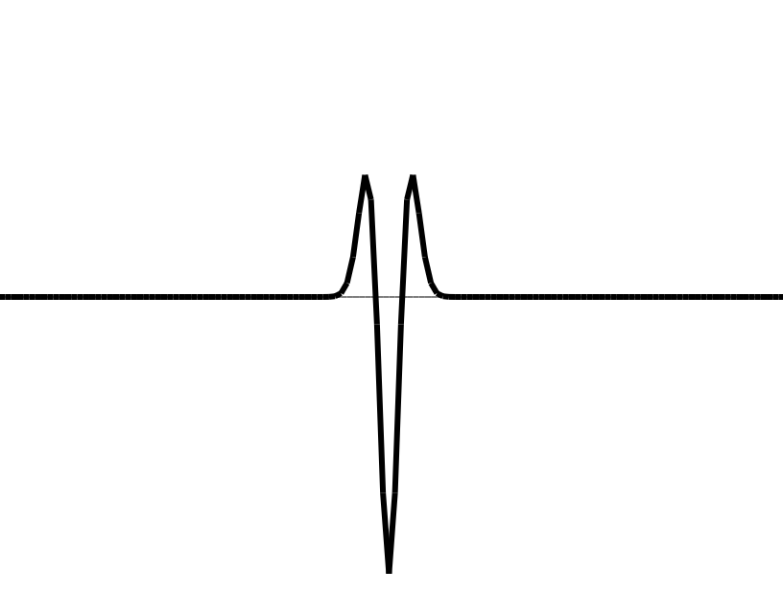
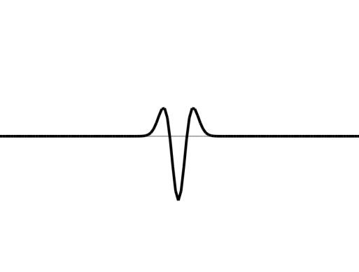
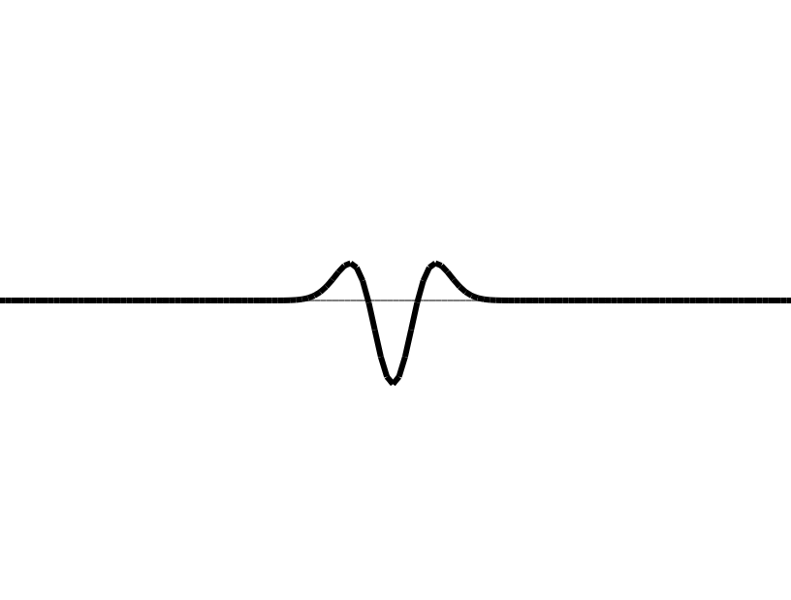
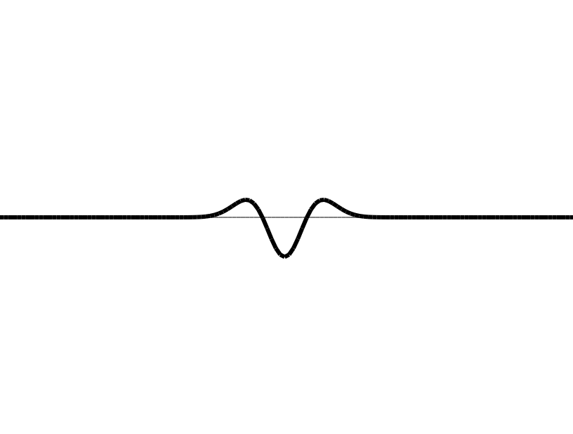
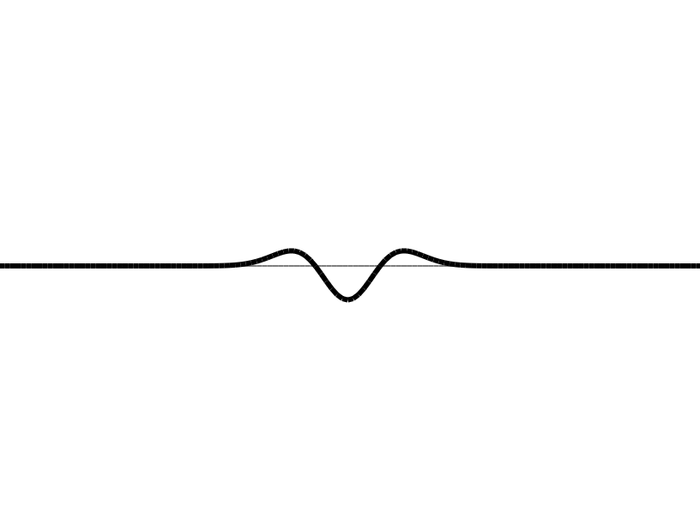
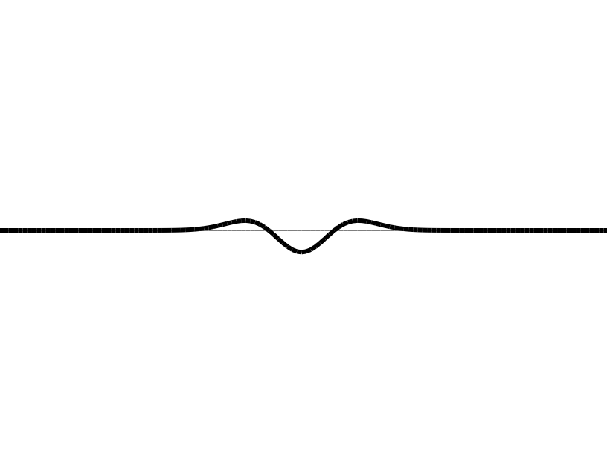
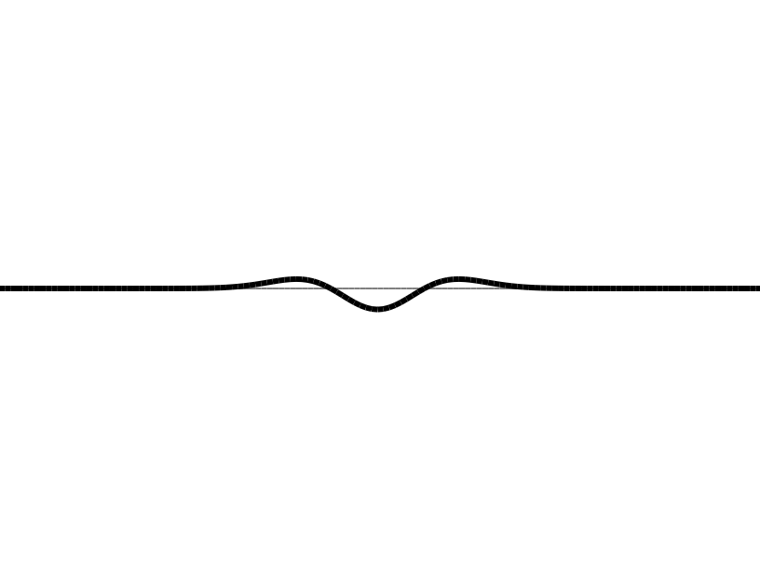



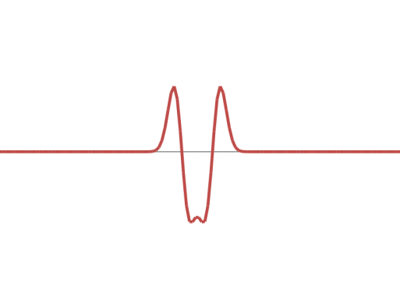
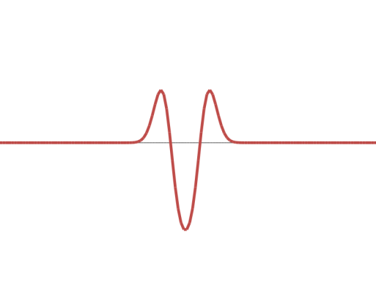
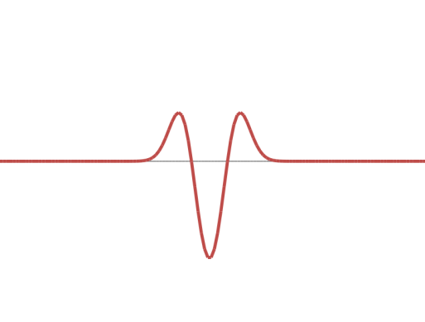
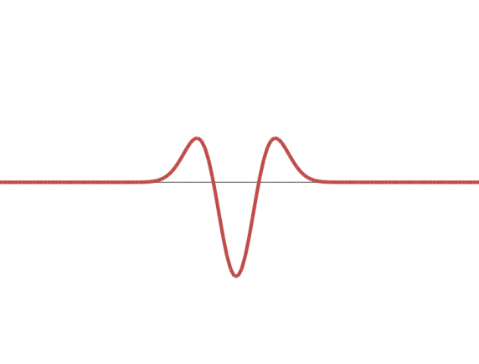
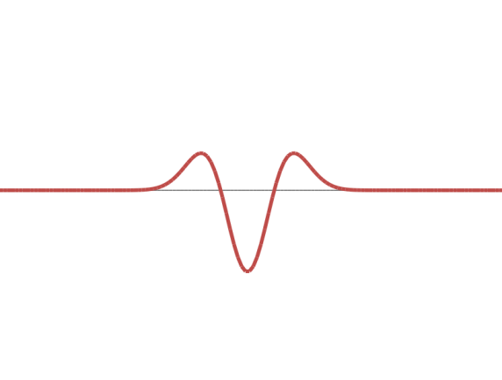
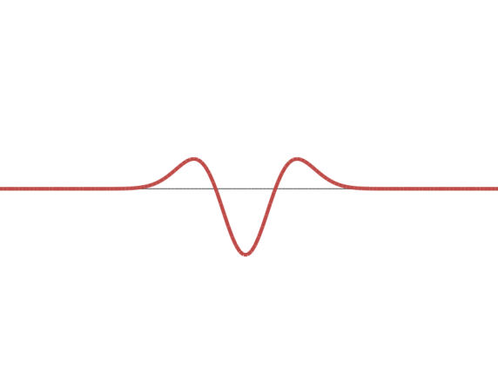
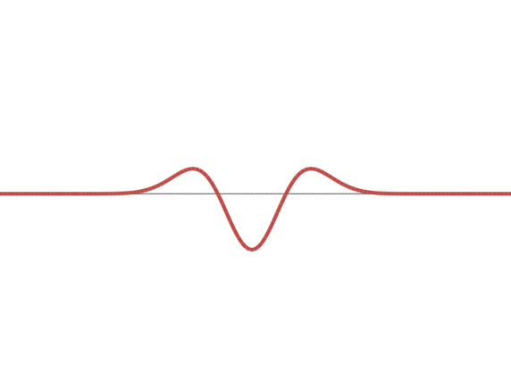
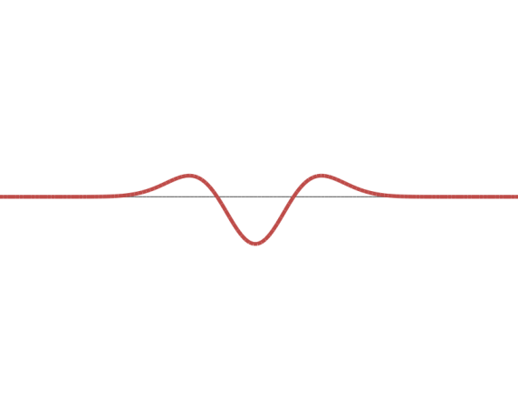
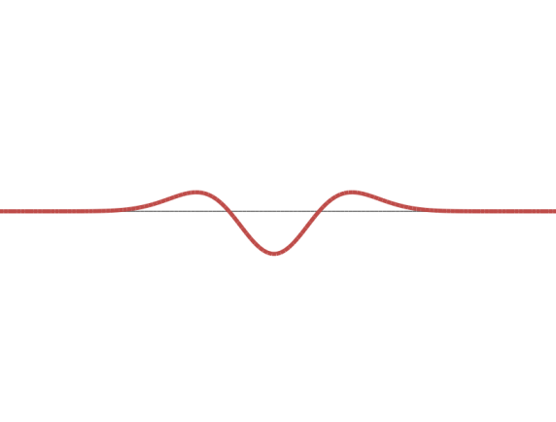
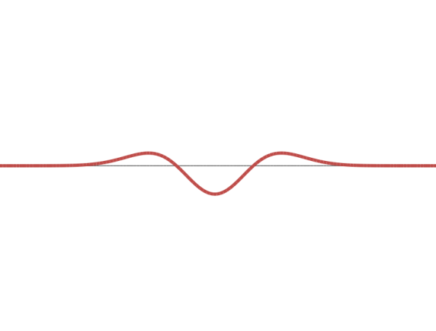
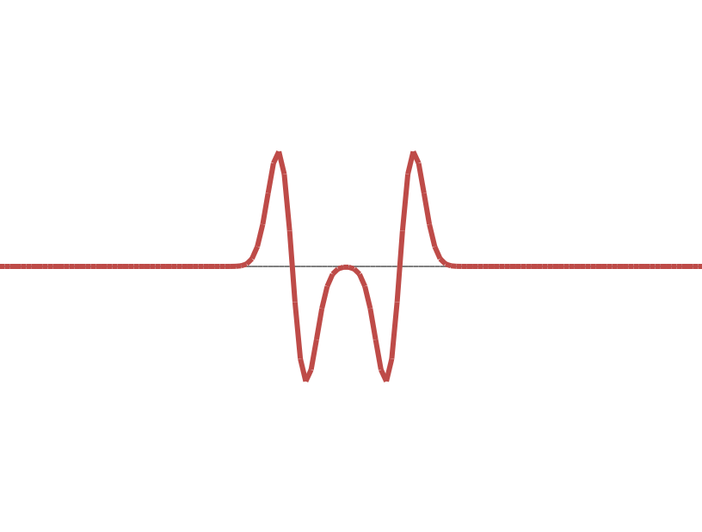
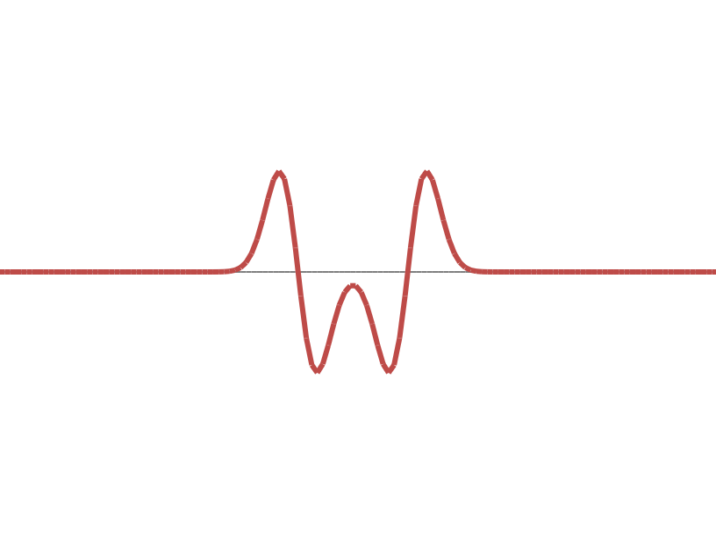
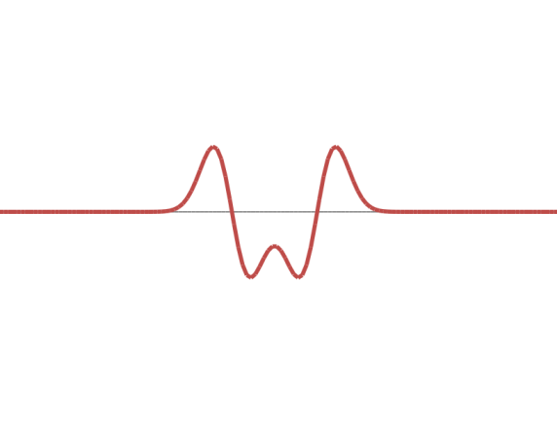
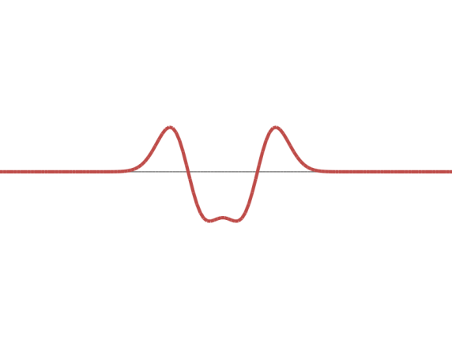
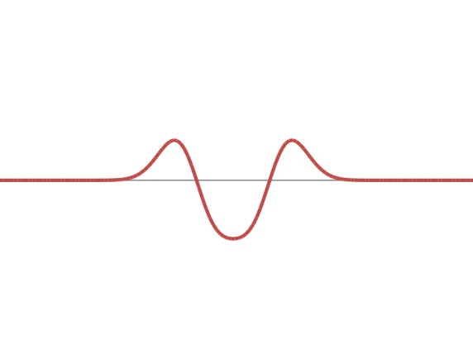
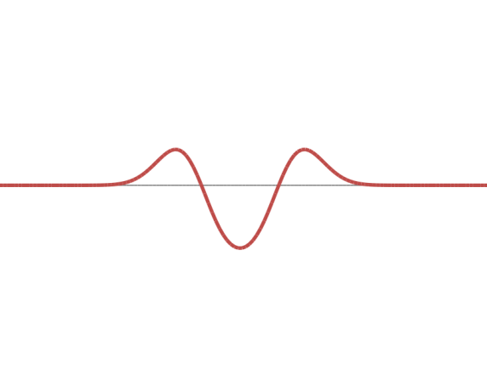



















1D Blob and 2nd Derivative of Gaussian
Blob A
Blob B
Blob C
$$f(x)$$
$$n_{σ}$$
$$\frac{∂^{2}n_{σ}}{∂x^{2}}$$
$$g\left(x\right)=$$
$$\frac{∂^{2}n_{σ}}{∂x^{2}}∗f\left(x\right)$$

Slide 19

1D Blob and 2nd Derivative of Gaussian
Blob A
Blob B
Blob C
$$f(x)$$
$$n_{σ}$$
Characteristic Scale ($σ^{∗}$)
$$\frac{∂^{2}n_{σ}}{∂x^{2}}$$
$$g\left(x\right)=$$
$$\frac{∂^{2}n_{σ}}{∂x^{2}}∗f\left(x\right)$$
Local Extrema in $\left(x,σ\right)$-Space Represent Blobs

Slide 20







Characteristic Scale and Blob Size
Blob A
Blob B
Blob C
$$f(x)$$
$$n_{σ}$$
Characteristic Scale ($σ^{∗}$)
$${σ_{A}}^{∗}=σ_{1}$$
$${σ_{B}}^{∗}=2σ_{1}$$
$${σ_{C}}^{∗}=3σ_{1}$$
Characteristic Scale:
The $σ$ at which 2nd Derivative attains its extreme value.
Characteristic Scale $∝$ Size of Blob
$${σ_{A}}^{∗}$$
$${σ_{B}}^{∗}$$
$${σ_{B}}^{∗}$$
$${σ_{C}}^{∗}$$
Size of Blob A
Size of Blob B
Size of Blob B
Size of Blob C
=
;
=

Slide 21



1D Blob Detection Summary
Given a 1D signal $f(x)$.
$$\frac{∂^{2}n_{σ}}{∂x^{2}}∗f\left(x\right)$$
Compute at many scales $\left(σ_{0},σ_{1},σ_{2},…,σ_{k}\right)$.
$$\left(x^{∗},σ^{∗}\right)=\underset{(x, σ)}{arg max}{ \left|\frac{∂^{2}n_{σ}}{∂x^{2}}∗f\left(x\right)\right|}$$
Find:
$x^{∗}$: Blob Position
$σ^{∗}$: Characteristic Scale (Blob Size)

Slide 22







2D Blob Detector
Normalized Laplacian of Gaussian (NLoG) is used as the 2D equivalent for Blob Detection.
Laplacian
Gaussian
LoG
NLoG
$$∇^{2}=\frac{∂^{2}}{∂x^{2}}+\frac{∂^{2}}{∂y^{2}}$$
$$n_{σ}$$
$$∇^{2}n_{σ}$$
$$σ^{2}∇^{2}n_{σ}$$
Location of Blobs given by Local Extrema after applying Normalized Laplacian of Gaussian at many scales.
Notes:
When the size of the LoG kernel matches with the size of a blob-like structure the response attains an extremum.
The LoG is well adapted to blob detection due to its circular symmetry, but it also provides a good estimation of the characteristic scale for other local structures such as corners, edges, ridges and multi-junctions.

Slide 23










Scale-Space
…
$$S\left(x,y,σ_{0}\right)$$
$$S\left(x,y,σ_{1}\right)$$
$$S\left(x,y,σ_{2}\right)$$
$$S\left(x,y,σ_{3}\right)$$
Increasing $σ$, Higher Scale, Lower Resolution
Scale Space: Stack created by filtering an image with Gaussians of different sigma$\left(σ\right)$
$$S\left(x,y,σ\right)=n\left(x,y,σ\right)∗I(x,y)$$

Slide 24




Creating Scale-Space
…
$$S\left(x,y,σ_{0}\right)$$
$$S\left(x,y,σ_{1}\right)$$
$$S\left(x,y,σ_{2}\right)$$
$$S\left(x,y,σ_{3}\right)$$
Increasing $σ$, Higher Scale, Lower Resolution
Selecting sigma’s to generate the scale-space:
$$σ_{k}=σ_{0}s^{k}$$
$$k=0,1,2,3, …$$
where,
$s$: Constant multiplier
$σ_{0}$: Initial Scale

Slide 25










Blob Detection using Local Extrema
…
$$S\left(x,y,σ_{0}\right)$$
$$S\left(x,y,σ_{1}\right)$$
$$S\left(x,y,σ_{2}\right)$$
$$S\left(x,y,σ_{3}\right)$$
$$σ^{2}∇^{2}S\left(x,y,σ\right)$$
$$(NLoG ∗ I(x,y))$$
Extremum
$$σ_{0}$$
$$σ_{1}$$
$$σ_{2}$$
$$σ_{3}$$
Scale
Characteristic Scale ($σ^{∗}$)
[Lindeberg 1994]
Notes:
The idea is to select the characteristic scale of a local structure, for which a given function attains an extremum over scales.
The characteristic scale is relatively independent of the image resolution. It is related to the structure and not to the resolution at which the structure is represented

Slide 26

Blob Detection using Local Extrema
…
$$S\left(x,y,σ_{0}\right)$$
$$S\left(x,y,σ_{1}\right)$$
$$S\left(x,y,σ_{2}\right)$$
$$S\left(x,y,σ_{3}\right)$$
$$σ^{2}∇^{2}S\left(x,y,σ\right)$$
$$(NLoG ∗ I(x,y))$$
No Strong Extremum $⇒$ No Blob
$$σ_{0}$$
$$σ_{1}$$
$$σ_{2}$$
$$σ_{3}$$
Scale
[Lindeberg 1994]
Notes:
The idea is to select the characteristic scale of a local structure, for which a given function attains an extremum over scales.
The characteristic scale is relatively independent of the image resolution. It is related to the structure and not to the resolution at which the structure is represented

Slide 27










Comparison of Characteristic Scales
$$σ^{2}∇^{2}S(x,y,σ)$$
$${σ_{1}}^{∗}$$
$$σ^{2}∇^{2}S(x,y,σ)$$
$${σ_{2}}^{∗}$$
Scale$(σ)$
Scale$(σ)$
$\frac{{σ_{1}}^{∗} }{{σ_{2}}^{∗} }$:Ratio of Blob Sizes
[Mikolajczyk 2002]
Notes:
The ratio of the scales at which the extrema are found for corresponding points is the actual scale factor between the point neighborhoods.

Slide 28




2D Blob Detection Summary
Given an image $I(x,y)$.
Convolve the image using NLoG at many scales $σ$.
$$\left(x^{∗},y^{∗},σ^{∗}\right)=\underset{(x,y,σ)}{arg max}{ \left|σ^{2}∇^{2}n_{σ}∗I(x,y)\right|}$$
Find:
or
$$\left(x^{∗},y^{∗},σ^{∗}\right)=\underset{(x,y,σ)}{arg max}{ \left|σ^{2}∇^{2}S(x,y,σ)\right|}$$
$(x^{∗},y^{∗})$: Position of the blob
$σ^{∗}$: Size of the blob

Slide 29



The SIFT Detector
An Efficient Implementation of Blob Detector
Uses Difference of Gaussian (DoG) as an approximation of NLoG
Difference of Gaussian(DoG)
$$=\left(n_{sσ}−n_{σ}\right)≈(s−1)σ^{2}∇^{2}n_{σ}$$
DoG $≈$ NLoG
Notes:
Showing char scale as a circle, which should contain same information

Slide 30








Extracting SIFT Interest Points
Image
$$I(x,y)$$
Gaussian
Scale-Space
Difference of Gaussians (DoG)
$$S(x,y,σ)$$
$$≈σ^{2}∇^{2}S(x,y,σ)$$

Slide 31

Extracting SIFT Interest Points
Image
$$I(x,y)$$
Gaussian
Scale-Space
Difference of Gaussians (DoG)
$$S(x,y,σ)$$
$$\sim σ^{2}∇^{2}S(x,y,σ)$$

Slide 32


Extracting SIFT Interest Points
Filter
Bad Points
SIFT
Points
Difference of Gaussians (DoG)
Find Extrema
in every
3x3x3 grid
Interest Point
Candidates
$$\sim σ^{2}∇^{2}S(x,y,σ)$$
(includes weak extrema, bad contrast, …)

Slide 33
Extracting SIFT Interest Points
Filter
Bad Points
SIFT
Points
Difference of Gaussians (DoG)
Find Extrema
in every
3x3x3 grid
Interest Point
Candidates
$$\sim σ^{2}∇^{2}S(x,y,σ)$$
(includes weak extrema, bad contrast, …)

Slide 34
Extracting SIFT Interest Points
Interest Point
Candidates
SIFT
Interest Points
(after removing
weak points)
(includes weak extrema, bad contrast, …)

Slide 35
Extracting SIFT Interest Points
Interest Point
Candidates
SIFT
Interest Points
(after removing
weak points)
Interest Point
Depiction
(includes weak extrema, bad contrast, …)

Slide 36

SIFT Detection Examples

Slide 37

SIFT Detection Examples

Slide 38

SIFT Detection Examples

Slide 39


SIFT Scale Invariance
Use the characteristic scales to match sizes

Slide 40


Computing the Principal Orientation
Use the histogram of gradient directions
Principal Orientation
Image gradient directions
Choose the most
prominent gradient direction
$$θ=\tan^{−1}\left(\frac{∂I}{∂y}/\frac{∂I}{∂x}\right)$$

Slide 41


SIFT Rotation Invariance
Use the principal orientations to match rotation

Slide 42

The SIFT Descriptor
“Describe” points so they can be compared
Notes:
The “stuff” inside the circle is what we’re interested in. We want to describe this stuff in an invariant way to compare things.

Slide 43

Computing the SIFT Descriptor
Histograms of gradient directions over spatial regions
Invariant to Scale, Lighting, Brightness

Slide 44


SIFT Results: Scale Invariance
A
B
SIFT detects corresponding features in images at different resolutions

Slide 45



SIFT Results: Rotation Invariance
A
B
C
SIFT detects corresponding features in rotated images

Slide 46



SIFT Robustness to Clutter

Slide 47




Panorama Stitching using SIFT
Image 1
Image 2
Match SIFT Interest Points
[Autopano]

Slide 48

Panorama Stitching using SIFT
Transform/Warp one or both images so that corresponding SIFT points in images are aligned.
[Autopano]

Slide 49

Auto Collage using SIFT

Slide 50

Auto Collage using SIFT

Slide 51



SIFT for 3D Objects?
No Change in Viewpoint
30° Change in Viewpoint
90° Change in Viewpoint

Slide 52
References
[Autopano] Software to make panaromas using SIFT. http://user.cs.tu-berlin.de/~nowozin/autopano-sift/
[Brown and Lowe 2002] M. Brown and D. Lowe. “Invariant Features from Interest Point Groups”. BMVC, 2002.
[Harris and Stephens 1988] C. Harris and M. Stephens. “A Combined Corner and Edge Detector”. 4th Alvey Vision Conference, 1988.
[Lowe 2004] D. Lowe.“Distinctive Image Features from Scale-Invariant Keypoints”. IJCV, 2004.
[Lindeberg 1994] T. Lindeberg. “Scale-Space Theory: A Basic Tool for Analysing Structures at Different Scales.” J. of Applied Statistics, 1994.
[Matas 2002] J. Matas, O. Chum, M. Urban, and T. Pajdla. “Robust Wide Baseline Stereo from Maximally Stable Extremal Regions. BMVC, 2002.
[Mikolajczyk 2002] K. Mikolajczyk. “Detection of Local Features Invariant to Affine Transformations.” Ph.D. Thesis, 2002.

Slide 53
References
[Mikolajczyk 2004] K. Mikolajczyk and C. Schmid. “Scale and Affine Invariant Interest Point Detectors.” IJCV, 2004.
[Mikolajczyk 2005] K. Mikolajczyk and C. Schmid. “A Performance Evaluation of Local Descriptors.” PAMI, 2005.
[SIFT] SIFT Binaries. http://www.cs.ubc.ca/~lowe/keypoints/
[Witkin 1983] A. Witkin. “Scale-Space Filtering”. IJCAI, 1983.

Slide 54
Notes:
Inertia (in binary image processing)
Make the optimization more difficult

Slide 55

SIFT Object Matcher DEMO

Slide 56



SIFT Lighting Invariance Results

Slide 57
SIFT Lighting Invariance
Affine lighting model
Ideal
Gain
Normalization removes gain
Image Irradiance
Offset
Gradients remove offset
Scene Radiance
Descriptor

Slide 58

3D Rotation Invariant Detector
State of the Art Detector: Uses Scale-Space,
Laplacian, Harris Corner Detector, Affine Transformations, …
[Mikolajczyk 2004]

Slide 59

3D Rotation Invariant Detector
State of the Art Detector: Uses Scale-Space,
Laplacian, Harris Corner Detector, Affine Transformations, …
[Mikolajczyk 2004]

Slide 60


Matching Objects Using SIFT
Scene
Object
Hough-like Accumulator

