Slide 1
COVID-19, Online Instruction, and You 15-213/18-213/15-513/18-613: Introduction to Computer Systems 16.5th Lecture, March 17, 2020

Slide 2
Today’s Agenda
Zoom Tips
COVID-19/Coronavirus Context
How 213/613 Will Handle Online Instruction

Slide 3
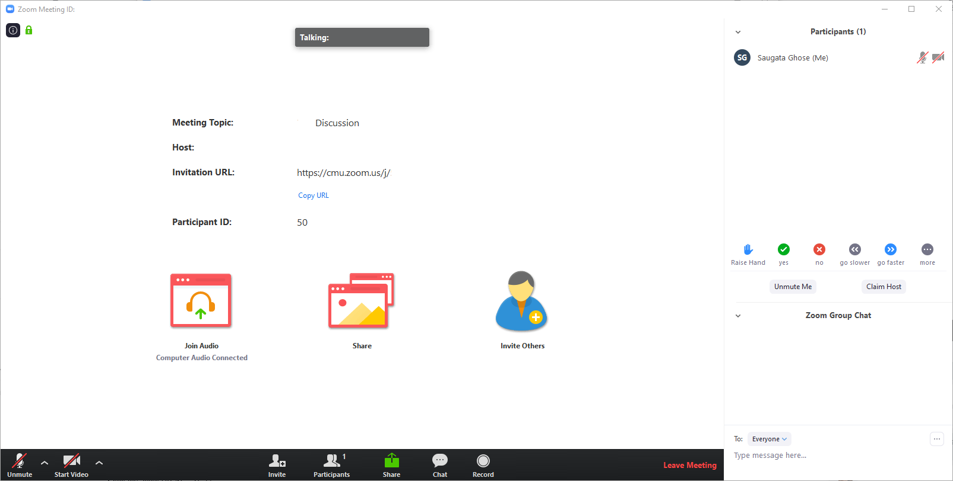
Zoom Interface

Slide 4
General Zoom Interactions
While you are listening
Keep your video off (Zoom doesn’t handle all that bandwidth well)
Keep your mic muted
Please ask questions and interact!
Use the Chat feature – we will look for questions there
Under the Participants tab, raise your hand
Click Yes/No when prompted, and then click again to clear your response
When asking questions
Unmute your mic
If you can, show your video – we miss seeing you!
Mute your mic and turn off your video after your question has been answered

Slide 5
Today’s Agenda
Zoom Tips
COVID-19/Coronavirus Context
How 213/613 Will Handle Online Instruction

Slide 6
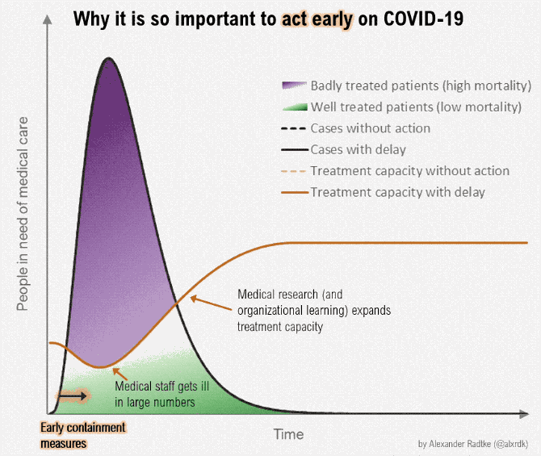
Why All This? To Flatten the Curve!

Slide 7
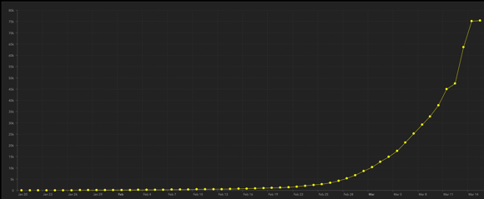
Infection Spread Increases Exponentially (at least initially)
Number of coronavirus cases outside of China over time
(source: JHU coronavirus database
https://www.arcgis.com/apps/opsdashboard/index.html#/bda7594740fd40299423467b48e9ecf6 )
Our healthcare system can’t easily absorb a new large-scale disease
With uncontrolled transmission, more people will die
Lowering the exponent is our best hope to not overwhelm the system
Hence social distancing: these measures seem radical, but are necessary
Early interventions are key
This requires a change in behavior from all of us
See for yourself: https://www.washingtonpost.com/graphics/2020/world/corona-simulator/

Slide 8
I Am Young, Should I Still Worry?
People of all ages can be infected by the new coronavirus (2019-nCoV). Older people, and people with pre-existing medical conditions (such as asthma, diabetes, heart disease) appear to be more vulnerable to becoming severely ill with the virus. [WHO]
But it is easy, even for asymptomatic people with COVID-19, to spread the illness.
So, if you get sick, you increase the exponent. Especially if you get sick early.
So, stay safe, hang out in small sets of people, and, despite everything, try to not worry too much.

Slide 9
Things to Remember During Distancing
Take care of yourself and others around you
Single most important thing you can do now
Remember: COVID-19 can be asymptomatic
Watch your mental health as well
Social distancing can be lonely
Make time to Skype/Zoom with friends, play games, and distract yourself with hobbies
CDC pointers: https://www.cdc.gov/coronavirus/2019-ncov/about/coping.html
There is always someone who wants to talk with you, no matter what it’s about
Don’t stress out about courses
We’re all wading through this experiment together
It’s fine to retune your expectations – you’ll be fine in the long run

Slide 10
Today’s Agenda
Zoom Tips
COVID-19/Coronavirus Context
How 213/613 Will Handle Online Instruction

Slide 11
Using Zoom for 213/613
Lecture discussions, recitations, OH through Zoom
Recommended: Download the Zoom app
Quick install for all platforms (Linux build a little wonky…)
Log in using “Sign in with SSO” – goes through CMU login
Go to our Zoom hub
https://piazza.com/class/k4x5uvxc2mnit?cid=1983
All Zoom links will be posted here

Slide 12
Lectures
We are transitioning to flipped lectures
You are responsible for watching videos before class starts
We will have a (shorter) discussion during class time
Videos/slides will be posted 24 hours before class
In class
Start with a short summary of key points from lecture
One activity to do in breakout rooms
Take the quiz
Discuss the quiz
Handle any remaining questions (similar to conceptual OH)

Slide 13
Recitations
Scheduled at normal times (all times Eastern)
Try to attend your regular recitation session if possible
If not, pick any one that’s convenient: we offer recitations as early as 9:30 AM Eastern and as late as 8:00 PM Eastern
Will provide a recording by Thursday morning for those with connectivity issues
Will work much the same as usual
TAs will lead discussion
Will involve frequent interaction with students, so participate!
Will try to use breakout rooms for small group activities

Slide 14
Recordings
Lecture videos will be posted online
Flipped lecture discussions in class are not recorded
One recitation will be recorded/posted each week
HOWEVER, we strongly encourage you to attend live as much as possible
Recitations and discussions are meant to facilitate you asking questions – can’t ask a recording!
Helps build and maintain our sense of community with each other
Will keep you on track
Reduces everyone’s sense of isolation

Slide 15
Office Hours
Lab office hours
YOU need to add your Zoom link to the description on the office hours queue
TA will connect to you when your turn is up
Details: https://piazza.com/class/k4x5uvxc2mnit?cid=1984
Video of what to do: https://youtu.be/kgMC4grHp10
Conceptual/faculty OH
Zoom links will be posted online
Public discussions that anyone can drop in on
For private discussions with faculty
Contact us on Piazza or with a private chat message during OH
We will work out a time and set up a private Zoom meeting

Slide 16
Assessments
Malloc lab
We want to ensure that you have enough time for the main assignment
Malloc traces are now for extra credit
Other malloc deadlines remain the same
Malloc bootcamp: this Thursday
Exams
Will be administered online
Still working out the logistics – more details forthcoming
Also still working out makeup/regrade logistics – sit tight, please
In-class quizzes
New quizzes do not count for credit – only for discussion now

Slide 17
Summary
Take care of yourself!
All classes remote for the rest of the semester
213/613 lectures are now flipped
Videos released 24 hours before class
You MUST watch before class time
During class: summary, discussion, quiz, questions
213/613 recitations as usual, but online
OH will be done online – require your cooperation
Malloc traces are now for extra credit
Fill out feedback form on Piazza, please!

