Slide 1
Machine-Level Programming IV: Data
15-213/18-213/14-513/15-513/18-613: Introduction to Computer Systems
8th Lecture, February 6, 2020

Slide 2
Today
Switch Statements
Arrays
  One-dimensional
  Multi-dimensional (nested)
  Multi-level
Structures
  Allocation
  Access
  Alignment
Floating Point

Slide 3
Switch Statement Example
long my_switch
(long x, long y, long z)
{
long w = 1;
switch(x) {
case 1:
w = y*z;
break;
case 2:
w = y/z;
/* Fall Through */
case 3:
w += z;
break;
case 5:
case 6:
w -= z;
break;
default:
w = 2;
}
return w;
}
Multiple case labels
  Here: 5 & 6
Fall through cases
  Here: 2
Missing cases
  Here: 4

Slide 4
Jump Table Structure
Switch Form
Jump Table
Jump Targets
switch(x) {
case val_0:
Block 0
case val_1:
Block 1
• • •
case val_n-1:
Block n–1
}
jtab:
Targ0
Targ0:
Code Block
0
Targ1
Targ2
Targ1:
Code Block
1
•
•
•
Targ2:
Code Block
2
Targn-1
•
•
•
Translation (Extended C)
goto *JTab[x];
Targn-1:
Code Block
n–1

Slide 5
Switch Statement Example
long my_switch(long x, long y, long z)
{
long w = 1;
switch(x) {
. . .
}
return w;
}
Setup
Register | Use(s)
%rdi | Argument x
%rsi | Argument y
%rdx | Argument z
%rax | Return value
my_switch:
movq %rdx, %rcx
cmpq $6, %rdi # x:6
ja .L8
jmp *.L4(,%rdi,8)
What range of values takes default?
Note that w not initialized here
Notes:
Cmpq 6 rdi → go to default if above all case values
W not initialized until it is sure to be used.

Slide 6
Switch Statement Example
long my_switch(long x, long y, long z)
{
long w = 1;
switch(x) {
. . .
}
return w;
}
Jump table
.section .rodata
.align 8
.L4:
.quad .L8 # x = 0
.quad .L3 # x = 1
.quad .L5 # x = 2
.quad .L9 # x = 3
.quad .L8 # x = 4
.quad .L7 # x = 5
.quad .L7 # x = 6
Setup
Setup
my_switch:
movq %rdx, %rcx
cmpq $6, %rdi # x:6
ja .L8 # use default
jmp *.L4(,%rdi,8) # goto *Jtab[x]
Indirect
jump
Notes:
*.L4(,rdi,8) is L4 + rdi * addrsize → go to *Jtab[x], with x in rdi

Slide 7
Assembly Setup Explanation
Table Structure
  Each target requires 8 bytes
  Base address at .L4
Jumping
  Direct: jmp .L8
  Jump target is denoted by label .L8
  Indirect: jmp *.L4(,%rdi,8)
  Start of jump table: .L4
  Must scale by factor of 8 (addresses are 8 bytes)
  Fetch target from effective Address .L4 + x*8
    Only for 0 ≤ x ≤ 6
Jump table
.section .rodata
.align 8
.L4:
.quad .L8 # x = 0
.quad .L3 # x = 1
.quad .L5 # x = 2
.quad .L9 # x = 3
.quad .L8 # x = 4
.quad .L7 # x = 5
.quad .L7 # x = 6

Slide 8
Jump Table
Jump table
switch(x) {
case 1: // .L3
w = y*z;
break;
case 2: // .L5
w = y/z;
/* Fall Through */
case 3: // .L9
w += z;
break;
case 5:
case 6: // .L7
w -= z;
break;
default: // .L8
w = 2;
}
.section .rodata
.align 8
.L4:
.quad .L8 # x = 0
.quad .L3 # x = 1
.quad .L5 # x = 2
.quad .L9 # x = 3
.quad .L8 # x = 4
.quad .L7 # x = 5
.quad .L7 # x = 6

Slide 9
Code Blocks (x == 1)
switch(x) {
case 1: // .L3
w = y*z;
break;
. . .
}
.L3:
movq %rsi, %rax # y
imulq %rdx, %rax # y*z
ret
Register | Use(s)
%rdi | Argument x
%rsi | Argument y
%rdx | Argument z
%rax | Return value

Slide 10
Handling Fall-Through
long w = 1;
. . .
switch(x) {
. . .
case 2:
w = y/z;
/* Fall Through */
case 3:
w += z;
break;
. . .
}
case 2:
w = y/z;
goto merge;
case 3:
w = 1;
merge:
w += z;

Slide 11
Code Blocks (x == 2, x == 3)
.L5: # Case 2
movq %rsi, %rax
cqto # sign extend
# rax to rdx:rax
idivq %rcx # y/z
jmp .L6 # goto merge
.L9: # Case 3
movl $1, %eax # w = 1
.L6: # merge:
addq %rcx, %rax # w += z
ret
long w = 1;
. . .
switch(x) {
. . .
case 2:
w = y/z;
/* Fall Through */
case 3:
w += z;
break;
. . .
}
Register | Use(s)
%rdi | Argument x
%rsi | Argument y
%rcx | z
%rax | Return value

Slide 12
Code Blocks (x == 5, x == 6, default)
switch(x) {
. . .
case 5: // .L7
case 6: // .L7
w -= z;
break;
default: // .L8
w = 2;
}
.L7: # Case 5,6
movl $1, %eax # w = 1
subq %rdx, %rax # w -= z
ret
.L8: # Default:
movl $2, %eax # 2
ret
Register | Use(s)
%rdi | Argument x
%rsi | Argument y
%rdx | Argument z
%rax | Return value

Slide 13
Today
Switch Statements
Arrays
  One-dimensional
  Multi-dimensional (nested)
  Multi-level
Structures
  Allocation
  Access
  Alignment
Floating Point

Slide 14
Array Allocation
Basic Principle
  T A[L];
  Array of data type T and length L
  Contiguously allocated region of L * sizeof(T) bytes in memory
char string[12];
x
x + 12
int val[5];
x
x + 4
x + 8
x + 12
x + 16
x + 20
double a[3];
x
x + 8
x + 16
x + 24
char *p[3];
x
x + 8
x + 16
x + 24

Slide 15
Array Access
Basic Principle
  T A[L];
  Array of data type T and length L
  Identifier A can be used as a pointer to array element 0: Type T*
Reference Type Value
  val[4] int
  val int *
  val+1 int *
  &val[2] int *
  val[5] int
  *(val+1) int
  val + i int *
int val[5];
1
5
2
1
3
x
x + 4
x + 8
x + 12
x + 16
x + 20

Slide 16
Array Access
Basic Principle
  T A[L];
  Array of data type T and length L
  Identifier A can be used as a pointer to array element 0: Type T*
Reference Type Value
  val[4] int 3
  val int *
  val+1 int *
  &val[2] int *
  val[5] int
  *(val+1) int
  val + i int *
int val[5];
1
5
2
1
3
x
x + 4
x + 8
x + 12
x + 16
x + 20

Slide 17
Array Access
Basic Principle
  T A[L];
  Array of data type T and length L
  Identifier A can be used as a pointer to array element 0: Type T*
Reference Type Value
  val[4] int 3
  val int * x
  val+1 int * x + 4
  &val[2] int * x + 8
  val[5] int ??
  *(val+1) int 5 //val[1]
  val + i int * x + 4 * i //&val[i]
int val[5];
1
5
2
1
3
x
x + 4
x + 8
x + 12
x + 16
x + 20

Slide 18
Array Example
#define ZLEN 5
typedef int zip_dig[ZLEN];
zip_dig cmu = { 1, 5, 2, 1, 3 };
zip_dig mit = { 0, 2, 1, 3, 9 };
zip_dig ucb = { 9, 4, 7, 2, 0 };
zip_dig cmu;
1
5
2
1
3
16
20
24
28
32
36
zip_dig mit;
0
2
1
3
9
36
40
44
48
52
56
zip_dig ucb;
9
4
7
2
0
56
60
64
68
72
76
Declaration “zip_dig cmu” equivalent to “int cmu[5]”
Example arrays were allocated in successive 20 byte blocks
  Not guaranteed to happen in general

Slide 19
Array Accessing Example
zip_dig cmu;
1
5
2
1
3
16
20
24
28
32
36
int get_digit
(zip_dig z, int digit)
{
return z[digit];
}
Register %rdi contains starting address of array
Register %rsi contains
array index
Desired digit at
%rdi + 4*%rsi
Use memory reference (%rdi,%rsi,4)
x86-64
# %rdi = z
# %rsi = digit
movl (%rdi,%rsi,4), %eax # z[digit]

Slide 20
Array Loop Example
void zincr(zip_dig z) {
size_t i;
for (i = 0; i < ZLEN; i++)
z[i]++;
}
# %rdi = z
movl $0, %eax # i = 0
jmp .L3 # goto middle
.L4: # loop:
addl $1, (%rdi,%rax,4) # z[i]++
addq $1, %rax # i++
.L3: # middle
cmpq $4, %rax # i:4
jbe .L4 # if <=, goto loop
rep; ret

Slide 21
Array Loop Example
void zincr(zip_dig z) {
size_t i;
for (i = 0; i < ZLEN; i++)
z[i]++;
}
# %rdi = z
movl $0, %eax # i = 0
jmp .L3 # goto middle
.L4: # loop:
addl $1, (%rdi,%rax,4) # z[i]++
addq $1, %rax # i++
.L3: # middle
cmpq $4, %rax # i:4
jbe .L4 # if <=, goto loop
rep; ret

Slide 22
Understanding Pointers & Arrays #1
Decl | A1 , A2 |  |  | *A1 , *A2
 | Comp | Bad | Size | Comp | Bad | Size
int A1[3]
int *A2
Comp: Compiles (Y/N)
Bad: Possible bad pointer reference (Y/N)
Size: Value returned by sizeof

Slide 23
Understanding Pointers & Arrays #1
Decl | A1 , A2 |  |  | *A1 , *A2
 | Comp | Bad | Size | Comp | Bad | Size
int A1[3]
int *A2
A1
Allocated pointer
Unallocated pointer
A2
Allocated int
Unallocated int
Comp: Compiles (Y/N)
Bad: Possible bad pointer reference (Y/N)
Size: Value returned by sizeof

Slide 24
Understanding Pointers & Arrays #1
Decl | A1 , A2 |  |  | *A1 , *A2
 | Comp | Bad | Size | Comp | Bad | Size
int A1[3] | Y | N | 12 | Y | N | 4
int *A2 | Y | N | 8 | Y | Y | 4
A1
Allocated pointer
Unallocated pointer
A2
Allocated int
Unallocated int
Comp: Compiles (Y/N)
Bad: Possible bad pointer reference (Y/N)
Size: Value returned by sizeof

Slide 25
Understanding Pointers & Arrays #2
Decl | An |  |  | *An |  |  | **An
 | Cmp | Bad | Size | Cmp | Bad | Size | Cmp | Bad | Size
int A1[3]
int *A2[3]
int (*A3)[3]
Allocated pointer
Unallocated pointer
Allocated int
Unallocated int

Slide 26
Understanding Pointers & Arrays #2
Decl | An |  |  | *An |  |  | **An
 | Cmp | Bad | Size | Cmp | Bad | Size | Cmp | Bad | Size
int A1[3]
int *A2[3]
int (*A3)[3]
A1
A2
A3
Allocated pointer
Unallocated pointer
Allocated int
Unallocated int

Slide 27
Understanding Pointers & Arrays #2
Decl | An |  |  | *An |  |  | **An
 | Cmp | Bad | Size | Cmp | Bad | Size | Cmp | Bad | Size
int A1[3] | Y | N | 12 | Y | N | 4 | N | - | -
int *A2[3] | Y | N | 24 | Y | N | 8 | Y | Y | 4
int (*A3)[3] | Y | N | 8 | Y | Y | 12 | Y | Y | 4
A1
A2
A3
Allocated pointer
Unallocated pointer
Allocated int
Unallocated int

Slide 28
Multidimensional (Nested) Arrays
Declaration
  T A[R][C];
  2D array of data type T
  R rows, C columns
Array Size
  R * C * sizeof(T) bytes
Arrangement
  Row-Major Ordering
A[0][0]
• • •
A[0][C-1]
•
•
•
•
•
•
A[R-1][0]
• • •
A[R-1][C-1]
int A[R][C];
• • •
A
[0]
[0]
A
[0]
[C-1]
• • •
A
[1]
[0]
A
[1]
[C-1]
• • •
• • •
A
[R-1]
[0]
A
[R-1]
[C-1]
4*R*C Bytes
Notes:
Board: show 3D example: a[2][3][2] to illustrate the idea of row major as enumerating indices from right to left

Slide 29
Nested Array Example
#define PCOUNT 4
typedef int zip_dig[5];
zip_dig pgh[PCOUNT] =
{{1, 5, 2, 0, 6},
{1, 5, 2, 1, 3 },
{1, 5, 2, 1, 7 },
{1, 5, 2, 2, 1 }};
zip_dig
pgh[4];
1
5
2
0
6
1
5
2
1
3
1
5
2
1
7
1
5
2
2
1
76
96
116
136
156
“zip_dig pgh[4]” equivalent to “int pgh[4][5]”
  Variable pgh: array of 4 elements, allocated contiguously
  Each element is an array of 5 int’s, allocated contiguously
“Row-Major” ordering of all elements in memory

Slide 30
Nested Array Row Access
Row Vectors
  A[i] is array of C elements of type T
  Starting address A + i * (C * sizeof(T))
int A[R][C];
A[0]
A[i]
A[R-1]
• • •
A
[0]
[0]
A
[0]
[C-1]
• • •
• • •
A
[i]
[0]
A
[i]
[C-1]
• • •
• • •
A
[R-1]
[0]
A
[R-1]
[C-1]
A
A+(i*C*4)
A+((R-1)*C*4)

Slide 31
Nested Array Row Access Code
1
5
2
0
6
1
5
2
1
3
1
5
2
1
7
1
5
2
2
1
pgh
pgh[2]
int *get_pgh_zip(int index)
{
return pgh[index];
}
# %rdi = index
leaq (%rdi,%rdi,4),%rax # 5 * index
leaq pgh(,%rax,4),%rax # pgh + (20 * index)
Row Vector
  pgh[index] is array of 5 int’s
  Starting address pgh+20*index
Machine Code
  Computes and returns address
  Compute as pgh + 4*(index+4*index)

Slide 32
Nested Array Element Access
Array Elements
  A[i][j] is element of type T, which requires K bytes
  Address A + i * (C * K) + j * K
  = A + (i * C + j) * K
int A[R][C];
A[0]
A[i]
A[R-1]
• • •
A
[0]
[0]
A
[0]
[C-1]
• • •
• • • • • •
A
[i]
[j]
• • •
• • •
A
[R-1]
[0]
A
[R-1]
[C-1]
A
A+(i*C*4)
A+((R-1)*C*4)
A+(i*C*4)+(j*4)

Slide 33
Nested Array Element Access Code
1
5
2
0
6
1
5
2
1
3
1
5
2
1
7
1
5
2
2
1
pgh
pgh[1][1]
int get_pgh_digit(int index, int dig)
{
return pgh[index][dig];
}
leaq (%rdi,%rdi,4), %rax # 5*index
addl %rax, %rsi # 5*index+dig
movl pgh(,%rsi,4), %eax # M[pgh + 4*(5*index+dig)]
Array Elements
  pgh[index][dig] is int
  Address: pgh + 20*index + 4*dig
    = pgh + 4*(5*index + dig)

Slide 34
Multi-Level Array Example
zip_dig cmu = { 1, 5, 2, 1, 3 };
zip_dig mit = { 0, 2, 1, 3, 9 };
zip_dig ucb = { 9, 4, 7, 2, 0 };
Variable univ denotes array of 3 elements
Each element is a pointer
  8 bytes
Each pointer points to array of int’s
#define UCOUNT 3
int *univ[UCOUNT] = {mit, cmu, ucb};
cmu
1
5
2
1
3
univ
16
20
24
28
32
36
160
36
mit
0
2
1
3
9
168
16
ucb
36
40
44
48
52
56
176
56
9
4
7
2
0
56
60
64
68
72
76

Slide 35
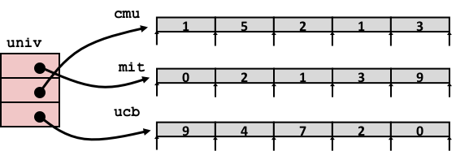
Element Access in Multi-Level Array
int get_univ_digit
(size_t index, size_t digit)
{
return univ[index][digit];
}
salq $2, %rsi # 4*digit
addq univ(,%rdi,8), %rsi # p = univ[index] + 4*digit
movl (%rsi), %eax # return *p
ret
Computation
  Element access Mem[Mem[univ+8*index]+4*digit]
  Must do two memory reads
    First get pointer to row array
    Then access element within array

Slide 36
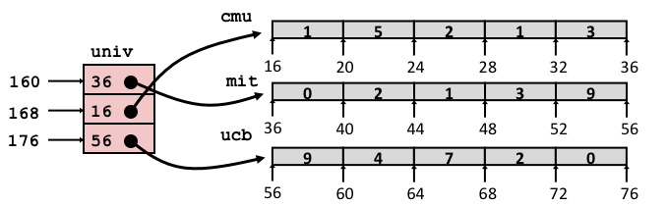
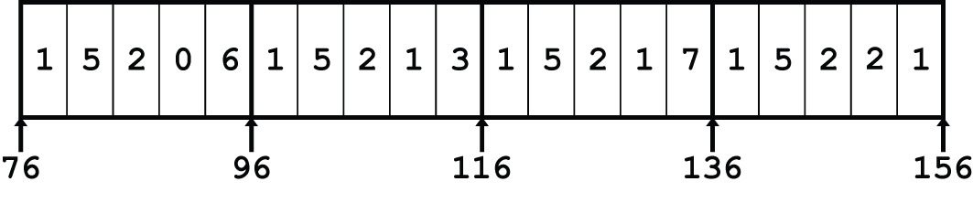
Array Element Accesses
Nested array
Multi-level array
int get_pgh_digit
(size_t index, size_t digit)
{
return pgh[index][digit];
}
int get_univ_digit
(size_t index, size_t digit)
{
return univ[index][digit];
}
Accesses looks similar in C, but address computations very different:
Mem[pgh+20*index+4*digit]
Mem[Mem[univ+8*index]+4*digit]

Slide 37
N X N Matrix Code
#define N 16
typedef int fix_matrix[N][N];
/* Get element A[i][j] */
int fix_ele(fix_matrix A,
size_t i, size_t j)
{
return A[i][j];
}
Fixed dimensions
  Know value of N at compile time
Variable dimensions, explicit indexing
  Traditional way to implement dynamic arrays
Variable dimensions, implicit indexing
  Now supported by gcc
#define IDX(n, i, j) ((i)*(n)+(j))
/* Get element A[i][j] */
int vec_ele(size_t n, int *A,
size_t i, size_t j)
{
return A[IDX(n,i,j)];
}
/* Get element A[i][j] */
int var_ele(size_t n, int A[n][n],
size_t i, size_t j) {
return A[i][j];
}

Slide 38
16 X 16 Matrix Access
Array Elements
  int A[16][16];
  Address A + i * (C * K) + j * K
  C = 16, K = 4
/* Get element A[i][j] */
int fix_ele(fix_matrix A, size_t i, size_t j) {
return A[i][j];
}
# A in %rdi, i in %rsi, j in %rdx
salq $6, %rsi # 64*i
addq %rsi, %rdi # A + 64*i
movl (%rdi,%rdx,4), %eax # Mem[A + 64*i + 4*j]
ret

Slide 39
n X n Matrix Access
Array Elements
  size_t n;
  int A[n][n];
  Address A + i * (C * K) + j * K
  C = n, K = 4
  Must perform integer multiplication
/* Get element A[i][j] */
int var_ele(size_t n, int A[n][n], size_t i, size_t j) {
return A[i][j];
}
# n in %rdi, A in %rsi, i in %rdx, j in %rcx
imulq %rdx, %rdi # n*i
leaq (%rsi,%rdi,4), %rax # A + 4*n*i
movl (%rax,%rcx,4), %eax # A + 4*n*i + 4*j
ret
Notes:
Why multiply?

Slide 40
Example: Array Access
#include <stdio.h>
#define ZLEN 5
#define PCOUNT 4
typedef int zip_dig[ZLEN];
int main(int argc, char** argv) {
zip_dig pgh[PCOUNT] =
{{1, 5, 2, 0, 6},
{1, 5, 2, 1, 3 },
{1, 5, 2, 1, 7 },
{1, 5, 2, 2, 1 }};
int *linear_zip = (int *) pgh;
int *zip2 = (int *) pgh[2];
int result =
pgh[0][0] +
linear_zip[7] +
*(linear_zip + 8) +
zip2[1];
printf("result: %d\n", result);
return 0;
}
linux> ./array
Notes:
Stop and ask students to work out what this might print.

Slide 41
Example: Array Access
#include <stdio.h>
#define ZLEN 5
#define PCOUNT 4
typedef int zip_dig[ZLEN];
int main(int argc, char** argv) {
zip_dig pgh[PCOUNT] =
{{1, 5, 2, 0, 6},
{1, 5, 2, 1, 3 },
{1, 5, 2, 1, 7 },
{1, 5, 2, 2, 1 }};
int *linear_zip = (int *) pgh;
int *zip2 = (int *) pgh[2];
int result =
pgh[0][0] +
linear_zip[7] +
*(linear_zip + 8) +
zip2[1];
printf("result: %d\n", result);
return 0;
}
linux> ./array
result: 9

Slide 42
Quiz Time!
Check out:
https://canvas.cmu.edu/courses/13182

Slide 43
Understanding Pointers & Arrays #3
Decl | An |  |  | *An |  |  | **An
 | Cmp | Bad | Size | Cmp | Bad | Size | Cmp | Bad | Size
int A1[3][5]
int *A2[3][5]
int (*A3)[3][5]
int *(A4[3][5])
int (*A5[3])[5]
Decl | ***An
 | Cmp | Bad | Size
int A1[3][5]
int *A2[3][5]
int (*A3)[3][5]
int *(A4[3][5])
int (*A5[3])[5]
Cmp: Compiles (Y/N)
Bad: Possible bad pointer reference (Y/N)
Size: Value returned by sizeof

Slide 44
Allocated pointer
Declaration
int A1[3][5]
int *A2[3][5]
int (*A3)[3][5]
int *(A4[3][5])
int (*A5[3])[5]
Allocated pointer to unallocated int
Unallocated pointer
Allocated int
Unallocated int

Slide 45
Allocated pointer
Declaration
int A1[3][5]
int *A2[3][5]
int (*A3)[3][5]
int *(A4[3][5])
int (*A5[3])[5]
Allocated pointer to unallocated int
Unallocated pointer
Allocated int
Unallocated int
A1
A2/A4
A3
A5

Slide 46
Understanding Pointers & Arrays #3
Decl | An |  |  | *An |  |  | **An
 | Cmp | Bad | Size | Cmp | Bad | Size | Cmp | Bad | Size
int A1[3][5] | Y | N | 60 | Y | N | 20 | Y | N | 4
int *A2[3][5] | Y | N | 120 | Y | N | 40 | Y | N | 8
int (*A3)[3][5] | Y | N | 8 | Y | Y | 60 | Y | Y | 20
int *(A4[3][5]) | Y | N | 120 | Y | N | 40 | Y | N | 8
int (*A5[3])[5] | Y | N | 24 | Y | N | 8 | Y | Y | 20
Decl | ***An
 | Cmp | Bad | Size
int A1[3][5] | N | - | -
int *A2[3][5] | Y | Y | 4
int (*A3)[3][5] | Y | Y | 4
int *(A4[3][5]) | Y | Y | 4
int (*A5[3])[5] | Y | Y | 4
Cmp: Compiles (Y/N)
Bad: Possible bad pointer reference (Y/N)
Size: Value returned by sizeof

Slide 47
Today
Arrays
  One-dimensional
  Multi-dimensional (nested)
  Multi-level
Structures
  Allocation
  Access
  Alignment
Floating Point

Slide 48
Structure Representation
r
struct rec {
int a[4];
size_t i;
struct rec *next;
};
a
i
next
0
16
24
32
Structure represented as block of memory
  Big enough to hold all of the fields
Fields ordered according to declaration
  Even if another ordering could yield a more compact representation
Compiler determines overall size + positions of fields
  Machine-level program has no understanding of the structures in the source code

Slide 49
Generating Pointer to Structure Member
r
r+4*idx
struct rec {
int a[4];
size_t i;
struct rec *next;
};
a
i
next
0
16
24
32
Generating Pointer to Array Element
  Offset of each structure member determined at compile time
  Compute as r + 4*idx
int *get_ap
(struct rec *r, size_t idx)
{
return &r->a[idx];
}
# r in %rdi, idx in %rsi
leaq (%rdi,%rsi,4), %rax
ret

Slide 50
Following Linked List #1
struct rec {
int a[4];
size_t i;
struct rec *next;
};
C Code
Loop assembly code
r
long length(struct rec*r) {
long len = 0L;
while (r) {
len ++;
r = r->next;
}
return len;
}
a
i
next
0
16
24
32
Register | Value
%rdi | r
%rax | len
.L11: # loop:
addq $1, %rax # len ++
movq 24(%rdi), %rdi # r = Mem[r+24]
testq %rdi, %rdi # Test r
jne .L11 # If != 0, goto loop

Slide 51
Following Linked List #2
struct rec {
int a[4];
size_t i;
struct rec *next;
};
C Code
r
void set_val
(struct rec *r, int val)
{
while (r) {
size_t i = r->i;
// No bounds check
r->a[i] = val;
r = r->next;
}
}
a
i
next
0
16
24
32
Element i
Register | Value
%rdi | r
%rsi | val
.L11: # loop:
movq 16(%rdi), %rax # i = Mem[r+16]
movl %esi, (%rdi,%rax,4) # Mem[r+4*i] = val
movq 24(%rdi), %rdi # r = Mem[r+24]
testq %rdi, %rdi # Test r
jne .L11 # if !=0 goto loop

Slide 52
Structures & Alignment
Unaligned Data
Aligned Data
  Primitive data type requires B bytes implies
  Address must be multiple of B
struct S1 {
char c;
int i[2];
double v;
} *p;
c
i[0]
i[1]
v
p
p+1
p+5
p+9
p+17
c
3 bytes
i[0]
i[1]
4 bytes
v
p+0
p+4
p+8
p+16
p+24
Multiple of 4
Multiple of 8
Multiple of 8
Multiple of 8

Slide 53
Alignment Principles
Aligned Data
  Primitive data type requires B bytes
  Address must be multiple of B
  Required on some machines; advised on x86-64
Motivation for Aligning Data
  Memory accessed by (aligned) chunks of 4 or 8 bytes (system dependent)
    Inefficient to load or store datum that spans cache lines (64 bytes). Intel states should avoid crossing 16 byte boundaries.
      [Cache lines will be discussed in Lecture 11.]
    Virtual memory trickier when datum spans 2 pages (4 KB pages)
      [Virtual memory pages will be discussed in Lecture 17.]
Compiler
  Inserts gaps in structure to ensure correct alignment of fields

Slide 54
Specific Cases of Alignment (x86-64)
1 byte: char, …
  no restrictions on address
2 bytes: short, …
  lowest 1 bit of address must be 02
4 bytes: int, float, …
  lowest 2 bits of address must be 002
8 bytes: double, long, char *, …
  lowest 3 bits of address must be 0002

Slide 55
Satisfying Alignment with Structures
Within structure:
  Must satisfy each element’s alignment requirement
Overall structure placement
  Each structure has alignment requirement K
    K = Largest alignment of any element
  Initial address & structure length must be multiples of K
Example:
  K = 8, due to double element
struct S1 {
char c;
int i[2];
double v;
} *p;
c
3 bytes
i[0]
i[1]
4 bytes
v
p+0
p+4
p+8
p+16
p+24
Multiple of 4
Multiple of 8
Multiple of 8
Multiple of 8
Internal padding

Slide 56
Meeting Overall Alignment Requirement
For largest alignment requirement K
Overall structure must be multiple of K
struct S2 {
double v;
int i[2];
char c;
} *p;
External padding
 | v |  |  |  |  |  |  | i[0] |  |  |  | i[1] |  |  |  | c | 7 bytes
p+0 |  |  |  |  |  |  | p+8 |  |  |  |  |  |  |  | p+16 |  |  |  |  |  |  |  | p+24
Multiple of K=8

Slide 57
Arrays of Structures
struct S2 {
double v;
int i[2];
char c;
} a[10];
Overall structure length multiple of K
Satisfy alignment requirement
for every element
 | a[0] |  |  |  |  | a[1] |  |  |  |  | a[2] |  |  |  |  | • • •
a+0 |  |  |  |  | a+24 |  |  |  |  | a+48 |  |  |  |  | a+72
 | v |  |  |  |  |  |  | i[0] |  |  |  | i[1] |  |  |  | c | 7 bytes
a+24 |  |  |  |  |  |  | a+32 |  |  |  |  |  |  |  | a+40 |  |  |  |  |  |  |  | a+48

Slide 58
Accessing Array Elements
struct S3 {
short i;
float v;
short j;
} a[10];
Compute array offset 12*idx
  sizeof(S3), including alignment spacers
Element j is at offset 8 within structure
Assembler gives offset a+8
  Resolved during linking
 | a[0] |  |  |  |  | • • • |  |  |  | a[idx] |  |  |  | • • |  |  | •
a+0 |  |  |  |  | a+12 |  |  |  | a+12*idx
 |  |  |  |  | i | 2 bytes |  | v |  |  | j | 2 bytes
 |  |  |  | a+12*idx |  |  |  |  |  | a+12*idx+8
short get_j(int idx)
{
return a[idx].j;
}
# %rdi = idx
leaq (%rdi,%rdi,2),%rax # 3*idx
movzwl a+8(,%rax,4),%eax
Notes:
Give the pseudo-code for the assembly, which field / element is being accessed?

Slide 59
Saving Space
Put large data types first
Effect (largest alignment requirement K=4)
struct S4 {
char c;
int i;
char d;
} *p;
struct S5 {
int i;
char c;
char d;
} *p;
c
3 bytes
i
d
3 bytes
12 bytes
i
c
d
2 bytes
8 bytes

Slide 60
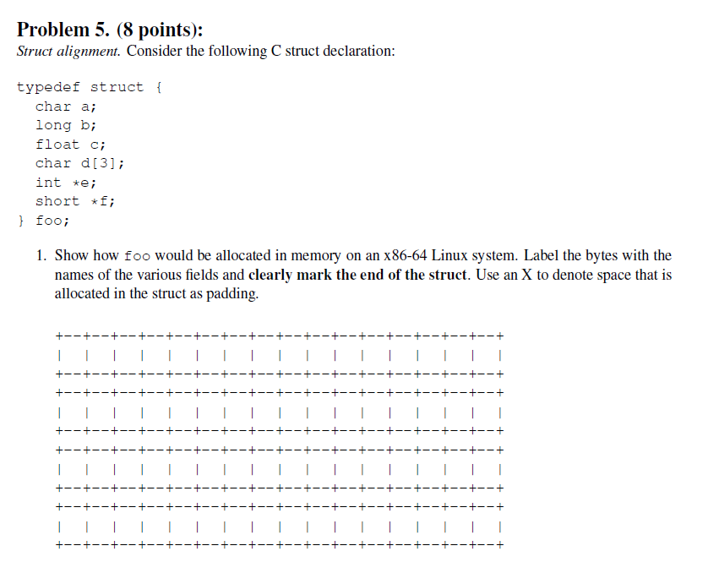
Example Struct Exam Question
http://www.cs.cmu.edu/~213/oldexams/exam1-f12.pdf

Slide 61
Example Struct Exam Question
a
X
X
X
X
X
X
X
b
b
b
b
b
b
b
b
c
c
c
c
d
d
d
X
e
e
e
e
e
e
e
e
f
f
f
f
f
f
f
|
f
http://www.cs.cmu.edu/~213/oldexams/exam1-f12.pdf

Slide 62
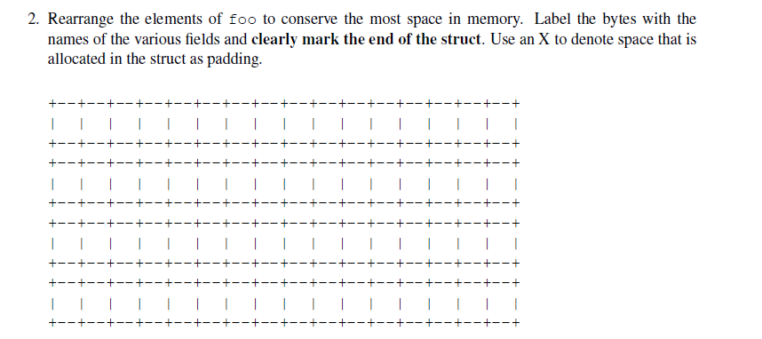
Example Struct Exam Question (Cont’d)
http://www.cs.cmu.edu/~213/oldexams/exam1-f12.pdf

Slide 63
Example Struct Exam Question (Cont’d)
a
d
d
d
c
c
c
c
b
b
b
b
b
b
b
b
e
e
e
e
e
e
e
e
f
f
f
|
f
f
f
f
f
http://www.cs.cmu.edu/~213/oldexams/exam1-f12.pdf

Slide 64
Today
Arrays
  One-dimensional
  Multi-dimensional (nested)
  Multi-level
Structures
  Allocation
  Access
  Alignment
Floating Point

Slide 65
Background
History
  x87 FP
    Legacy, very ugly
  SSE FP
    Supported by Shark machines
    Special case use of vector instructions
  AVX FP
    Newest version
    Similar to SSE (but registers are 32 bytes instead of 16)
    Documented in book

Slide 66
Programming with SSE4
XMM Registers
  16 total, each 16 bytes
  16 single-byte integers
  8 16-bit integers
  4 32-bit integers
  4 single-precision floats
  2 double-precision floats
  1 single-precision float
  1 double-precision float

Slide 67
Scalar & SIMD Operations
  Scalar Operations: Single Precision
  SIMD Operations: Single Precision
  Scalar Operations: Double Precision
addss %xmm0,%xmm1
%xmm0
+
%xmm1
addps %xmm0,%xmm1
%xmm0
+
+
+
+
%xmm1
addsd %xmm0,%xmm1
%xmm0
+
%xmm1

Slide 68
FP Basics
Arguments passed in %xmm0, %xmm1, ...
Result returned in %xmm0
All XMM registers caller-saved
float fadd(float x, float y)
{
return x + y;
}
double dadd(double x, double y)
{
return x + y;
}
# x in %xmm0, y in %xmm1
addss %xmm1, %xmm0
ret
# x in %xmm0, y in %xmm1
addsd %xmm1, %xmm0
ret

Slide 69
FP Memory Referencing
Integer (and pointer) arguments passed in regular registers
FP values passed in XMM registers
Different mov instructions to move between XMM registers, and between memory and XMM registers
double dincr(double *p, double v)
{
double x = *p;
*p = x + v;
return x;
}
# p in %rdi, v in %xmm0
movapd %xmm0, %xmm1 # Copy v
movsd (%rdi), %xmm0 # x = *p
addsd %xmm0, %xmm1 # t = x + v
movsd %xmm1, (%rdi) # *p = t
ret

Slide 70
Other Aspects of FP Code
Lots of instructions
  Different operations, different formats, ...
Floating-point comparisons
  Instructions ucomiss and ucomisd
  Set condition codes ZF, PF and CF
  Zeros OF and SF
Using constant values
  Set XMM0 register to 0 with instruction xorpd %xmm0, %xmm0
  Others loaded from memory
UNORDERED: ZF,PF,CF←111
GREATER_THAN: ZF,PF,CF←000
LESS_THAN: ZF,PF,CF←001
EQUAL: ZF,PF,CF←100
Parity Flag

Slide 71
Summary
Arrays
  Elements packed into contiguous region of memory
  Use index arithmetic to locate individual elements
Structures
  Elements packed into single region of memory
  Access using offsets determined by compiler
  Possible require internal and external padding to ensure alignment
Combinations
  Can nest structure and array code arbitrarily
Floating Point
  Data held and operated on in XMM registers

Slide 72
Understanding Pointers & Arrays #3
Decl | An |  |  | *An |  |  | **An
 | Cmp | Bad | Size | Cmp | Bad | Size | Cmp | Bad | Size
int A1[3][5]
int *A2[3][5]
int (*A3)[3][5]
int *(A4[3][5])
int (*A5[3])[5]
Decl | ***An
 | Cmp | Bad | Size
int A1[3][5]
int *A2[3][5]
int (*A3)[3][5]
int *(A4[3][5])
int (*A5[3])[5]
Cmp: Compiles (Y/N)
Bad: Possible bad pointer reference (Y/N)
Size: Value returned by sizeof

Slide 73
Allocated pointer
Declaration
int A1[3][5]
int *A2[3][5]
int (*A3)[3][5]
int *(A4[3][5])
int (*A5[3])[5]
Allocated pointer to unallocated int
Unallocated pointer
Allocated int
Unallocated int
A1
A2/A4
A3
A5

Slide 74
Understanding Pointers & Arrays #3
Decl | An |  |  | *An |  |  | **An
 | Cmp | Bad | Size | Cmp | Bad | Size | Cmp | Bad | Size
int A1[3][5] | Y | N | 60 | Y | N | 20 | Y | N | 4
int *A2[3][5] | Y | N | 120 | Y | N | 40 | Y | N | 8
int (*A3)[3][5] | Y | N | 8 | Y | Y | 60 | Y | Y | 20
int *(A4[3][5]) | Y | N | 120 | Y | N | 40 | Y | N | 8
int (*A5[3])[5] | Y | N | 24 | Y | N | 8 | Y | Y | 20
Decl | ***An
 | Cmp | Bad | Size
int A1[3][5] | N | - | -
int *A2[3][5] | Y | Y | 4
int (*A3)[3][5] | Y | Y | 4
int *(A4[3][5]) | Y | Y | 4
int (*A5[3])[5] | Y | Y | 4
Cmp: Compiles (Y/N)
Bad: Possible bad pointer reference (Y/N)
Size: Value returned by sizeof

