Slide 1
15-213: S20 Midterm Review Session
Kashish, Jeremy, Di

Slide 2
Agenda
Review midterm problems
  Cache
  Assembly
  Stack
  Floats, Arrays, Structs (time permitting)
Q&A for general midterm problems

Slide 3
Reminders
ONLY Conceptual office hours until Wednesday. If you need any help with midterm questions after today, please make a public Piazza post (and specify exactly which question!)
Cheat sheet: ONE 8½ x 11 in. sheet, both sides. Please use only English! Make a copy prior to midterm. No practice problems!
Lecture is still happening this week! Go learn things!

Slide 4
Problem 1: Cache
Things to remember/put on a cheat sheet because please don’t try to memorize all of this:
  Direct mapped vs. n-way associative vs. fully associative
  Tag/Set/Block offset bits, how do they map depending on cache size?
  LRU policies

Slide 5
Problem 1: Cache
Assume you have a cache of the following structure:
  32-byte blocks
  2 sets
  Direct-mapped
  8-bit address space
  The cache is cold prior to access
What does the address decomposition look like?
0 0 0 0 0 0 0 0

Slide 6
Problem 1: Cache
Assume you have a cache of the following structure:
  32-byte blocks
  2 sets
  Direct-mapped
  8-bit address space
  The cache is cold prior to access
What does the address decomposition look like?
0 0 0 0 0 0 0 0

Slide 7
Problem 1: Cache
Address | Set | Tag | H/M | Evict? Y/N
0x56
0x6D
0x49
0x3A

Slide 8
Problem 1: Cache
Address | Set | Tag | H/M | Evict? Y/N
0101 0110
0110 1101
0100 1001
0011 1010

Slide 9
Problem 1: Cache
Address | Set | Tag | H/M | Evict? Y/N
0101 0110 | 0 | 01 | M | N
0110 1101
0100 1001
0011 1010

Slide 10
Problem 1: Cache
Address | Set | Tag | H/M | Evict? Y/N
0101 0110 | 0 | 01 | M | N
0110 1101 | 1 | 01 | M | N
0100 1001
0011 1010

Slide 11
Problem 1: Cache
Address | Set | Tag | H/M | Evict? Y/N
0101 0110 | 0 | 01 | M | N
0110 1101 | 1 | 01 | M | N
0100 1001 | 0 | 01 | H | N
0011 1010

Slide 12
Problem 1: Cache
Address | Set | Tag | H/M | Evict? Y/N
0101 0110 | 0 | 01 | M | N
0110 1101 | 1 | 01 | M | N
0100 1001 | 0 | 01 | H | N
0011 1010 | 1 | 00 | M | Y

Slide 13
Problem 1: Cache
Assume you have a cache of the following structure:
  2-way associative
  4 sets, 64-byte blocks
What does the address decomposition look like?
… 0 0 0 0 0 0 0 0 0 0 0 0 0 0 0 0

Slide 14
Problem 1: Cache
Assume you have a cache of the following structure:
  2-way associative
  4 sets, 64-byte blocks
What does the address decomposition look like?
… 0 0 0 0 0 0 0 0 0 0 0 0 0 0 0 0

Slide 15
Problem 1: Cache
Assume A and B are 128 ints and cache-aligned.
  What is the miss rate of pass 1?
  What is the miss rate of pass 2?
int get_prod_and_copy(int *A, int *B) {
int length = 64;
int prod = 1;
// pass 1
for (int i = 0; i < length; i+=4) {
prod*=A[i];
}
// pass 2
for (int j = length-1; j > 0; j-=4) {
A[j] = B[j];
}
return prod;
}

Slide 16
Problem 1: Cache
Pass 1: Only going through 64 ints with step size 4. Each miss loads 16 ints into a cache line, giving us 3 more hits before loading into a new line.
int get_prod_and_copy(int *A, int *B) {
int length = 64;
int prod = 1;
// pass 1
for (int i = 0; i < length; i+=4) {
prod*=A[i];
}
// pass 2
for (int j = length-1; j > 0; j-=4) {
A[j] = B[j];
}
return prod;
}

Slide 17
Problem 1: Cache
Pass 1: 25% miss
int get_prod_and_copy(int *A, int *B) {
int length = 64;
int prod = 1;
// pass 1
for (int i = 0; i < length; i+=4) {
prod*=A[i];
}
// pass 2
for (int j = length-1; j > 0; j-=4) {
A[j] = B[j];
}
return prod;
}

Slide 18
Problem 1: Cache
Pass 2: Our cache is the same size as our working set! Due to cache alignment, we won’t evict anything from A, but still get a 1:3 miss:hit ratio for B.
int get_prod_and_copy(int *A, int *B) {
int length = 64;
int prod = 1;
// pass 1
for (int i = 0; i < length; i+=4) {
prod*=A[i];
}
// pass 2
for (int j = length-1; j > 0; j-=4) {
A[j] = B[j];
}
return prod;
}

Slide 19
Problem 1: Cache
Pass 2: For every 4 loop iterations, we get all hits for accessing A and 1 miss for accessing B, which gives us ⅛ miss.
int get_prod_and_copy(int *A, int *B) {
int length = 64;
int prod = 1;
// pass 1
for (int i = 0; i < length; i+=4) {
prod*=A[i];
}
// pass 2
for (int j = length-1; j > 0; j-=4) {
A[j] = B[j];
}
return prod;
}

Slide 20
Problem 1: Cache
Pass 2: 12.5% miss
int get_prod_and_copy(int *A, int *B) {
int length = 64;
int prod = 1;
// pass 1
for (int i = 0; i < length; i+=4) {
prod*=A[i];
}
// pass 2
for (int j = length-1; j > 0; j-=4) {
A[j] = B[j];
}
return prod;
}

Slide 21
Problem 2: Assembly
Typical questions asked
  Given a function, look at assembly to fill in missing portions
  Given assembly of a function, intuit the behavior of the program
  (More rare) Compare different chunks of assembly, which one implements the function given?
Important things to remember/put on your cheat sheet:
  Memory Access formula: D(Rb,Ri,S)
  Distinguish between mov/lea instructions
  Callee/Caller save regs
  Condition codes and corresponding eflags

Slide 22
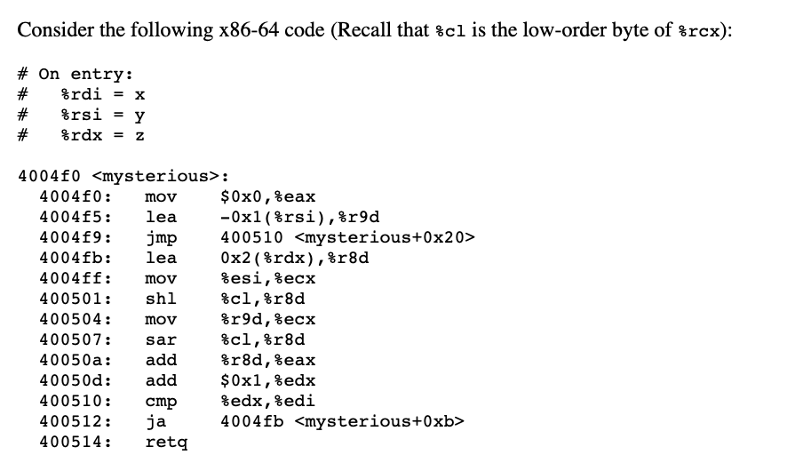
Problem 2: Assembly
Katherine TODO: pick one

Slide 23
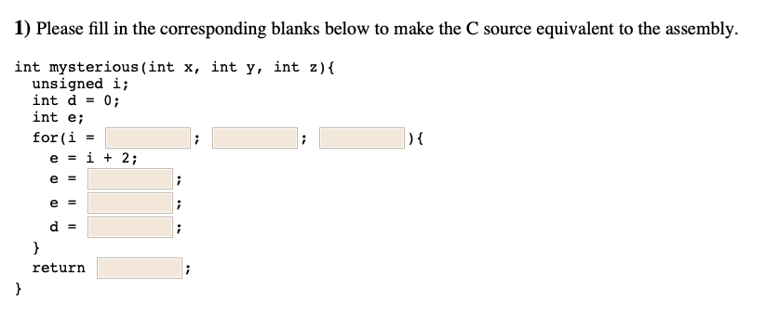
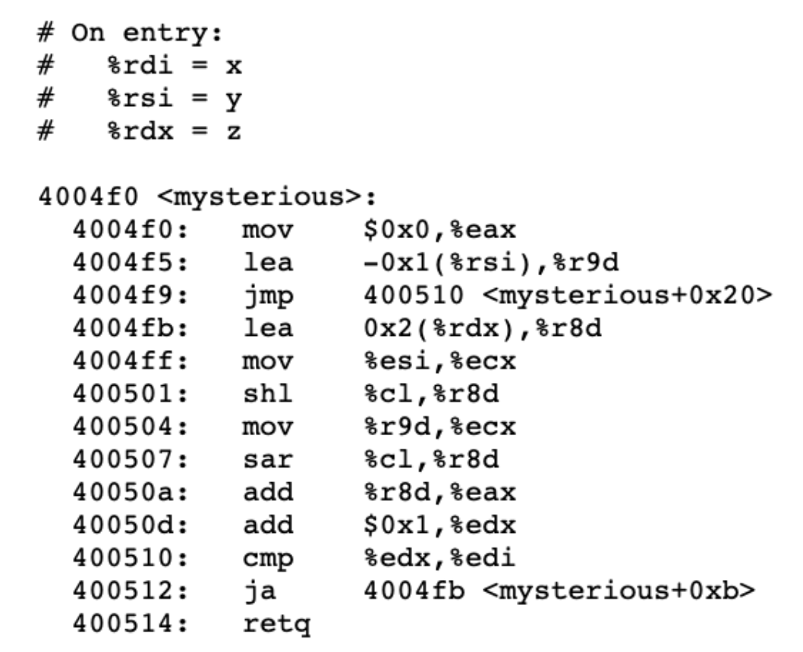
Problem 2: Assembly
z

Slide 24
Problem 2: Assembly
z
e = %r8d

Slide 25
Problem 2: Assembly
z
i++
Loop end: add 1, compare, iterate

Slide 26
Problem 2: Assembly
z
x > i
i++
cmp %edx, %edi => (edi - edx > 0), same as x > i

Slide 27
Problem 2: Assembly
z
x > i
i++
We know that e = %r8d...

Slide 28

Problem 2: Assembly
z
x > i
i++
e << y
Where did %cl come from?

Slide 29
Problem 2: Assembly
z
x > i
i++
e << y
Again, e = %r8d...

Slide 30
Problem 2: Assembly
z
x > i
i++
e << y
e >> (y - 1)

Slide 31
Problem 2: Assembly
z
x > i
i++
e << y
e >> (y - 1)
What’s left?

Slide 32
Problem 2: Assembly
z
x > i
i++
e << y
e >> (y - 1)
e + d

Slide 33
Problem 2: Assembly
z
x > i
i++
e << y
e >> (y - 1)
e + d

Slide 34
Problem 2: Assembly
z
x > i
i++
e << y
e >> (y - 1)
e + d
d

Slide 35
Problem 2: Assembly
z
x > i
i++
e << y
e >> (y - 1)
e + d
d

Slide 36
Problem 3: Stack
Important things to remember:
  Stack grows towards lower addresses
  %rsp = stack pointer, always point to “top” of stack
  Push and pop, call and ret
  Stack frames: how they are allocated and freed
  Which registers used for arguments? Return values?
  Little endianness
ALWAYS helpful to draw a stack diagram!!
Stack questions are like Assembly questions on steroids

Slide 37
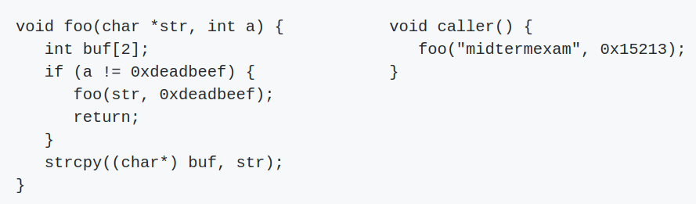
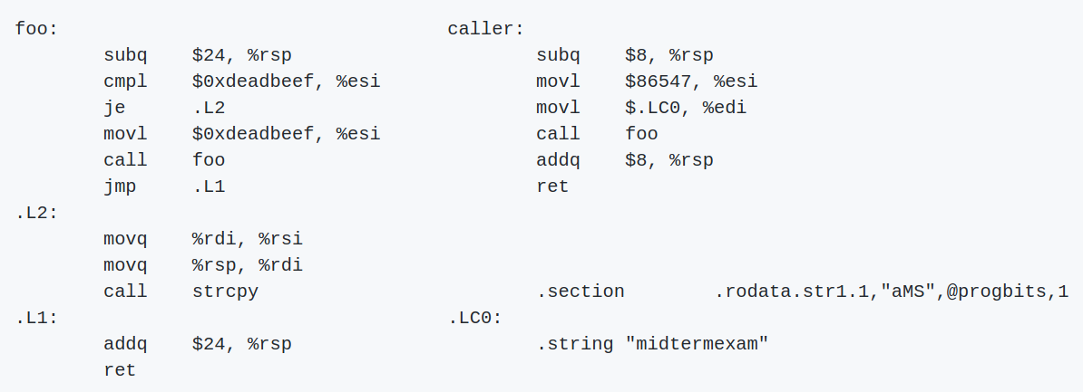
Problem 3: Stack
Consider the following code:
Hints:
strcpy(char *dst, char *src) copies the string at address src (including the terminating '\0' character) to address dst.
Keep endianness in mind!
Table of hex values of characters in “midtermexam”
Assumptions:
%rsp = 0x800100 just before caller() calls foo()
.LC0 is at address 0x400300

Slide 38
Problem 3: Stack
Consider the following code:
Hints:
strcpy(char *dst, char *src) copies the string at address src (including the terminating '\0' character) to address dst.
Keep endianness in mind!
Table of hex values of characters in “midtermexam”
Assumptions:
%rsp = 0x800100 just before caller() calls foo()
.LC0 is at address 0x400300
%rsp = 0x800100
= 0x400300

Slide 39
Problem 3: Stack
Question 1: What is the hex value of %rsp just before strcpy() is called for the first time in foo()?
Hints:
Step through the program instruction by instruction from start to end
Draw a stack diagram!!!
Keep track of registers too
Start
%rsp = 0x800100
End
= 0x400300

Slide 40
Problem 3: Stack
Arrow is instruction that will execute NEXT
Question 1: What is the hex value of %rsp just before strcpy() is called for the first time in foo()?
%rsp | 0x800100
%rdi | .LC0
%rsi | 0x15213
0x800100
0x8000f8
0x8000f0
0x8000e8
0x8000e0
0x8000d8
0x8000d0
0x8000c8
0x8000c0
0x8000b8
%rsp = 0x800100
End
= 0x400300
Notes:
Start stack diagram at point where we know value of %rsp
Keep track of register value too

Slide 41
Problem 3: Stack
Question 1: What is the hex value of %rsp just before strcpy() is called for the first time in foo()?
%rsp | 0x8000f8
%rdi | .LC0
%rsi | 0x15213
0x800100 | ?
0x8000f8 | ret address for foo()
0x8000f0
0x8000e8
0x8000e0
0x8000d8
0x8000d0
0x8000c8
0x8000c0
0x8000b8
End
= 0x400300
Notes:
Call pushes return address onto top of stack

Slide 42
Problem 3: Stack
Hint: $24 in decimal = 0x18
Question 1: What is the hex value of %rsp just before strcpy() is called for the first time in foo()?
%rsp | 0x8000e0
%rdi | .LC0
%rsi | 0x15213
0x800100 | ?
0x8000f8 | ret address for foo()
0x8000f0 | ?
0x8000e8 | ?
0x8000e0 | ?
0x8000d8
0x8000d0
0x8000c8
0x8000c0
0x8000b8
End
= 0x400300
Notes:
Compare %rsi to 0xdeadbeef.
“je” = jump if equal
Since they are not equal, we DO NOT jump
movl modifies %rsi

Slide 43
Problem 3: Stack
Question 1: What is the hex value of %rsp just before strcpy() is called for the first time in foo()?
%rsp | 0x8000e0
%rdi | .LC0
%rsi | 0xdeadbeef
0x800100 | ?
0x8000f8 | ret address for foo()
0x8000f0 | ?
0x8000e8 | ?
0x8000e0 | ?
0x8000d8
0x8000d0
0x8000c8
0x8000c0
0x8000b8
End
= 0x400300

Slide 44
Problem 3: Stack
Question 1: What is the hex value of %rsp just before strcpy() is called for the first time in foo()?
%rsp | 0x8000d8
%rdi | .LC0
%rsi | 0xdeadbeef
0x800100 | ?
0x8000f8 | ret address for foo()
0x8000f0 | ?
0x8000e8 | ?
0x8000e0 | ?
0x8000d8 | ret address for foo()
0x8000d0
0x8000c8
0x8000c0
0x8000b8
End
= 0x400300
Notes:
Called foo again!

Slide 45
Problem 3: Stack
Question 1: What is the hex value of %rsp just before strcpy() is called for the first time in foo()?
%rsp | 0x8000c0
%rdi | .LC0
%rsi | 0xdeadbeef
0x800100 | ?
0x8000f8 | ret address for foo()
0x8000f0 | ?
0x8000e8 | ?
0x8000e0 | ?
0x8000d8 | ret address for foo()
0x8000d0 | ?
0x8000c8 | ?
0x8000c0 | ?
0x8000b8
End
= 0x400300
Notes:
Compare %rsi to 0xdeadbeef again
This time, they are equal!

Slide 46
Problem 3: Stack
Question 1: What is the hex value of %rsp just before strcpy() is called for the first time in foo()?
%rsp | 0x8000c0
%rdi | .LC0
%rsi | 0xdeadbeef
0x800100 | ?
0x8000f8 | ret address for foo()
0x8000f0 | ?
0x8000e8 | ?
0x8000e0 | ?
0x8000d8 | ret address for foo()
0x8000d0 | ?
0x8000c8 | ?
0x8000c0 | ?
0x8000b8
End
= 0x400300
Notes:
Jump to .L2 because of the “je” instruction

Slide 47
Problem 3: Stack
Question 1: What is the hex value of %rsp just before strcpy() is called for the first time in foo()?
%rsp | 0x8000c0
%rdi | 0x8000c0
%rsi | .LCO
0x800100 | ?
0x8000f8 | ret address for foo()
0x8000f0 | ?
0x8000e8 | ?
0x8000e0 | ?
0x8000d8 | ret address for foo()
0x8000d0 | ?
0x8000c8 | ?
0x8000c0 | ?
0x8000b8
Answer!
End
= 0x400300
Notes:
“movq” instructions update our %rdi and %rsi
We have our answer now!

Slide 48
Problem 3: Stack
Question 2: What is the hex value of buf[0] when strcpy() returns?
%rsp | 0x8000c0
%rdi | 0x8000c0
%rsi | .LC0
0x800100 | ?
0x8000f8 | ret address for foo()
0x8000f0 | ?
0x8000e8 | ?
0x8000e0 | ?
0x8000d8 | ret address for foo()
0x8000d0 | ?
0x8000c8 | ?
0x8000c0 | ?
0x8000b8
= 0x400300
Notes:
To figure out what strcpy does, we have to figure out its arguments

Slide 49
Problem 3: Stack
%rsp | 0x8000c0
%rdi | 0x8000c0
%rsi | .LC0
Question 2: What is the hex value of buf[0] when strcpy() returns?
0x800100 | ?
0x8000f8 | ret address for foo()
0x8000f0 | ?
0x8000e8 | ?
0x8000e0 | ?
0x8000d8 | ret address for foo()
0x8000d0 | ?
0x8000c8
0x8000c0 |  |  |  |  |  | ‘d’ | ‘i’ | ‘m’
0x8000b8
= 0x400300
c7
c2
c1
c0
Notes:
Simulate strcpy and KEEP TRACK OF ENDIANNESS
First byte goes into 0x8000c0, second into 0x8000c1, and so on...
Think back to attacklab and your input buffers

Slide 50
Problem 3: Stack
%rsp | 0x8000c0
%rdi | 0x8000c0
%rsi | .LC0
Question 2: What is the hex value of buf[0] when strcpy() returns?
0x800100 | ?
0x8000f8 | ret address for foo()
0x8000f0 | ?
0x8000e8 | ?
0x8000e0 | ?
0x8000d8 | ret address for foo()
0x8000d0 | ?
0x8000c8 | ? | ? | ? | ? | ‘\0’ | ‘m’ | ‘a’ | ‘x’
0x8000c0 | ‘e’ | ‘m’ | ‘r’ | ‘e’ | ‘t’ | ‘d’ | ‘i’ | ‘m’
0x8000b8
= 0x400300
c7
c2
c1
c0
Notes:
Simulate strcpy and KEEP TRACK OF ENDIANNESS
First byte goes into 0x8000c0, second into 0x8000c1, and so on...
Think back to attacklab and your input buffers

Slide 51
Problem 3: Stack
%rsp | 0x8000c0
%rdi | 0x8000c0
%rsi | .LC0
Question 2: What is the hex value of buf[0] when strcpy() returns?
0x800100 | ?
0x8000f8 | ret address for foo()
0x8000f0 | ?
0x8000e8 | ?
0x8000e0 | ?
0x8000d8 | ret address for foo()
0x8000d0 | ?
0x8000c8 | ? | ? | ? | ? | ‘\0’ | ‘m’ | ‘a’ | ‘x’
0x8000c0 | ‘e’ | ‘m’ | ‘r’ | ‘e’ | ‘t’ | ‘d’ | ‘i’ | ‘m’
0x8000b8
= 0x400300
c3
c0
buf[0]
Notes:
Simulate strcpy and KEEP TRACK OF ENDIANNESS
buf[0] = int stored at 0x8000c0 (4 bytes)

Slide 52
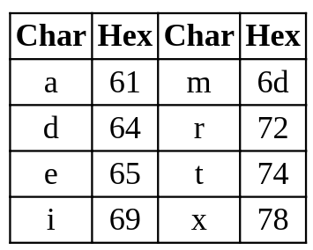
Problem 3: Stack
buf[0] =
=
(as int)= 0x7464696d
‘t’ | ‘d’ | ‘i’ | ‘m’
0x800100 | ?
0x8000f8 | ret address for foo()
0x8000f0 | ?
0x8000e8 | ?
0x8000e0 | ?
0x8000d8 | ret address for foo()
0x8000d0 | ?
0x8000c8 | ? | ? | ? | ? | ‘\0’ | ‘m’ | ‘a’ | ‘x’
0x8000c0 | ‘e’ | ‘m’ | ‘r’ | ‘e’ | ‘t’ | ‘d’ | ‘i’ | ‘m’
0x8000b8
74 | 64 | 69 | 6d
buf[0]
Notes:
Little Endianness = lowest address -> least significant byte

Slide 53
Problem 3: Stack
%rsp | 0x8000c0
%rdi | 0x8000c0
%rsi | .LC0
Question 3: What is the hex value of buf[1] when strcpy() returns?
0x800100 | ?
0x8000f8 | ret address for foo()
0x8000f0 | ?
0x8000e8 | ?
0x8000e0 | ?
0x8000d8 | ret address for foo()
0x8000d0 | ?
0x8000c8 | ? | ? | ? | ? | ‘\0’ | ‘m’ | ‘a’ | ‘x’
0x8000c0 | ‘e’ | ‘m’ | ‘r’ | ‘e’ | ‘t’ | ‘d’ | ‘i’ | ‘m’
0x8000b8
= 0x400300
c7
c4
buf[1]
buf[0]
Notes:
Simulate strcpy and KEEP TRACK OF ENDIANNESS
buf[0] = int stored at 0x8000c0
buf[1] = int stored at &buf[0] + sizeof(int) = int stored at 0x8000c4

Slide 54
Problem 3: Stack
buf[1] =
=
(as int)= 0x656d7265
‘e’ | ‘m’ | ‘r’ | ‘e’
0x800100 | ?
0x8000f8 | ret address for foo()
0x8000f0 | ?
0x8000e8 | ?
0x8000e0 | ?
0x8000d8 | ret address for foo()
0x8000d0 | ?
0x8000c8 | ? | ? | ? | ? | ‘\0’ | ‘m’ | ‘a’ | ‘x’
0x8000c0 | ‘e’ | ‘m’ | ‘r’ | ‘e’ | ‘t’ | ‘d’ | ‘i’ | ‘m’
0x8000b8
65 | 6d | 72 | 65
buf[1]
Notes:
Little Endianness = lowest address -> least significant byte

Slide 55
Problem 3: Stack
Question 4: What is the hex value of %rdi at the point where foo() is called recursively in the successful arm of the if statement?
This is before the recursive call to foo()
= 0x400300
Notes:
This is when we recurse on foo() because %rsi wasn’t equal to 0xdeadbeef initially.
Go back to slide 35 and get value of %rdi

Slide 56
Problem 3: Stack
Question 4: What is the hex value of %rdi at the point where foo() is called recursively in the successful arm of the if statement?
This is before the recursive call to foo()
Going backwards, %rdi was loaded in caller()
%rdi = $.LC0 = 0x400300
(based on hint)
loaded %rdi
= 0x400300
Notes:
This is when we recurse on foo() because %rsi wasn’t equal to 0xdeadbeef initially.
Go back to slide 35 and get value of %rdi

Slide 57
Problem 3: Stack
Question 5: What part(s) of the stack will be corrupted by invoking caller()? Check all that apply.
return address from foo() to caller()
return address from the recursive call to foo()
strcpy()’s return address
there will be no corruption
Notes:
Check your stack diagram for corruption!

Slide 58
Problem 3: Stack
Question 5: What part(s) of the stack will be corrupted by invoking caller()? Check all that apply.
return address from foo() to caller()
return address from the recursive call to
foo()
strcpy()’s return address
there will be no corruption
The strcpy didn’t overwrite any return
addresses, so there was no corruption!
0x800100 | ?
0x8000f8 | ret address for foo()
0x8000f0 | ?
0x8000e8 | ?
0x8000e0 | ?
0x8000d8 | ret address for foo()
0x8000d0 | ?
0x8000c8 | ? | ? | ? | ? | ‘\0’ | ‘m’ | ‘a’ | ‘x’
0x8000c0 | ‘e’ | ‘m’ | ‘r’ | ‘e’ | ‘t’ | ‘d’ | ‘i’ | ‘m’
0x8000b8

Slide 59
Bonus Coverage: Float
Things to remember/ put on your cheat sheet:
  Floating point representation (-1)^{s} M 2E
  Values of M in normalized vs denormalized
  Difference between normalized, denormalized and special floating point numbers
  Rounding
  Bit values of smallest and largest normalized and denormalized numbers

Slide 60
Bonus Coverage: Float
Consider a floating point representation with 1 sign bit, 2 exponent bits and 3 fraction bits. Convert the following numbers into their floating point representation.
31/8

Slide 61
Bonus Coverage: Float
Consider a floating point representation with 1 sign bit, 2 exponent bits and 3 fraction bits. Convert the following numbers into their floating point representation.
31/8
Step 1: Convert the fraction into the form (-1)^{s} M 2E

Slide 62
Bonus Coverage: Float
Consider a floating point representation with 1 sign bit, 2 exponent bits and 3 fraction bits. Convert the following numbers into their floating point representation.
31/8
Step 1: Convert the fraction into the form (-1)^{s} M 2E
s = 0
M = 31/16 (M should be in the range [1.0, 2.0) for
normalised numbers)
E = 1

Slide 63
Bonus Coverage: Float
Consider a floating point representation with 1 sign bit, 2 exponent bits and 3 fraction bits. Convert the following numbers into their floating point representation.
31/8
Step 2: Convert M into binary and find value of exp
s = 0
M = 31/16 (M should be in the range [1.0, 2.0) for
normalised numbers)
E = 1

Slide 64
Bonus Coverage: Float
Consider a floating point representation with 1 sign bit, 2 exponent bits and 3 fraction bits. Convert the following numbers into their floating point representation.
31/8
Step 2: Convert M into binary and find value of exp
s = 0
M = 31/16 => 1.1111
bias = 2^{k-1} - 1 (k is the number of exponent bits) = 1
E = 1 => exponent = 1 + bias = 2

Slide 65
Bonus Coverage: Float
Consider a floating point representation with 1 sign bit, 2 exponent bits and 3 fraction bits. Convert the following numbers into their floating point representation.
31/8
Step 3: Find the fraction bits and exponent bits
s = 0
M = 1.1111 => fraction bits are 1111
exponent bits are 10

Slide 66
Bonus Coverage: Float
Consider a floating point representation with 1 sign bit, 2 exponent bits and 3 fraction bits. Convert the following numbers into their floating point representation.
31/8
Step 4: Take care of rounding issues
Current number is 0 10 111 1 <= excess bit

Slide 67
Bonus Coverage: Float
Consider a floating point representation with 1 sign bit, 2 exponent bits and 3 fraction bits. Convert the following numbers into their floating point representation.
31/8
Step 4: Take care of rounding issues
Current number is 0 10 111 1 <= excess bit
Guard bit = 1
Round bit = 1
Round up! (add 1 to the fraction bits)

Slide 68
Bonus Coverage: Float
Consider a floating point representation with 1 sign bit, 2 exponent bits and 3 fraction bits. Convert the following numbers into their floating point representation.
31/8
Step 4: Take care of rounding issues
Current number is 0 10 111 1 <= excess bit
Adding 1 overflows the floating bits, so we increment the
exponent bits by 1 and set the fraction bits to 0

Slide 69
Bonus Coverage: Float
Consider a floating point representation with 1 sign bit, 2 exponent bits and 3 fraction bits. Convert the following numbers into their floating point representation.
31/8
Step 4: Take care of rounding issues
Result is 0 11 000 <= Infinity!

Slide 70
Bonus Coverage: Float
Consider a floating point representation with 1 sign bit, 2 exponent bits and 3 fraction bits. Convert the following numbers into their floating point representation.
b) -7/8

Slide 71
Bonus Coverage: Float
Consider a floating point representation with 1 sign bit, 2 exponent bits and 3 fraction bits. Convert the following numbers into their floating point representation.
b) -7/8
Step 1: Convert the fraction into the form (-1)^{s} M 2E
s = 1
M = 7/4
E = -1

Slide 72
Bonus Coverage: Float
Consider a floating point representation with 1 sign bit, 2 exponent bits and 3 fraction bits. Convert the following numbers into their floating point representation.
b) -7/8
Step 2: Convert M into binary and find value of exp
s = 1
M = 7/4 => 1.11
bias = 2^{k-1} - 1 (k is the number of exponent bits) = 1
E = -1 => exponent = -1 + bias = 0

Slide 73
Bonus Coverage: Float
Consider a floating point representation with 1 sign bit, 2 exponent bits and 3 fraction bits. Convert the following numbers into their floating point representation.
b) -7/8
Step 2: Convert M into binary and find value of exp
s = 1
M = 7/4 => 1.11 <= (We assumed M was in the range [1.0, 2.0). Need to update the value of M)
bias = 2^{k-1} - 1 (k is the number of exponent bits) = 1
E = -1 => exponent = -1 + bias = 0 <= denormalized

Slide 74
Bonus Coverage: Float
Consider a floating point representation with 1 sign bit, 2 exponent bits and 3 fraction bits. Convert the following numbers into their floating point representation.
b) -7/8
Step 2: Convert M into binary and find value of exp
s = 1
M = 7/8 => 0.111 <= M should be in the range [0.0, 1.0) for denormalized numbers so we divide it by 2
exp = 0

Slide 75
Bonus Coverage: Float
Consider a floating point representation with 1 sign bit, 2 exponent bits and 3 fraction bits. Convert the following numbers into their floating point representation.
b) -7/8
Step 3: Find the fraction bits and exponent bits
s = 1
M = 0.111 => Fraction bits = 111
exp bits = 00
Result = 1 00 111

Slide 76
Bonus Coverage: Float
Consider a floating point representation with 1 sign bit, 2 exponent bits and 3 fraction bits. Convert the following numbers into their floating point representation.
b) 0 10 101

Slide 77
Bonus Coverage: Float
Consider a floating point representation with 1 sign bit, 2 exponent bits and 3 fraction bits. Convert the following numbers into their floating point representation.
a) 0 10 101
s = 0
exp = 2 => E = exp - bias = 1 (normalized)
M = 1.101 (between 1 and 2 since it is normalised)
Result = 2*1.101 = 2*(13/8) = 13/4

Slide 78

Bonus Coverage: Arrays
IMPORTANT POINTS + TIPS:
Remember your indexing rules! They’ll take you 95% of the way there.
Be careful about addressing (&) vs. dereferencing (*)
You may be asked to look at assembly!
Feel free to put lecture/recitation/textbook examples in your cheatsheet.

Slide 79
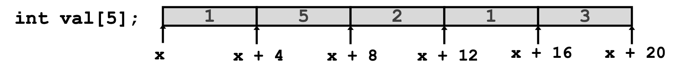
Bonus Coverage: Arrays
Good toy examples (for your cheatsheet and/or big brain):
A can be used as the pointer to the first array element: A[0]
Type Value
val
val[2]
*(val + 2)
&val[2]
val + 2
val + i

Slide 80
Bonus Coverage: Arrays
Good toy examples (for your cheatsheet and/or big brain):
A can be used as the pointer to the first array element: A[0]
Type Value
val int * x
val[2] int 2
*(val + 2) int 2
&val[2] int * x + 8
val + 2 int * x + 8
val + i int * x + (4 * i)

Slide 81
Bonus Coverage: Arrays
Good toy examples (for your cheatsheet and/or big brain):
A can be used as the pointer to the first array element: A[0]
Type Value
val int * x
val[2] int 2
*(val + 2) int 2
&val[2] int * x + 8
val + 2 int * x + 8
val + i int * x + (4 * i)
Accessing methods:
val[index]
*(val + index)

Slide 82
Bonus Coverage: Arrays
Good toy examples (for your cheatsheet and/or big brain):
A can be used as the pointer to the first array element: A[0]
Type Value
val int * x
val[2] int 2
*(val + 2) int 2
&val[2] int * x + 8
val + 2 int * x + 8
val + i int * x + (4 * i)
Accessing methods:
val[index]
*(val + index)
Addressing methods:
&val[index]
val + index

Slide 83
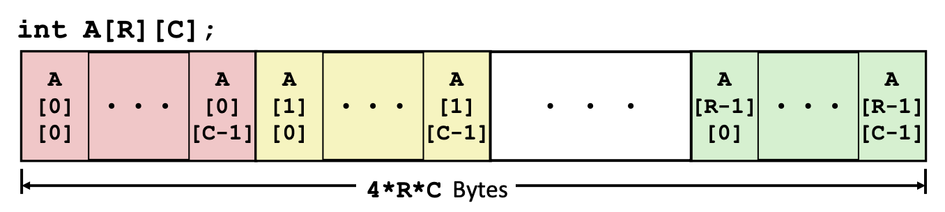
Bonus Coverage: Arrays
Nested indexing rules (for your cheatsheet and/or big brain):
Declared: T A[R][C]
Contiguous chunk of space (think of multiple arrays lined up next to each other)

Slide 84
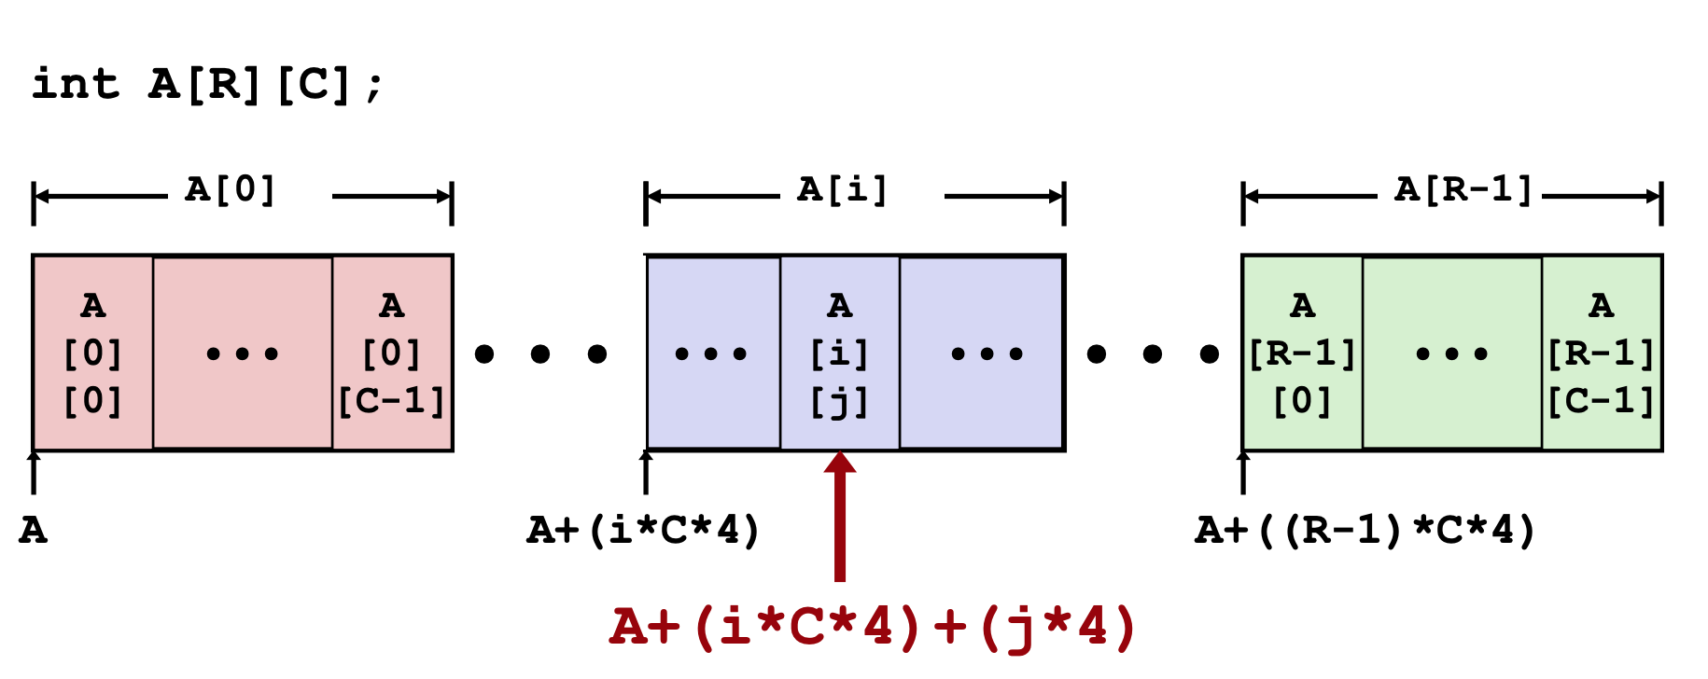
Bonus Coverage: Arrays
Nested indexing rules (for your cheatsheet and/or big brain):
Arranged in ROW-MAJOR ORDER - think of row vectors
A[i] is an array of C elements (“columns”) of type T

Slide 85
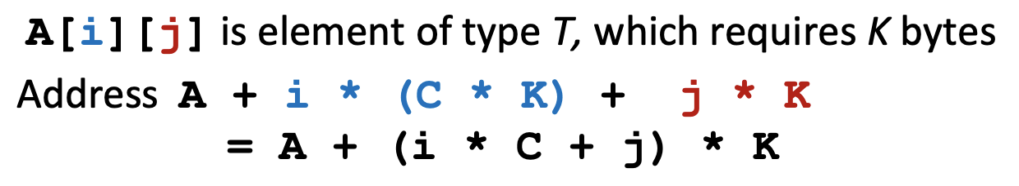
Bonus Coverage: Arrays
Nested indexing rules (for your cheatsheet and/or big brain):

Slide 86
Bonus Coverage: Arrays
Consider accessing elements of A….
Compiles Bad Deref? Size (bytes)
int A1[3][5]
int *A2[3][5]
int (*A3)[3][5]
int *(A4[3][5])
int (*A5[3])[5]

Slide 87
Bonus Coverage: Arrays
Consider accessing elements of A….
Compiles Bad Deref? Size (bytes)
int A1[3][5] Y N 3*5*4 = 60
int *A2[3][5]
int (*A3)[3][5]
int *(A4[3][5])
int (*A5[3])[5]

Slide 88
Bonus Coverage: Arrays
Consider accessing elements of A….
Compiles Bad Deref? Size (bytes)
int A1[3][5] Y N 3*5*(4) = 60
int *A2[3][5] Y N 3*5*(8) = 120
int (*A3)[3][5]
int *(A4[3][5])
int (*A5[3])[5]

Slide 89
Bonus Coverage: Arrays
Consider accessing elements of A….
Compiles Bad Deref? Size (bytes)
int A1[3][5] Y N 3*5*(4) = 60
int *A2[3][5] Y N 3*5*(8) = 120
int (*A3)[3][5] Y N 1*8 = 8
int *(A4[3][5])
int (*A5[3])[5]

Slide 90
Bonus Coverage: Arrays
Consider accessing elements of A….
Compiles Bad Deref? Size (bytes)
int A1[3][5] Y N 3*5*(4) = 60
int *A2[3][5] Y N 3*5*(8) = 120
int (*A3)[3][5] Y N 1*8 = 8
int *(A4[3][5]) Y N 3*5*(8) = 120
int (*A5[3])[5]
A4 is a pointer to a 3x5 (int *) element array

Slide 91
Bonus Coverage: Arrays
Consider accessing elements of A….
Compiles Bad Deref? Size (bytes)
int A1[3][5] Y N 3*5*(4) = 60
int *A2[3][5] Y N 3*5*(8) = 120
int (*A3)[3][5] Y N 1*8 = 8
int *(A4[3][5]) Y N 3*5*(8) = 120
int (*A5[3])[5] Y N 3*8 = 24
A5 is an array of 3 elements of type (int *)

Slide 92
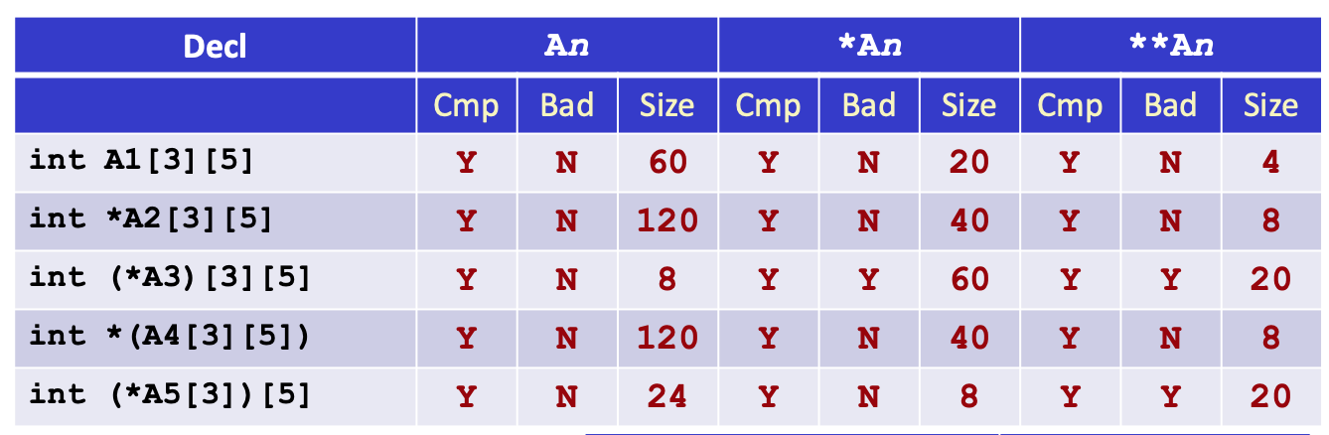
Bonus Coverage: Arrays
ex., A3: pointer to a 3x5 int array
*A3: 3x5 int array (3 * 5 elements * each 4 bytes = 60)
**A3: BAD, but means stepping inside one of 3 “rows” c

Slide 93
Bonus Coverage: Arrays
ex., A5: array of 3 (int *) pointers
*A5: 1 (int *) pointer, points to an array of 5 ints
**A5: BAD, means accessing 5 individual ints of the pointer
(stepping inside “row”)

Slide 94
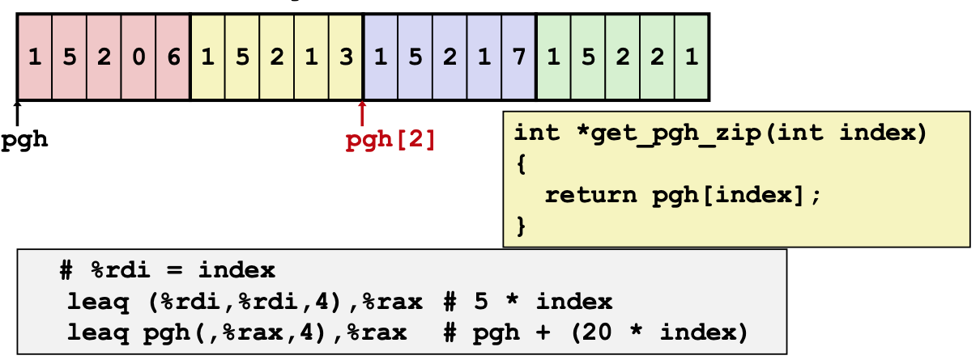
Bonus Coverage: Arrays
Sample assembly-type questions

Slide 95
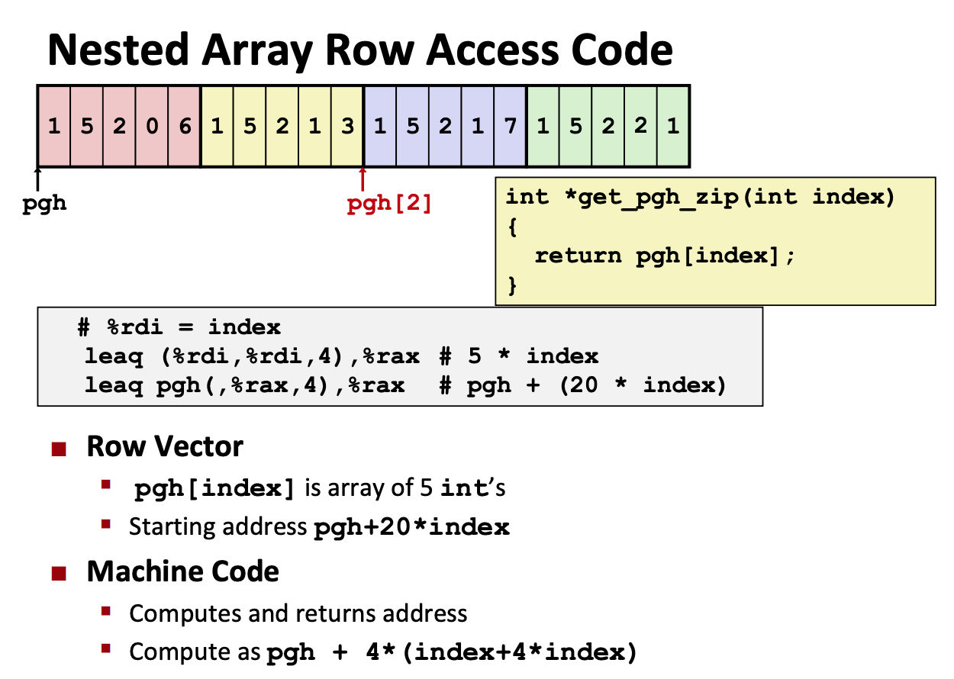
Bonus Coverage: Arrays

Slide 96
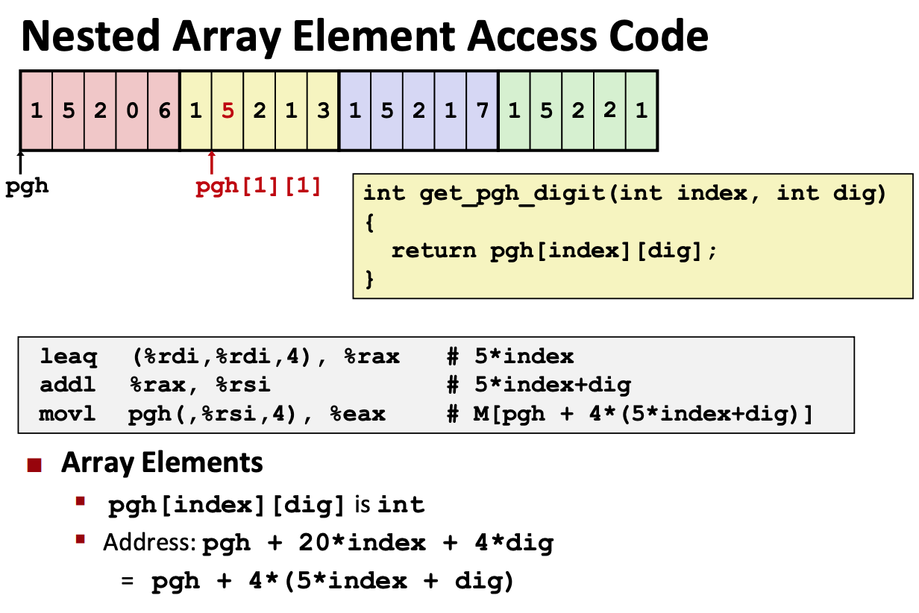
Bonus Coverage: Arrays

Slide 97
Bonus! Another Cache problem
Consider you have the following cache:
  64-byte capacity
  Directly mapped
  You have an 8-bit address space

Slide 98
Bonus!
How many tag bits are there in the cache?
  Do we know how many set bits there are? What about offset bits?
  If we have a 64-byte direct-mapped cache, we know the number of s + b bits there are total!
  Then t + s + b = 8 → t = 8 - (s + b)
  Thus, we have _________
2⁶ = 64
2 tag bits!

Slide 99
Bonus!
Fill in the following table, indicating the set number based on the hit/miss pattern.
  By the power of
guess and check
tracing through,
identify which
partition of s + b
bits matches the
H/M pattern.
Load | Binary Address | Set | H/M
1 | 1011 0011 |  | M
2 | 1010 0111 |  | M
3 | 1101 1001 |  | M
4 | 1011 1100 |  | H
5 | 1011 1001 |  | H

Slide 100
Bonus!
Fill in the following table, indicating the set number based on the hit/miss pattern.
  By the power of
guess and check
tracing through,
identify which
partition of s + b
bits matches the
H/M pattern.
Load | Binary Address | Set | H/M
1 | 1011 0011 |  | M
2 | 1010 0111 |  | M
3 | 1101 1001 |  | M
4 | 1011 1100 |  | H
5 | 1011 1001 |  | H

Slide 101
Bonus!
Fill in the following table, indicating the set number based on the hit/miss pattern.
  By the power of
guess and check
tracing through,
identify which
partition of s + b
bits matches the
H/M pattern.
Load | Binary Address | Set | H/M
1 | 1011 0011 |  | M
2 | 1010 0111 |  | M
3 | 1101 1001 |  | M
4 | 1011 1100 |  | H
5 | 1011 1001 |  | H

Slide 102
Bonus!
Fill in the following table, indicating the set number based on the hit/miss pattern.
  By the power of
guess and check
tracing through,
identify which
partition of s + b
bits matches the
H/M pattern.
Load | Binary Address | Set | H/M
1 | 1011 0011 | 3 | M
2 | 1010 0111 | 2 | M
3 | 1101 1001 | 1 | M
4 | 1011 1100 | 3 | H
5 | 1011 1001 | 3 | H

Slide 103
Bonus!
How many sets are there? 2 bits → 4 sets
How big is each cache line? 4 bits → 16 bytes

Slide 104
In summary...
Read the write-up textbook!
Also read the write-up lecture slides!
Midterm covers CS:APP Ch. 1-3, 6
Ask questions on Piazza! For the midterm, make them public and specific if from the practice server!
G~O~O~D~~L~U~C~K (also go Knicks)

