Slide 1
Autotuning and ECE Computing Infrastructure
18-613: Foundations of Computer Systems 9th Lecture, April 18, 2019
Instructor:
Franz Franchetti

Slide 2
Outline
Autotuning
ECE software
Andrew software
PSC software
Computing infrastructure

Slide 3
Programmer Demographics
Black Belt Programmer
Performance libraries, device drivers
C, Assembly, low-level tricks
Goal: performance above all
Software engineers
Large applications
C++, Java, C#
Goal: Maintenance vs. performance
Average programmers
Small ad-hoc applications
C, C++, Java, Perl, Python
Goal: implement their algorithm quickly
Notes:
3

Slide 4
Compilers: The Fundamental Problem
Matrix-matrix multiplication
for i=1:N
for j=1:N
for k=1:N
C[i,j] += A[i,k]*B[k,j]
+=

Tiled matrix-matrix multiplication
for i=1:NB:N
for j=1:NB:N
for k=1:NB:N
for i0=i:NU:i+NB
for j0=j:NU:j+NB
for k0=k:NU:k+NB
for k00=k0:1:k0+NU
for j00=j0:1:j0+NU
for i00=i0:1:i0+NU
C[i00,j00] +=
A[i00,k00]*B[k00,j00]
+=

Problem: which transformation order? What parameter values?
Notes:
4

Slide 5
How to Overcome Compiler Limitations?
Autotuning Write parameterized program and empirically find good parameters
Program generation Automatically generate big basic blocks and special case code
+=

Parameter: tile size, levels
for (i = 0; i < 4; i++)
A[i] = B[i] * C[i];
A[0] = B[0] * C[0];
A[1] = B[1] * C[1];
A[2] = B[2] * C[2];
A[3] = B[3] * C[3];
Parameter: which loop, unroll factor
Notes:
5

Slide 6
Autotuning: From Simple to “Really Hard”
Level 0: simple C program implements the algorithm cleanly
Level 1: C macros plus search script use C preprocessor for meta-programming
Level 2: scripting for code specialization text-based program generation, e.g., ATLAS
Level 3: add compiler technology internal code representation, e.g., FFTW’s genfft
Level 4: synthesize the program from scratch high level representation, e.g., TCE and Spiral
Notes:
Productive code when port to another machine
Search mechanism
Better sol than trying out all
Framwork first
Can do through search
But more smart ones
Arch is not exact
Extract degree of freedom
Interaction of parameters is non-trivial
Can guess, but not scale to new arch..
How to automate search space of auto-tunig
Heavily parameterized framework
Parameter space? stability?
Happy that space is not too different

Slide 7
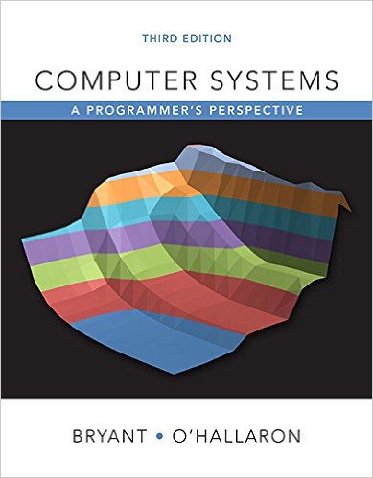
Step 1: Basic C Level Optimizations
Level 0: simple C program implements the algorithm cleanly
Level 1: C macros plus search script use C preprocessor for meta-programming
http://www.cs.cmu.edu/afs/cs/academic/class/15213-s12/www/
Notes:
7

Slide 8
Unrolling & Accumulating: Double *
Case
Intel Haswell
Double FP Multiplication
Latency bound: 5.00. Throughput bound: 0.50
FP * | Unrolling Factor L
K | 1 | 2 | 3 | 4 | 6 | 8 | 10 | 12
1 | 5.01 | 5.01 | 5.01 | 5.01 | 5.01 | 5.01 | 5.01
2 |  | 2.51 |  | 2.51 |  | 2.51
3 |  |  | 1.67
4 |  |  |  | 1.25 |  | 1.26
6 |  |  |  |  | 0.84 |  |  | 0.88
8 |  |  |  |  |  | 0.63
10 |  |  |  |  |  |  | 0.51
12 |  |  |  |  |  |  |  | 0.52
Accumulators
Bryant and O’Hallaron, Computer Systems: A Programmer’s Perspective, Third Edition

Slide 9
Autotuning: From Simple to “Really Hard”
Level 0: simple C program implements the algorithm cleanly
Level 1: C macros plus search script use C preprocessor for meta-programming
Level 2: scripting for code specialization text-based program generation, e.g., ATLAS
Level 3: add compiler technology internal code representation, e.g., FFTW’s genfft
Level 4: synthesize the program from scratch high level representation, e.g., TCE and Spiral
Notes:
Productive code when port to another machine
Search mechanism
Better sol than trying out all
Framwork first
Can do through search
But more smart ones
Arch is not exact
Extract degree of freedom
Interaction of parameters is non-trivial
Can guess, but not scale to new arch..
How to automate search space of auto-tunig
Heavily parameterized framework
Parameter space? stability?
Happy that space is not too different

Slide 10
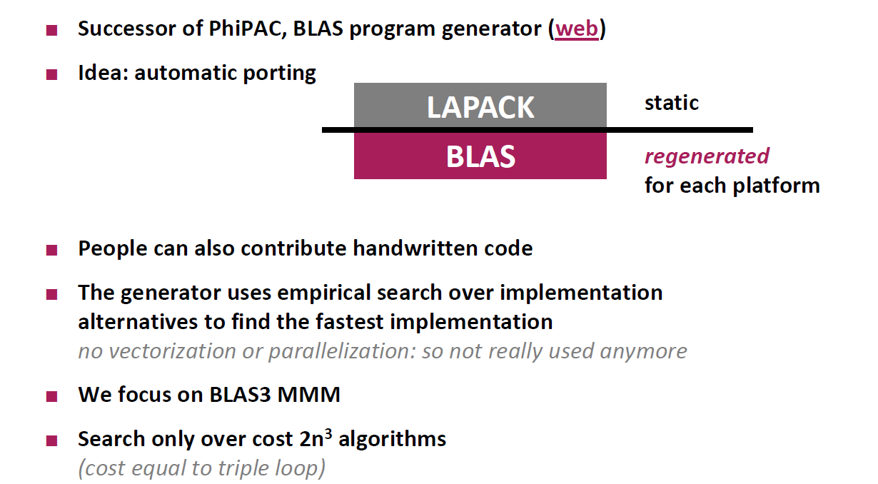
ATLAS: Code Generation for MMM
Source: Markus Püschel, ETH Zürich: How to Write Fast Numerical Code, 2011 https://www.inf.ethz.ch/personal/markusp/teaching/263-2300-ETH-spring11/course.html
Notes:
Productive code when port to another machine
Search mechanism
Better sol than trying out all
Framwork first
Can do through search
But more smart ones
Arch is not exact
Extract degree of freedom
Interaction of parameters is non-trivial
Can guess, but not scale to new arch..
How to automate search space of auto-tunig
Heavily parameterized framework
Parameter space? stability?
Happy that space is not too different

Slide 11
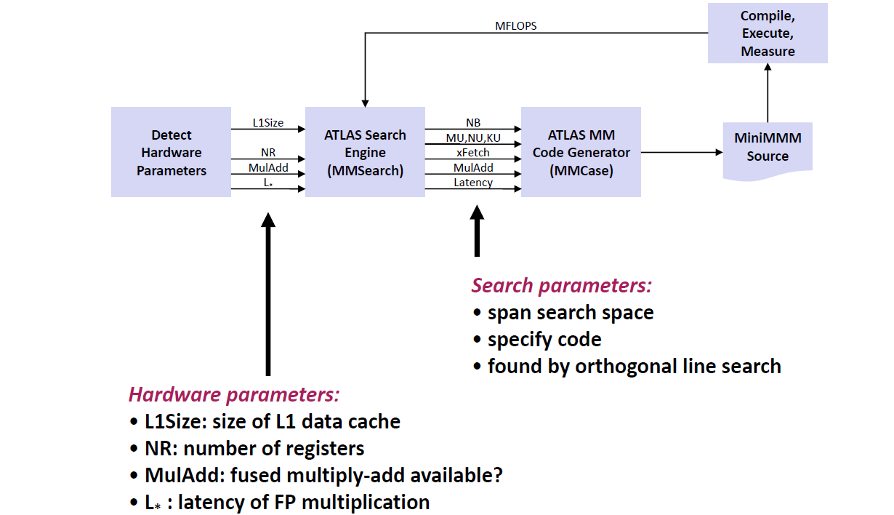
ATLAS: Architecture
Source: Markus Püschel, ETH Zürich: How to Write Fast Numerical Code, 2011 https://www.inf.ethz.ch/personal/markusp/teaching/263-2300-ETH-spring11/course.html
Notes:
Productive code when port to another machine
Search mechanism
Better sol than trying out all
Framwork first
Can do through search
But more smart ones
Arch is not exact
Extract degree of freedom
Interaction of parameters is non-trivial
Can guess, but not scale to new arch..
How to automate search space of auto-tunig
Heavily parameterized framework
Parameter space? stability?
Happy that space is not too different

Slide 12
Autotuning: From Simple to “Really Hard”
Level 0: simple C program implements the algorithm cleanly
Level 1: C macros plus search script use C preprocessor for meta-programming
Level 2: scripting for code specialization text-based program generation, e.g., ATLAS
Level 3: add compiler technology internal code representation, e.g., FFTW’s genfft
Level 4: synthesize the program from scratch high level representation, e.g., TCE and Spiral
Notes:
Productive code when port to another machine
Search mechanism
Better sol than trying out all
Framwork first
Can do through search
But more smart ones
Arch is not exact
Extract degree of freedom
Interaction of parameters is non-trivial
Can guess, but not scale to new arch..
How to automate search space of auto-tunig
Heavily parameterized framework
Parameter space? stability?
Happy that space is not too different

Slide 13
Example FFT: Recursive FFT Algorithm

Slide 14
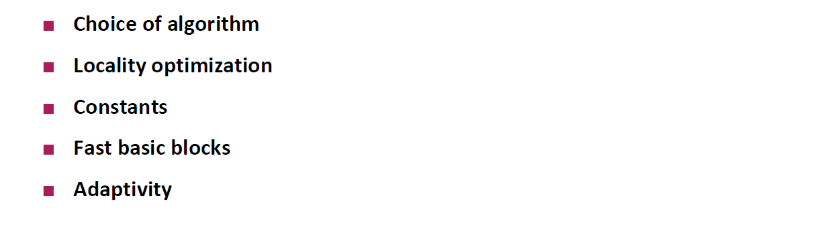
FFTW: Compiler and Autotuner for FFTs
FFTW
Library infrastructure
Recursive functions needed
Vectorization (partially)
Threading
Adaptation mechanism (plan)
Codelet generator
Codelets
(10–20 types)
2
3
4
5
6
32
64
Source: Markus Püschel, ETH Zürich: How to Write Fast Numerical Code, 2011 https://www.inf.ethz.ch/personal/markusp/teaching/263-2300-ETH-spring11/course.html
Notes:
Productive code when port to another machine
Search mechanism
Better sol than trying out all
Framwork first
Can do through search
But more smart ones
Arch is not exact
Extract degree of freedom
Interaction of parameters is non-trivial
Can guess, but not scale to new arch..
How to automate search space of auto-tunig
Heavily parameterized framework
Parameter space? stability?
Happy that space is not too different

Slide 15
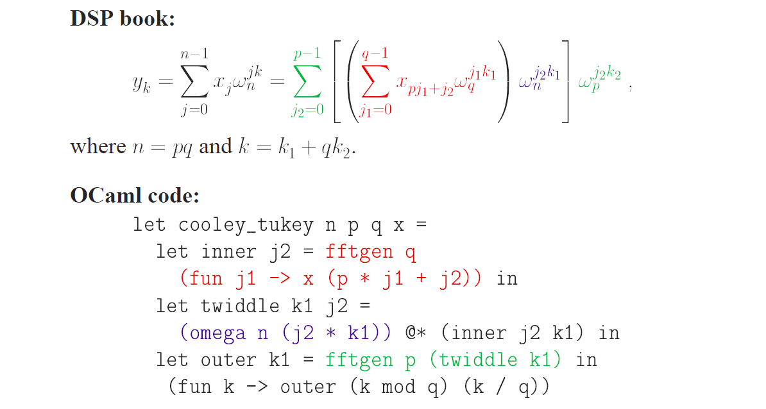
FFTW: genfft and the Cooley Tukey FFT
Source: Matteo Frigo: “A Fast Fourier Transform Compiler,” In Proceedings ACM PLDI 1999 http://www.fftw.org/pldi99-slides.ps.gz
Notes:
Productive code when port to another machine
Search mechanism
Better sol than trying out all
Framwork first
Can do through search
But more smart ones
Arch is not exact
Extract degree of freedom
Interaction of parameters is non-trivial
Can guess, but not scale to new arch..
How to automate search space of auto-tunig
Heavily parameterized framework
Parameter space? stability?
Happy that space is not too different

Slide 16
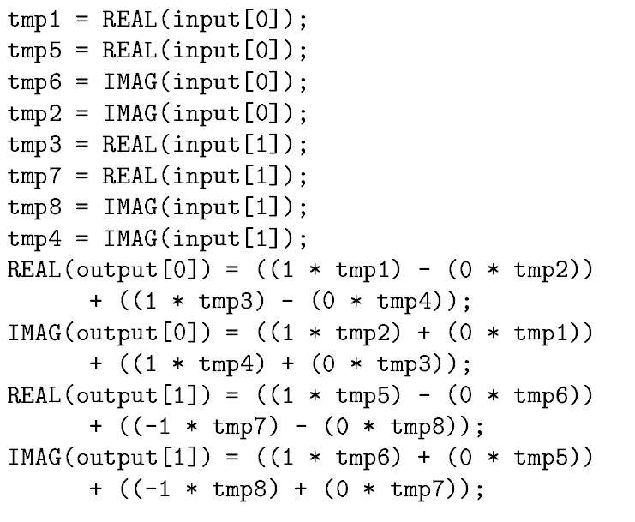
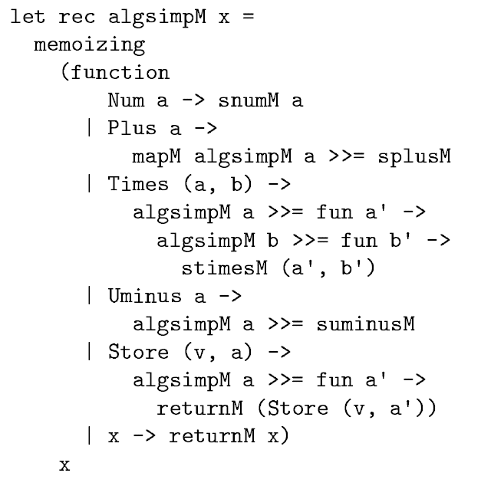
FFTW: genfft at Work
2-point FFT
Algebraic Simplification
Source: Matteo Frigo: “A Fast Fourier Transform Compiler,” In Proceedings ACM PLDI 1999 http://www.fftw.org/pldi99.pdf
Notes:
Productive code when port to another machine
Search mechanism
Better sol than trying out all
Framwork first
Can do through search
But more smart ones
Arch is not exact
Extract degree of freedom
Interaction of parameters is non-trivial
Can guess, but not scale to new arch..
How to automate search space of auto-tunig
Heavily parameterized framework
Parameter space? stability?
Happy that space is not too different

Slide 17
Autotuning: From Simple to “Really Hard”
Level 0: simple C program implements the algorithm cleanly
Level 1: C macros plus search script use C preprocessor for meta-programming
Level 2: scripting for code specialization text-based program generation, e.g., ATLAS
Level 3: add compiler technology internal code representation, e.g., FFTW’s genfft
Level 4: synthesize the program from scratch high level representation, e.g., TCE and Spiral
Notes:
Productive code when port to another machine
Search mechanism
Better sol than trying out all
Framwork first
Can do through search
But more smart ones
Arch is not exact
Extract degree of freedom
Interaction of parameters is non-trivial
Can guess, but not scale to new arch..
How to automate search space of auto-tunig
Heavily parameterized framework
Parameter space? stability?
Happy that space is not too different

Slide 18
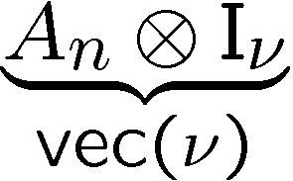
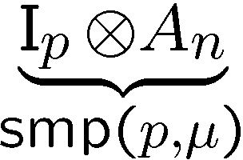
Spiral’s Domain-Specific Program Synthesis
Model: common abstraction
= spaces of matching formulas
abstraction
abstraction
νp
μ
defines
rewriting
search
pick
architecture
space
algorithm
space
Architectural parameter:
Vector length,
#processors, …
optimization
Kernel:
problem size,
algorithm choice

Slide 19
How Spiral Works
Problem specification (“DFT 1024” or “DFT”)
Complete automation of the implementation and optimization task
Basic ideas:
Declarative representation of algorithms
Rewriting systems to generate and optimize algorithms at a high level of abstraction
controls
Algorithm Generation
Algorithm Optimization
algorithm
controls
Implementation
Search
Code Optimization
C code
Compilation
performance
Compiler Optimizations
Spiral
Fast executable

Slide 20
Autotuning: From Simple to “Really Hard”
Level 0: simple C program implements the algorithm cleanly
Level 1: C macros plus search script use C preprocessor for meta-programming
Level 2: scripting for code specialization text-based program generation, e.g., ATLAS
Level 3: add compiler technology internal code representation, e.g., FFTW’s genfft
Level 4: synthesize the program from scratch high level representation, e.g., TCE and Spiral
Notes:
Productive code when port to another machine
Search mechanism
Better sol than trying out all
Framwork first
Can do through search
But more smart ones
Arch is not exact
Extract degree of freedom
Interaction of parameters is non-trivial
Can guess, but not scale to new arch..
How to automate search space of auto-tunig
Heavily parameterized framework
Parameter space? stability?
Happy that space is not too different

Slide 21
Outline
Autotuning
ECE software
Andrew software
PSC software
Computing infrastructure

Slide 22
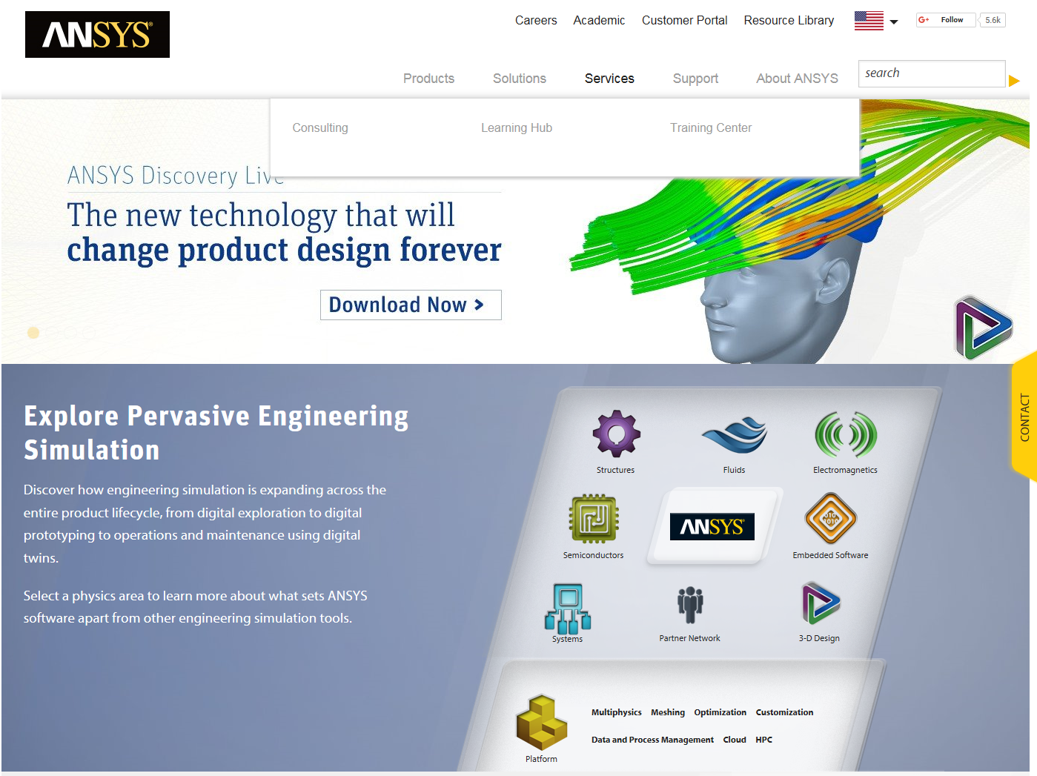
http://www.ansys.com/

Slide 23
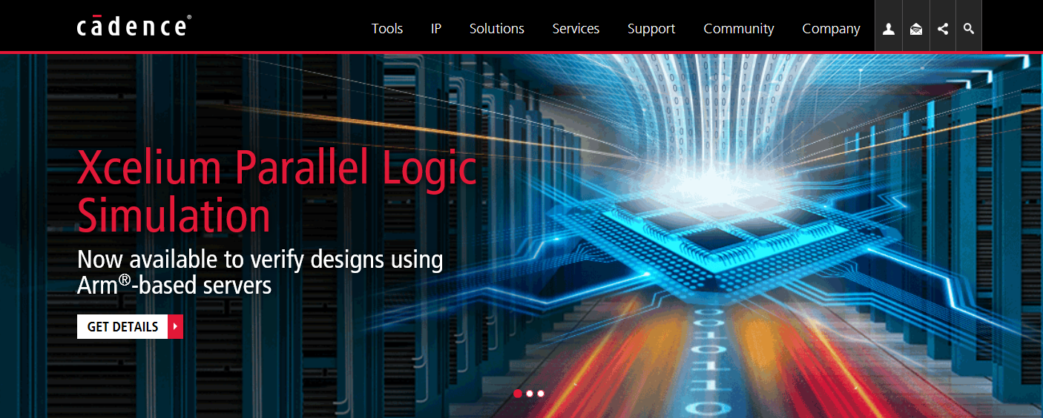
Cadence
https://www.cadence.com/

Slide 24
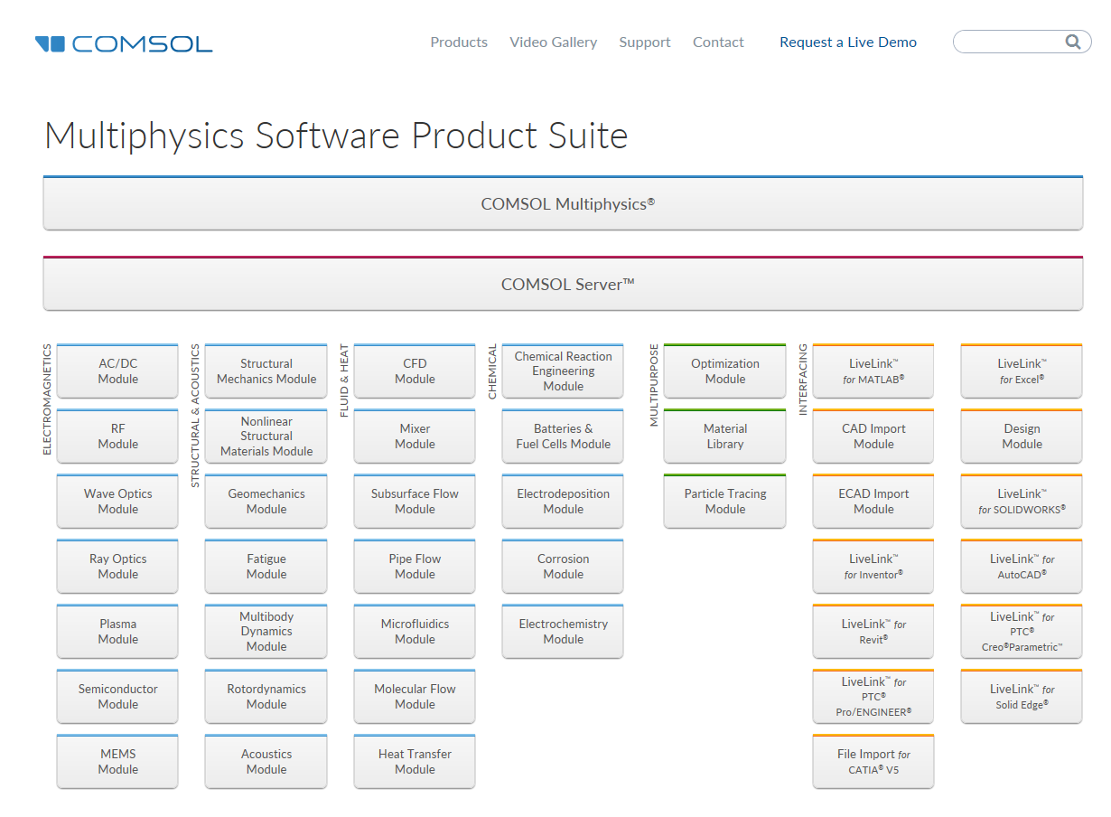
https://www.comsol.com/

Slide 25
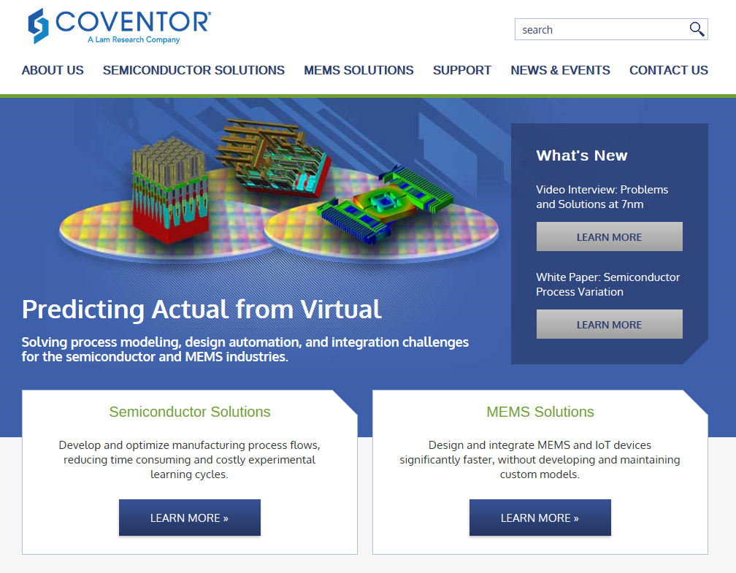
http://www.coventor.com/

Slide 26
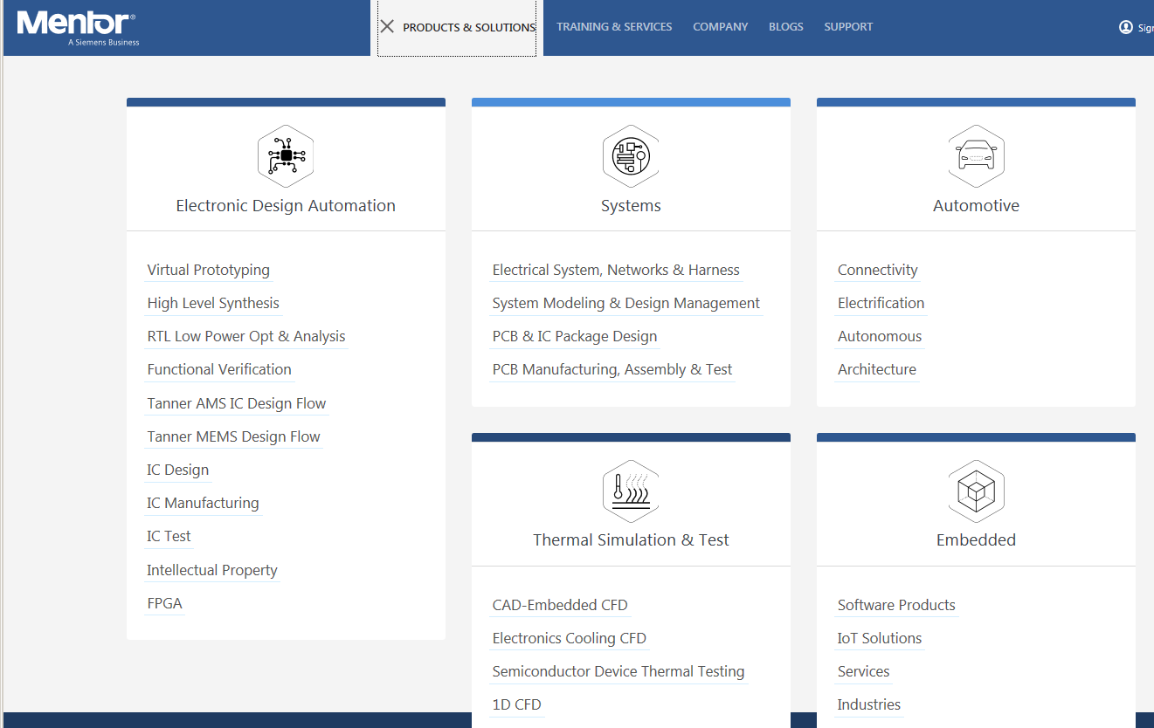
https://www.mentor.com/

Slide 27
Outline
Autotuning
ECE software
Andrew software
PSC software
Computing infrastructure

Slide 28
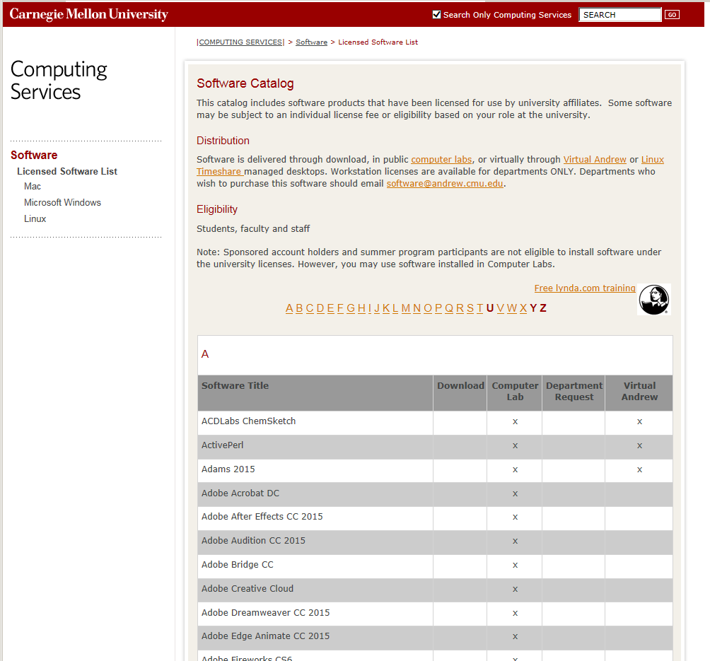
Andrew Software
https://www.cmu.edu/computing/software/all/
SPSS
IMSL
Maple
Mathematica
Matlab
SAS
S-PLUS
Wolfram Alpha
R/R Studio
Python
MySQL, MS SQL Server, PostgreSQL

Slide 29
Outline
Autotuning
ECE software
Andrew software
PSC software
Computing infrastructure

Slide 30
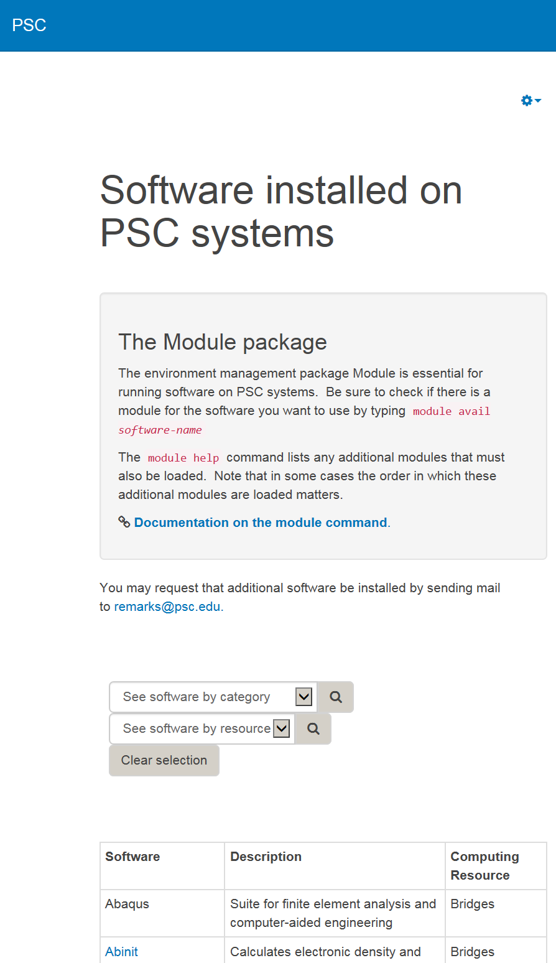
PSC Software
https://www.psc.edu/resources/software
Abaqus (finite elements)
Abinit (density functional theory)
Anaconda (data science platform)
ANSYS
BLAST (protein sequence alignment)
Caffe (deep learning)
CFOUR (computational chemistry)
Chainer (neural nets)
Desmond (molecular dynamics)
DReAMM (MCell simulation)

Slide 31
PSC Software (2)
GAMESS (ab initio quantum chemistry)
Gurobi (optimization system)
Julia (programming language)
Keras (neural networks, on top of Theano and TensorFlow)
LevelDB (key-value store)
LS-DYNA (finite element program)
Mathematica, Matlab, R
MCell (Monte Carlo cell simulation)
MCT (library for creating coupled models)
MUMPS (solver for large linear systems)
SuperLU (solves sparse linear systems)

Slide 32
PSC Software (3)
NAMD, NWCHEM, LAMMPS, CHARMM, CFOUR, Quantum Espresso, SIESTA,
OpenCV (computer vision)
PETSc (PDE solver)
Python, Spark, TensorFlow, Theano, Torch
PyTorch (deep learning)
Scikit-learn (data mining)
SCOTCH (graph partitioning and clustering)

Slide 33
Outline
Autotuning
ECE software
Andrew software
PSC software
Computing infrastructure

Slide 34
Outline
Personal Computing
CMU Andrew Computing
ECE Physical Spaces
ECE Compute Clusters
ECE Data Science Cloud
ECE HTCondor
CIT Partnerships
PSC Bridges
XSEDE Project
Cloud Providers

Slide 35

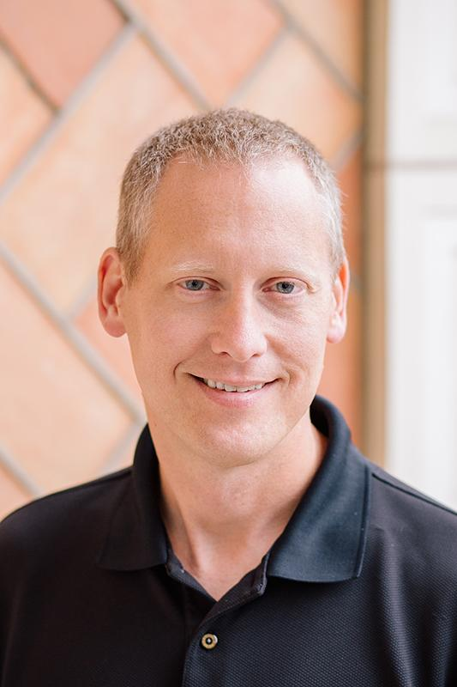
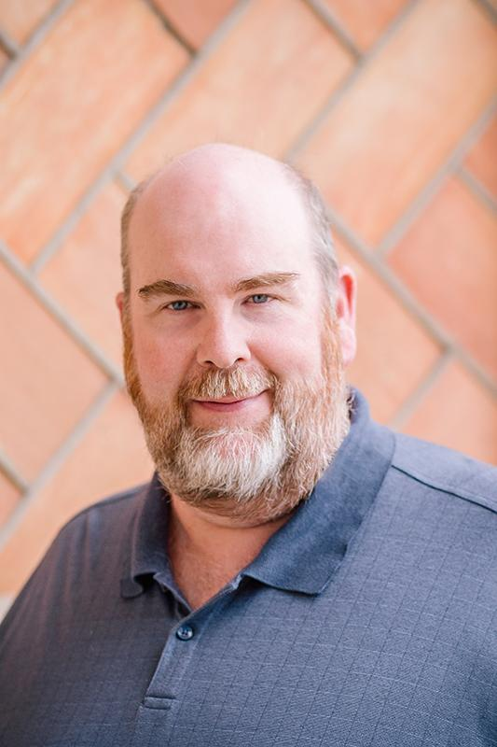
Introductions
Dan Fassinger
Executive Manager
ECE IT Services
Jim McKinney
Data Center Manager
ECE IT Services
Hours: M-F 8a-5p
Location:
Hamerschlag Hall A200 suites
Docs and resources: https://userguide.its.cit.cmu.edu/
Email: help@ece.cmu.edu

Slide 36

Computing Options: Personal Computing
Personal computer (2018)
Laptop or desktop
Intel Core i5/i7 w/ HT, 2-4 cores
8GB to 64GB DDR4
500GB SSD
Integrated graphics (Intel HD or Iris)
1GB LAN / 802.11ac WLAN
Typical programs and problem sets
Personal productivity, internet browser
Development workflow tools
Concept testing and simulation
Notes:
Benefits:
Control of environment, agility
Sole use of resources, no contention with other users
Limiting factors
Network I/O – 700Mbps at best with reliability issues
Power – limited battery capacity
Mostly single threaded applications, additional cores are idle
Memory bandwidth
Disk capacity
Conflicting software, resource contention (email, cloud sync, Matlab, Excel)
Data safety (malware, hardware failure)
Collaboration with others is manual and error prone
Software licensing – seats are costly

Slide 37
Computing Options CMU Andrew Computing
Public Clusters
Workstation or Desktop
Most University software installed
Virtual Andrew
VMWare Horizon Client (VDI)
Cluster software accessible remotely
Linux Timeshares
SSH and X-session
Restarted nightly
Campus Cloud
SaaS, PaaS w/ fee ($$)
Guest VM instance with managed environment
Ready to use
Prepared and managed for you
Good for productivity or moving small data
Comparable or worse performance compared to personal laptop
Rental capacity
Personal server w/o physical responsibility
Notes:
Variations on a theme – prepared computing, much like prepared food
Can be drive-through, fast, sit-down, but all managed and handled by someone else
Spontaneous changes outside sandbox not possible

Slide 38
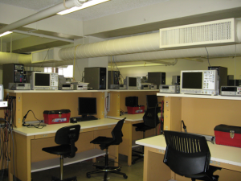
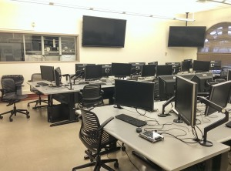
Computing Options: ECE Physical Spaces
Ugrad/grad labs
HH 1303, 1204, A101, A104 – Equipment stations
Linux cluster/lab
HH 1305
Workstation class systems
Capstone Lab
HH 1307
Teaching space (ex. 18-240 18-100)
GPU SDK, LabView
Console access for graphical Linux simulations (EDA and FEA tools)
All require cardkey access
Notes:
EDA – Electronic Design Automation
Examples – Cadence, Synopsys
FEA – Finite Element Analysis
Examples – Comsol, Ansys
Be aware of lab times – long term jobs may interfere with teaching labs

Slide 39
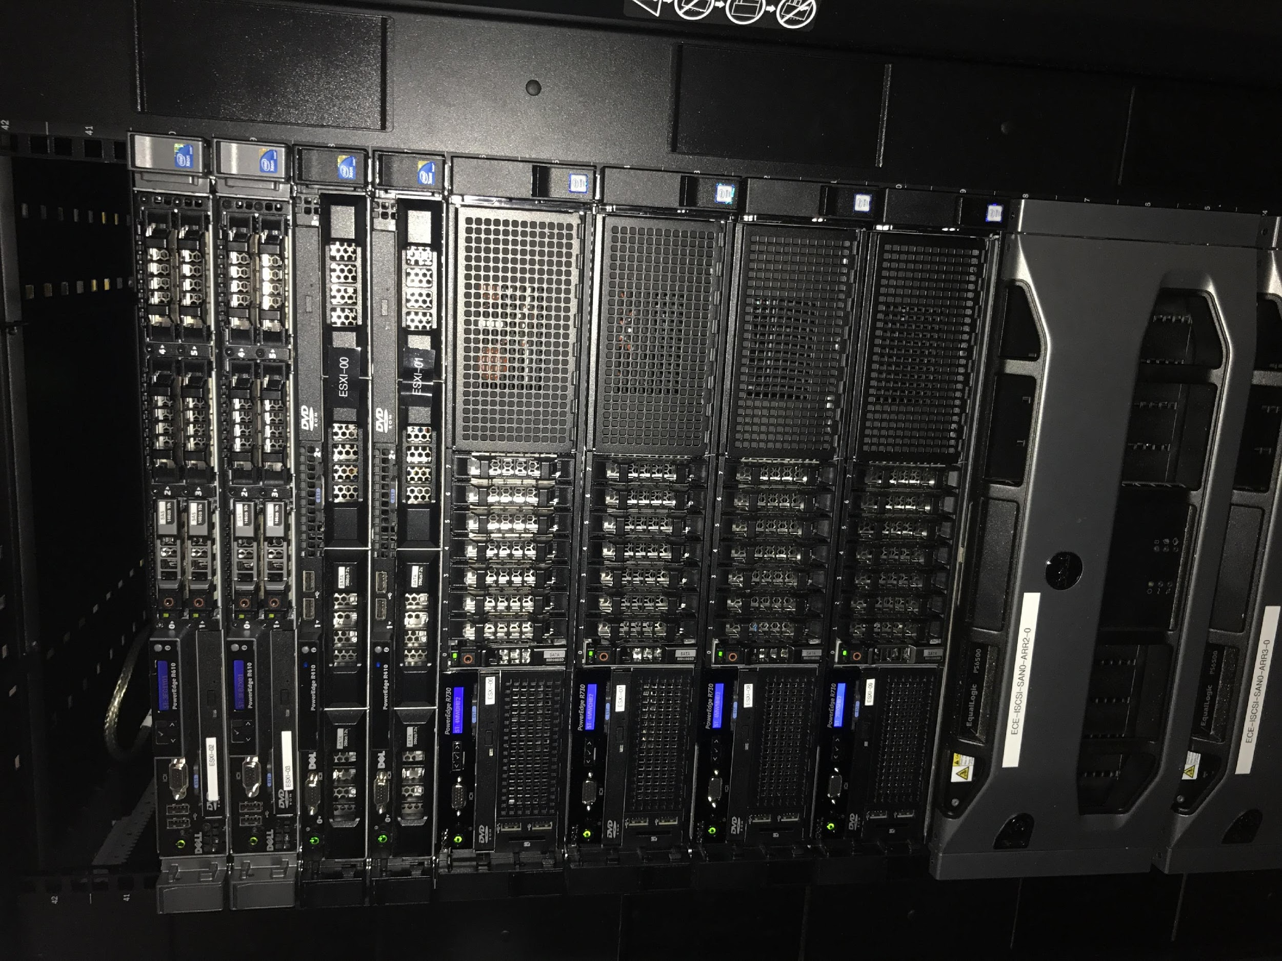
Computing Options: ECE Compute Clusters
Numbers cluster
Ece[000:031].ece.local.cmu.edu
RedHat Enteprise Linux
Condor access
Engineering software
Shared storage
GUI cluster
Ece-gui-[000-007].ece.cmu.edu
FastX or X-session for remote graphical access
PowerEdge R430
2 x Intel Xeon E5-2640 v4, 2.4GHz, 8GT/s QPI, 10 cores w/ HT
128GB 2400MT/s RDIMM
iSCSI link to SAN
Housed in Cyert Data Center
Notes:
Rules for usage
Be reasonable – this is a shared resource
Jobs needing multiple systems may need more horsepower
Graphical environment
running full GUI consumes resources
If you need a full desktop, login to HH 1305 or ECE-GUI machines and submit job to larger compute
If you use VNC, reconnect to session instead of spawning new – avoids consuming many console sessions
If machine is under load from job, talk to ITS about getting more resources instead of making the system unusable

Slide 40
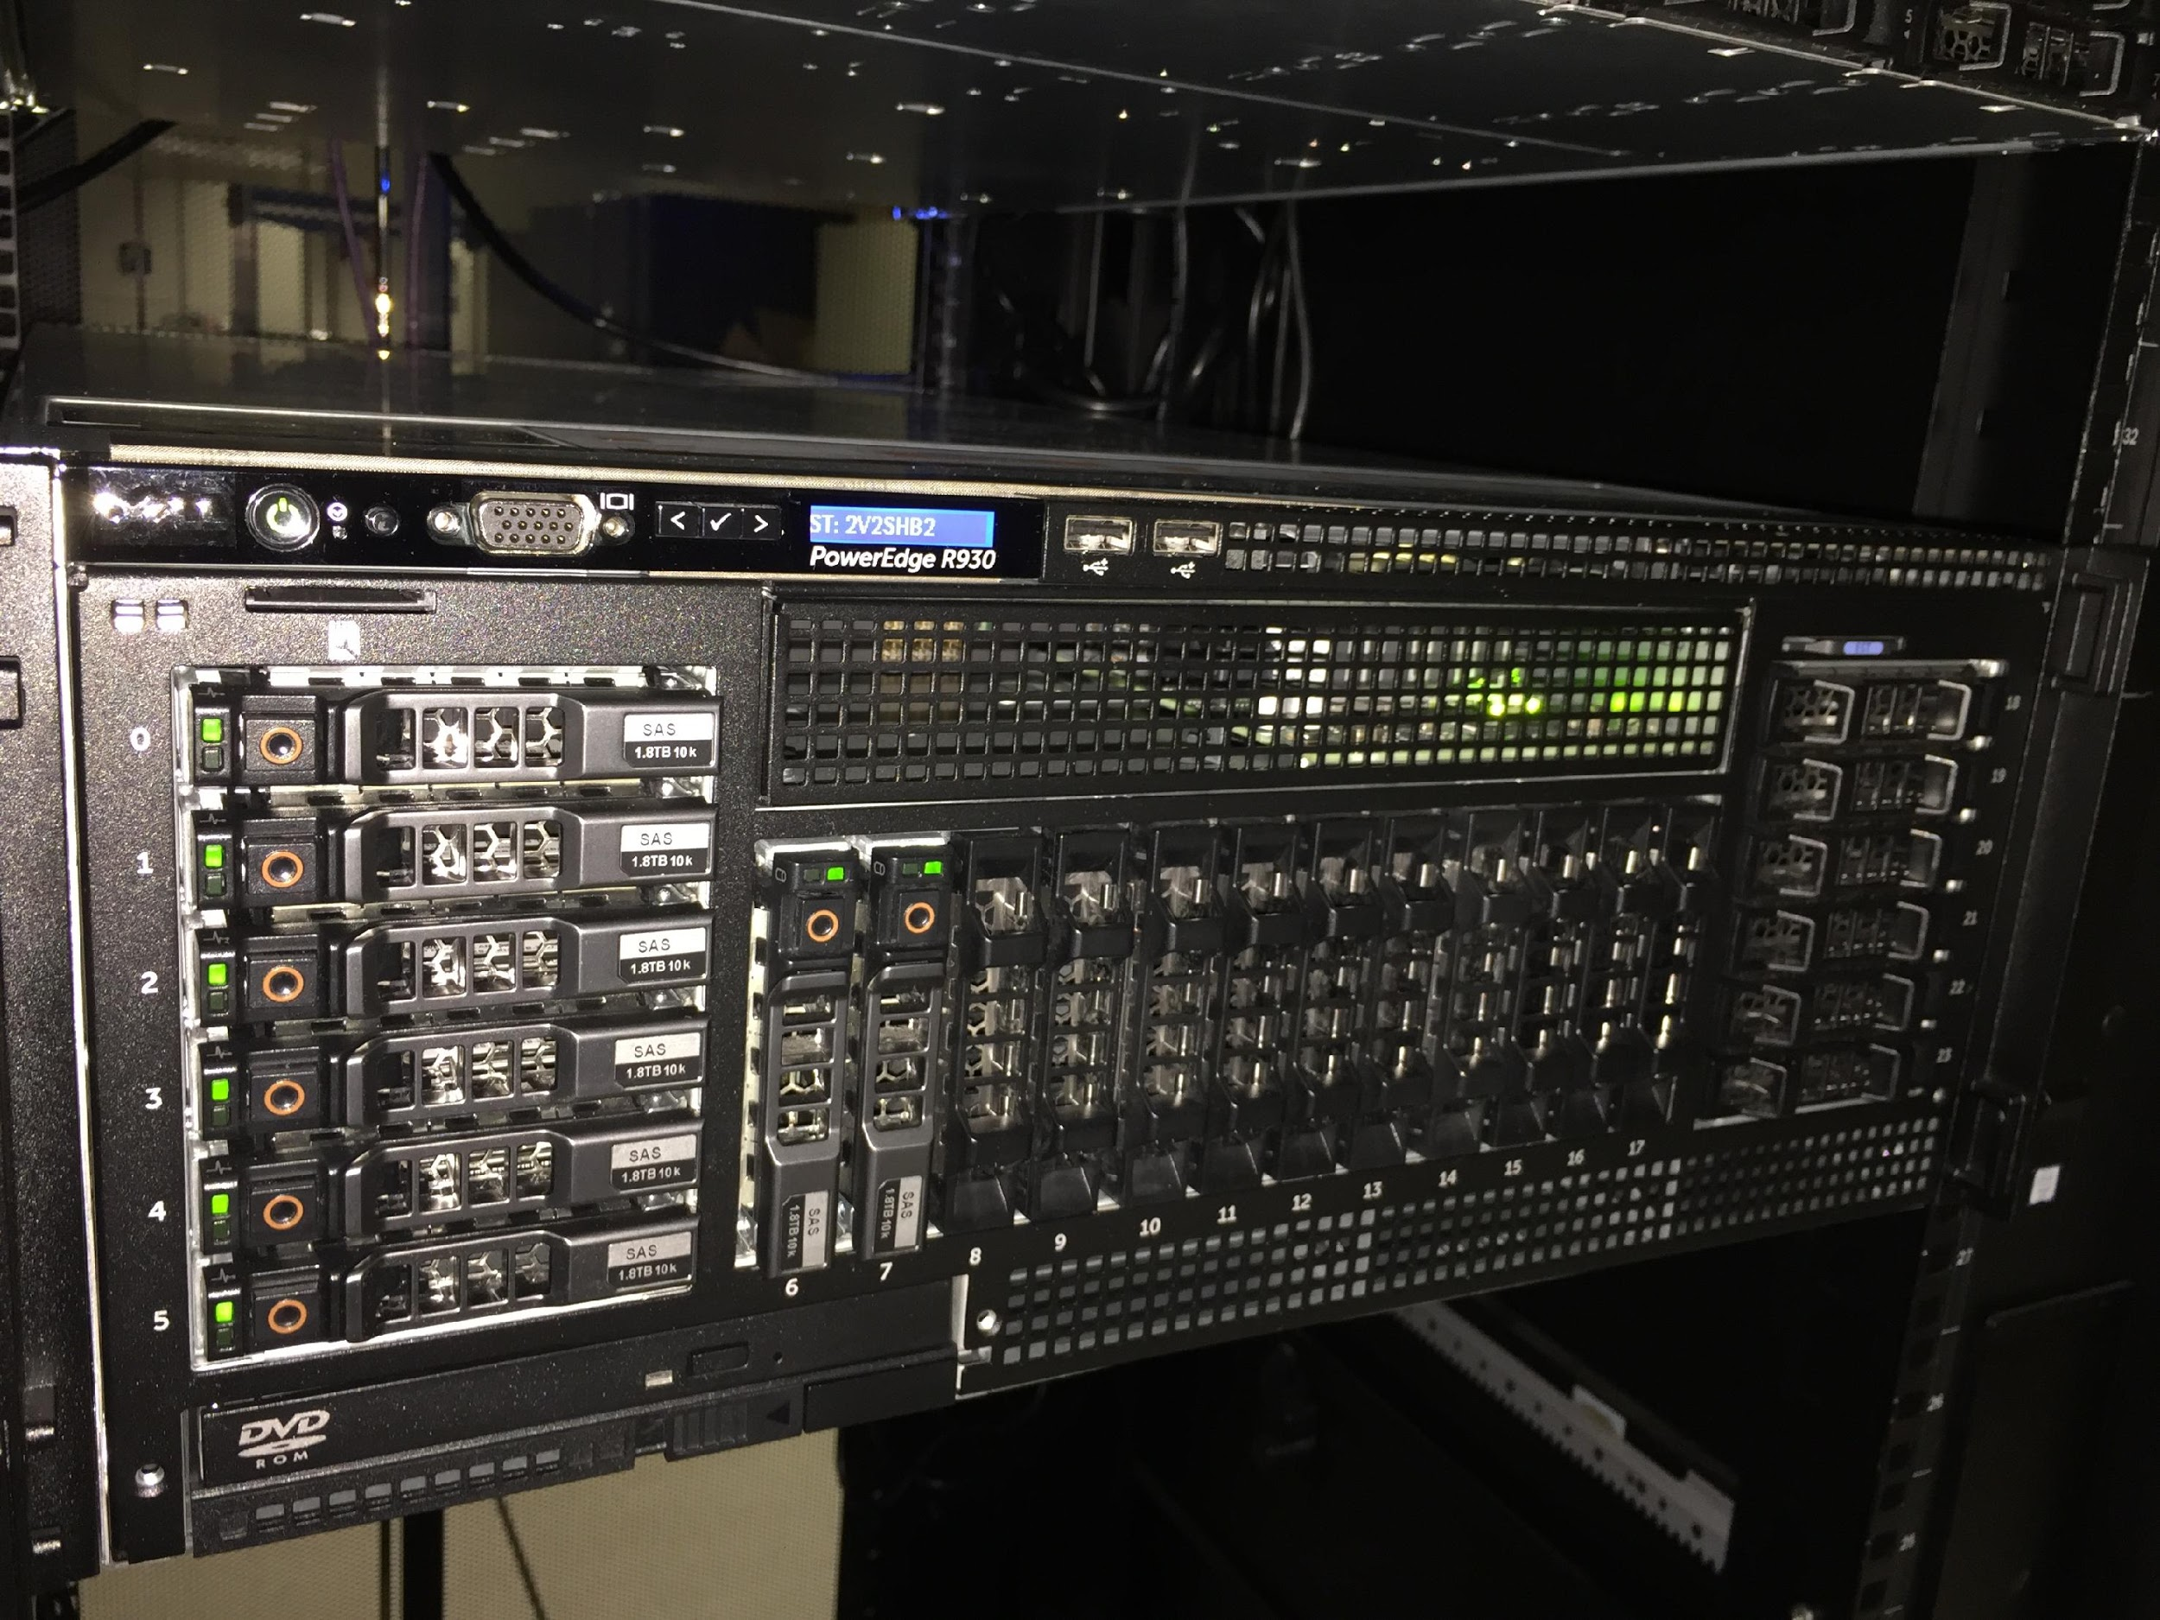
Computing Options: ECE Data Science Cloud
Large memory and GPU
Moderate sized simulations and parallel compute jobs
Customized environment
Fast storage access
10GB uplinks
PowerEdge R930
4 x Intel Xeon E7-8870 v3, 9.6GT/s QPI, 18 cores w/ HT
3TB 2133 MT/s RDIMM
PowerEdge R730
2 x Intel Xeon E5-2698 v3, 9.6GT/s QPI, 16 cores w/ HT
768GB 2133MT/s RDIMM
2 x Nvidia Tesla K80 GPU (x2)
Notes:
Access by request
This class has access
Requires conversation/justification, faculty sponsorship
All machines dedicated/bare metal
Hostnames
Dsc-[01,02,03].ece.local.cmu.edu
DSC-01 -> 3TB
DSC-02 -> GPU
DSC-03 -> 512GB

Slide 41

Computing Options: ECE HTCondor
Access via ECE Numbers Cluster
Submitting first Condor job
Prepare
Compile
Submit
Retrieve
Use with Matlab, Comsol, Cadence, std. engineering simulations
Batch submission system
Job queuing, scheduling
Serial or parallel jobs
Harness compute power of entire clusters
Notes:
Increases throughput but not latency – unable to improve huge long-running jobs
Better at repeated simulations with varying parameters
Highlights
Monitors job
Add fault tolerance – recover from failures
Flocking sends job to available resources if specified cluster is constrained
Researchers can have priority over other jobs
Job can be pre-empted by a higher priority job
Console processes have highest priority
Striking a balance
30-45 minute jobs are best
Short jobs in large quantity – too much overhead
Long jobs in small quantity – risk eviction and inefficient
Types of jobs
Write own code
Submit entire VMs
Matlab
Portable across architectures and operating systems
Can be precompiled to Java – improves performance and avoids licensing issues

Slide 42
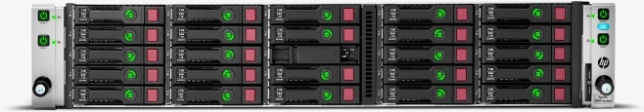
Computing Options: CIT Partnerships
Venkat Viswanathan
Co-location in PSC Monroeville data center
12 x HPE Blades
12 x XL1x0r Gen9 Intel Xeon E5-2683v4, 16 core
128GB DDR4 RAM
48 x Nvidia Tesla K80
Managed by Venkat partnership group

Slide 43
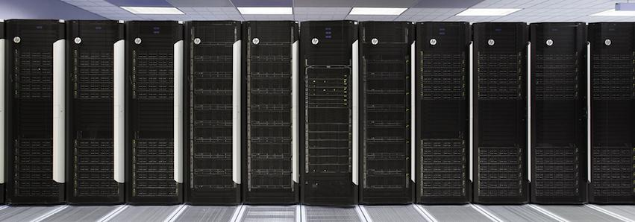
Computing Options: PSC Bridges
Hosted by Pittsburgh Supercomputing Center in Monroeville
Bridges Architecture
Bridges Virtual Tour
Large Memory Systems (3TB)
Many Nvidia GPUs
Extremely Large Memory Systems (12TB)
Slurm job scheduler

Slide 44

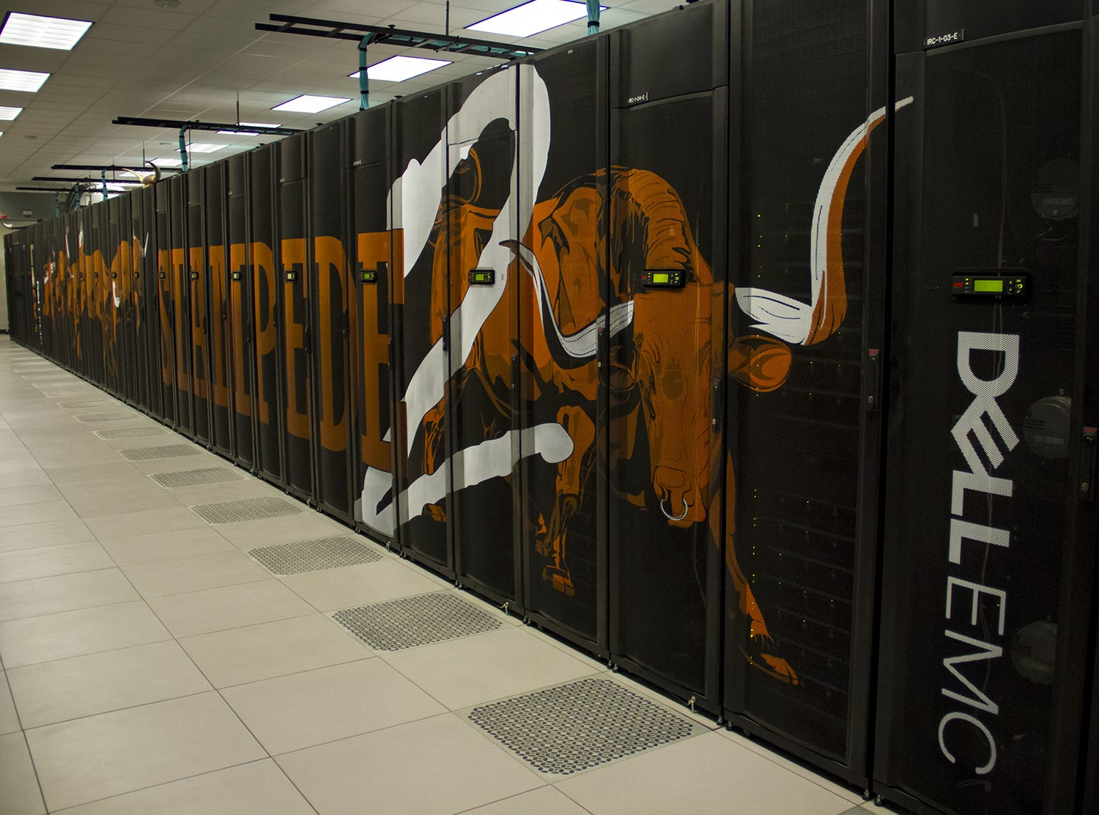
Computing Options: Xsede Project (PSC)
Xsede resources
SCSC Comet – 144 GPUs
Open Science Grid – Condor - 1000 cores avg available
JetStream – IU and TACC – ½ Petaflop
Notes:
XSEDE is a single virtual system that scientists can use to interactively share computing resources, data and expertise. People around the world use these resources and services — things like supercomputers, collections of data and new tools — to improve our planet.

Slide 45
Computing Options: Cloud Providers
Amazon AWS
https://aws.amazon.com/grants/
https://aws.amazon.com/education/awseducate/
Google Cloud Compute
https://cloud.google.com/edu/
https://lp.google-mkto.com/CloudEduGrants_Faculty.html
Microsoft Azure
https://www.microsoft.com/en-us/research/academic-programs/
https://azure.microsoft.com/en-us/free/
Notes:
https://aws.amazon.com/research-credits/
https://portal.azure.com/
https://azure.microsoft.com/en-us/pricing/details/app-service/
https://blogs.msdn.microsoft.com/education/2013/05/05/is-there-academic-pricing-for-windows-azure-no-but-theres-something-betterfree-azure/

