Slide 1
Parallelization
18-613: Foundations of Computer Systems 8th Lecture, April 9, 2019
Instructor:
Franz Franchetti

Slide 2
Outline
Example: Solving a Linear System of Equations
Parallel machine models
Algorithmic approaches
Amdahl, strong and weak scaling
CUDA
MPI, OpenMP, OpenACC

Slide 3
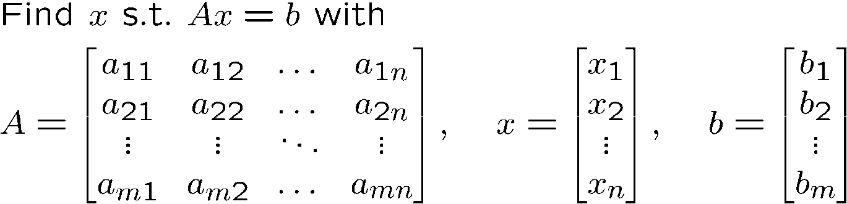

Solving a Linear System of Equations
Problem specification
Textbook approach: Gauss Elimination
Augmented matrix
Elementary row operations
Reach echelon form
Do you see any issues here?

Slide 4
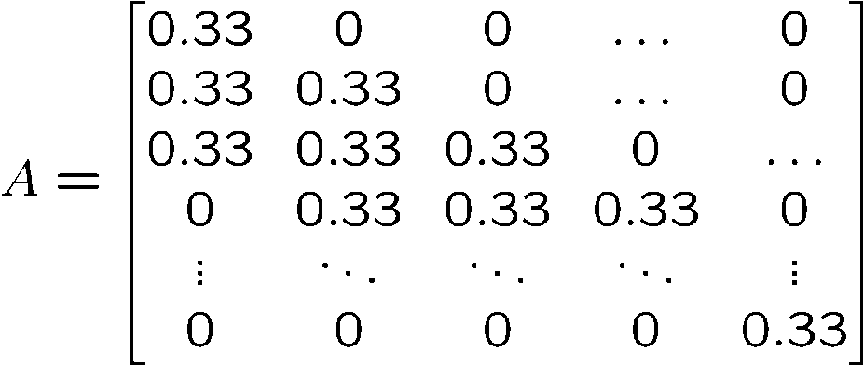
Gauss-Seidel and Jacobi Iterations
Gauss Seidel: in-place updates
Jacobi Iteration
Special case: tri-diagonal matrix
for (t=0; t<T; t++) {
for (i=1; i<N-1; i++) {
A[i] = 0.33*(A[i-1] +
A[i] + A[i+1]);
}
for (t=0; t<T; t++) {
for (i=1; i<N-1; i++) {
B[i] = 0.33*(A[i-1] + A[i] + A[i+1]);
for (i=1; i<N-1; i++)
A[i] = B[i];
}

Slide 5
Blocking: Locality and Parallelism
Representation of iteration
Trapezoidal blocking
Time iteration
Time iteration
Overhead: recomputation, data reloading/communicating

Slide 6
Better Parallelization
Prologue
Core 1
Core 2
Steady state
Data transfer between cores requires a memory fence
Epilogue

Slide 7
Outline
Example: Solving a Linear System of Equations
Parallel machine models
Algorithmic approaches
Amdahl, strong and weak scaling
CUDA
MPI, OpenMP, OpenACC

Slide 8
Distributed Memory: Clusters and MPP
Topology: memory distributed, may have central storage
Programming
Programming model: Bulk synchronous parallel
Classical/cluster: message passing (MPI)
Modern/big data: MapReduce/Hadoop
Disks can be central or local (file system can hide that)
CPU
CPU
…
CPU
memory
memory
memory

Slide 9
Shared Memory: SMP, NUMA, SIMT
Topology: memory is globally addressable (may be physically partitioned)
Programming
Programming model: PRAM
OpenMP, pthreads
Cilk, TBB
CUDA, OpenCL
…
CPU
CPU
CPU
memory

Slide 10
Pipelining: Systolic Arrays, Workflow
Topology: Data is pipelined from unit to unit
Programming
Programming model: data flow
TensorFlow
Simulink, Labview, StreamIt
Graphical tools
CPU
CPU
CPU
…
CPU
memory
memory
memory
memory

Slide 11
Outline
Example: Solving a Linear System of Equations
Parallel machine models
Algorithmic approaches
Amdahl, strong and weak scaling
CUDA
MPI, OpenMP, OpenACC

Slide 12
Data Parallelism vs. Task Parallelism
Data parallelism: same operation performed on all data
Data is distributed across computing node
Parallelism is proportional to problem size
Often available in large scale scientific/engineering computations
Automatic parallelization well-studied/well-understood
Task parallelism: different operation performed across data
More irregular problems
Limited parallelism
Large scale Parallelism often comes from solving many problems
Web servers, data bases
Often data parallelism now augmented by task parallelism support

Slide 13
Loop Parallelization
Idea: distribute iterations across processors
Core approach for data parallelism across parallel architectures
Shared memory: OpenMP
GPUs: CUDA, OpenCL, OpenACC
Distributed memory: MPI
Loop pipelining
// sequential program
for (i=0; i<N; i++) {
y[2*i] = x[2*i] + x[2*i+1]
y[2*i+1] = x[2*i] - x[2*i+1]
}
// run in parallel on processor i, N/2 processors
void iteration(double *x, double *y, int i) {
y[2*i] = x[2*i] + x[2*i+1]
y[2*i+1] = x[2*i] - x[2*i+1]
}

Slide 14
Domain Decomposition
Break problem domain into pieces, distribute across processors
Needed for scalable parallelization
Originally: array-based data structures
Applies to general data sets
MUST for distributed memory, BUT needed everywhere for performance
Most systems require locality
Advanced: ghost cells, asynchronous updates
Distribution: cyclic, block-cyclic,…

Slide 15
Speculation and Transactions
How to parallelize sequential problems: try, allow to fail
Often can predict outcome with high probability of success
In hardware: Branch predictions
Tree traversals: don’t know which way to go—pick one (or all)
Must be able to roll back data structure if guess was wrong
Transactions: atomic operations that either succeed or fail
Important for parallelizing state machines, discrete simulations, etc.
Parse string (state machine):
Find if string contains “AGCTACGTTAGC”
In parallel:
1) Find if string contains “AGCTAC”
2) Find if string contains “GTTAGC”
Then: see if locations are consecutive

Slide 16
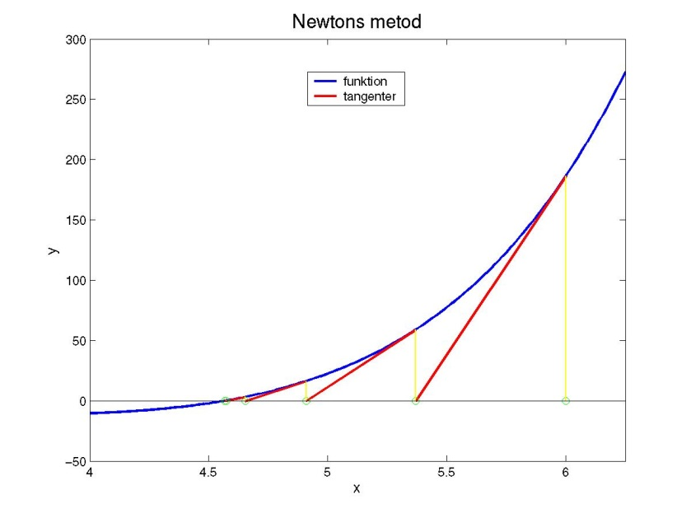

Asynchronous Approaches
What if we can tolerate some stale (older) data?
Algorithms are often stable w.r.t. old data
Algorithms often converge (maybe slower)
PDEs, message passing algorithms
Machine learning algorithms: batching of vectors
Often trade-off cost of iteration vs. cost of communication/update
Some algorithms absolutely cannot tolerate stale data
Newton method with fixed gradient

Slide 17
Outline
Example: Solving a Linear System of Equations
Parallel machine models
Algorithmic approaches
Amdahl, strong and weak scaling
CUDA
MPI, OpenMP, OpenACC

Slide 18
Characterizing Parallel Program Performance
p processor cores, T_{k} is the running time using k cores
Def. Speedup: S_{p} = T₁ / T_{p}
S_{p} is relative speedup if T₁ is running time of parallel version of the code running on 1 core
S_{p} is absolute speedup if T₁ is running time of sequential version of code running on 1 core
Absolute speedup is a much truer measure of the benefits of parallelism
Def. Efficiency: E_{p} = S_{p} /p = T₁ /(pT_{p})
Reported as a percentage in the range (0, 100]
Measures the overhead due to parallelization
Is super-linear speed-up (S_{p} > p, E_{p} > 100%) possible?
Yes: Due to hyperthreading and cache effects

Slide 19
Amdahl’s Law
Gene Amdahl (Nov. 16, 1922 – Nov. 10, 2015)
Captures the difficulty of using parallelism to speed things up.
Overall problem
T Total sequential time required
p Fraction of total that can be sped up (0 ≤ p ≤ 1)
k Speedup factor
Resulting Performance
T_{k} = pT/k + (1-p)T
Portion which can be sped up runs k times faster
Portion which cannot be sped up stays the same
Least possible running time:
k = ∞
T∞ = (1-p)T

Slide 20
Amdahl’s Law Example
Overall problem
T = 10 Total time required
p = 0.9 Fraction of total which can be sped up
k = 9 Speedup factor
Resulting Performance
T₉ = 0.9 * 10/9 + 0.1 * 10 = 1.0 + 1.0 = 2.0
Least possible running time:
T∞ = 0.1 * 10.0 = 1.0
Limit on strong scaling: fixed problem size, increasing cores
Not on weak scaling: problem size scales with increasing cores

Slide 21
Outline
Example: Solving a Linear System of Equations
Parallel machine models
Algorithmic approaches
Amdahl, strong and weak scaling
CUDA
MPI, OpenMP, OpenACC
Based on “15-418/15-618: Parallel Computer Architecture and Programming” by Randy Bryant and Nathan Beckmann

Slide 22
GPU Architecture
Multi-core chip
SIMD execution within a single core (many execution units performing the same instruction)
Multi-threaded execution on a single core (multiple threads executed concurrently by a core)
Notes:
22

Slide 23
NVIDIA Tesla architecture (2007)
(GeForce 8xxx series GPUs) First alternative, non-graphics-specific (“compute mode”) interface to GPU hardware
Lets say a user wants to run a non-graphics program on the GPU’s programmable cores…
Application can allocate buffers in GPU memory and copy data to/from buffers
Application (via graphics driver) provides GPU a single kernel program binary
Application tells GPU to run the kernel in an SPMD fashion (“run N instances”)
Go! (launch(myKernel, N))
Notes:
23

Slide 24
CUDA Programming Language
Introduced in 2007 with NVIDIA Tesla architecture
“C-like” language to express programs that run on GPUs using the compute-mode hardware interface
Relatively low-level: CUDA’s abstractions closely match the capabilities/performance characteristics of modern GPUs (design goal: maintain low abstraction distance)
Note: OpenCL is an open standards version of CUDA
CUDA only runs on NVIDIA GPUs
OpenCL runs on CPUs and GPUs from many vendors
Almost everything we say about CUDA also holds for OpenCL
Notes:
24

Slide 25
Basic CUDA Syntax
“Host” code: serial execution Running as part of normal C/C++ application on CPU
Bulk launch of many CUDA threads “launch a grid of CUDA thread blocks” Call returns when all threads have terminated
SPMD execution of device kernel function:
“CUDA device” code: kernel function (__global__ denotes a CUDA kernel function) runs on GPU
Each thread computes its overall grid thread id from its position in its block (threadIdx) and its block’s position in the grid (blockIdx)
Notes:
25

Slide 26
Clear Separation of Host and Device Code
Separation of execution into host and device code is performed statically by the programmer
“Host” code : serial execution on CPU
“Device” code (SPMD execution on GPU)
Notes:
26

Slide 27
Number of SPMD Threads is Explicit in Program
Number of kernel invocations is not determined by size of data collection (a kernel launch is not map(kernel, collection) as was the case with graphics shader programming)
Notes:
27

Slide 28
CUDA Memory Model
Distinct host and device address spaces
Notes:
28

Slide 29
memcpy Primitive
Move data between address spaces
Notes:
29

Slide 30
CUDA device Memory Model
Three distinct types of memory visible to kernels
Notes:
30

Slide 31
CUDA Example: 1D Convolution
output[i] = (input[i] + input[i+1] + input[i+2]) / 3.f;
Notes:
31

Slide 32
1D Convolution in CUDA
One thread per output element
Notes:
32

Slide 33
CUDA Synchronization Constructs
__syncthreads() Barrier: wait for all threads in the block to arrive at this point
Atomic operations e.g., float atomicAdd(float* addr, float amount) Atomic operations on both global memory and shared memory variables
Host/device synchronization Implicit barrier across all threads at return of kernel
Notes:
33

Slide 34
CUDA Abstractions
Execution: thread hierarchy
Bulk launch of many threads
Two-level hierarchy: threads are grouped into thread blocks
Distributed address space
Built-in memcpy primitives to copy between host and device address spaces
Three different types of device address spaces
Per thread, per block (“shared”), or per program (“global”)
Barrier synchronization primitive for threads in thread block
Atomic primitives for additional synchronization shared and global variables
Notes:
34

Slide 35
Outline
Example: Solving a Linear System of Equations
Parallel machine models
Algorithmic approaches
Amdahl, strong and weak scaling
CUDA
MPI, OpenMP, OpenACC

Slide 36
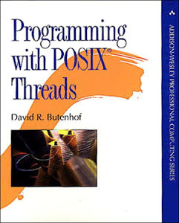
PThreads
#include <stdio.h> #include <stdlib.h> #include <pthread.h> void *print_message_function( void *ptr ); main() { pthread_t thread1, thread2; char *message1 = "Thread 1"; char *message2 = "Thread 2"; int iret1, iret2; iret1 = pthread_create(&thread1, NULL, print_message_function,
(void*) message1); iret2 = pthread_create( &thread2, NULL, print_message_function,
(void*) message2); pthread_join( thread1, NULL); pthread_join( thread2, NULL); printf("Thread 1 returns: %d\n",iret1); printf("Thread 2 returns: %d\n",iret2); exit(0); } void *print_message_function( void *ptr ) { char *message; message = (char *) ptr; printf("%s \n", message); }

Slide 37
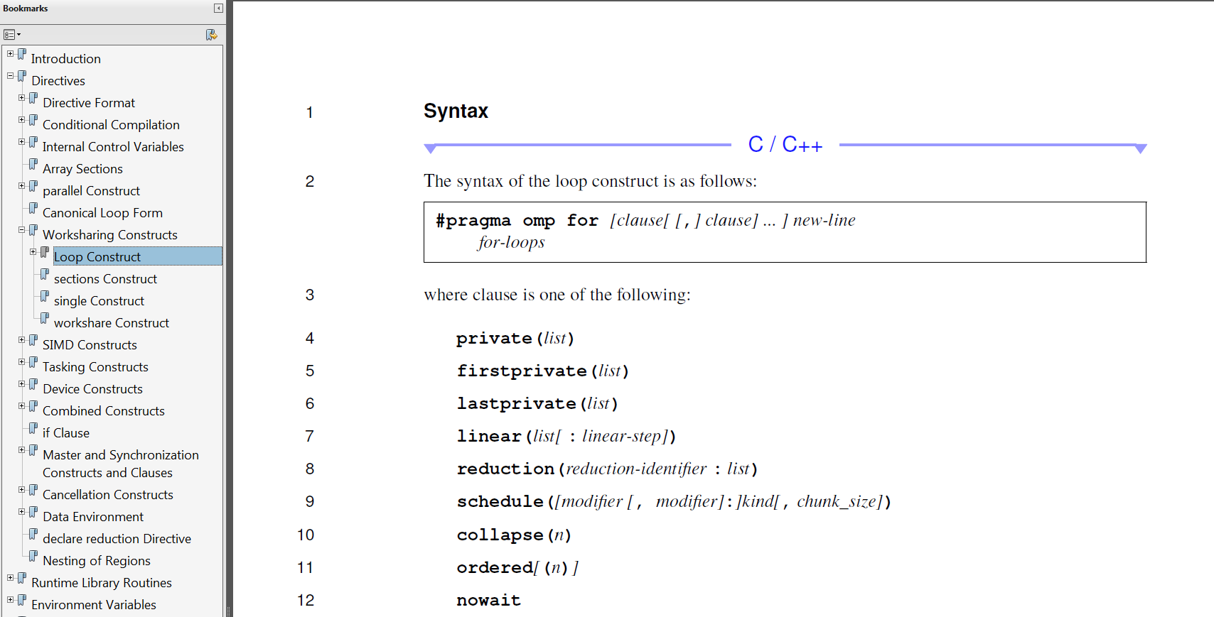
OpenMP
void conv_openmp(int n, float *a, float *b) {
int i;
#pragma omp parallel for
for (i=1; i<n-1; i++) /* i is private by default */
b[i] = (a[i-1] + a[i] + a[i+1]) / 3.0;
}

Slide 38
More OpenMP
#include <stdio.h>
#include <omp.h>
int main() {
int x;
x = 2;
#pragma omp parallel num_threads(2) shared(x)
{
if (omp_get_thread_num() == 0) {
x = 5;
} else {
/* Print 1: the following read of x has a race */
printf("1: Thread# %d: x = %d\n", omp_get_thread_num(),x );
}
#pragma omp barrier
if (omp_get_thread_num() == 0) {
/* Print 2 */
printf("2: Thread# %d: x = %d\n", omp_get_thread_num(),x );
} else {
/* Print 3 */
printf("3: Thread# %d: x = %d\n", omp_get_thread_num(),x );
}
}
return 0;
}

Slide 39
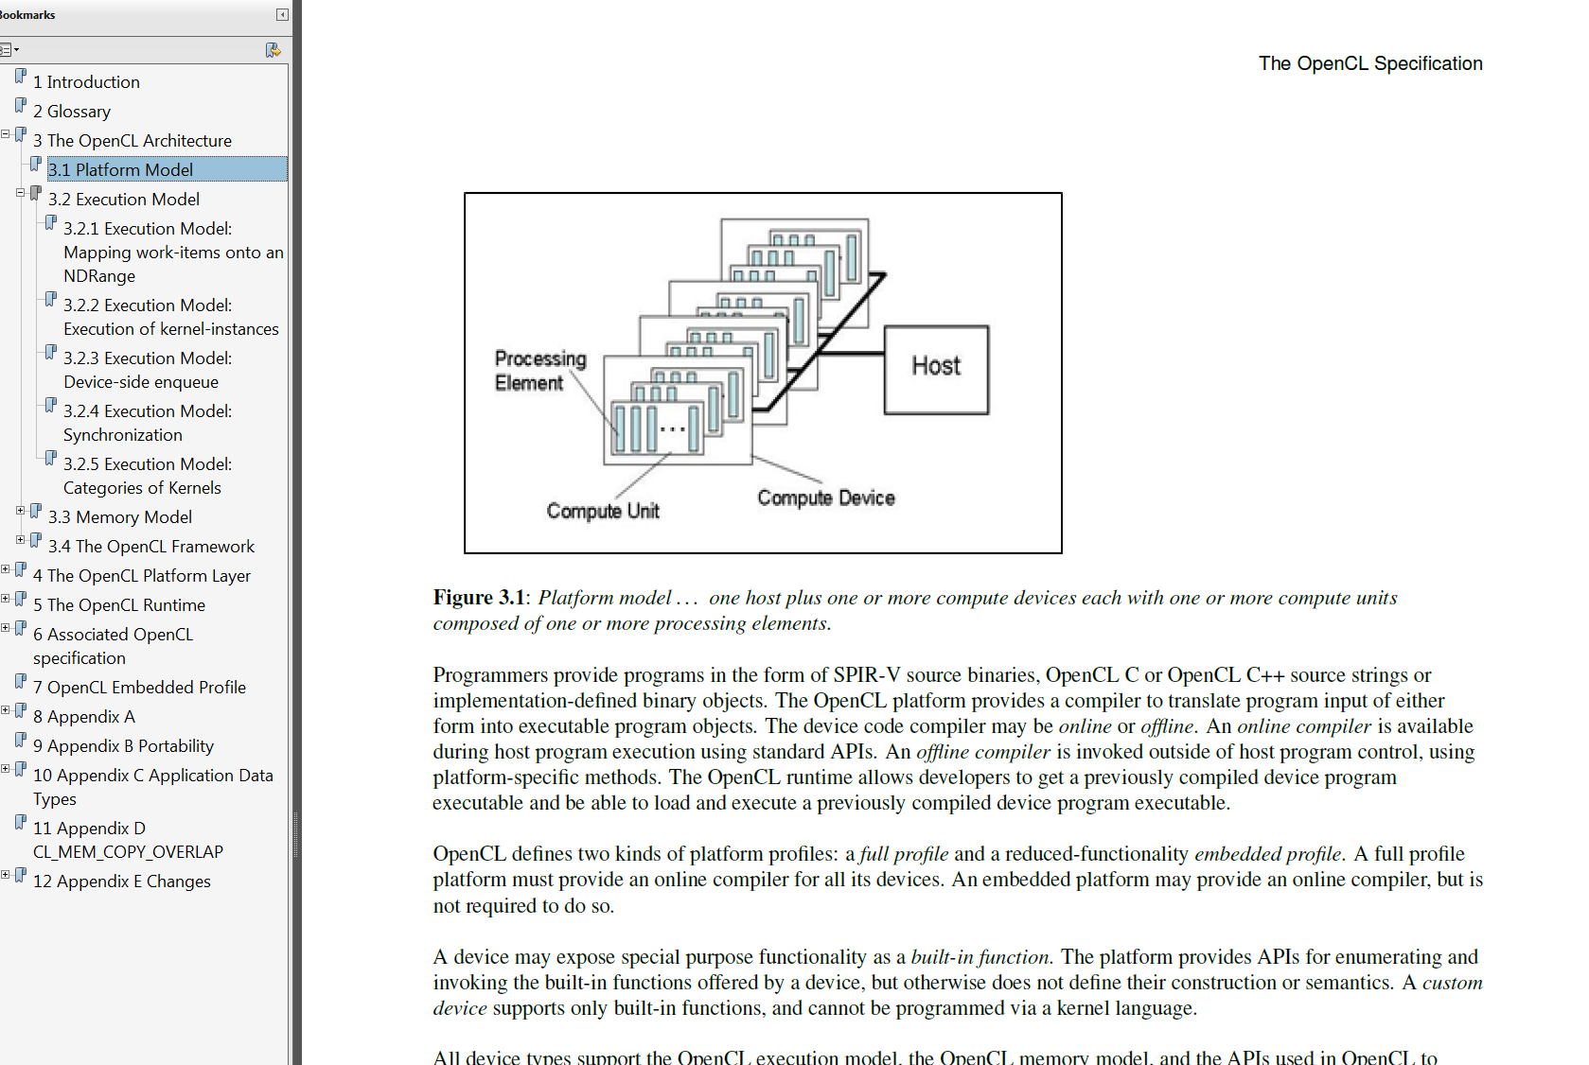
OpenCL

Slide 40
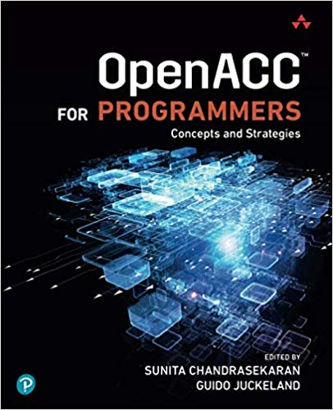
OpenACC
https://www.openacc.org

Slide 41
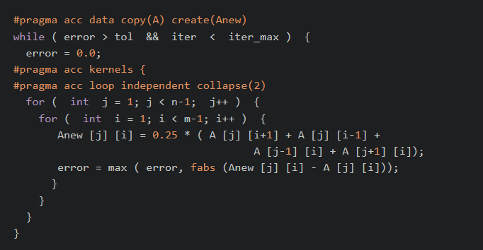
OpenACC Example

Slide 42
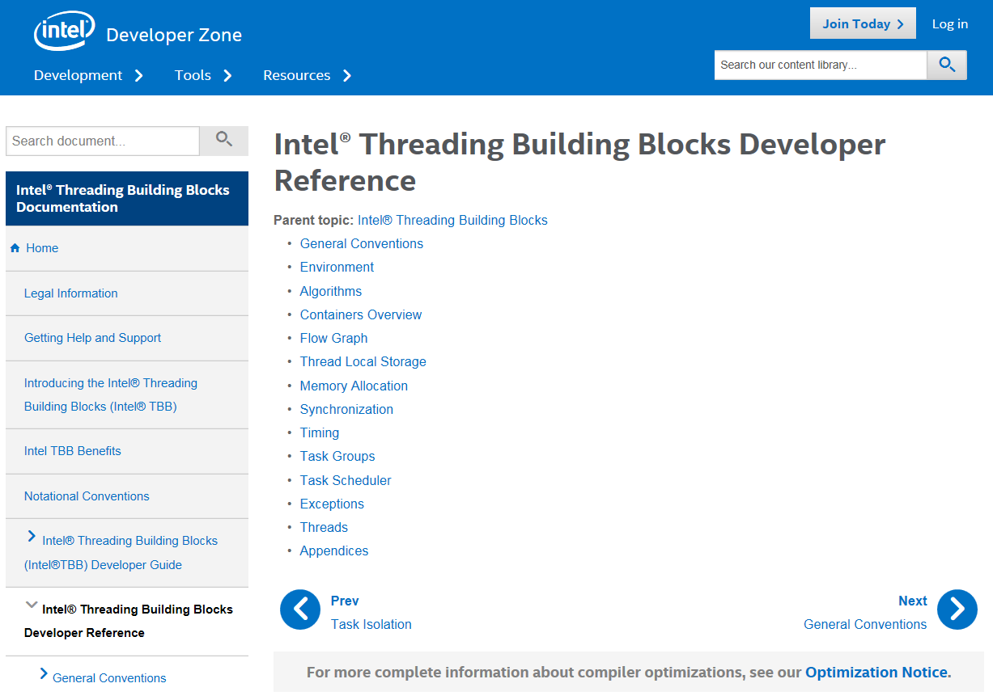

Thread Building Blocks

Slide 43
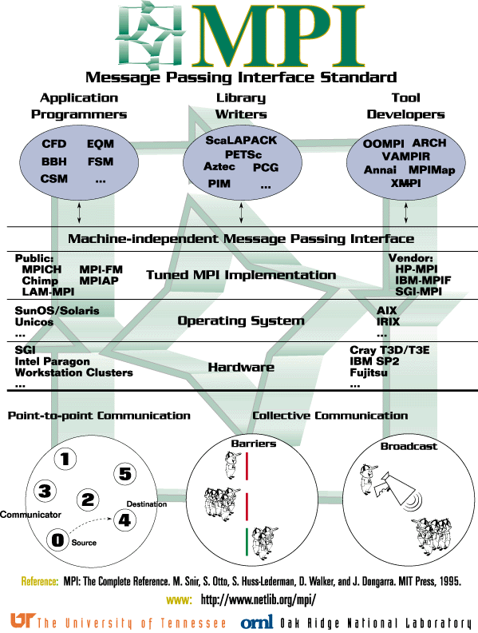
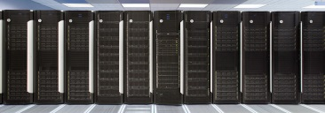
MPI
CPU
CPU
…
CPU
memory
memory
memory
PSC HPC
11k cores 200 GPUs
21.35 Pflop/s

Slide 44
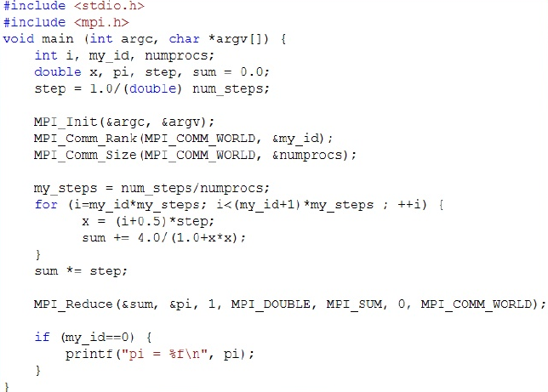
MPI

Slide 45
Summary
Example: Solving a Linear System of Equations
Parallel machine models
Algorithmic approaches
Amdahl, strong and weak scaling
CUDA
MPI, OpenMP, OpenACC

Slide 46
18-847G
Special Topics in Computer Systems: Computational Problem Solving for Engineers
Franz Franchetti Instructor
TBD Teaching Assistants
This is Section G. Other sections (F, RW, SH) are different courses.

