Slide 1
Multicores, Manycores, and Acclerators
18-613: Foundations of Computer Systems 7th Lecture, March 21, 2019
Instructor:
Franz Franchetti

Slide 2
Outline
Multicores, Manycores, accelerators
Experimental accelerators
Latest Nvidia GPUs
CUDA
Summary

Slide 3
The Future is Parallel and Heterogeneous
2012 and later
?
Sun Niagara 32 threads
2009
Intel Larrabee
Intel Sandy Bridge 8-way float vectors
Cell BE 8+1 cores
Virtex 5 FPGA+ 4 CPUs
Intel Haswell vector coprocessors
before 2000
Xtreme DATA Opteron + FPGA
CPU platforms
multicore
IBM POWER7 2x8 cores
IBM Cyclops64 80 cores
SGI RASC Itanium + FPGA
BlueGene/Q
Core2 Duo
Core2 Extreme
Tilera TILEPro 64 cores
ClearSpeed 192 cores
Nvidia GPUs 240 streaming cores
Nvidia Fermi
AMD Fusion
Programmability?
Performance portability?

Slide 4
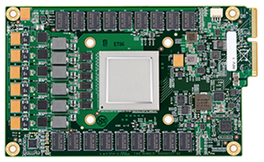
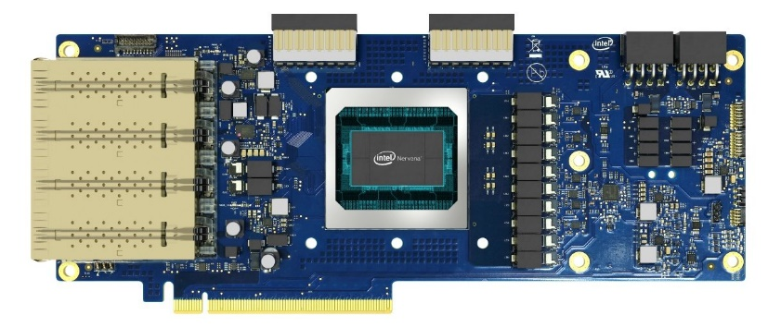
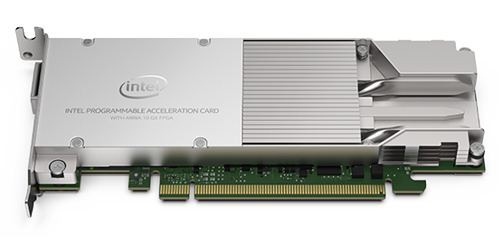
The Future Is Here: Accelerators
Intel Nervana Neural Network Processor aka Lake Crest, release date 2019
Google TPU 2.0 600 GB/s, 45 Tflop/s
Intel Arria 10 GX FPGA
15Gbps SERDES transceivers
1,150K logic elements, 53 Mb 8 GB DDR4 ECC
Nvidia V100 GPU 100 Tflop/s tensor operations 7.5 Tflop/s FP64 SIMT
4
Notes:
4

Slide 5
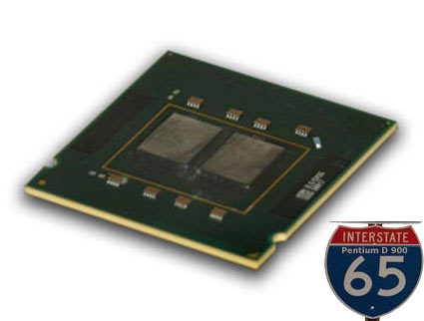
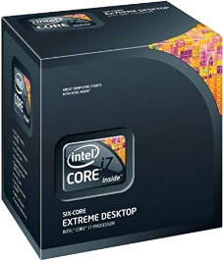
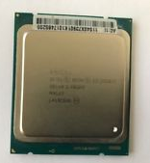
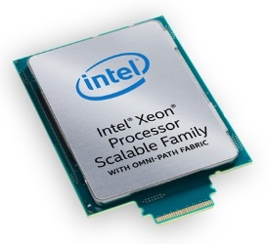
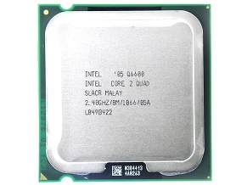
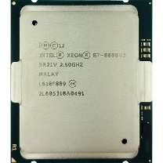
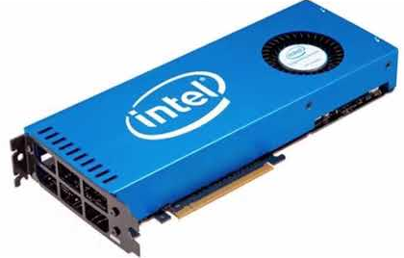
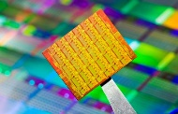
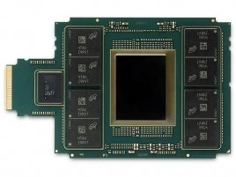
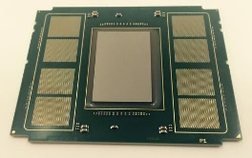
Intel Multicores and Manycores
Desktop and Server Multicores
2005 Pentium D 2 cores, 3.6 GHz
2007
Core 2 Quad 4 cores, 2.67 GHz
2010
Core i7 980X 6 cores, 3.3 GHz
2014
Xeon E5-4624Lv2
10 cores, 2.5 GHz
2015
Xeon E7-8890 v3 18 cores, 2.5 GHz
2019
Xeon Platinum 8176F
28 cores, 3.8 GHz
Experimental Chips and Server Manycores
2008 Larrabee GPU 32 cores, 2 GHz
2009
Intel SCC 48 cores, 1GHz
2013
Xeon Phi 5120D 60 cores, 1.05 GHz
2016
Xeon Phi 7290F
72 cores, 1.5 GHz

Slide 6
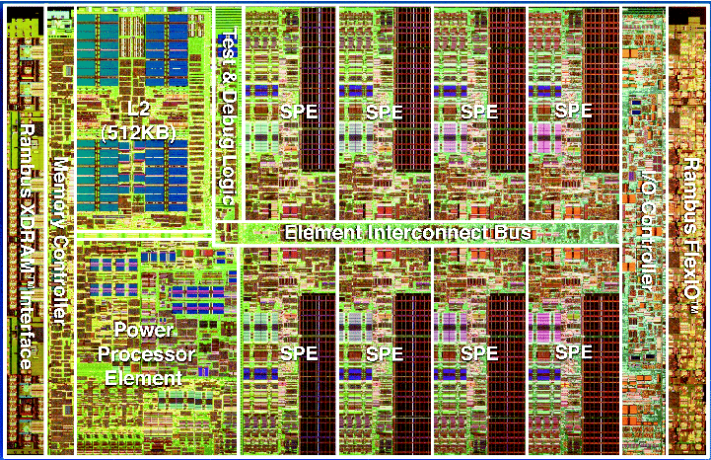
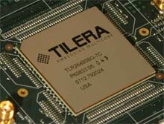
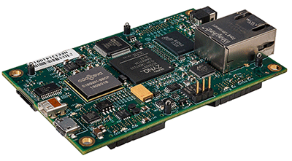
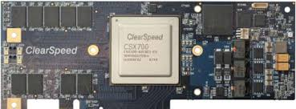
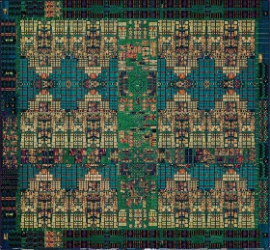
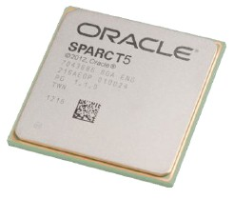
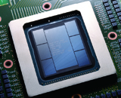
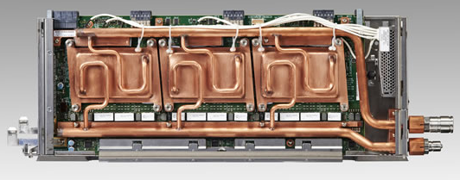
Other CPU-Style Multicores/Manycores
2006
IBM Cell BE
8+1 cores, 3.2 GHz
2007
Tilera Tile64
64 cores, 900 MHz
2008
ClearSpeed CSX700
192 cores, 250 MHz
2012
Parallella
16 cores, 1GHz
2013
IBM POWER9
24 cores, 4 GHz
2013
Oracle SPARC T5
16 cores, 3.6 GHz
2014
Fujitsu SPARC64 XIfx
32+2 cores, 2.2 GHz
2017
NEC SX-Aurora 8 cores, 1.6 GHz
Notes:
6

Slide 7
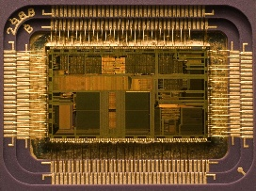
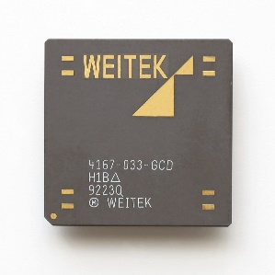
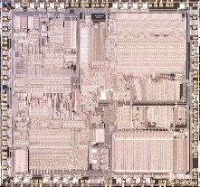
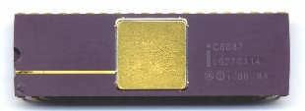
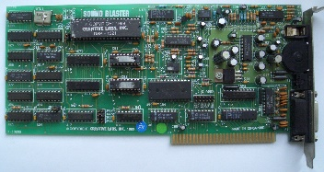
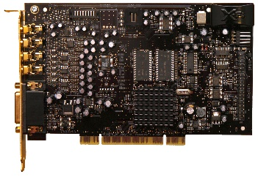
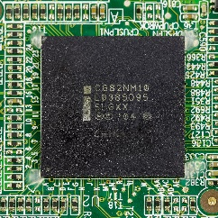
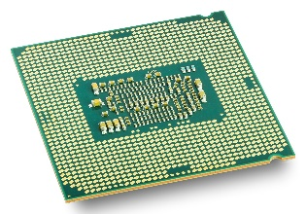
Math Co-Processors and Sound Cards
x87 Co-Processors
1980
Intel 8087
x87 FPU, 10 MHz
1987
Intel 80387
IEEE754 x87 FPU, 33 MHz
1989
Intel 80486
x87 FPU integrated
1990
Weitek 4167 x87 FPU, 33 MHz
Audio Co-Processors
1989
Sound Blaster 1.0
11 voice FM synthesizer
2012
SoundBlaster X-Fi
Advanced DSP, 48kHz
2008
Platform Controller Hub
Sound, clock, display
2014
On chip PCH
SoC design
Notes:
7

Slide 8
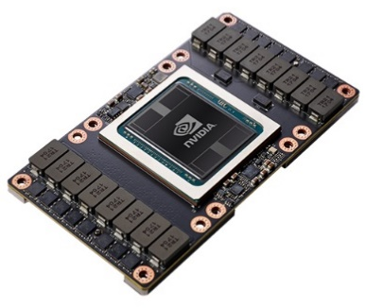
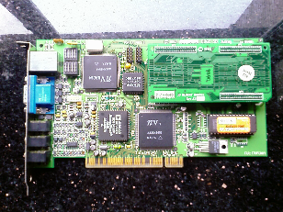
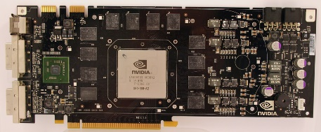
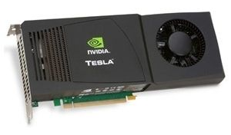
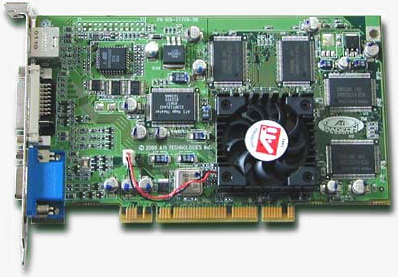
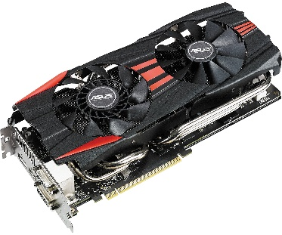
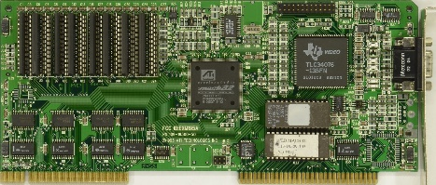
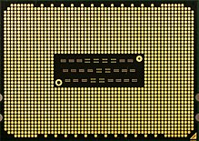
Graphics Processors (GPUs)
Nvidia
1995
Nvidia NV1
2D/3D GPU
2006
Nvidia G80
CUDA
2009
Nvidia Tesla C1060
double GPU computing
2019
Nvidia V100 Tensor cores, 125 Tflop/s
ATI/AMD
1992
ATI Mach32
GUI acceleration
2000
ATI Radeon
DirexctX 7.0 3D, MPEG-1
2014
Radeon R9 295X2
1.43 Tflop/s double
2017
Opteron X3000 APU
4 cores + 3rd gen GCN GPU
Notes:
8

Slide 9
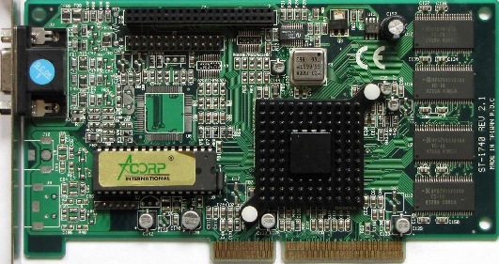
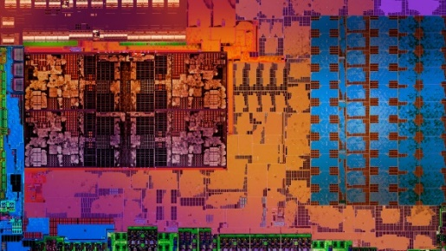
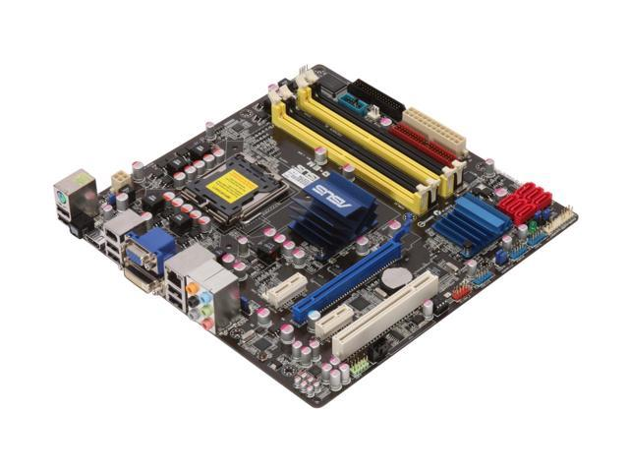
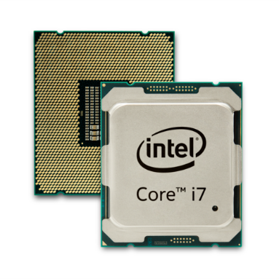
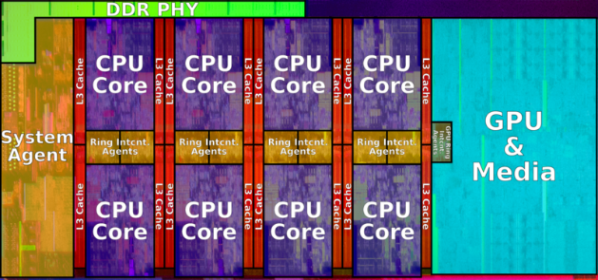
Intel GPUs
1998
Intel 740 VGA card
2008
Larrabee Discrete GPU
2008
GMA X4500HD G45 chipset
2018
UHD 630 Coffe Lake, on-die
Notes:
9

Slide 10
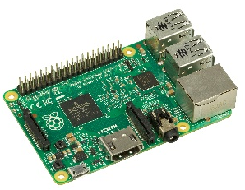
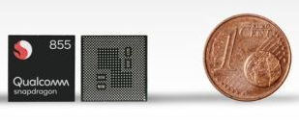
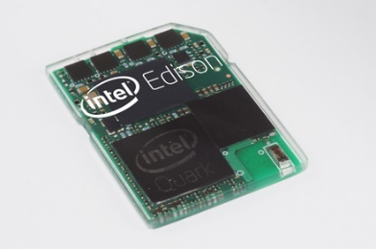
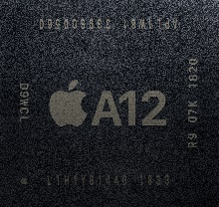
Embedded and System on a Chip (SoC)
Raspberry Pi
Broadcom BCM2837B0 1.4 GHz, ARM Cortex A53
Qualcomm Snapdragon 855 ARM CPU, GPU, DSP, CV
modem
Apple A12
6 cores, ARM, 2.5 GHz
Intel Quark 1 core, 32 MHz
Notes:
10

Slide 11
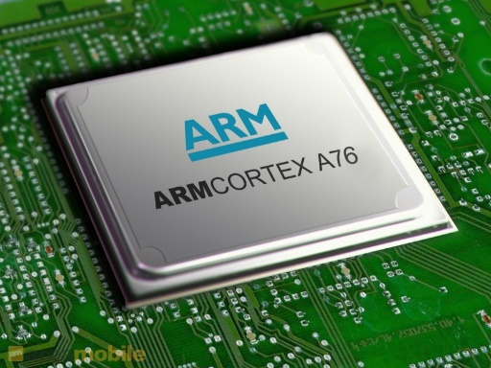
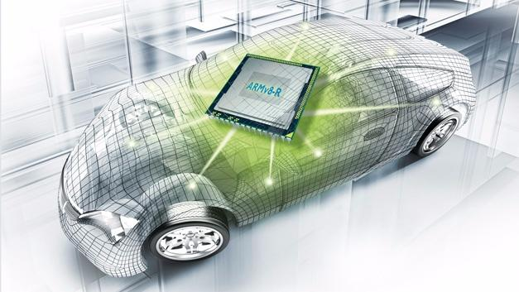
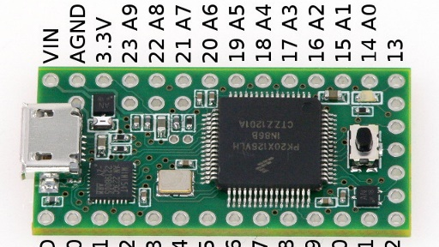
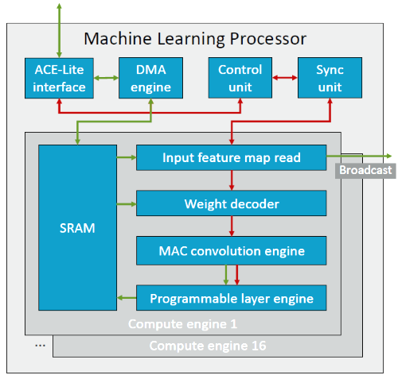


ARM
Processor classes
Cortex-M
Targets SoC
Cortex-R
Real-time
Cortex-A
Application processors
Accelerators and special features
Mali GPU
ARM GPU
Trillium
Machine learning
SecurCore
Tamper proof, security
Notes:
11

Slide 12




Field Programmable Gate Arrays (FPGAs)
8GB of on-chip High Bandwidth Memory (HBM)
Multiple external memory interfaces (RLDRAM3, QDR-IV, DDR4)
Quad 32Gbps QSFP28 Interfaces
PCIe Gen3 x16 & Gen4 x8
VITA 57.4 FMC+ Interface
10/100/1000 Mbps Ethernet
PicoZed
Xilinx Zynq-7000 SoC
Xilinx Virtex UltraScale+ HBM VCU128-ES1
24 TeraFLOPS processing: 16x Altera Arria 10 or Stratix V FPGAs
Up to 18 million logic elements (Arria 10 GX)
Up to 62,000 multipliers (Stratix V GS)
1.28 Terabits/sec I/O
128x 10GigE, 32x 40GigE, 32x 100 GigE, or 32x QDR Infiniband
6.5 Terabits/sec memory bandwidth
Up to 64 banks DDR3-1600 (512 GBytes)
DDR4, QDRII+, and RLDRAM3 memory options
4U or 5U Rackmount PCIe system (server, industrial, or expansion)
Dual socket Intel Ivy Bridge with up to 12 cores
Up to 768 GBytes of system memory
8 Gen3 x16 PCIe slots
Complete software support
Windows and Linux 64 drivers, interface libraries, and hardware management
FPGA development kit for Arria 10 and Stratix V
Intel Arria 10 GX
1,150K logic elements
BittWare TeraBox 8 FPGA cards, 2 TB DDR4
Notes:
12

Slide 13









Memory and Packaging
Memory chips
DDR4 DIMM
Standard memory
SO-DIMM
Laptops
GDDR5
For GPUs
HMC
3D memory on PCB
HBM2
For SoC/SiP
Integration
Printed circuit board (PCB)
Traditional circuit board
Multi chip packaging (MCP)
Tighter integration
Silicon interposer
Chip-on-chip integration
Notes:
13

Slide 14









Bulk Storage and Busses
Bulk storage (disks)
Hard drive
Standard disk
SSD
Flash as disk drive
NVMe
HDD on PCIe
SD card
Memory for cell phone etc
Extension busses
PCIe x1, x4, x8, x16
Desktop/laptop standard
NVLink
Fast GPU interconnect
Coherent Accelerator Processor Interface (CAPI)
IBM/server class open standard
Notes:
14

Slide 15
Outline
Multicores, Manycores, accelerators
Experimental accelerators
Latest Nvidia GPUs
CUDA
Summary
Based on “15-740 Computer Architecture” by Nathan Beckmann

Slide 16




Example 1: DianNao
DianNao [Chen et al, ASPLOS’14, Best paper]
DaDianNao [Chen et al, MICRO’14, Best paper]
PuDianNao [Liu et al, ASPLOS’15]
ShiDianNao [Du et al, ISCA’15]
Notes:
16

Slide 17



Example 2: EIE: Sparse Neural Networks
EIE: Efficient Inference Engine
[Han et al, ISCA’16]
Notes:
17

Slide 18




Example 3: Graphicianado
[Ham et al, MICRO’16, Best paper]
Notes:
18

Slide 19



Example 4: Plasticine
Pattern based reconfigurable computing
[Prabhakar et al, ISCA’17]
Notes:
19

Slide 20
Outline
Multicores, Manycores, accelerators
Experimental accelerators
Latest Nvidia GPUs
CUDA
Summary

Slide 21
Volta GV100 with 84 SM Units
Notes:
21

Slide 22
Volta GV100 Streaming Multiprocessor (SM)
Notes:
22

Slide 23
Tensor Cores
Notes:
23

Slide 24
Volta GV100 with 84 SM Units
Notes:
24

Slide 25
Multi-GPU Systems: NVLink
Notes:
25

Slide 26
Thread Divergence
Notes:
26

Slide 27
Outline
Multicores, Manycores, accelerators
Experimental accelerators
Latest Nvidia GPUs
CUDA
Summary
Based on “15-418/15-618: Parallel Computer Architecture and Programming” by Randy Bryant and Nathan Beckmann

Slide 28
GPU Architecture
Multi-core chip
SIMD execution within a single core (many execution units performing the same instruction)
Multi-threaded execution on a single core (multiple threads executed concurrently by a core)
Notes:
28

Slide 29
NVIDIA Tesla architecture (2007)
(GeForce 8xxx series GPUs) First alternative, non-graphics-specific (“compute mode”) interface to GPU hardware
Lets say a user wants to run a non-graphics program on the GPU’s programmable cores…
Application can allocate buffers in GPU memory and copy data to/from buffers
Application (via graphics driver) provides GPU a single kernel program binary
Application tells GPU to run the kernel in an SPMD fashion (“run N instances”)
Go! (launch(myKernel, N))
Notes:
29

Slide 30
CUDA Programming Language
Introduced in 2007 with NVIDIA Tesla architecture
“C-like” language to express programs that run on GPUs using the compute-mode hardware interface
Relatively low-level: CUDA’s abstractions closely match the capabilities/performance characteristics of modern GPUs (design goal: maintain low abstraction distance)
Note: OpenCL is an open standards version of CUDA
CUDA only runs on NVIDIA GPUs
OpenCL runs on CPUs and GPUs from many vendors
Almost everything we say about CUDA also holds for OpenCL
Notes:
30

Slide 31
Basic CUDA Syntax
“Host” code: serial execution Running as part of normal C/C++ application on CPU
Bulk launch of many CUDA threads “launch a grid of CUDA thread blocks” Call returns when all threads have terminated
SPMD execution of device kernel function:
“CUDA device” code: kernel function (__global__ denotes a CUDA kernel function) runs on GPU
Each thread computes its overall grid thread id from its position in its block (threadIdx) and its block’s position in the grid (blockIdx)
Notes:
31

Slide 32
Clear Separation of Host and Device Code
Separation of execution into host and device code is performed statically by the programmer
“Host” code : serial execution on CPU
“Device” code (SPMD execution on GPU)
Notes:
32

Slide 33
Number of SPMD Threads is Explicit in Program
Number of kernel invocations is not determined by size of data collection (a kernel launch is not map(kernel, collection) as was the case with graphics shader programming)
Notes:
33

Slide 34
CUDA Memory Model
Distinct host and device address spaces
Notes:
34

Slide 35
memcpy Primitive
Move data between address spaces
Notes:
35

Slide 36
CUDA device Memory Model
Three distinct types of memory visible to kernels
Notes:
36

Slide 37
CUDA Example: 1D Convolution
output[i] = (input[i] + input[i+1] + input[i+2]) / 3.f;
Notes:
37

Slide 38
1D Convolution in CUDA
One thread per output element
Notes:
38

Slide 39
CUDA Synchronization Constructs
__syncthreads() Barrier: wait for all threads in the block to arrive at this point
Atomic operations e.g., float atomicAdd(float* addr, float amount) Atomic operations on both global memory and shared memory variables
Host/device synchronization Implicit barrier across all threads at return of kernel
Notes:
39

Slide 40
CUDA Abstractions
Execution: thread hierarchy
Bulk launch of many threads
Two-level hierarchy: threads are grouped into thread blocks
Distributed address space
Built-in memcpy primitives to copy between host and device address spaces
Three different types of device address spaces
Per thread, per block (“shared”), or per program (“global”)
Barrier synchronization primitive for threads in thread block
Atomic primitives for additional synchronization shared and global variables
Notes:
40

Slide 41
Summary
Multicores, Manycores, accelerators
Experimental accelerators
Latest Nvidia GPUs
CUDA

