Slide 1
SIMD Instructions
18-613: Foundations of Computer Systems 4th Lecture, Feb 19, 2019
Instructor:
Franz Franchetti
Based on ETH 263-2800-00L: “Design of Parallel and High-Performance Computing” by Markus Püschel: http://spcl.inf.ethz.ch/Teaching/2018-dphpc/lectures/lecture8-simd.pdf

Slide 2
SIMD Vector Instructions in a Nutshell
What are these instructions?
Extension of the ISA. Data types and instructions for parallel computation on short (2-16) vectors of integers and floats
Why are they here?
Useful: Many applications (e.g.,multi media) feature the required fine grain parallelism – code potentially faster
Doable: Chip designers have enough transistors available, easy to implement
+
x
4-way
SIMD = Single Instruction Multiple Data

Slide 3
Other SIMD/Vector Hardware
Original SIMD machines (CM-2,…)
Don’t really have anything in common with SIMD vector extension
Vector Computers (NEC SX6, Earth simulator, SX-Aurora)
Vector lengths of up to 128
High bandwidth memory, no memory hierarchy
Pipelined vector operations
Very long instruction word (VLIW) architectures
Explicit parallelism
More flexible
No data reorganization necessary
SIMT (Nvidia)
SIMD lane == tread
Predicated execution, scheduling,…

Slide 4
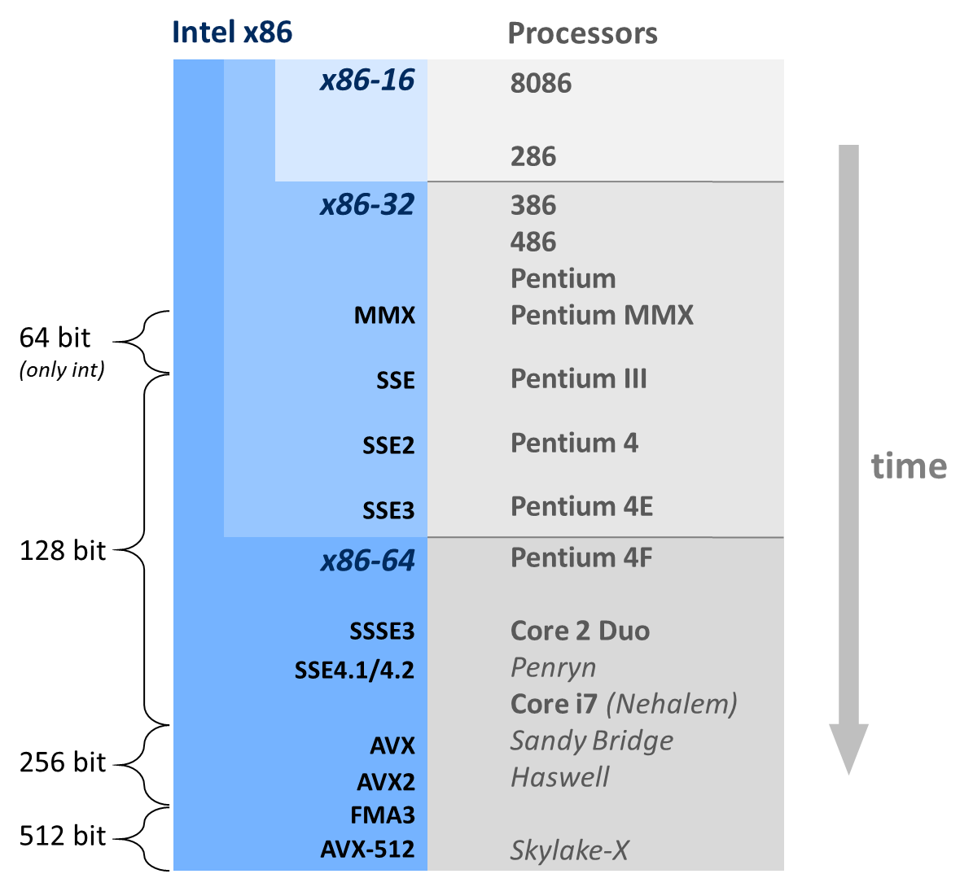
Evolution of Intel Vector Instructions
MMX:
Multimedia extension
SSE:
Streaming SIMD extension
AVX:
Advanced vector extensions
register
width

Slide 5
Intel SSE/AVX: Floating Point
512 bit
16x float
8x double
AVX512, KNC
AVX2, FMA3
256 bit
8x float
4x double
AVX
SSE4.1/4.2
SSSE3
128 bit
4x float
2x double
SSE3
SSE2
128-bit
4x float
SSE

Slide 6
Intel MMX/SSE/AVX: Integer
512 bit
16x float
8x double
AVX512, KNC
AVX2, FMA3
256 bit
8/16/32/64/128 bit int
AVX
SSE4.1/4.2
SSSE3
SSE3
128 bit
8/16/32/64/128 bit int
SSE2
SSE
MMX
64-bit
8/16/32/64 bit int

Slide 7
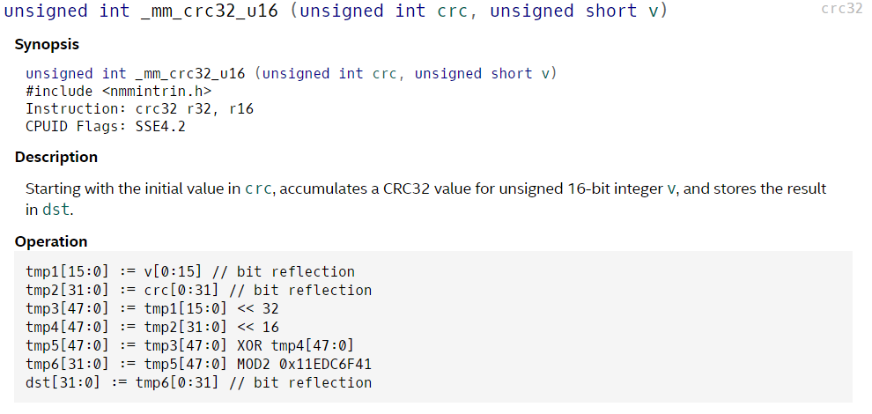
Other Types of Special Instructions
Cryptography
Bit-manipulation
Cache/TLB control
Debug support
bounds checks
Hardware random number generator
String operations
Half precision (FP16) support
Machine control register access
Galois field arithmetic

Slide 8
SSE3/4/AVX128 XMM Register File
128 bit = 2 doubles = 4 singles
%xmm0
%xmm8
%xmm1
%xmm9
%xmm2
%xmm10
%xmm3
%xmm11
%xmm4
%xmm12
%xmm5
%xmm13
%xmm6
%xmm14
%xmm7
%xmm15
Since SSE2 also vectors of 8/16/32/64/128-bit integers

Slide 9
AVX Register File (Sandy Bridge and Later)
256 bit = 4 doubles = 8 singles
%ymm0
%ymm8
%ymm1
%ymm9
%ymm2
%ymm10
%ymm3
%ymm11
%ymm4
%ymm12
%ymm5
%ymm13
%ymm6
%ymm14
%ymm7
%ymm15
Since AVX2 also vectors of 8/16/32/64/128/256-bit integers

Slide 10
AVX512 Register File
512 bit = 16 doubles = 32 singles
%zmm0
%zmm8
%zmm16
%zmm24
%zmm1
%zmm9
%zmm17
%zmm25
%zmm2
%zmm10
%zmm18
%zmm26
%zmm3
%zmm11
%zmm19
%zmm27
%zmm4
%zmm12
%zmm20
%zmm28
%zmm5
%zmm13
%zmm21
%zmm29
%zmm6
%zmm14
%zmm22
%zmm30
%zmm7
%zmm15
%zmm23
%zmm31
Also vectors of 8/16/32/64/128/256/512-bit integers

Slide 11
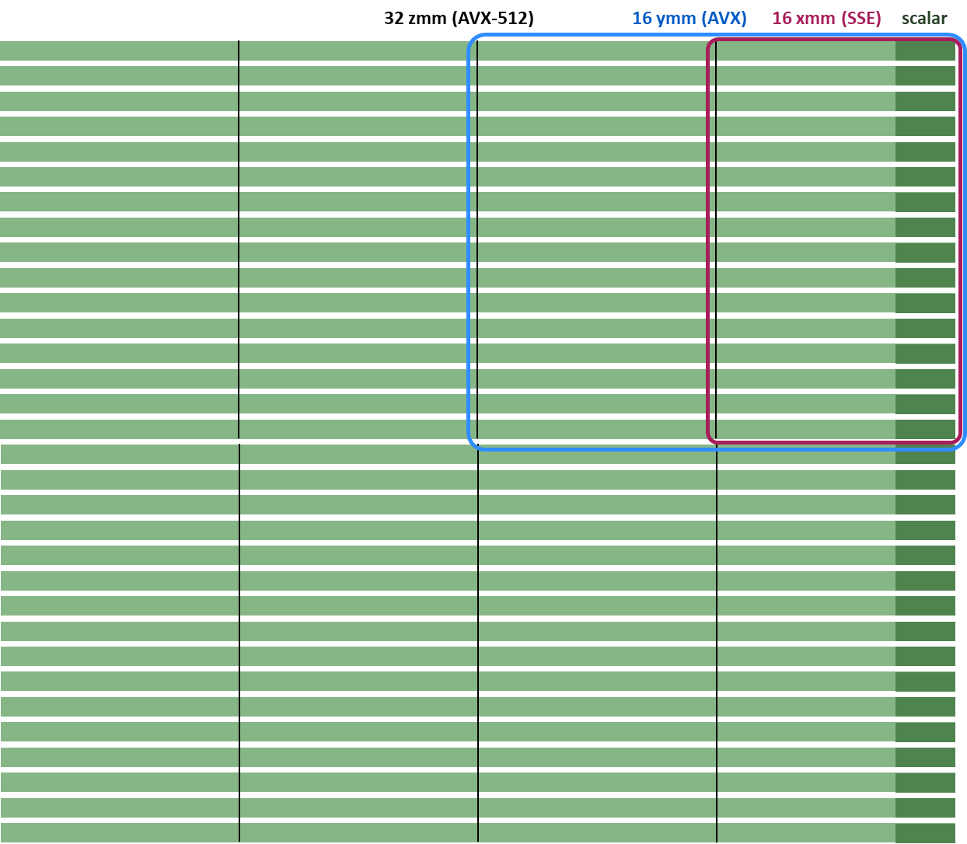
XMM/YMM/ZMM Relationship

Slide 12
Detail: XMM/SSE2/3/4 Register
Different data types and associated instructions
Integer vectors:
16-way byte
8-way 2 bytes
4-way 4 bytes
2-way 8 bytes
Floating point vectors:
4-way single (since SSE)
2-way double (since SSE2)
Floating point scalars:
single (since SSE)
double (since SSE2)
128 bit
LSB

Slide 13
SSE3 Instructions: Examples
Single precision 4-way vector add: addps %xmm0, %xmm1
Single precision scalar add: addss %xmm0, %xmm1
%xmm0
+
%xmm1
%xmm0
+
%xmm1
With x86-64 all FPU operations are done in xmm scalar

Slide 14
AVX Instructions: Examples
Double precision 4-way vector add: vaddpd %ymm0, %ymm1, %ymm2
%ymm1
%ymm2
+
%ymm0
Since AVX: Intel has 3-operand instructions and added AVX-style SSE instructions

Slide 15
Instruction Names
packed (vector)
single slot (scalar)
addps
addss
single precision
vaddpd
addsd
3 op
double precision
Compiler will use this for floating point
Set arch to AVX even for SSE code on SandyBridge and newer
SSE vs AVX: register operand decides

Slide 16
x86-64 FP Code Example
float ipf (float x[],
float y[],
int n) {
int i;
float result = 0.0;
for (i = 0; i < n; i++)
result += x[i]*y[i];
return result;
}
Inner product of two vectors
Single precision arithmetic
Compiled: not vectorized, uses SSE instructions
ipf:
xorps %xmm1, %xmm1 # result = 0.0
xorl %ecx, %ecx # i = 0
jmp .L8 # goto middle
.L10: # loop:
movslq %ecx,%rax # icpy = i
incl %ecx # i++
movss (%rsi,%rax,4), %xmm0 # t = y[icpy]
mulss (%rdi,%rax,4), %xmm0 # t *= x[icpy]
addss %xmm0, %xmm1 # result += t
.L8: # middle:
cmpl %edx, %ecx # i:n
jl .L10 # if < goto loop
movaps %xmm1, %xmm0 # return result
ret

Slide 17
SSE/AVX: How to Take Advantage?
+
instead of
+
Necessary: fine grain parallelism
Options (ordered by effort):
Use vectorized libraries (easy, not always available)
Compiler vectorization (good option)
Use intrinsics (this lecture)
Write assembly
We will focus on 4-way (SSE single and AVX double)

Slide 18
Vector Instructions: Language Extension
Data types
__m128 f; // = {float f3, f2, f1, f0}
__m128d d; // = {double d1, d0}
__m128i i; // = {int i3, i2, i1, i0}
__m256 f; // = {float f7, ..., f1, f0}
...
__m512 f; // = {float f15, ..., f1, f0}
...
Intrinsics
Native instructions: _mm_add_ps(), _mm256_mul_pd(),…
Multi-instruction: _mm_setr_ps(), _mm512_set1_pd(), …
Macros
Block operations: _MM_TRANSPOSE4_PS(),…
Helper: _MM_SHUFFLE(), _MM_GET_EXCEPTION_MASK()

Slide 19
Intrinsics
Assembly coded C functions
Expanded inline upon compilation: no overhead
Like writing assembly inside C
Floating point:
Intrinsics for basic operations (add, mult, …)
Intrinsics for math functions: log, sin, …
Our introduction is based on icc
Most intrinsics work with gcc and Visual Studio (VS)
Some language extensions are icc (or even VS) specific
https://software.intel.com/sites/landingpage/IntrinsicsGuide/

Slide 20
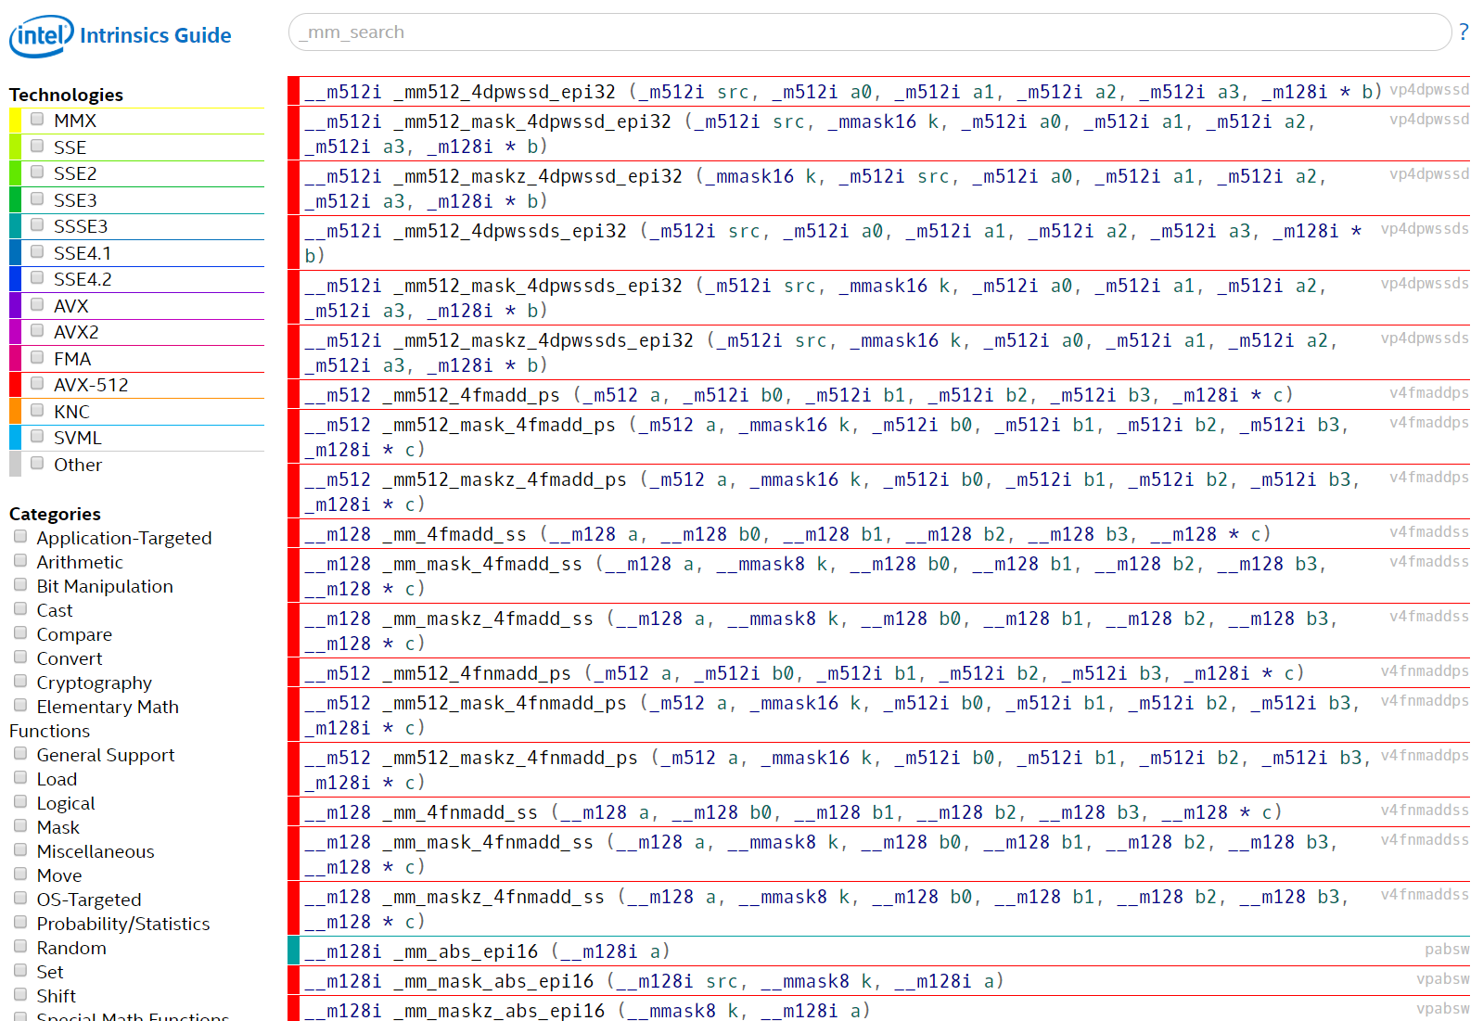

Slide 21
About 5,000 pages

Slide 22
Visual Conventions We Will Use
Memory
Registers
Commonly:
We will use
increasing address
memory
LSB
R3
R2
R1
R0
LSB
R0
R1
R2
R3

Slide 23
SSE4/AVX2 Data Types
SSE4 data types
__m128 f; // = {float f0, f1, f2, f3}
__m128d d; // = {double d0, d1} __m128i i; // 16 8-bit, 8 16-bit, 4 32-bit, or 2 64-bit ints
AVX2 data types
__m256 f; // = {float f0, f1, ..., f7}
__m256d d; // = {double d0, d1, d2, d3}
__m128i i; // 32 8-bit, 16 16-bit, 8 32-bit, or 4 64-bit ints
int8
int16
int32 or float
int64 or double
SSE4==AVX128 and AVX2 can be mixed if done carefully

Slide 24
SSE4/AVX128 4 x float Intrinsics
Instructions
Naming convention: _mm_<intrin_op>_<suffix>
Example:
Same result as
// a is 16-byte aligned
float a[4] = {1.0, 2.0, 3.0, 4.0}; __m128 t = _mm_load_ps(a);
p: packed
s: single precision
LSB
1.0
2.0
3.0
4.0
__m128 t = _mm_set_ps(4.0, 3.0, 2.0, 1.0)

Slide 25
AVX2 4 x double Intrinsics
Instructions
Naming convention: _mm256_<intrin_op>_<suffix>
Example:
Same result as
// a is 32-byte aligned
double a[4] = {1.0, 2.0, 3.0, 4.0}; __m256d t = _mm256_load_pd(a);
p: packed
d: double precision
LSB
1.0
2.0
3.0
4.0
__m256d t = _mm256_set_pd(4.0, 3.0, 2.0, 1.0)

Slide 26
SSE4/AVX128 and AVX2 Intrinsics
Load and store
Constants
Arithmetic
Comparison
Conversion
Shuffles

Slide 27
Loads and Stores
p
1.0
2.0
3.0
4.0
memory
avoid unaligned (can be expensive)
on recent Intel
possibly no penalty
LSB
1.0
2.0
3.0
4.0
a
a = _mm_load_ps(p); // p 16-byte aligned
a = _mm_loadu_ps(p); // p not aligned
a = _mm256_load_pd(p); // p 32-byte aligned
a = _mm256_loadu_pd(p); // p not aligned
load_ps/pd on unaligned pointer: seg fault

Slide 28
Example: Load and Set in SSE4/AVX128 and AVX2
Intrinsic Name | Operation | Corresponding SSE/AVX Instructions
_mm256_broadcast_pd | Broadcast 128 bits from memory to all elements of dst | vbroadcastf128
_mm_i32gather_epi32 | Gather 32-bit integers from memory using 32-bit indices | vpgatherdd
_mm_load_ss | Load the low value and clear the three high values | movss
_mm256_loadu2_m128i | Load two 128-bit values from memory, and combine them into dst | composite
_mm256_load_ps | Load eight values, address aligned | vmovaps
_mm_loadu_ps | Load four values, address unaligned | movups
_mm_maskload_pd | Load packed double-precision elements from memory using mask | vmaskmovpd
Intrinsic Name | Operation | Corresponding SSE/AVX Instruction
_mm_set_ss | Set the low value and clear the three high values | Composite
_mm_set1_ps | Set all four words with the same value | Composite
_mm_set_ps | Set four values | Composite
_mm_setr_ps | Set four values, in reverse order | Composite
_mm_setzero_ps | Clear all four values | Composite
_mm256_set1_pd | Set all four words with the same value | Composite
_mm256_set_ps | Set eight values | Composite
_mm256_set1_epi64x | Broadcast 64-bit integer a to all elements of dst | Composite
_mm256i_setzero_si256 | Clear all 256 bits | Composite

Slide 29
Stores Less Powerful than Loads
Intrinsic Name | Operation | Corresponding SSE/AVX Instructions
_mm256_store_pd | Store 4 doubles to aligned memory | vmovapd
_mm_store_pd | Store 2 doubles to aligned memory | movapd
_mm256_maskstore_ps | Store single-precision elements from a into memory using mask | vmaskmovps
_mm256_stream_si256 | Non-temporal store | vmovntdq
_mm256_storeu2_m128d | Store the high and low 128-bit into memory two different locations | composite
_mm_storel_epi64 | Store 64 bit of XMM register to memory | movq
_mm_store1_pd | Store lowest double to memory | composite

Slide 30
Constants
LSB
1.0
2.0
3.0
4.0
a
a = _mm_set_ps(4.0, 3.0, 2.0, 1.0);
LSB
1.0
1.0
1.0
1.0
b
b = _mm_set1_ps(1.0);
LSB
1.0
0
0
0
c
c = _mm_set_ss(1.0);
LSB
0
0
0
0
d
d = _mm_setzero_ps();

Slide 31
Arithmetic
SSE/SSE2
SSE3
Intrinsic Name | Operation | Corresponding SSE Instruction
_mm_add_ss | Addition | ADDSS
_mm_add_ps | Addition | ADDPS
_mm_sub_ss | Subtraction | SUBSS
_mm_sub_ps | Subtraction | SUBPS
_mm_mul_ss | Multiplication | MULSS
_mm_mul_ps | Multiplication | MULPS
_mm_div_ss | Division | DIVSS
_mm_div_ps | Division | DIVPS
_mm_sqrt_ss | Squared Root | SQRTSS
_mm_sqrt_ps | Squared Root | SQRTPS
_mm_rcp_ss | Reciprocal | RCPSS
_mm_rcp_ps | Reciprocal | RCPPS
_mm_rsqrt_ss | Reciprocal Squared Root | RSQRTSS
_mm_rsqrt_ps | Reciprocal Squared Root | RSQRTPS
_mm_min_ss | Computes Minimum | MINSS
_mm_min_ps | Computes Minimum | MINPS
_mm_max_ss | Computes Maximum | MAXSS
_mm_max_ps | Computes Maximum | MAXPS
Intrinsic Name | Operation | Corresponding SSE3 Instruction
_mm_addsub_ps | Subtract and add | ADDSUBPS
_mm_hadd_ps | Add | HADDPS
_mm_hsub_ps | Subtracts | HSUBPS
AVX
Intrinsic | Operation | Corresponding SSE4 Instruction
_mm256_add_pd | Addition | vaddpd
_mm256_addsub_pd | Subtract and add | vaddsubpd
_mm256_hadd_pd | Horizontal add | vhaddpd
_mm256_fmaddsub_pd | Fused multiply add | vfmaddsub132pd vfmaddsub213pd vfmaddsub231pd
_mm256_fmsub_pd | Fused multiply subtract | vfmsub132pd vfmsub213pd vfmsub231pd
_mm256_div_pd | Division | vdivpd
_mm256_sub_pd | Subtraction | vsubpd
_mm256_dp_ps | Dot product | vdpps

Slide 32
Arithmetic
LSB
1.0
2.0
3.0
4.0
a
LSB
0.5
1.5
2.5
3.5
b
LSB
1.5
3.5
5.5
7.5
c
c = _mm_add_ps(a, b);
c = _mm256_add_pd(a, b);
analogous:
analogous:
c = _mm_sub_ps(a, b);
c = _mm256_sub_pd(a, b);
c = _mm_mul_ps(a, b);
c = _mm256_mul_pd(a, b);

Slide 33
Example: AVX
void addindex(double *x, int n) {
for (int i = 0; i < n; i++)
x[i] = x[i] + i;
}
#include <immintrin.h>
// n a multiple of 4, x is 32-byte aligned
void addindex_vec(double *x, int n) {
__m256d index, x_vec;
for (int i = 0; i < n; i+=4) {
x_vec = _mm256_load_pd(x+i); // load 4 double
index = _mm256_set_pd(i+3, i+2, i+1, i); // create vector with indexes
x_vec = _mm256_add_pd(x_vec, index); // add the two
_mm256_store_pd(x+i, x_vec); // store back
}
}

Slide 34
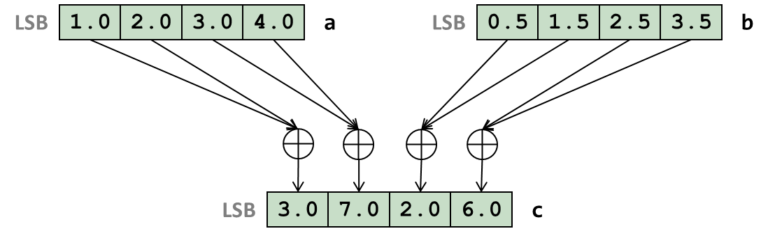
Example: SSE4
// n is even
void lp(float *x, float *y, int n) {
for (int i = 0; i < n/2; i++)
y[i] = (x[2*i] + x[2*i+1])/2;
}
c = _mm_hadd_ps(a, b);
c = _mm_hsub_ps(a, b);
#include <ia32intrin.h>
// n a multiple of 8, x, y are 16-byte aligned
void lp_vec(float *x, int n) {
__m128 half, v1, v2, avg;
half = _mm_set1_ps(0.5); // set vector to all 0.5
for(int i = 0; i < n/8; i++) {
v1 = _mm_load_ps(x+i*8); // load first 4 floats
v2 = _mm_load_ps(x+4+i*8); // load next 4 floats
avg = _mm_hadd_ps(v1, v2); // add pairs of floats
avg = _mm_mul_ps(avg, half); // multiply with 0.5
_mm_store_ps(y+i*4, avg); // save result
}
}

Slide 35
Comparisons: SSE4/AVX128
Intrinsic Name | Operation | Corresponding SSE Instruction
_mm_cmpeq_ss | Equal | CMPEQSS
_mm_cmpeq_ps | Equal | CMPEQPS
_mm_cmplt_ss | Less Than | CMPLTSS
_mm_cmplt_ps | Less Than | CMPLTPS
_mm_cmple_ss | Less Than or Equal | CMPLESS
_mm_cmple_ps | Less Than or Equal | CMPLEPS
_mm_cmpgt_ss | Greater Than | CMPLTSS
_mm_cmpgt_ps | Greater Than | CMPLTPS
_mm_cmpge_ss | Greater Than or Equal | CMPLESS
_mm_cmpge_ps | Greater Than or Equal | CMPLEPS
_mm_cmpneq_ss | Not Equal | CMPNEQSS
_mm_cmpneq_ps | Not Equal | CMPNEQPS
_mm_cmpnlt_ss | Not Less Than | CMPNLTSS
_mm_cmpnlt_ps | Not Less Than | CMPNLTPS
_mm_cmpnle_ss | Not Less Than or Equal | CMPNLESS
_mm_cmpnle_ps | Not Less Than or Equal | CMPNLEPS
_mm_cmpngt_ss | Not Greater Than | CMPNLTSS
_mm_cmpngt_ps | Not Greater Than | CMPNLTPS
_mm_cmpnge_ss | Not Greater Than or Equal | CMPNLESS
_mm_cmpnge_ps | Not Greater Than or Equal | CMPNLEPS
Intrinsic Name | Operation | Corresponding SSE Instruction
_mm_cmpord_ss | Ordered | CMPORDSS
_mm_cmpord_ps | Ordered | CMPORDPS
_mm_cmpunord_ss | Unordered | CMPUNORDSS
_mm_cmpunord_ps | Unordered | CMPUNORDPS
_mm_comieq_ss | Equal | COMISS
_mm_comilt_ss | Less Than | COMISS
_mm_comile_ss | Less Than or Equal | COMISS
_mm_comigt_ss | Greater Than | COMISS
_mm_comige_ss | Greater Than or Equal | COMISS
_mm_comineq_ss | Not Equal | COMISS
_mm_ucomieq_ss | Equal | UCOMISS
_mm_ucomilt_ss | Less Than | UCOMISS
_mm_ucomile_ss | Less Than or Equal | UCOMISS
_mm_ucomigt_ss | Greater Than | UCOMISS
_mm_ucomige_ss | Greater Than or Equal | UCOMISS
_mm_ucomineq_ss | Not Equal | UCOMISS

Slide 36
Comparisons: AVX
Intrinsic Name | Operation | Corresponding SSE Instruction
_mm_cmp_pd | Controlled by imm8 | vcmppd
_mm256_cmp_pd | Controlled by imm8 | vcmppd
imm8:
0: OP := _CMP_EQ_OQ
1: OP := _CMP_LT_OS
2: OP := _CMP_LE_OS
3: OP := _CMP_UNORD_Q
4: OP := _CMP_NEQ_UQ
5: OP := _CMP_NLT_US
6: OP := _CMP_NLE_US
7: OP := _CMP_ORD_Q
8: OP := _CMP_EQ_UQ
9: OP := _CMP_NGE_US
10: OP := _CMP_NGT_US
11: OP := _CMP_FALSE_OQ
12: OP := _CMP_NEQ_OQ
13: OP := _CMP_GE_OS
14: OP := _CMP_GT_OS
15: OP := _CMP_TRUE_UQ
16: OP := _CMP_EQ_OS
17: OP := _CMP_LT_OQ
18: OP := _CMP_LE_OQ
19: OP := _CMP_UNORD_S
20: OP := _CMP_NEQ_US
21: OP := _CMP_NLT_UQ
22: OP := _CMP_NLE_UQ
23: OP := _CMP_ORD_S
24: OP := _CMP_EQ_US
25: OP := _CMP_NGE_UQ
26: OP := _CMP_NGT_UQ
27: OP := _CMP_FALSE_OS
28: OP := _CMP_NEQ_OS
29: OP := _CMP_GE_OQ
30: OP := _CMP_GT_OQ
31: OP := _CMP_TRUE_US

Slide 37
Comparison Example: SSE4
LSB
1.0
2.0
3.0
4.0
a
LSB
1.0
1.5
3.0
3.5
b
=?
=?
=?
=?
LSB
0xffffffff
0x0
0xffffffff
0x0
c
c = _mm_cmpeq_ps(a, b);
Each field:
0xffffffff if true
0x0 if false
analogous:
c = _mm_cmple_ps(a, b);
Return type: __m128
c = _mm_cmplt_ps(a, b);
c = _mm_cmpge_ps(a, b);
etc.

Slide 38
SSE4 Code Example
void fcond(float *x, size_t n) {
int i;
for(i = 0; i < n; i++) {
if(x[i] > 0.5)
x[i] += 1.;
else x[i] -= 1.;
}
}
#include <xmmintrin.h>
void fcond(float *a, size_t n) {
int i;
__m128 vt, vmask, vp, vm, vr, ones, mones, thresholds;
ones = _mm_set1_ps(1.);
mones = _mm_set1_ps(-1.);
thresholds = _mm_set1_ps(0.5);
for(i = 0; i < n; i+=4) {
vt = _mm_load_ps(a+i);
vmask = _mm_cmpgt_ps(vt, thresholds);
vp = _mm_and_ps(vmask, ones);
vm = _mm_andnot_ps(vmask, mones);
vr = _mm_add_ps(vt, _mm_or_ps(vp, vm));
_mm_store_ps(a+i, vr);
}
}

Slide 39
Shuffles: SSE
SSE
SSE3
Intrinsic Name | Operation | Corresponding SSE Instruction
_mm_shuffle_ps | Shuffle | SHUFPS
_mm_unpackhi_ps | Unpack High | UNPCKHPS
_mm_unpacklo_ps | Unpack Low | UNPCKLPS
_mm_move_ss | Set low word, pass in three high values | MOVSS
_mm_movehl_ps | Move High to Low | MOVHLPS
_mm_movelh_ps | Move Low to High | MOVLHPS
_mm_movemask_ps | Create four-bit mask | MOVMSKPS
Intrinsic Name | Operation | Corresponding SSE3 Instruction
_mm_movehdup_ps | Duplicates | MOVSHDUP
_mm_moveldup_ps | Duplicates | MOVSLDUP
SSSE3
Intrinsic Name | Operation | Corresponding SSSE3 Instruction
_mm_shuffle_epi8 | Shuffle | PSHUFB
_mm_alignr_epi8 | Shift | PALIGNR
SSE4
Intrinsic Syntax | Operation | Corresponding SSE4 Instruction
__m128 _mm_blend_ps(__m128 v1, __m128 v2, const int mask) | Selects float single precision data from 2 sources using constant mask | BLENDPS
__m128 _mm_blendv_ps(__m128 v1, __m128 v2, __m128 v3) | Selects float single precision data from 2 sources using variable mask | BLENDVPS
__m128 _mm_insert_ps(__m128 dst, __m128 src, const int ndx) | Insert single precision float into packed single precision array element selected by index. | INSERTPS
int _mm_extract_ps(__m128 src, const int ndx) | Extract single precision float from packed single precision array selected by index. | EXTRACTPS

Slide 40
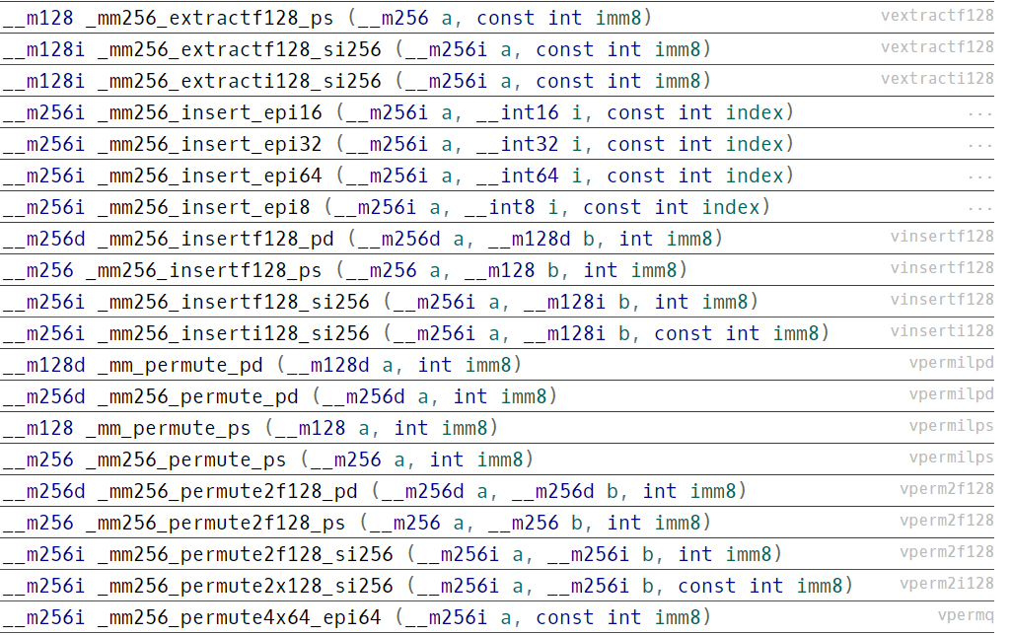
Shuffles: AVX

Slide 41
Shuffles: SSE
LSB
1.0
2.0
3.0
4.0
a
LSB
0.5
1.5
2.5
3.5
b
LSB
1.0
0.5
2.0
1.5
c
c = _mm_unpacklo_ps(a, b);
LSB
1.0
2.0
3.0
4.0
a
LSB
0.5
1.5
2.5
3.5
b
LSB
3.0
2.5
4.0
3.5
c
c = _mm_unpackhi_ps(a, b);

Slide 42
Shuffles
c = _mm_shuffle_ps(a, b, _MM_SHUFFLE(l, k, j, i));
helper macro to create mask
LSB
1.0
2.0
3.0
4.0
a
LSB
0.5
1.5
2.5
3.5
b
LSB
c0
c1
c2
c3
c
c0 = ai
c1 = aj
c2 = bk
c3 = bl
i,j,k,l in {0,1,2,3}
any element
of a
any element
of b

Slide 43
Example: Gather Operation
p0
p1
p2
p3
1.0
2.0
3.0
4.0
memory
4x _mm_load_ss
LSB
1.0
0
0
0
LSB
3.0
0
0
0
LSB
2.0
0
0
0
LSB
4.0
0
0
0
LSB
1.0
0
2.0
0
LSB
3.0
0
4.0
0
LSB
1.0
2.0
3.0
4.0
7 instructions, this is one good way of doing it

Slide 44
Code For Previous Slide
#include <ia32intrin.h>
__m128 LoadArbitrary(float *p0, float *p1, float *p2, float *p3) {
__m128 a, b, c, d, e, f;
a = _mm_load_ss(p0);
b = _mm_load_ss(p1);
c = _mm_load_ss(p2);
d = _mm_load_ss(p3);
e = _mm_shuffle_ps(a, b, _MM_SHUFFLE(1,0,2,0)); //only zeros are important
f = _mm_shuffle_ps(c, d, _MM_SHUFFLE(1,0,2,0)); //only zeros are important
return _mm_shuffle_ps(e, f, _MM_SHUFFLE(2,0,2,0));
}
With AVX2 and AVX-512 gather/scatter operations are introduced

Slide 45
Vectorization With Intrinsics: Key Points
Use aligned loads and stores as much as possible
Minimize shuffle instructions
Minimize use of suboptimal arithmetic instructions. e.g., add_ps has higher throughput than hadd_ps
Be aware of available instructions (intrinsics guide!)

Slide 46
Example: Complex Multiplication SSE3
a
b
c
d
Memory
load
load
load
a
b
c
c
d
d
Result:
4 load/stores
3 arithm. ops.
1 reorder op
mult
swap
ac
bc
b
a
mult
bd
ad
addsub
Not available
in SSE2
ac-bd
ad+bc
store
ac-bd
ad+bc
Memory

Slide 47
Looking a t the Assembly
SSE3:
movapd xmm0, XMMWORD PTR A
movddup xmm2, QWORD PTR B
mulpd xmm2, xmm0
movddup xmm1, QWORD PTR B+8
shufpd xmm0, xmm0, 1
mulpd xmm1, xmm0
addsubpd xmm2, xmm1
movapd XMMWORD PTR C, xmm2
SSE2:
movsd xmm3, QWORD PTR A
movapd xmm4, xmm3
movsd xmm5, QWORD PTR A+8
movapd xmm0, xmm5
movsd xmm1, QWORD PTR B
mulsd xmm4, xmm1
mulsd xmm5, xmm1
movsd xmm2, QWORD PTR B+8
mulsd xmm0, xmm2
mulsd xmm3, xmm2
subsd xmm4, xmm0
movsd QWORD PTR C, xmm4
addsd xmm5, xmm3
movsd QWORD PTR C, xmm5
In SSE2 Intel C++ generates scalar code (better?)

Slide 48
SSE4.1 Code Example
int dwmonitor(float *X, double *D) {
__m128d u1, u2, u3, u4, u5, u6, u7, u8 , x1, x10, x13, x14, x17, x18, x19, x2, x3, x4, x6, x7, x8, x9;
int w1;
unsigned _xm = _mm_getcsr();
_mm_setcsr(_xm & 0xffff0000 | 0x0000dfc0);
u5 = _mm_set1_pd(0.0);
u2 = _mm_cvtps_pd(_mm_addsub_ps(_mm_set1_ps(FLT_MIN), _mm_set1_ps(X[0])));
u1 = _mm_set_pd(1.0, (-1.0));
for(int i5 = 0; i5 <= 2; i5++) {
x6 = _mm_addsub_pd(_mm_set1_pd((DBL_MIN + DBL_MIN)), _mm_loaddup_pd(&(D[i5])));
x1 = _mm_addsub_pd(_mm_set1_pd(0.0), u1);
x2 = _mm_mul_pd(x1, x6);
x3 = _mm_mul_pd(_mm_shuffle_pd(x1, x1, _MM_SHUFFLE2(0, 1)), x6);
x4 = _mm_sub_pd(_mm_set1_pd(0.0), _mm_min_pd(x3, x2));
u3 = _mm_add_pd(_mm_max_pd(_mm_shuffle_pd(x4, x4, _MM_SHUFFLE2(0, 1)), _mm_max_pd(x3, x2)), _mm_set1_pd(DBL_MIN));
u5 = _mm_add_pd(u5, u3);
x7 = _mm_addsub_pd(_mm_set1_pd(0.0), u1);
x8 = _mm_mul_pd(x7, u2);
x9 = _mm_mul_pd(_mm_shuffle_pd(x7, x7, _MM_SHUFFLE2(0, 1)), u2);
x10 = _mm_sub_pd(_mm_set1_pd(0.0), _mm_min_pd(x9, x8));
u1 = _mm_add_pd(_mm_max_pd(_mm_shuffle_pd(x10, x10, _MM_SHUFFLE2(0, 1)), _mm_max_pd(x9, x8)), _mm_set1_pd(DBL_MIN));
}
u6 = _mm_set1_pd(0.0);
for(int i3 = 0; i3 <= 1; i3++) {
u8 = _mm_cvtps_pd(_mm_addsub_ps(_mm_set1_ps(FLT_MIN), _mm_set1_ps(X[(i3 + 1)])));
u7 = _mm_cvtps_pd(_mm_addsub_ps(_mm_set1_ps(FLT_MIN), _mm_set1_ps(X[(3 + i3)])));
x14 = _mm_add_pd(u8, _mm_shuffle_pd(u7, u7, _MM_SHUFFLE2(0, 1)));
x13 = _mm_shuffle_pd(x14, x14, _MM_SHUFFLE2(0, 1));
u4 = _mm_shuffle_pd(_mm_min_pd(x14, x13), _mm_max_pd(x14, x13), _MM_SHUFFLE2(1, 0));
u6 = _mm_shuffle_pd(_mm_min_pd(u6, u4), _mm_max_pd(u6, u4), _MM_SHUFFLE2(1, 0));
}
x17 = _mm_addsub_pd(_mm_set1_pd(0.0), u6);
x18 = _mm_addsub_pd(_mm_set1_pd(0.0), u5);
x19 = _mm_cmpge_pd(x17, _mm_shuffle_pd(x18, x18, _MM_SHUFFLE2(0, 1)));
w1 = (_mm_testc_si128(_mm_castpd_si128(x19), _mm_set_epi32(0xffffffff, 0xffffffff, 0xffffffff, 0xffffffff)) –
(_mm_testnzc_si128(_mm_castpd_si128(x19), _mm_set_epi32(0xffffffff, 0xffffffff, 0xffffffff, 0xffffffff))));
__asm nop;
if (_mm_getcsr() & 0x0d) {
_mm_setcsr(_xm);
return -1;
}
_mm_setcsr(_xm);
return w1;
}

Slide 49
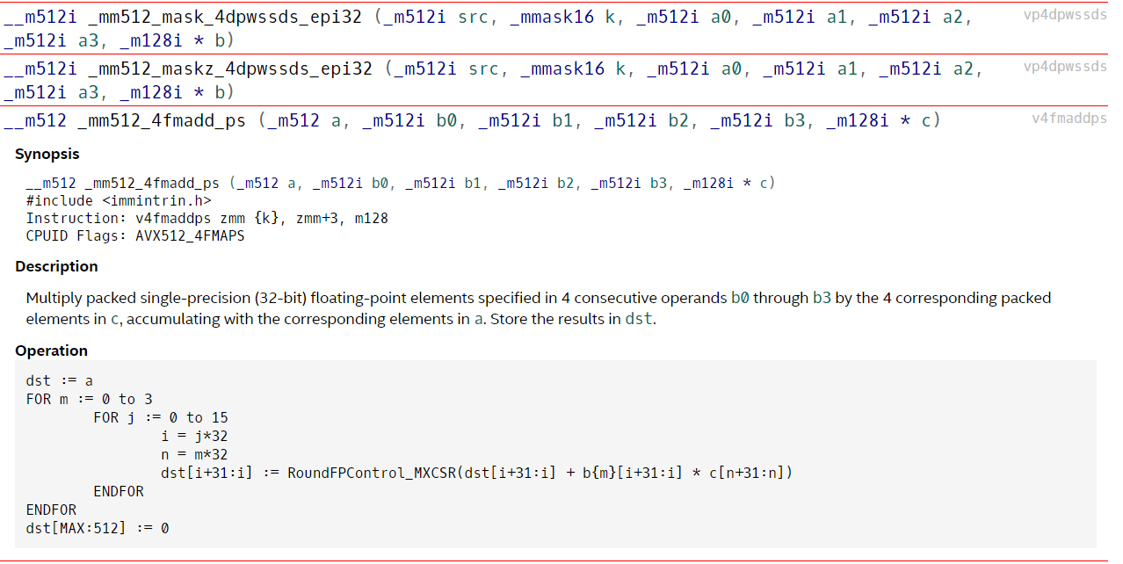
Beyond AVX2: AVX-512/KNC

Slide 50
Beyond Intel
IBM PowerPC
PowerPC: AltiVec, Cell Processor
POWER: VMX, VMX128, VSX
Supercomputer: Double FPU, Quad FPU
AMD
Early competition with Intel: 3DNow! vs. MMX/SSE
Later: FMA4 vs. AVX/FMA3
Now: cross-licensed
ARM
NEON instruction set
Complex numbers, half precision, advanced SIMD instructions
RISC V
Hwatcha vector unit

Slide 51
How to Write Good Vector Code?
Take the “right” algorithm and the “right” data structures
Fine grain parallelism
Correct alignment in memory
Contiguous arrays
Use a good compiler (e. g., vendor compiler)
First: Try compiler vectorization
Right options, pragmas and dynamic memory functions (Inform compiler about data alignment, loop independence,…)
Check generated assembly code and runtime
If necessary: Write vector code yourself
Most expensive subroutine first
Use intrinsics, no (inline) assembly
Important: Understand the ISA
Annoying: understand the microarchitecture and instruction cost

Slide 52
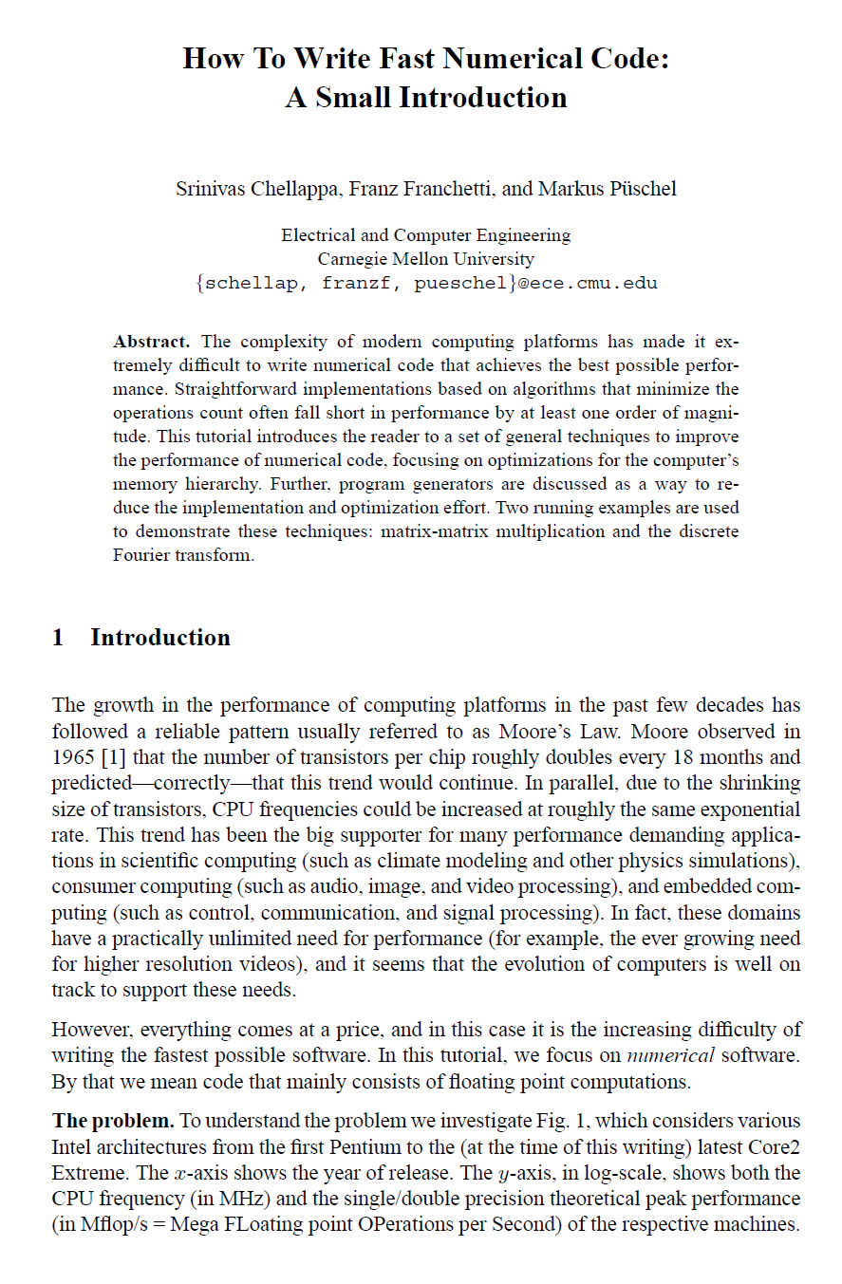
18-645: How to Write Fast Code
https://courses.ece.cmu.edu/18645
http://www.ece.cmu.edu/~franzf/papers/gttse07.pdf
https://www.inf.ethz.ch/personal/markusp/teaching/18-645-CMU-spring08/course.html

Slide 53
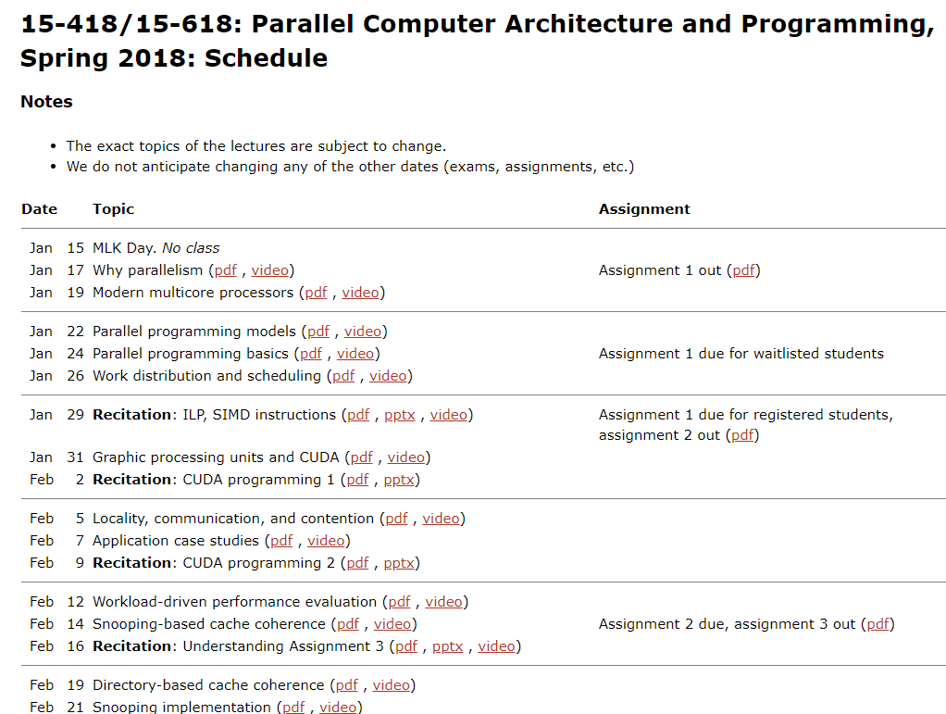
https://www.cs.cmu.edu/afs/cs.cmu.edu/academic/class/15418-s18/www/schedule.html

