Slide 1
The C Language And Some Extensions
18-613: Foundations of Computer Systems
3rd Additional Lecture, Jan. 31, 2019
Instructor:
Franz Franchetti

Slide 2
Scope of C in 18-613
Bootcamp: Linux and Windows
Basic data types and functions
Structures, arrays, etc.
C Standard Library
Linux/POSIX Libraries
Language Extensions
Final thoughts

Slide 3
Linux and Windows
Linux Bootcamp:
http://www.cs.cmu.edu/afs/cs/academic/class/15213-s19/www/activities/linux-bootcamp/linux-bootcamp.pdf
Navigate and work on the shark machines
vim, emacs, nano, ls, mkdir, cd, ps,…
Windows Setup:
http://www.cs.cmu.edu/~213/activities/linux-bootcamp/windows-setup.pdf
Windows SSH, SFTP, public key setup
Putty, Tectia, Bitvise
GIT Client: TortoiseGIT
Remote Editor: Visual Studio Code + sftp
Xterm/X-Windows: X-Win32 or MobaXterm
Cisco AnyConnect VPN
OpenAFS
See Windows section at
http://www.cs.cmu.edu/afs/cs/academic/class/15213-s19/www/faq.html

Slide 4
Scope of C in 18-613
Bootcamp: Linux and Windows
Basic data types and functions
Structures, arrays, etc.
C Standard Library
Linux/POSIX Libraries
Language Extensions
Final thoughts

Slide 5
C For Non-C Programmers
You need to be firm with C in 18-613
https://fresh2refresh.com/c-programming/ https://www.youtube.com/watch?v=KJgsSFOSQv0
https://www.edx.org/course/c-programming-language-foundations
https://www.edx.org/course/c-programming-advanced-data-types
Remember the main differences from your favorite language
  Strings, arrays, multidimensional arrays
  Arithmetic and logic and/or/xor/not
  Type casting/type checking, scoping, Not object oriented
  (No) array bounds checking
  Pointers, function pointers, composite data structures, void pointers
  Typedefs, structs and unions
  Malloc/free, File I/O, keyboard I/O
  C preprocessor/macros
  Standard libraries and POSIX libraries

Slide 6
Basic Data Types
C Data Type | Typical 32-bit | Typical 64-bit | x86-64
char | 1 | 1 | 1
short | 2 | 2 | 2
int | 4 | 4 | 4
long | 4 | 8 | 8
float | 4 | 4 | 4
double | 8 | 8 | 8
pointer | 4 | 8 | 8
Remember: unexpected size guarantees

Slide 7
Bit-Level Operations in C
Decimal
Operations &, |, ~, ^ Available in C
  Apply to any “integral” data type
    long, int, short, char, unsigned
  View arguments as bit vectors
  Arguments applied bit-wise
Examples (Char data type)
  ~0x41 → 0xBE
    ~0100 00012 → 1011 11102
  ~0x00 → 0xFF
    ~0000 00002 → 1111 11112
  0x69 & 0x55 → 0x41
    0110 10012 & 0101 01012 → 0100 00012
  0x69 | 0x55 → 0x7D
    0110 10012 | 0101 01012 → 0111 11012
Hex
Binary
0
0
0000
1
1
0001
2
2
0010
3
3
0011
4
4
0100
5
5
0101
6
6
0110
7
7
0111
8
8
1000
9
9
1001
A
10
1010
B
11
1011
C
12
1100
D
13
1101
E
14
1110
F
15
1111

Slide 8
Contrast: Logic Operations in C
Contrast to Bit-Level Operators
  Logic Operations: &&, ||, !
    View 0 as “False”
    Anything nonzero as “True”
    Always return 0 or 1
    Early termination
Examples (char data type)
  !0x41 → 0x00
  !0x00 → 0x01
  !!0x41→ 0x01
  0x69 && 0x55 → 0x01
  0x69 || 0x55 → 0x01
  p && *p (avoids null pointer access)

Slide 9
Signed vs. Unsigned in C
Constants
  By default are considered to be signed integers
  Unsigned if have “U” as suffix
    0U, 4294967259U
Casting
  Explicit casting between signed & unsigned same as U2T and T2U
    int tx, ty;
    unsigned ux, uy;
    tx = (int) ux;
    uy = (unsigned) ty;
  Implicit casting also occurs via assignments and procedure calls
    tx = ux; int fun(unsigned u);
    uy = ty; uy = fun(tx);

Slide 10
Why Should I Use Unsigned? (cont.)
Do Use When Performing Modular Arithmetic
  Multiprecision arithmetic
Do Use When Using Bits to Represent Sets
  Logical right shift, no sign extension
Do Use In System Programming
  Bit masks, device commands,…

Slide 11
Casting Surprises
Expression Evaluation
  If there is a mix of unsigned and signed in single expression,
  signed values implicitly cast to unsigned
  Including comparison operations <, >, ==, <=, >=
  Examples for W = 32: TMIN = -2,147,483,648 , TMAX = 2,147,483,647
Constant₁ Constant₂ Relation Evaluation
  0 0U
  -1 0
  -1 0U
  2147483647 -2147483647-1
  2147483647U -2147483647-1
  -1 -2
  (unsigned)-1 -2
  2147483647 2147483648U
  2147483647 (int) 2147483648U
  0 0U == unsigned
  -1 0 < signed
  -1 0U > unsigned
  2147483647 -2147483648 > signed
  2147483647U -2147483648 < unsigned
  -1 -2 > signed
  (unsigned) -1 -2 > unsigned
  2147483647 2147483648U < unsigned
  2147483647 (int) 2147483648U > signed

Slide 12


Integer C Puzzles
x < 0 ⇒ ((x*2) < 0)
ux >= 0
x & 7 == 7 ⇒ (x<<30) < 0
ux > -1
x > y ⇒ -x < -y
x * x >= 0
x > 0 && y > 0 ⇒ x + y > 0
x >= 0 ⇒ -x <= 0
x <= 0 ⇒ -x >= 0
(x|-x)>>31 == -1
ux >> 3 == ux/8
x >> 3 == x/8
x & (x-1) != 0
Initialization
int x = foo();
int y = bar();
unsigned ux = x;
unsigned uy = y;

Slide 13
Byte Ordering Example
Example
  Variable x has 4-byte value of 0x01234567
  Address given by &x is 0x100
Big Endian
0x100
0x101
0x102
0x103
01
01
23
23
45
45
67
67
Little Endian
0x100
0x101
0x102
0x103
67
67
45
45
23
23
01
01
This is key in gdb and ProxyLab

Slide 14
Representing Strings
char S[6] = "18213";
Strings in C
  Represented by array of characters
  Each character encoded in ASCII format
    Standard 7-bit encoding of character set
    Character “0” has code 0x30
      Digit i has code 0x30+i
  String should be null-terminated
    Final character = 0
Compatibility
  Byte ordering not an issue
x86-64
31
38
32
31
33
00

Slide 15
Floating Point in C
C Guarantees Two Levels
  float single precision
  double double precision
Conversions/Casting
  Casting between int, float, and double changes bit representation
  double/float → int
    Truncates fractional part
    Like rounding toward zero
    Not defined when out of range or NaN: Generally sets to TMin
  int → double
    Exact conversion, as long as int has ≤ 53 bit word size
  int → float
    Will round according to rounding mode

Slide 16
Floating Point Puzzles
For each of the following C expressions, either:
  Argue that it is true for all argument values
  Explain why not true
x == (int)(float) x
x == (int)(double) x
f == (float)(double) f
d == (double)(float) d
f == -(-f);
2/3 == 2/3.0
d < 0.0 ⇒ ((d*2) < 0.0)
d > f ⇒ -f > -d
d * d >= 0.0
(d+f)-d == f
int x = …;
float f = …;
double d = …;
Assume neither
d nor f is NaN

Slide 17
Summarizing C Control Flow
C Control
  if-then-else
  do-while
  while, for
  switch
What to watch out for
  if-then-else
  proper {…} for else if, logical condition in (…), = vs. ==
  do-while, while, for:
  init, test, update: which ones execute at least once,…
  break, continue
  switch
  break, default
  goto, labels, setjmp/longjmp

Slide 18
Functions
Functions
have return value, can be ignored
Procedures: no return value
void x();
Call by value/by reference
use of pointers, when to copy
Recursion: nothing special
Declaration and definition
Modifiers: __inline, __naked , …
Variable length arguments:
printf, scanf,…
In your own functions:
int sum(int n, …)
va_arg()

Slide 19
Scope of C in 18-613
Bootcamp: Linux and Windows
Basic data types and functions
Structures, arrays, etc.
C Standard Library
Linux/POSIX Libraries
Language Extensions
Final thoughts

Slide 20
Array Access
Basic Principle
  T A[L];
  Array of data type T and length L
  Identifier A can be used as a pointer to array element 0: Type T*
Reference Type Value
  val[4] int 3
  val int * x
  val+1 int * x + 4
  &val[2] int * x + 8
  val[5] int ??
  *(val+1) int 5
  val + i int * x + 4 i
int val[5];
1
5
2
1
3
x
x + 4
x + 8
x + 12
x + 16
x + 20

Slide 21
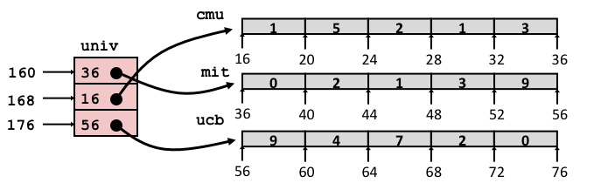
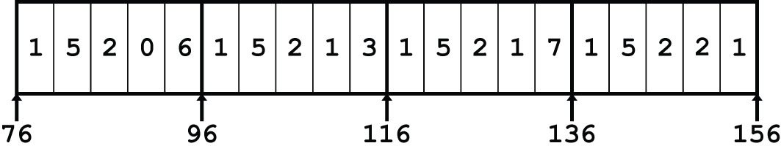
Array Element Accesses
Nested array
Multi-level array
int get_pgh_digit
(size_t index, size_t digit)
{
return pgh[index][digit];
}
int get_univ_digit
(size_t index, size_t digit)
{
return univ[index][digit];
}
Accesses looks similar in C, but address computations very different:
Mem[pgh+20*index+4*digit]
Mem[Mem[univ+8*index]+4*digit]

Slide 22
N X N Matrix Code
#define N 16
typedef int fix_matrix[N][N];
/* Get element A[i][j] */
int fix_ele(fix_matrix A,
size_t i, size_t j)
{
return A[i][j];
}
Fixed dimensions
  Know value of N at compile time
Variable dimensions, explicit indexing
  Traditional way to implement dynamic arrays
Variable dimensions, implicit indexing
  Now supported by gcc
#define IDX(n, i, j) ((i)*(n)+(j))
/* Get element A[i][j] */
int vec_ele(size_t n, int *A,
size_t i, size_t j)
{
return A[IDX(n,i,j)];
}
/* Get element a[i][j] */
int var_ele(size_t n, int A[n][n],
size_t i, size_t j) {
return A[i][j];
}

Slide 23
Understanding Pointers & Arrays #1
Decl | An |  |  | *An
 | Cmp | Bad | Size | Cmp | Bad | Size
int A1[3]
int *A2
Cmp: Compiles (Y/N)
Bad: Possible bad pointer reference (Y/N)
Size: Value returned by sizeof

Slide 24
Understanding Pointers & Arrays #1
Decl | An |  |  | *An
 | Cmp | Bad | Size | Cmp | Bad | Size
int A1[3] | Y | N | 12 | Y | N | 4
int *A2 | Y | N | 8 | Y | Y | 4
A1
Allocated pointer
Unallocated pointer
A2
Allocated int
Unallocated int
Cmp: Compiles (Y/N)
Bad: Possible bad pointer reference (Y/N)
Size: Value returned by sizeof

Slide 25
Understanding Pointers & Arrays #2
Decl | An |  |  | *An |  |  | **An
 | Cmp | Bad | Size | Cmp | Bad | Size | Cmp | Bad | Size
int A1[3]
int *A2[3]
int (*A3)[3]
int (*A4[3])
Cmp: Compiles (Y/N)
Bad: Possible bad pointer reference (Y/N)
Size: Value returned by sizeof

Slide 26
Understanding Pointers & Arrays #2
Decl | An |  |  | *An |  |  | **An
 | Cmp | Bad | Size | Cmp | Bad | Size | Cmp | Bad | Size
int A1[3] | Y | N | 12 | Y | N | 4 | N | - | -
int *A2[3] | Y | N | 24 | Y | N | 8 | Y | Y | 4
int (*A3)[3] | Y | N | 8 | Y | Y | 12 | Y | Y | 4
int (*A4[3]) | Y | N | 24 | Y | N | 8 | Y | Y | 4
A1
A2/A4
A3
Allocated pointer
Unallocated pointer
Allocated int
Unallocated int

Slide 27
Understanding Pointers & Arrays #3
Decl | An |  |  | *An |  |  | **An
 | Cmp | Bad | Size | Cmp | Bad | Size | Cmp | Bad | Size
int A1[3][5]
int *A2[3][5]
int (*A3)[3][5]
int *(A4[3][5])
int (*A5[3])[5]
Cmp: Compiles (Y/N)
Bad: Possible bad pointer reference (Y/N)
Size: Value returned by sizeof
Decl | ***An
 | Cmp | Bad | Size
int A1[3][5]
int *A2[3][5]
int (*A3)[3][5]
int *(A4[3][5])
int (*A5[3])[5]

Slide 28
Allocated pointer
Declaration
int A1[3][5]
int *A2[3][5]
int (*A3)[3][5]
int *(A4[3][5])
int (*A5[3])[5]
Allocated pointer to unallocated int
Unallocated pointer
Allocated int
Unallocated int
A1
A2/A4
A3
A5

Slide 29
Understanding Pointers & Arrays #3
Decl | An |  |  | *An |  |  | **An
 | Cmp | Bad | Size | Cmp | Bad | Size | Cmp | Bad | Size
int A1[3][5] | Y | N | 60 | Y | N | 20 | Y | N | 4
int *A2[3][5] | Y | N | 120 | Y | N | 40 | Y | N | 8
int (*A3)[3][5] | Y | N | 8 | Y | Y | 60 | Y | Y | 20
int *(A4[3][5]) | Y | N | 120 | Y | N | 40 | Y | N | 8
int (*A5[3])[5] | Y | N | 24 | Y | N | 8 | Y | Y | 20
Cmp: Compiles (Y/N)
Bad: Possible bad pointer reference (Y/N)
Size: Value returned by sizeof
Decl | ***An
 | Cmp | Bad | Size
int A1[3][5] | N | - | -
int *A2[3][5] | Y | Y | 4
int (*A3)[3][5] | Y | Y | 4
int *(A4[3][5]) | Y | Y | 4
int (*A5[3])[5] | Y | Y | 4

Slide 30
Pointers and Function Pointers
int *p
int *p[13]
int *(p[13])
int **p
int (*p)[13]
int *f()
int (*f)()
int (*(*f())[13])()
int (*(*x[3])())[5]
p is a pointer to int
p is an array[13] of pointer to int
p is an array[13] of pointer to int
p is a pointer to a pointer to an int
p is a pointer to an array[13] of int
f is a function returning a pointer to int
f is a pointer to a function returning int
f is a function returning ptr to an array[13]
of pointers to functions returning int
x is an array[3] of pointers to functions
returning pointers to array[5] of ints
Source: K&R Sec 5.12

Slide 31
Typedef, Struct, Volatile, Memory Error…
typedef struct {
int a[2];
double d;
} struct_t;
double fun(int i) {
volatile struct_t s;
s.d = 3.14;
s.a[i] = 1073741824; /* Possibly out of bounds */
return s.d;
}
fun(0) -> 3.14
fun(1) -> 3.14
fun(2) -> 3.1399998664856
fun(3) -> 2.00000061035156
fun(4) -> 3.14
fun(6) -> Segmentation fault
  Result is system specific

Slide 32
Union
Allocate according to largest element
Can only use one field at a time
union U1 {
char c;
int i[2];
double v;
} *up;
 | c
 | i[0] |  |  |  | i[1]
 | v
up+0 |  |  | up+4 |  |  |  |  | up+8
struct S1 {
char c;
int i[2];
double v;
} *sp;
 | c | 3 bytes |  |  | i[0] |  |  |  | i[1] |  |  |  | 4 bytes |  |  | v
sp+0 |  |  |  | sp+4 |  |  |  | sp+8 |  |  |  |  |  |  | sp+16 |  |  |  |  |  | sp+24

Slide 33
Union: Byte Ordering Example
union {
unsigned char c[8];
unsigned short s[4];
unsigned int i[2];
unsigned long l[1];
} dw;
c[0] | c[1] | c[2] | c[3] | c[4] | c[5] | c[6] | c[7]
s[0] |  | s[1] |  | s[2] |  | s[3]
i[0] |  |  |  | i[1]
l[0]

Slide 34
Variable Declarations: Multiple Files
int x;
p1() {}
p1() {}
Link time error: two strong symbols (p1)
int x;
p1() {}
int x;
p2() {}
References to x will refer to the same
uninitialized int. Is this what you really want?
int x;
int y;
p1() {}
double x;
p2() {}
Writes to x in p2 might overwrite y!
Evil!
int x=7;
int y=5;
p1() {}
double x;
p2() {}
Writes to x in p2 will overwrite y!
Nasty!
int x=7;
p1() {}
int x;
p2() {}
References to x will refer to the same initialized
variable.
Nightmare scenario: two identical weak structs, compiled by different compilers
with different alignment rules.

Slide 35
Global Variables
Avoid if you can
Otherwise
  Use static if you can
  Initialize if you define a global variable
  Use extern if you reference an external global variable

Slide 36
Preprocessor: Pragmas and Macros
Textual expansion to avoid copy-and-paste
Control compilation, can set from command line gcc -DDEBUG
Pragmas control compilation and compiler options
#define MIN(a,b) (((a)<(b))?(a):(b))
#ifdef DEBUG
…
#else
…
#endif
foo() {
#pragma GCC diagnostic ignored "-Wunused-variable"
int i, j;
i=3;
}

Slide 37
Scope of C in 18-613
Bootcamp: Linux and Windows
Basic data types and functions
Structures, arrays, etc.
C Standard Library
Linux/POSIX Libraries
Language Extensions
Final thoughts

Slide 38
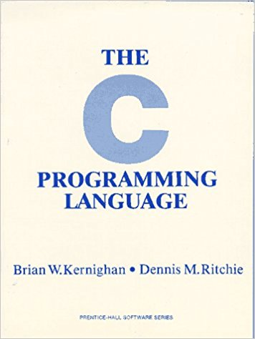
C Standard Libraries: K&R Appendix B
Input & output: <stdio.h>
String functions: <string.h>
Mathematical functions: <math.h>
Utility functions: <stdlib.h>
Date and time: <time.h>
and a few more …

Slide 39
Standard I/O Functions
The C standard library (libc.so) contains a collection of higher-level standard I/O functions
  Documented in Appendix B of K&R
Examples of standard I/O functions:
  Opening and closing files (fopen and fclose)
  Reading and writing bytes (fread and fwrite)
  Reading and writing text lines (fgets and fputs)
  Formatted reading and writing (fscanf and fprintf)

Slide 40
Standard I/O Streams
Standard I/O models open files as streams
  Abstraction for a file descriptor and a buffer in memory
C programs begin life with three open streams
(defined in stdio.h)
  stdin (standard input)
  stdout (standard output)
  stderr (standard error)
#include <stdio.h>
extern FILE *stdin; /* standard input (descriptor 0) */
extern FILE *stdout; /* standard output (descriptor 1) */
extern FILE *stderr; /* standard error (descriptor 2) */
int main() {
fprintf(stdout, "Hello, world\n");
}

Slide 41
malloc Example
#include <stdio.h>
#include <stdlib.h>
void foo(int n) {
int i, *p;
/* Allocate a block of n ints */
p = (int *) malloc(n * sizeof(int));
if (p == NULL) {
perror("malloc");
exit(0);
}
/* Initialize allocated block */
for (i=0; i<n; i++)
p[i] = i;
/* Return allocated block to the heap */
free(p);
}

Slide 42
Nonlocal Jumps: setjmp/longjmp
Powerful (but dangerous) user-level mechanism for transferring control to an arbitrary location
  Controlled to way to break the procedure call / return discipline
  Useful for error recovery and signal handling
int setjmp(jmp_buf j)
  Must be called before longjmp
  Identifies a return site for a subsequent longjmp
  Called once, returns one or more times
void longjmp(jmp_buf j, int i)
  Meaning:
    return from the setjmp remembered by jump buffer j again ...
    … this time returning i instead of 0
  Called after setjmp
  Called once, but never returns

Slide 43
Scope of C in 18-613
Bootcamp: Linux and Windows
Basic data types and functions
Structures, arrays, etc.
C Standard Library
Linux/POSIX Libraries
Language Extensions
Final thoughts

Slide 44
Functions in Shared Objects
#ifdef RUNTIME
#define _GNU_SOURCE
#include <stdio.h>
#include <stdlib.h>
#include <dlfcn.h>
/* malloc wrapper function */
void *malloc(size_t size)
{
void *(*mallocp)(size_t size);
char *error;
mallocp = dlsym(RTLD_NEXT, "malloc"); /* Get addr of libc malloc */
if ((error = dlerror()) != NULL) {
fputs(error, stderr);
exit(1);
}
char *ptr = mallocp(size); /* Call libc malloc */
printf("malloc(%d) = %p\n", (int)size, ptr);
return ptr;
}

Slide 45
Process Control
Spawning processes
  Call fork
  One call, two returns
Process completion
  Call exit
  One call, no return
Reaping and waiting for processes
  Call wait or waitpid
Loading and running programs
  Call execve (or variant)
  One call, (normally) no return

Slide 46
Signals
void sigint_handler(int sig) /* SIGINT handler */
{
printf("So you think you can stop the bomb with ctrl-c, do you?\n");
sleep(2);
printf("Well...");
fflush(stdout);
sleep(1);
printf("OK. :-)\n");
exit(0);
}
int main()
{
/* Install the SIGINT handler */
if (signal(SIGINT, sigint_handler) == SIG_ERR)
unix_error("signal error");
/* Wait for the receipt of a signal */
pause();
return 0;
}

Slide 47
Unix I/O
Elegant mapping of files to devices allows kernel to export simple interface called Unix I/O:
  Opening and closing files
    open()and close()
  Reading and writing a file
    read() and write()
  Changing the current file position (seek)
    indicates next offset into file to read or write
    lseek()
B₀
B₁
• • •
B_{k-1}
B_{k}
B_{k+1}
• • •
Current file position = k

Slide 48
Networking: Sockets Interface
Set of system-level functions used in conjunction with Unix I/O to build network applications.
Created in the early 80’s as part of the original Berkeley distribution of Unix that contained an early version of the Internet protocols.
Available on all modern systems
  Unix variants, Windows, OS X, IOS, Android, ARM
Clients and servers use the socket function to create a socket descriptor:
Example:
int socket(int domain, int type, int protocol)
int clientfd = Socket(AF_INET, SOCK_STREAM, 0);

Slide 49
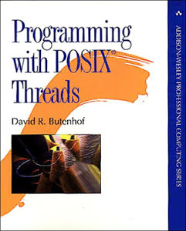
Posix Threads (Pthreads) Interface
Pthreads: Standard interface for ~60 functions that manipulate threads from C programs
  Creating and reaping threads
    pthread_create()
    pthread_join()
  Determining your thread ID
    pthread_self()
  Terminating threads
    pthread_cancel()
    pthread_exit()
    exit() [terminates all threads] ,
    RET [terminates current thread]
  Synchronizing access to shared variables
    pthread_mutex_init
    pthread_mutex_[un]lock

Slide 50
Scope of C in 18-613
Bootcamp: Linux and Windows
Basic data types and functions
Structures, arrays, etc.
C Standard Library
Linux/POSIX Libraries
Language Extensions
Final thoughts

Slide 51
C Standards
C99, C11, Advanced Constructs
Kerninghan & Ritchie
ANSI C/C 89
GNU C 89
C99
C11
Shark machines: gcc version 4.8.5
C18: not yet supported
Variable length arrays
Designated initializers
Type-generic math library
New datatypes: long long, _Complex, _Bool
restrict pointers, _Generic
Intermingled declarations of variables
Inline functions
One-line comments that begin with //

Slide 52



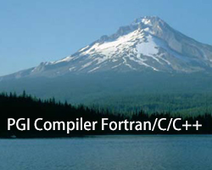

Advanced C/C++ Compilers
Intel C/C++
LLVM and GCC
PGI Compiler
IBM XL C

Slide 53
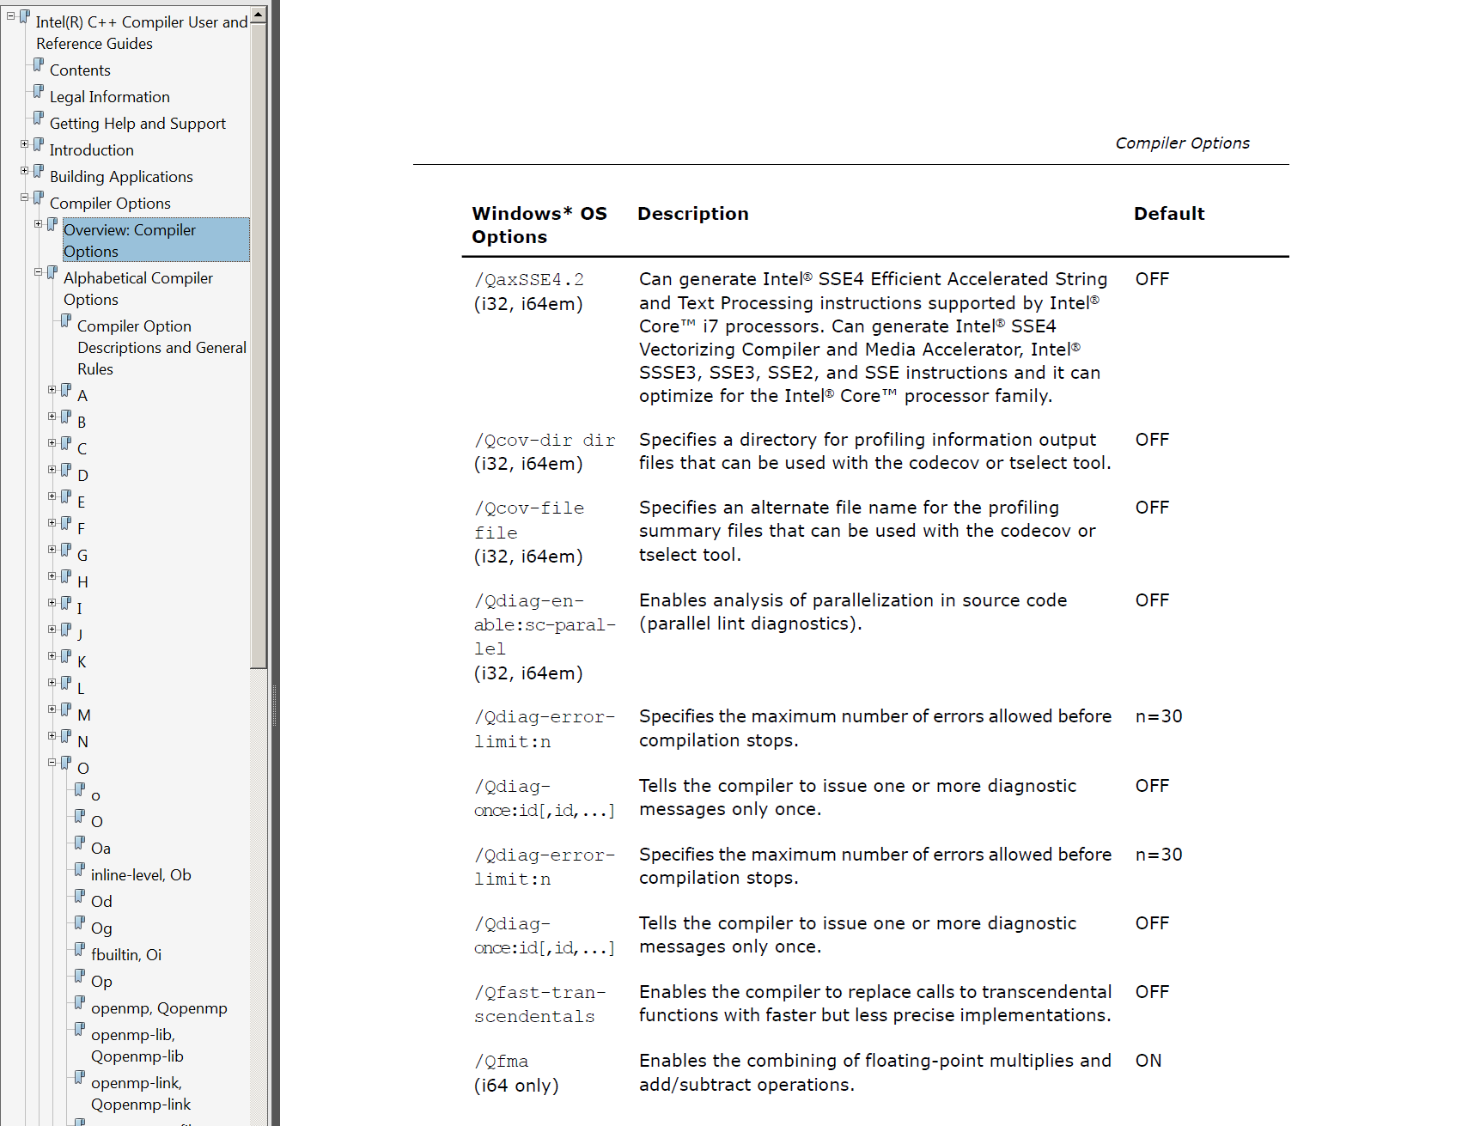
Compiler Options

Slide 54
Beyond 18-613: Bit Fields
Convenient way to access bits in status registers etc.
Useful with union to avoid type casting (up to long long)
Must fit within integral type
#include <stdio.h>
struct ieee754d {
unsigned int s: 1;
unsigned int exp: 11;
unsigned int frac: 52;
};
int main() {
struct ieee754d d = {0U, 0U, 33729U};
d.exp = 113U;
printf("%e", (double *)(&d));
return 0;
}

Slide 55
18-613: Programming with SSE3,…,AVX512
XMM registers (later versions: YMM, ZMM)
  16 total, each 16 bytes
  16 single-byte integers
  8 16-bit integers
  4 32-bit integers
  4 single-precision floats
  2 double-precision floats
  1 single-precision float
  1 double-precision float

Slide 56
Vector Instructions: Language Extension
Language extension
  Aligned C library functions: _mm_malloc(), _mm_free()
  Attributes: _assume_aligned(), __declspec(__align())
  Pragmas
  #pragma vector aligned | unaligned | always
  #pragma ivdep, #pragma novector
Data types
  __m128 f; // ={float f3, f2, f1, f0}
  __m128d d; // ={double d1, d0}
Intrinsics
  Native instructions: _mm_add_ps(), _mm_mul_ps(),…
  Multi-instruction: _mm_setr_ps(), _mm_set1_ps, …
Macros
  Transpose: _MM_TRANSPOSE4_PS(),…
  Helper: _MM_SHUFFLE()

Slide 57
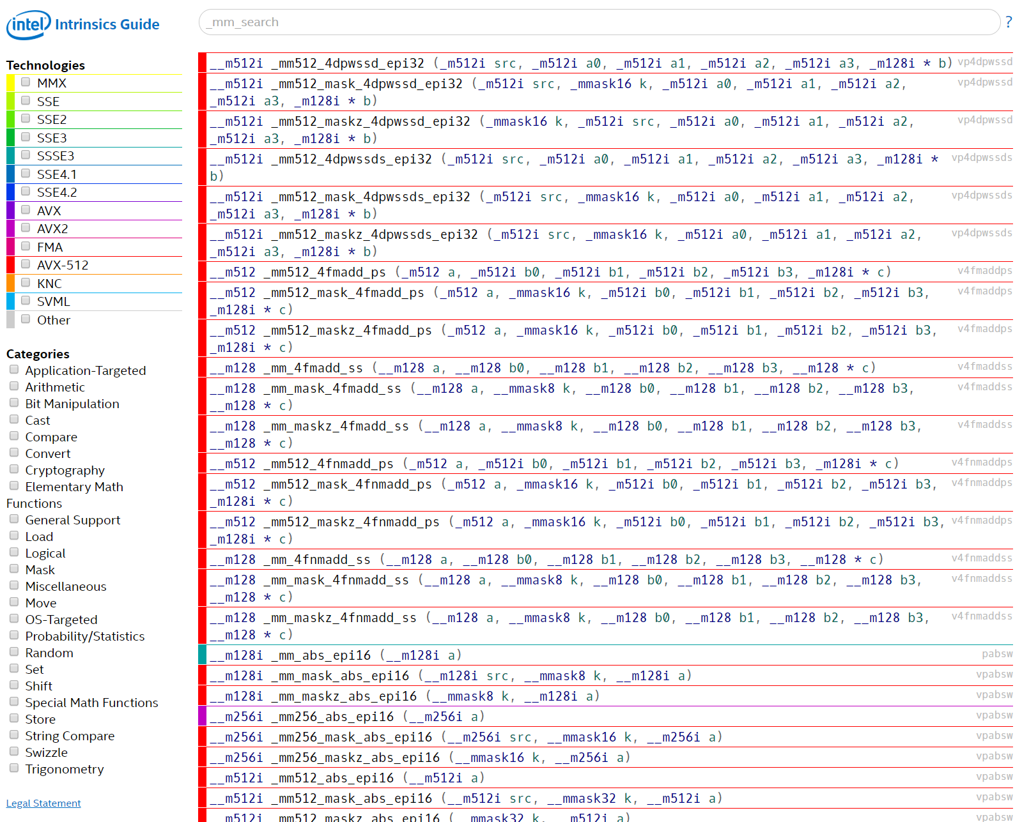

Slide 58
SSE4.1 Code Example
int dwmonitor(float *X, double *D) {
__m128d u1, u2, u3, u4, u5, u6, u7, u8 , x1, x10, x13, x14, x17, x18, x19, x2, x3, x4, x6, x7, x8, x9;
int w1;
unsigned _xm = _mm_getcsr();
_mm_setcsr(_xm & 0xffff0000 | 0x0000dfc0);
u5 = _mm_set1_pd(0.0);
u2 = _mm_cvtps_pd(_mm_addsub_ps(_mm_set1_ps(FLT_MIN), _mm_set1_ps(X[0])));
u1 = _mm_set_pd(1.0, (-1.0));
for(int i5 = 0; i5 <= 2; i5++) {
x6 = _mm_addsub_pd(_mm_set1_pd((DBL_MIN + DBL_MIN)), _mm_loaddup_pd(&(D[i5])));
x1 = _mm_addsub_pd(_mm_set1_pd(0.0), u1);
x2 = _mm_mul_pd(x1, x6);
x3 = _mm_mul_pd(_mm_shuffle_pd(x1, x1, _MM_SHUFFLE2(0, 1)), x6);
x4 = _mm_sub_pd(_mm_set1_pd(0.0), _mm_min_pd(x3, x2));
u3 = _mm_add_pd(_mm_max_pd(_mm_shuffle_pd(x4, x4, _MM_SHUFFLE2(0, 1)), _mm_max_pd(x3, x2)), _mm_set1_pd(DBL_MIN));
u5 = _mm_add_pd(u5, u3);
x7 = _mm_addsub_pd(_mm_set1_pd(0.0), u1);
x8 = _mm_mul_pd(x7, u2);
x9 = _mm_mul_pd(_mm_shuffle_pd(x7, x7, _MM_SHUFFLE2(0, 1)), u2);
x10 = _mm_sub_pd(_mm_set1_pd(0.0), _mm_min_pd(x9, x8));
u1 = _mm_add_pd(_mm_max_pd(_mm_shuffle_pd(x10, x10, _MM_SHUFFLE2(0, 1)), _mm_max_pd(x9, x8)), _mm_set1_pd(DBL_MIN));
}
u6 = _mm_set1_pd(0.0);
for(int i3 = 0; i3 <= 1; i3++) {
u8 = _mm_cvtps_pd(_mm_addsub_ps(_mm_set1_ps(FLT_MIN), _mm_set1_ps(X[(i3 + 1)])));
u7 = _mm_cvtps_pd(_mm_addsub_ps(_mm_set1_ps(FLT_MIN), _mm_set1_ps(X[(3 + i3)])));
x14 = _mm_add_pd(u8, _mm_shuffle_pd(u7, u7, _MM_SHUFFLE2(0, 1)));
x13 = _mm_shuffle_pd(x14, x14, _MM_SHUFFLE2(0, 1));
u4 = _mm_shuffle_pd(_mm_min_pd(x14, x13), _mm_max_pd(x14, x13), _MM_SHUFFLE2(1, 0));
u6 = _mm_shuffle_pd(_mm_min_pd(u6, u4), _mm_max_pd(u6, u4), _MM_SHUFFLE2(1, 0));
}
x17 = _mm_addsub_pd(_mm_set1_pd(0.0), u6);
x18 = _mm_addsub_pd(_mm_set1_pd(0.0), u5);
x19 = _mm_cmpge_pd(x17, _mm_shuffle_pd(x18, x18, _MM_SHUFFLE2(0, 1)));
w1 = (_mm_testc_si128(_mm_castpd_si128(x19), _mm_set_epi32(0xffffffff, 0xffffffff, 0xffffffff, 0xffffffff)) –
(_mm_testnzc_si128(_mm_castpd_si128(x19), _mm_set_epi32(0xffffffff, 0xffffffff, 0xffffffff, 0xffffffff))));
__asm nop;
if (_mm_getcsr() & 0x0d) {
_mm_setcsr(_xm);
return -1;
}
_mm_setcsr(_xm);
return w1;
}

Slide 59
Beyond 18-613: Inline Assembly
Write assembly instructions directly in C
Compiler and machine specific
Can trigger breakpoints
(but there are better ways to do this)
int src = 1;
int dst;
asm ("mov %1, %0\n\t"
"add $1, %0"
: "=r" (dst)
: "r" (src));
printf("%d\n", dst)
asm volatile ("int 3");

Slide 60
18-613: OpenMP for Multicore
//compute the sum of two arrays in parallel
#include <stdio.h>
#include <omp.h>
#define N 1000000
int main(void) {
float a[N], b[N], c[N];
int i;
/* Initialize arrays a and b */
for (i = 0; i < N; i++) {
a[i] = i * 2.0;
b[i] = i * 3.0;
}
/* Compute values of array c = a+b in parallel. */
#pragma omp parallel shared(a, b, c) private(i)
{
#pragma omp for
for (i = 0; i < N; i++)
c[i] = a[i] + b[i];
}
}

Slide 61
18-613: CUDA for Nvidia GPUs
// Kernel definition
__global__ void MatAdd(float A[N][N], float B[N][N],
float C[N][N])
{
int i = threadIdx.x;
int j = threadIdx.y;
C[i][j] = A[i][j] + B[i][j];
}
int main()
{
...
// Kernel invocation with one block of N * N * 1 threads
int numBlocks = 1;
dim3 threadsPerBlock(N, N);
MatAdd<<<numBlocks, threadsPerBlock>>>(A, B, C);
...
}

Slide 62
Scope of C in 18-613
Bootcamp: Linux and Windows
Basic data types and functions
Structures, arrays, etc.
C Standard Library
Linux/POSIX Libraries
Language Extensions
Final thoughts

Slide 63
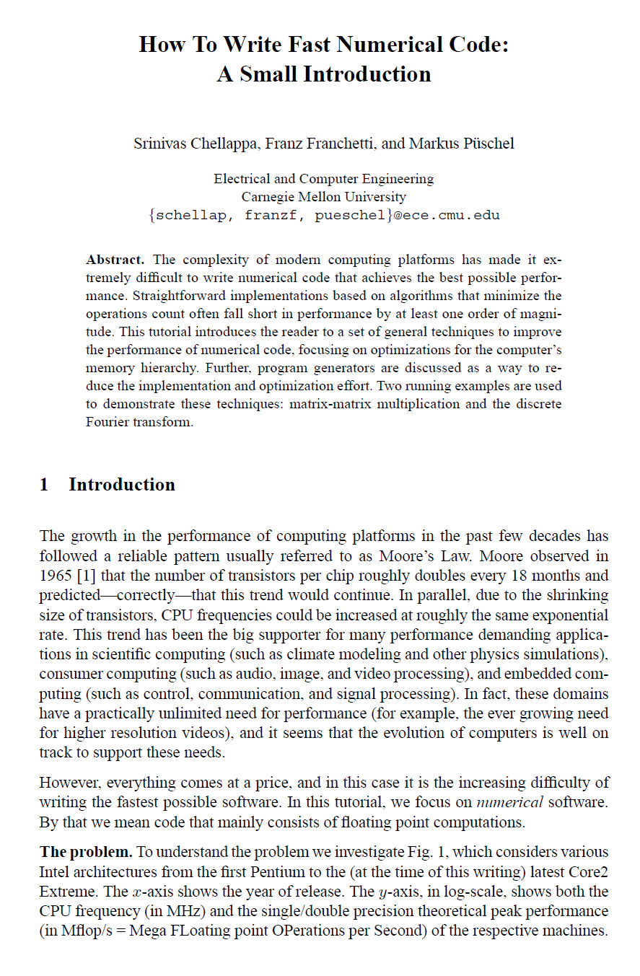
18-645: How to Write Fast Code
https://courses.ece.cmu.edu/18645
http://www.ece.cmu.edu/~franzf/papers/gttse07.pdf
https://www.inf.ethz.ch/personal/markusp/teaching/18-645-CMU-spring08/course.html

Slide 64
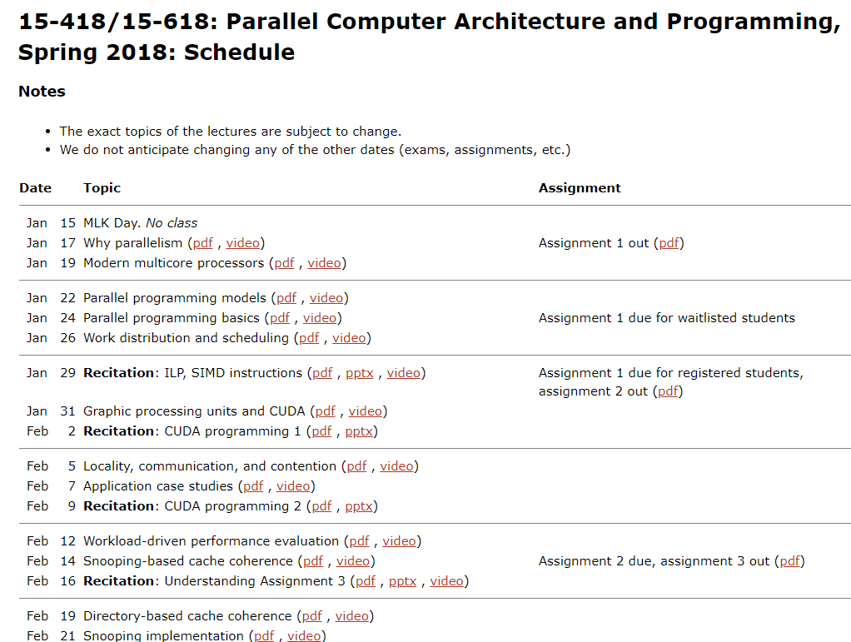
https://www.cs.cmu.edu/afs/cs.cmu.edu/academic/class/15418-s18/www/schedule.html

Slide 65
#include<fcntl.h>
#include<unistd.h>
#include<termios.h>
#include <sys/time.h>
#include <sys/mman.h>
# define L } if(!i -- ){
struct timeval F,G; struct termios H,U={ T} ; enum{ N=64,a=N<<7,b=a-1,c=a*32,d
=c-1, e=c/ 2,f= a*2, g=a/2,h =g/2,j =h/ 2,Q=V*j*5} ; char*s=P,K,M;
int* p, l[ a] ,m,n,J,o=A, O=j,E,R,i,k,t,r,q,u,v,w,x,y,z
,B,C, *D,Z ;int main (){ for(D=mmap(D,4*Q,3,W,open(I,2 ),K); *s; o
++[ l]=k|=* s++%N){ k=* s++%N<<12; k|=*s++% N*N; } tcgetattr(q,& H); tcsetattr
(y,2, &U); for( fcntl(B,4,4); ; o&=b){ if(k& c){ q=- --k%N; if(!q)
k-=c ;i =k /N&7; { L L if(J&1) m+= t; J|=m%N*c; J/=2; m
/= 2; if(! q&&r ^n){ m^=d; J^= d; n=0; } L L J+=J; J|=m>=0; if(q){
m+=m; m|=J/c; m+=m<0?t:-t; } else{ m+=(m<0)*t; if(r)m^=d; if(n^r)J^= d; n=0; }
L if( (m^2 *m)/ e%2) k&=d; else{ J+=J; m+=m; m|=J/c; } L m|=n*c; J
|= m %N *c ;m /=2; J /=2; L m+=m; J+=J; J|=n; m|=J/c; L
m+=m; m|=n ; } J&=d ; } else{ i=k/f; t=i?k&b:16; p=l+t; if(k&a)p=
l+((*p+=13>i&&7<t&&16>t)&b); { L i=1; L*p=m; L*p++=o|n*e; o=p-l; L*p=0; L m=*p
; L m ^=*p ; L t=m; m +=*p; m+=d<m ; n|=((m^t)& (m^*p))/e; L m+=*p
; n=m/c; L k=*p; if( !Z||k/f-8) /*$ %*/ continue ; k=-k
; L++*p; o +=!(*p&=d) ; L m&=*p; L if(m!=*p)++ o; L o=p -l; L if(
k&a)n=m/e; if(k&g)J= 0; r=k&h&&m&e; if(k&j)J|=m; else if(r)m^=d; if(k&512)m=0;
i=k/N &7; { L if(k &4)J ^=d; if(k&2)m|=J; if (k&1 )m|= q; }
else { if(k%N)k += c; { L t =o ++[ l] ; if(r
)J^=d; L L t=o++[l]; if(r )J^=d; m-=t; if(m>=0 ){ k -=c; n=1;
++o; } } i=2; } L if(Z)k=-1; else{ if(k&8)m=0; t=r=0; i=k/N%N; if(i==27){ if(k
&2)u=v=w=Z=0; } if (i==57){ i=k/16&3; { L w =1; if(k&1)x =0; if(k&
2) { t= z/N; t= t/80*/*/*/100+t% 80; r=0 ; while(t) { r
+=t%10*w; t/= 10;w <<=4; } m|=r; } if(k&4){ r=m ; t=0; while (r) {
t+=r%16*w; w*=10; r>>=4; } r=t/100; t%=100; if(V<=r||79<t)x|=c/8; else z=(r*80
+t)*N ; } w=0; L if(k& 1&&x &(e|g) )++o; if(k& 2)m|=x |y;if
(k&4 )C =- m&65535; L if( k&1 )x=y=0; if (k&2
)B=m; if ( k&4) { y^=m&(h|j| j/2); if(y&j ){ y^=j;x|=g ; do{
B&=b; if(y&j/2)z[D]=B[l]; else B[l]=z[D]; ++z; z%=Q; ++B; } while(-- C); } } }
x%=e; if(x /a)x |=e; if(x&(e|g)&&y&h)u|=c ; else u%=c; L if(
k&1) t= h; if (k&2 )r= e; if( k&4){ r=j; u&=~
h ; } if(k &16) Z=f* 2; L L L t=f; if(k&2 )m|=M|Y; if( k&4)m
|=u|v; L t=a; if(k&4){ K=m&~Y; write(1,&K,1); u|=t; t=0; } } i=2; if(t){ if(k&
1&&u&t)++ o; if(k&2)u &=~ t; } if( r){ if(k&32) w=r; else v&=~r; }
} L if(k&a)m=k; else { t=0; if( k & N)t |= m/e%2; if(k&
128)t|=!m; if(k&256)t |= n; if( k& 512 )t=!t; o +=t; if(k& h)n =0;
if(k&g)m=0; if(k&1)m^=d; if(k&2)n^=1; if(k&4)m|=S; if(k&8){ m|=n*c; m+=m; if(k
& j)m +=m; m|=m /a/N ; n=m/c; } if(k&16){ m|=n*c; m|=m *2%N*
c; m /= 2; if (k&j) m/=2; n=m/c; } if (k &32)
{ if( Z)k= -1 ; else break; } } } } n&=1; if(k<c) { m &= d;
o &=b; if(!R--){ if (~u&f &&read(0, &M,1)>0){ if(X&& M== X)break; R=0; u|=f; }
gettimeofday(&G,0); G.tv_usec/=16667; if(G.tv_sec>F.tv_sec||F.tv_usec<G.
tv_usec){ F=G; if(v&j){ p=l+7; ++*p; *p&=d; if(!*p)u|=h; } R=0; } if
(!R){ E=O/4; O=4; } O+=R=E; } if(!++k||(v&e&&u)){ *l=o|n*e|Z;v%=
e; o=1+!k; Z=0; } v|=w; w=0; k=o++[l]; } }tcsetattr(w,1,&H); }
?
https://www.ioccc.org/2018/mills/prog.c

Slide 66
?!
send(to, from, count)
register short *to, *from;
register count;
{
register n = (count + 7) / 8;
switch (count % 8) {
case 0: do { *to = *from++;
case 7: *to = *from++;
case 6: *to = *from++;
case 5: *to = *from++;
case 4: *to = *from++;
case 3: *to = *from++;
case 2: *to = *from++;
case 1: *to = *from++;
} while (--n > 0);
}
}
https://en.wikipedia.org/wiki/Duff%27s_device

