Slide 1

18-613 Lecture 2:
State-of-the Art in Computing
January 22, 2019
Franz Franchetti Instructor

Slide 2
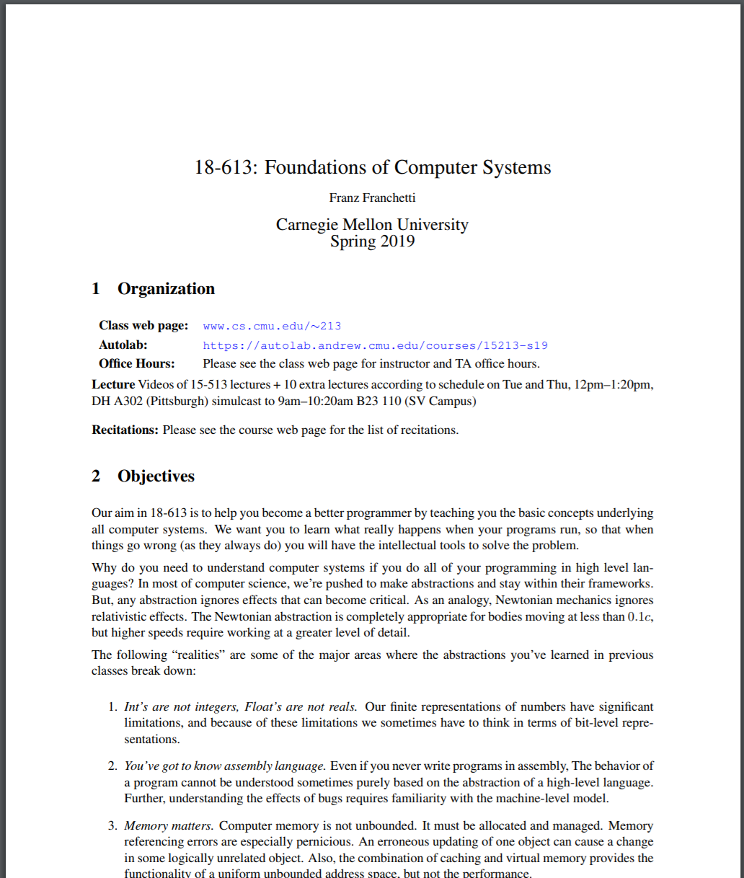
Questions from Piazza
18-613 Syllabus is the authorative source for information http://www.cs.cmu.edu/afs/cs/academic/class/15213-s19/www/syllabus613/syllabus.pdf
Labs: 50%, Exams: 50%
Extra exam question beyond 15-513
Extra Credit lab LX (ArchLab)
Difference from 15-213/18-213/15-513
NO Problem Sets
NO In-Class Quizzes
NO Bonus points
Careful: Look at the correct syllabus

Slide 3
Lab 0 ?

Slide 4
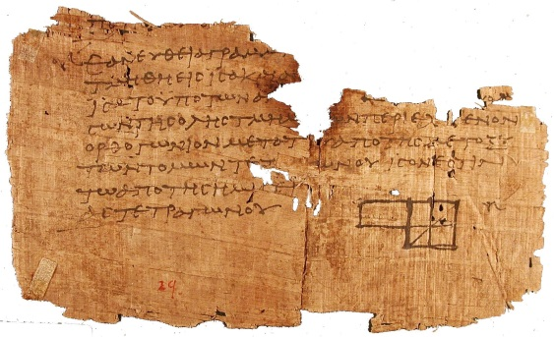

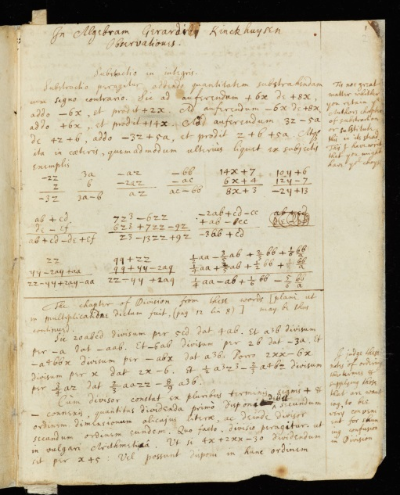
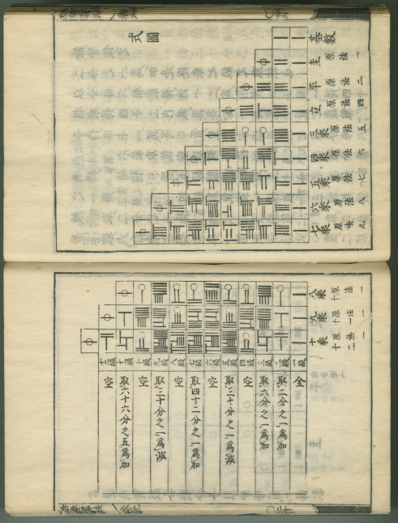
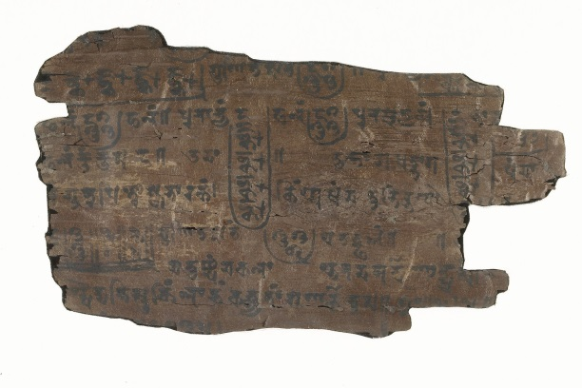

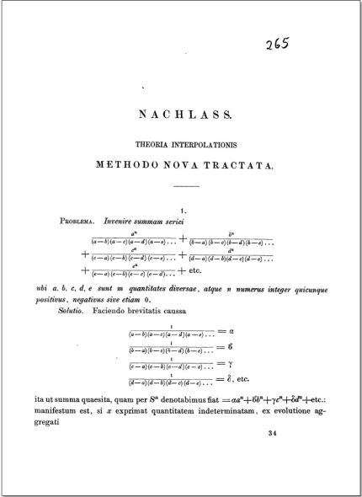
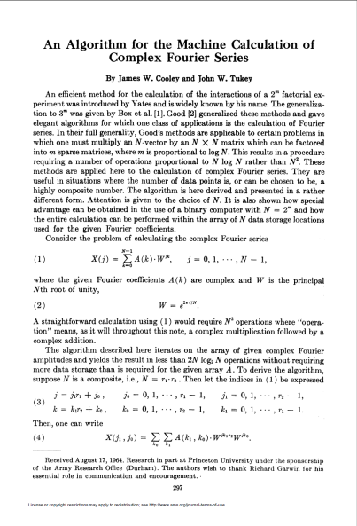

Algorithms and Mathematics: 2,500+ Years
Bernoulli Numbers
Kōwa, 1712
Geometry
Euclid, 300 BC
Square roots, value of Pi
Baudhāyan, 800 BC
Gaussian Elimination
unknown, 179 AD
Equations of Motion
Newton, 1687
Fast Fourier Transform
Algebra
al-Khwārizmī, 830
FFT in Matrix Form
Van Loan, 1992
Fast Fourier Transform
C.F. Gauss, 1805
FFT Algorithm
Cooley & Tukey, 1965
Notes:
4

Slide 5
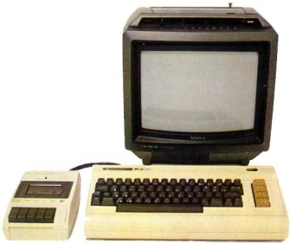
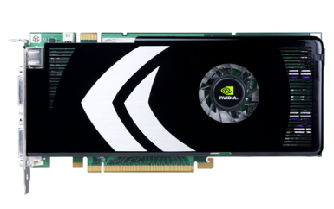
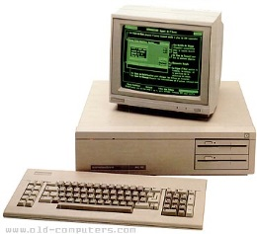
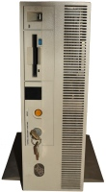
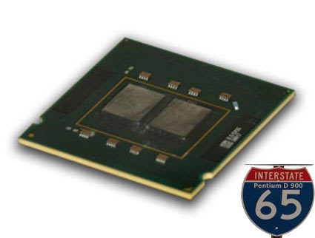
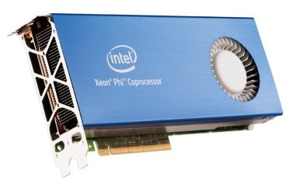
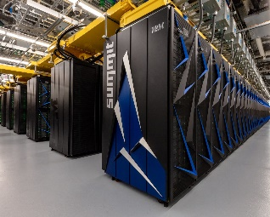
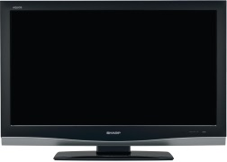
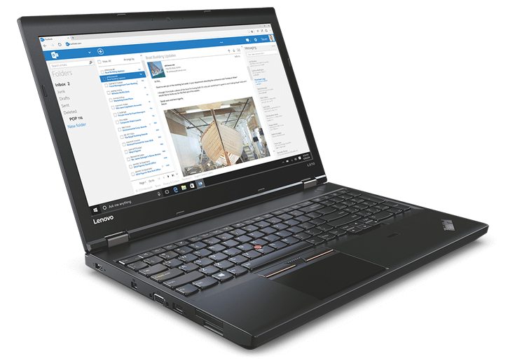
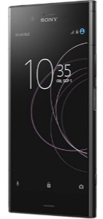
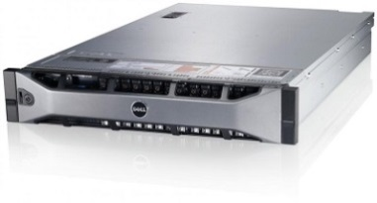
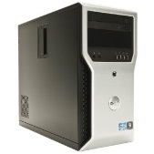
Computers I have Used: 10¹⁰x Gain in 35 Years
The first computer I...
“My” first...
Intel 4004, 1971
176×184
10 kflop/s
...programmed
Commodore VIC20
1MHz MOS 6502
5 kB RAM, TV
1985
...owned IBM PC/XT compatible
8088 @ 8 MHz, 640kB RAM
360 kB FDD, 720x348 mono,
1989
...telnet’ed into
IBM RS/6000-390
256 MB RAM, 6GB HDD
67 MHz Power2+, AIX
1994
…multicore
Pentium D
2 cores, 3.6 GHz
2/4-way SIMD
2005
...GPGPU
GeForce 8800
1.3 GHz, 128 shaders
16-way SIMT
2006
…manycore
Xeon Phi
1.3 GHz, 60 cores
8/16-way SIMD
2011
Computers I use, circa 2019
110 Tflop/s FP16 (ML)
3840x2160
1920x1080
1920x1080
Summit
2,282,544 cores @ 3.07 GHz
200 Pflop/s, #1 in Top500
Dell Power Edge
80 cores @ 3GHz
3 TB RAM
Dell Precision 3620
3.7 GHz Xeon Quad-core
Nvidia TITAN V, 64 GB RAM
Lenovo X270
2.8 GHz Core i7 Dual-core
Mobile GPU, 16GB RAM
Sony Xperia XZ1
2.5 GHz Octa-core
Mobile GPU, 4GB RAM
1 Gflop/s = one billion floating-point operations (additions or multiplications) per second
5
Notes:
VIC20: 176×184
Dell T1600: 1080p: 1920x1080
8x
5

Slide 6
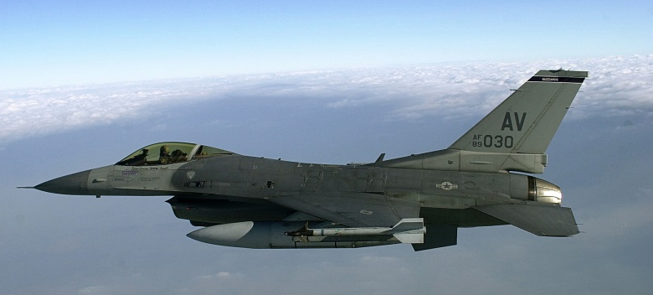
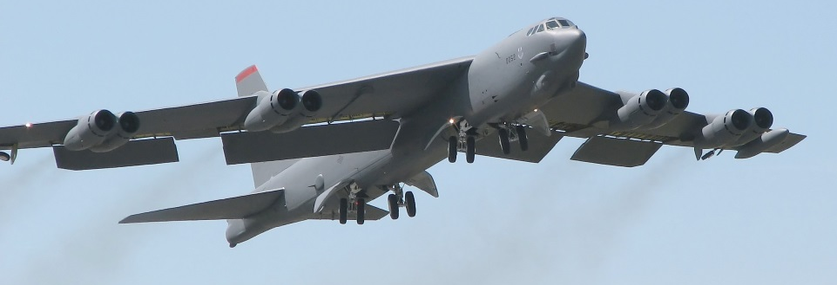

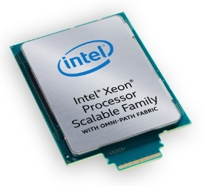
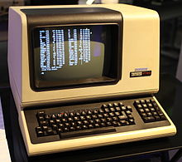
Computing Platforms Over The Years
F-16A/B, C/D, E/F, IN, IQ, N, V
B52 Stratofortress
Flying since 1974
Flying since 1955
Compare: Desktop/workstation class CPUs/machines
Assembly code compatible !!
x86 binary compatible, but 500x parallelism ?!
1972 Intel 8008
0.2—0.8 MHz
Intelligent terminal
1989 IBM PC/XT compatible
8088 @ 8 MHz, 640kB RAM
360 kB FDD, 720x348 mono
1994
IBM RS/6000-390
256 MB RAM, 6GB HDD
67 MHz Power2+, AIX
2006
GeForce 8800
1.3 GHz, 128 shaders
16-way SIMT
2011
Xeon Phi
1.3 GHz, 60 cores
8/16-way SIMD
2019
Xeon Platinum 8180M
28 cores, 2.5-3.6 GHz
2/4/8/16-way SIMD
x86 ISA: hiding 10⁷ – 10⁸ compounded performance gain over 45 years
6

Slide 7
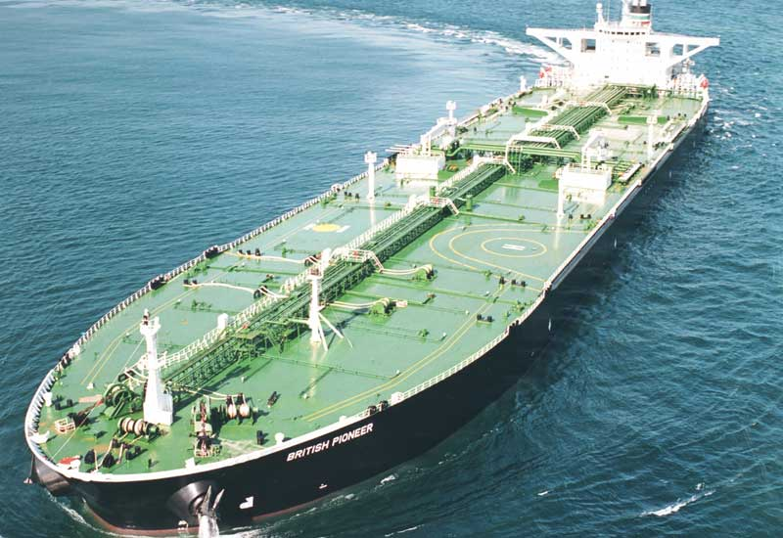
Programming/Languages Libraries Timeline
Popular performance programming languages
1953: Fortran
1973: C
1985: C++
1997: OpenMP
2007: CUDA
2009: OpenCL
Popular performance libraries
1979: BLAS
1992: LAPACK
1994: MPI
1995: ScaLAPACK
1995: PETSc
1997: FFTW
Popular productivity/scripting languages
1987: Perl
1989: Python
1993: Ruby
1995: Java
2000: C#
7
Notes:
7

Slide 8
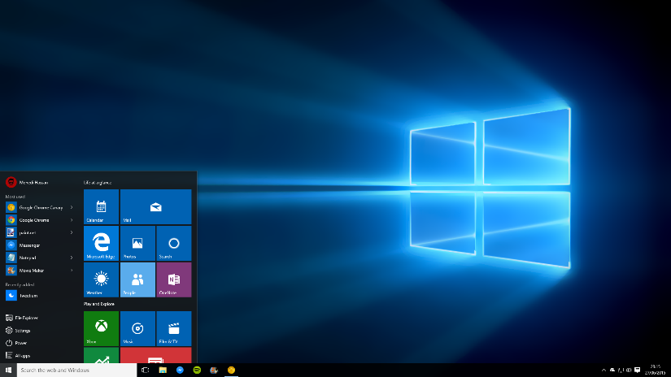
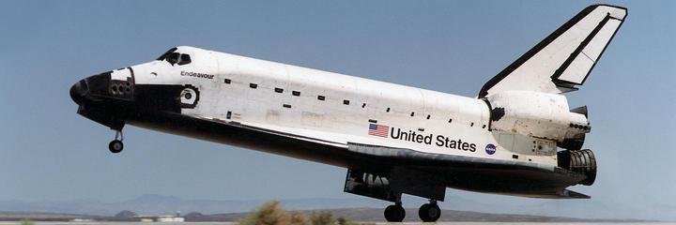
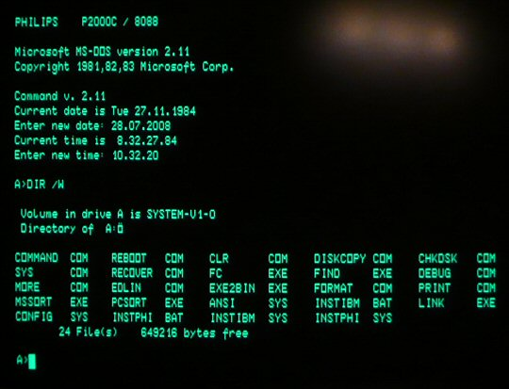
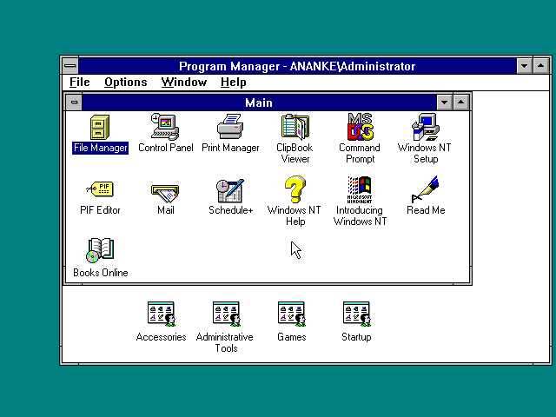
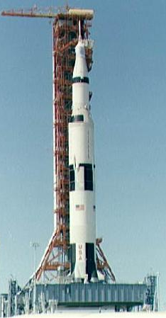
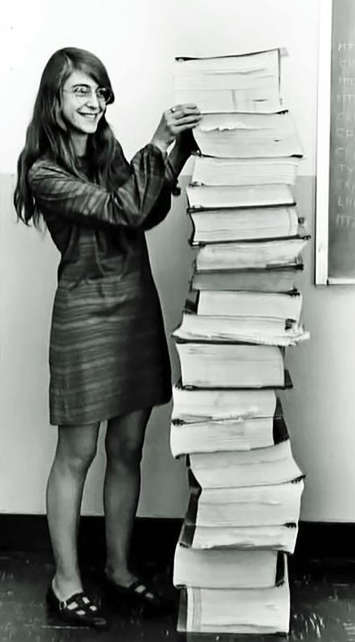
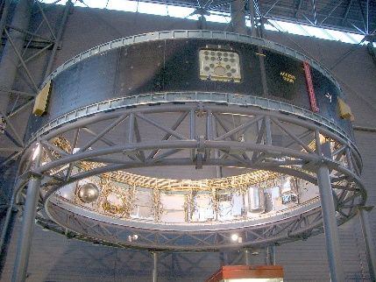
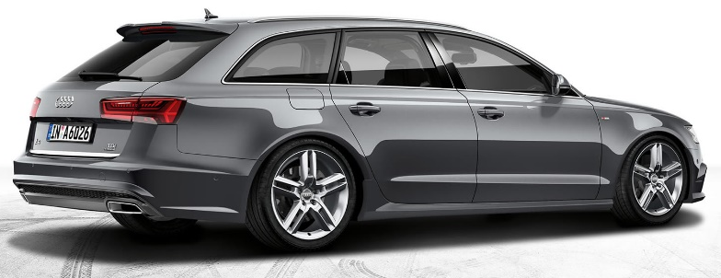
Growth of Source Code
Windows 10, 2015 60M LOC
400k LOC 5 CPUs
Windows NT 3.51, 1993
5M LOC
MS-DOS 2.1
1984 50k LOC 8088 ASM
100M LOC 50 CPUs
8
Notes:
8

Slide 9
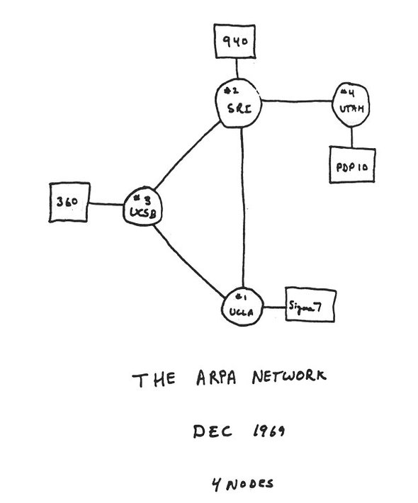
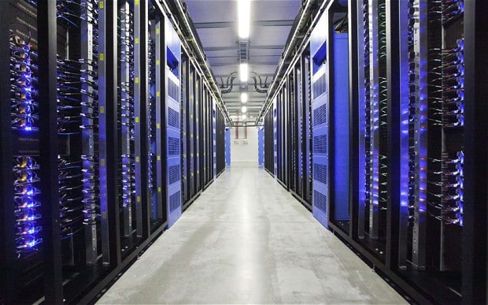
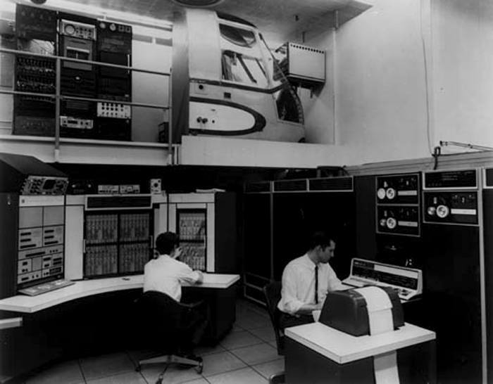
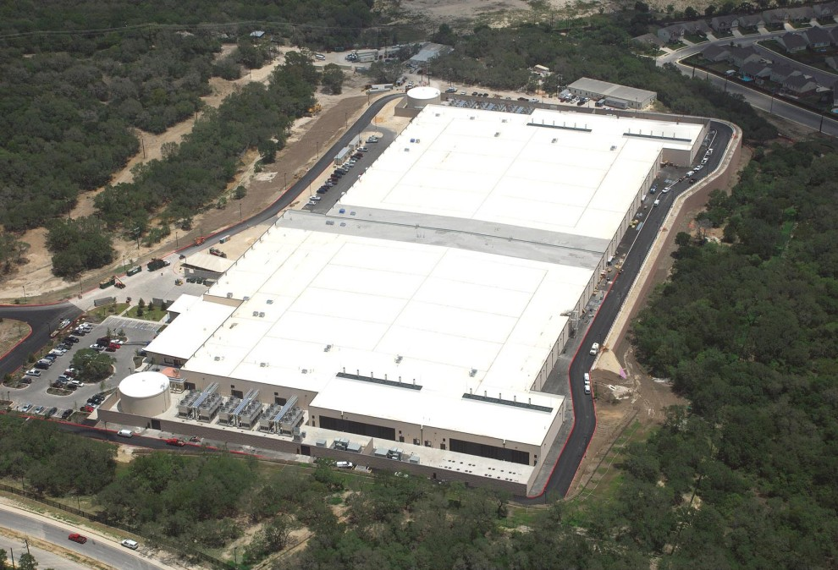

From ARPA Net to the Cloud
50 years…
9
Notes:
9

Slide 10
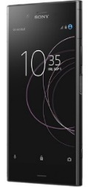
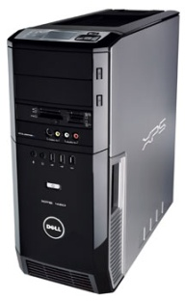
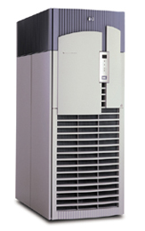
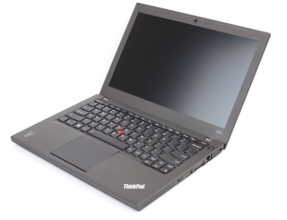
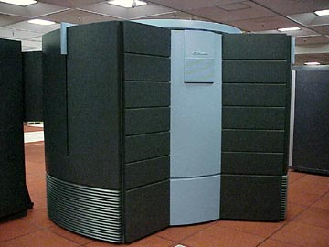
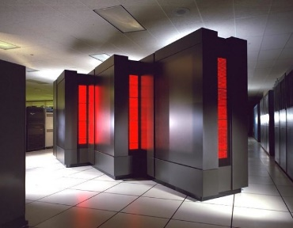
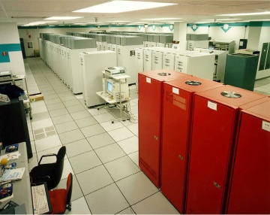
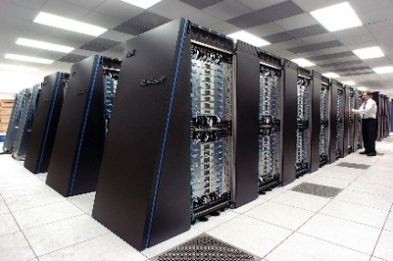
Giving Moore’s Law a Face
1 flop/s = one floating-point operation (addition or multiplication) per second mega (M) = 10⁶, giga (G) = 10⁹, tera (T) = 10¹², peta (P) = 10¹⁵, exa (E) = 10¹⁸
In 2019…
Cell phone
15 Gflop/s
Laptop
90 Gflop/s
Workstation
1.5 Tflop/s (CPU) 170 Tflop (GPU)
HPC
80 Tflop/s (CPU) 1.7 Pflop/s (GPU)
#1 supercomputer
200 Pflop/s
…would have been the #1 supercomputer back in…
Cray Y-MP C90 16 Gflop/s
1991
CM-5/1024 131 Gflop/s 1993
Intel ASCI Red 1.338 Tflop/s 1997
BlueGene/L 70.72 Tflop/s 2004
10
Notes:
10

Slide 11
The Evolution of Performance: Top500.org
11

Slide 12
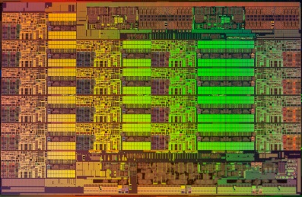
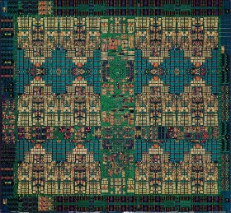
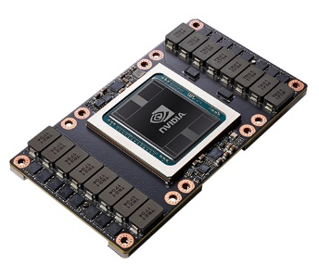
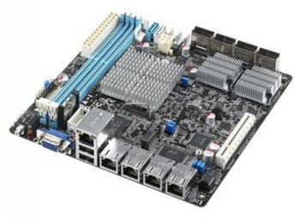
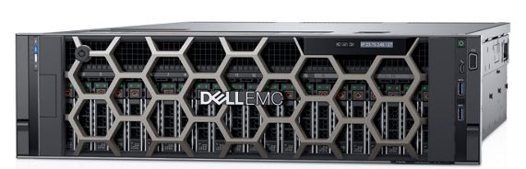
Today’s Computing Landscape
1 Gflop/s = one billion floating-point operations (additions or multiplications) per second
Intel Xeon 8180M
2.25 Tflop/s, 205 W
28 cores, 2.5—3.8 GHz
2-way—16-way AVX-512
IBM POWER9
768 Gflop/s, 300 W
24 cores, 4 GHz
4-way VSX-3
Nvidia Tesla V100
7.8 Tflop/s, 300 W
5120 cores, 1.2 GHz
32-way SIMT
Intel Xeon Phi 7290F 1.7 Tflop/s, 260 W
72 cores, 1.5 GHz
8-way/16-way AVX512
Snapdragon 835
15 Gflop/s, 2 W
8 cores, 2.3 GHz
A540 GPU, 682 DSP, NEON
Intel Atom C3858
32 Gflop/s, 25 W
16 cores, 2.0 GHz
2-way/4-way SSSE3
Dell PowerEdge R940
3.2 Tflop/s, 6 TB, 850 W
4x 24 cores, 2.1 GHz
4-way/8-way AVX
Summit
200 Pflop/s, 13 MW
9,216 x 22 cores POWER9 + 27,648 V100 GPUs
12
Notes:
12

Slide 13



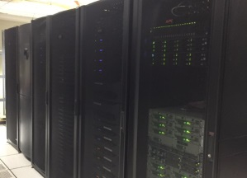



What Is High Performance Computing?
1 flop/s = one floating-point operation (addition or multiplication) per second mega (M) = 10⁶, giga (G) = 10⁹, tera (T) = 10¹², peta (P) = 10¹⁵, exa E) = 10¹⁸
Computing systems in 2019 available to ECE students
Your laptop
4 cores
100 Gflop/s
Your desktop
48 cores + GPU
1.2 Tflop/s + 7.5 Tflop/s GPU
ECE Cluster
1k cores + GPUs
32 Tflop/s
PSC HPC
11k cores 200 GPUs
21.35 Pflop/s
Cloud
1,000s of cores many small machines
18-613 Labs
High Performance Computing
Your own machines
Laptop: quad core, 10s of GB
Desktop: 1—2 sockets, 6—28 cores/socket, GPU, 64 GB or more
Larger than your own machines
Large shared memory machines: up to 12 TB
Parallel HPC machines: up to 10k cores
Cloud and high throughput systems
13
Notes:
13

Slide 14
What Problems Can You Solve?
1 flop/s = one floating-point operation (addition or multiplication) per second mega (M) = 10⁶, giga (G) = 10⁹, tera (T) = 10¹², peta (P) = 10¹⁵, exa (E) = 10¹⁸
Matrix-matrix multiplication…
for i=1:n
for j=1:n
for k=1:n
C[i,j] +=
A[i,k]*B[k,j]
+=

...running on…
Cell phone
15 Gflop/s
12k  12k
3.5 GB, 4 min
Laptop
90 Gflop/s
25k  25k
14 GB, 5min
Workstation
1.5 Tflop/s
50k  50k
64 GB, 3min
HPC
80 Tflop/s
1.5M  1.5M
80 TB, 22h
#1 supercomputer
200 Pflop/s
10M  10M
2.8 PB, 1.8h
14
Notes:
14

Slide 15



Looking into the Future: In 2009…
…the performance of the #1 supercomputer of 2009…
#1 supercomputer 1 Pflop/s
…could be available as
HPC 1 Pflop/s 2018
Workstation 1 Pflop/s
2023
Laptop 1 Pflop/s
2030
Cell phone 1 Pflop/s
2036
We are actually ahead of the prediction. Surprising every time I see this.
15
Notes:
15

Slide 16



Dream to Reality: Petaflop in a Rack
In 2010: hard research goal DARPA UHPC ExtremeScale
Goal: In 2018 have 1 Pflop/s in 57kW, single rack, air cooled
In 2019: commercially available 2 Pflop/s, 10U, 10kW
Reality: 04/2018 Nvidia DGX-2: 2 Pflop/s
16 V100 GPUs, 2x24-core Xeon
1.5 TB CPU, 512 GB GPU
2 Pflop/s, 10 kW in ¼ rack
16
Notes:
16

Slide 17


Grand Callenges, 50 Years Apart…
Saturn V,
Moon, 1969
SATURNV: First ExaFlop (FP16), 2016
Name your project carefully…
17
Notes:
17

Slide 18

2019: Computing on your Wrist
Display: 1.2" full circle AMOLED, 390 x 390 (327 ppi)
OS: Wear OS by Google
Processor: Qualcomm Snapdragon Wear 3100
Compatibility: iOS 9.3+ and Android 4.4+
Power: 340 mAh - one full day, extra 4-5 days in Time Only Mode
Memory: 1 GB
Storage: 8 GB
Sensors: Heart rate, Microphone, Altimeter, Accelerometer, Gyroscope, Ambient light
Connectivity: Bluetooth 4.2, Wi-Fi (802.11b/g/n 2.4GHz), GPS, NFC payment
Snapdragon Wear 3100: 1 GB RAM, 8 GB SSD, quad core, 1.2 GHz, Wi-Fi,…
18
Notes:
18

Slide 19






2019: A $1M COTS* System
24U rack
7.5kW
<$1M
Dell PowerEdge R940
3.2 Tflop/s, 6 TB, 850 W
4x 24 cores, 2.1 GHz
OSS FSAn-4 200 TB PCIe NVMe flash 80 GB/s throughput
BittWare TeraBox
18M logic elements, 4.9 Tb/sec I/O
8 FPGA cards/16 FPGAs, 2 TB DDR4
Nvidia DGX-1 8x Tesla V100, 3.2 kW 170 Tflop/s FP64, 1Pflop/s FP16, 128 GB
AberSAN ZXP4 90x 12TB HDD, 1 kW 1PB raw
*COTS = Commercial off-the-shelf
Notes:
19

Slide 20
At the Top End: 138x in 9 Years…
#1 supercomputer of 2009: RoadRunner
1.45 Pflop/s
#1 supercomputer of 2018…
200 Pflop/s
20
Notes:
20

Slide 21







Storage: Big Data
4U storage server: 600 TB
1 rack:
3.6 PB
Library of Congress: 10 TB
Desktop:
40 TB
180 kB
360 kB
1.44 MB
Notes:
21

Slide 22









Communication: Bandwidth
I/O bandwidth: 288 GB/s
802.11ac
3.2 Gb/s
DSL/cable
1 Gb/s
Ethernet
10 Gb/s
10Mb/s
4G LTE
12 Mb/s
OmniPath
100 Gb/s
56kb/s
14.4kb/s
22
Notes:
22

Slide 23





Memory Bandwidth
85 GB/s
Aggregate memory bandwidth:
5,591 TB/s
Tesla V100:
900 GB/s
POWER8:
410 GB/s
400 MB/s
4x Xeon:
340 GB/s
DDR4: 25GB/s
23
Notes:
23

Slide 24



Accelerators
Intel Nervana Neural Network Processor aka Lake Crest, release date 2019
Google TPU 2.0 600 GB/s, 45 Tflop/s
Intel Arria 10 GX FPGA
15Gbps SERDES transceivers
1,150K logic elements, 53 Mb 8 GB DDR4 ECC
Nvidia V100 GPU 100 Tflop/s tensor operations 7.5 Tflop/s FP64 SIMT
24
Notes:
24

Slide 25




Remember: A’int Talkin’ ‘Bout 2055…*
Quantum computing
DNA computing
Optical computing
Other far-out technologies
* With apologies to Van Halen
25
Notes:
25

Slide 26

Gordon Bell 2016: Climate Simulation
770B unknowns, 7.95 Pflop/s, 488m resolution,
0.07 simulated-years/compute-day
26
Notes:
26

Slide 27


Gordon Bell 2006: Material Science
First principle molecular dynamics 1,000 molybdenum atoms, 12,000 electrons, 108 Tflop/s
27
Notes:
27

Slide 28

2013 Science Run on BlueGene/Q
Simulate universe since Big Bang, trillions of particles, billions of years
28
Notes:
28

Slide 29





Computer Graphics
1997 Windows PC
C64, 1985
2017: Big Hero 6: 55,000 cores
2012
29
Notes:
29

Slide 30




Self-Driving Cars: Compute, Sensors, etc.
2004
2018
2017: Big Hero 6: 55,000 cores
30
Notes:
30

Slide 31



Simulation Scaling
unsolvable
HPC
Laptop/desktop
Toy problem
31
Notes:
31

Slide 32







Scalability
Sub-linear
Linear, N log N
Polynomial
Exponential
32
Notes:
32

Slide 33





Approximations, Models, and Heuristics
Physics: n-body problem
Direct solver: O(n²)
Fast multipole: O(n log n)
Particle/mesh: O(k log k)
33
Notes:
33

Slide 34




Take Home Lesson
Your laptop = #1 supercomputer from 1993
=
2019
1993
You have access to 10,000x your laptop’s power
ECE Cluster
Pittsurgh Supercomputing Center
34
Notes:
34

